Slide 1
Dealer Presentation Book
Home Comfort Center
(In Home Selling Tool)
Natalie DeRousse
Sr. Sales Training Manager

Slide 2
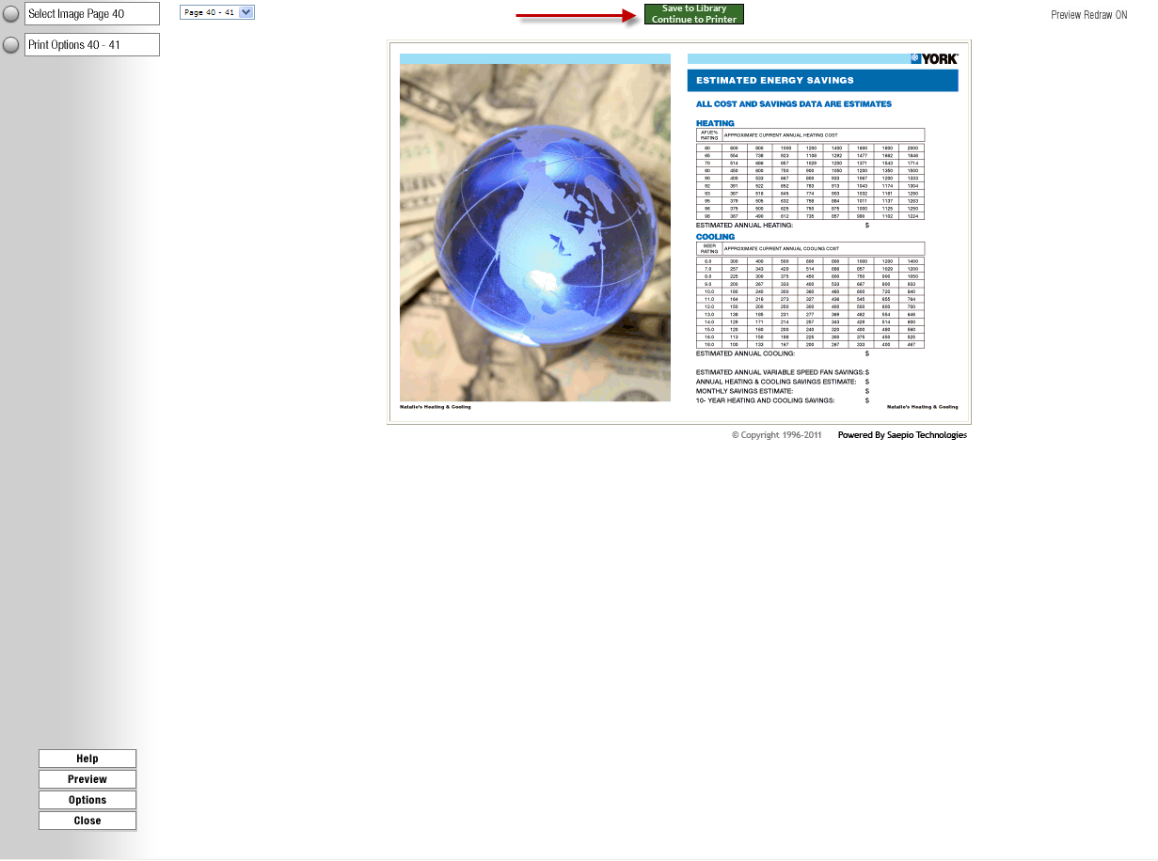
Dealer Presentation Book
Go to the Marketing Action Center – create your book!

Slide 3
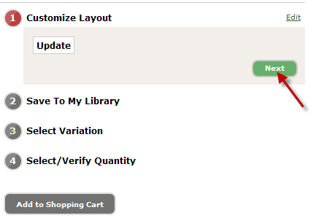
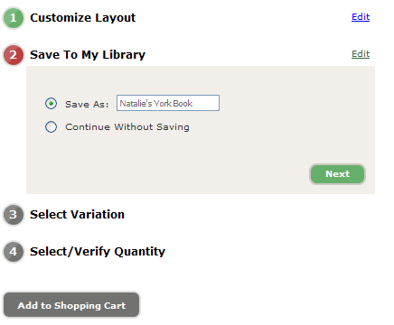
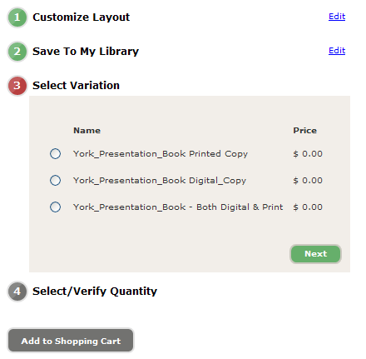
Dealer Presentation Book

Slide 4
Dealer Presentation Book
Dealers can order one free digital and printed version of their Dealer Presentation Book (same book, ordered at the same time)
Distributors/Branches can order a digital version Dealer Presentation Book for $20 (formatting fee)
Distributors/Branches can order a digital and printed version of Dealer Presentation Book for $70
Digital versions of Dealer Presentation Book are in a .pdf and can be uploaded to a Mobile Tablet in numerous ways:
1. SAVE the DPB .pdf file to your computer

Slide 5
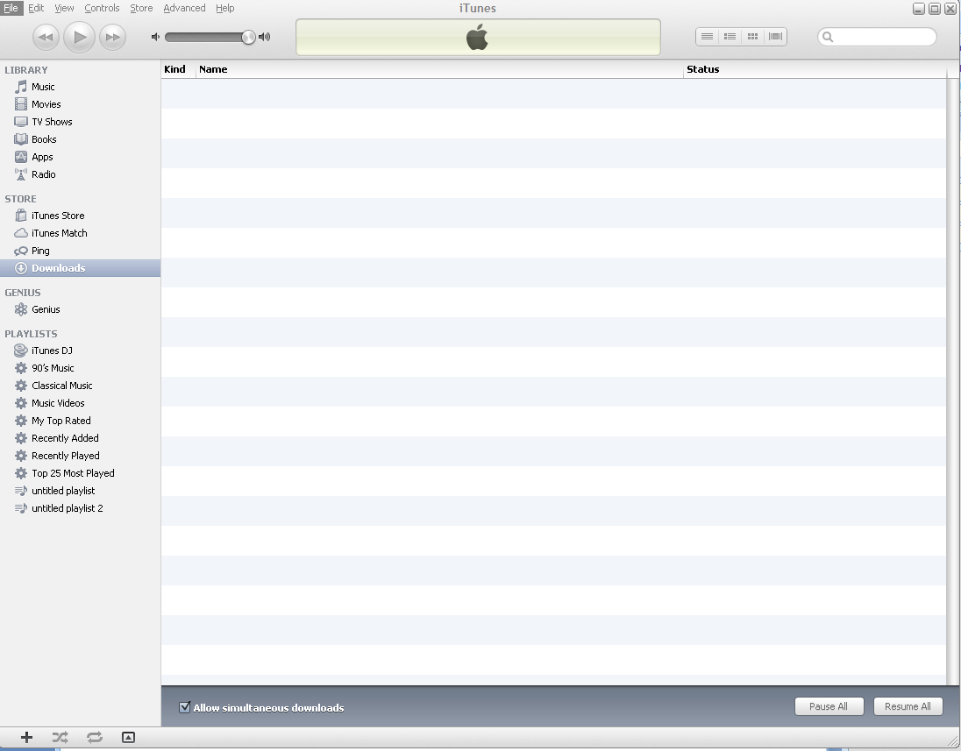
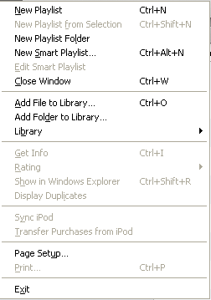
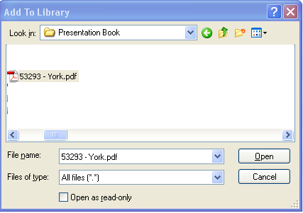
Dealer Presentation Book - iPad

Slide 6
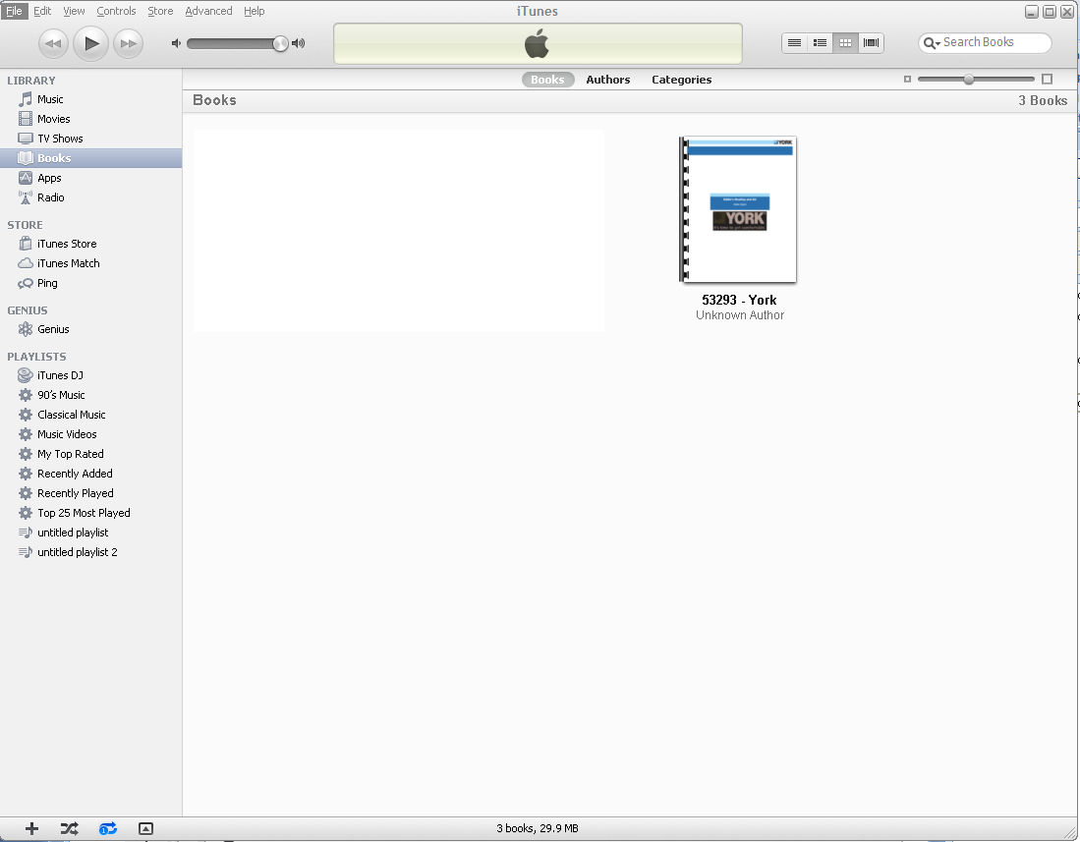
Dealer Presentation Book - iPad
iPad - Make sure that you download iBooks (free app) from the App Store
Sync iPad with iTunes
Dealer Presentation Book will automatically appear in your iBooks Collection.
“Dropbox” can also be used to upload DPB to your iPad

Slide 7
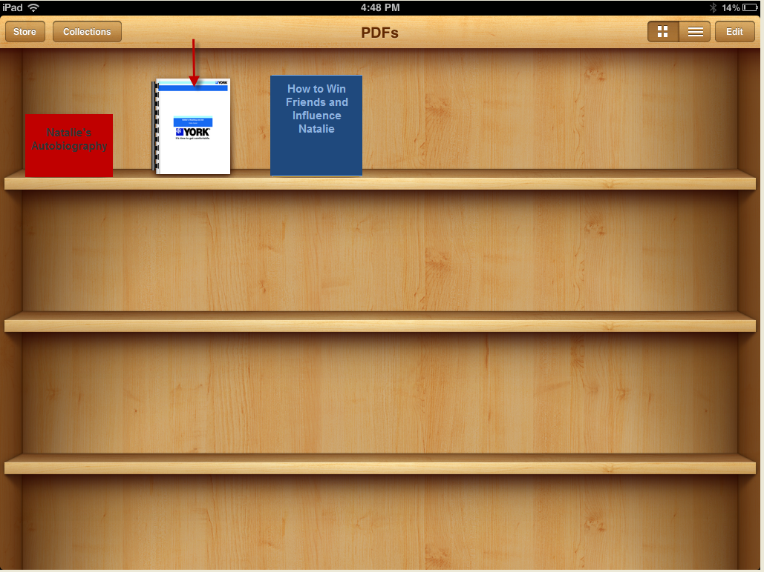

Slide 8

Dealer Presentation Book - iPad

Slide 9
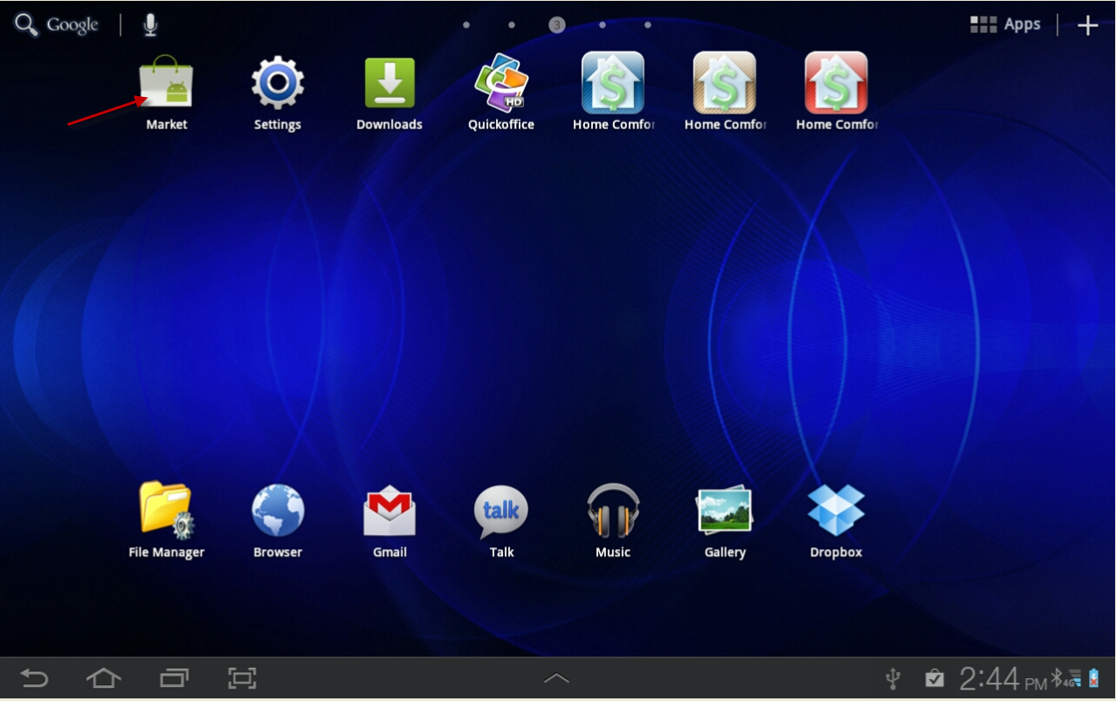
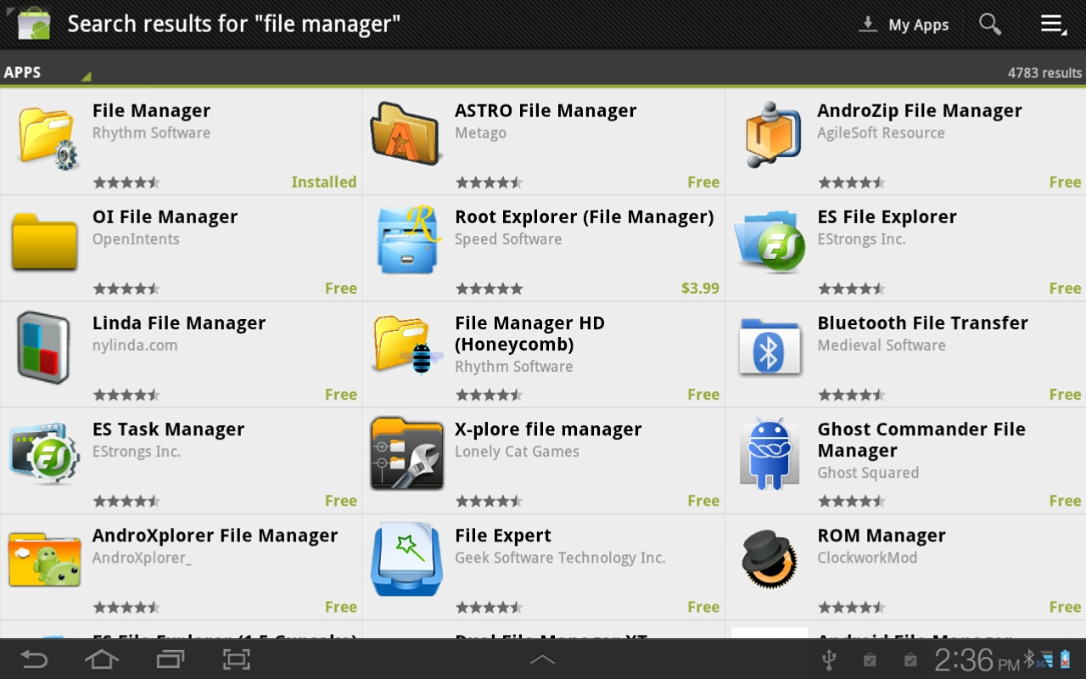
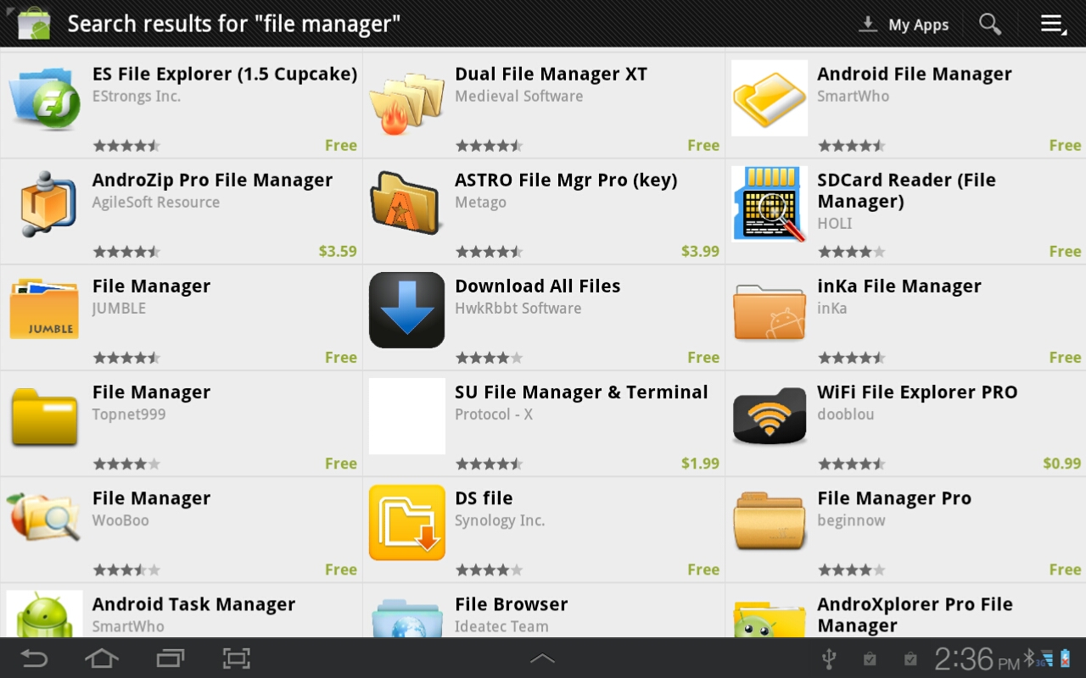
Dealer Presentation Book - Android
File Manager App must be on your Tablet – first
2. Go to Android Market and find a “File Manager”

Slide 10
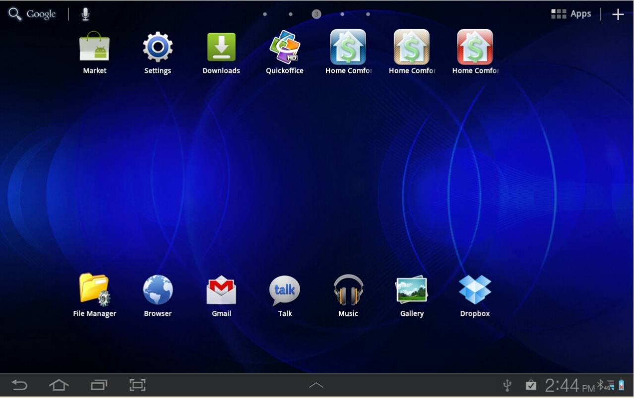
Dealer Presentation Book - Android

Slide 11
Dealer Presentation Book - Android
Saved DPB .pdf to your computer
File Manager App
Connect Android Tablet to your computer (USB connect)
Click: “Open Device to view Files . . .”
Copy .pdf file to your Download File in your Tablet
(On your computer, right click on .pdf copy/paste to
Tablet Download file)
6. “Dropbox”can also be used

Slide 12
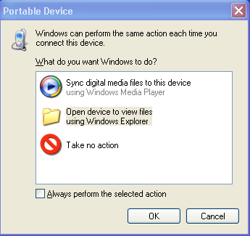
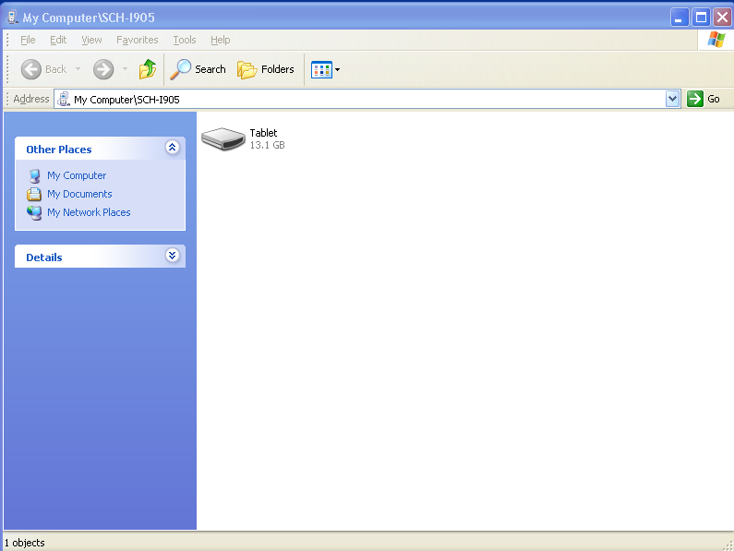
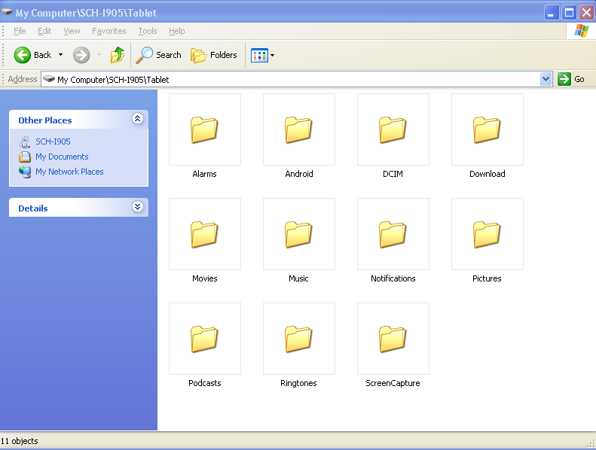
Dealer Presentation Book – Android Upload

Slide 13
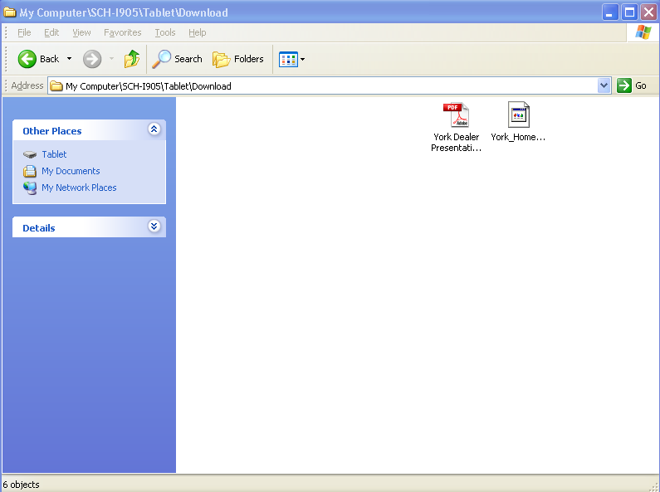
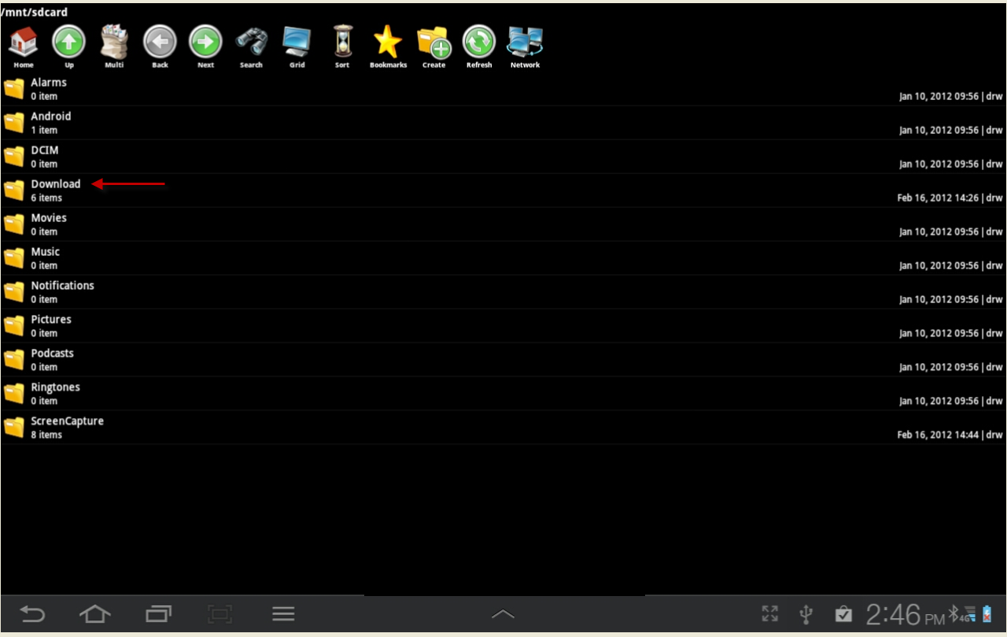
Dealer Presentation Book

Slide 14
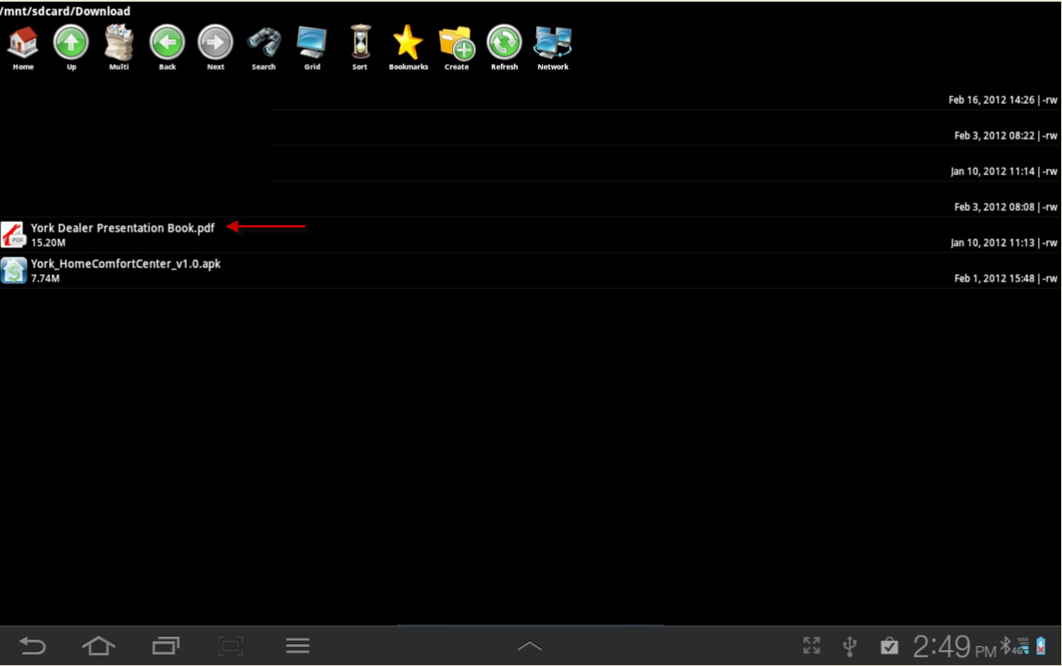
Dealer Presentation Book - Android

Slide 15
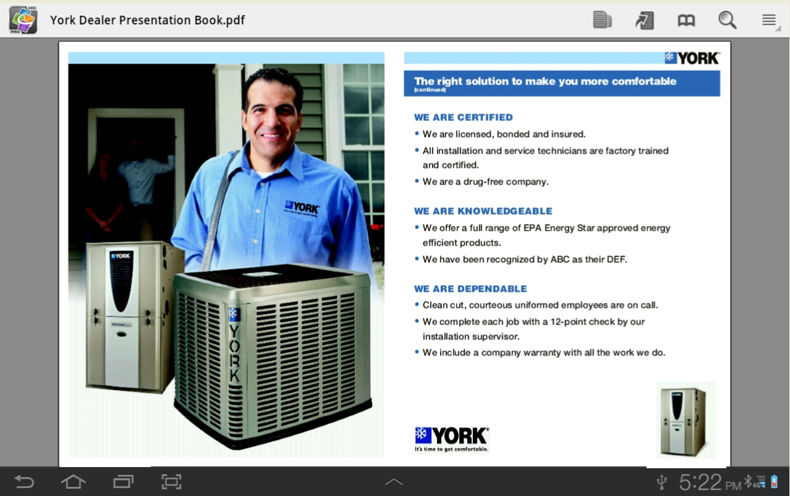
Dealer Presentation Book Android

Slide 16
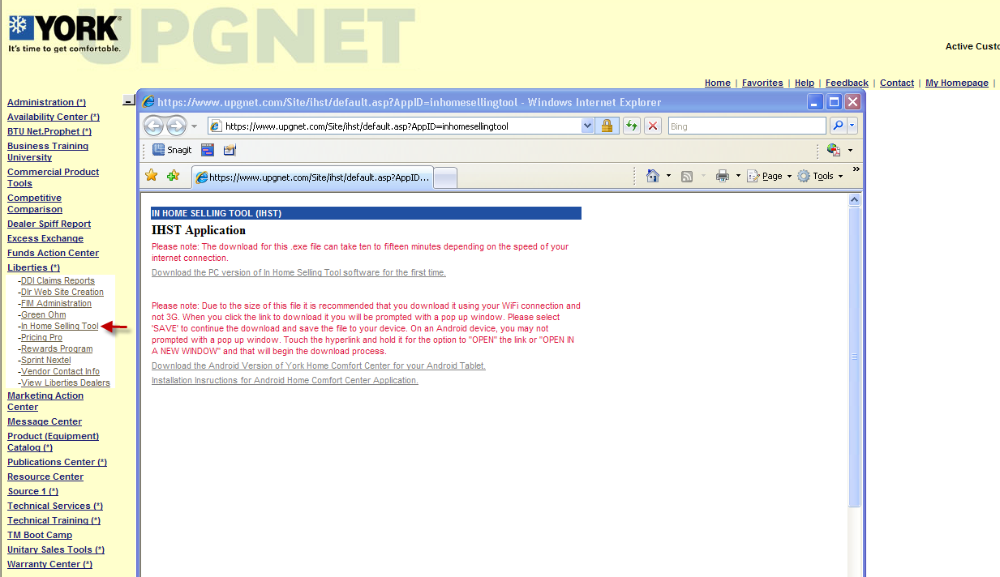
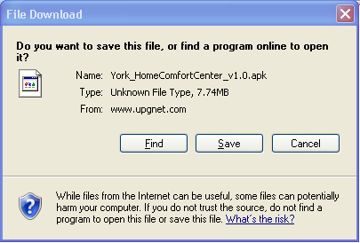
Home Comfort Center (In Home Selling Tool)

Slide 17
Home Comfort Center - Android
Can upload thru Dropbox or thru your computer synced to your Tablet

Slide 18
Home Comfort Center

Slide 19

Home Comfort Center
Click - Install . . .

Slide 20
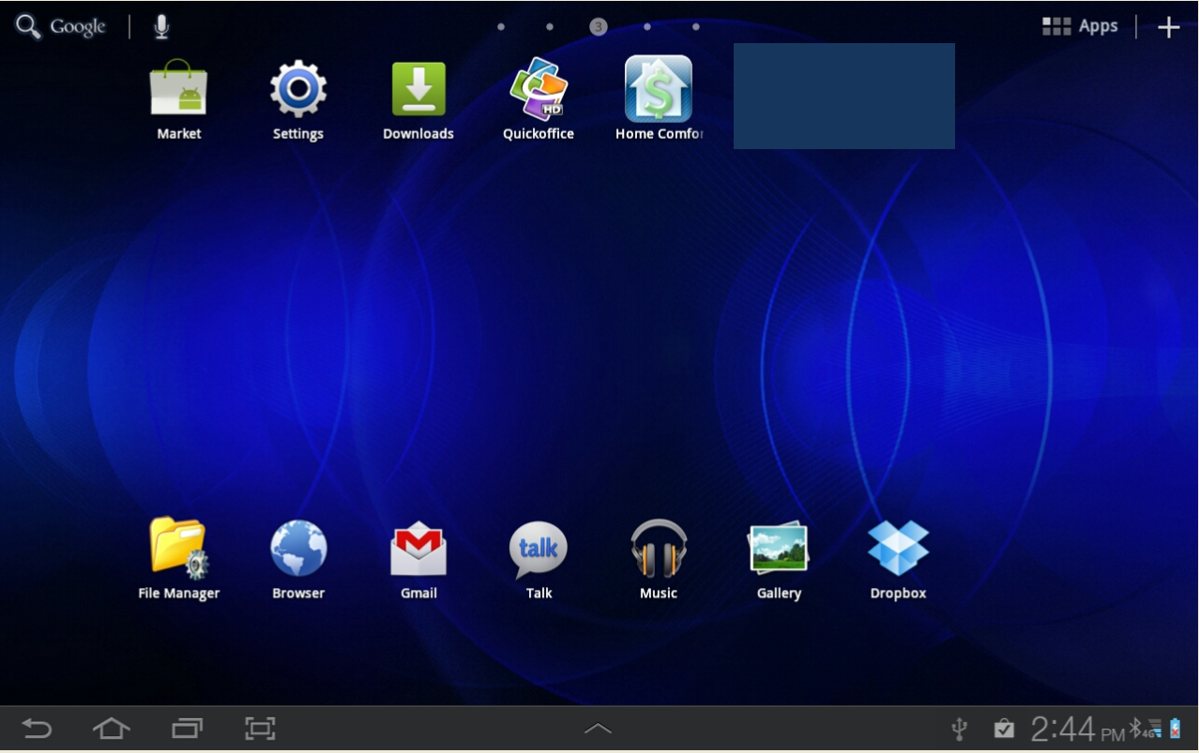
Home Comfort Center

Slide 21
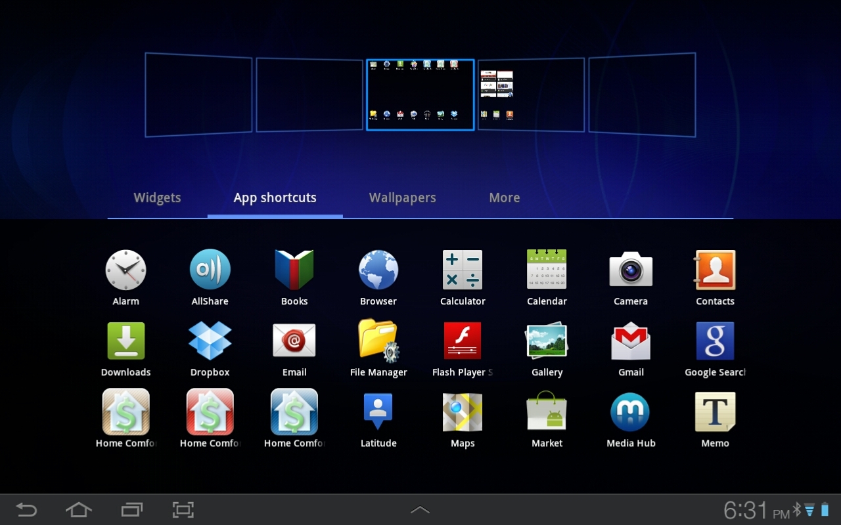

Home Comfort Center
If the HCC Icon does not appear on the Tablet Main Screen – touch & hold on Main Screen
Click on App Shortcuts – Find HCC Icon
Tap on Icon

Slide 22
Home Comfort Center

Slide 23
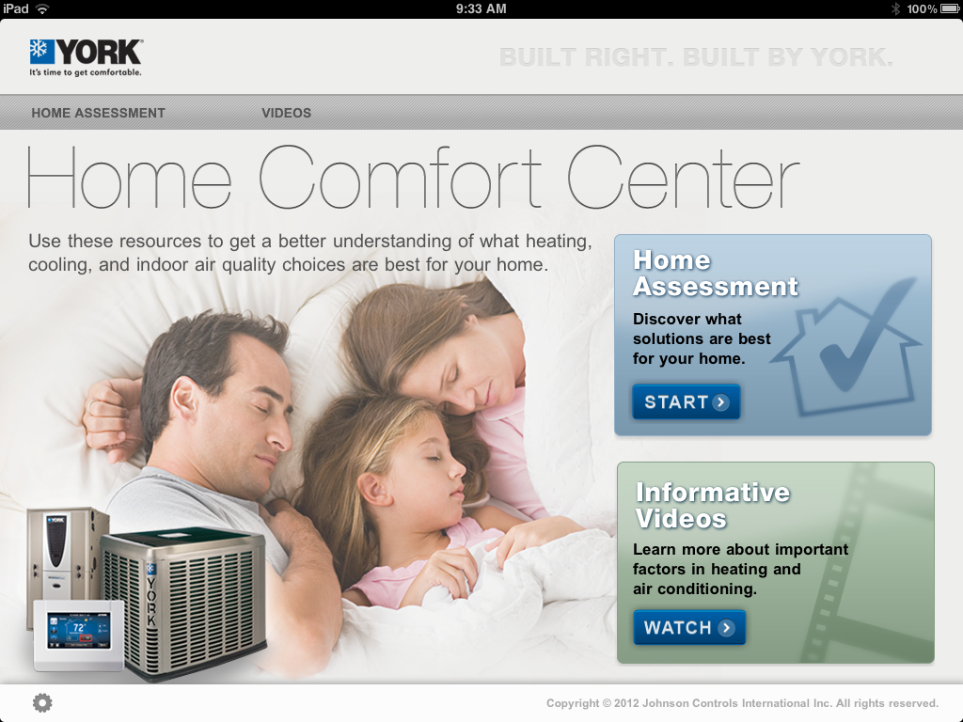
Home Comfort Center
Loading Resources . . .
Loading Resources 67%
Loading Resources 0%
Allow 5-15 minutes for HCC to load after initial install – must be connected to wireless or 3G

Slide 24
Home Comfort Center

Slide 25
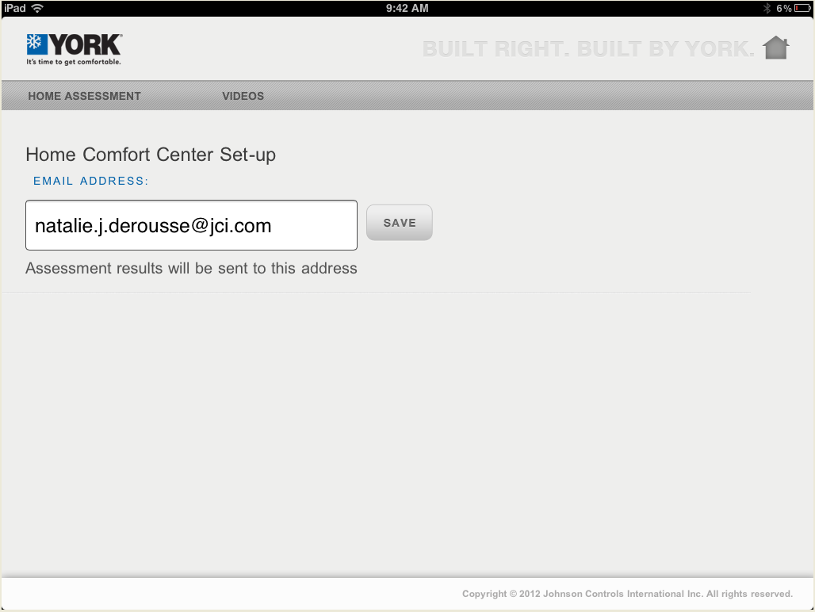
Home Comfort Center

Slide 26
Home Comfort Center

Slide 27
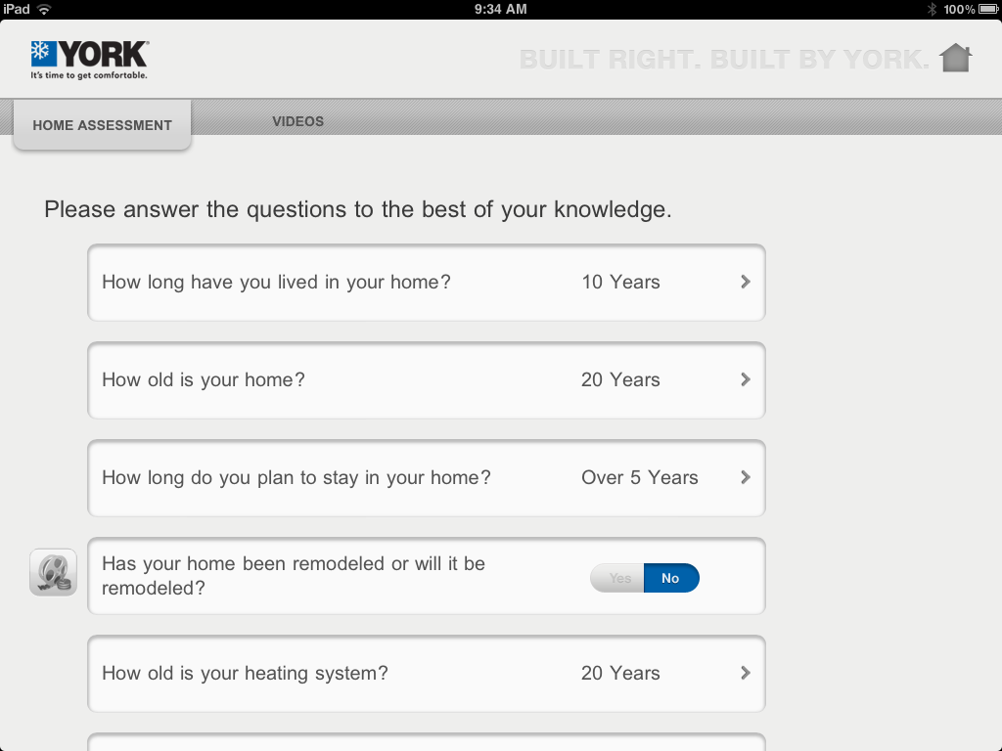
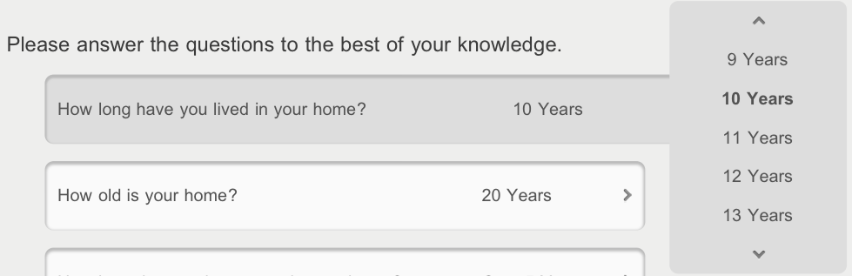
Home Comfort Center

Slide 28
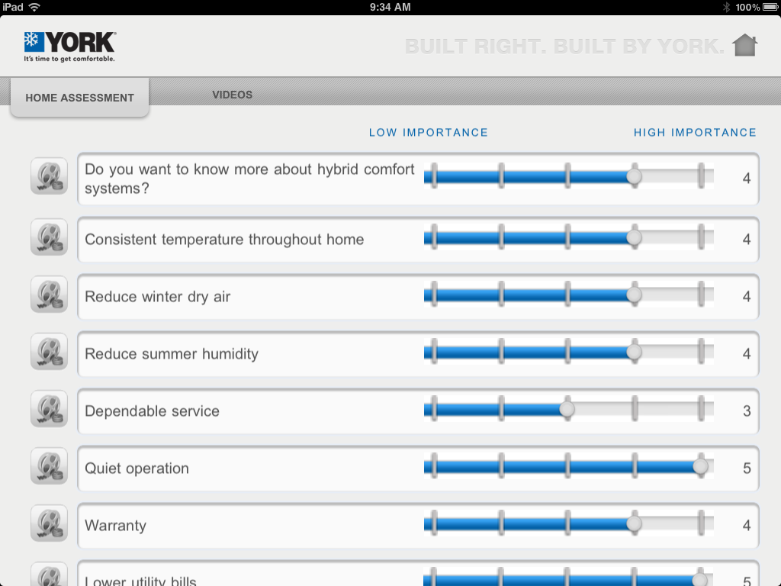
Home Comfort Center

Slide 29
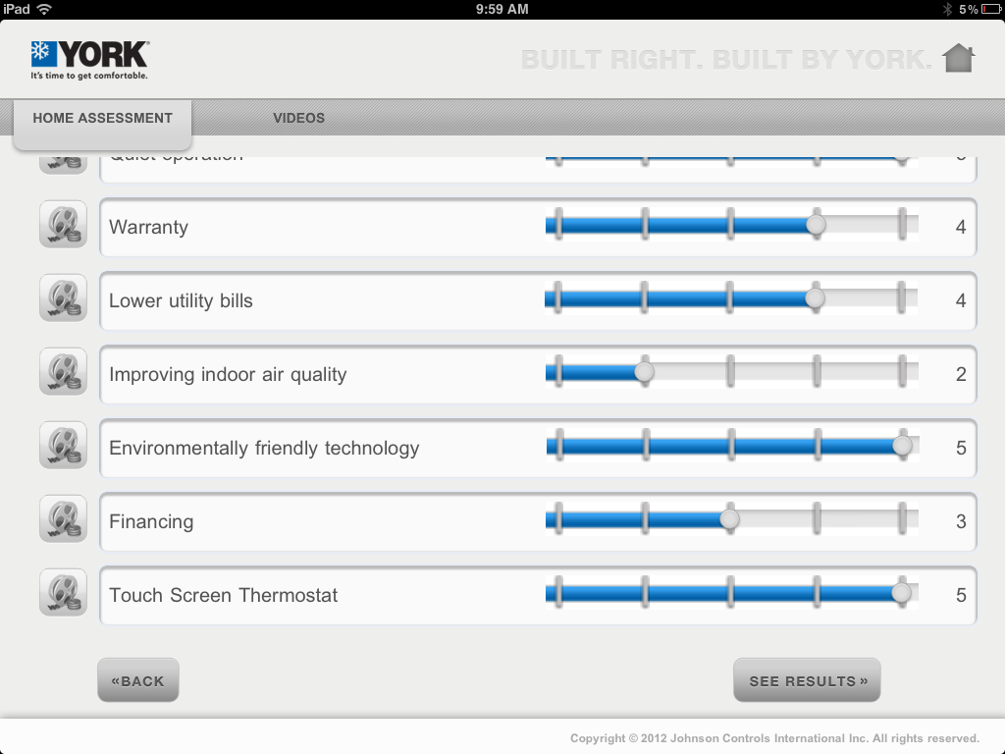
Home Comfort Center

Slide 30
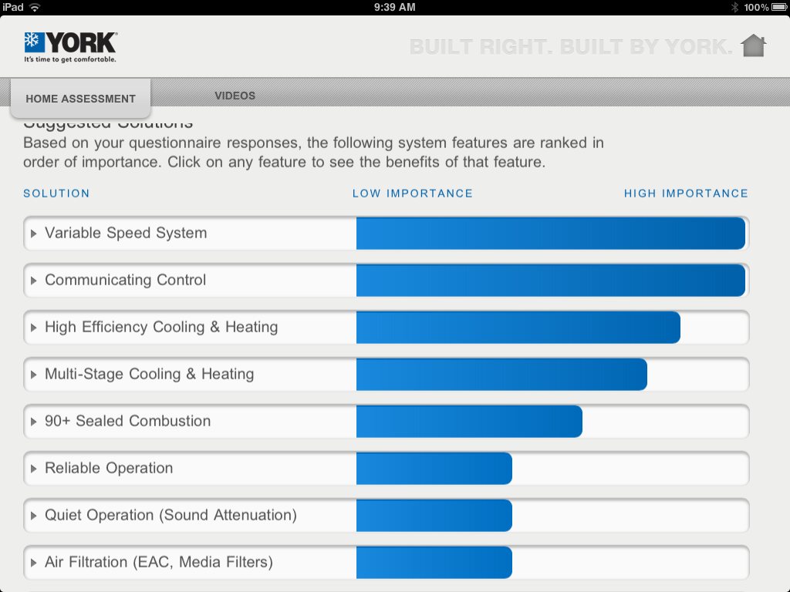
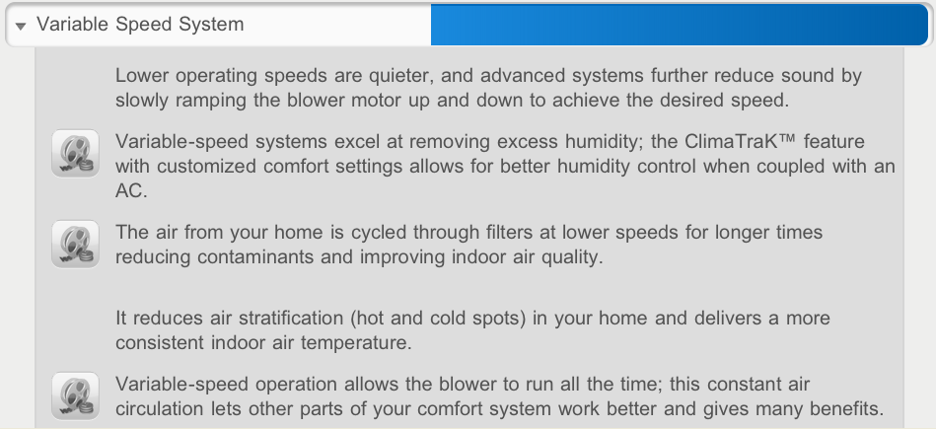
Home Comfort Center

Slide 31
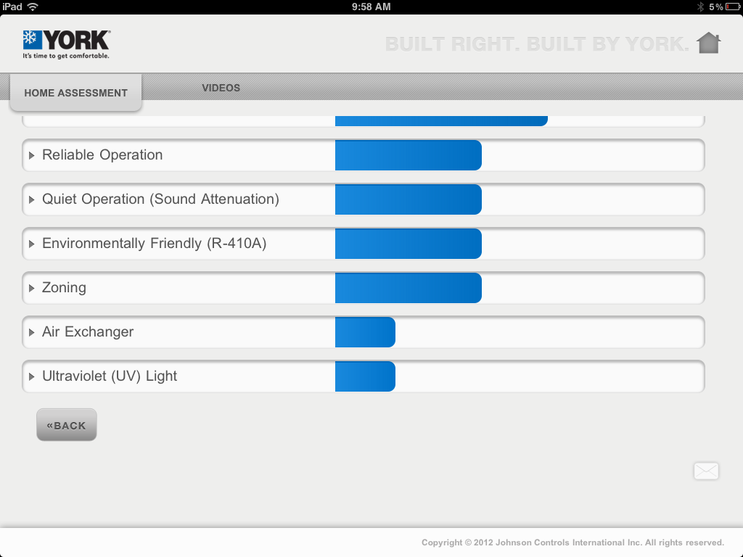

Home Comfort Center

Slide 32
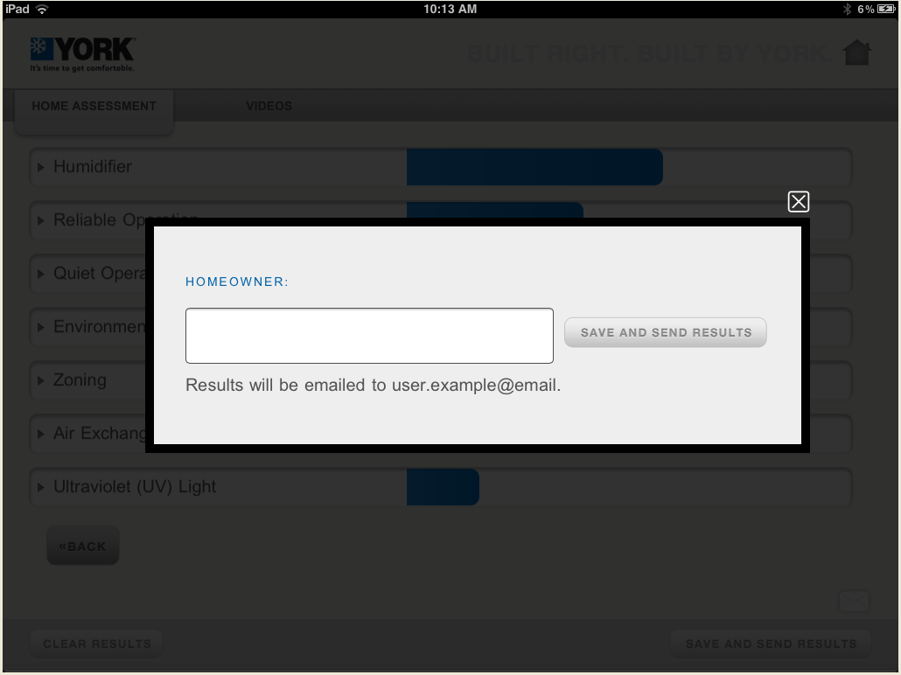
Home Comfort Center
lovelynatalie@hotmail.com

Slide 33
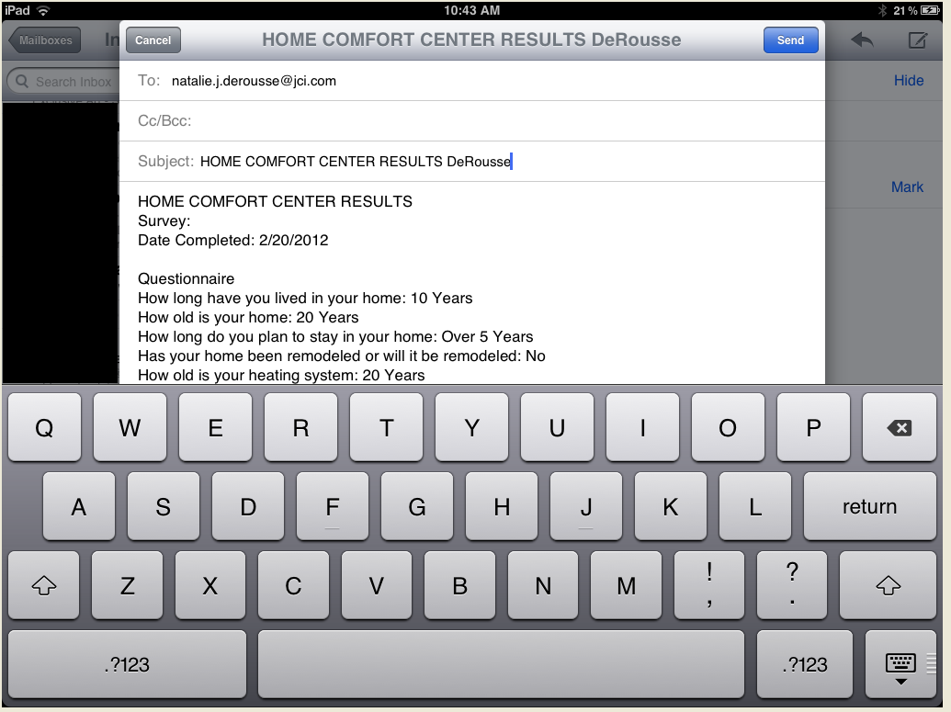
Home Comfort Center
lovelynatalie@hotmail.com

Slide 34
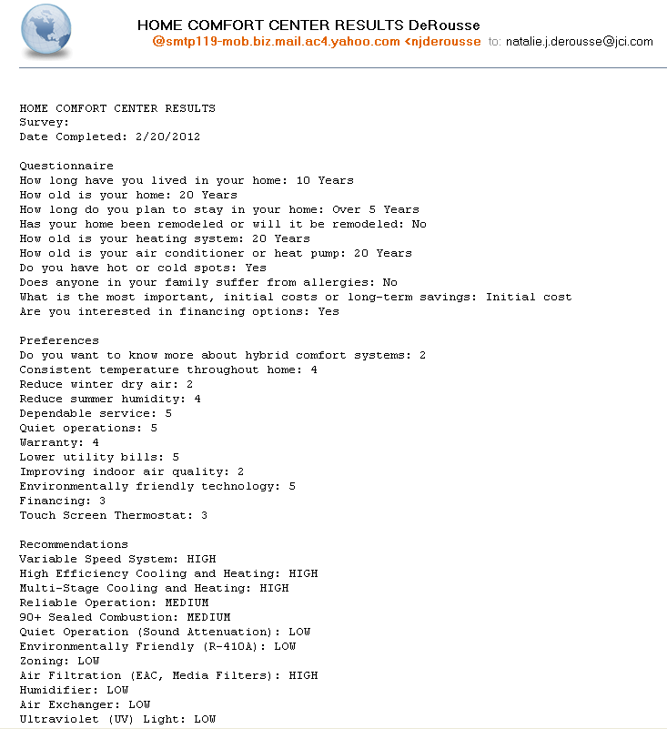
Home Comfort Center - Email

Slide 35
Home Comfort Center

Slide 36
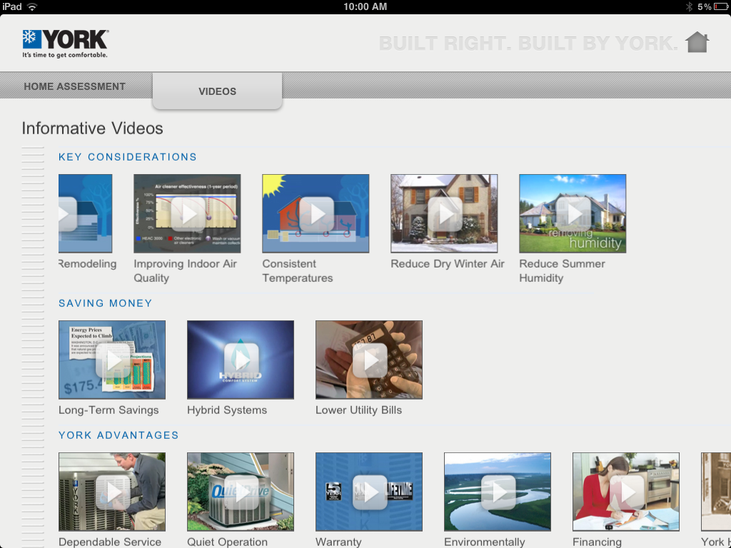
HCC - Informative Videos

Slide 37
Home Comfort Center

Slide 38


QUESTIONS?

