Slide 1
Installing the factory configuration file onto a replacement SSE Unit Control Board
(when the configuration parameters were not saved on a USB drive or PC when equipment was Commissioned and Started up)

Slide 2
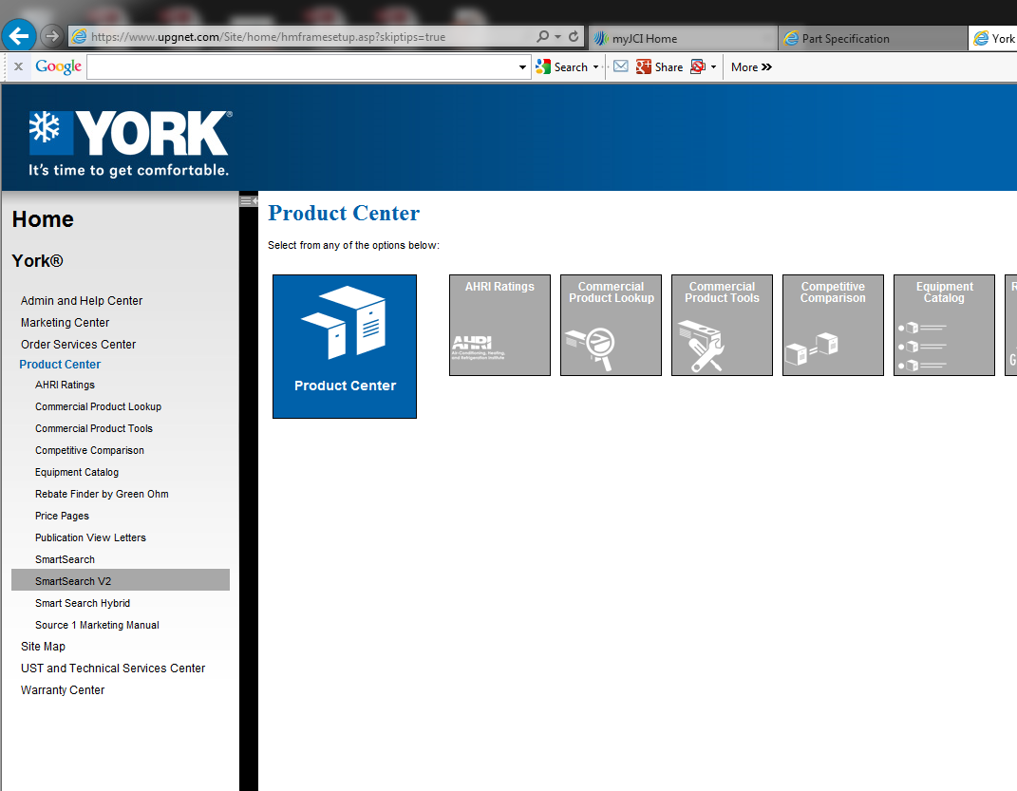
1) Open UPGNet
2) Select Product Center
3) Select SmartSearch V2

Slide 3
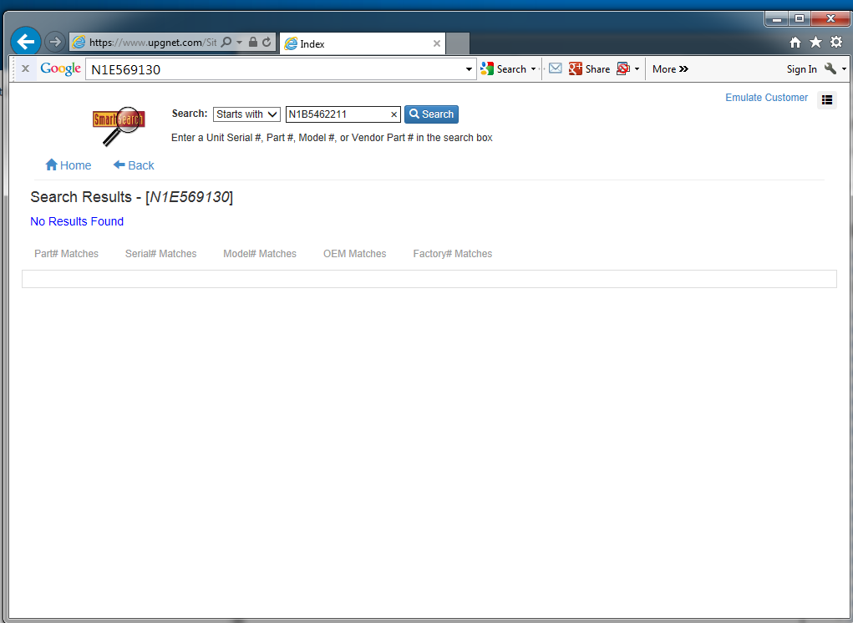
1) Enter Serial Number of Unit
2) Press “Search”

Slide 4
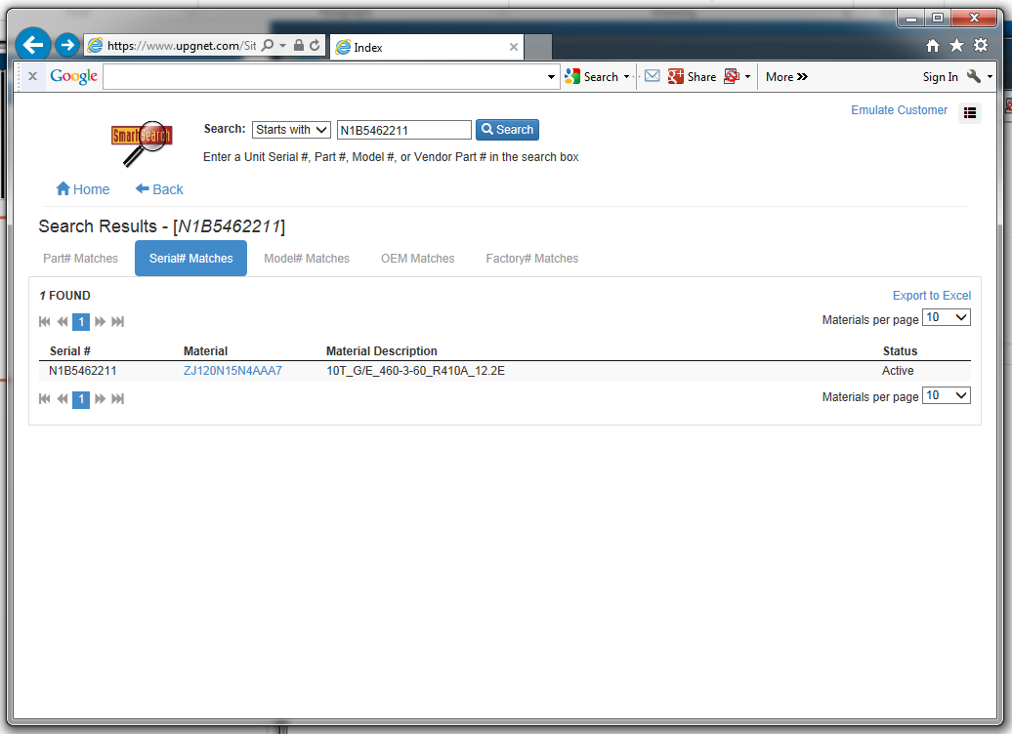
1) Click on Unit “Material” number in blue

Slide 5
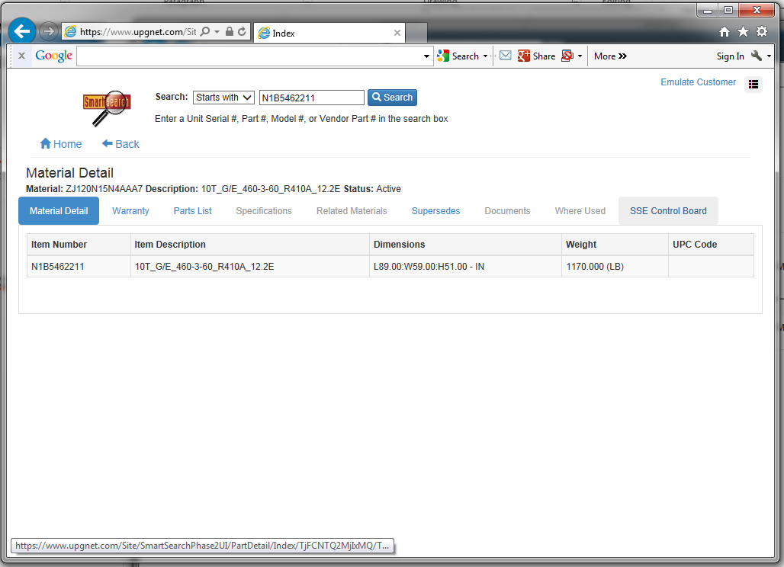
1) Click on “SSE Control Board”

Slide 6
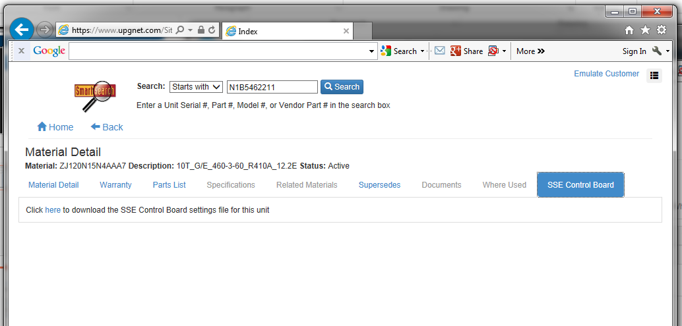
1) Click on “here” to download Factory configuration file

Slide 7
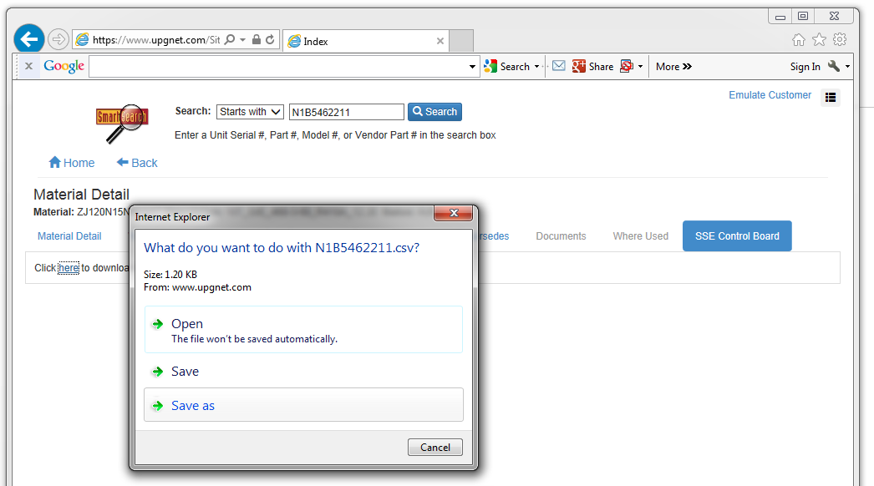
1) Save as (keep name), but save onto USB drive

Slide 8
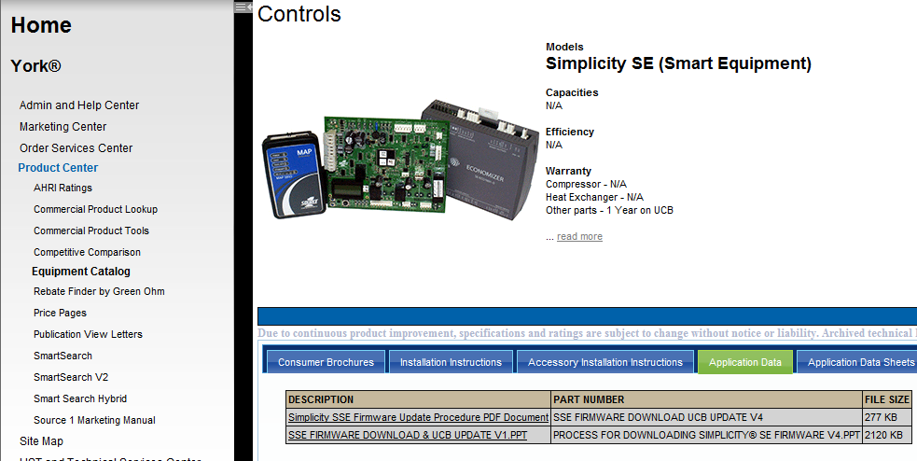
TO CONFIRM FIRMWARE VERSION ON UCB:
  >Controller
  >Firm
  >FirmVer
  3.0.0.1072
  (if it is not 3.0.0.1072, follow instructions on UPGNet)
  If it is 3.0.0.1072, press CANCEL several times until returning to main menu and proceed
TO INSTALL FACTORY SETTINGS:
Insert USB drive into USB port on UCB
Scroll down to
>Update
>Restore
Press “Enter”
This has now updated all factory defaults. You may return to main menu on UCB and remove the USB drive

Slide 9
Cautions:
SSE Board from Source 1 would come with OccMode set to Schedule. This will run the unit off the internal schedule.
→If you are using a thermostat only control or are using a Building Automation System, you will want to change this to “External”
  >Commission
  >HVACZone
  >OccMode
  External
Your USB drive must be “FAT”. See instructions for confirming or reformatting your USB drive on Page 10

Slide 10
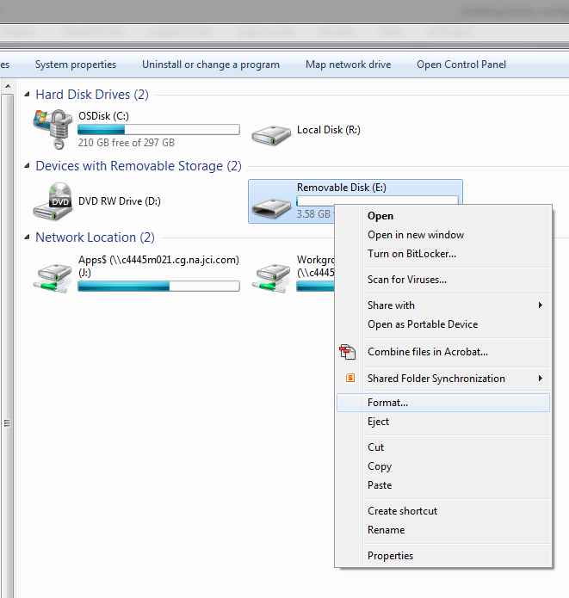
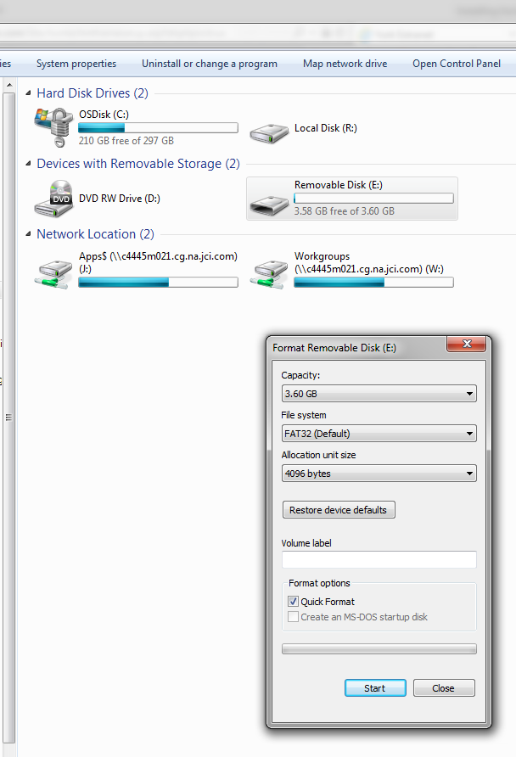
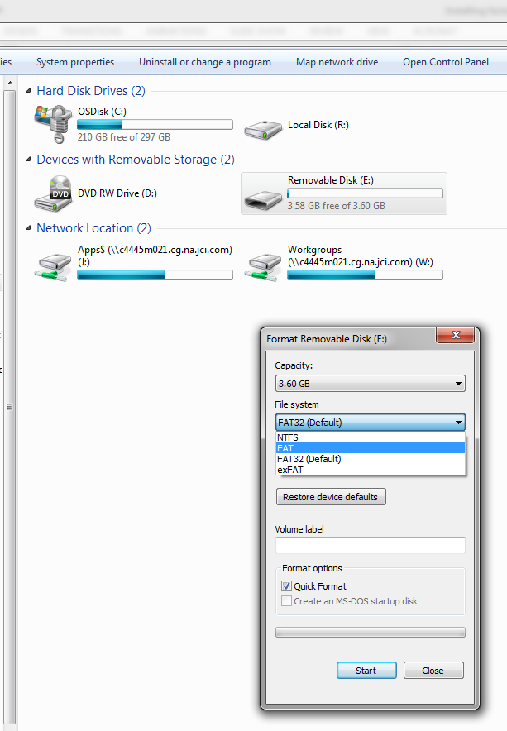
TO CONFIRM OR RE-FORMAT YOUR USB DRIVE:
1) Right click on your Removable Disk
2) Select “File system” pull down menu
3) Select “FAT” then “Start”

