Slide 1
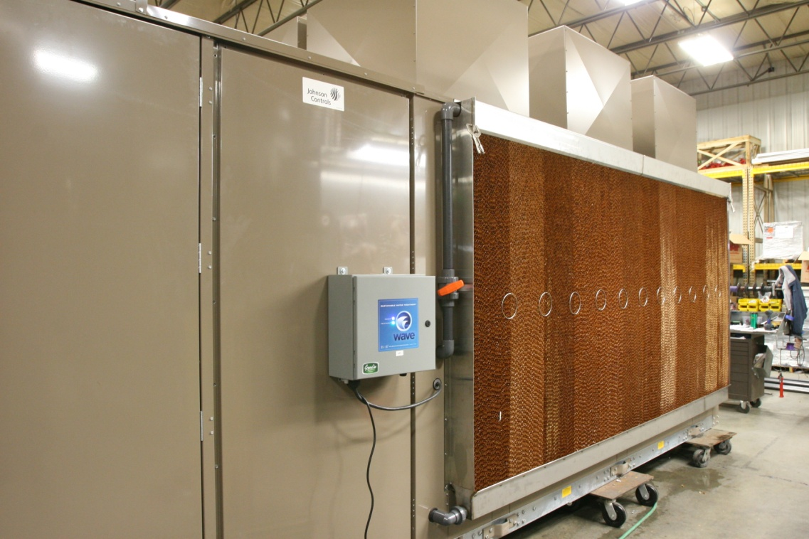
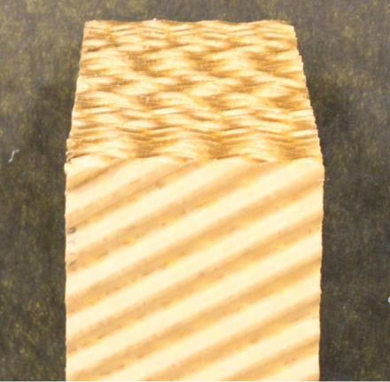
Chiller – Evaporative Cooling
Options:
    Media depth 4” – 12”
    Field installed or assembled at Fisen
    Check Fisen website for standard options and field installed kit pricing
    Contact Fisen for assembled pricing
Notes:
List pricing is available for 4 media depths and the pricing is for installed kits. They can also accommodate assembling the kit when the unit ships to Fisen.

