Slide 1
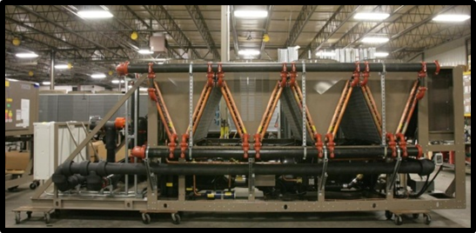
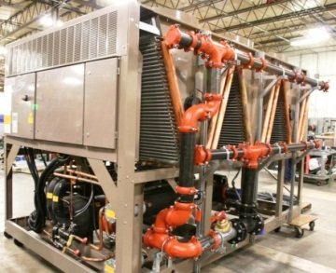
Chiller – Free Cooling (Waterside Economizer)
Top Benefits:
Compressors don’t run when ambient is ~20F below LWT
Simultaneous Free/Mech. Cooling
Free cooling available any time ambient is below EWT
ANY 24/7 cooling process
Typically data centers
30,000 + Tons In Operation
Competitors:
Trane, Motivair
Notes:
.

Slide 2
Chiller – Free Cooling (Waterside Economizer)
Top Benefits:
Basis Of Design Support
Presubmittals and Payback Analysis
Pumping Package Layouts
Reference Database

Slide 3
Chiller – Free Cooling (Waterside Economizer)
Marketing Flyer Available on Website:

Slide 4
Chiller – Free Cooling (Waterside Economizer)
Scope:
Simple Addition of Water Coils
3-Way Valve
Simple Controls
Standard Unit Sequence When Refrigeration Operating

