Slide 1
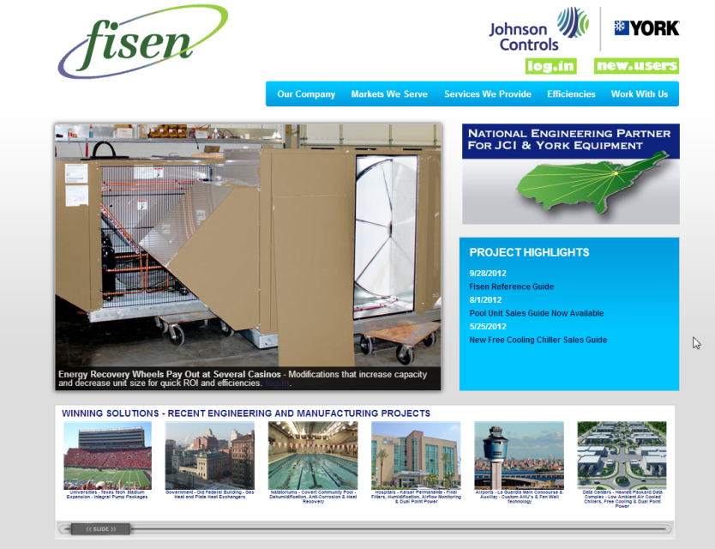

Fisen – Who are they?
Factory Authorized Modification Partner
used to extend reach with current offering
Started in 2004 in Dutton, MI
Exclusive with Johnson Controls since 2007
Competencies include –
Manufacturing
Engineering
Design
Controls
Troubleshooting
Product positioning
Website: www.fisenusa.com
Phone: 616-698-7279
The Fisen Website has budget pricing as a start on many options, along with brochures for select modifications.
Notes:
CHRIS: Johnson Controls has partnered with Fisen to enable our sales team to WIN projects they may not have otherwise been able to secure. Either by providing modifications to provide units that our factories can’t or to deliver the units faster than a factory lead time may be able to accommodate.

Slide 2
Fisen – What sets them apart?
A factory authorized modification partner means…
Fisen works closely with your factory
Factory warranty remains intact
Fisen supports you on the front end laying projects out with engineers
Fisen supports you on the back end once the product is in the field
The Fisen Sale…
Allows you to sell more volume
Increases margins and hit ratio
Is a true engineered sale
Fisen Factory Tours…
Fisen encourages you and your customers to come to our facility
Fisen has everything from a 3T RTU to a 500T ACCH on our floor at a given time, we would love you to take advantage of the opportunity
Notes:
CHRIS: A partnership with Fisen means they have worked closely with our factories and they will support you every step of the way from laying out projects with the engineers, to supporting their modifications once the product is installed in the field.
JENNIFER: With a partnership like the one we have with Fisen, you will be able to sell more volume by capturing projects you may not otherwise WIN. The Fisen sale increases the volume because we are customizing our product, this should increase the hit ratio and margin, in the end, the Fisen sale is a true engineered sale. They can assist with the layout, positioning and closing the sale and since Fisen only works with JCI , it is a team effort.
ADAM: They encourage visits for factory tours to see them in action– the units on the floor will vary depending on the schedule which allows for a unique look at our products and their capabilities.

Slide 3

Fisen – Who to contact?
Who to contact:
Johnson Controls Offices Contact:
Adam Donovan - adonovan@fisenusa.com
Office: (616) 698-7279 x201
Cell: (616) 401-4690
Johnson Controls Agents Contact:
Chris Beggs - cbeggs@fisenusa.com
Office: (616) 698-7279 x107
Cell: (616) 291-5170
Website: www.fisenusa.com
Phone: 616-698-7279

