Slide 1
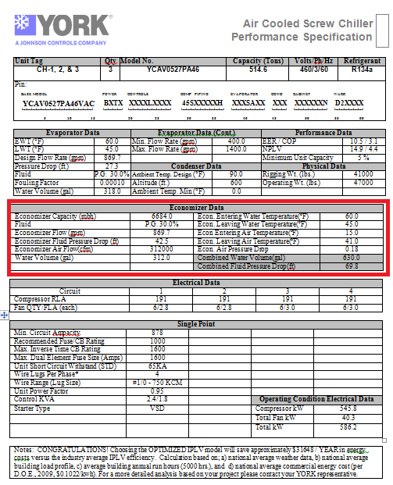
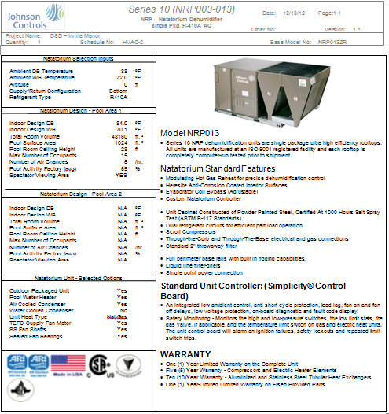
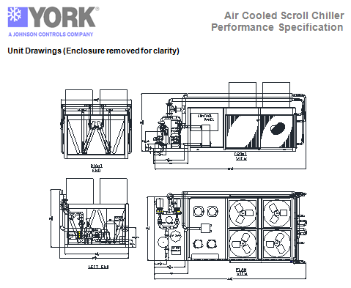
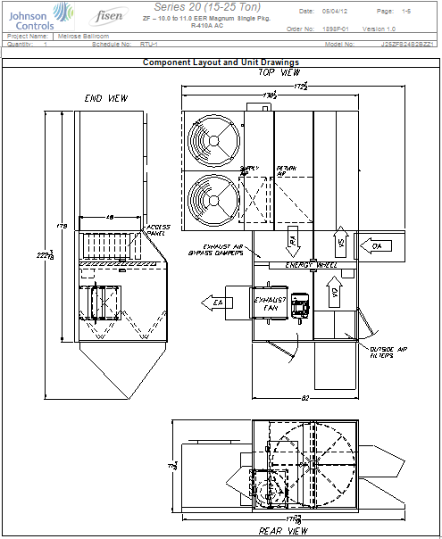
Fisen – How to Engage Them
Call or Email with an Opportunity
Email Pertinent Plans and Specs
Email UST .doc perf. file
Email YW File (Fisen has full version)
Basis of Design is THE BEST Opportunity
Strategic selling, differentiate offering
Elevate products to eliminate traditional competition
Fisen can help educate you on the custom solution
Pre-Submittals with drawings and performance for engineer’s schedule
1 to 2 day turnaround. Time is of the essence, Fisen we understands that

Slide 2


Fisen/Johnson Controls Partnership
Expanding the capabilities of our factory with a factory authorized partner.
A partnership means:
Easy exchange of information with the factory
Warranty remains intact
Run test all equipment prior to shipment
Fisen ONLY works with Johnson Controls
Know the equipment inside and out
Motivated to help you strategically sell more Johnson Controls product by getting BOD
and modifying your base equipment to compete in the custom market
Elevate the product offering for better margins and higher success rates
Notes:
JENNIFER: Speak to slide, invite Chris to explain warranty as part of this slide as well as how they can work easily with the factory.

Slide 3

Expanding the capabilities of our factory…
Who to contact:
Johnson Controls Offices Contact:
Adam Donovan - adonovan@fisenusa.com
Office: (616) 698-7279 x201
Cell: (616) 401-4690
Johnson Controls Agents Contact:
Chris Beggs - cbeggs@fisenusa.com
Office: (616) 698-7279 x107
Cell: (616) 291-5170
Website: www.fisenusa.com
Phone: 616-698-7279

