Slide 1
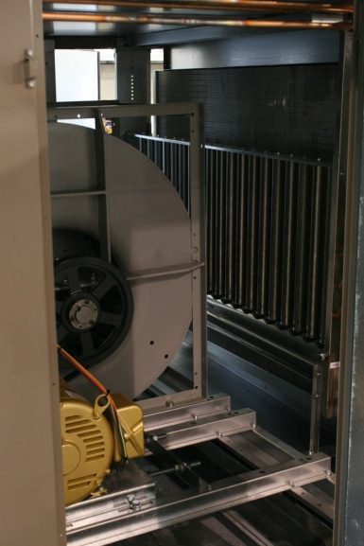
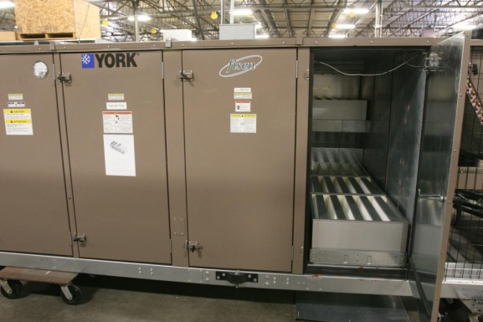
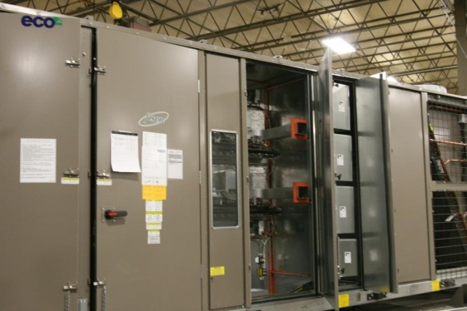
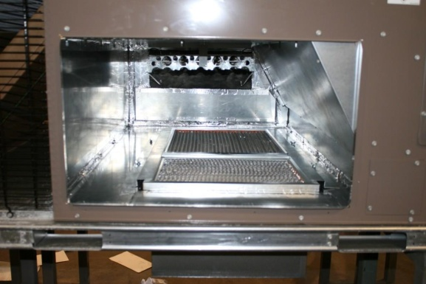
RTU – Medical Office Building Modifications
Final Filters and Humidification
Benefits:
    Final filters available in all industry
    standard efficiencies and types
    High efficiency vapor dispersion system
Competitor:
McQuay
Notes:
CHRIS: Speak to Slide, This is one of the Fisen manufactured product. Fisen manufactured products contain special features, the are pre-engineered to meet a specific market which helps reduce the price to the field.
With air filtration critical in the medical environment, the Fisen modification for the Johnson Controls rooftop is cost effective. The humidification and air filtration components are easily and seamlessly added to the packaged rooftop unit. The high efficiency vapor dispersion system allows for exceptional humidity control and the final filters can trap and eliminate microscopic contaminants. The biggest competitor for the Medical Office building modifications is the McQuay unit, they are aggressive with their product.

Slide 2
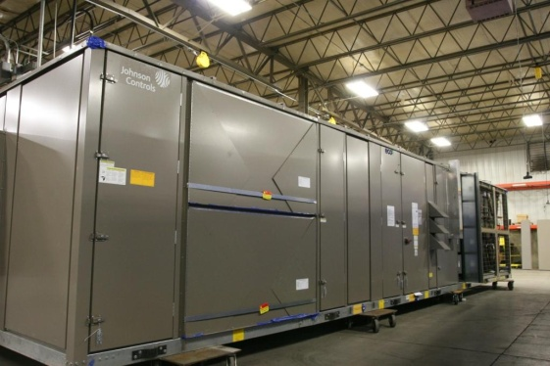
RTU – Medical Office Building Modifications
    Flyer available on Fisen website

