Slide 1
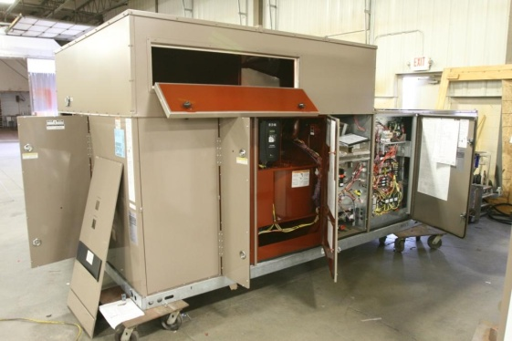
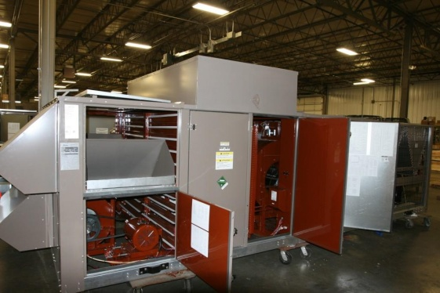
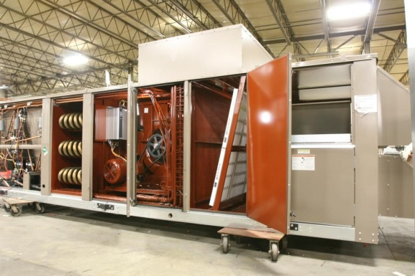
Standard Modification - Pool Units
Top Benefits:
    Packaged DX pool units
    Basis of Design :
      Big Performance Advantage
    High margin market
Market Brands:
Poolpak, Seresco,
Desert Air, Dectron

Slide 2

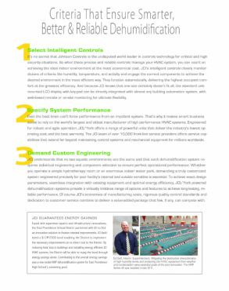
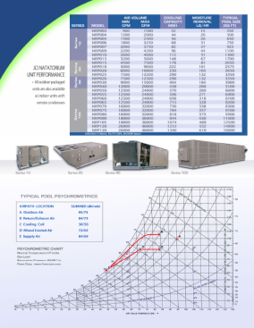

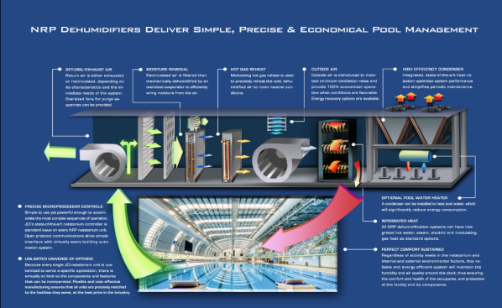
Pool Units
    Flyer available on Fisen website
Marketing:
    System Description
    Basic Performance Table
    Psychrometrics
    Options / Features
    Required Inputs for Selection

Slide 3
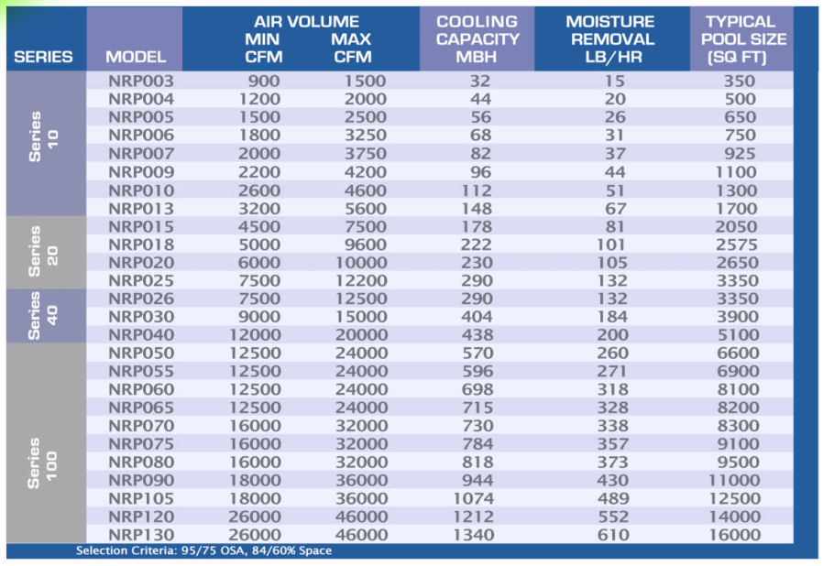

Slide 4
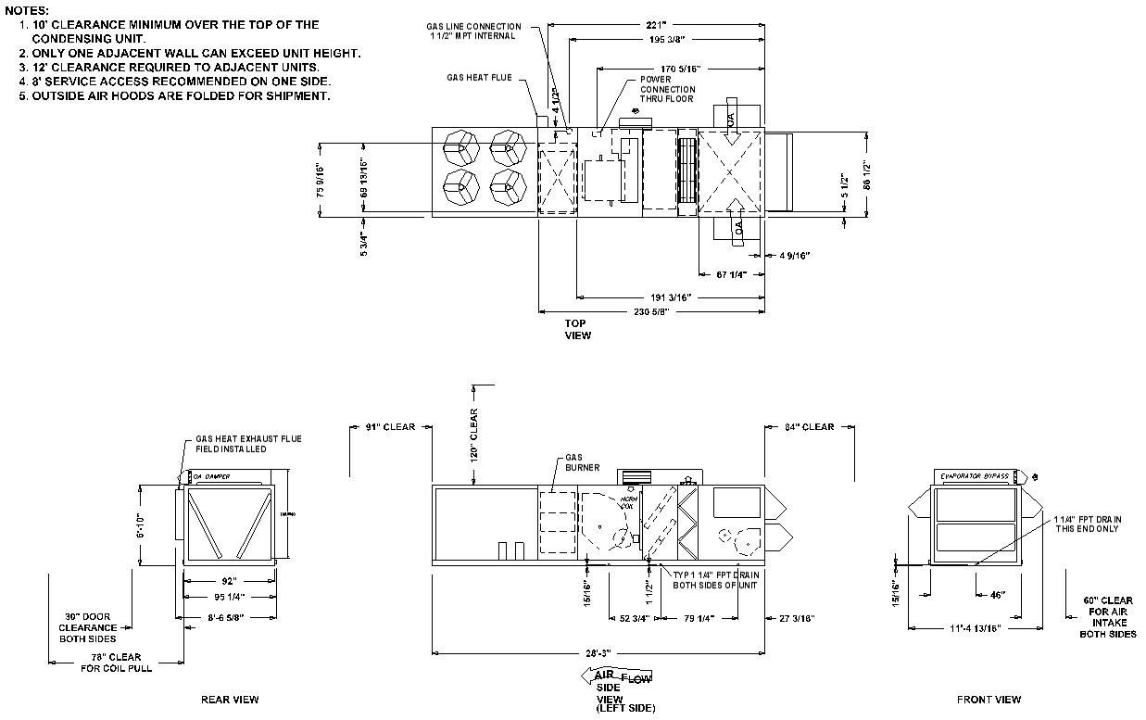
Pool Units
BOD Support:
    Unit Selection
    Standard Presubmittals
    Guide Spec w/ Hooks
    Performance Template
    1-Day Turnaround

Slide 5
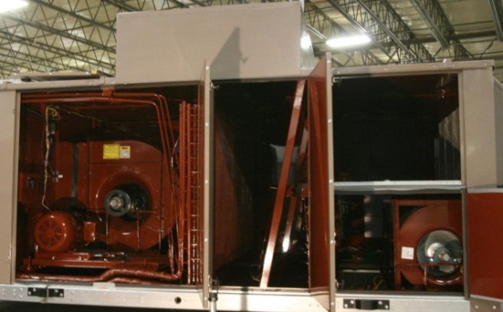
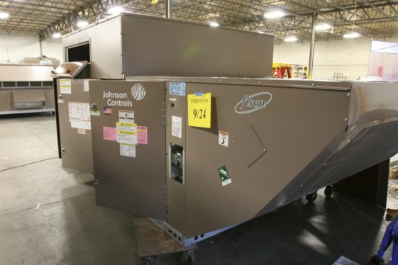
Pool Units
Scope:
    Interior Coating
      2-Part Epoxy
      Steel Surfaces
    DX Coil Protection
      Factory Coated Series 5, 10, 20, 40
      Copper Coil Series 100
    Custom Dehumidification Controls
      All Temp, Humidity, Skin Sensors
    Modulating Heat (Elec, HW, Gas, Steam)
    Hot Gas Reheat
      Modulation of Factory Series 5, 10, 20
      Fisen HGRHT Series 40, 100
    DX Bypass – Optimal Dew Point Control
    OA Intake Past DX Coil
    Optional: Pool Water Heat
    Pump Down, Receivers, etc. – to Manage Conditions and Charge

