Slide 1

HVAC Energy Savings & Better Indoor Air Quality

Slide 2
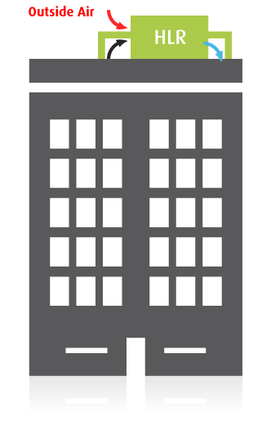

Key to air quality in buildings: air replacement
AHU
Fact
Indoor air is continually replaced with outside air
  Entire building volume, 10-20 times per day
Reason
Maintaining indoor air quality By diluting CO₂ and VOCs (“Volatile Organic Compounds”)
Problem
Air replacement ➔ increased energy consumption and introduces outdoor pollutants

Slide 3




The new alternative: treat and recycle the indoor air
Remove CO₂ , VOCs and other contaminants
Reduce amount of outside air
Save energy*
*and get better indoor air quality

Slide 4

A practical solution has only now become feasible
Key Technology #1 Low-cost CO₂ removal
  Developed by leading national labs
  Re-engineered for indoor conditions
Key Technology #2 High capacity VOC reduction
  Micro-activated carbon fiber technology
Key Technology #3 Formaldehyde reduction

Slide 5
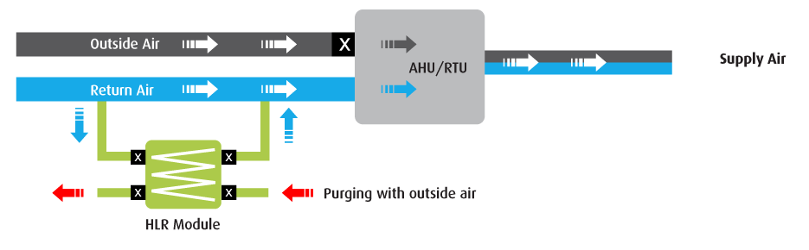
The HVAC Load Reduction (HLR) Module: How It Works
A fraction of the airflow is diverted through the HLR Module (a “bypass”)
Can attach to ducts or directly to AHU; located rooftop or indoors
Switches periodically to a brief self-cleaning (”regeneration”) cycle
Self regulating with fail-safe protection

Slide 6
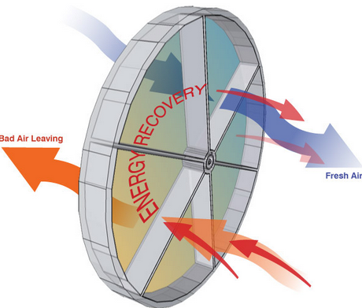
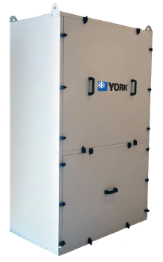
HLR Compared to ERV ( 4K CFM Standalone ERV with DCV)
ERV (4K CFM Unit)
Installed Cost Estimate $25K
Weight – 950 LBS
Effectiveness – 70%
Clean the Wheel
Typically No Alert if ERV breaks
Used for High Exhaust Areas
  Kitchen and Labs
HLR-1000E
Installed Cost Estimate $14K
5 Years of Cartridges – $5K
Weight - 400 LBs
Effectiveness- 95%
IAQ Remote Monitoring
Integrated DCV
Energy Savings Reports
9 LEED Points
Captures CO2 and VOCs

Slide 7
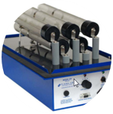
HLR Compared to Bipolar Ionization ( 20K CFM AHU)
Ionizer
Installed cost Estimate $15K
5 year Tube Replacement - $4,000
Weight – 40 LBS
No CO2 removal
Debatable Formaldehyde Removal
Not Recognized by LEED
Excellent at Removing Air Borne Viruses
No Energy Savings
HLR-1000E
Installed Cost Estimate $14K
5 Years of Cartridges – $5K
Weight - 400 LBs
Effectiveness- 95%
IAQ Remote Monitoring
Integrated DCV
Energy Savings Reports
9 LEED Points
Captures CO2 and VOCs

Slide 8
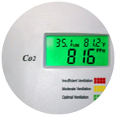
HLR Compared to DCV ( 20K CFM AHU)
Demand Control Ventilation
Estimated Price - $2,000
Increased VOC Concentration
No CO2 removal
Minimal Energy Savings
Set High Electrical Peaks
Good IAQ is typically lost
  600 PPM up to 1000PPM
HLR-1000E
Installed Cost Estimate $14K
5 Years of Cartridges – $5K
Weight - 400 LBs
Effectiveness- 95%
Reduces Electrical Peak
Integrated DCV
Energy Savings Reports
9 LEED Points
Captures VOCs

Slide 9
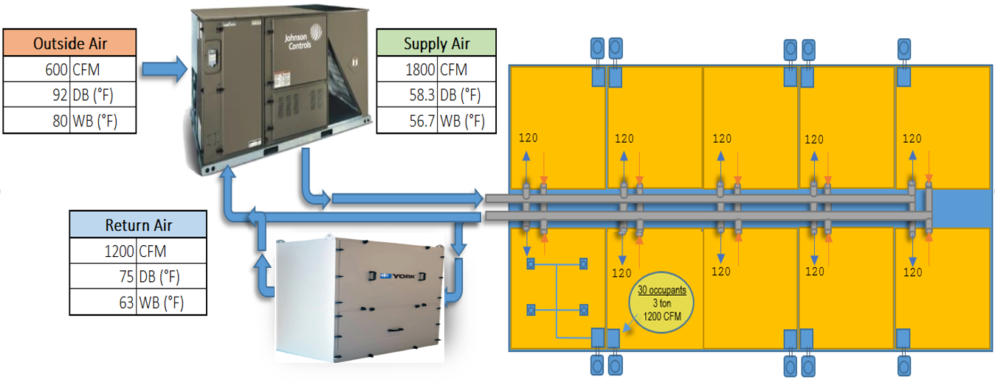
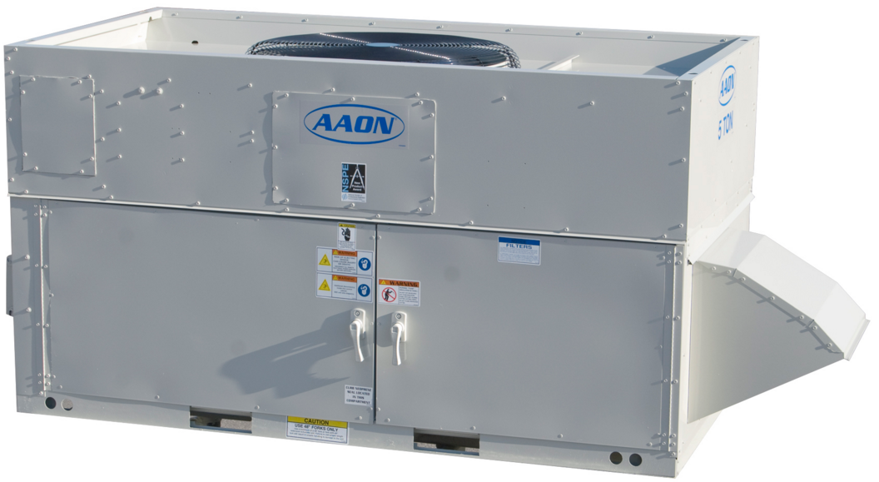



Job Sizing Demo ( 10 Room K-12 School Example)

Slide 10
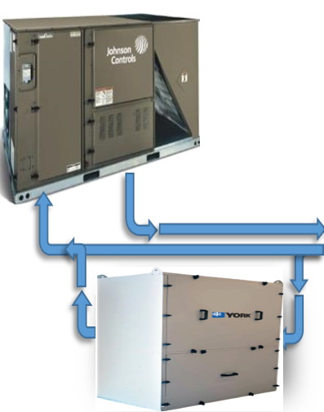
Savings Estimates for K-12 School (35 Weeks per Year Occupancy)
4500 CFM Aaon Unit
Approximately $45K
$2,200 Annual Electrical Cost
$840 Annual Gas Cost
5T RTU with HLR
Approximately $25K
$650 Annual Electrical Cost
$700 Annual Gas Cost
See Appendix 1 Slide for Savings Details

Slide 11
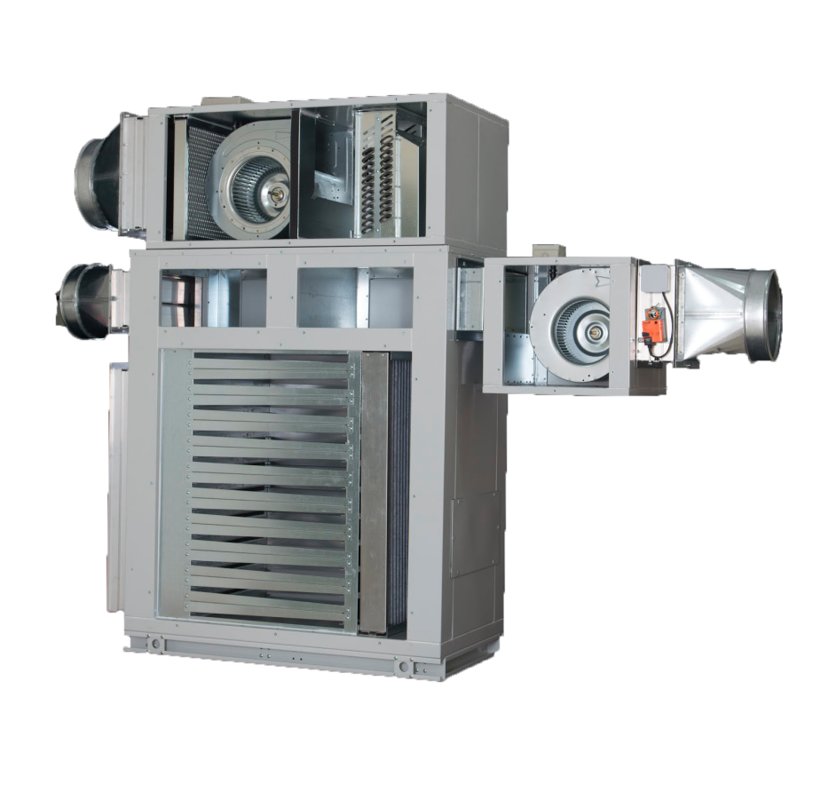
An Inside Look at the HLR
Electrical heater
Regeneration fan
Sorption fan
Replaceable Cartridges

Slide 12
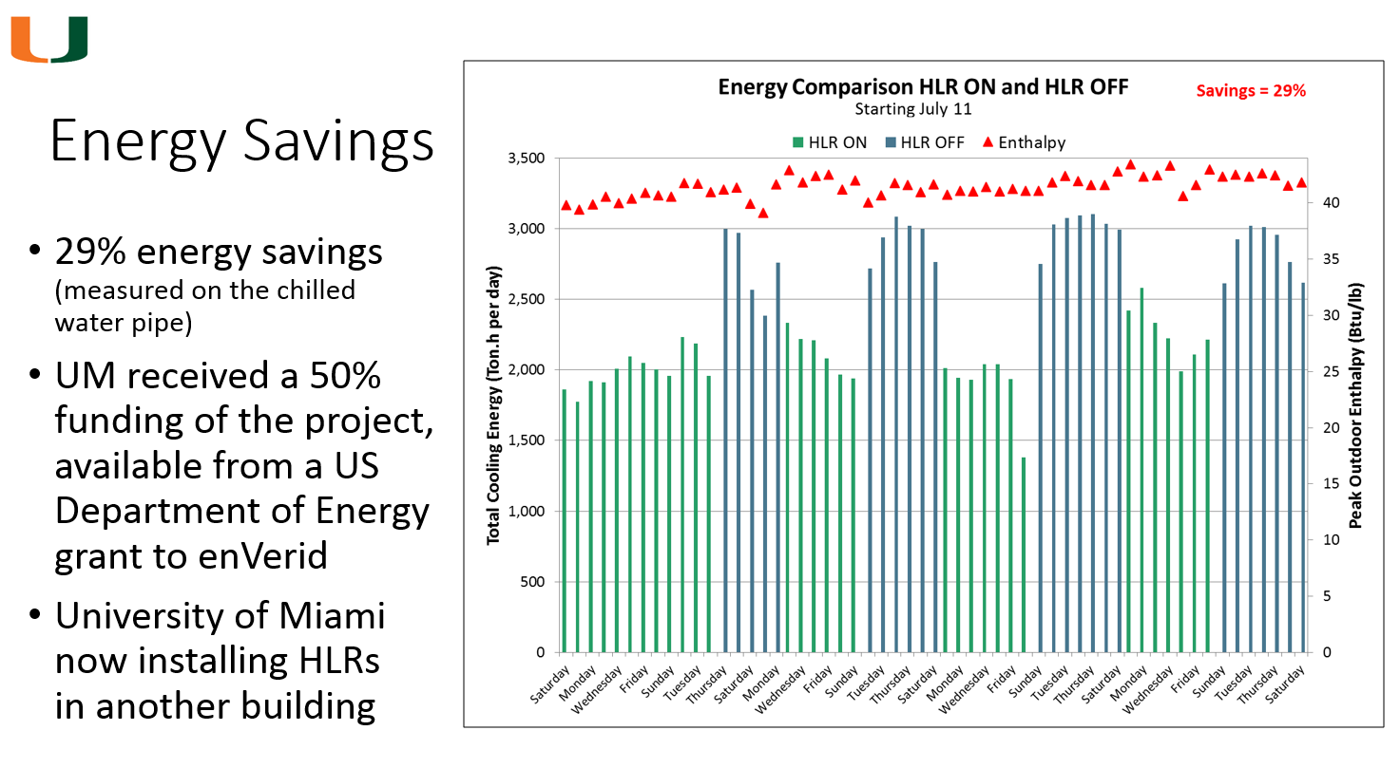
University of Miami (Fitness Center 60K SQFT)

Slide 13

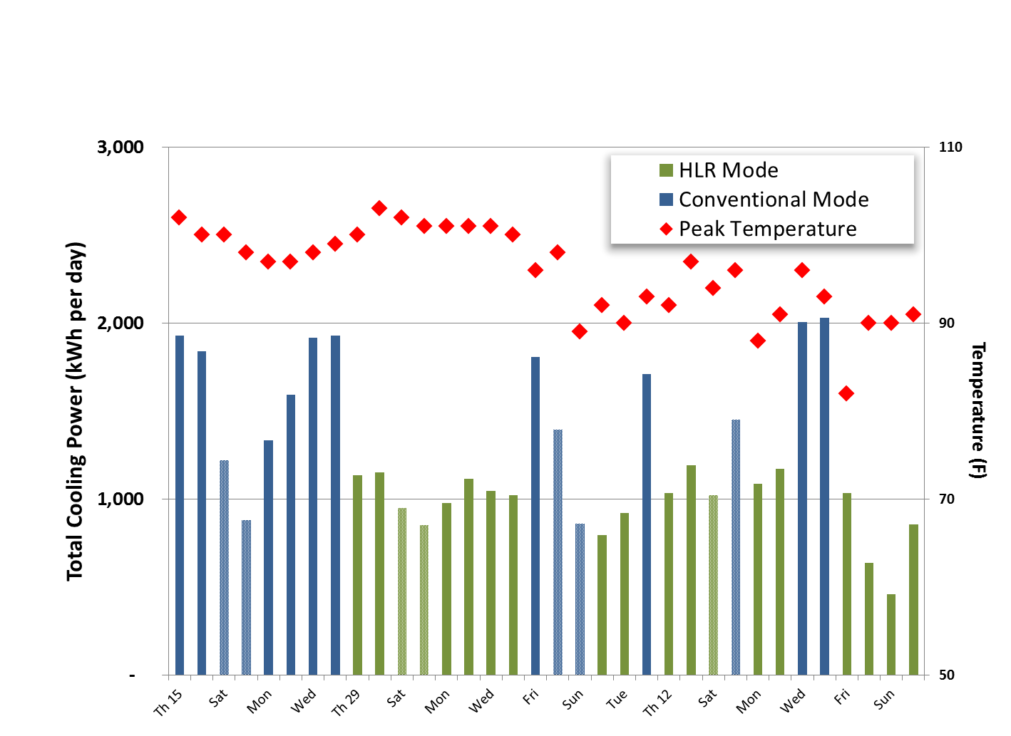
HLR Installation in San Antonio, TX
30% energy savings during 8/15- 9/30, 2013

Slide 14
Optimal and Non-optimal Buildings
Non-optimal
Optimal
Operating Rooms
Laboratories/Kitchen
  High Exhaust
100 % OA Systems
Short Occupancy Schedules
  Less then 40 Hours
Efficient Cooling/Heating Systems
High Mandatory Exhaust
Office Building
Universities
K-12 Schools
Public Buildings/Assemblies
Gyms Fitness Centers
Retail Stores
  VOC Off Gassing Materials
Mixed Air Systems
Long Occupancy Schedules
Inefficient Cooling/Heating Systems
Low Mandatory Exhaust

Slide 15
Optimal and Non-optimal AHUS/RTUs
Non-optimal
Optimal
100 % OA Systems
No Return Duct or Return Air Plenum
Bottom Feed Return Air
Small Mechanical Rooms No Space
No Access to Exhaust Duct
Greater Than 25 Ft to Return Duct
Easy Access to Return Air Duct
Mechanical Room Plenum Return
Easy Access to Exhaust Duct
Space in the Mechanical Room
10K - 50K CFM AHUs
Less Than 25 Ft to Return Duct

Slide 16
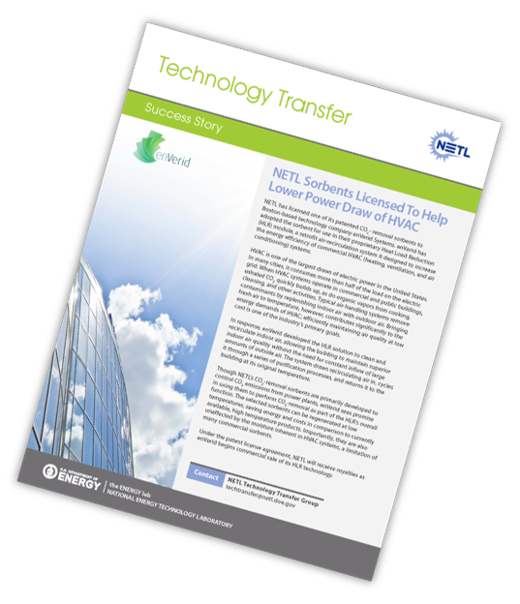

Backed by DOE ( 50% Credit for HLR Projects)
NETL Magazine
National Energy Technology Laboratories
July 2013

Slide 17
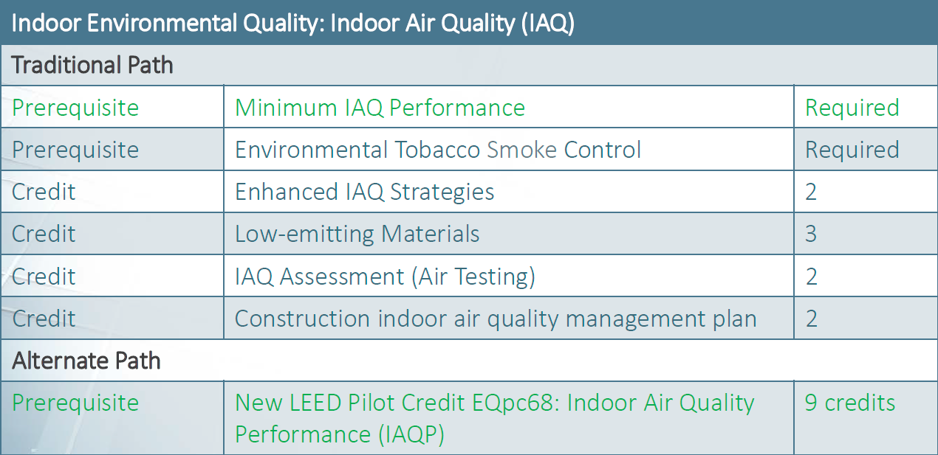
Backed by LEED (Qualify for 9 Points)

Slide 18
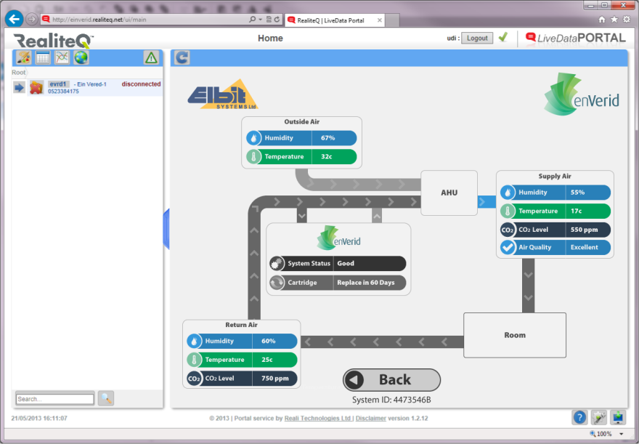
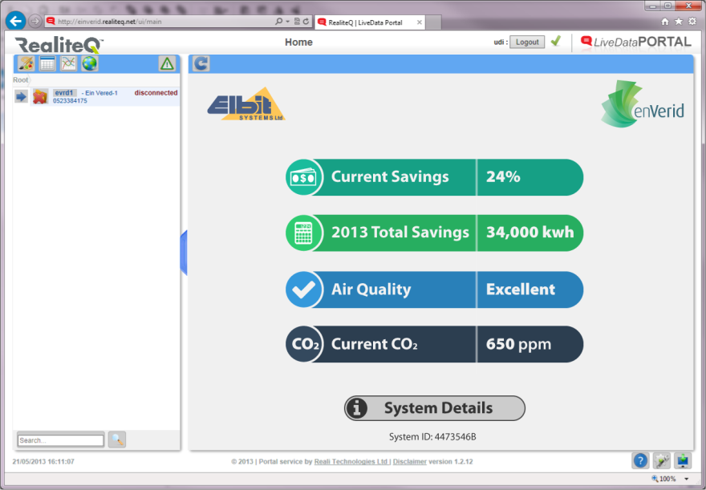
Real-time Remote Control and Monitoring
24-7 access online, including smart-phone
Monitor and record energy and air quality

Slide 19
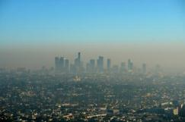
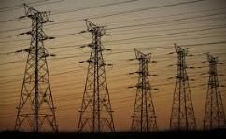
Other benefits: peak demand and air quality
Indoor air quality improvement
  Less injection of outside gas pollutants
  Sulfur oxides, nitrous oxides, fumes, smoke
  Less filters replacement
  Less humidity load on HVAC systems
  Reduced risk of mold and bacteria
  Less outdoor dust/particle buildup on filters
  Reduce need to replace filters
Peak demand reduction
  High savings coincide with peak demand
  Peak-shaving benefit to utility, grid
  End-user benefit: utility incentives / penalties

Slide 20
Frequently Asked Questions
How much energy is saved?
Dependent on climate and baseline building efficiency, most buildings will see 15 - 20% average annual savings, with peak savings as high as 40-50%
Does the system use energy?
  Yes it has a small fan and also requires short bursts of warm air to purge the adsorbent. The amount of energy consumed is small and accounted for in the ROI calculation
Does the system require maintenance?
  Once a year replace the CO₂ Cartridges.

Slide 21
Frequently Asked Questions
Any health risk to the people in the building?
Absolutely not. In the unlikely case where the system malfunctions or if for any reason air quality is not meeting standards, the HVAC system automatically reverts to conventional operation mode with outside air to assure air quality (until problem is fixed). If equipment had been downsized then the malfunction would have to be corrected. This is the exact scenario with an ERV malfunction.
Any official or regulatory issues?
  Although the technology is new, its use falls under Indoor Air Quality
  Procedure of the ASHRAE 62.1 guidelines approved
  by most governments and municipalities.

Slide 22
Summary
A solution offering material HVAC energy savings with excellent economics and no risk or disruption
Real technology – proven, and now commercially available
Scalable and compatible with any building
and infrastructure

Slide 23
Thanks for your time

Slide 24
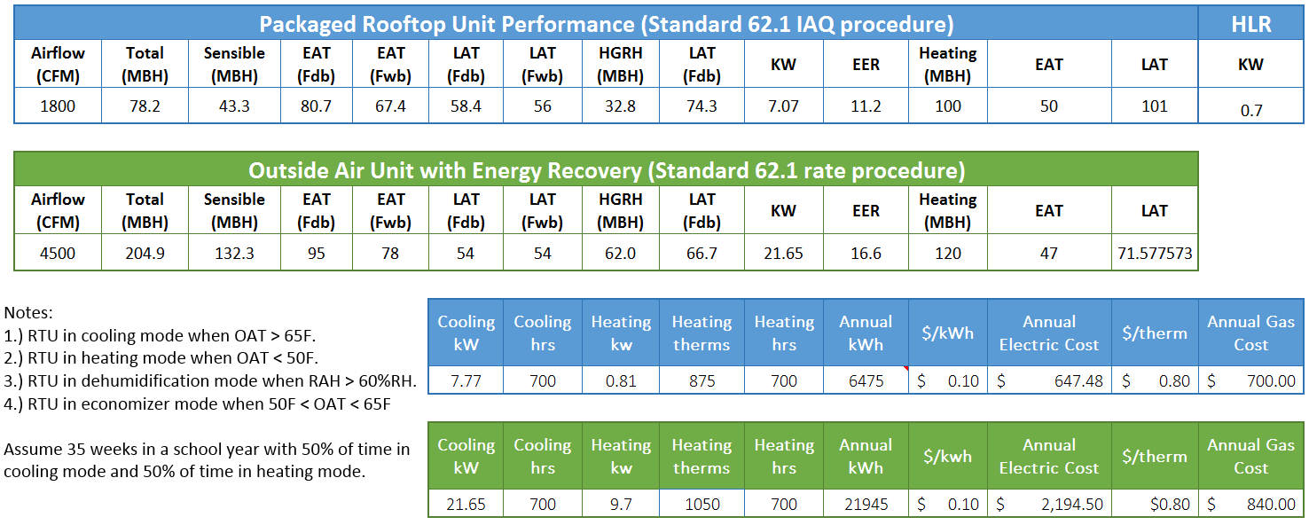
Appendix 1

