Slide 1


York® ECOaDVANCE™ Technology
Energy savings and Indoor Air Quality

Slide 2
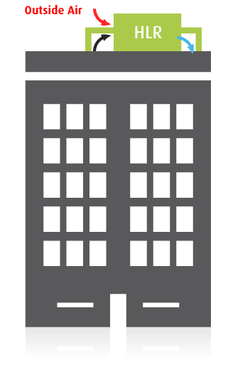
Problem: Ventilating buildings is costly and inefficient
Commercial buildings use a lot of outside air
Entire building volume replaced 10-20 times per day
Why? Indoor air quality
Offset the buildup of indoor gas contaminants
Mostly CO₂ , formaldehyde, VOCs
A universal but inefficient practice
Energy waste
Peak Demand Charges
Outdoor pollutants introduced
HVAC
Notes:
Commercial buildings use a lot of energy ventilating for IAQ. The assumption is that “dilution is the solution to pollution”. However, even when effective, high ventilation rates require a tremendous amount of energy to pretreat OA, they drive up Peak Demand – when energy is most expensive, and it introduces outdoor pollutants into the building.

Slide 3

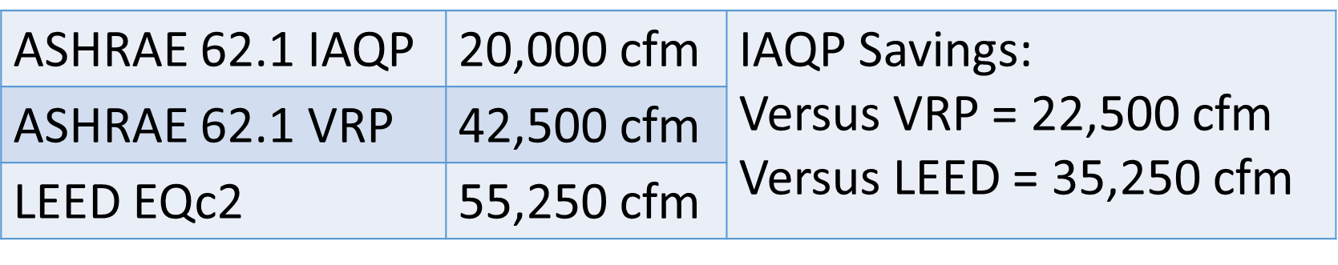
ASHRAE 62.1 Indoor Air Quality Methods
PATHS
VRP – Ventilation Rate Procedure
Zone types, Sq. Ft, and Occupant Density
Provides Minimum OA Flow Rate
IAQP – Indoor Air Quality Procedure
USGBC Recommended
Qualifies for up to 9 LEED Credits
Identifies highest MOA for containments of concern which becomes the new MOA requirement

Slide 4
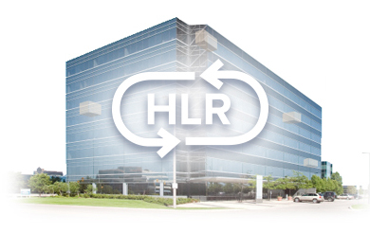
Introducing York® EcoAdvance™ Technology
EcoAdvance™ technology actively and intelligently reduces building energy loads
Replaces outdated, inefficient and costly ventilation methods with a practical, proven, energy-efficient approach
Cleans the indoor air instead of continuously replacing it
Works with ASHRAE 62.1 IAQP
Notes:
This ground-breaking capability is entirely the result of leveraging advanced technology never before used in HVAC.
Works in virtually any commercial building.

Slide 5
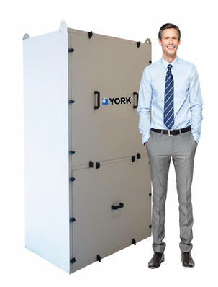
York® EcoAdvance™ Technology
Modular, scalable, networked “smart” scrubbers
Bolt-on retrofit to existing HVAC systems
Easy to install; indoor or rooftop installation
Designed to reduce outside air intake
Enables downsizing of equipment for new construction
Notes:
NEW PICTURE – YORK MODEL
REMOVE ROOFTOP INSTALLATION WORDING
“Smart”, self-contained module that can easily bolted on to an existing system.
6 ft x 4 ft x 2 ft – operational weight ~400 lbs
If HLR fails:
Goes back to normal operation in a retrofit scenario
No different/worse than DOAS failing in a new construction scenario (However must be careful of undersized HVAC system and reduced capacity to quickly condition space after evening / weekend shutdown periods)

Slide 6
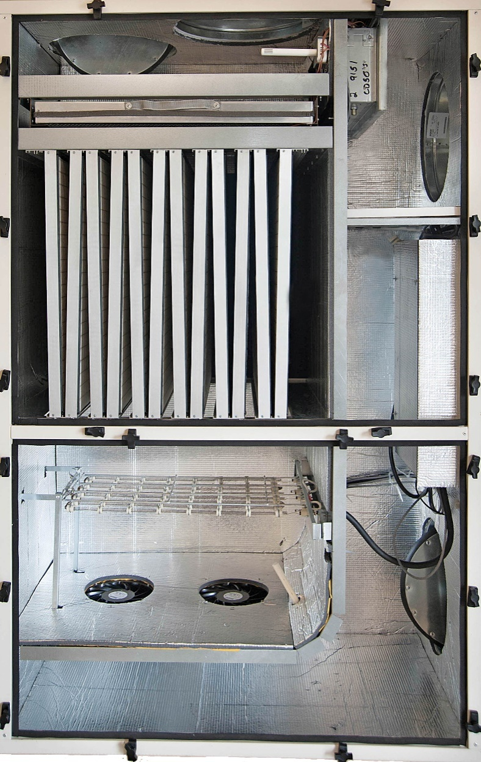
York® EcoAdvance™ 1000E
Sorption Out
Regen Out
Adsorption
Regen In
Closed Loop Heating
Regeneration
Cartridges
Sorption In
Notes:
MAY WANT TO RELABLE IN/OUT
DRAW A PATH FOR GREEN AND YELLOW
REGEN IS ABOUT 1000 CFM PER CYCLE

Slide 7
A Superior Approach: clean & recycle indoor air
Remove molecular contaminants
Reduce outside air for ventilation
Lower energy costs & maintain indoor air quality
Notes:
The HLR approach – By cleaning (catch & release) and recycling the indoor air, we dramatically reduce energy consumption. In doing so, we can actually IMPROVE IAQ.

Slide 8
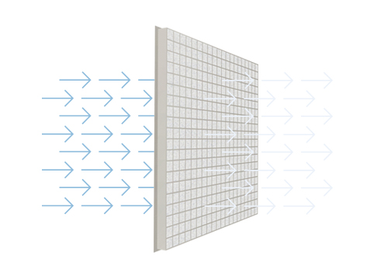



Indoor Air Treatment – Patented Sorbents
Remove molecular contaminants
Sorbents housed in cartridge set
Non-toxic
No byproducts
Recyclable
Low-cost CO₂ removal & Volatile organic compound (VOC) capture
New adsorbents developed to address global climate change
Re-engineered for indoor conditions
Formaldehyde-selective sorbents
Leveraging similar chemistry to that of CO₂ sorbents
Selective Chemistry captures 250+ VOCs
Notes:
Speaks to the indoor air treatment
Material science breakthroughs applied to indoor air treatment for the first time. The sorbents are entirely non toxic, create no byproducts, and have no special disposal requirements.
Sorbents are amine-based (not carbon), and have been engineered to “self-clean” at relatively low temperatures (~120 deg F). In other sorbent applications such as submarines and spacecraft, sorbents had to be heated to many 100’s of deg F in order to “purge”.
The sorbents feature selective chemistry, which removes 250+ VOCs along with CO₂.
Leading national labs were involved in the development and testing of these sorbents.

Slide 9
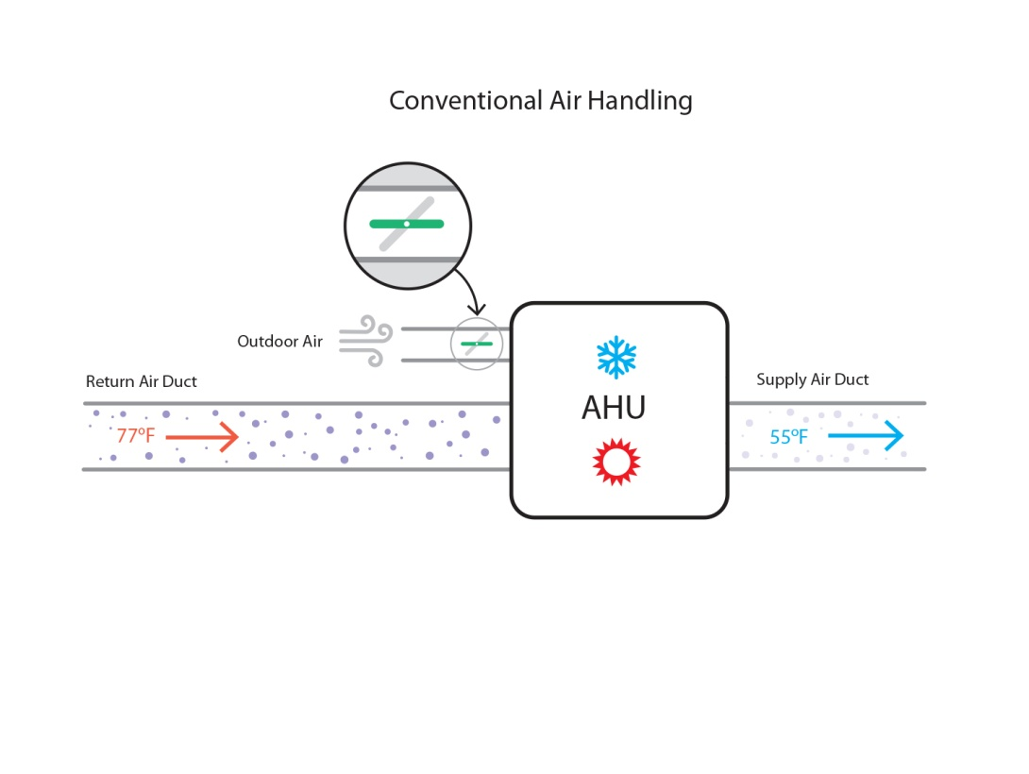
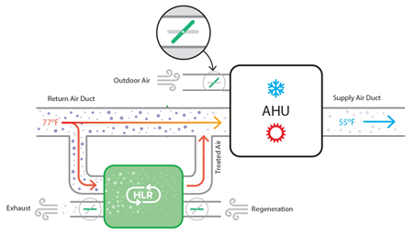
York® EcoAdvance™ Technology applied in AHU systems
Reduce outside air for ventilation
Notes:
MOVE TO BEFORE SLIDE 11
A typical AHU will mix a substantial amount of outside air with the return in order to maintain acceptable IAQ.
With HLR, a portion of the return air is cleaned of molecular contaminants and returned to the systems, reducing the need for OA for ventilation/IAQ.

Slide 10

Monitoring and Reporting
Embedded sensors monitor and record:
Indoor air quality
Energy savings
Air temperature and humidity
System operating conditions
State-of-the art cloud connectivity for advanced system control and operability
Sophisticated proprietary machine learning algorithms maximize energy savings
Building management and facility managers can monitor energy savings and IAQ in real-time
Notes:
USE NEW GRAPHIC FROM SLIDE 11
Onboard sensors monitor and report unit performance continuously.
Cloud-based self-learning software optimizes unit operation 24/7.

Slide 11
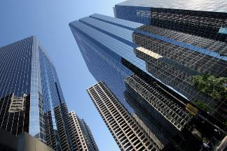
York® Eco-Advance™ Economics and ROI
Lower energy costs & maintain indoor air quality
Typical annual savings ~ 20%
Peak savings routinely exceed 40%
Payback for retrofit is 1.5 – 3 years
Immediate payback for new construction
Eligible for local utility rebate programs
Detailed energy savings model
City & building specific; historical climate data
Notes:
Typical financial benefits of Eco-Advance technology. We have advanced tools to estimate the savings in a specific building in a specific location with specific billing rates.
Use tons/CFM of OA rule of thumb to illustrate downsizing capability.
~10% capacity reduction can be reasonably expected. (However must be careful of undersized HVAC system and reduced capacity to quickly condition space after evening / weekend shutdown periods)

Slide 12
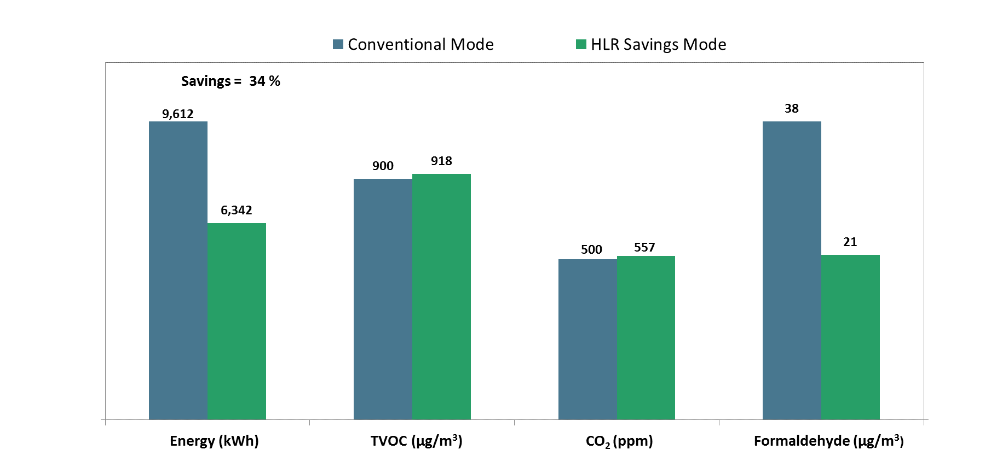
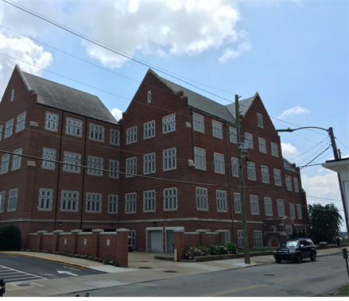
Project: University of Tennessee at Chattanooga August 2015
In Eco-Advance Savings Mode:
34% reduction in energy consumption
Formaldehyde concentration decreased
Notes:
WHICH OF THESE CASE STUDIES DO WE WANT TO INCLUDE? SOME OF THE PICS HAVE ENVERID LOGOS ON THE UNIT… SEE NEXT FEW SLIDES

Slide 13
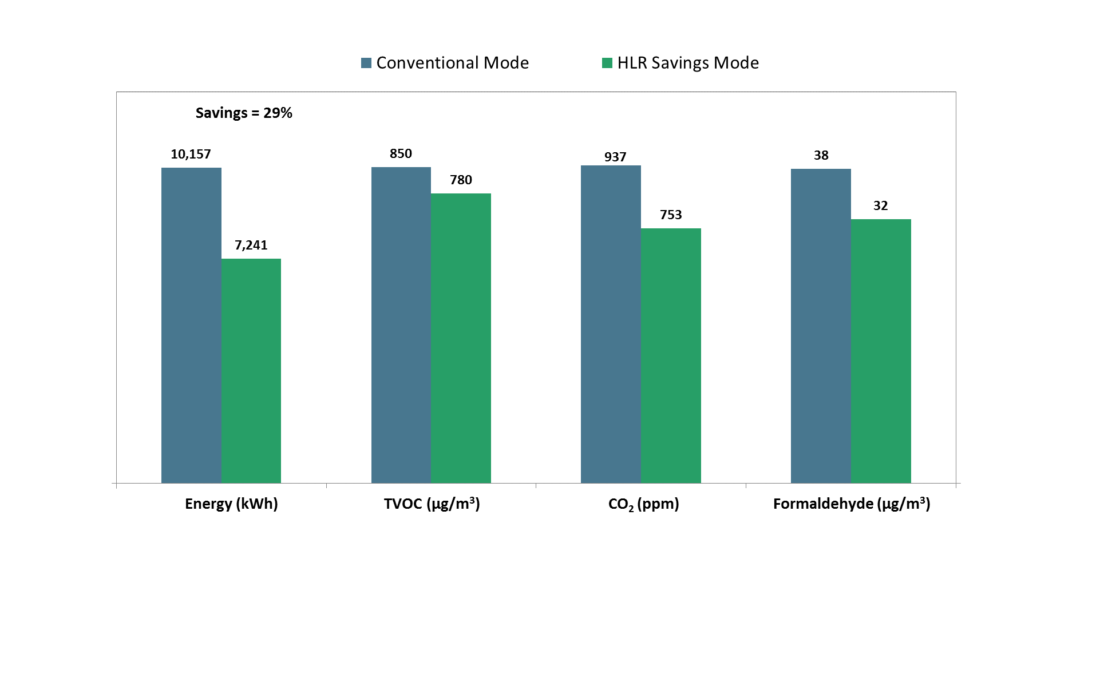

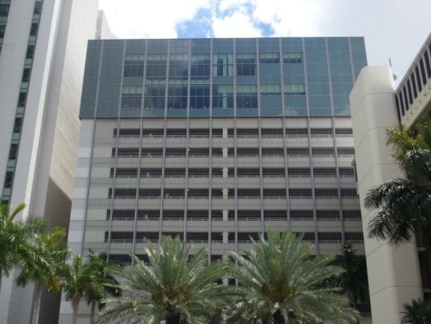
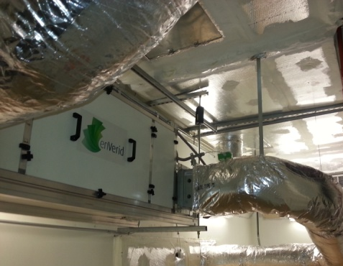
Project: University of Miami Wellness Center June 2015
In Eco-Advance Savings Mode:
29% reduction in energy consumption
All three IAQ measurements improved

Slide 14


EcoAdvance™ Benefit: Compliance (ASHRAE) and Sustainability (LEED)
100% compliant with ASHRAE 62.1-2013 Guidelines
Under “Performance” ventilation procedure
Specific RFI confirming compliance clarified and published in Jan. 2015
USGBC & HLR Modules
Pilot program launched in 2014 to encourage adoption
Up to 9 LEED credits for installations
Notes:
HOW DO WE SHOW THAT POINTS CANNOT BE DOUBLE-DIPPED FOR GREEN CREDITS, ETC.?
Eco-Advance technology and methodology is fully compliant with ASHRAE 62.1-2013.
USGBC endorses a performance-based approach to IAQ – Pilot Credit launched and encouraged.
We have already earned 9 LEED points on one project via this Pilot Credit (Alternate Compliance Path 68)

Slide 15


enVerid: Strategic Technology Partner
Innovative, proprietary solid sorbents
Low cost molecular sensors
Machine learning with advanced control algorithms
Extensive IP portfolio (30+ patents / applications)
Notes:
Describe who enVerid is.
Creator/Inventor of advanced sorbent technology, molecular sensors, and cloud based controls software.
Large patent portfolio developed over the past 5 years.
New EcoAdvance technology has been widely recognized, inside the HVAC industry and out, as being highly innovative and having game-changing potential.

Slide 16


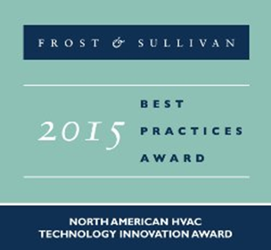

Industry Recognition
US Department of Energy $2.4M award
“Green Proving Ground” program
Installation of HLR modules in US Custom House in Houston, TX

Slide 17

Summary Benefits of the EcoAdvance Solution
Substantial Energy Savings
Excellent IAQ
Real-time Monitoring, Reporting & Validation
Scalability and Flexibility
Reliability – Simple, Elegant Mechanical Design
Compliance and Sustainability
Notes:
USE NEW GRAPHIC FROM SLIDE 11
Onboard sensors monitor and report unit performance continuously.
Cloud-based self-learning software optimizes unit operation 24/7.

