Slide 1

Pump Theory
UA Pumps
CH 1
Learning Outcome 1

Slide 2
What is a Pump?
A pump is a device through which an external source of power is used to apply force to a fluid in order to move the fluid from one place to another.

Slide 3
What is a Pump?
A pump develops no energy of it’s own; it merely transforms energy from the external source, its power end, into kinetic energy, which is manifested by the motion of the fluid. (Power end can be Electric Motor, Steam Turbine, ect)
This Kinetic Energy is then utilized to do work

Slide 4
What is a Pump?
Each Pump also has a fluid end, where the fluid enters (suction) and leaves (discharges) the pump.

Slide 5
What is a Pump?
Learning Objective Completed
Describe what a pump is and its basic function
Quick review Vocabulary
Power End
Pump End
Suction
Discharge
Kinetic Energy

Slide 7
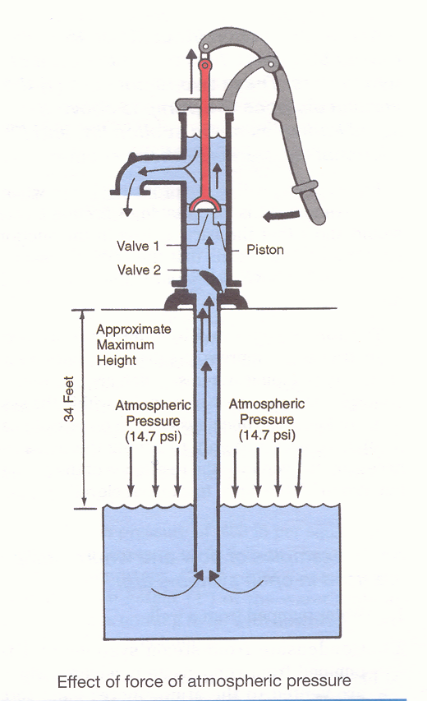
How can pumps be used?
A pump can be used in a piping system
To move water: well to water fixtures

Slide 8
How can pumps be used?
Examples from the class?

Slide 9
How can pumps be used?
To transfer fuel oil: storage tank to a boiler
To circulate chilled water
To circulate hot water
To raise water or sewage: sumps up to a point of gravity drainage
To return steam condensate back to a boiler

Slide 10
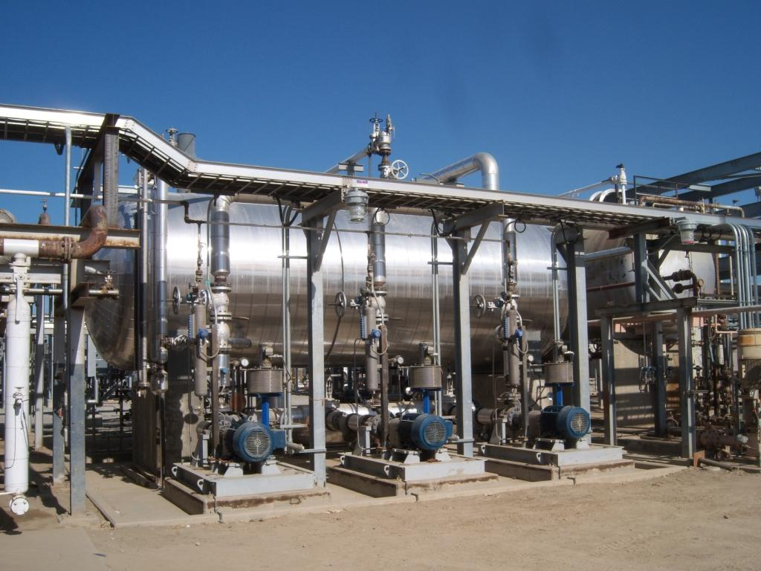
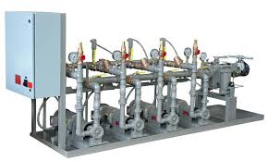
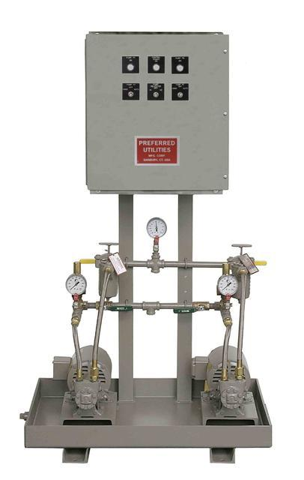
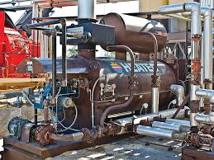
Transfer fuel oil: storage tank to a boiler

Slide 11
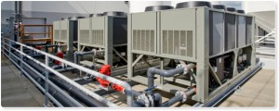
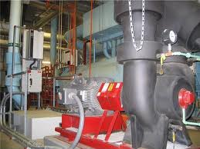
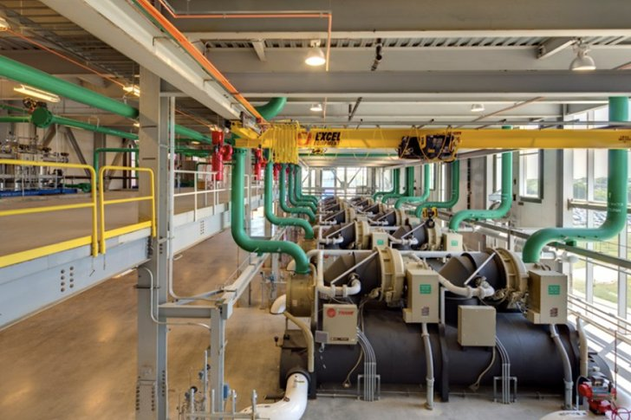
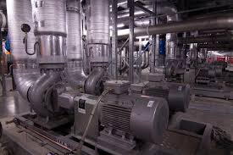
Circulate chilled water

Slide 12
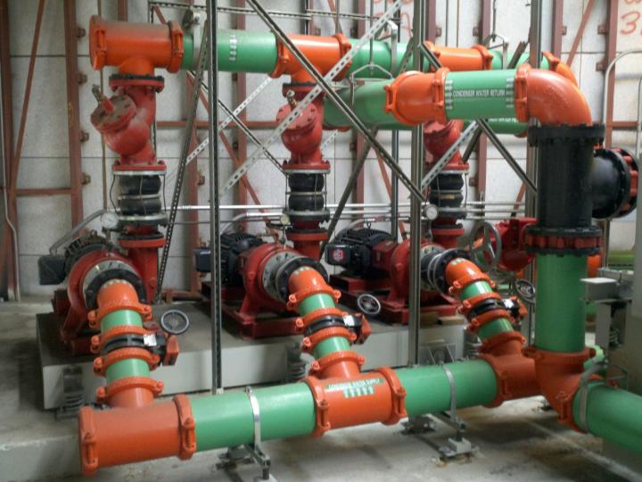

Slide 13
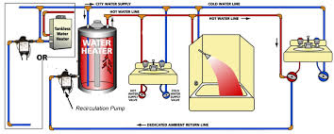
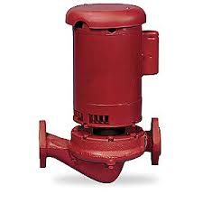
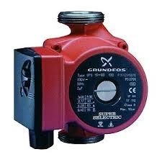
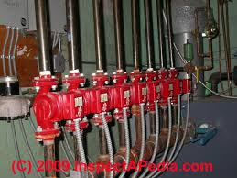
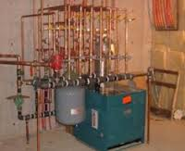
To circulate hot water

Slide 14
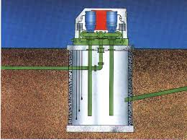
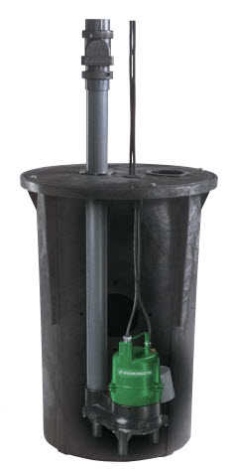
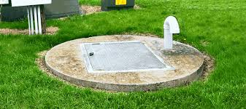
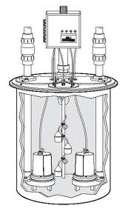
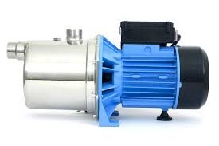
Raise water or sewage: sumps up to a point of gravity drainage

Slide 15
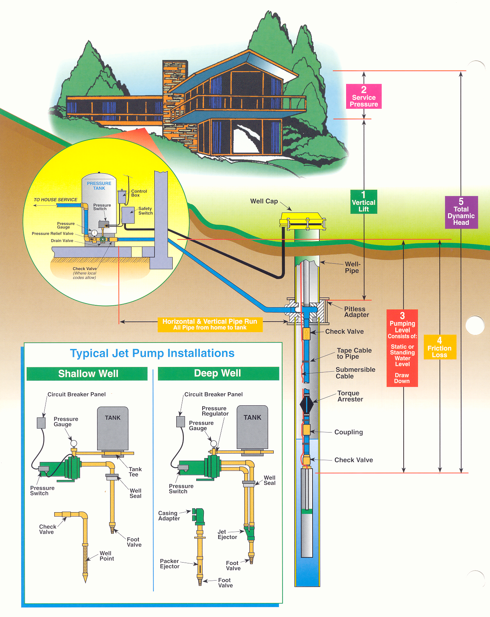

Slide 16
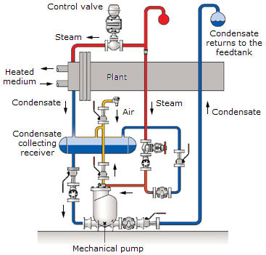
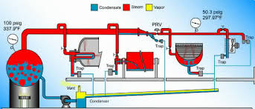
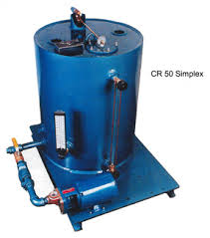
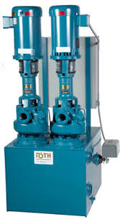
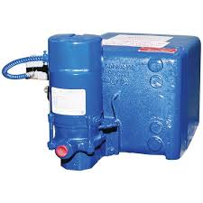
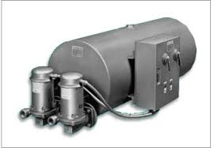
Return steam condensate back to a boiler

Slide 17
How can pumps be used?
Learning Objective Completed
List examples and applications that a pump can be used in
Expose on Stanford Central Plant
http://sustainable.stanford.edu/campus-action/stanford-energy-system-innovations-sesi

Slide 18
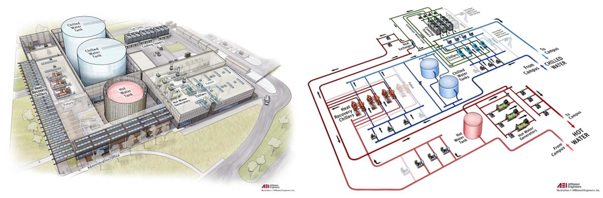
How can pumps be used?

Slide 19
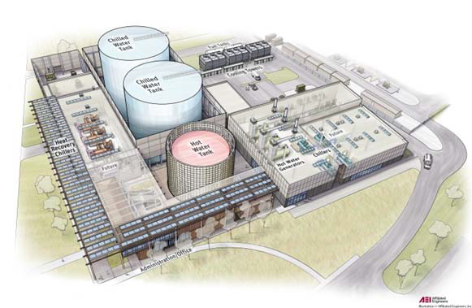
How can pumps be used?

Slide 20
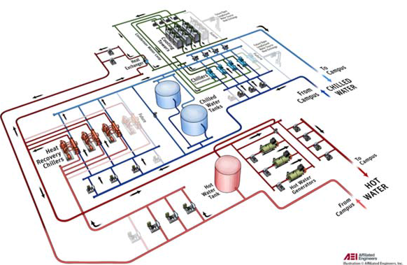
How can pumps be used?

Slide 22
What are two ways liquids can be raised?
Suction
Positive Pressure

Slide 23
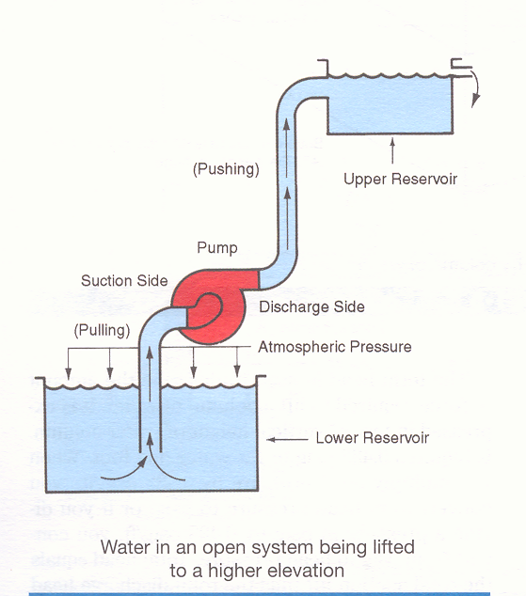

Slide 24
Liquids Can Be Raised By Suction
Pumps can create a partial vacuum at the suction inlet and atmospheric pressure (14.7 psi) causes the water to rise in the suction pipe
Theoretically water can be pulled (raised) approximately 34’ vertically

Slide 25
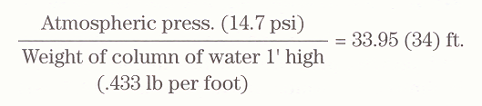
Or
14.7 psi x 2.31 ft/psi = 33.95 (34) ft.

Slide 26
Liquids Can Be Raised By Suction
Reality changes things
Distance from water level (open systems)
Friction resistance of pipe
Practical suction lift on
Positive displacement pumps is 22’
Centrifugal pumps it is 15’

Slide 28
What are two ways liquids can be raised?
Learning Objective Completed
Describe two ways liquids can be raised. Illustrate theoretical lift vs.. actual
Quick review: Concept
Suction vs.. Positive Pressure
Theoretical max lift vs.. actual max lift

Slide 30
Pump Systems and Atmosphere
Describe two types of pumping systems in relation to atmosphere
Open Systems
Closed Systems

Slide 31
Open Systems
Piping systems, which are exposed to atmospheric pressure at some point within the system, are known as open systems
In open systems, pumps are used to not only to supply the pressure necessary to overcome the resistance of the piping, but also lift the liquid to a higher elevation

Slide 32
Pumps in Open Systems
Water pumped from a well
Condensate from steam systems that is pumped from condensate receivers (which are vented to the atmosphere) back to the boiler
Drainage which has accumulated in a vented sump and is lifted by a pump to a higher point of entry into a drainage system
Dishwasher water which is pumped during the washing cycle

Slide 33
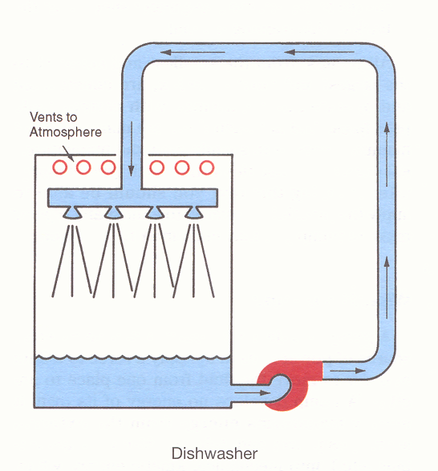

Slide 34
Closed Systems
In closed systems, pumps supply the pressure necessary to circulate the liquid in the system
Whatever liquid is lifted is counterbalanced by the equal height of the liquid returning to the pump
The pump is used to simply overcome the friction losses within the piping system

Slide 35
Pumps in Closed Systems
Examples from the class

Slide 36
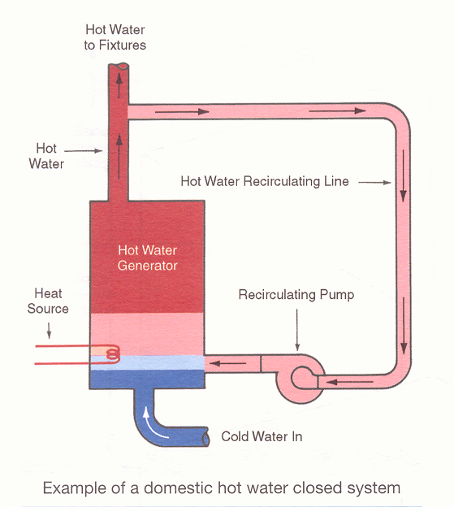

Slide 37
Pump Systems and Atmosphere
Learning Objective Completed
Illustrate basic differences between open and closed piping systems. Give examples.
Quick review: Concept
Open Systems
Closed Systems

Slide 39
Pressure Definitions
Pounds of Weight vs.. Pressure
What is the difference?
Who can illustrate?
Head vs.. Total Head
What is the difference?
Who can illustrate?

Slide 40
Pounds of Weight
Pounds of weight is the measure of total heaviness of a substance as it is read on a scale
One cubic foot of water weighs 62.5 lbs, not counting the container.

Slide 41
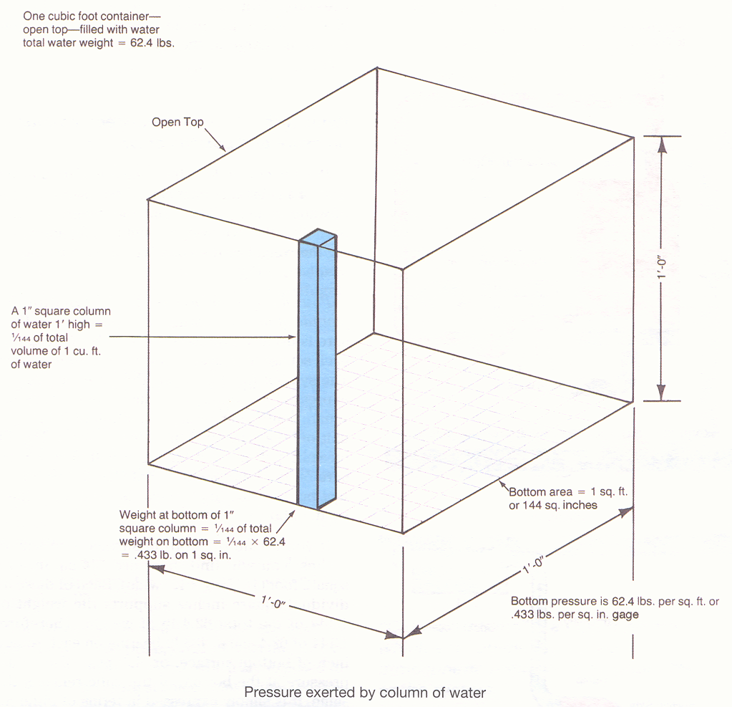

Slide 42
Pounds of Pressure
Pounds of pressure is the designation for pounds of weight bearing on a specific area
Pressure is usually expressed in pounds of weight on each square inch, called pounds per square inch. Symbol for this is psi
Pressure according to the height of a liquid is called head and is expressed in units of length.

Slide 44
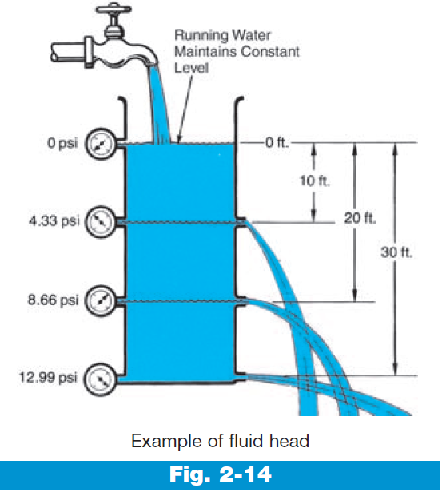

Slide 45
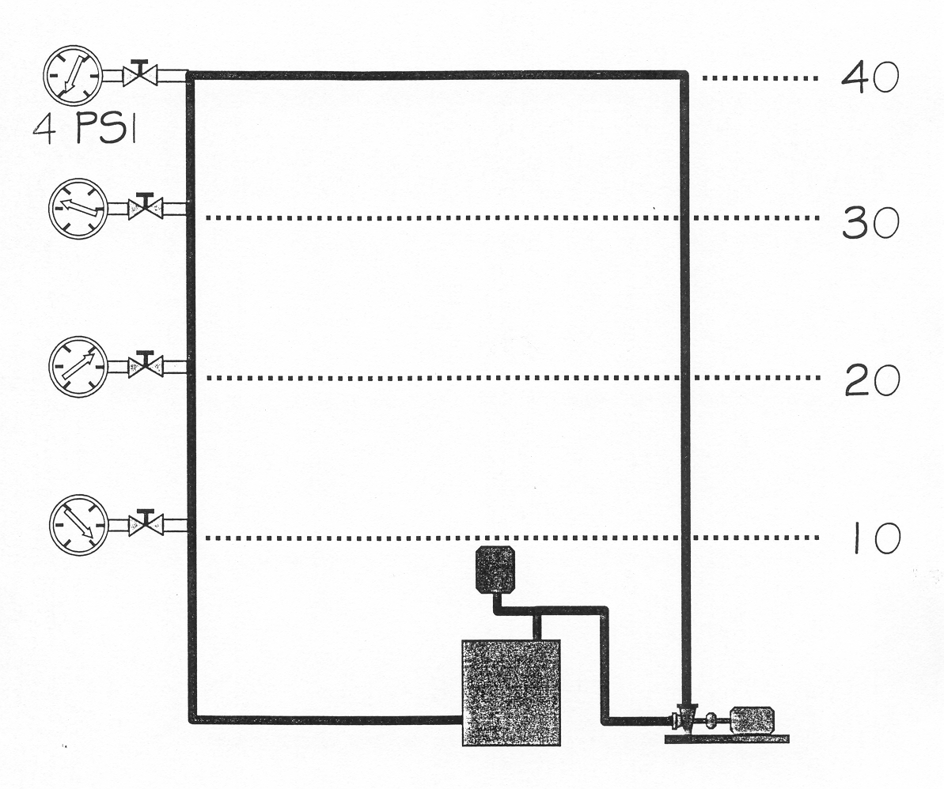

Slide 46
Head and Total Head
The term head is used to describe the amount of force required to lift a column of water
It is expressed in feet of vertical height of water column
It requires .433 psig to lift water one foot
Total head equals the total suction lift plus the total discharge head of a pump.

Slide 47
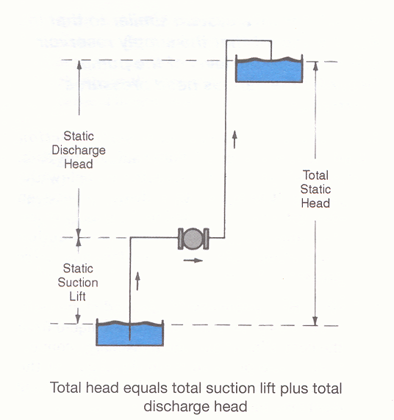

Slide 48
Pressure Definitions
Learning Objective Completed
Explain the following terms and how they apply to pumps:
Pounds of pressure vs.. pounds of weight
Head vs.. Total Head
Quick review: Vocabulary
Pounds of pressure psi
Pounds of weight
Head
Total Head

Slide 51
Static Suction Lift
Static suction lift is the vertical distance liquid is raised by atmospheric pressure, from the surface of the supply reservoir to the centerline of the pump suction connection
This liquid is under a partial vacuum created by the pump.

Slide 52
Static Discharge Head
Static discharge head is the vertical distance the liquid is being pushed, as measured from the centerline of the pump discharge connection to the point of open discharge into the upper reservoir.

Slide 53
Total Static Head
Total static head is the overall vertical distance the liquid is being raised, from the level of the lower reservoir to the point of open discharge at the upper tank.

Slide 54
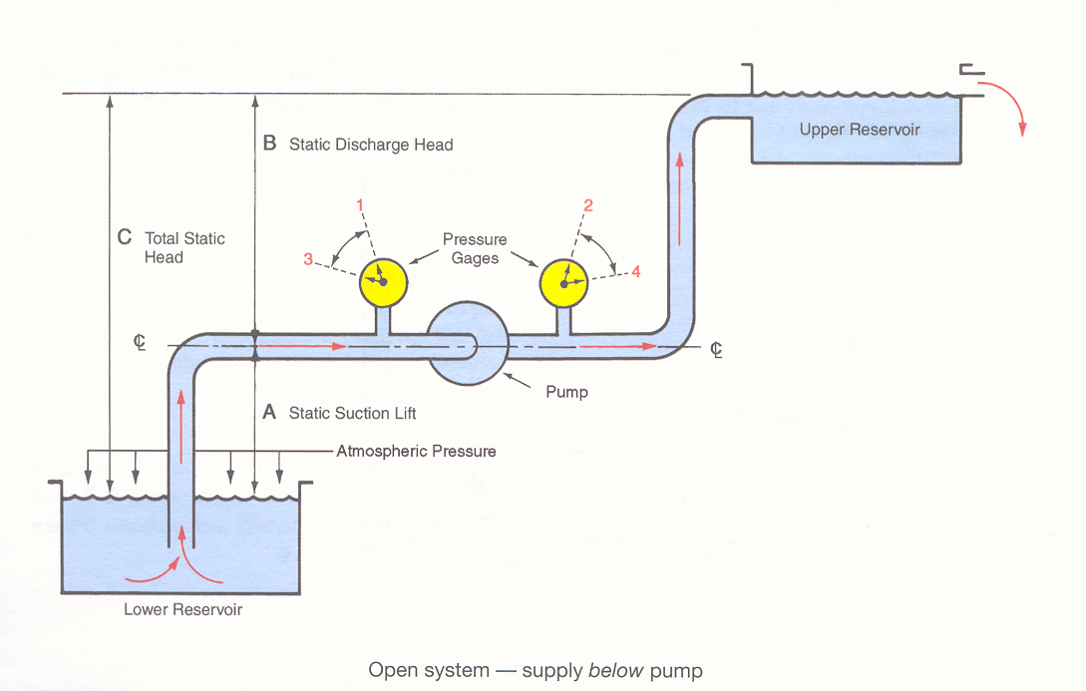

Slide 55
Concept Review Exercise
Fig 1-7
What does Head A represent?
What does Head B represent?
What does Head C represent?

Slide 56
Concept Review Exercise
Fig 1-7
If Head A is 4’ and
If Head B is 56’
What is Head C ?
60’

Slide 57
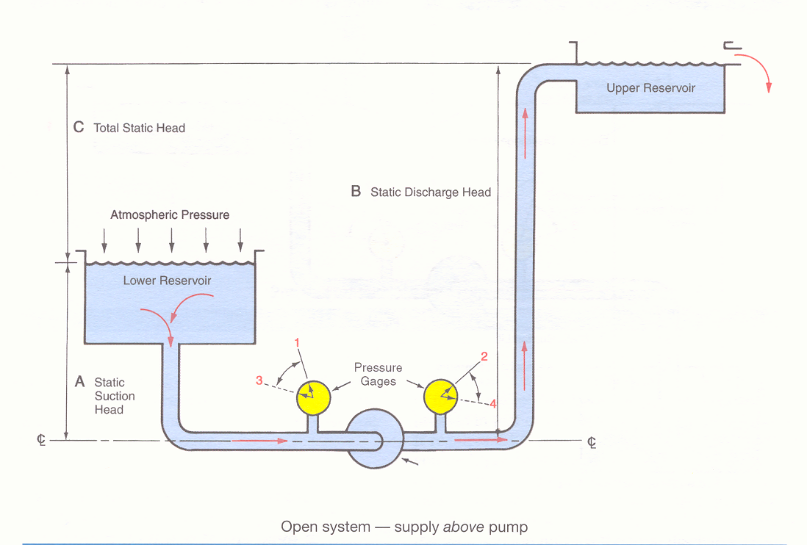
Gauges Static (No Flow) vs. Dynamic (Flow)

Slide 58
Concept Review Exercise
Fig 1-8
What does Head A represent?
What does Head B represent?
What does Head C represent?
What do the numbers on the gauges mean?

Slide 59
Concept Review Exercise
Fig 1-8
If Head A is 4’ and
If Head B is 56’
What is Head C in psi?
22.53

Slide 60
Friction Loss
Resistance of the relative motion of two bodies in contact with one another is called friction
There is a pressure loss due to friction within piping systems when fluids are flowing through them.

Slide 61
Pressure Definitions Continued
Learning Objective Completed
Reference provided diagrams IPT Pumps Fig-1-7&1-8 (Open System) and match to defined terms
Static Suction Lift
Static Discharge Head
Total Static Head
Quick review: Vocabulary
Suction Lift
Discharge Head
Total Static Head
Friction Loss

Slide 62
Checkpoint 1
Page 1 through Checkpoint 1
Pages 1 through 7
Learning Outcome Completed
Analyze a pump by defining its basic function, and its relationship to atmosphere
Review Questions

