Slide 1

Types of Pumps
UA Pumps
CH 2 Section 1
Learning Outcome 2

Slide 2
Two basic classifications of pumps
Positive Displacement
Non-positive Displacement

Slide 3
Positive Displacement
A Positive Displacement pump discharges a definite quantity of liquid for each operating cycle. Fixed Volume
As the name implies these pumps work on the principle of displacement
Liquid enters the pumps through the suction port and is ejected forcibly out of the discharge port by displacement
Reciprocating Pumps and Rotary Pumps are of this type

Slide 4
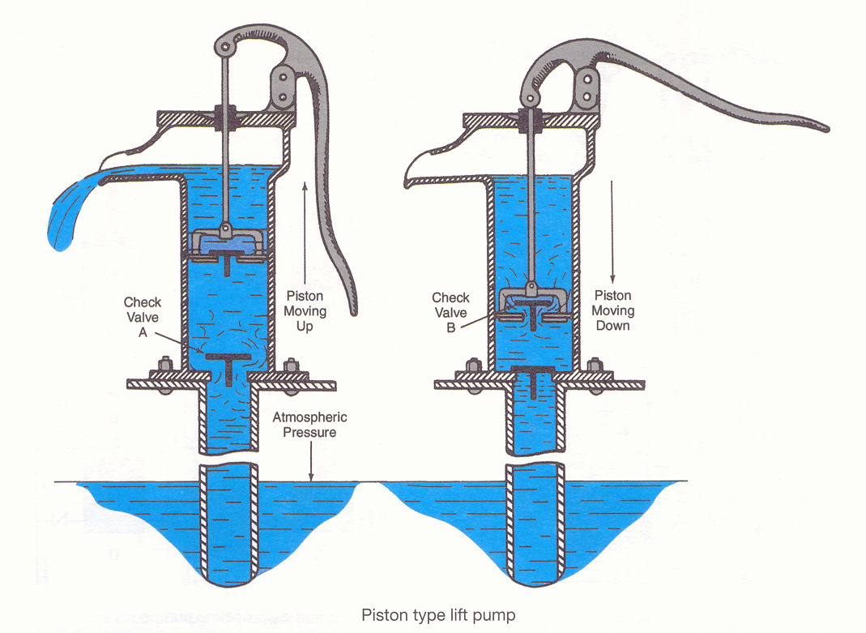
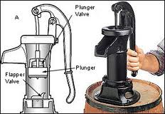

Slide 5
Non-Positive Displacement Pumps
Centrifugal pumps, propeller pumps, and special pumps such as jet pumps and hydraulic rams, etc., are non-positive displacement. Variable Volume
The common characteristic of Non-positive Displacement Pumps is that they do not deliver a specific amount of fluid for every movement of the pump
Their discharge rates are directly affected by the amount of pressure in the systems they are supplying

Slide 6
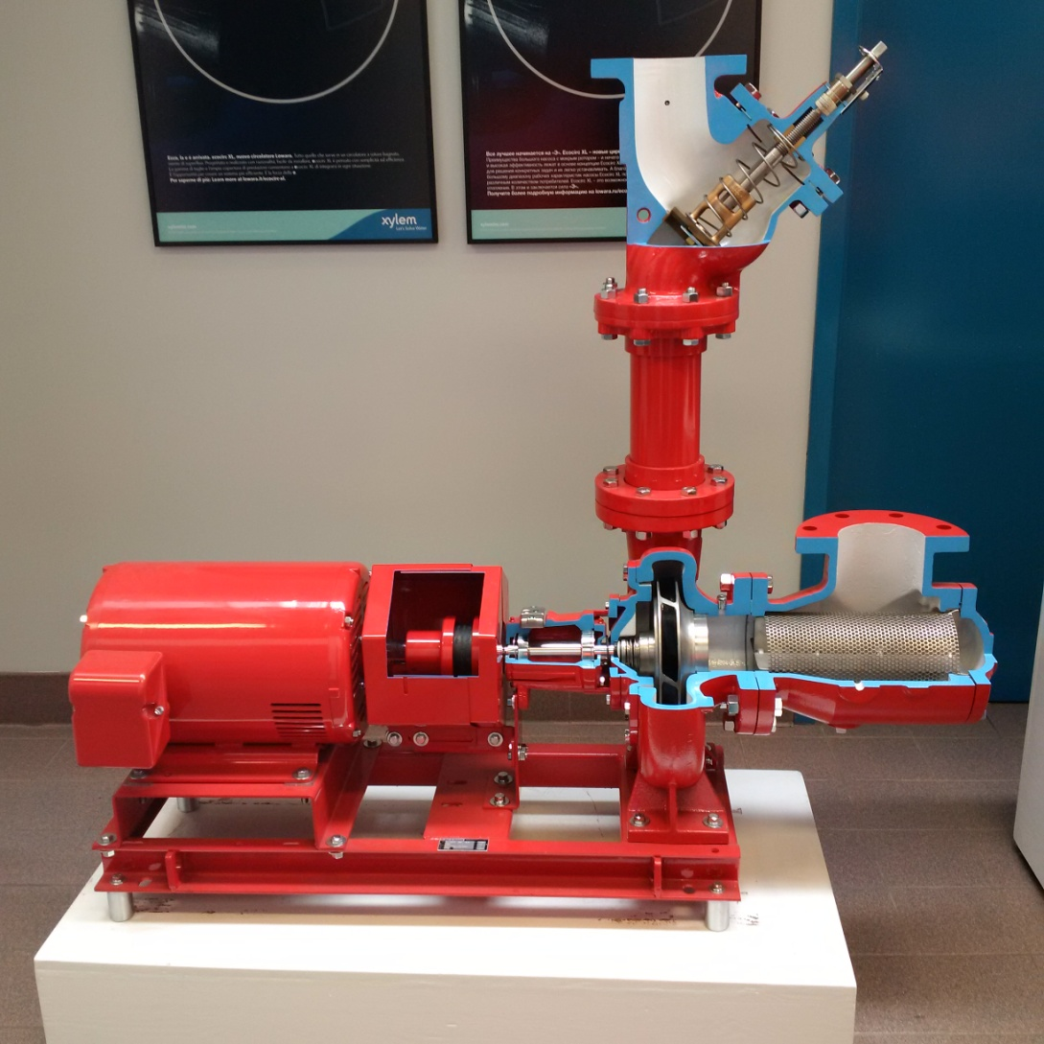
Non-Positive Displacement Pumps

Slide 7
Two basic classifications of pumps
Learning Objective Completed
Describe two basic classifications of pumps
Define the categories and list pros and cons
Quick review Concept
Positive Displacement Pump
Reciprocating Pumps
Rotary Pumps
Non-positive Displacement Pump

Slide 9
Positive Displacement
A Positive Displacement pump discharges a definite quantity of liquid for each operating cycle. Fixed Volume
As the name implies these pumps work on the principle of displacement
Liquid enters the pumps through the suction port and is ejected forcibly out of the discharge port by displacement
Reciprocating Pumps and Rotary Pumps are of this type

Slide 10
Reciprocating Pumps
A Reciprocating Pump can be described as a pump that has a backward and forward or upward and downward motion.
Basically two position (No spinning)
An example of this is the Pitcher Pump Fig 2-2

Slide 11
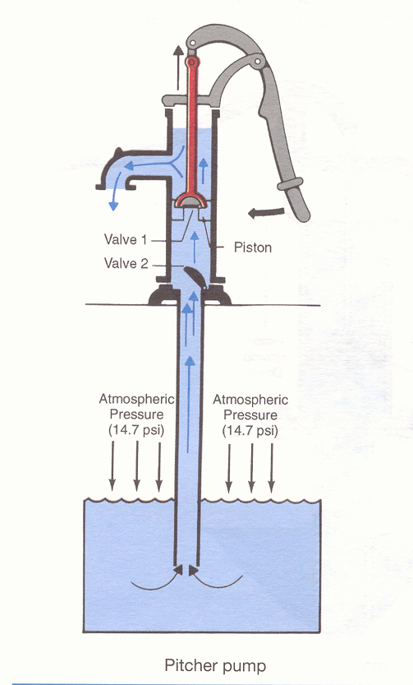
https://www.youtube.com/watch?v=GIRAm5gaUhg

Slide 12
Reciprocating Pumps
Can you give any other example?

Slide 13
Reciprocating Pumps
Air compressors
Boiler feed pumps
Deep well piston pumps (for water or oil)
Hydraulic power pumps
Vacuum pumps
Diaphragm type ditch pumps
Hydrostatic test pumps

Slide 14
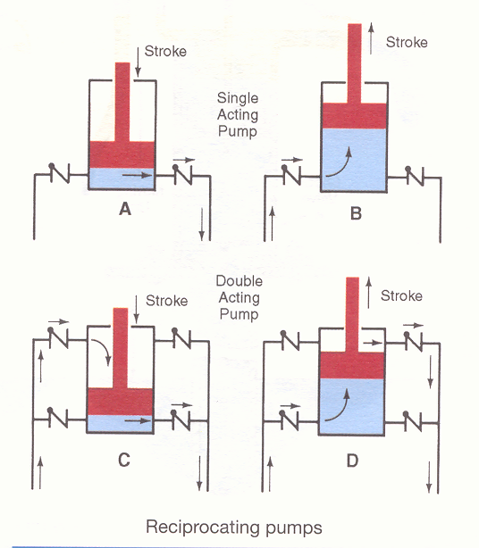

Slide 15
Reciprocating Pump Capacity
Fig 2-3
Capacity can vary by
Bore size
Length of stroke
Number of active pistons
Double Acting Pump
More check valves
Move fluid on both ends of stroke
https://www.youtube.com/watch?v=DXYrJq_fjbI&feature=player_detailpage

Slide 16
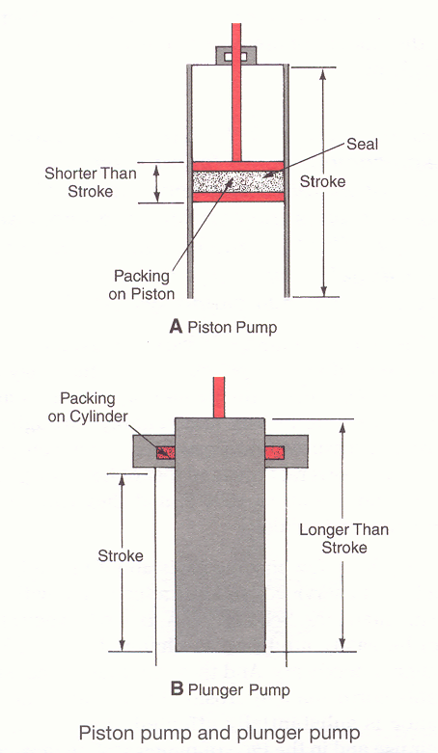

Slide 17
Piston Pump vs. Plunger Pump
Fig 2-4
Both are Reciprocating type of Pumps
Piston Pump
Piston is shorter than base stroke
Seal is on the piston
Plunger Pump
Piston is longer than base stroke
Seal is on the cylinder

Slide 18
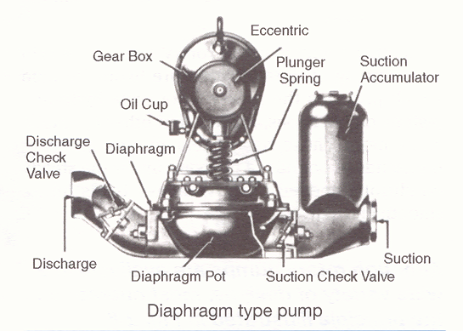

Slide 19
Diaphragm Pump
Fig 2-5
Reciprocating type of Pump
Utilizes rubber or neoprene in place of piston
Used to remove water from
Trenches
Drains
Places with mud, silt, sand
https://www.youtube.com/watch?v=Y6To-bgL4GE

Slide 20
Rotary Gear Pumps
The rotary gear pump is a positive displacement pump which discharges fluids in a smooth flow
It is simple in design, has few parts and, like a reciprocating pump, is positive acting
It is called a rotary pump because a rotary motion carries the fluid from the inlet to the outlet.

Slide 21
Rotary Gear Pumps Uses
Strength is the stability of flow
Can generate significant pressure
Thousands of pound under steady state
Move heavy loads safely
Commonly used for hydraulics
Backhoes
Loader
Commonly used on oil burners
Commonly used for refrigerant applications

Slide 22
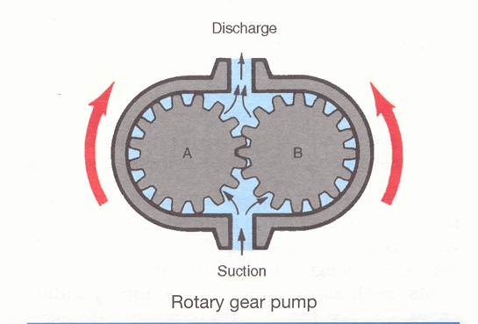

Slide 23
Rotary Gear Pump Operation
Fig 2-6
Gears A and B rotate in opposite directions
One driver gear
One driven gear
Clearance is gradually reduced
Trap fluid between teeth and moved along
Fluid acts as the seal/lubricant
https://www.youtube.com/watch?v=YDh2X0cn-3E
https://www.youtube.com/watch?v=iDAKfAib4bY

Slide 24
Rotary Gear Pump Variations
Fig 2-7
Different combinations of
Rotating components
Meshing Screw
Lobes
Slide/Swing Vanes
Eccentric
Offer stable fluid flow over wide pressure ranges

Slide 25
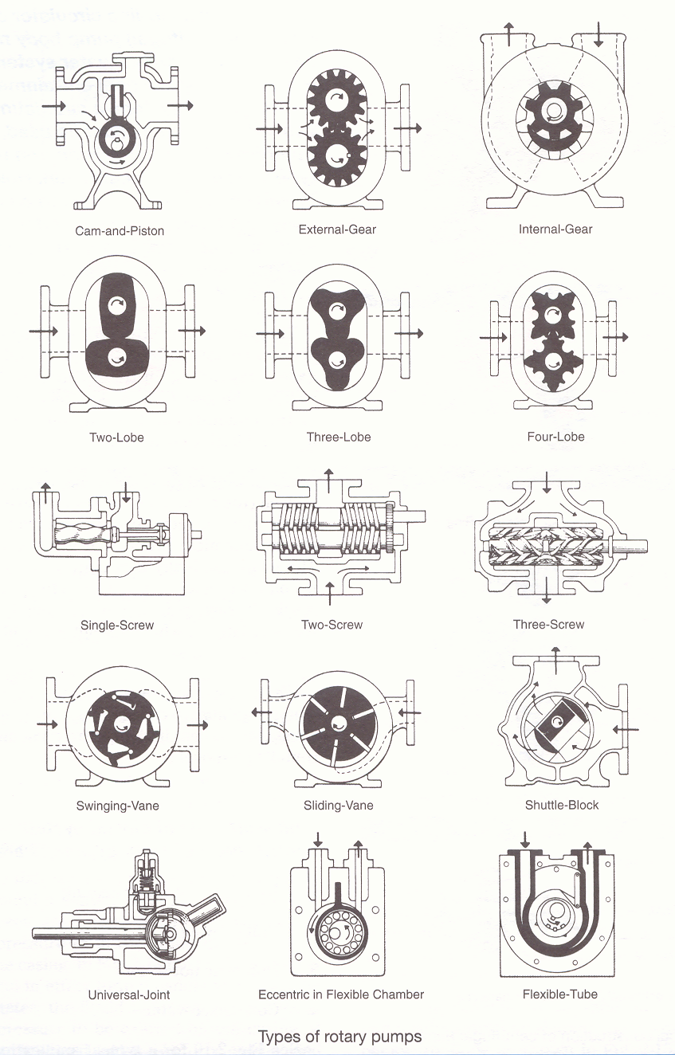
https://www.youtube.com/watch?v=eDTske_nSeI
https://www.youtube.com/watch?v=MYvbDaHoxRg
https://www.youtube.com/watch?v=o9re9d-iB5o
https://www.youtube.com/watch?v=69ah0Jdj1Ag (First 1 min)

Slide 26
Positive Displacement Pumps
Learning Objectives Completed
Describe two types of positive displacement pumps
Explain mechanical function and list common examples of reciprocating pumps
Explain mechanical function and list common examples of rotary gear pumps
Quick review Types Positive Displacement Pump
Reciprocating Pumps
Piston
Double Suction
Plunger
Diaphragm
Rotary Pumps

Slide 28
Non-Positive Displacement Pumps
The common characteristic of non-positive displacement pumps is that they do not deliver a specific amount of fluid for every movement of the pump Variable Volume
Their discharge rates are directly affected by the amount of pressure in the systems they are supplying
Teaser Concept Less Pressure = More Flow

Slide 29
Non-Positive Displacement Pumps
Types
Centrifugal pumps
Propeller pumps
Special pumps such
Jet pumps
Hydraulic rams
etc.

Slide 30
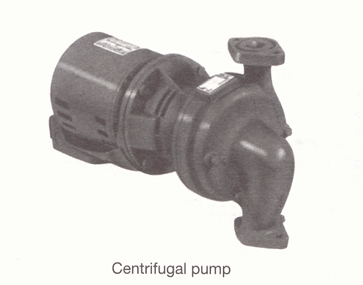

Slide 31
Centrifugal Pumps
Most common type of non-positive displacement pump found in piping systems
They can produce up to several thousand feet of head, they can handle liquids up to 1000 degree F, and they can pump abrasives and solids
They have few moving parts and if properly installed and serviced, will last a long time with little maintenance

Slide 32
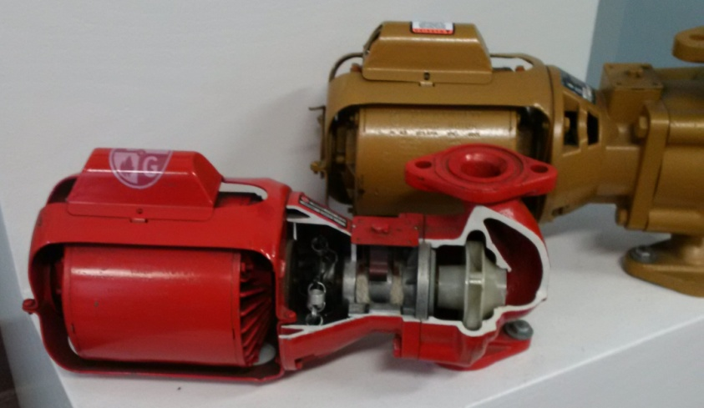
Centrifugal Pump

Slide 33
Centrifugal Pump Quick Note
Oxygen in water will affect the pump material
The dissolved O₂ will react with some materials to form rust
For systems that use potable water frequently
Material must be resist rust
Bronze is very common
Open systems such as domestic feed
For closed systems (Non frequent)
Material can be susceptible to rust
Cast Iron is very common

Slide 34
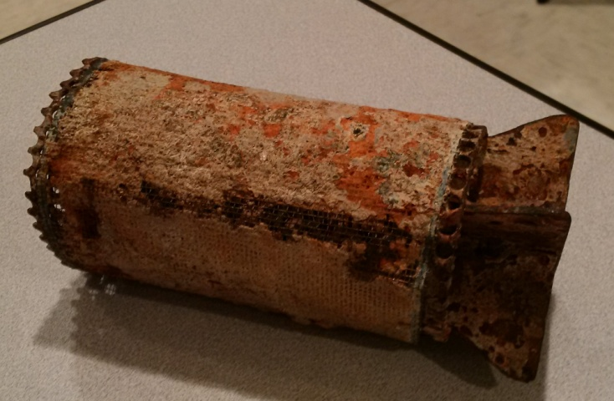
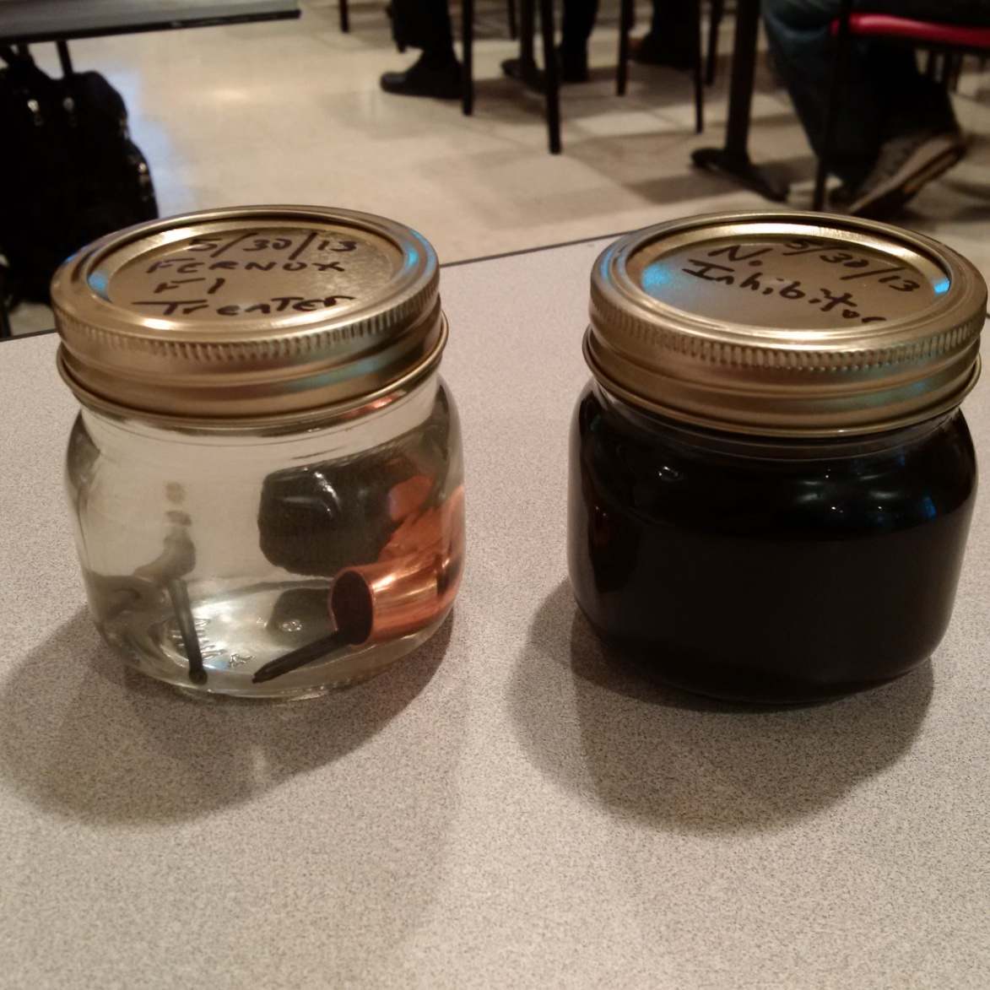
Centrifugal Pump Quick Note
Chemical Treatment Matters!

Slide 35
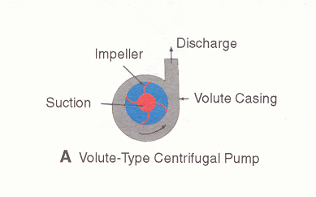

Slide 36
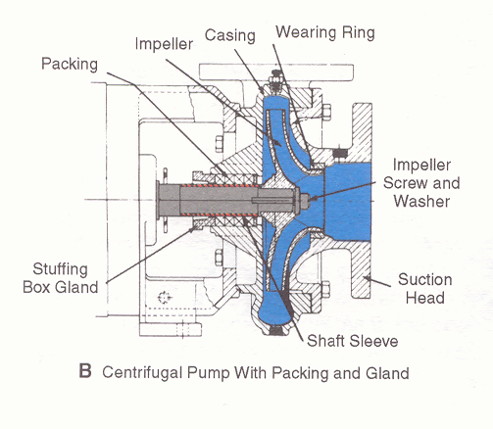

Slide 37
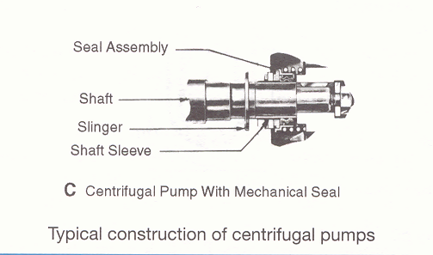

Slide 38
Closed Systems Using Centrifugal Pumps
Hydronic hot water heating
Chilled water
Domestic hot water
Condenser water

Slide 39
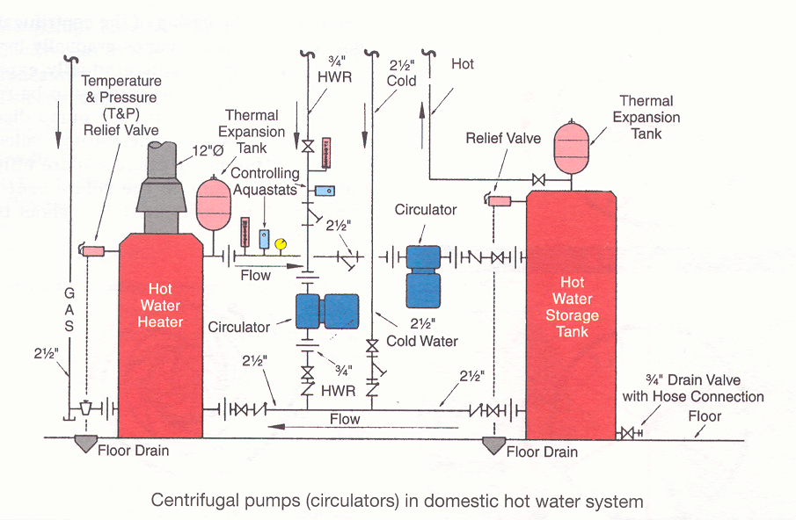

Slide 40
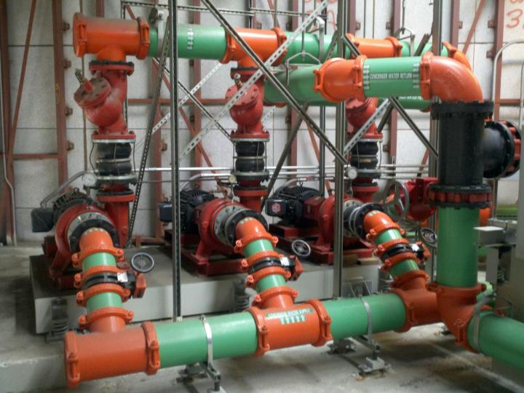

Slide 41
Non-Positive Displacement Pumps
Learning Objectives Completed
Describe two types of non-positive displacement or centrifugal pumps
Explain mechanical function and list common examples of centrifugal pumps
Quick review a Non-positive Displacement Pump is
Variable Flow
Dependant on System Pressure
Can be
Centrifugal
Construction material matters if air in system
Propeller
Special

Slide 43
Centrifugal Force
Centrifugal force is the force generated by rotation which acts directly outward from the center of rotation
Examples
Whirlpool created in the center of spinning liquid
Automobile tends to move out side on a bank turn
Merry-go-round

Slide 44
Centrifugal Force
A centrifugal pump takes its liquid at the center of rotation of the impeller
The liquid is picked up by the impeller vanes and thrown outward, away from the center of rotation, into a casing or volute
The effectiveness of the vanes in a centrifugal pump is improved by shaping them with a curved backward slope

Slide 45
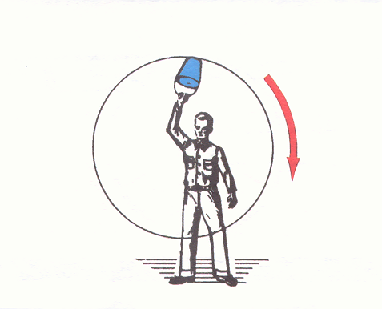
Fig 2-11

Slide 46
Centrifugal Force
Fig 2-11
Water remains in bucket even when upside down
What happens when we spin slower?

Slide 47
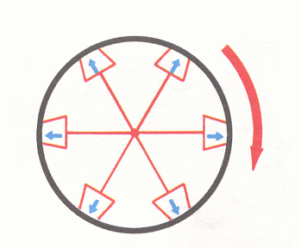
Fig 2-12

Slide 48
Centrifugal Force
Fig 2-12
Same concept but with multiple buckets rotating around a center point
Visualize the bottoms removed. The result is a continuous pressure from the liquid in the buckets against the casing
See the pressure differential potential?

Slide 49
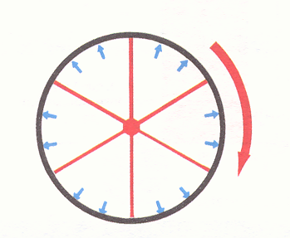
Fig 2-13

Slide 50
Centrifugal Force
Fig 2-13
Extend concept: Buckets are now pie shaped
Acts as a paddle wheel
Rotation forces the liquid out against casing

Slide 51
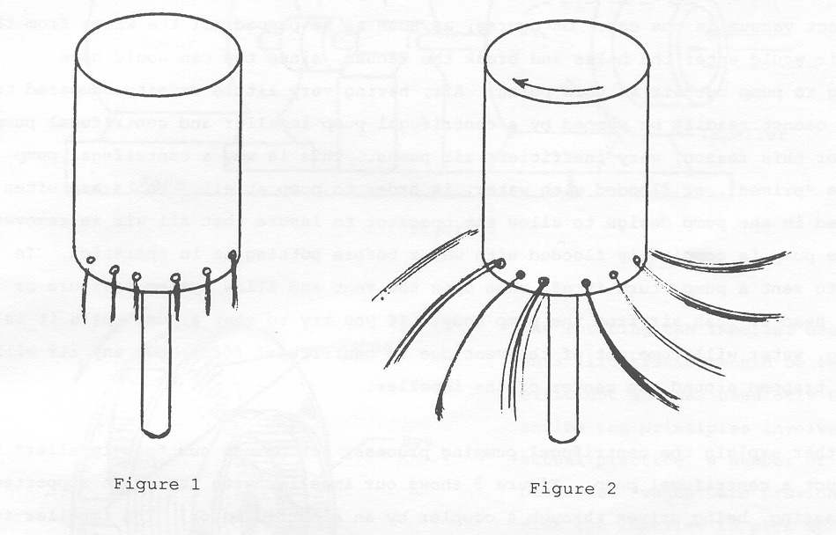

Slide 52
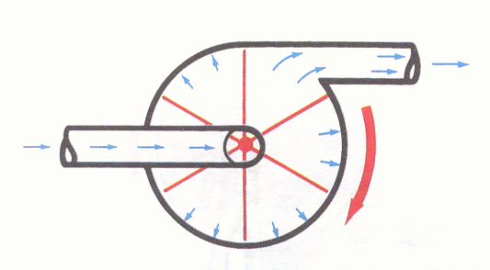
See the differential potential?
Fig 2-14

Slide 53
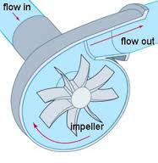
Centrifugal Force
Fig 2-14
Add inlet, outlet and a driver to form a basic centrifugal pump
Liquid picked up by impeller vanes is thrown outward until stopped by a casing or volute

Slide 54
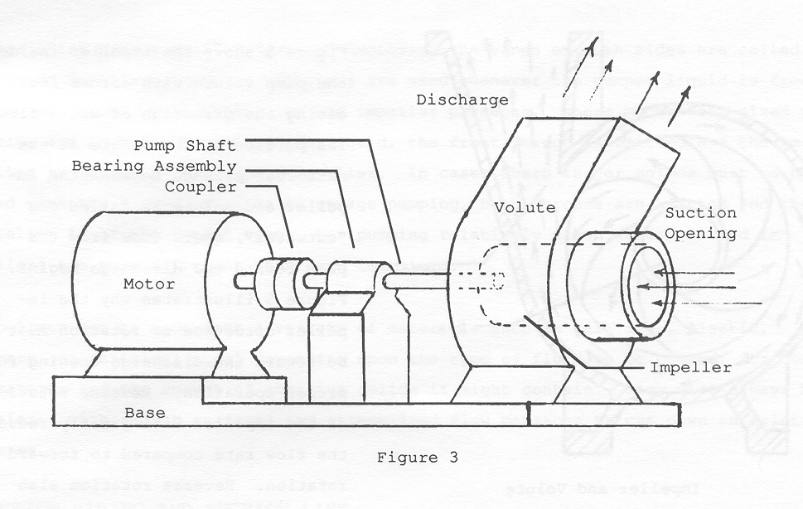

Slide 55
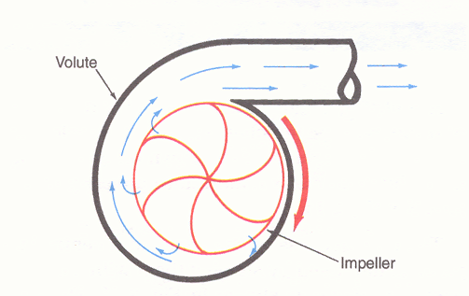
Notice the curve?
Fig 2-15

Slide 56
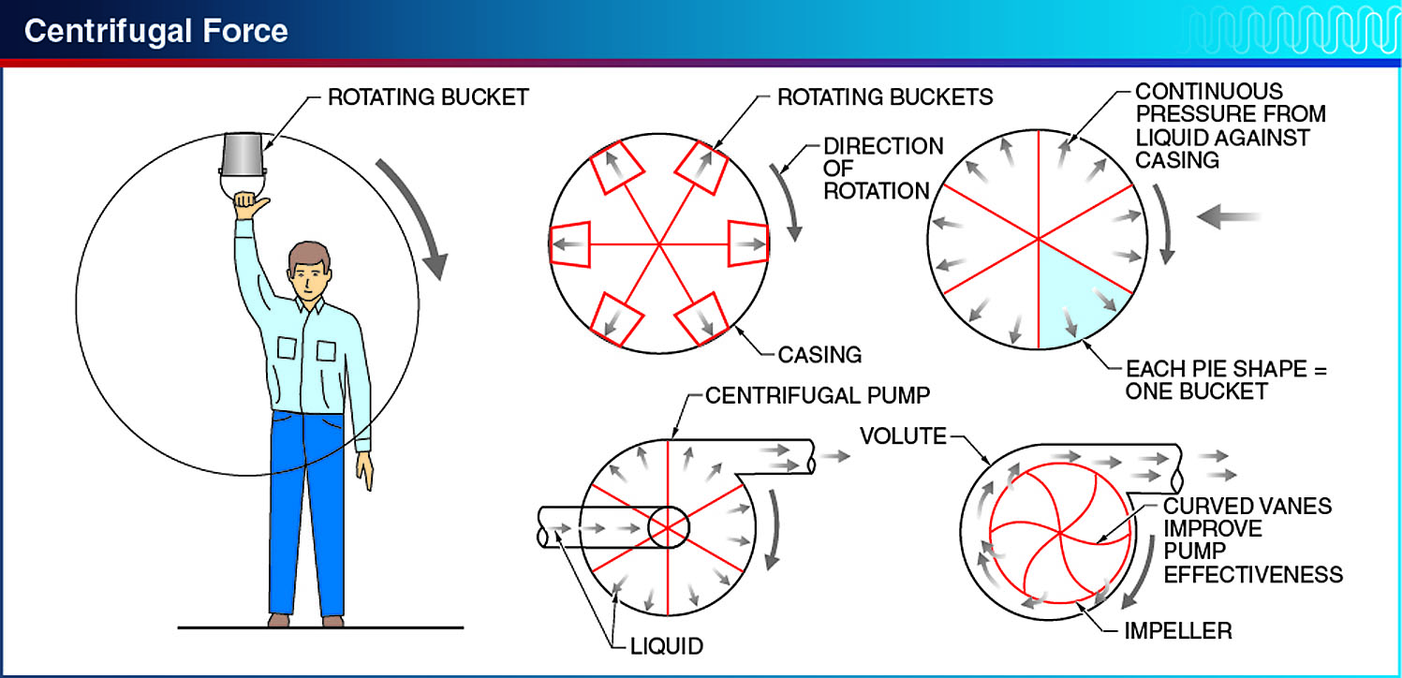
Centrifugal force is a force that pushes a body outward when it is spinning around a center.
Notes:
Although there are many variations of centrifugal pump designs, they all employ centrifugal force to operate. Centrifugal force is a force that pushes a body outward when it is spinning around a center. See Figure 4-7.

Slide 57
Centrifugal Force
Fig 2-15
Design changes to improve efficiency
Change the shape of the vanes to curve backwards
Known as an Impeller

Slide 58
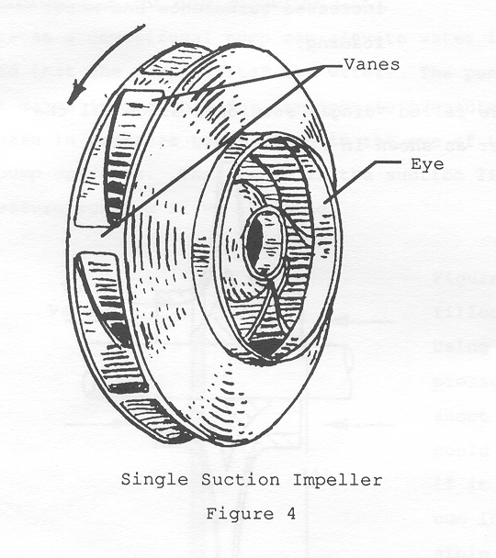
Notice the curve?

Slide 59
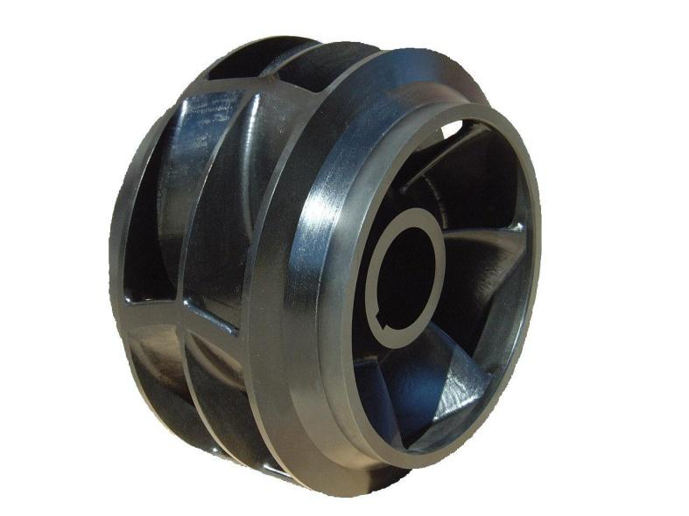
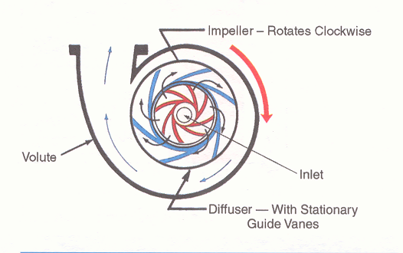
Fig 2-16

Slide 60
Centrifugal Pumps
Fig 2-16
The casing of the centrifugal pump expands gradually in the direction of rotation
This gradually expanding passage causes the flow velocity to be reduced as the fluid flows toward the pump discharge connection
This expanding casing, called a volute makes the pump operate more efficiently and gives the name to the volute centrifugal pump which is widely used throughout the piping industry

Slide 61
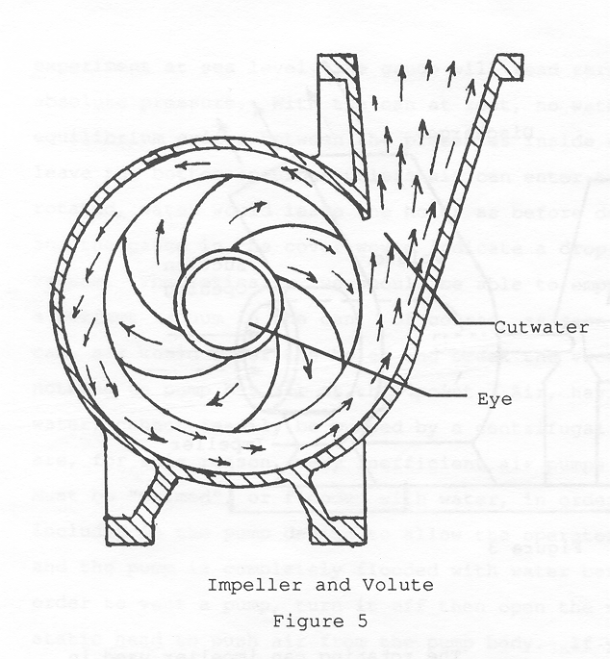

Slide 62
Centrifugal Pumps
The velocity head becomes pressure head before the water reaches the circumference of the casing, and flows toward the discharge outlet
The quantity of water pumped depends on the size of the suction and discharge lines, the size of the impeller and its speed

Slide 63
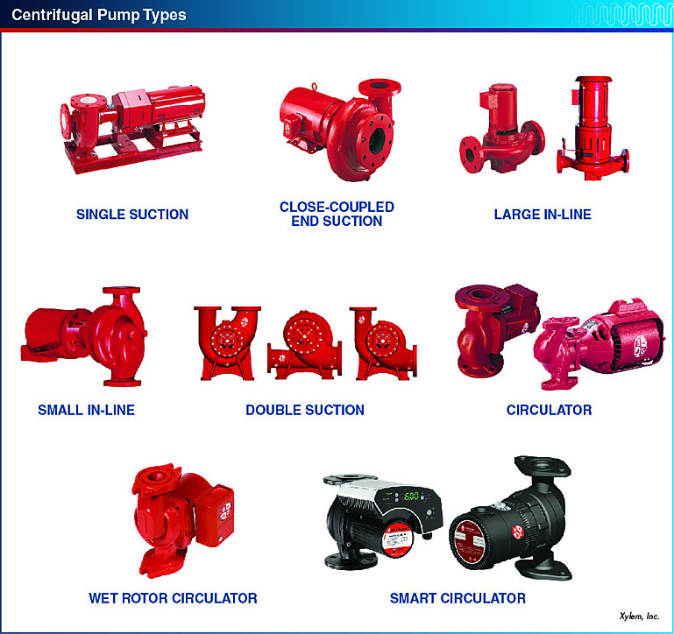
Centrifugal pump manufacturers have developed many volute and impeller configurations in order to meet the requirements for different applications.
Notes:
Centrifugal pumps may be single suction or double suction pumps. They may be base mounted, in which the pump, the bearing assembly, and the motor are all mounted on a common base and ready for installation on a foundation. They may also be in-line pumps intended for installation directly in a pipeline without a base. See Figure 4-13.

Slide 64
Centrifugal Force
Learning Objectives Completed
Describe the principles of centrifugal force and how it operates in this type of pump
Quick review Centrifugal Force
Theory
Vocabulary
Casing
Volute
Impeller
Centrifugal Pump Principle 1 (8 min)
https://www.youtube.com/watch?v=w8WcMnUiYQQ

Slide 66
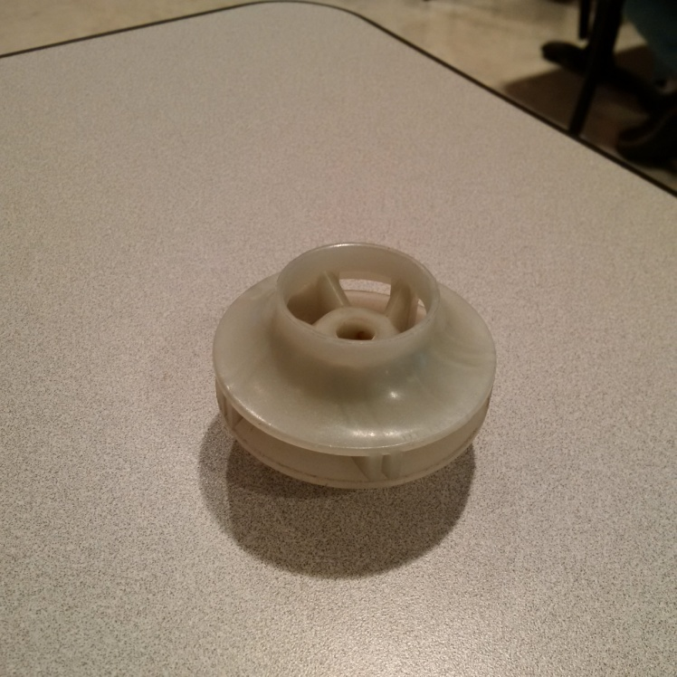
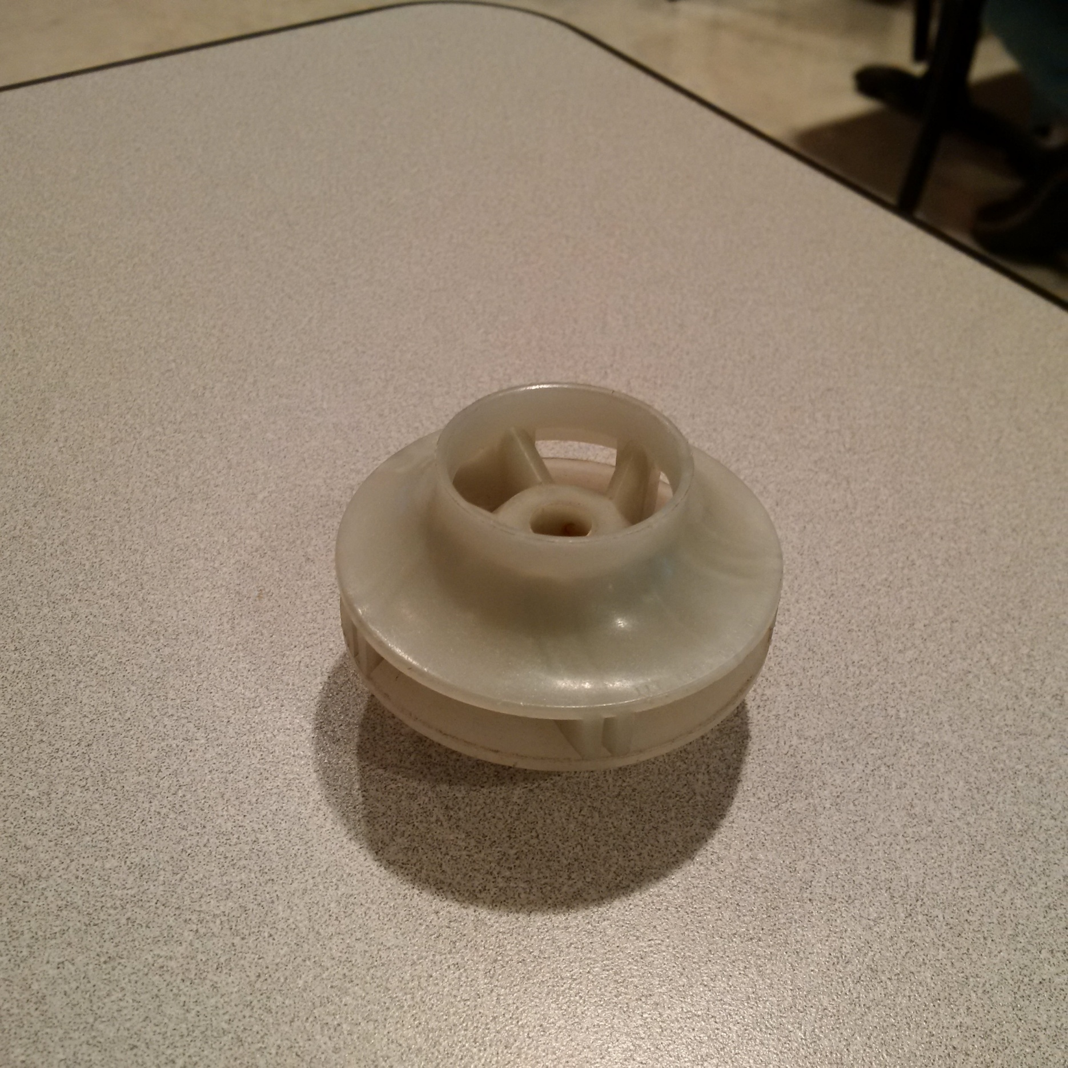
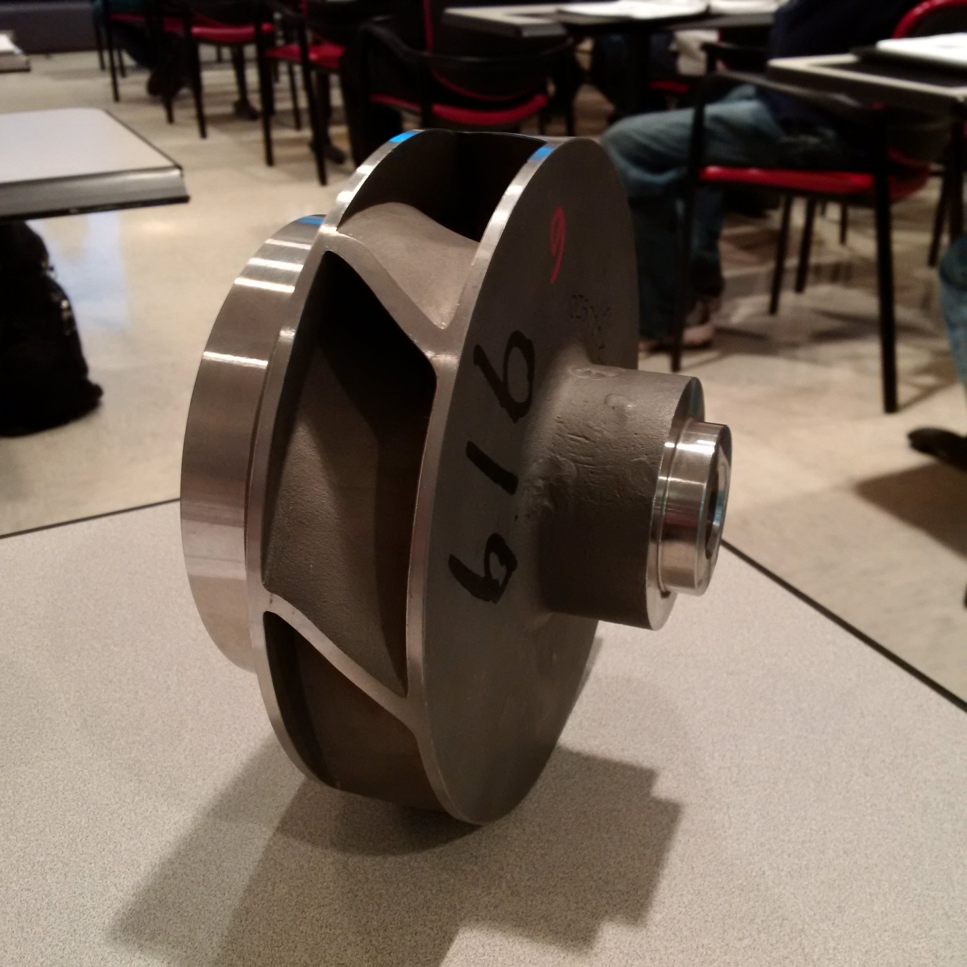


Slide 67
Centrifugal Impellers
Types
Open
Semi-open
Web
Enclosed
Web
Shroud

Slide 68
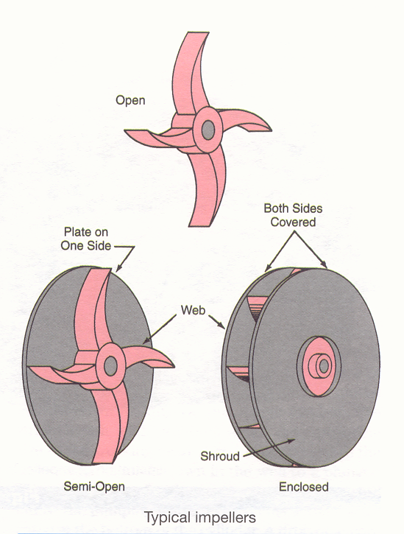

Slide 69
Centrifugal Impellers
Fig 2-17
Open
Consists of blades attached to a hub
Suited to pumping semi solids like sewage

Slide 70
Centrifugal Impellers
Fig 2-17
Semi-open
Added circular plate called the web
Provides additional support
Allows blades to be thinner
Sandwiches the fluid between the casing

Slide 71
Centrifugal Impellers
Fig 2-17
Enclosed
Additional circular plate called the shroud
Hold liquid between both pieces
Reduced friction loss for efficient operation

Slide 72
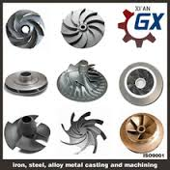
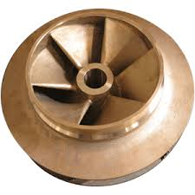
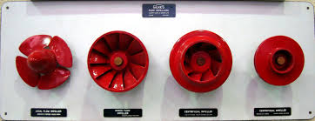
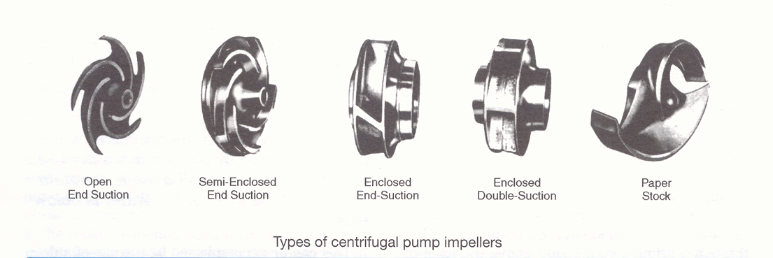

Slide 73
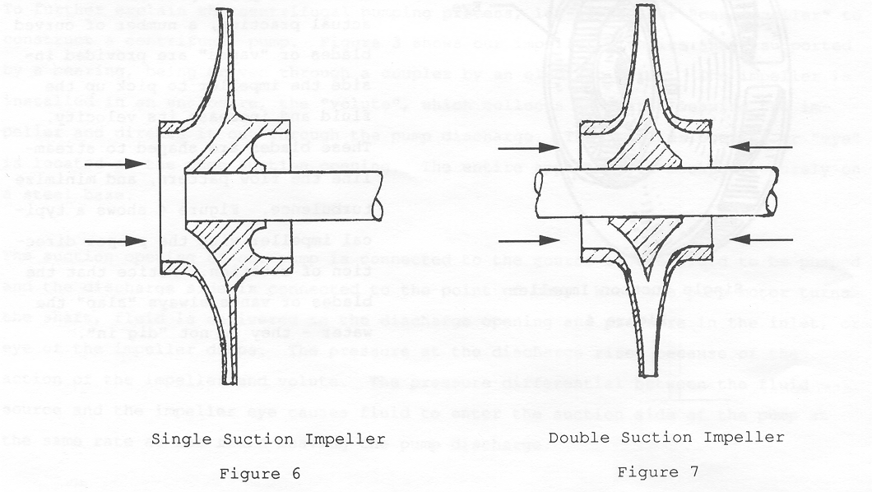

Slide 74
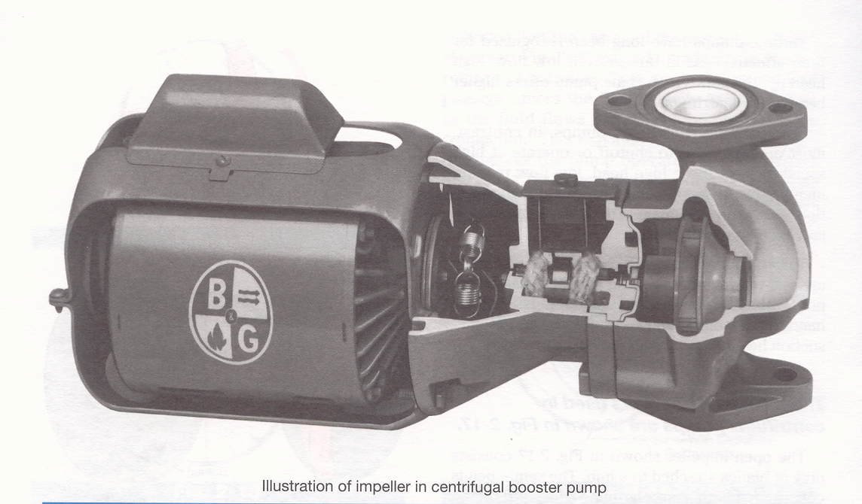

Slide 75
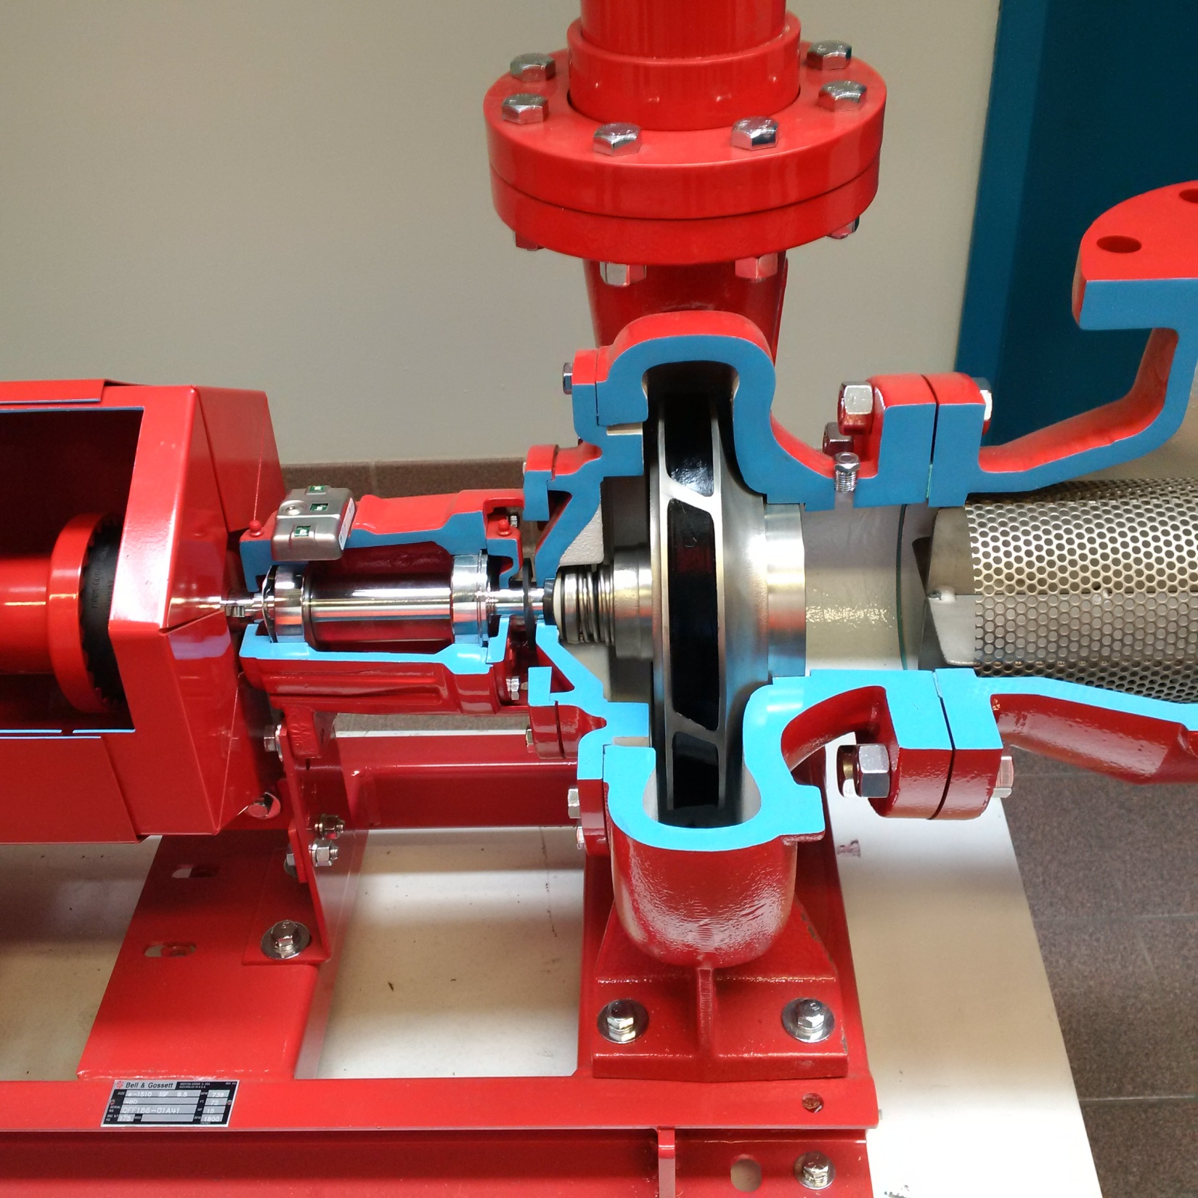

Slide 76
Centrifugal Impellers
Learning Objectives Completed
Compare 3 different types of centrifugal impellers
Quick review Centrifugal Impellers
Theory
Vocabulary
Open
Semi-open
Web
Enclosed
Shroud
Centrifugal Pump Principle 3 (13 min)
https://www.youtube.com/watch?v=3g_aZLzpRJs

Slide 78
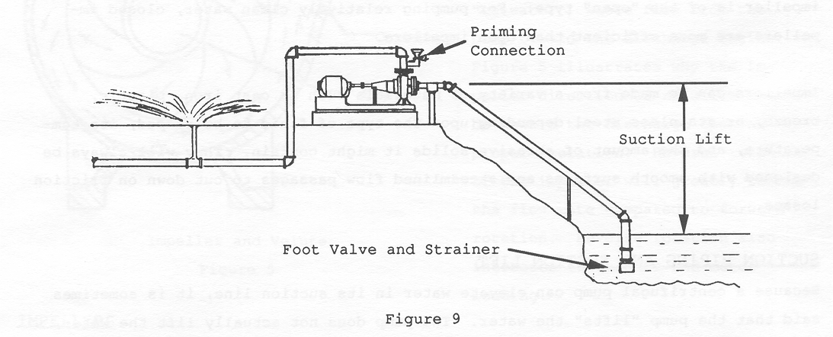
Centrifugal Pump Priming
Pump Priming videos 4 Min
https://www.youtube.com/watch?v=2FA6t7wHtF0

Slide 79
Centrifugal Pump Priming
Open systems such as lift stations
Pump starts with air in the impeller
Very little centrifugal force will be generated
Therefore very little pressure differential
Water must be allowed to enter to pump
Air must have a way to escape
This is called Priming

Slide 80
Centrifugal Pump Priming
Simplest arrangement
Impeller located below the water level
In this case the pump will fill automatically
Less favorable arrangement
Impeller located above the water level
Casing must be filled by a separate source
Piped to an empty chamber under pressure
Manually filled through a priming connection above

Slide 81
Centrifugal Pump Priming
Learning Objectives Completed
Define the phrase “pump priming” and explain why it is necessary for centrifugal pumps
Quick review Centrifugal Pump Priming
Theory
Vocabulary
Priming
Pump Priming Issues videos 4 Min
https://www.youtube.com/watch?v=GrpXdcSfbfA

Slide 83
Well Pumps
Shallow well
Require a foot valve (check valve)
Have a theoretical maximum lift of 34’
What was the actual maximum for pumps?
Practical suction lift on
Positive displacement pumps is 22’
Centrifugal pumps it is 15’

Slide 84
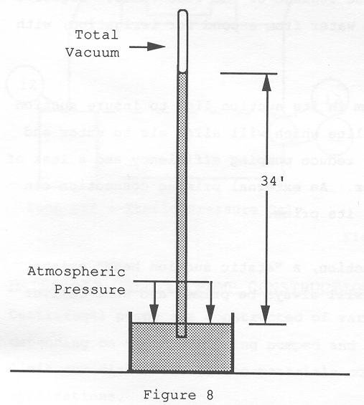

Slide 86
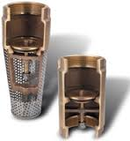
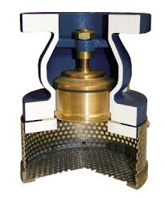
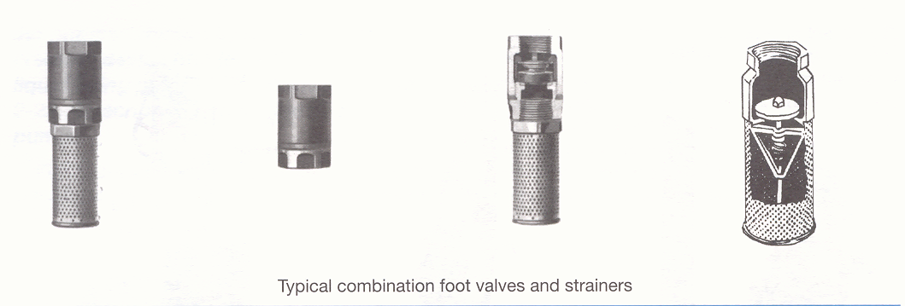
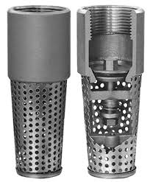
Notice the check valve?

Slide 87
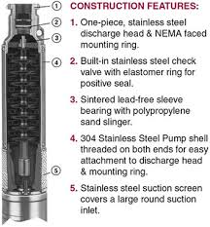
Deep Well Pumps
Are Submersible Pumps
Reciprocating Pumps
Jet Pump
Concept is to always keep the suction immersed in the pumping liquid

Slide 88



Slide 89
Deep Well Pumps
Submersible Pumps
How does a submersible pump retain it’s prime?
Entire pump, including motor, is submersed
Liquid lubricates and cools
Serious damage if well level drops to low
https://www.youtube.com/watch?v=RPpoWfuy_7Y Sewage example

Slide 90
Deep Well Pumps
Reciprocating Pumps AKA Pump Jack
Creates suction inside of a drop pipe
V-belt attached to a gear box
Rod connects to a plunger down in well
The cylinder, with plunger, is located below level
Up and down movement makes the upper and lower check valves open and close simultaneously
Operates on principle called Working Head

Slide 91


Slide 92

https://www.youtube.com/watch?v=kcykqOwDvyc

Slide 93


Slide 94


Slide 95


Slide 96
Deep Well Pumps
Jet Pumps
Use a suction creating device (the jet fitting)
Discharges to the jet fitting where a partial vacuum is formed by the high velocity fluid discharge from the jet nozzle
After passing through the restriction into the expanding venturi fitting the velocity decreases with a corresponding increase in pressure

Slide 97

https://www.youtube.com/watch?v=m0xBVMQ3wtw

Slide 98
Multistage Pumps
A multistage centrifugal pump is essentially a high head or high-pressure pump; it consists of two or more stages, depending on the pressure that is required in the system
Each stage is essentially a separate pump, they are located in the same housing and the impellers are attached to the same shaft
Two or more stages may be found in a single housing

Slide 99


Slide 100

https://www.youtube.com/watch?v=3IzA0Blvv9s
https://www.youtube.com/watch?v=5v8rj3Pyvds
https://www.youtube.com/watch?v=r4GJ34J0z2g

Slide 101
Propeller Pumps
Propeller Pumps Types
Axial
Very similar to an enclosed ship propeller
Problem low pressure differential
Mixed
To increase the pressure capability of the propeller pump, it is necessary to have part of the energy imparted to the liquid by centrifugal force
As the liquid flows through the impeller, it axially moves away from the center or rotation

Slide 102


Slide 103

https://www.youtube.com/watch?v=6FvePM1Hbl8

Slide 104
Peripheral Pump
The liquid enters the impeller at its peripheral opposite the suction opening of the pump
The short impeller vane, operating in the channel in the body of the pump, causes the liquid to be thrown away from the center of rotation by centrifugal force
The result is that the liquid flows through the pump in a circular spiral pattern continuously receiving energy and building up pressure as it moves from the suction toward the discharge of the pump

Slide 105


Slide 106


Slide 107
Other Centrifugal Pumps
Learning Objectives Completed
Explain the mechanical operation of the following types of pumps: Submersible, Jet, Multistage, Propeller, Peripheral
Quick review Other Centrifugal Pumps
Theory
Vocabulary.
Well Pump
Shallow
Foot Valve
Deep
Submersible
Reciprocating
Jet
Propeller
Perhiprial
https://www.youtube.com/watch?v=B8MV09HF-nY
Quick review of centrifugal pumps with different impellers
Last one looks like a perhiprial

Slide 109
Checkpoint 1
Assignment 1
Page 9 through Checkpoint 1
Pages 9 through 24
Learning Outcome 2 Completed
Articulate major pump classifications, and then compare/contrast operational theory with common applications
Review Questions
Classifying Centrifugal pumps 6 Min
https://www.youtube.com/watch?v=TLiBzn3Zlvg
Meant as a review

