Slide 1

Types of Pumps
UA Pumps
CH 2 Section 2
Learning Outcome 3+4

Slide 3
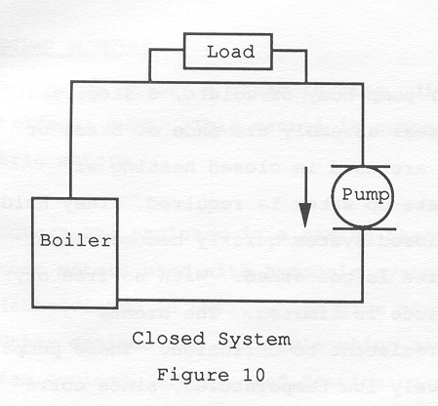

Slide 4
Closed Loop Systems
Key concepts
Are not exposed to atmosphere
Are under pressure even without fluid flow
When the system is in a Static Condition (no flow), pressure on both sides of the pump are the same
This is known as Static Head Negation

Slide 5
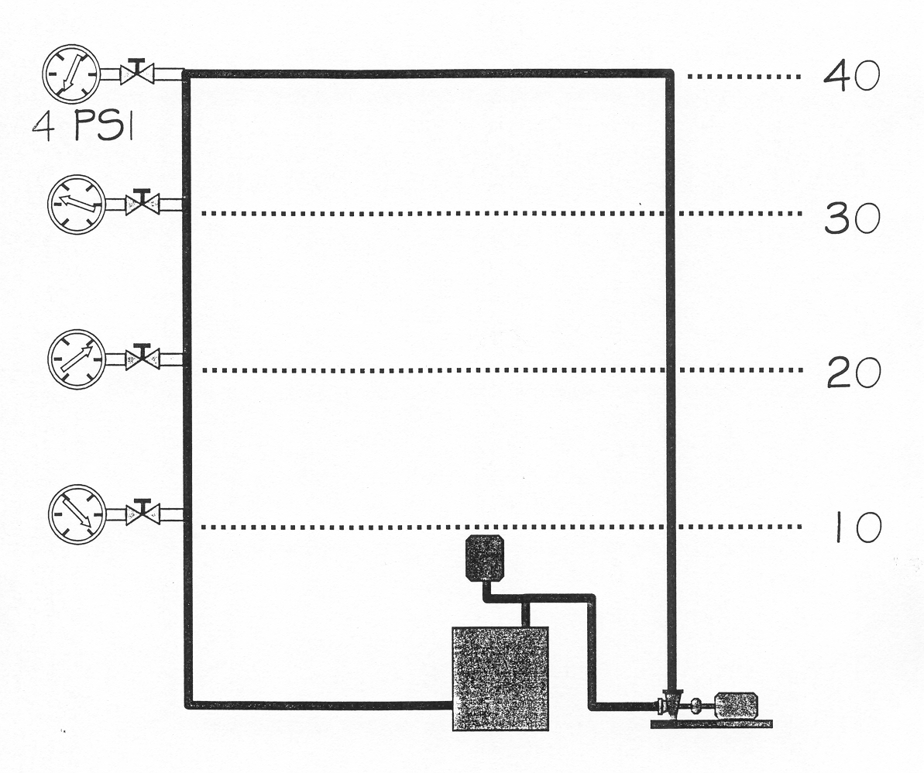

Slide 6
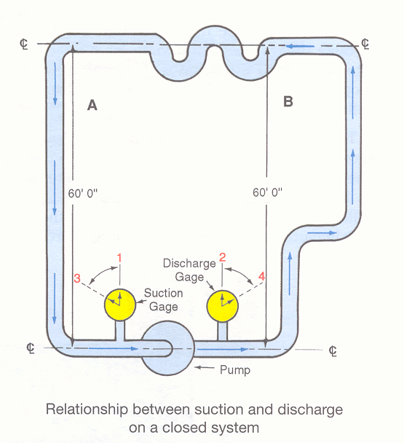

Slide 7
Closed Loop Systems
Fig 2-27
What is the pressure at gauge 1?
60ft x .433 psi/ft = 25.98 psi or 26 psi
What is the pressure at gauge 2?
See how it is the same?
This is known as Static Head Negation

Slide 8
Closed Loop Systems
In the closed system, the total of the changes in pressure on the pump gauges is equal to the additional head developed under flow conditions due to friction losses within the system
In a closed system Delta P represents the increase in head generated by the pump in order to overcome the resistance (or pressure drop) throughout the entire system due to friction loss

Slide 10
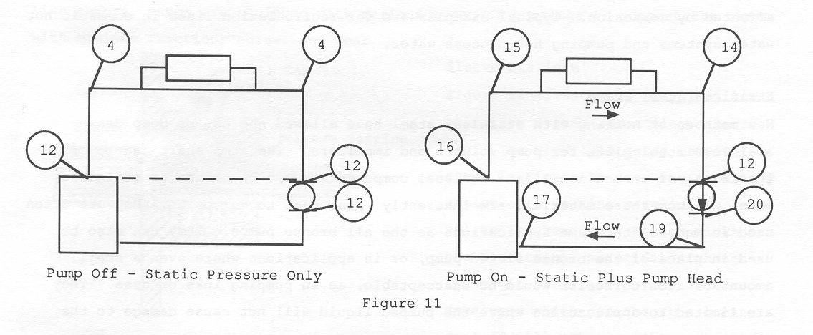

Slide 11
Total Dynamic Head
The Total Dynamic Head is a direct representation of the performance of the pump at a specific flow rate and is a very useful tool during start-up, testing and balancing and in troubleshooting pump performance

Slide 12
Closed Loop Systems
Learning Objectives Completed
Reference provided diagrams IPT Pumps Fig-2-27 (Closed System) and explain concepts, Static Head Negation, Delta P, System Friction Loss, Total Dynamic Head
Quick review Closed Loop Systems
Theory
Vocabulary

Slide 14
Pump Curves
As total head increases, flow rate decreases
Conversely, as the total head becomes lower, the flow rate increases
The discharge rate of centrifugal pumps will vary according to the amount of system pressure being pumped against (Delta P)
This relationship of flow to system pressure is described graphically for each individual pump through a diagram called a pump curve

Slide 15
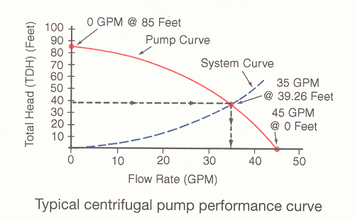

Slide 16
Centrifugal Pump Curves
May be used to measure pump performance
They can show shut-off head
Determine Impeller Size
Show system flow at other than prevailing conditions
Determine pump horsepower and efficiency

Slide 17
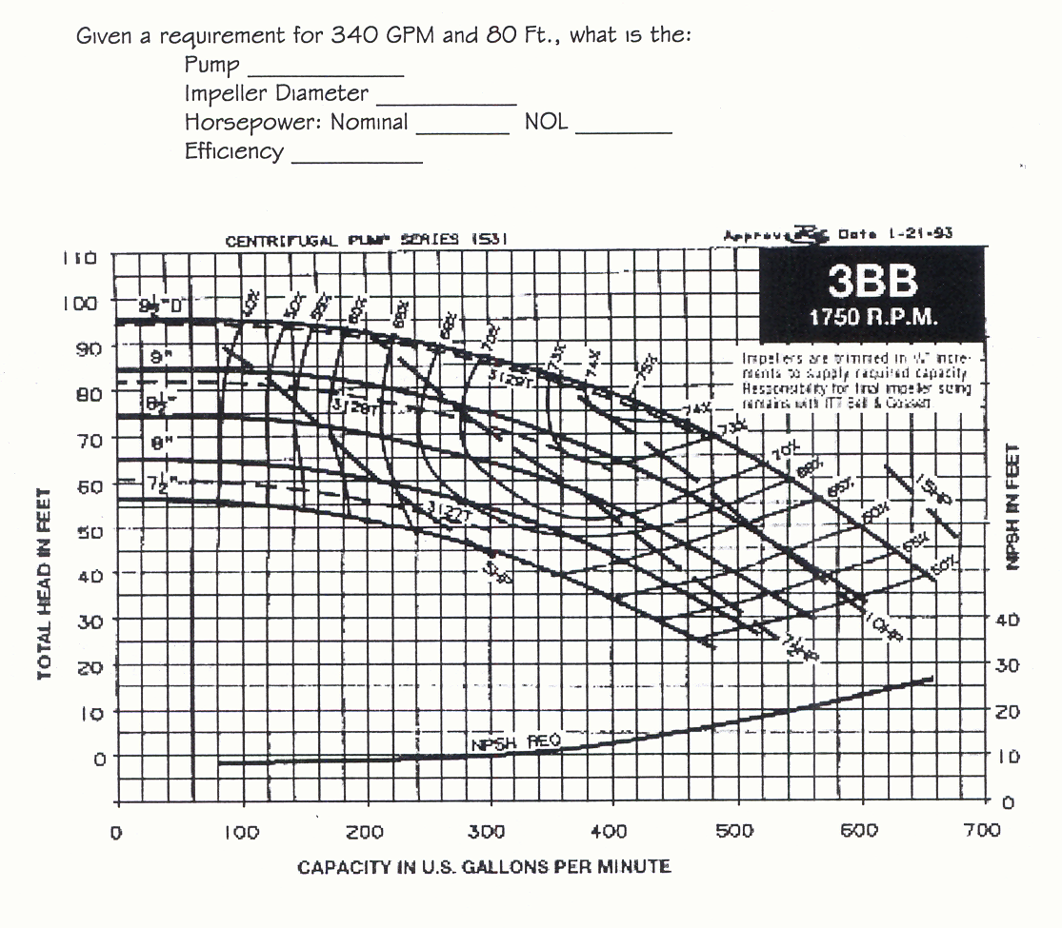

Slide 18
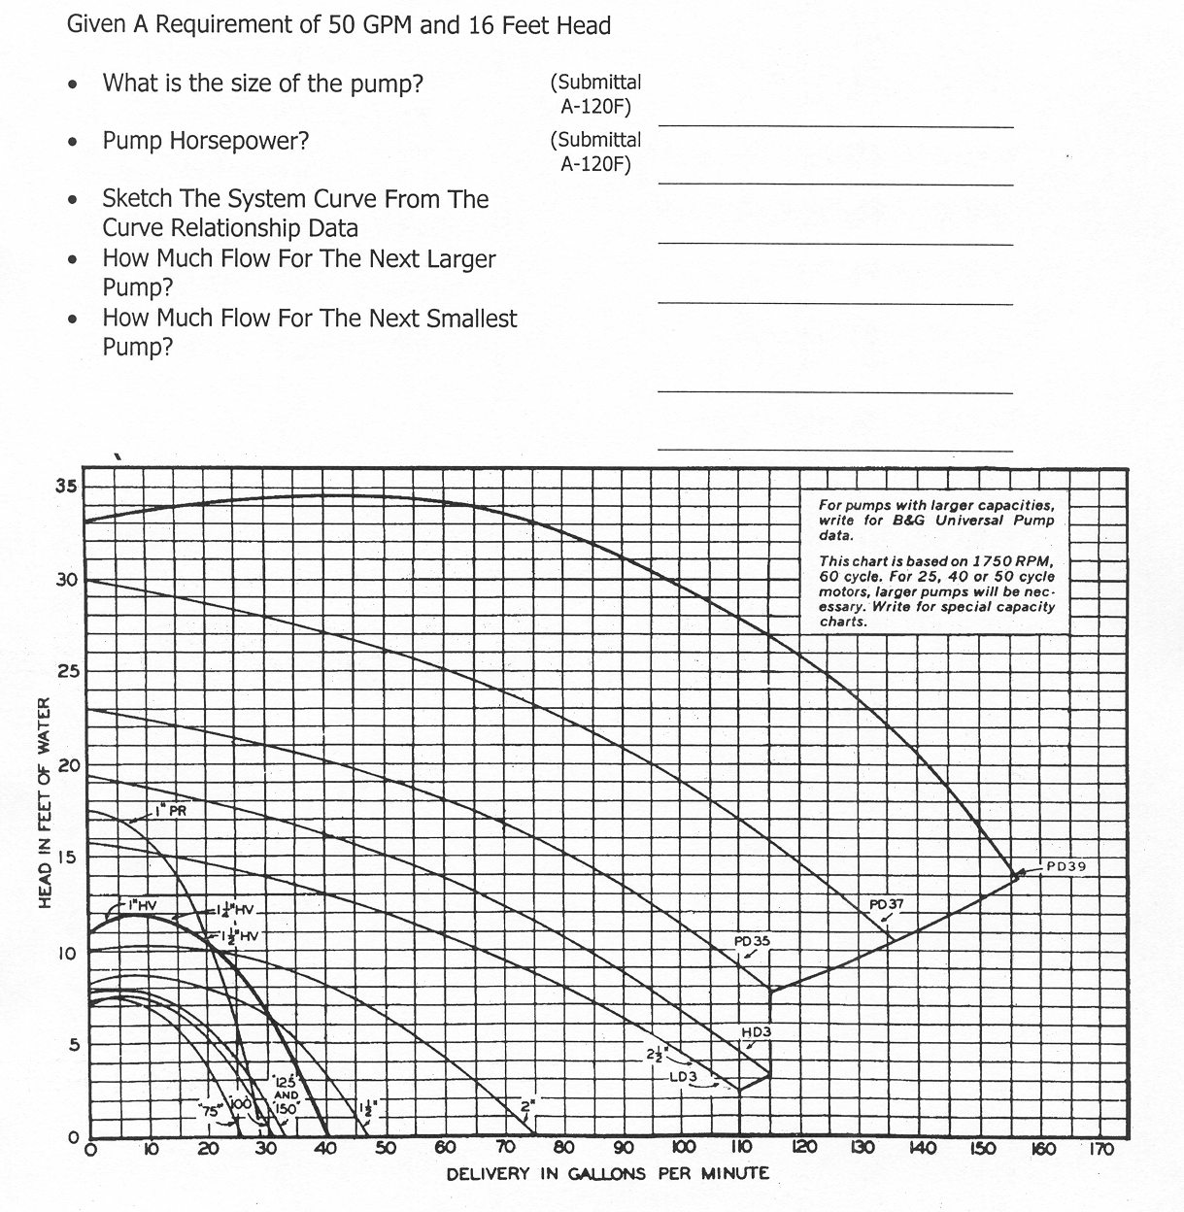
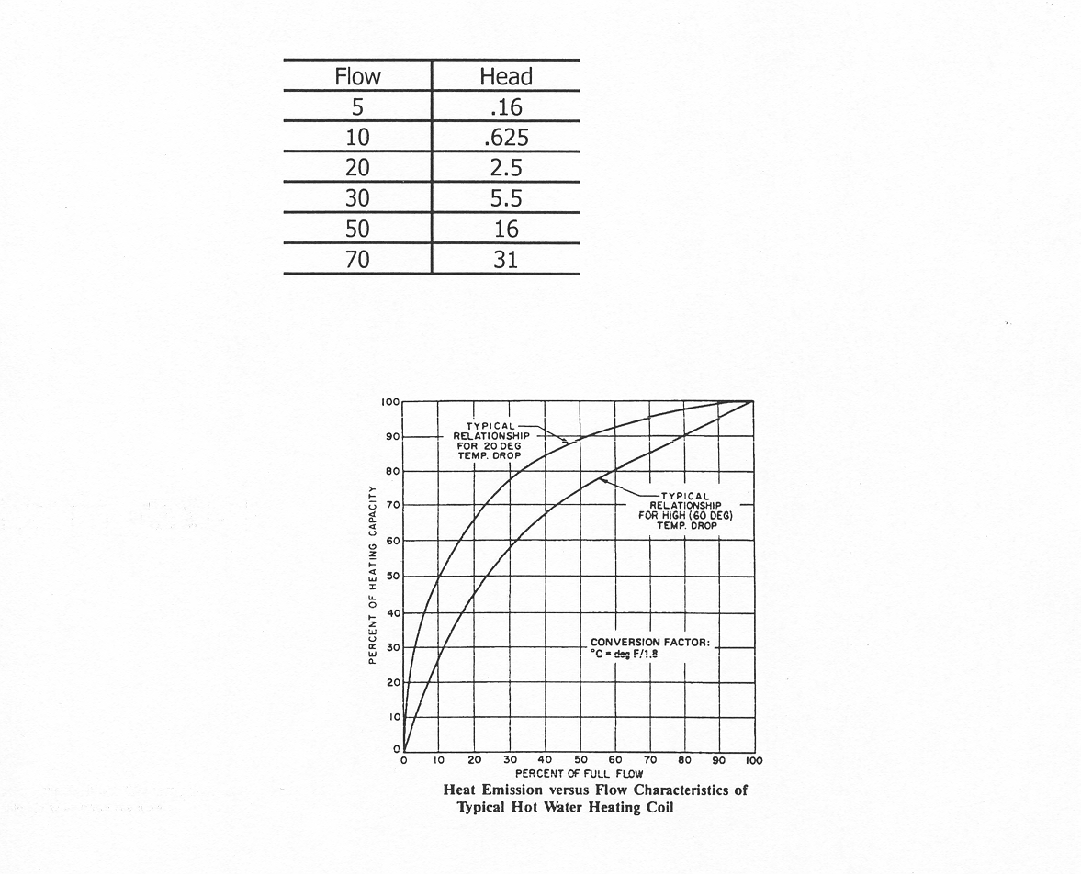

Slide 19
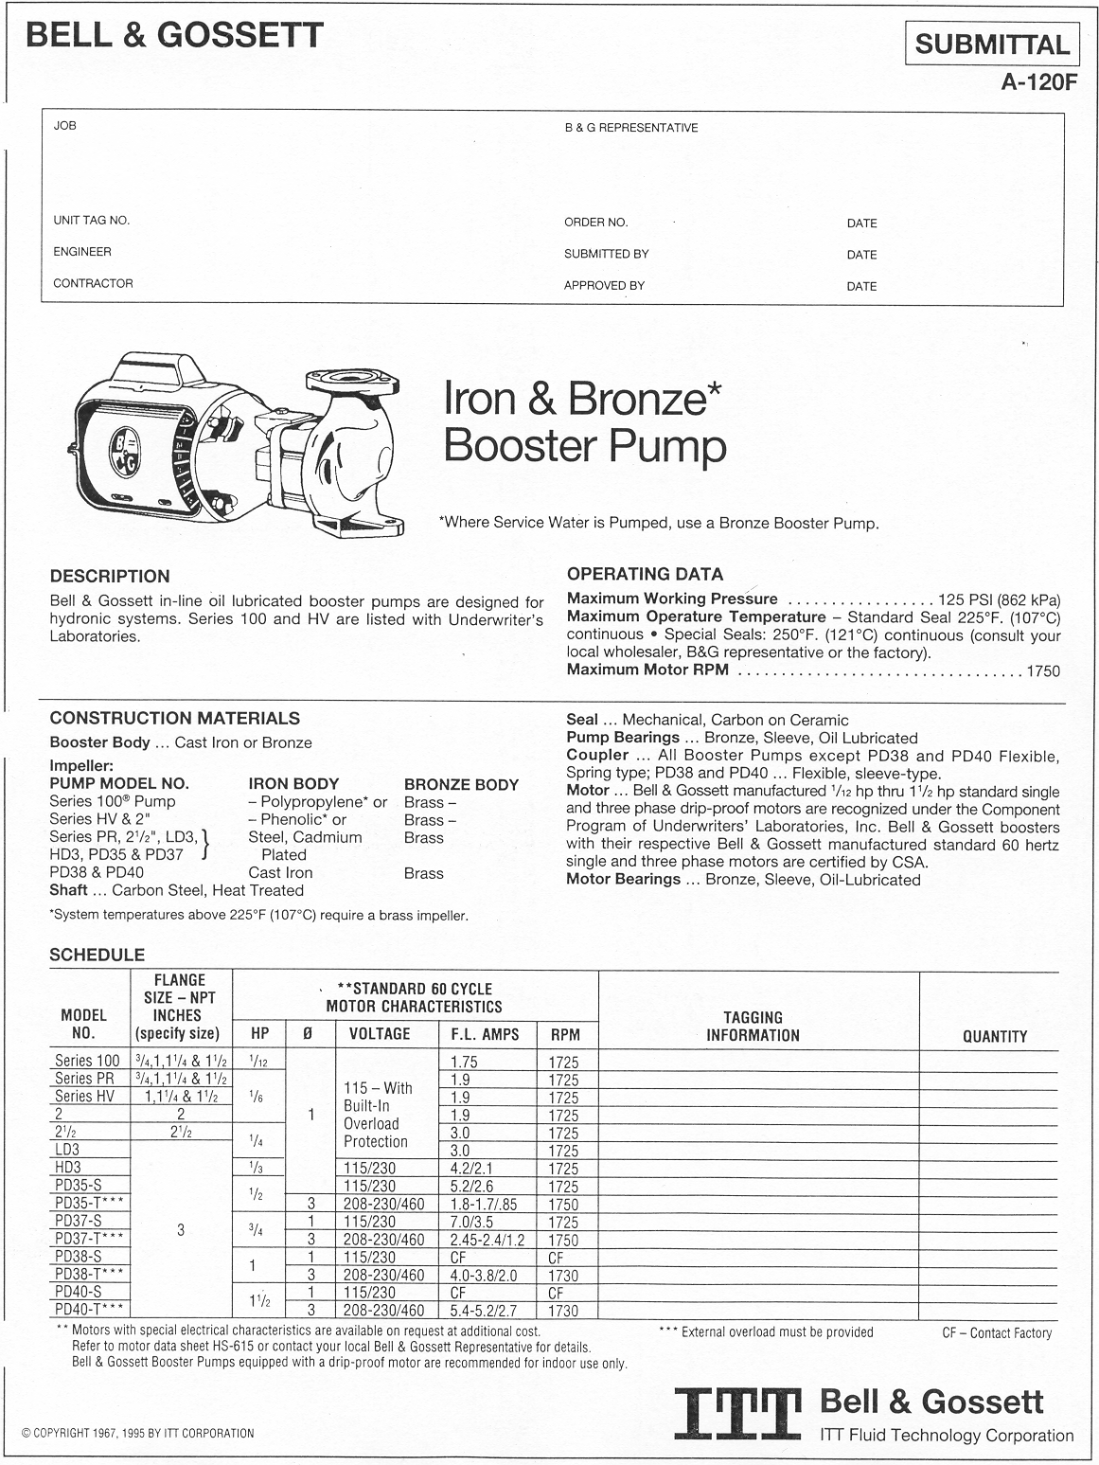

Slide 20
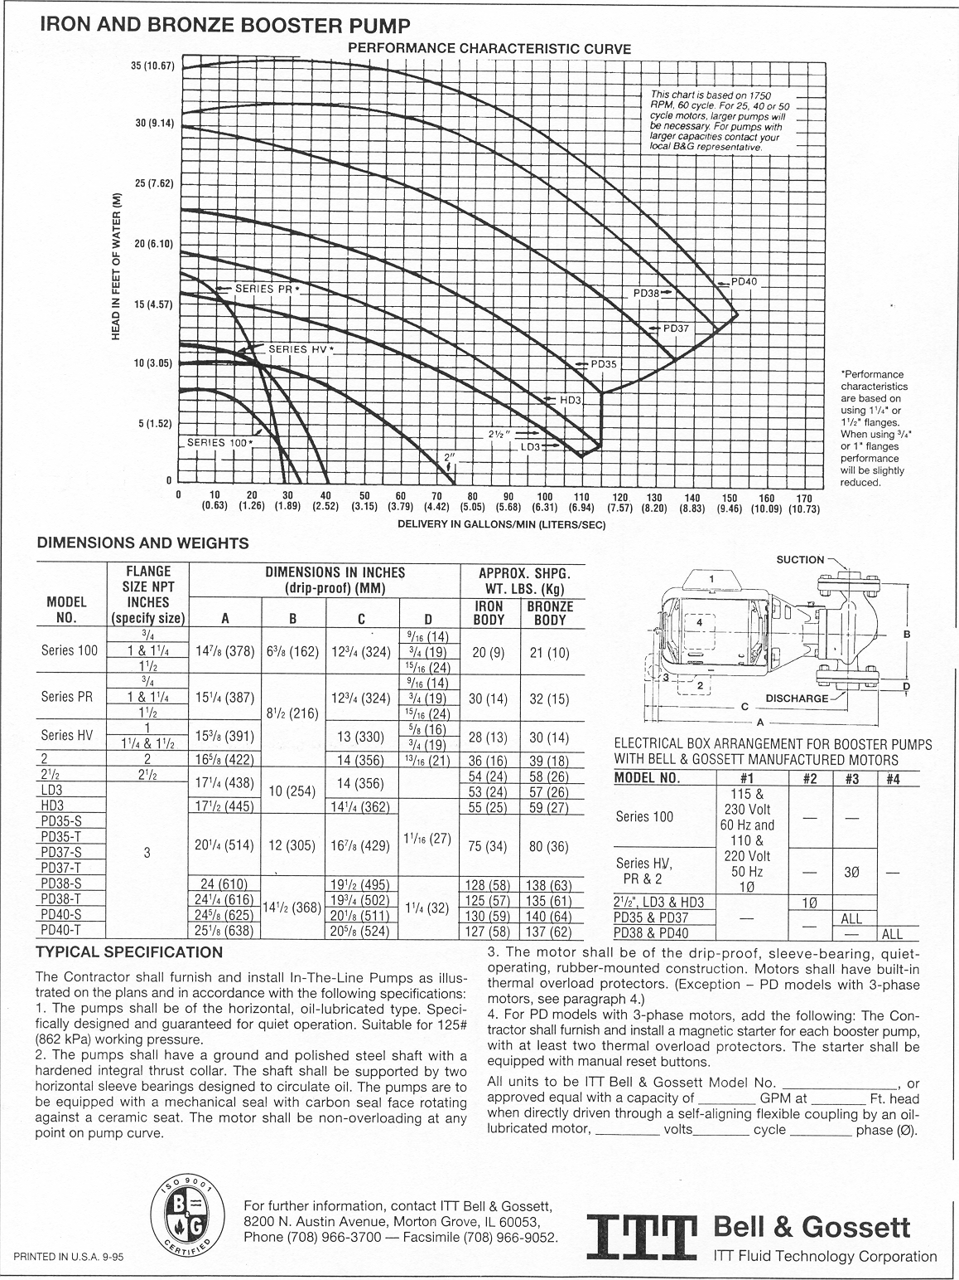

Slide 21
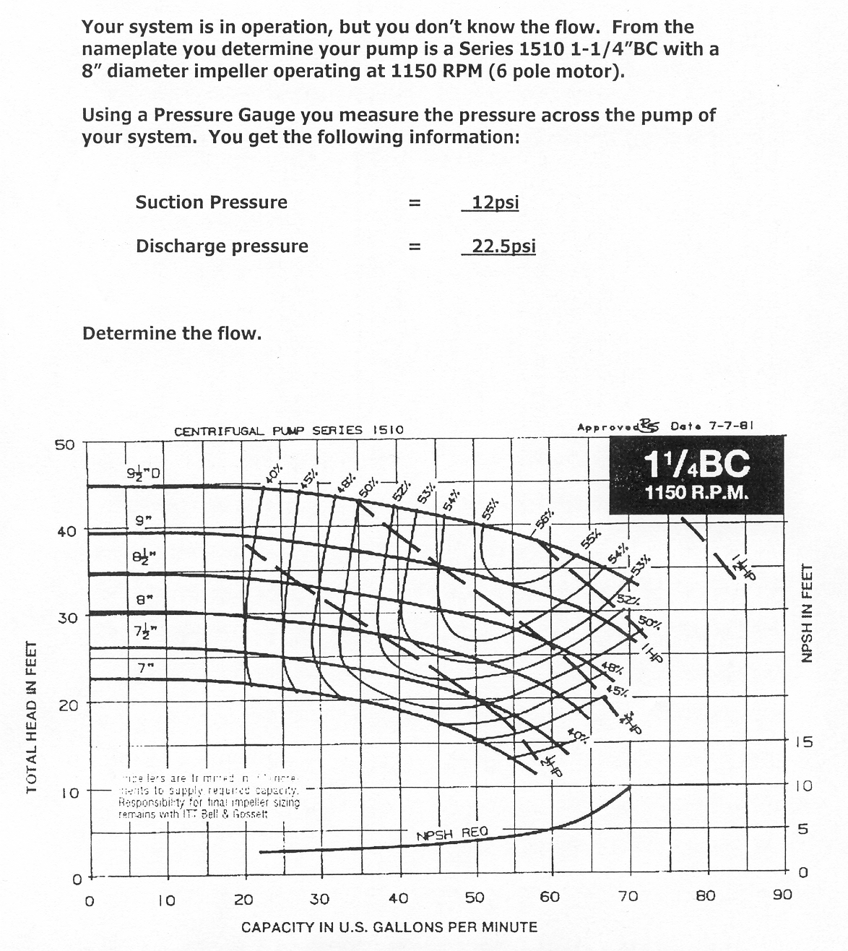

Slide 22
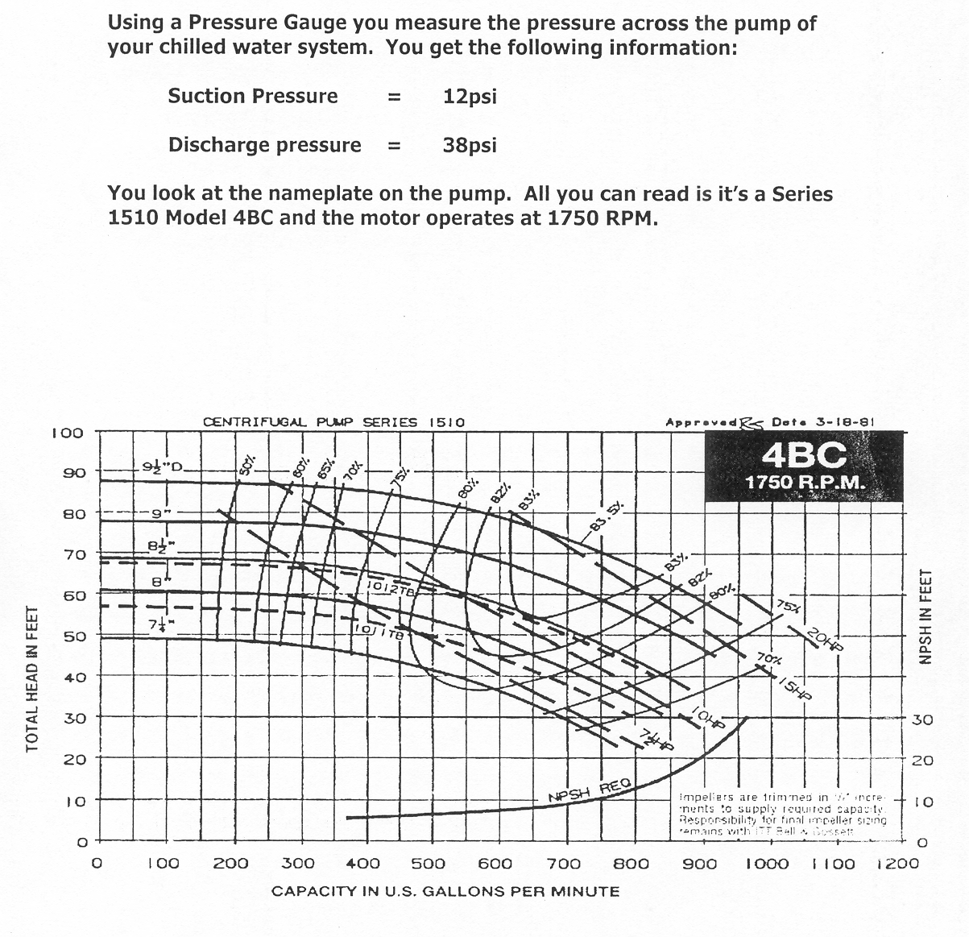

Slide 23
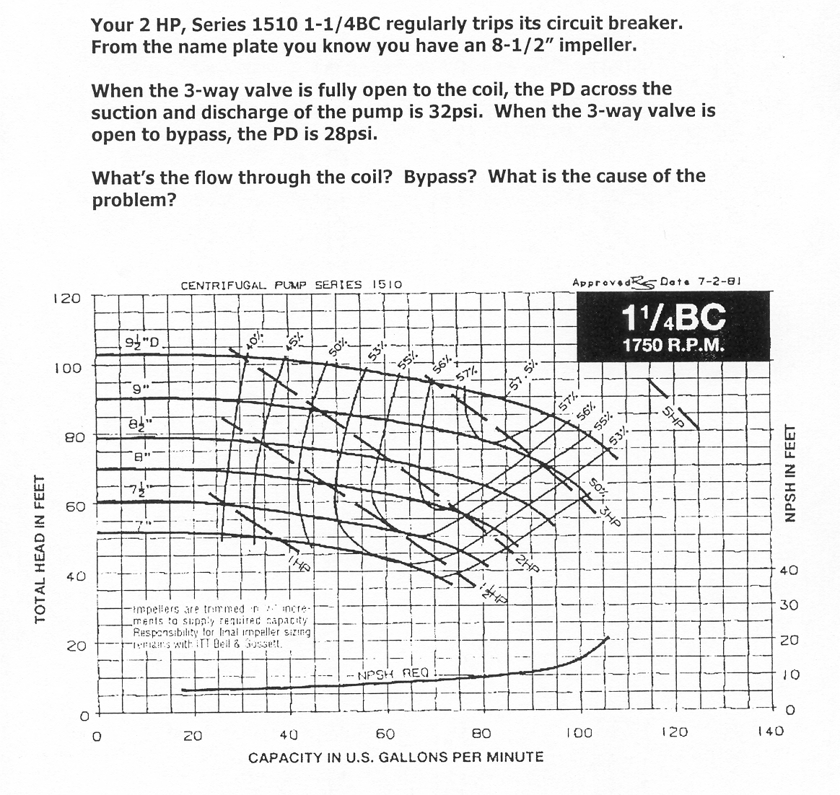

Slide 24
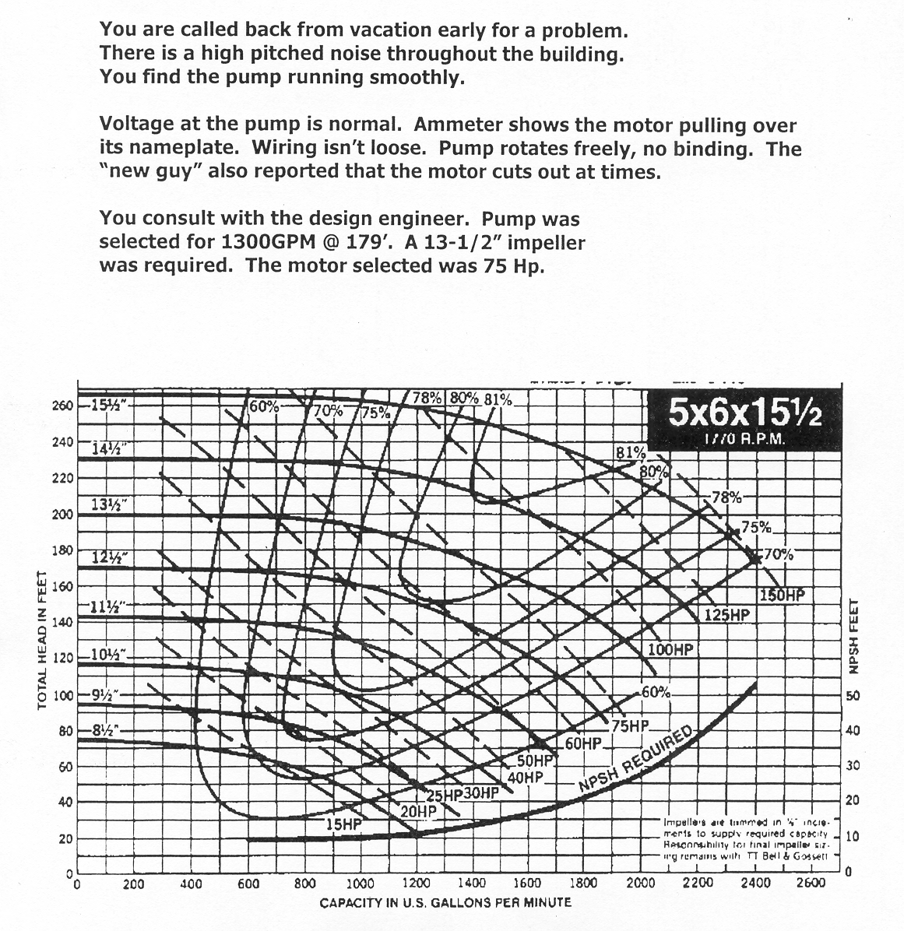

Slide 25
Changing Performance of a Centrifugal Pump
Change the rotational speed (RPM)
Change the diameter of the impeller
Change the style of the impeller

Slide 26
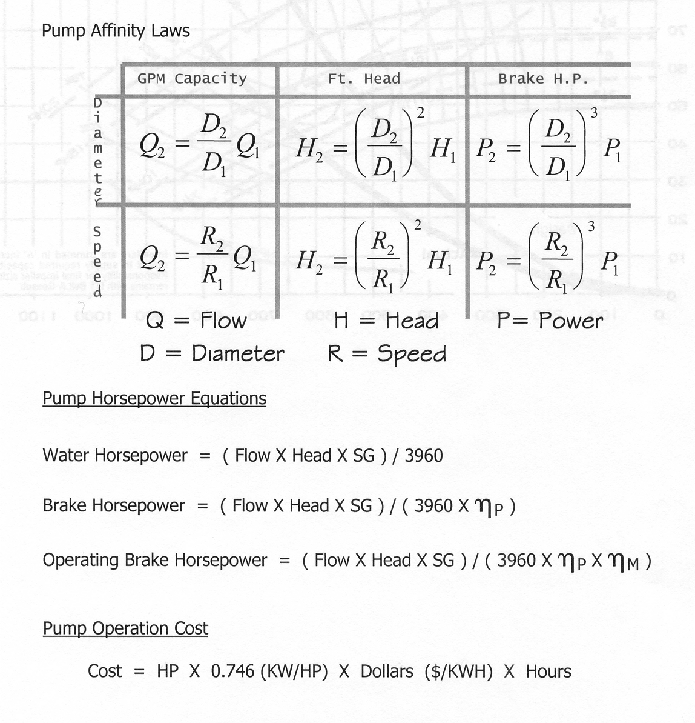

Slide 27
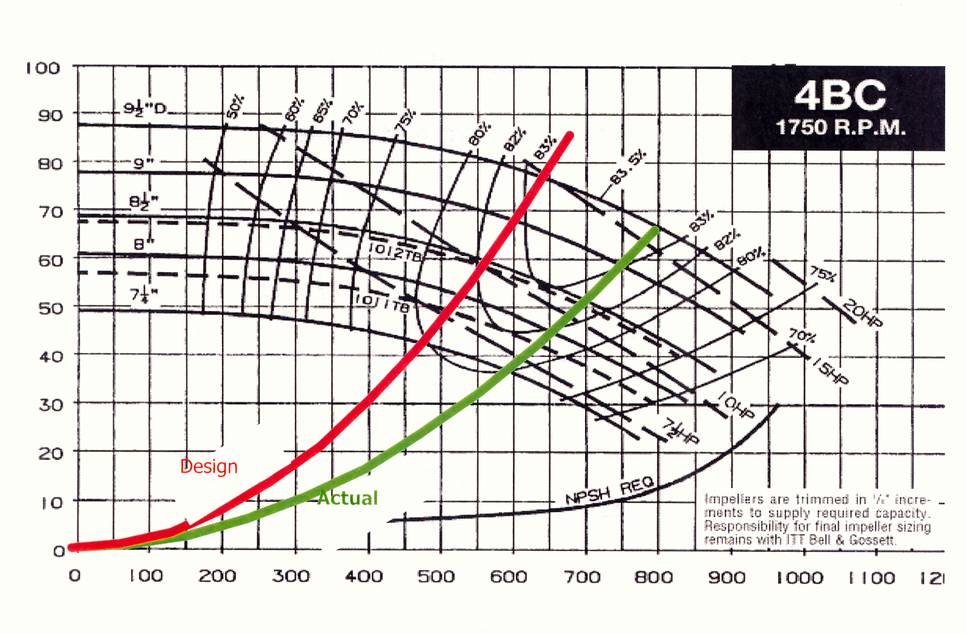

Slide 28
Pumping Performance Options
Multi-Speed Motor
Parallel Pumping
Each pump produces one-half of the total flow at the total system head
Series Pumping
Each pump supplies the full design flow rate at one-half of the required design head

Slide 29
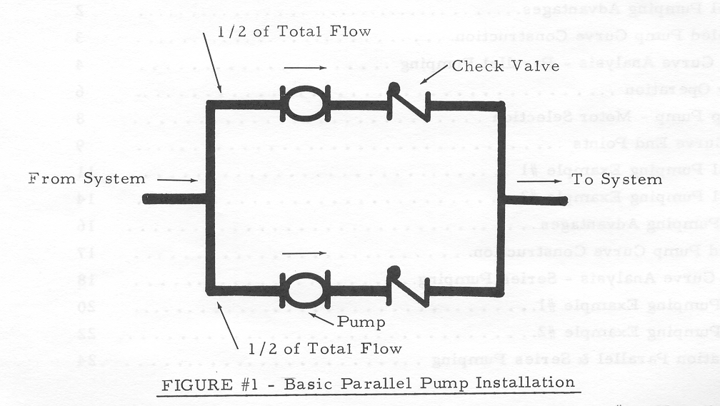

Slide 30
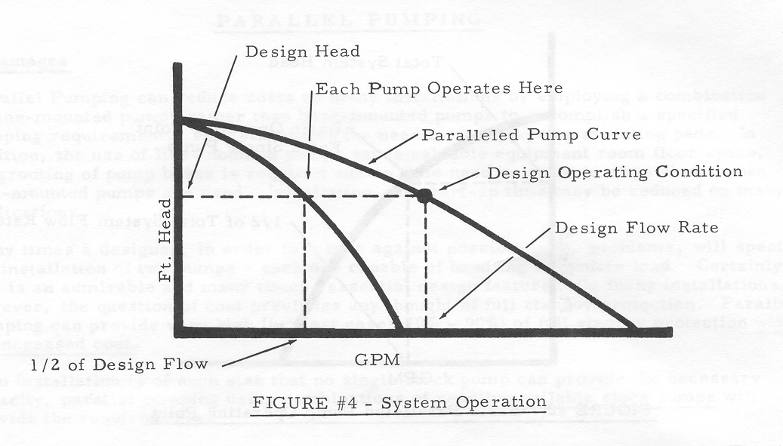

Slide 31
System Curve
Ft Hd
Pump A + B
Pump A
GPM
Parallel Pumping Curve

Slide 32
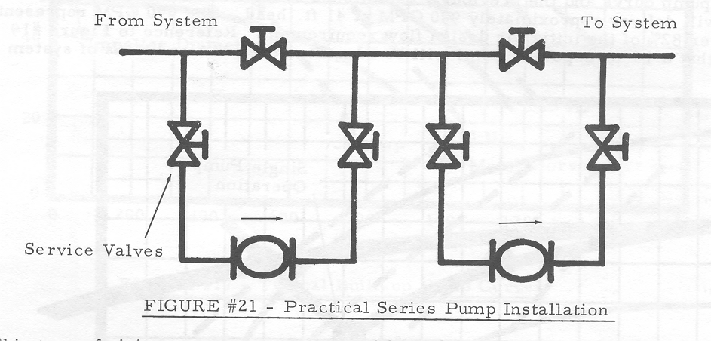

Slide 33
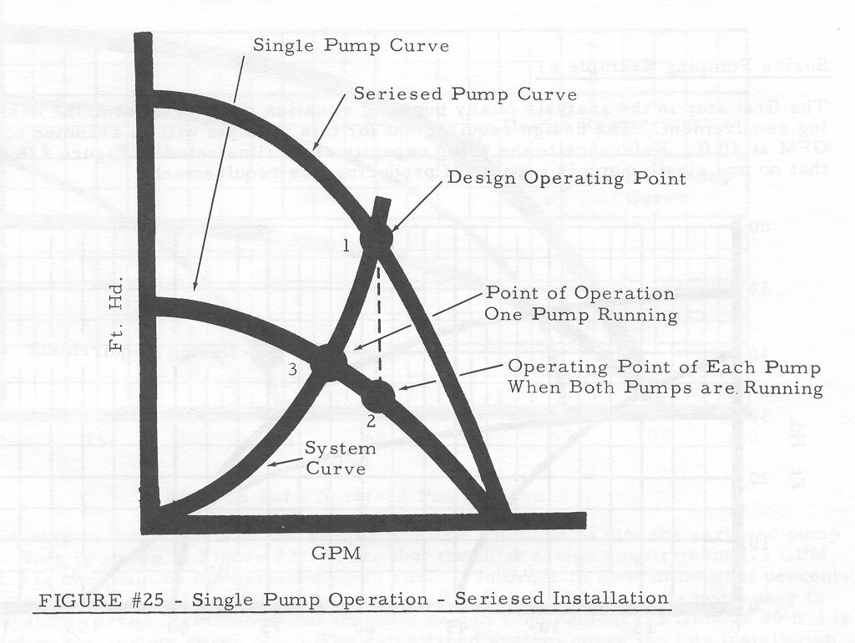

Slide 34
System
Curve
Ft Hd
Point of Operation
Pump A + B
Pump A
The pump curves for two identical centrifugal pumps connected in series
GPM

Slide 35
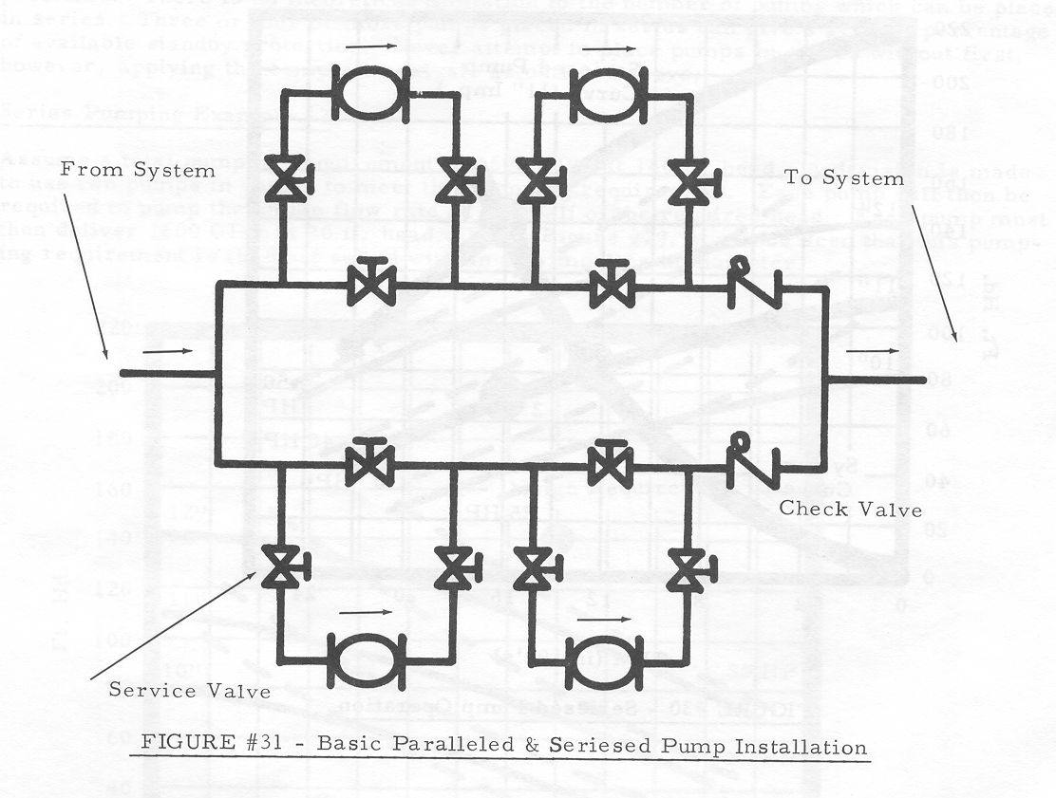

Slide 36
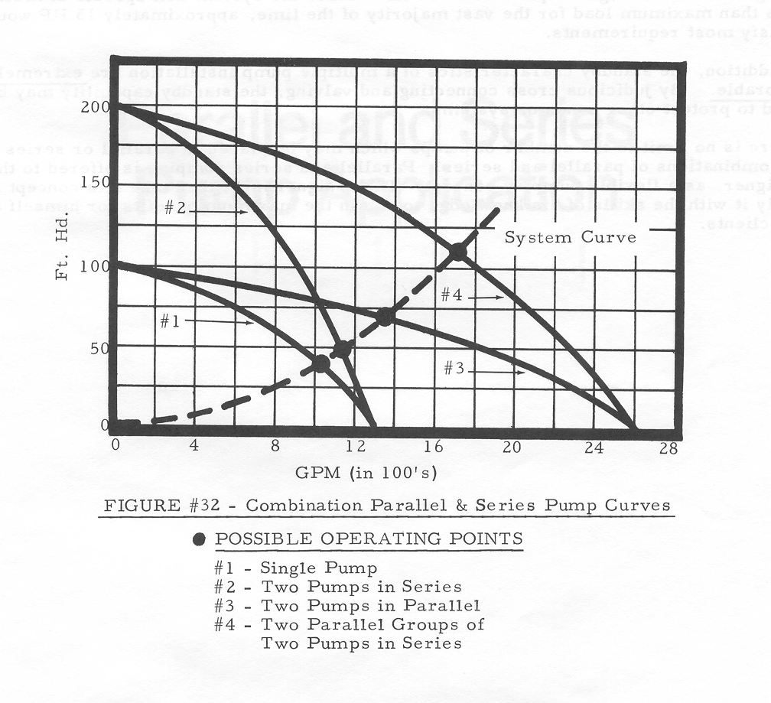

Slide 37
Pumping Performance Options
Variable Volume Pumping
Pump flow changes directly as a function of pump speed
Pump head changes as a squared function of the pump speed change
Pump Primary / Secondary Pumping
When two circuits are inter-connected, flow in one will not cause flow in the other if the pressure drop in the piping common to both is eliminated

Slide 38
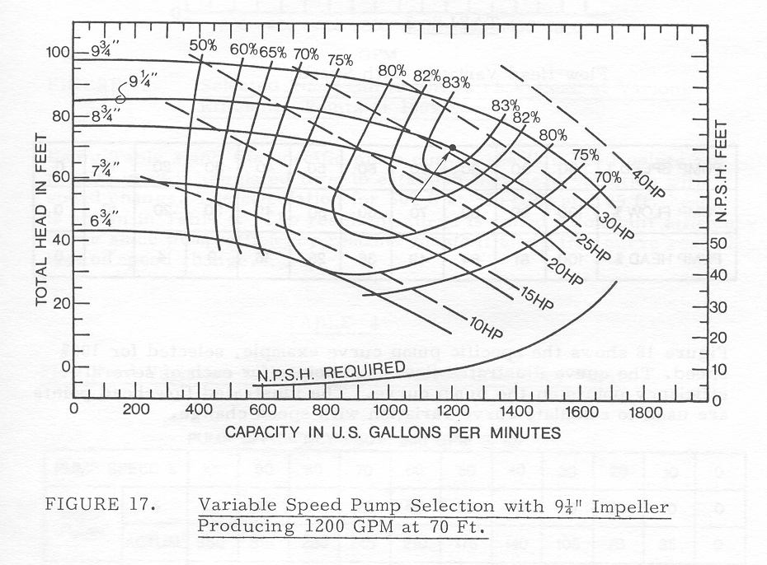

Slide 39
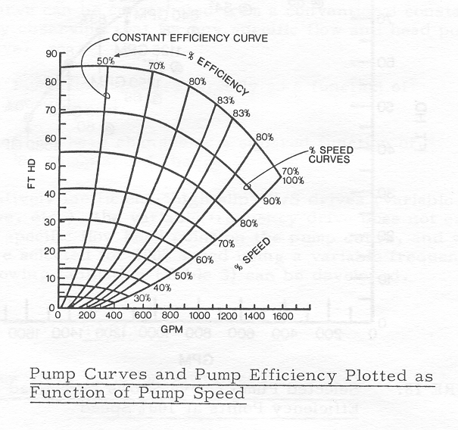
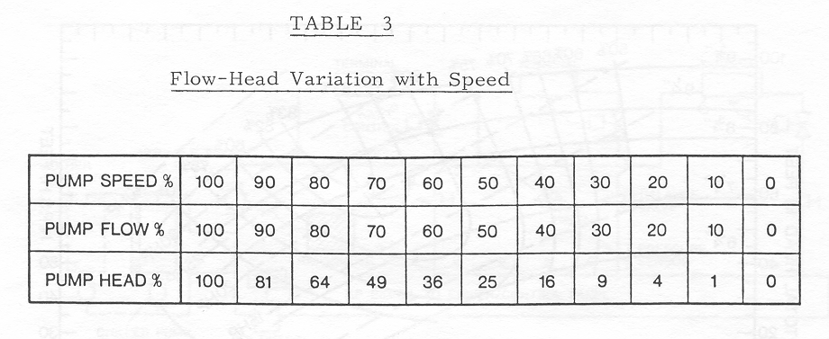
Pump Performance At Various Speeds

Slide 40
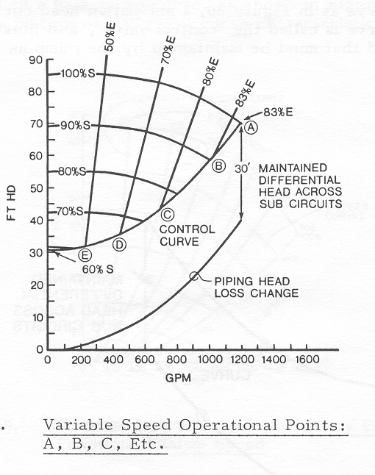
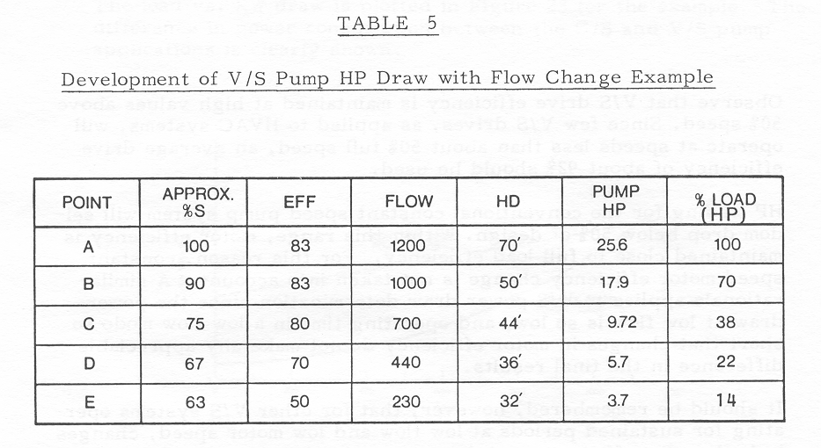
Pumping Horsepower At Various Speeds

Slide 41
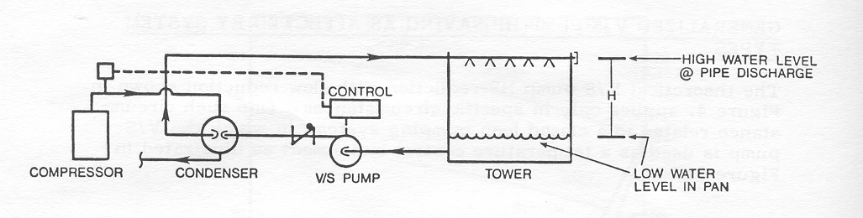
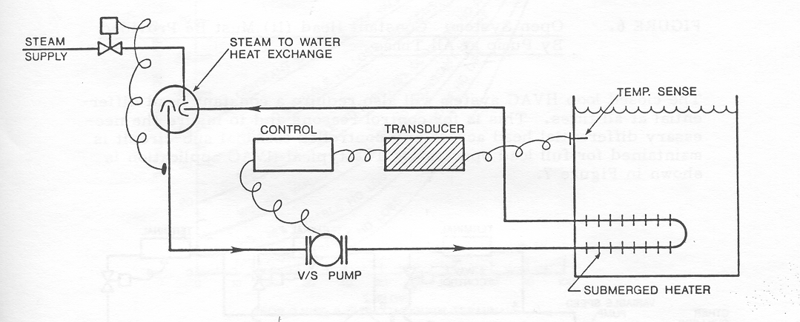

Slide 42
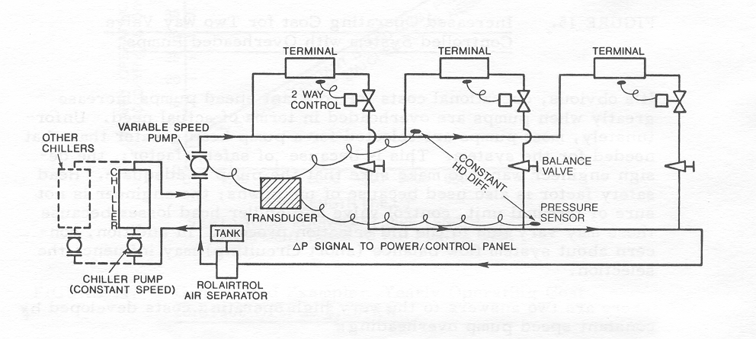

Slide 43
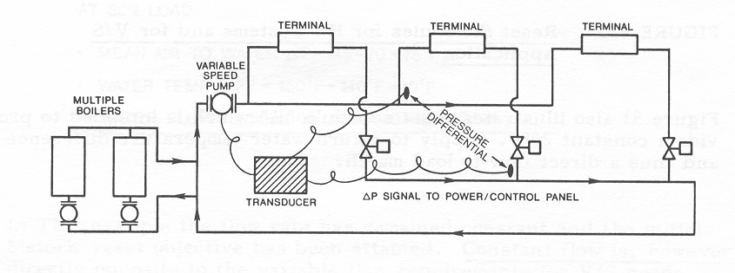

Slide 44
Pump Curve
Learning Objectives Completed
Demonstrate how to chart and interpret a pump curve and system curve
Explain relationship between delta P and flow for a centrifugal pump.
Explain three ways a centrifugal pump can be altered to achieve real world capacity
Quick review Pump/ System curve and Balancing
Theory
Vocabulary

Slide 46
Materials Used In Pump Construction for HVAC and General Pumping
Bronze Fitted Pumps
Cast iron pump body or volute
Steel shaft
Bronze impellor
All Bronze Pumps
All wetted parts made of bronze or other non ferrous materials
Stainless Steel Pumps
Volutes, impellors, and shafts of stainless steel

Slide 47
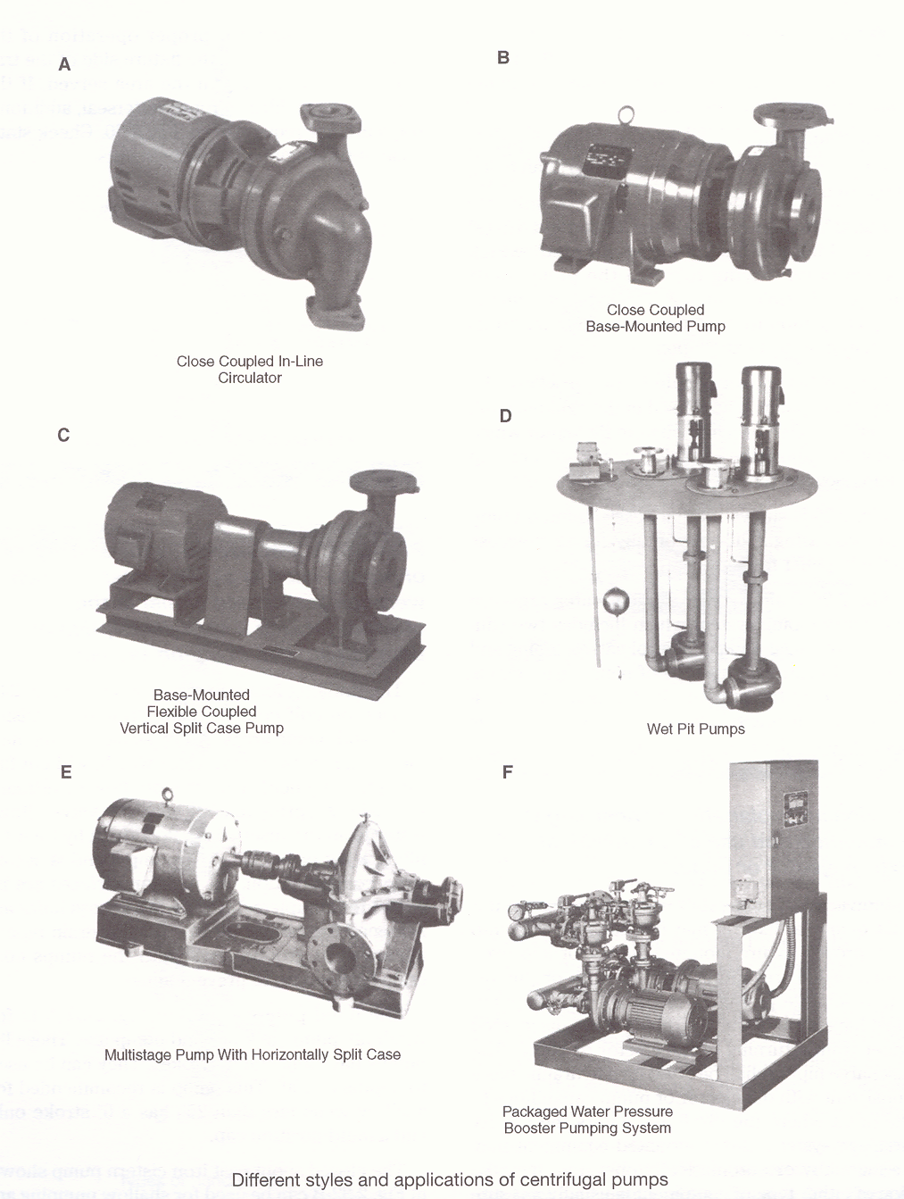
P 28

Slide 48
Pump Prime Movers
Steam Turbine
Diesel Engine
Electric Motor
Open Drip Proof (ODP)
Totally Enclosed Fan Cooled (TEFC)
Explosion Proof

Slide 49
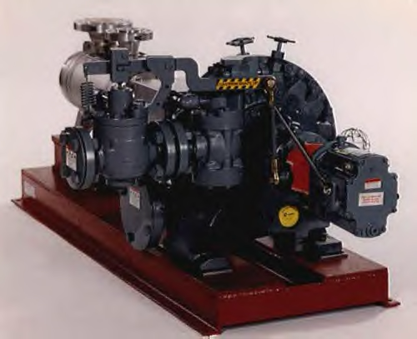

Slide 50
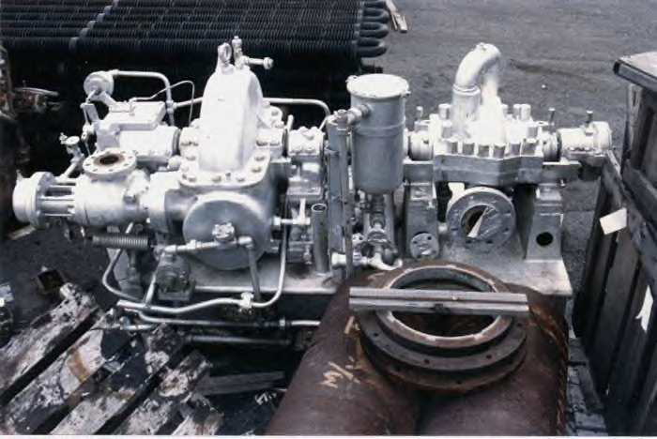

Slide 51
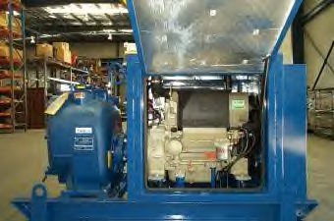

Slide 52
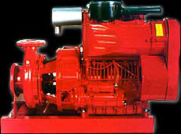

Slide 53
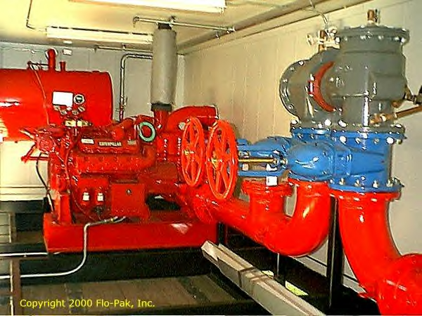

Slide 55
Pump Bodies
In-line
Close-coupled, in-line
End suction, close-coupled, foot-mounted
End suction, base-mounted
Double suction, vertical split case, base-mounted
Double suction, horizontal split case, base-mounted
Vertical, multi-stage
Vertical, turbine

Slide 57
In-line
Hydronic heating and cooling
Hot water recirculation
Heat recovery
Solar thermal heating
Heat pumps

Slide 58
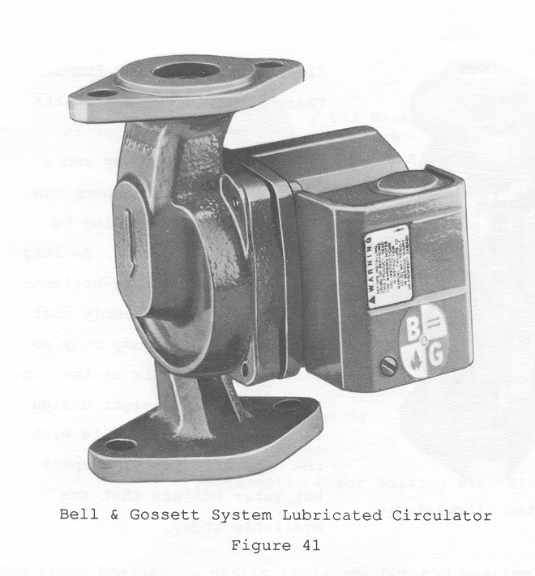

Slide 59
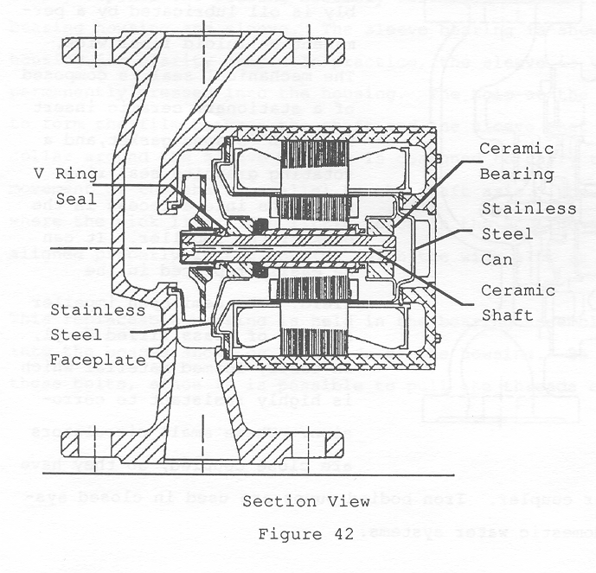

Slide 60
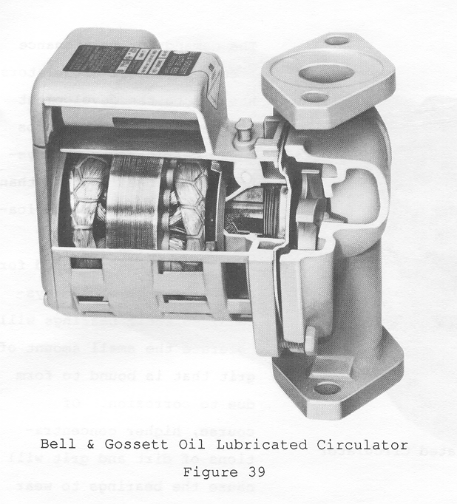

Slide 61
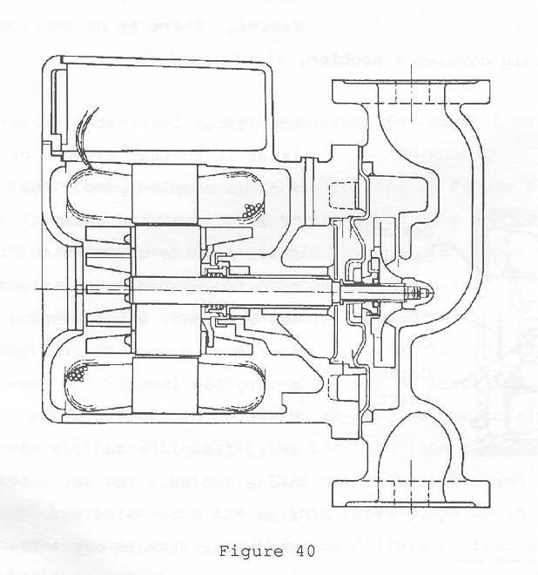

Slide 62
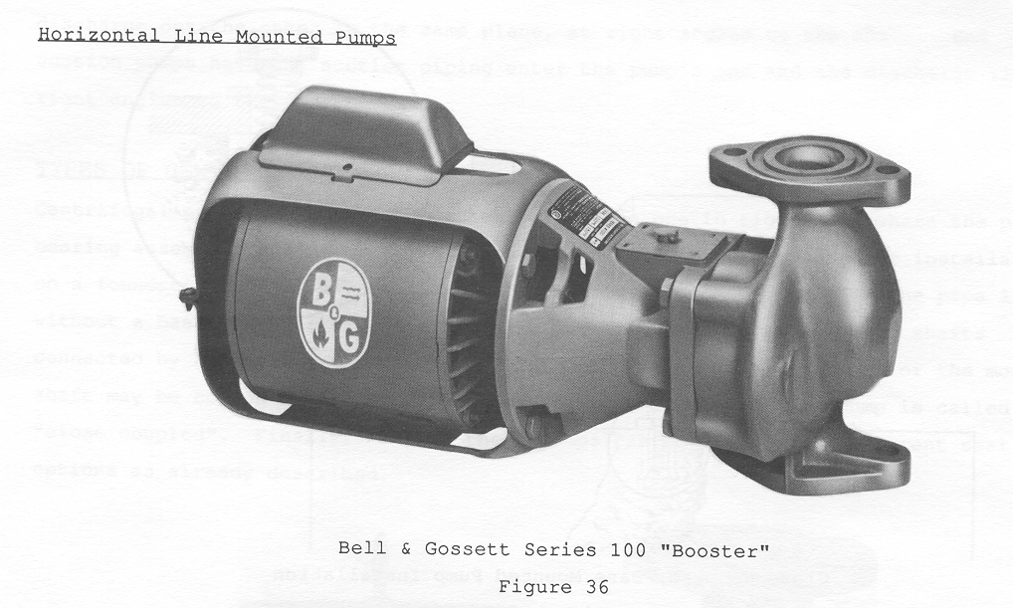

Slide 63
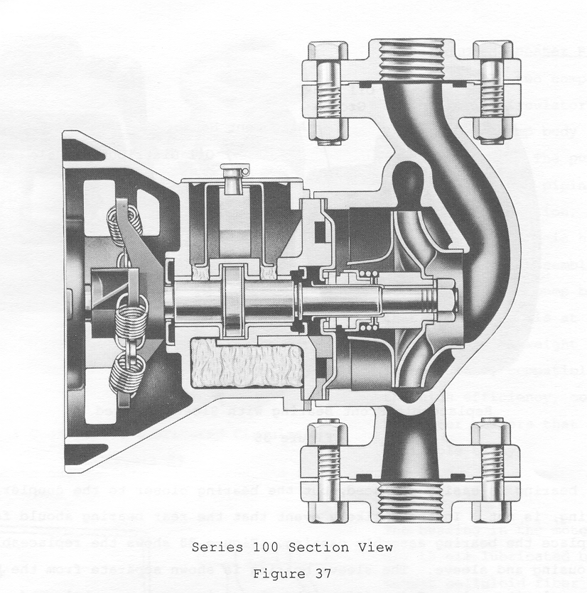

Slide 64
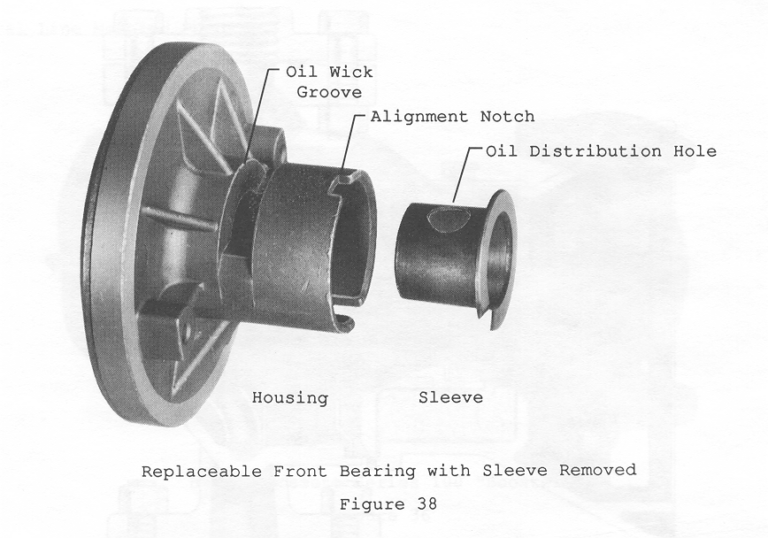

Slide 65
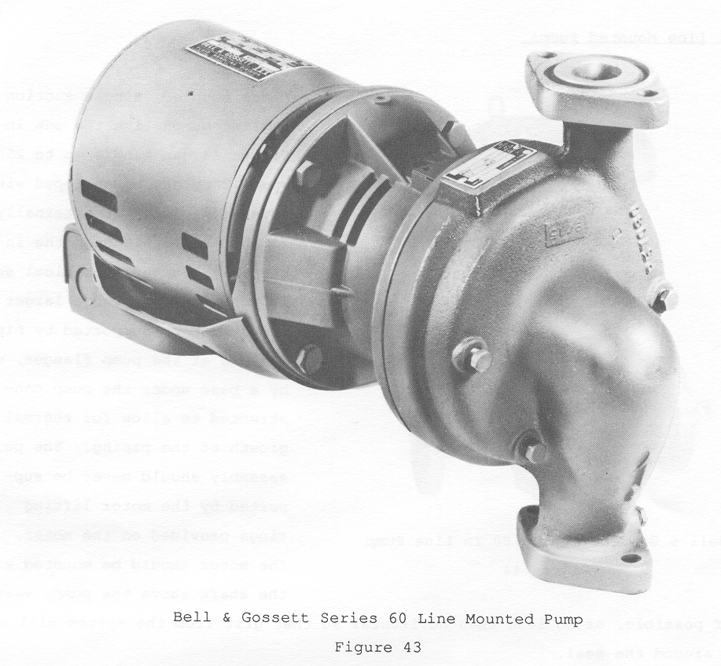

Slide 67
Close coupled, In-line
Water supply and boosting
Heating, air conditioning and condenser water systems
Liquid transfer and general service in commercial, industrial and agricultural applications

Slide 68
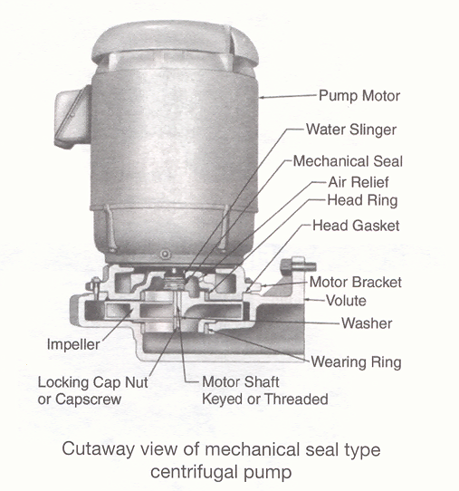

Slide 69
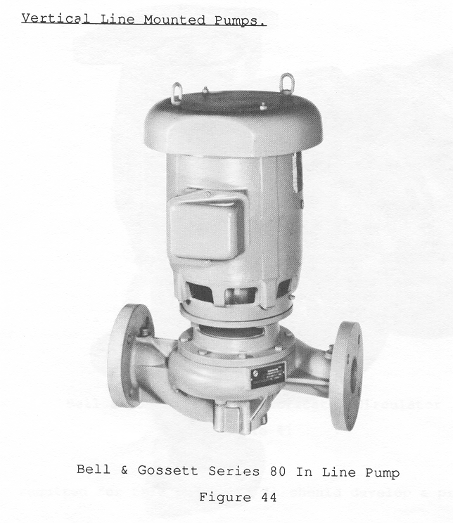

Slide 70
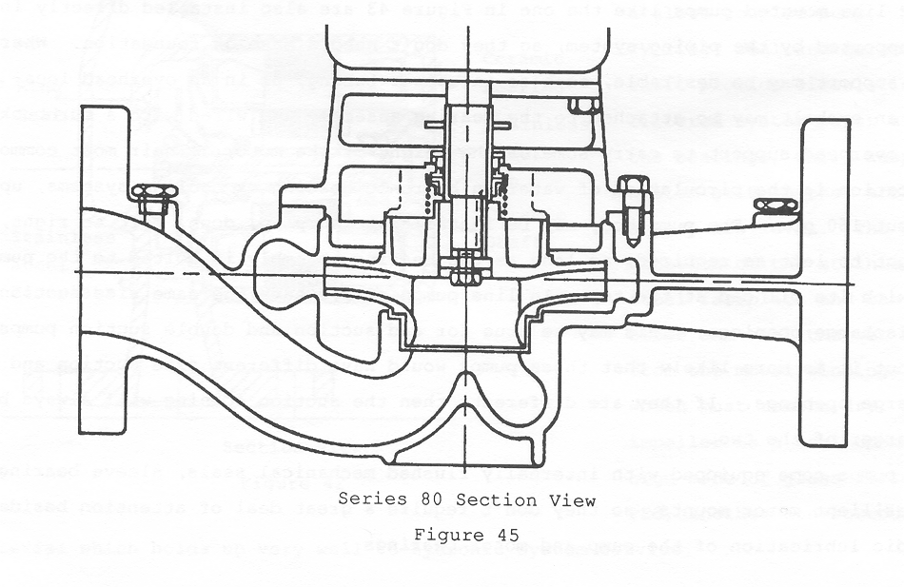

Slide 72
End Suction, Close Coupled, Foot Mount
Cooling Towers
HVAC
General Purpose

Slide 73
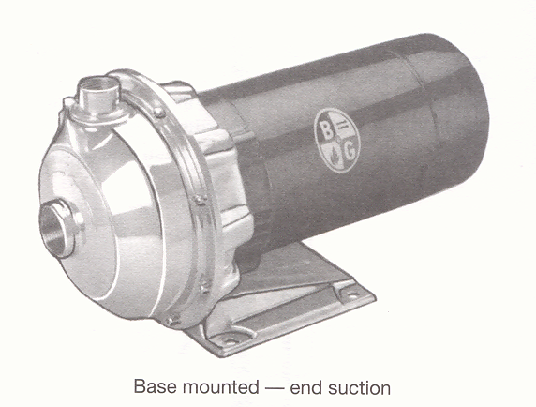

Slide 74
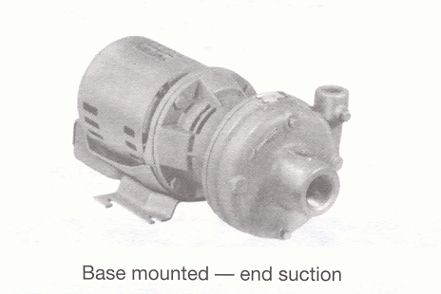

Slide 75


Slide 76


Slide 78
End Suction, Base Mounted
Heating Systems
Chilled Water
Cooling Tower
Industrial
General Purpose

Slide 79


Slide 80
Centrifugal Styles and Applications
Learning Objectives Completed
Explain 6 different styles and applications of centrifugal pumps IPT Pumps Fig 2-29
Quick review Centrifugal Style and Applications
Theory
Vocabulary

Slide 82

PUMP COMPONENTS

Slide 83

‘TRUE’ Back Pull-out Design
Remove back of pump without disturbing:
system piping
motor alignment
Reduced downtime
Lower cost

Slide 84

SELF FLUSHING SEAL
Provides Maximum:
Internal seal face lubrication
Heat dissipation
Debris removal
Passes 2 to 3 times more fluid over the
seal face than externally flushed seal

Slide 85

FOOT MOUNTED VOLUTE
integrally cast foot
maintains alignment
eliminates deflection

Slide 86

ANSI/OSHA Coupling Guard
Standard on 1510
Highest level of safety
Reduces potential for liability

Slide 87

SHORT SHAFT OVERHANG
Promotes reduced:
shaft deflection
bearing wear
seal wear
Casing wear ring not required

Slide 88


Slide 90
Double Suction, Vertical Split Case, Base Mounted
Hydronic Heating and Cooling Systems
Condenser Water
Cooling Towers
Refrigeration
General Service

Slide 91


Slide 92


Slide 93


Slide 94


Slide 95
Double Suction, Horizontal Split Case, Base Mounted
Hydronic Heating and Cooling Systems
General Service
Industrial
Fire Pumps

Slide 96


Slide 97


Slide 98


Slide 99


Slide 100


Slide 101
Vertical, Multistage
General Service
Pressure Boosting
Chilled Water Circulation
Boiler Feed
Condensate Return
Pressure Wash
Cooling Tower Circulation

Slide 102


Slide 103


Slide 104


Slide 105
Vertical, Turbine
Fluid Transfer
Petroleum Tank Farm
Booster Service
Fuel Loading
Cooling Tower
Industrial Process
Agriculture Irrigation
Water Treatment
Municipal Water Supply

Slide 106



Slide 107


Slide 108


Slide 109


Slide 110
Fixture Pumps
Water closets
Urinals
Laundry trays

Slide 111


Slide 113
Pumps Still Out There?
Drinking fountain pump
Pump Jack
Driven by windmill, pump jack, or hand
Cistern pump

Slide 114


Slide 115


Slide 116
Turbine Pumps
Turbine pumps are available in single, two, three or four stage models
They are generally used for low flow applications involving high pressures such as boiler feed water systems, etc
Available in heads up to 5400 ft. and in capacities up to 150 gpm

Slide 117


Slide 118


Slide 119


Slide 120
Turbine Pumps
Learning Objectives Completed
Define and describe different types of turbine pumps
Quick review Vacuum Pump
Theory
Vocabulary

Slide 122
Vacuum Pumps
A vacuum pump is used to exhaust air from a vessel or system to create a pressure condition below that of atmosphere
Vacuum pumps are used to evacuate refrigeration systems

Slide 123


Slide 124
Vacuum Pumps
Learning Objectives Completed
Explain the operation and uses of the vacuum pump
Quick review Vacuum Pump
Theory
Vocabulary

Slide 126
Hydrostatic Test Pumps
Hydrostatic test pumps are used to test piping systems installed by pipe trades journeyman
Hand operated hydrostatic test pumps can be used for testing residential water lines and pressure testing small pressure tanks, sprinkler, hydronic heating and solar piping systems

Slide 127


Slide 128


Slide 129


Slide 130
Hydrostatic Test Pumps
Learning Objectives Completed
Explain the operation and uses of the vacuum pump
Quick review Vacuum Pump
Theory
Vocabulary

Slide 132
Checkpoint 2
Assignment 2
Checkpoint 1 through Checkpoint 2
Pages 24 through 35
Learning Outcome 3 and 4 Completed
Examine pressure relationships in closed systems generated by a centrifugal pump to determine and adjust fluid capacity
Articulate major pump classifications, and then compare/contrast operational theory with common applications
Review Questions

