Slide 1

Pump Installation
UA Pumps
CH 3
Learning Outcome 5

Slide 3
Pump Placement
The first consideration for locating a pump is elevation
The lowest possible elevation is usually the best
The suction piping should be as short as possible, but not less than five suction pipe diameters
The greater the inlet pressure, the less likelihood of net positive suction head (NPSH) problems
Dry easy to access area

Slide 4
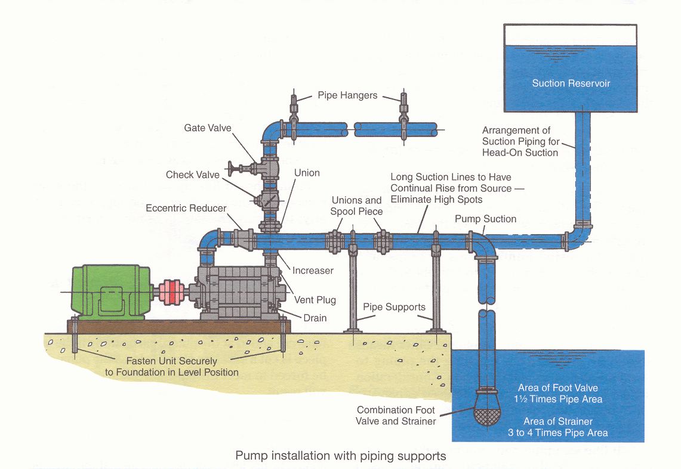

Slide 5
Pump Placement
Learning Objectives Completed
  Explain why elevation should be considered when placing a pump in a system
  Quick review Pump Placement
  Theory
    Cavitation Causes and Effects
    Cavitation in a Water Pump and Valve - Excellent Visual and Audible Demostration https://www.youtube.com/watch?v=0dd6AlyOnfc
    https://www.youtube.com/watch?v=oRYYP4F8LTU&feature=youtu.be 16 min
  Vocabulary
    NPSH

Slide 7
Foundation
What is the purpose?
Rigid support of the base plate
  Base plate alone is not enough to keep alignment
Use grout (cement) to get the needed mass
  Must be non shrinking
Special care needed layout and prep (Service Pad)

Slide 8
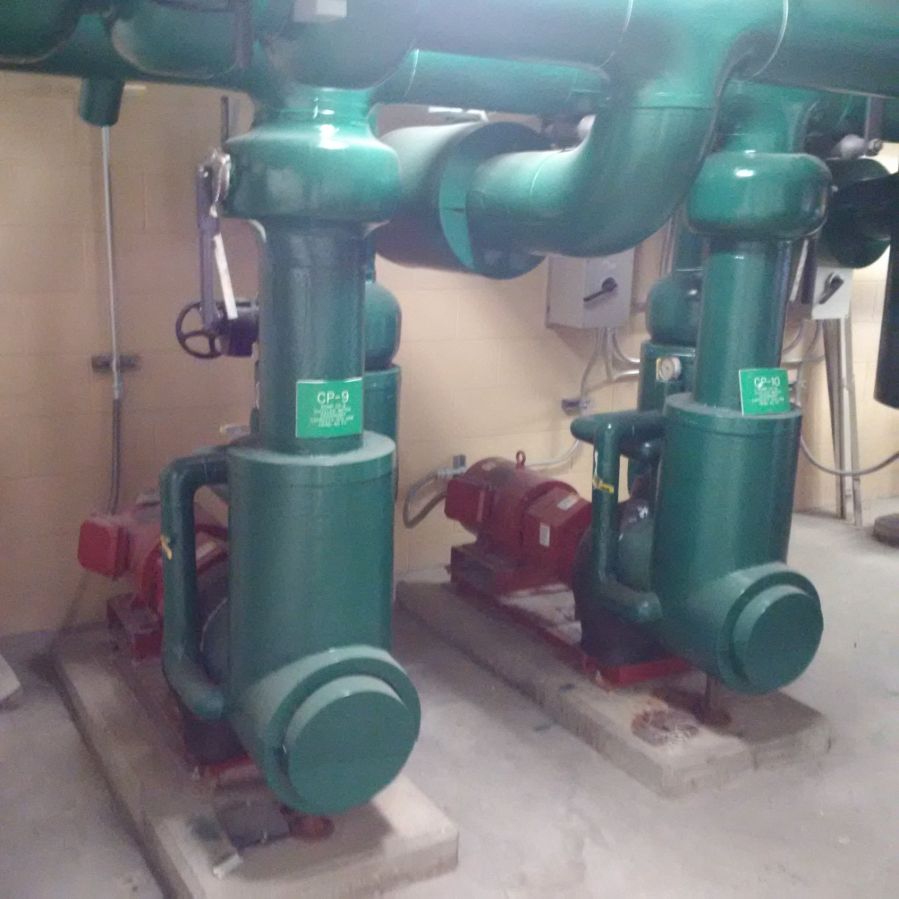
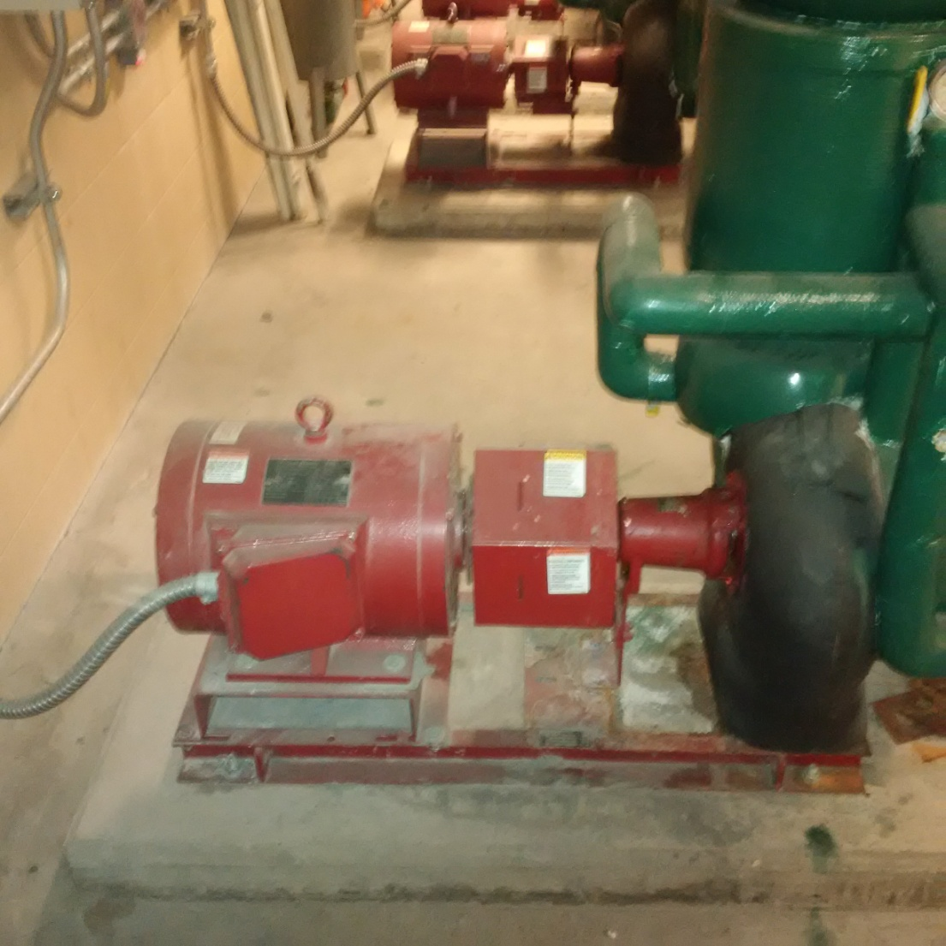
Foundation

Slide 9
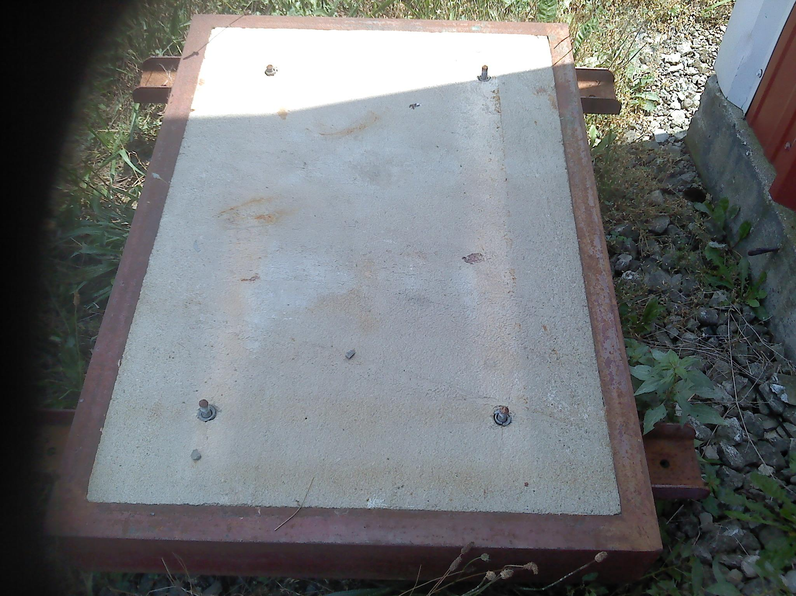
Foundation

Slide 10
Foundation
The importance of a good foundation cannot be overemphasized
The foundation must be heavy enough to provide rigid support for the pump, motor and base combination and to resist the normal forces encountered when the unit is in service
          Note service pad (foundation) should be 5 x the weight of the pump
The foundation must be able to absorb any vibration

Slide 11
Foundation
Foundation bolts should be located or embedded in the concrete by layout in relation to the suction and discharge piping
Foundation bolts of the specific size may be enclosed in a pipe sleeve two to three diameters larger than the bolts to compensate for minor variations in alignment
Close couple pumps may be mounted on a steel base prior to installation.
Shims should be installed under one or more feet so that strain and distortion will not result when bolts are tightened

Slide 12
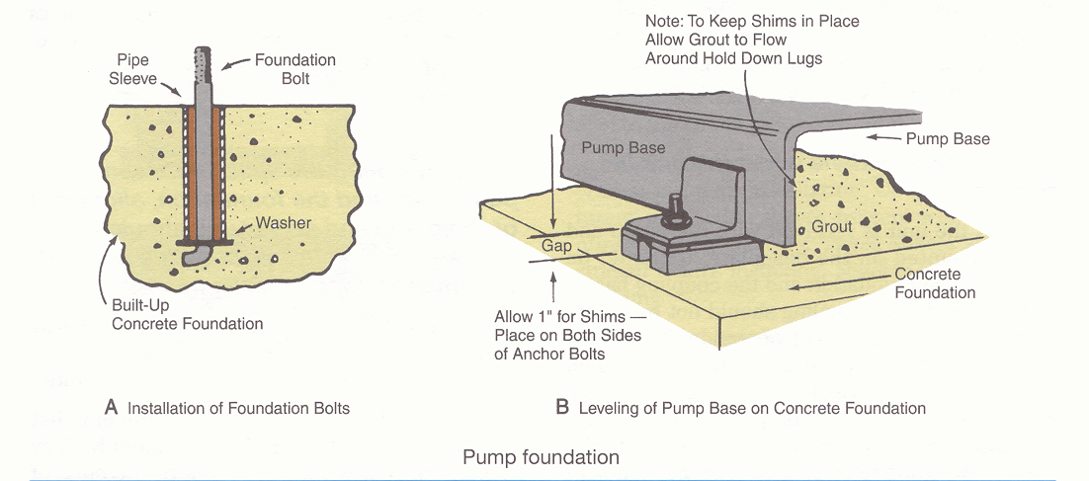

Slide 13
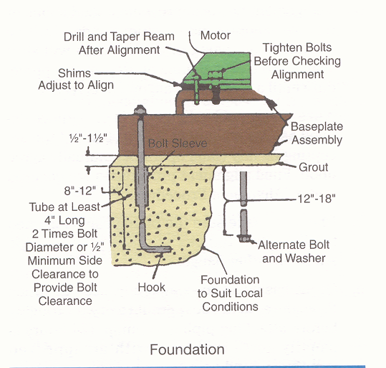

Slide 14
Foundation
Large pumps are often placed on a foundation sufficiently substantial to absorb vibration caused by the pump
To eliminate noise in a piping system caused by mechanical pump vibration
  Foundations of reinforced cement should be poured in advance to allow for proper drying and curing
  Foundation bolts and sleeves should be embedded as well

Slide 15
Foundation
What should be done when unit is received?
Place on foundation
Remove coupling between motor and pump
  Do not reinstall until alignment is complete
The base plate should be supported on metal shims or wedges having a small taper
Fig 3-2

Slide 16
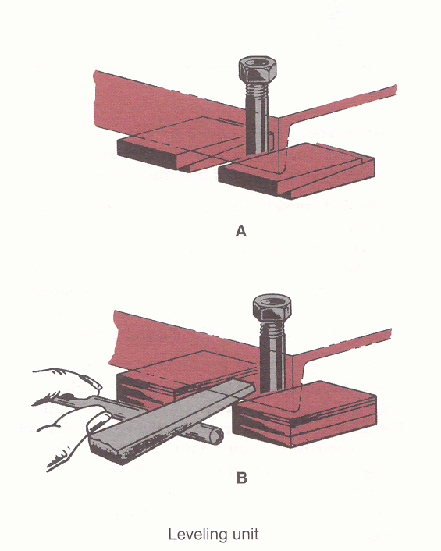

Slide 17
Foundation
Fig 3-2 (Before piping)
Tapered wedges should be placed
  Close to the foundation bolts
  Under the heaviest weight
  Uniformly spaced to evenly support
Adjust supports until the shafts of the pump and driver are level
Check coupling alignment with a strait edge
  No coupling

Slide 18
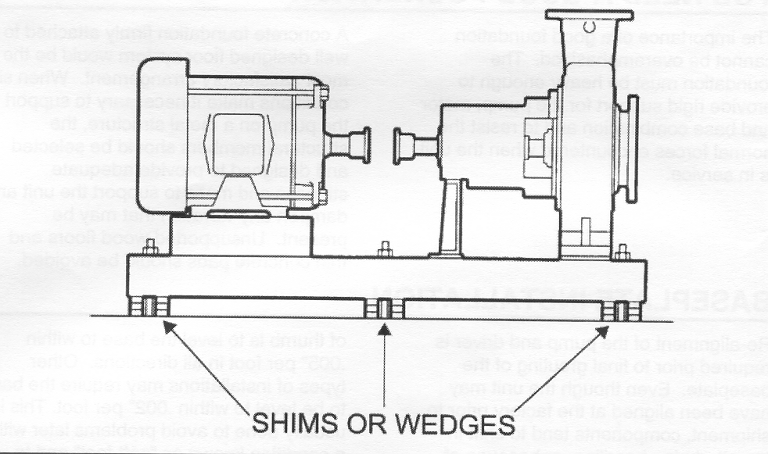

Slide 19
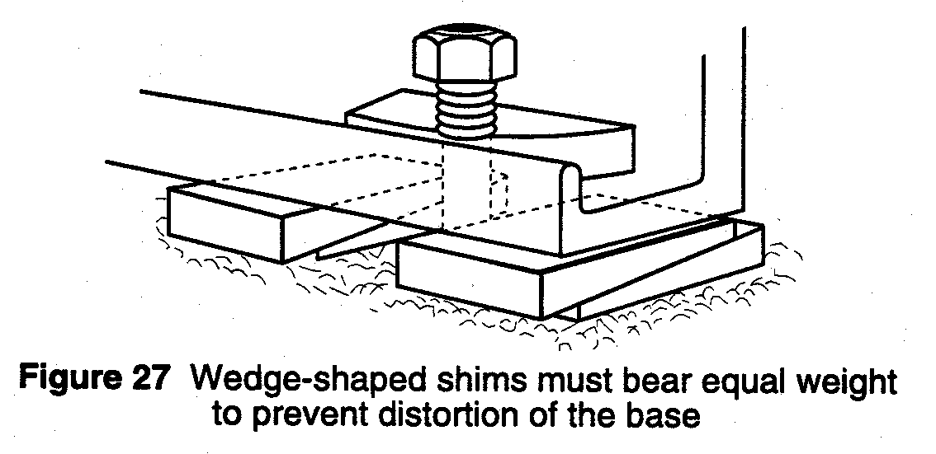
Proper Baseplate Installation

Slide 20
Base plate Installation (No Piping)
Use wedges and shims under the base for support at anchor bolts and midway between bolts, to position the base approximately 1” above the foundation
By adding or removing shims under the base, level and plumb the pump shaft and flanges
  Must be able to fit a pipe (level flange)
  Shafts grossly aligned (Strait Edge Method)
Draw anchor nuts tight against the base, and observe the pump and motor shafts or coupling hubs for alignment

Slide 21
Final Grouting

Slide 22
Grouting Procedure
Build a strong form around the foundation to contain grout
Use non-shrinking grout and mix to manufacturer’s instructions
Pour grout through hole in biteplate up level of form
Allow grout to set at least 48 hours
Tighten foundation bolts

Slide 23
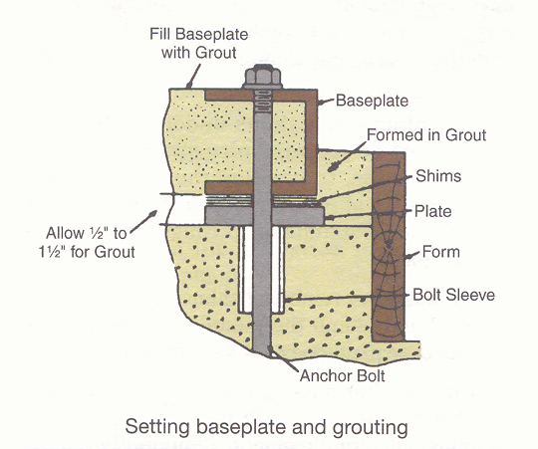

Slide 24
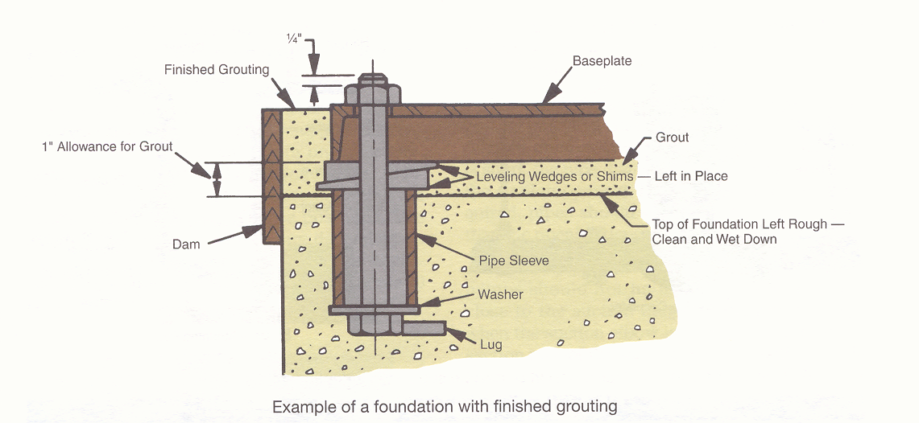

Slide 25
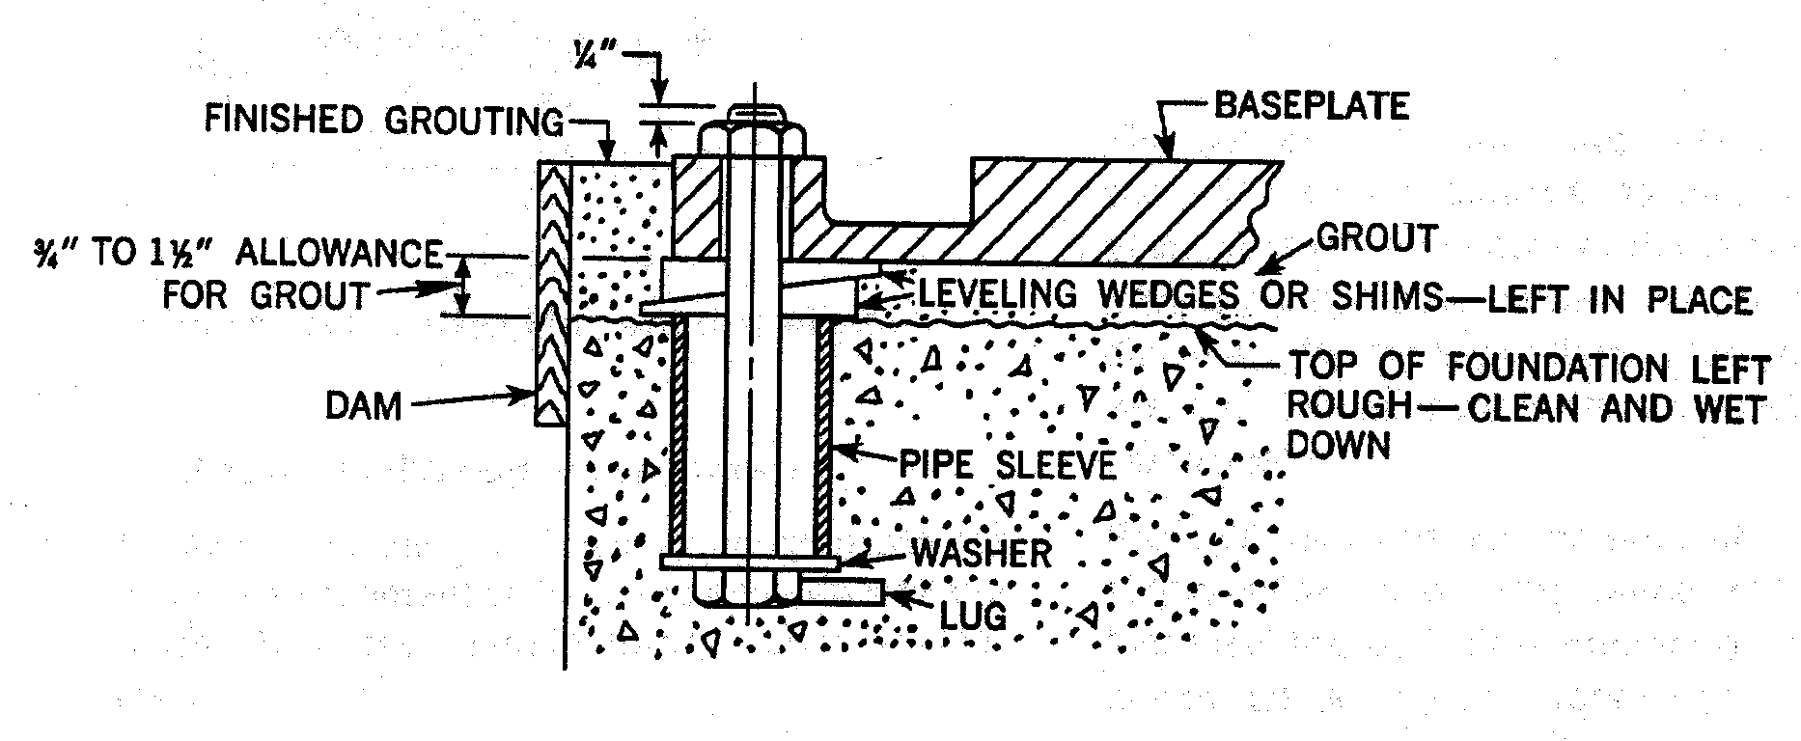
Grout the Baseplate

Slide 27
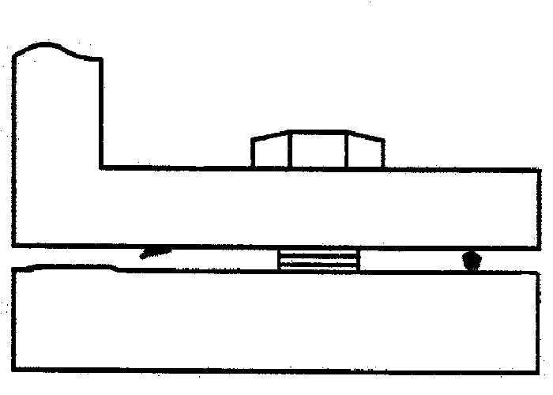
Surfaces - Clean & Flat
Motor Alignment

Slide 28
Soft Foot

Slide 29
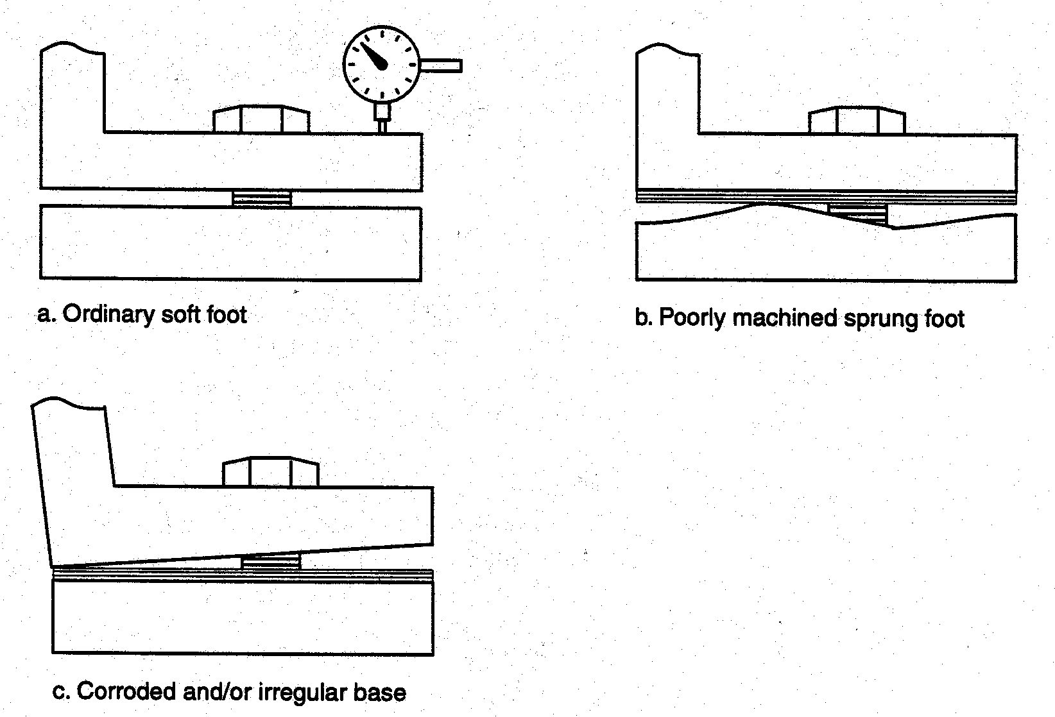
Different Types of Soft Foot

Slide 30
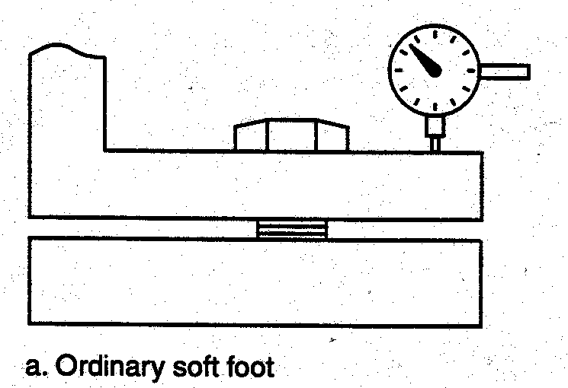
Soft Foot

Slide 31
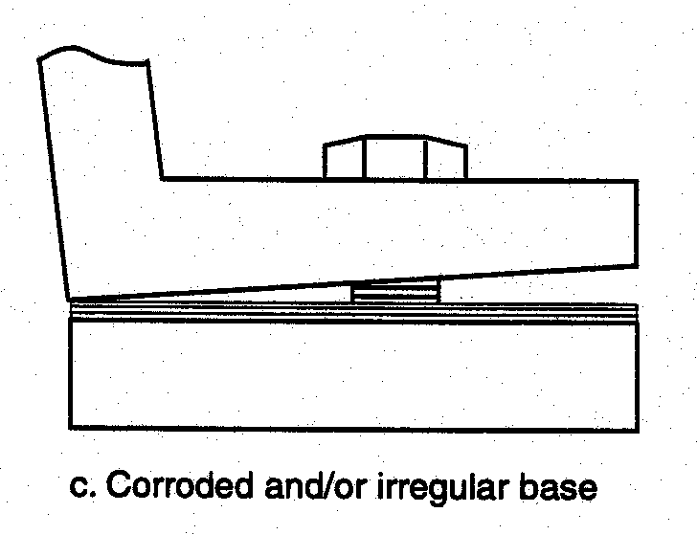
Soft Foot

Slide 32
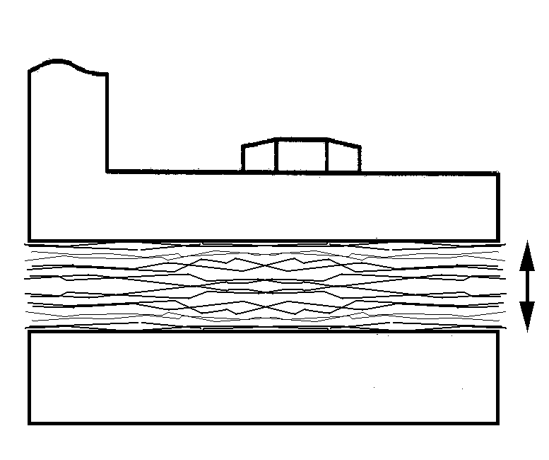
Soft Foot
Use as few shims as possible to avoid sponginess

Slide 33
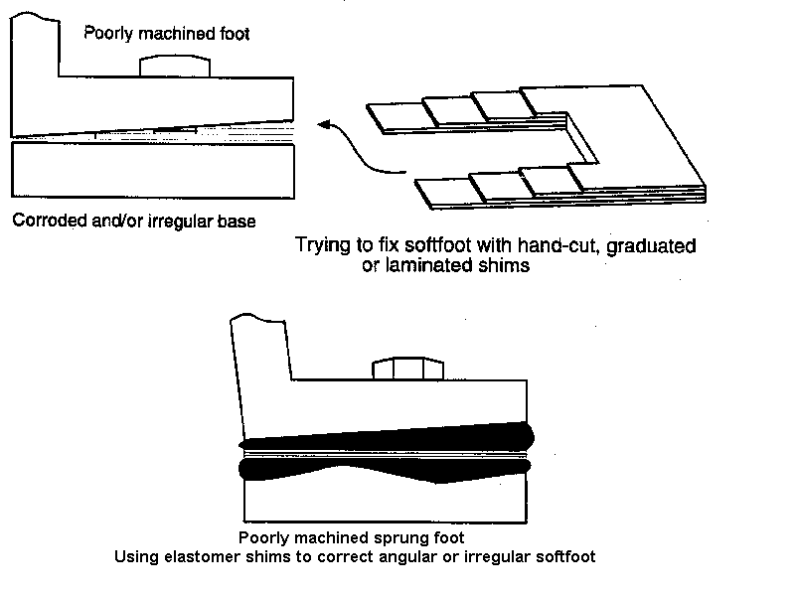
Correction ?

Slide 34
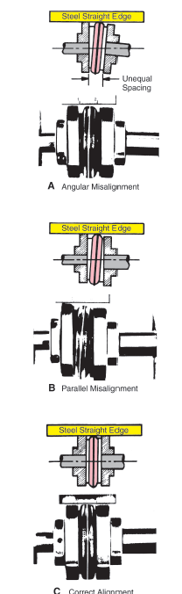
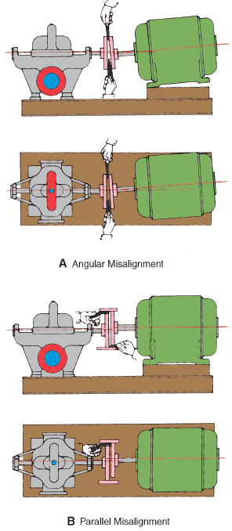
Alignment checks

Slide 35
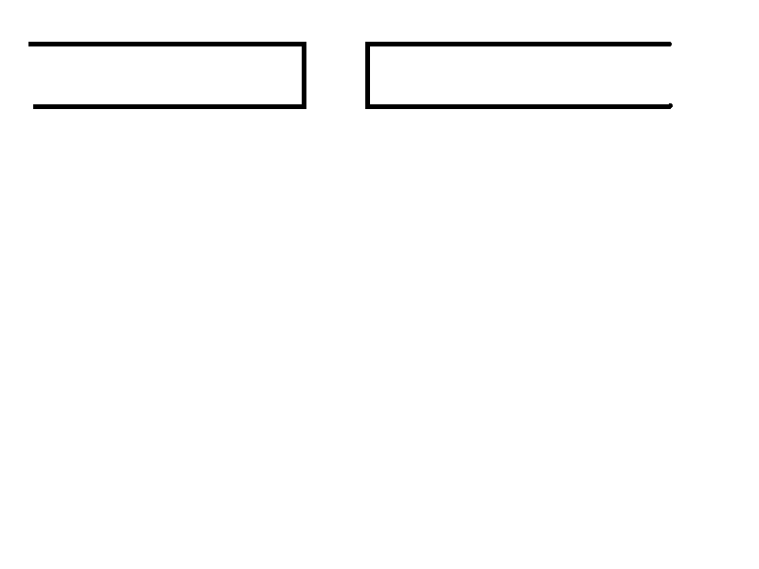
Alignment Procedure

Slide 36
Alignment is Critical
Always align the motor to the pump, and not the pump to the motor
Correct alignment of pump and motor shafts is critical to proper operation

Slide 37
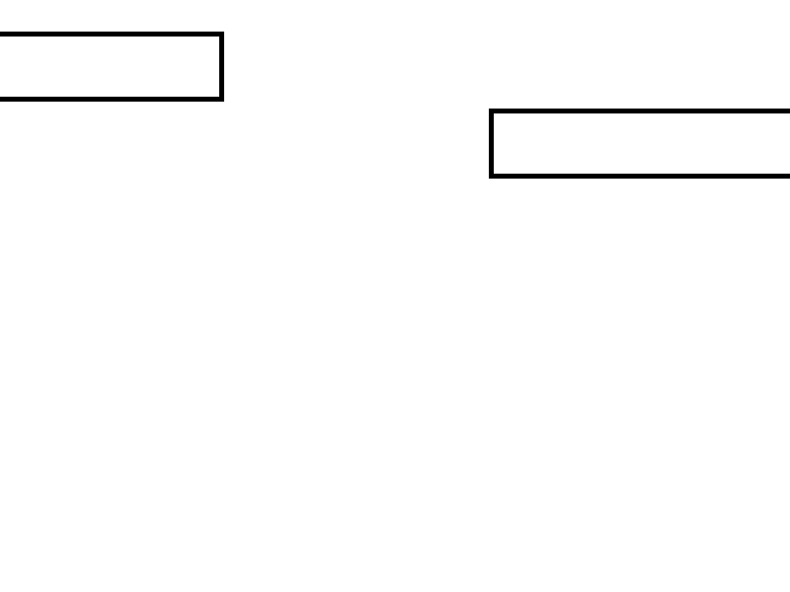
Alignment Procedure

Slide 38
Alignment is Critical
Misalignment could result in:
  reduced bearing life
  coupling damage
  high vibration
  reduced seal life
  increased downtime
  need for eventual re-alignment
  (do the job right the first time)

Slide 39
The baseplate comes from the factory rough aligned and has been checked to assure a precise alignment is possible.
In other words, you will not be hole bound when you try to align the pump.
Given:

Slide 40
Good Practice
It is a good idea to do a rough alignment (see Straight Edge method) with the base in place and ready to be grouted
The pump shaft should not move more than 0.002” when the piping is fastened

Slide 41
Pre-Alignment Checks:
Baseplate
Piping
Surfaces
Soft Foot
Shims
Heat

Slide 42
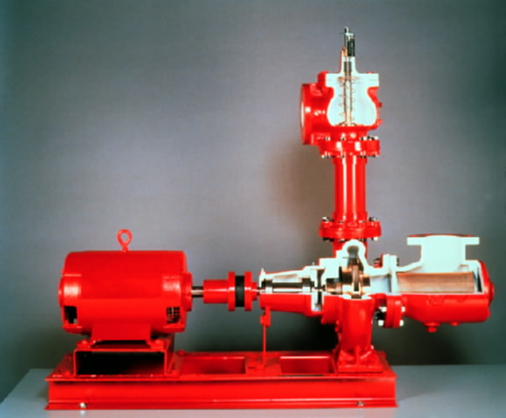
Typical Base Mounted Pump

Slide 43
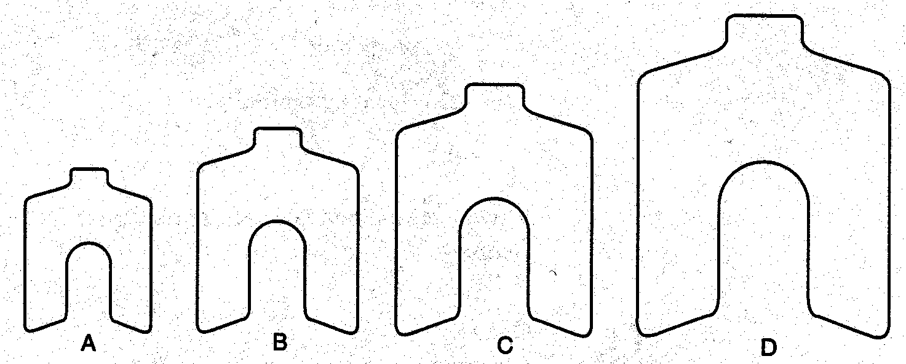
Shims
A=2”x2”, B=3”x3”, C=4”x4”, D=5”x5”
(0.001” through .125” thick)
Notes:
Shims should be at least the full size of the foot they are shimming

Slide 44
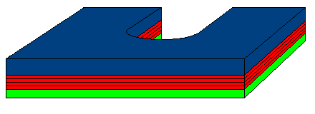
Shim Pack
Blue is the 1/8” shim
Red are the thinnest shims
Green is the second thickest shim

Slide 45
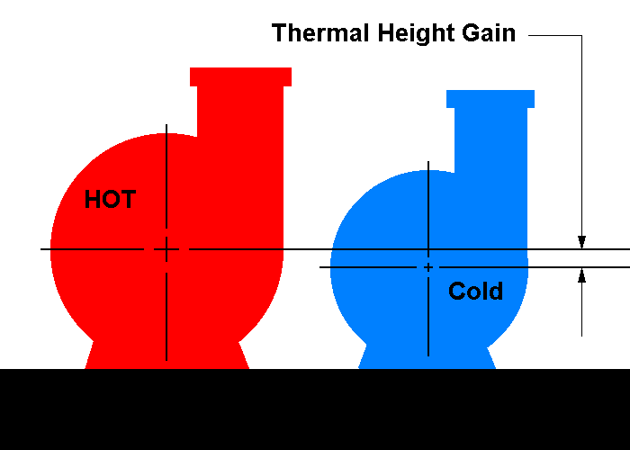
Heat
Important for Final Alignment

Slide 46
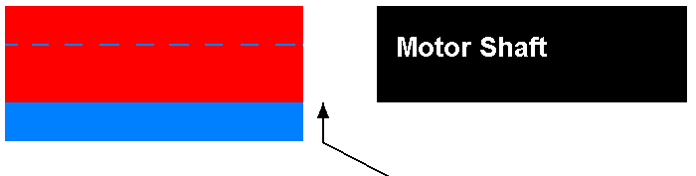
Heat
Pump Shaft
Red is hot
Blue is cold
Pump shaft height goes up with heat
Align cold pump shaft low by the amount of the calculated thermal height gain

Slide 47


Slide 48
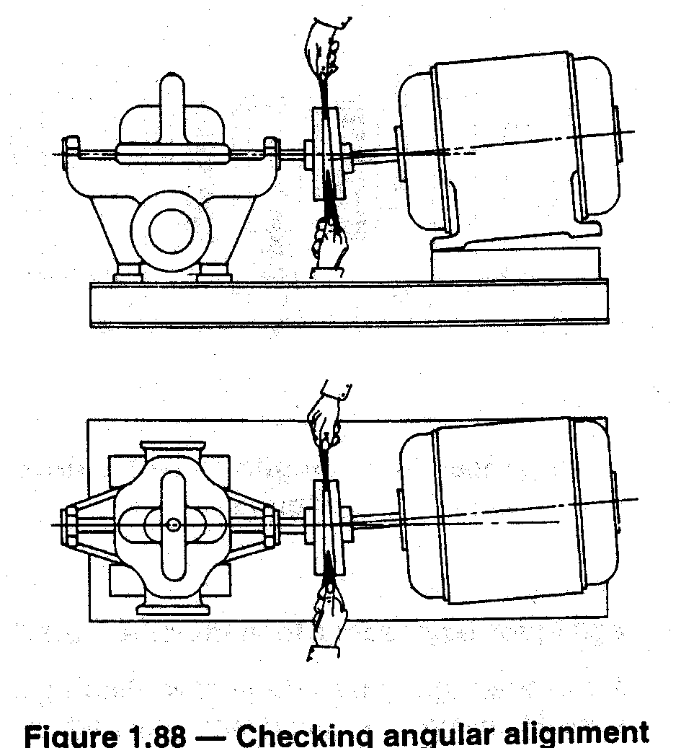
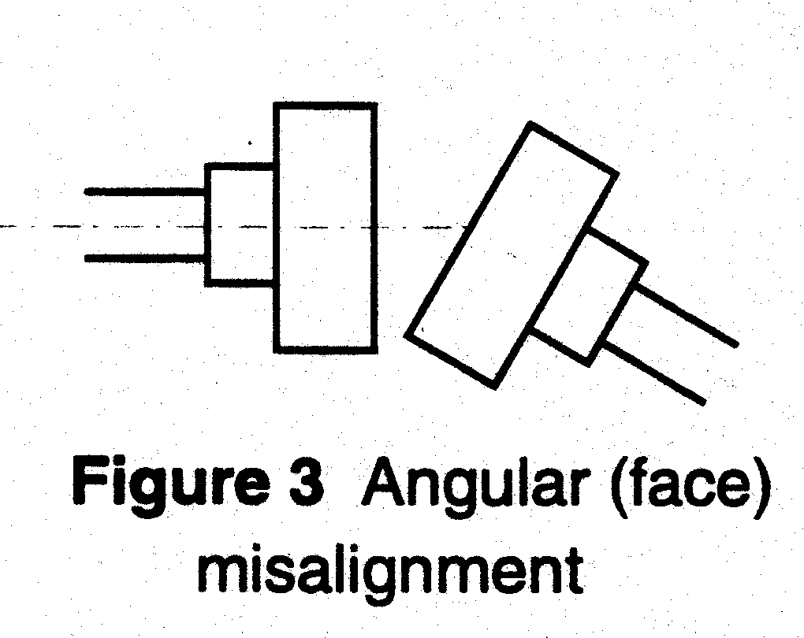
Angular Misalignment

Slide 49
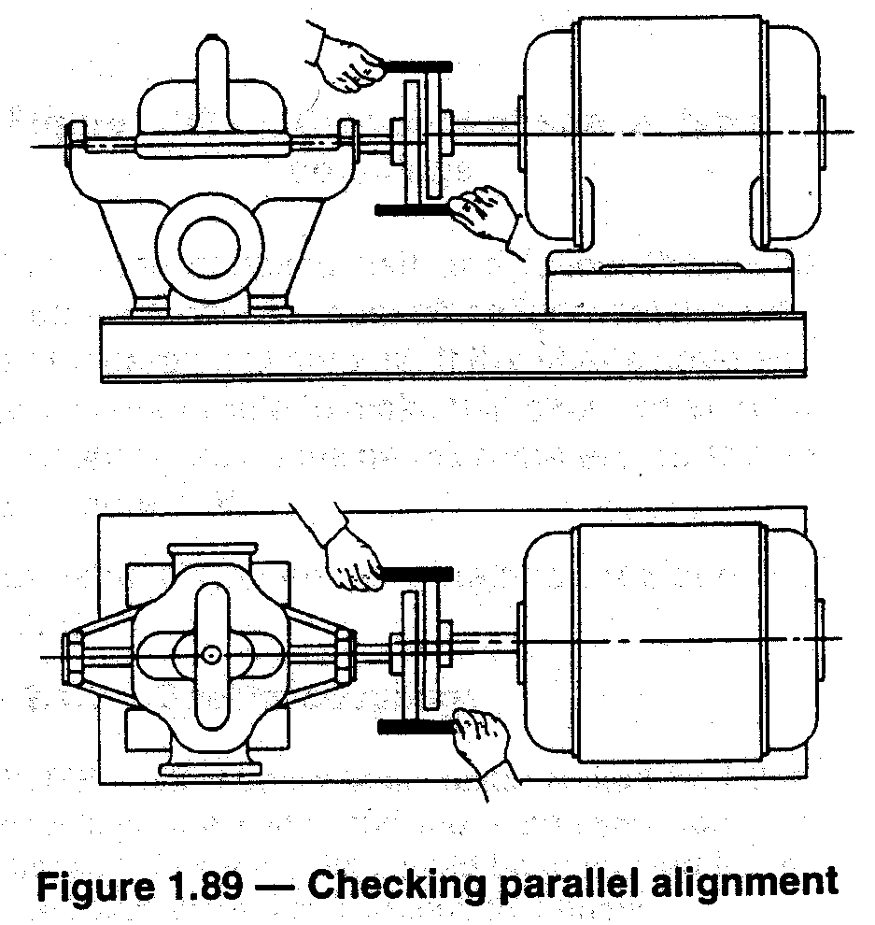
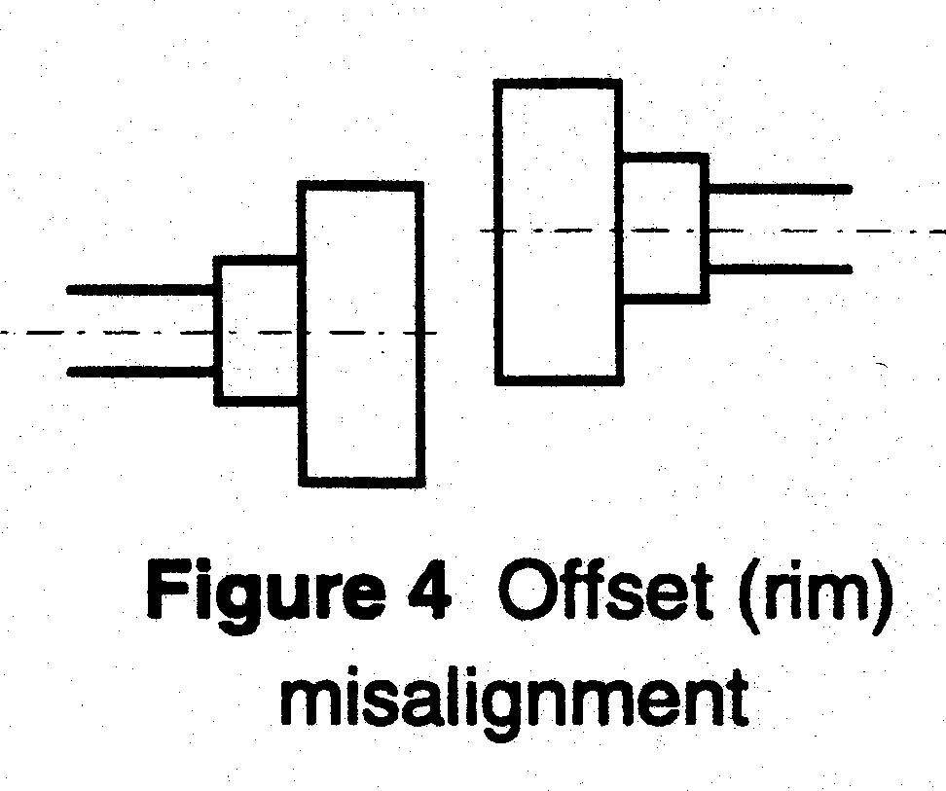
Parallel or Offset Misalignment

Slide 50
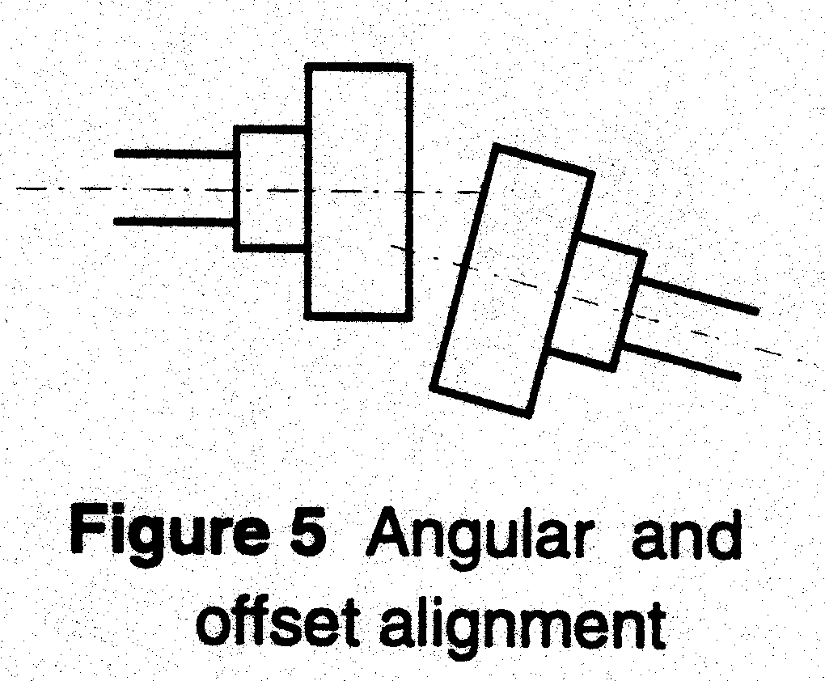
Combination of Both

Slide 51
Alignment Methods
Straight Edge
Dial Indicator
Laser

Slide 52
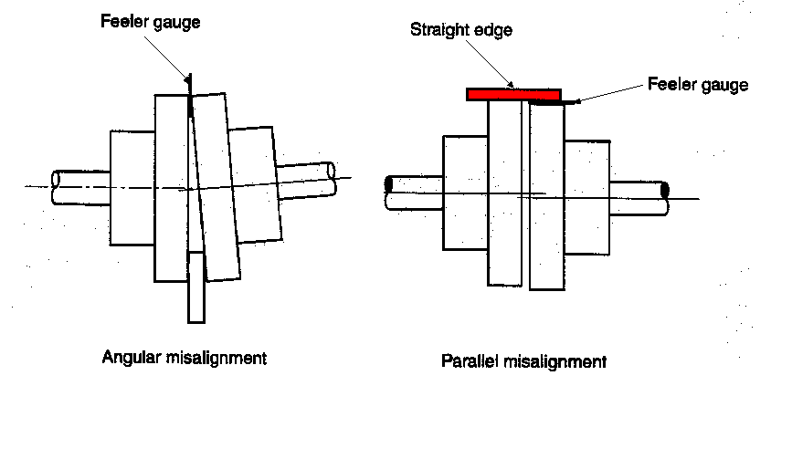
Straight Edge

Slide 53
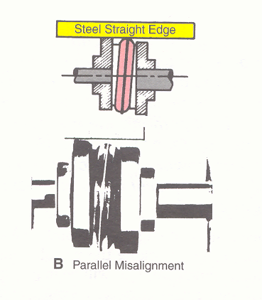
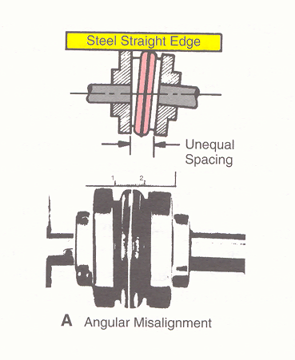
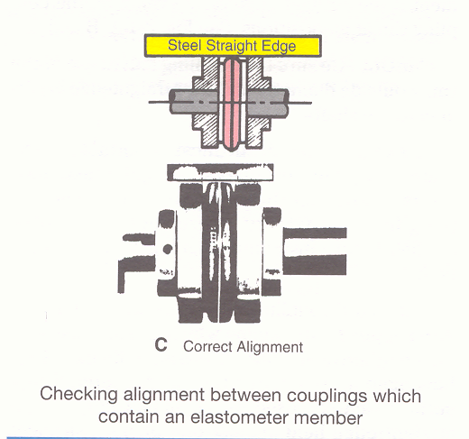

Slide 54
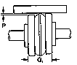
Parallel Alignment
Misalignment

Slide 55
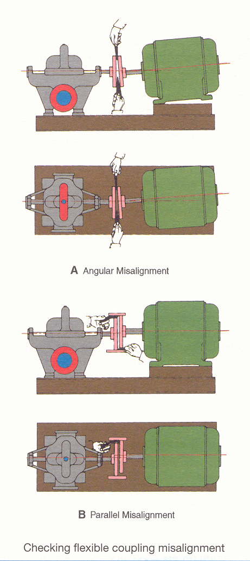

Slide 56
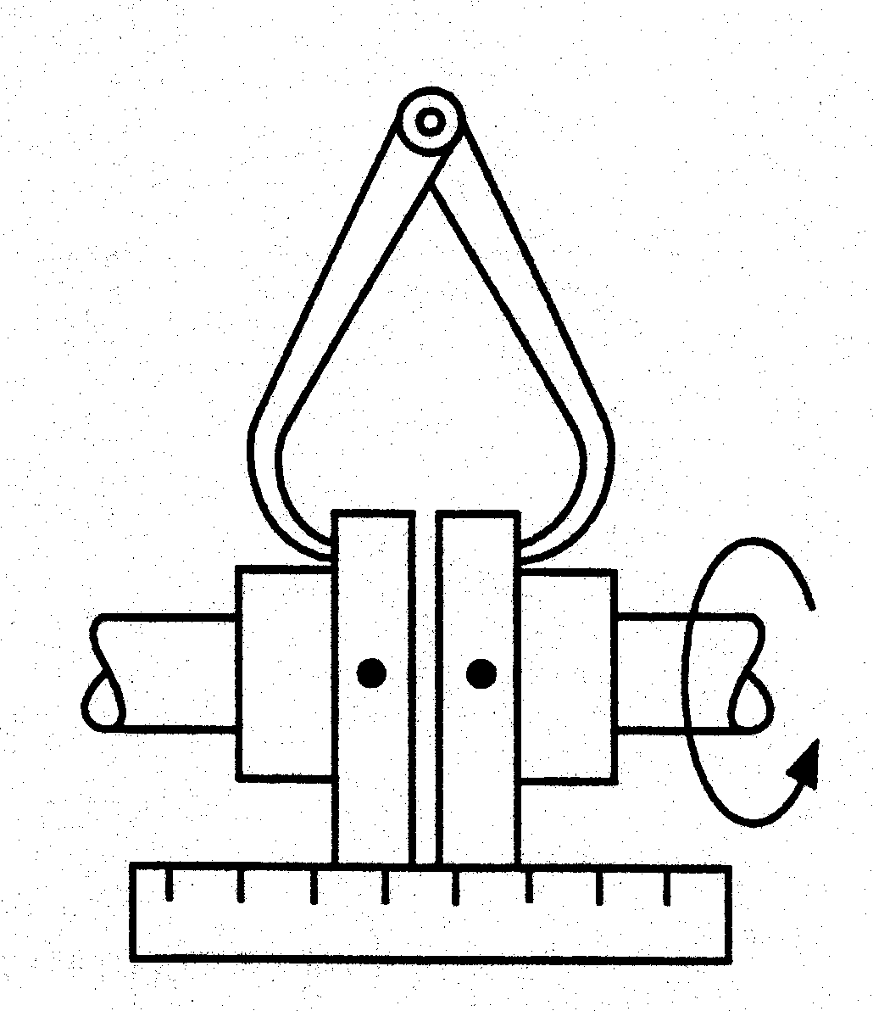
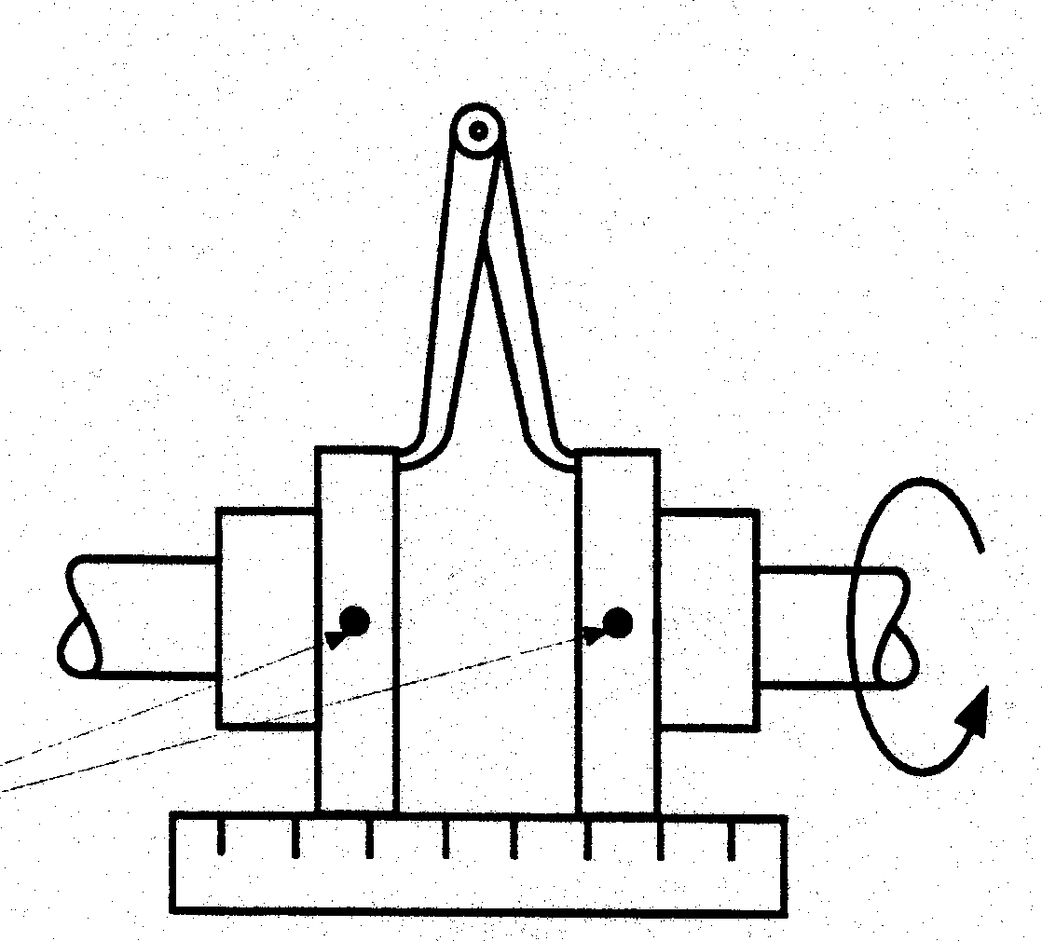
Angular Misalignment

Slide 57
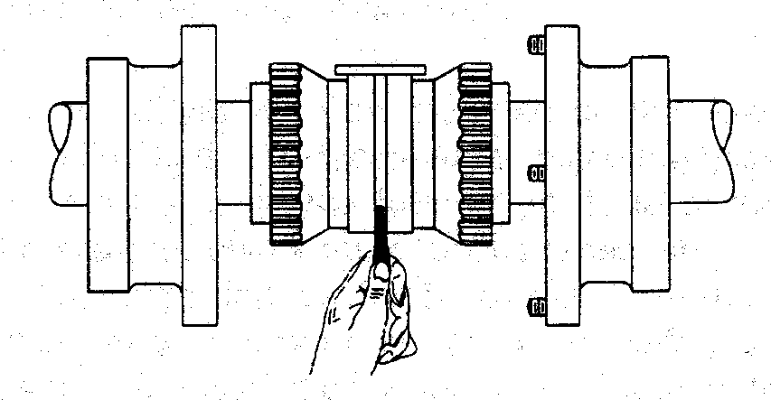
Remove outer hubs to align a gear coupling
Gear Coupling

Slide 58
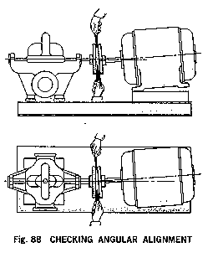
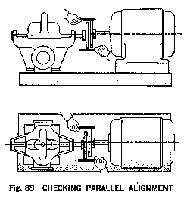
Alignment Sequence
1.
Vertical
Angular
2.
Vertical
Parallel

Slide 59
Alignment Sequence
3.
Horizontal
Angular
4.
Horizontal
Parallel

Slide 60
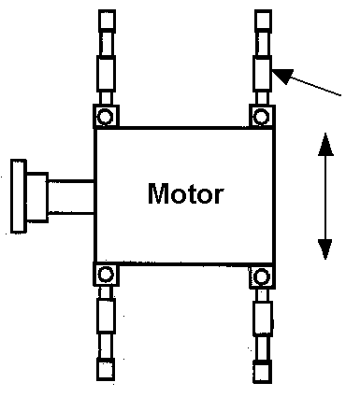
Move the motor, not the pump
Jackscrew
Movement
Notes:
Motors can be moved by:
hand
jackscrew
hammer & wood
crowbar
hydraulic jacks
etc.

Slide 61
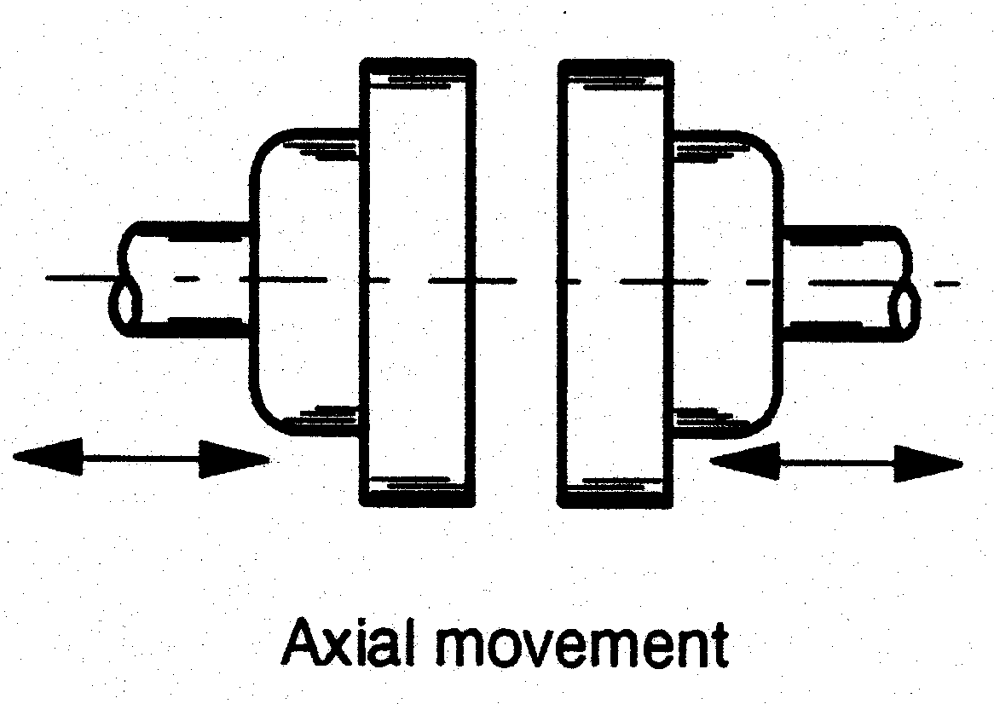
Caution

Slide 62
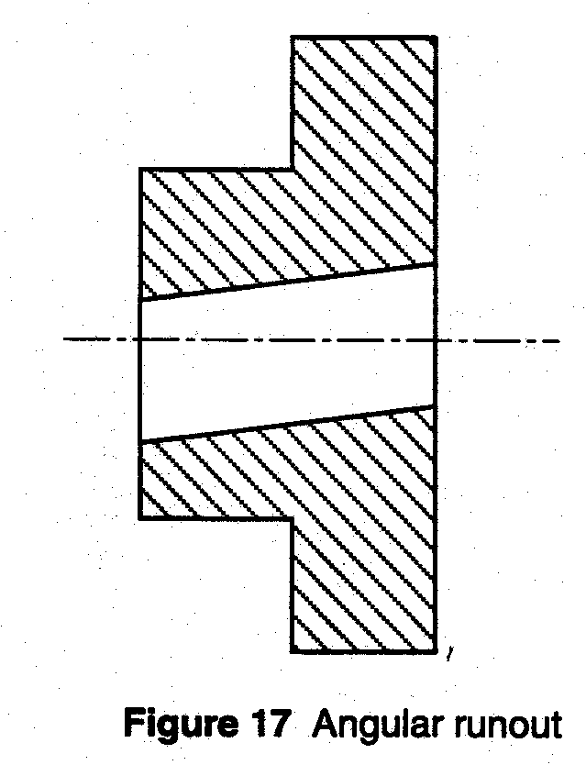
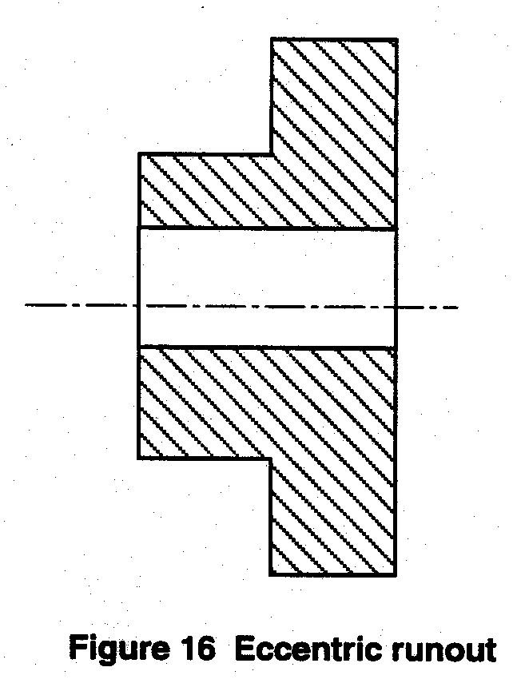
Caution

Slide 63
Alignment Methods
Straight Edge
Dial Indicator
Laser

Slide 64
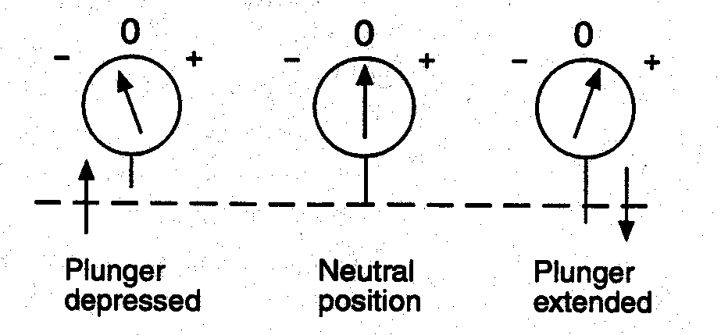
Dial Indicator Alignment
Dial operation:

Slide 65
Dial Indicator Alignment
Dial operation:
The dial indicator is a precision measuring instrument; take care while handling it
A rough alignment (straight edge method) should be done prior to the dial indicator alignment to minimize the possibility of the dial bottoming out or running off the surface
Set the dial securely at a right angle to the surface to be measured

Slide 66
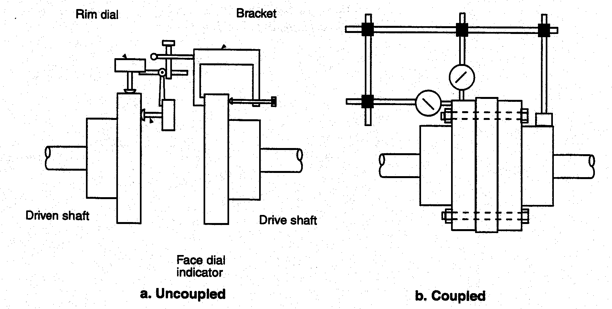
Rim & Face

Slide 67
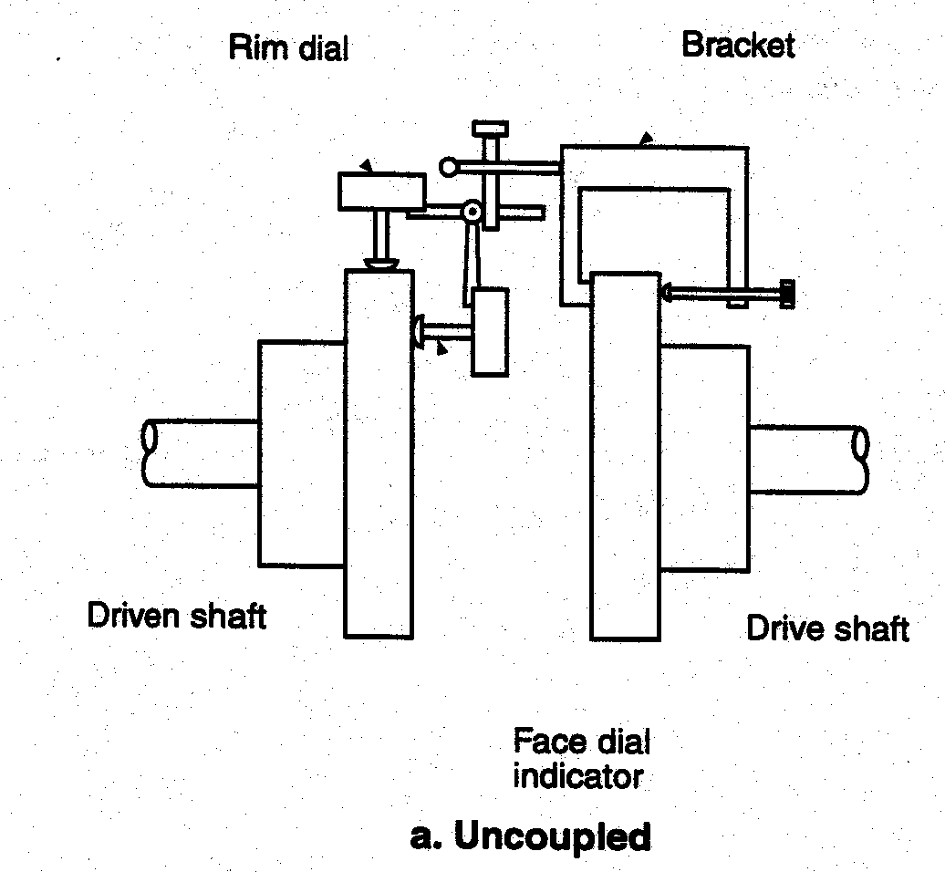
Rim & Face uncoupled

Slide 68

Rim & Face Coupled

Slide 69

Taking Face Readings

Slide 70

Face Readings
Formula for angular misalignment:
Shims required = TIR x distance between holes / coupling diameter wiped*
Shims required = 0.007” x 12” / 5”*
Shims required = 0.017”
(note that these shims are for
under the rear of the motor)

Slide 71

Face Method
The previous calculation was for vertical angular misalignment. The face method can also be used to determine the horizontal angular misalignment.

Slide 72
Dial Indicators on the Baseplate

Slide 73

Face Method
a=5
A=12
b=0.007”
B=.007x12/5
B=0.017”
Calculation math review:

Slide 74

Taking Rim Readings

Slide 75

Rim Shim
The 0.009” shims go under all of the motor feet
The rim method can also be used to determine the sideways movement required

Slide 76


Rim Shim 1/2 Runout Explanation

Slide 77


Dial Indicator Alignment
Remember:
Always make sure the pump is bolted down when taking dial indicator readings
Match mark the coupling halves and rotate them together when taking readings
Beware of defective couplings and runout
Beware of end float

Slide 78

Dial Indicator Sag Correction

Slide 79

Rim & Face with Motor Indicator
When rim & face readings are taken at once, a different formula is used than the 2-step method
(note the dial on the motor)

Slide 80

Rim & Face

Slide 81

Rim & Face

Slide 82

Rim & Face with Micrometer

Slide 83

Face - Hole Attachment

Slide 84

Cross Dialing (reverse reading)
Notes:
Also referred to as reverse reading alignment
Shimming values are usually obtained by mathematical formulas

Slide 85

Cross Dialing (reverse reading)

Slide 86

Cross Dialing (graph alignment)

Slide 87

Cross Dialing (graph alignment)
Notes:
Shimming values are usually obtained by plotting a graph
Also referred to as the graph alignment method

Slide 88

Cross Dialing
Advantages:
Not affected by axial float
Dial indicator readings are twice the actual misalignment giving greater accuracy
Limitations:
More complex setup
More complicated formula
Notes:
Shimming values are usually obtained by plotting a graph
Also referred to as the graph alignment method

Slide 89
Alignment Methods
Straight Edge
Dial Indicator
Laser

Slide 90
Laser ————————————
A laser alignment uses an absolutely straight laser beam with a prepackaged kit including a computer, beam transmitter, deflector units, fixtures and appurtenances
Laser beams may be Class 1 (invisible) or Class 2 (visible)

Slide 91
Laser ————————————
Advantages:
Dial indicator bracket sag is not a concern
Good for long spans
Consistent and accurate results
Limitations:
High initial cost
Sensitive to heat
Must be regularly calibrated

Slide 92
Computers
Computers may be used in most alignment procedures.
Hand held computers may come with dial indicator alignment kits.
They require a given set of readings to be entered into the computer. The computer then calculates the shims required.

Slide 93

Shaft Alignment Table
Maximum Misalignment Determined by:
Shaft Size, RPM, Manufacturer

Slide 94


Coupling Alignment Table

Slide 95
Alignment Calculation:
Step 1. Vertical Angular
Step 2. Vertical Parallel
Steps 3&4. Horizontal

Slide 96

Alignment Calculation:
Step 1. Vertical Angular

Slide 97
Alignment Calculation:
Step 1. Vertical Angular
Shim = TIR x motor dim.
cplg. dim.
Shim = 0.010” x 10”/5”
Shim = 0.020”

Slide 98

Alignment Calculation:
Step 2. Vertical Parallel

Slide 99
Alignment Calculation:
Steps 3&4. Horizontal
No shims required,
calculate or move until angular and parallel alignment are achieved

Slide 100
Alignment Sequence
3.
Horizontal
Angular
4.
Horizontal
Parallel

Slide 101
Doweling
Doweling permits exact repositioning of components if they have to be moved
Doweling must be completed with equipment at maximum operating temperature
Place dowels as nearly vertical as possible
Coat the dowels with lubricant to prevent rusting

Slide 102
Pump Foundation and Alignment
Learning Objectives Completed
  Define the phrase “pump foundation” and explain installation techniques
  Illustrate why alignment is necessary for the base plate and coupling. Describe specific techniques
  Quick review Pump Foundation / Alignment
  Theory
  Vocabulary

Slide 104

Pipe Strain

Slide 105


Slide 106
Suction and Discharge Piping
Piping should be always run to the pump
Both the suction and discharge piping should be independently supported near the pump
Piping should be properly aligned so that no strain is transmitted to the pump when the flange bolts are tightened
Provide for pipe expansion when hot fluids are to be pumped

Slide 107


Slide 109
Suction Piping
When installing suction piping, observe the following:
Sizing is exceptionally critical to avoid insufficient NPSH
Short length as possible
  Over size 1 or more sizes if not
Diameter same size as pump or bigger
  Never smaller

Slide 110
Suction Piping
Never install an elbow close to a double suction pump.
  Allow 10 pipe diameters
Leads to uneven flow to both inlets
  Causes undue stress on bearings and seals

Slide 111


Slide 112
Suction Piping
Suction Lift
  Vertical: Slope upward to pump nozzle
  Use eccentric taper
  Horizontal: Use eccentric taper
  Eccentric side down
Help avoid air pockets
Short section of pipe near inlet
  For servicing

Slide 113


Slide 114




Slide 115


Slide 116
Pump Pipe Support
Learning Objectives Completed
  Describe proper pipe support so as to not stress the pump.
  Review suction line sizing and why it is relevant to a pump installation
  Quick review Pump Pipe Support
  Theory
  Vocabulary

Slide 118
Suction Piping Valves
Manifold pumps require isolation valves
Must be gate valve type (Never globe)
  Mounted vertically for air management
  Never throttle only meant for service
Install drain valve between pump and gate

Slide 119
Pump Gauge Placement
Sized to 150% max pressure
Place gauges at same level
Prefer single gauge with iso-valves

Slide 120

Pressure gauges should be installed in appropriate areas on either side of a pump or circulator to monitor suction and discharge differential pressure to confirm correct pump head.
Notes:
Pressure gauges should be installed in appropriate areas on either side of a pump or circulator to monitor suction and discharge differential pressure to confirm correct pump head. They are available in numerous pressure ranges, dial graduations, and mounting methods. See Figure 4-18. Gauge pressure range should be selected so the pressures to be measured fall in the middle two-thirds of the scale range. The gauge should not be exposed to pressures greater than the maximum dial reading. In extremely pulsating conditions, a snubber should be installed before the gauge or an oil-filled gauge should be used. Gauges should be calibrated periodically.

Slide 121
Pump Valve and Gauge Placement
Learning Objectives Completed
  Explain what precautions are need to valve placement in a suction line
  Discuss proper gauge selection and placement
  Quick review Pump Valve and Gauge Placement
  Theory
  Vocabulary

Slide 123
Pump Cavitations
Learning Objectives Completed
  Define pump cavitations and what conditions cause it
  Quick review Pump Cavitations
  Theory
  Vocabulary
Cavitation Mitigation Part1 https://www.youtube.com/watch?v=TRo6DzjhMks
Cavitation Mitigation Part 2 https://www.youtube.com/watch?v=BJNkctctT30
Cavitation Mitigation Part 3 https://www.youtube.com/watch?v=vS2yHkY4phw

Slide 125
Seal Lubrication
Pumped liquid may be used to lubricate the seal when the following conditions prevail
Liquid is clean, free from sediment and chemical precipitation and is compatible with seal materials
Temperature is above 32ºF and below 160ºF
Suction pressure is below 75 psig
Liquid has lubricating qualities
Liquid is non-toxic and non-volatile

Slide 126


Slide 127
Mechanical Seals
Mechanical seals are preferred over packing on some applications because of better sealing qualities and longer serviceability
Leakage is eliminated when a seal is properly installed, and normal life is much greater than that of packing on similar applications

Slide 128

https://www.youtube.com/watch?v=m24uWL6f8K4&list=PLCC52AFC5EED3A08C

Slide 130
Mechanical Seals
Most water service pumps use carbon material or a combination of carbon and ceramic materials for the seal faces
When the seals wear out and show excessive leakage, they are replaced

Slide 131


Slide 132


Slide 133


Slide 134
SEAL OPTIONS
Standard Mechanical Seal
  Carbon ceramic, internally flushed
  175 psi w.p., 225’F w.t.
- S type mechanical seal
  externally flushed in stuffing box
  250 psi w.p., 250’F w.t.
-PF type seal
  externally flushed packing
  175psi w.p., 250’F w.t.

Slide 135


Slide 136


Slide 137
SEAL ACCESSORIES
Heat exchanger cooling kit
Cuno filter kit
Sight flow indicator

Slide 138


Slide 139


Slide 141
Pump Couplers
Clamp & Sleeve Couplings
Chain Couplings
Metallic Disk Couplings
Gear Type Couplings
Metallic Grid Couplings
Spring Type Couplings
Jaw Type Couplings
Drop Out Sleeve Type Couplings
Doughnut Couplings
Tire Couplings

Slide 142


Clamp & Sleeve Couplings

Slide 143

Chain Couplings

Slide 144


Metallic Disk Coupling

Slide 145

Gear Type Couplings

Slide 146


Metallic Grid

Slide 147

Spring Type Coupler
Equalizing Bar
Coupler Half
Coupler Spring

Slide 148


Slide 149



Jaw Type Couplers
Flexible Disc
Coupler Halves

Slide 150


Slide 151




Drop Out Sleeve Type Couplers
Sleeve
Type
Type “J”
“SC” Type
S -Type

Slide 152


Slide 153


Slide 154


Doughnut Couplings

Slide 155

Tire Coupling

Slide 156
Pump Seals and Bearings
Learning Objectives Completed
  Identify seals and bearings on pump. Explain the purpose of each and how to field verify
  Quick review Pump Seals and Bearings
  Theory
  Vocabulary

Slide 158

Make sure the pump is turning the right way

Slide 159
Receiving Pump
Check pump for shortages and damage immediately upon arrival
Use care when moving pumps
Lifting equipment must be able to adequately support the entire assembly
Shafts are in alignment when unit is shipped; however, due to shipping, the pumps may arrive misaligned

Slide 160


Slide 161


Slide 162


Slide 163
Temporary Storage
If the pump is not to be installed and operated soon after arrival, store it in a clean, dry place having slow, moderate changes in ambient temperature
Long Term (More than 6 months) Preservative treatment of bearings and machine surfaces will be required. Rotate shaft several times every 3 months

Slide 164


Slide 165
Checkpoint 1
Pages 37 through Checkpoint 1
Pages 37 through 51

