Slide 1

Pumps in Systems
UA Pumps
CH 4
Learning Outcomes 6,7,8

Slide 3
Chapter 4 Pumps in Systems
Pumps are the heart of many piping systems, and understanding how they work is the purpose of this chapter
U.A. journeyman must be able to apply their skills and knowledge in the installation, maintenance, and repair of any kind of pumping system they may encounter

Slide 4
Private Water System
Pump
The pump delivers the water from the well or other water sources to a tank where it is held under pressure
Storage Tank
A pressure tank is used for the storage of water
Air pressure in the upper part of the tank forces the water to flow out of the tank and into the system
Accessories
Pressure switch that turns the pump on and off. Typical cut-in at 30 psig and cut-out at 50 psig. Switches, fuses, and control box are also needed.

Slide 5
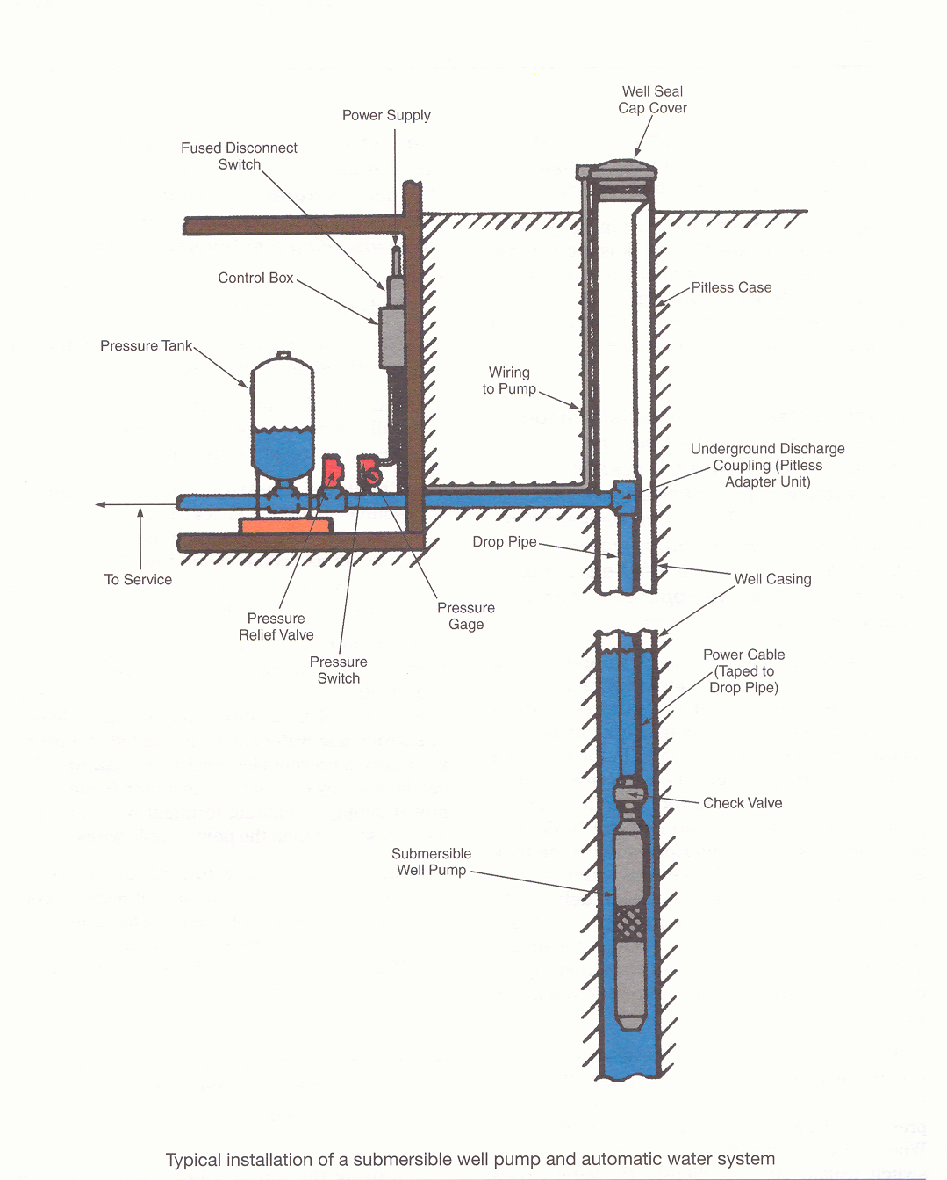

Slide 6
Installing a Submersible Well Pump
Preliminary Steps
Check pump for damage
Check the nameplate data
Examine the check valve for proper operation
Check the electrical supply

Slide 7
Installing a Submersible Well Pump
The well should be chlorinated before installing the pump
The top edge of the well casing should be checked for smoothness
Attach the pump to the drop pipe
Lower the pump into the well
Check and set the air pressure in the storage tank
Install pitless adapter
Verify proper wiring

Slide 8
Pitless Adapters
A pitless adapter forms an unbroken extension of a well, extending from below the frostline to above the ground
The water service line is attached to the unit and is buried permanently

Slide 9
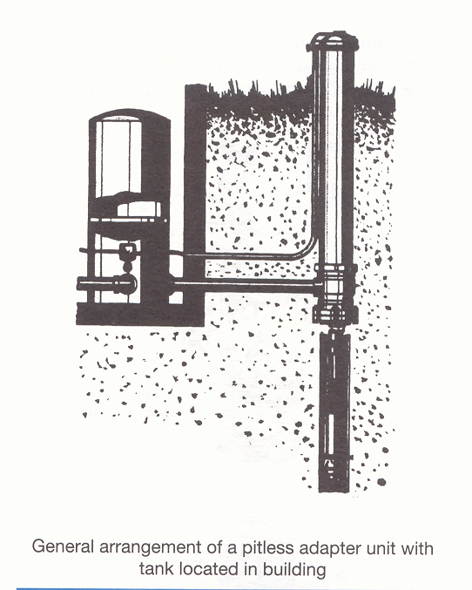

Slide 10
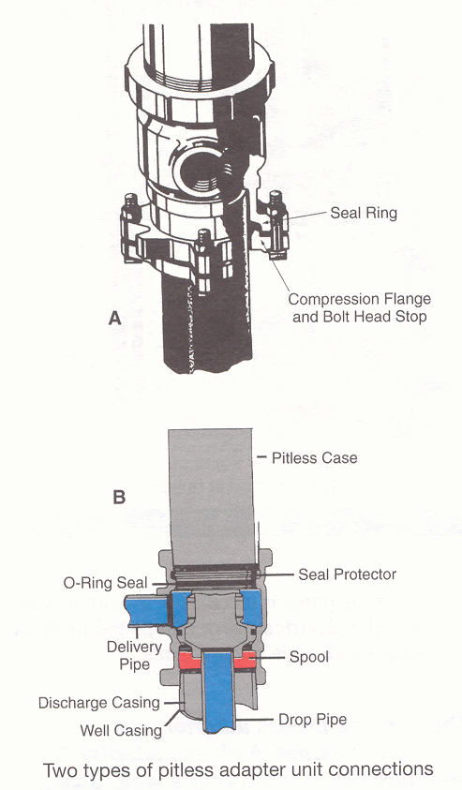

Slide 11
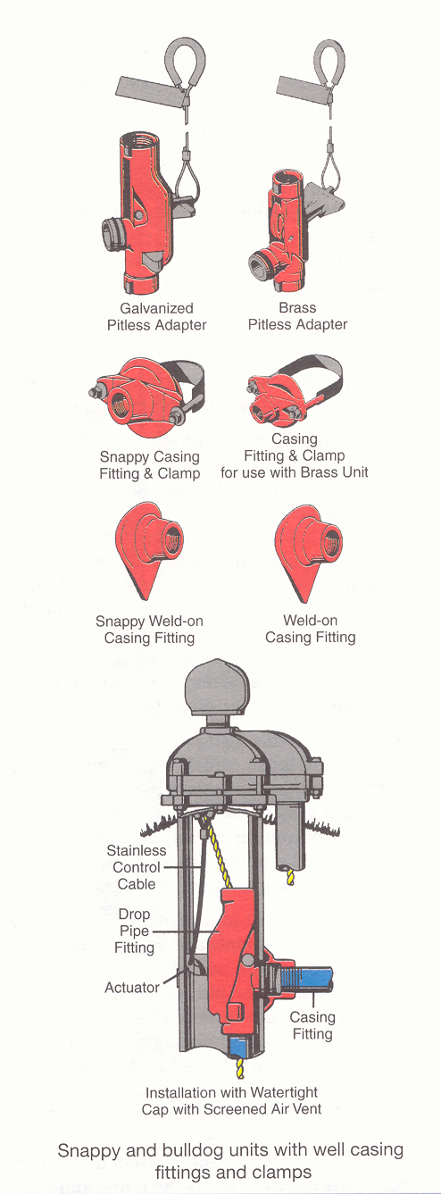

Slide 12
Pitless Adapters
Fittings used to connect pitless adapter units to a well casing
Welding nipple
Pitless connector
Swagged nipple
Dresser coupling
Adapter coupling

Slide 13
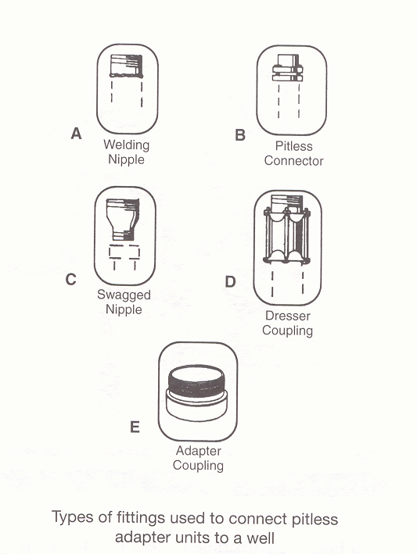

Slide 14
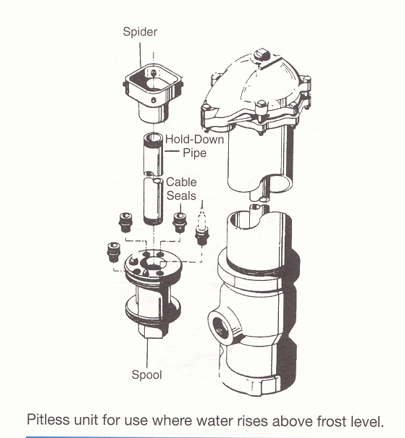

Slide 15
Shallow Well Jet Pumps
Well casing is under system pressure to drive jet fitting
Pump suction is connected to the suction drop pipe

Slide 16
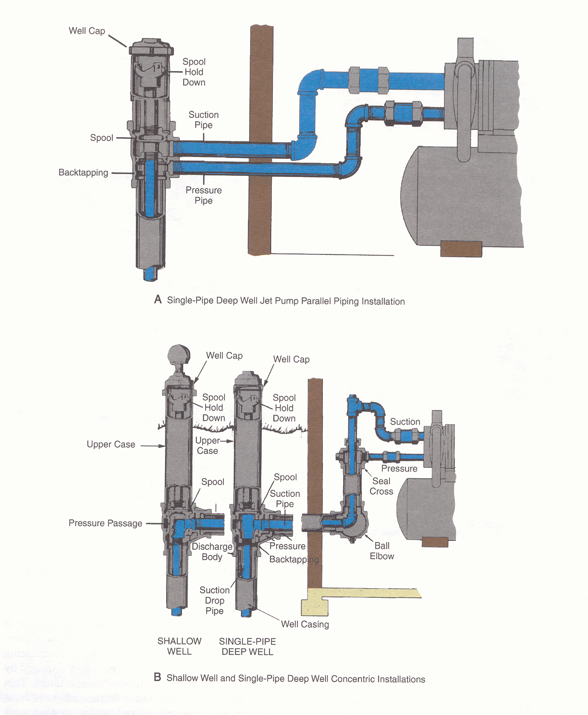

Slide 17
Storage Tanks
Require air to enter the tank by means of an air volume control
There is no separation between the air and the water in the tank
It is possible that air under pressure in a well water system storage tank can be absorbed in the system water
The storage tank can become waterlogged

Slide 18
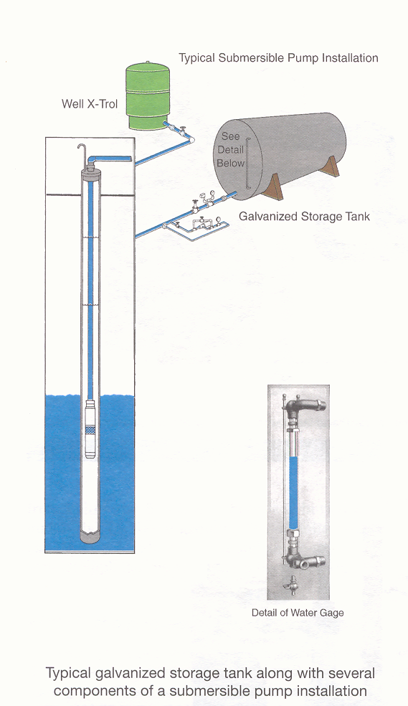

Slide 19
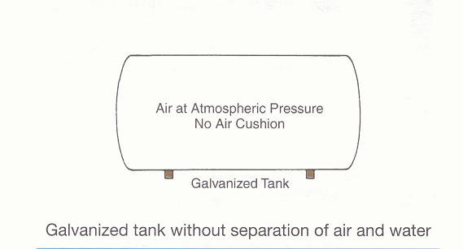

Slide 20
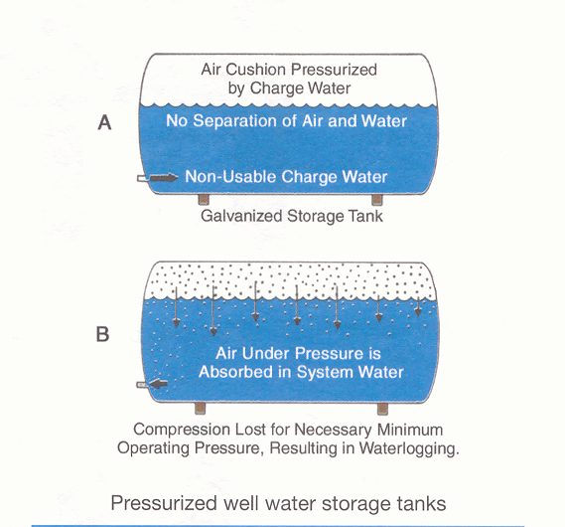

Slide 21
Well-X-Trol Tanks
The well-x-trol tank operates on the principle of the separation of air and water in a pre-pressurized hydro-pneumatic tank
It is pre-pressurized to minimum system pressure (usually pump cut-in pressure)

Slide 22
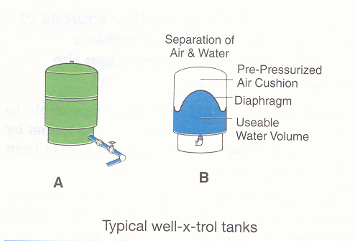

Slide 23
Well-X-Trol Tanks
Advantages:
Prevents water logging indefinitely
Allows the use of much smaller well tanks
Can utilize varying pressure tanks to accommodate a great variety of applications
Simplifies installation on large jobs
Reduces maintenance and replacement costs to a minimum

Slide 24
Vacuum Pumps for Steam Heating Systems
Capable of creating a vacuum for moving steam, air, and condensate through the system piping
Normally maintain a vacuum on the return piping from 3” Hg to 8” Hg
Able to create the positive pressure needed to return condensate, from radiators, coils, pipes, etc., to a boiler operating at pressures up to 15 psig

Slide 25
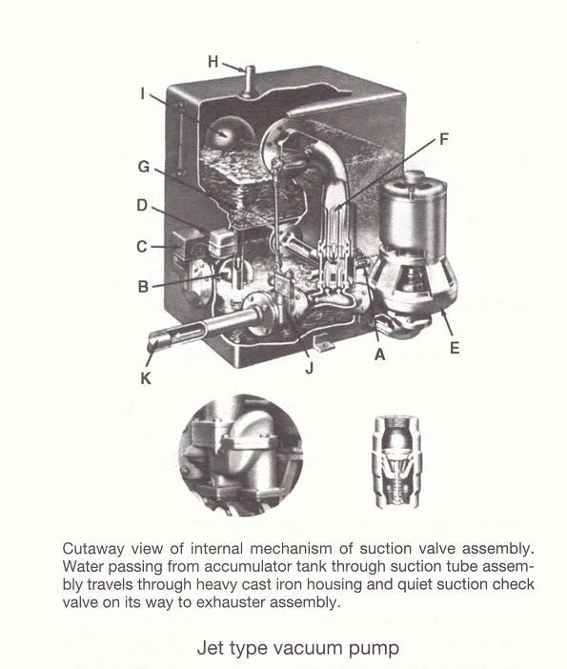

Slide 26
Checkpoint 1
Pages 53 through Checkpoint 1
Pages 53 through 62

Slide 27
Sumps
A sump can be defined as a watertight pit or receptacle at a low elevation into which liquid wastes or liquid carried wastes are drained
It is a tank or pit, sometimes called a sump pit that receives sewage or liquid waste, located below the normal grade of gravity system, and must be emptied by mechanical means

Slide 28
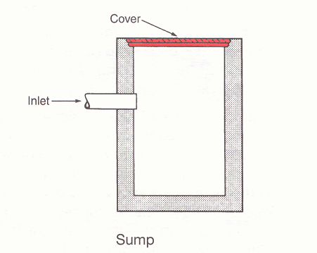

Slide 29
Sewage Ejector or Sump Pump
The plumbing device used to pump sanitary drainage from plumbing fixtures to a higher elevation is called a sewage ejector
For nonpolluted drainage from floor drains or other clear water sources a similar, but simpler device called a sump pump is used.

Slide 30
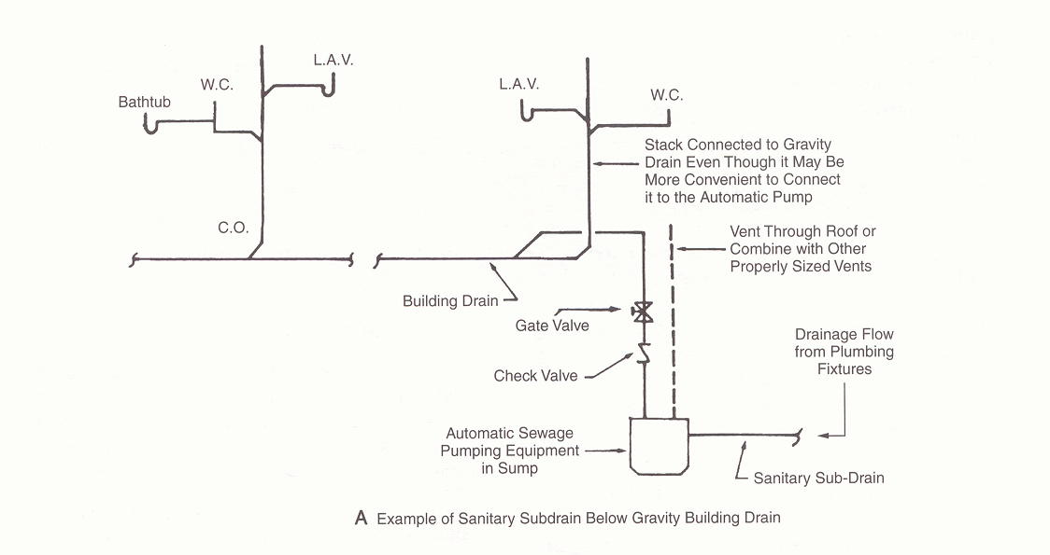

Slide 31
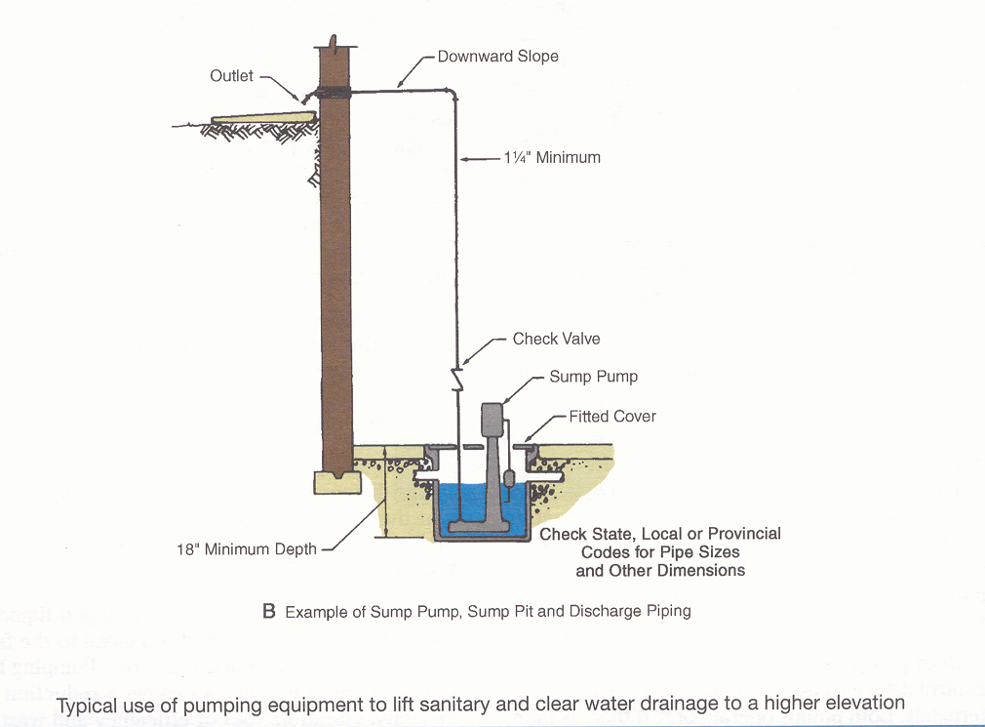

Slide 32
Installation of Sump Basin
Depth of basin
Distance between top of basin and basin inlet
Size of basin
Solid vibration free foundation
Size of piping
Elimination of noise
Follow Plumbing Code

Slide 33
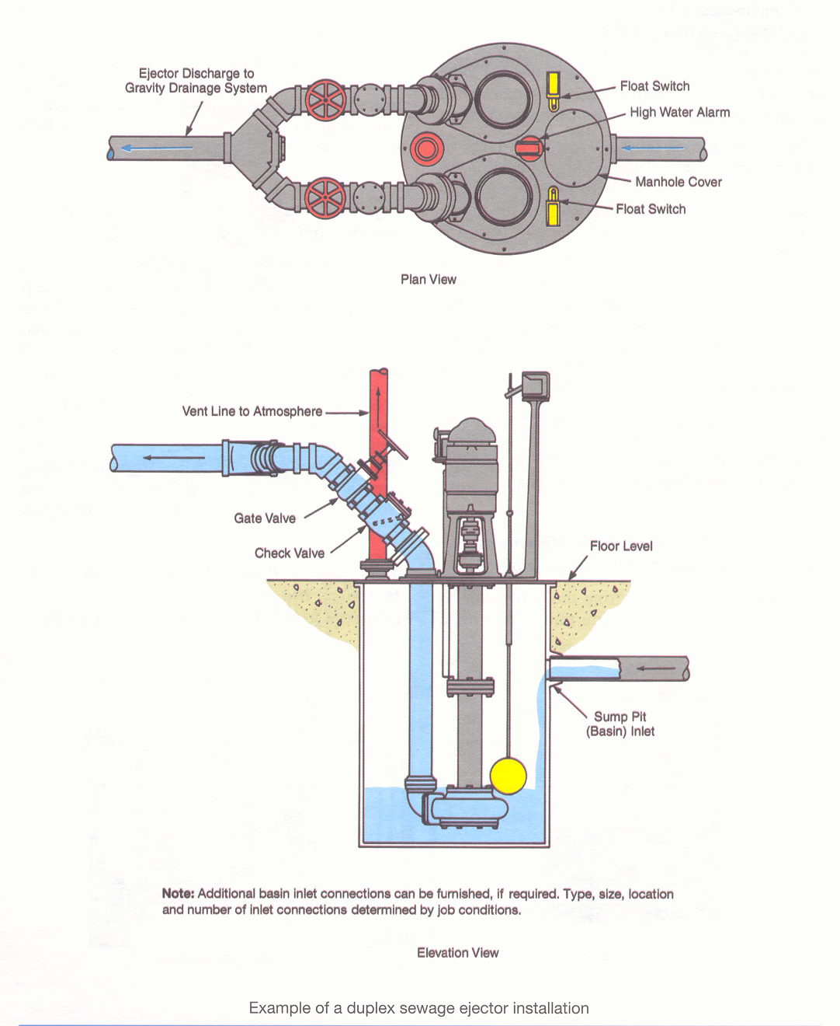

Slide 34
Wet Pit or Dry Pit
Wet pit installation uses a submerged non-clog sewage pump. It features a pump and motor with a sealed housing, helping to insure a long service life.
In a dry pit installation, neither the pump nor the driver is submerged. It is used where floor space is limited and flooding is marginal.

Slide 35
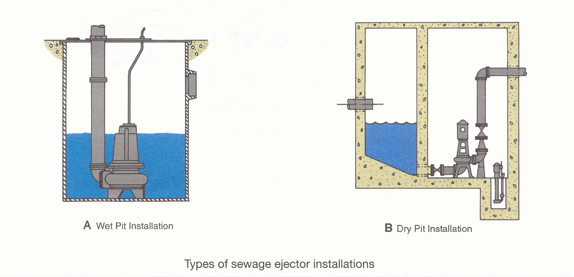

Slide 36
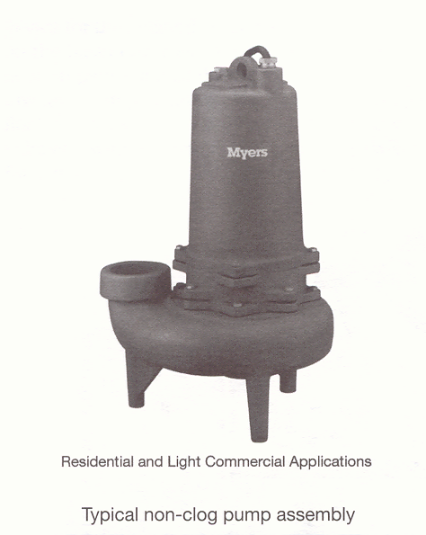

Slide 37
Controls
Floating ball and rod
Micro switch
Mercury float switch
Water level detectors
Water level alarms
Alternators
Motor starters

Slide 38
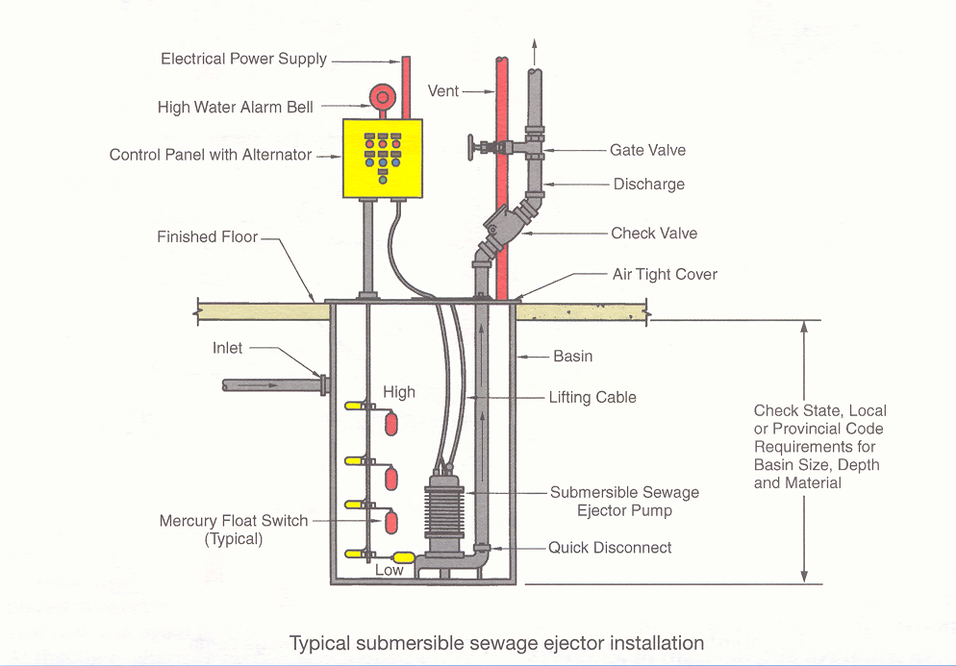

Slide 39
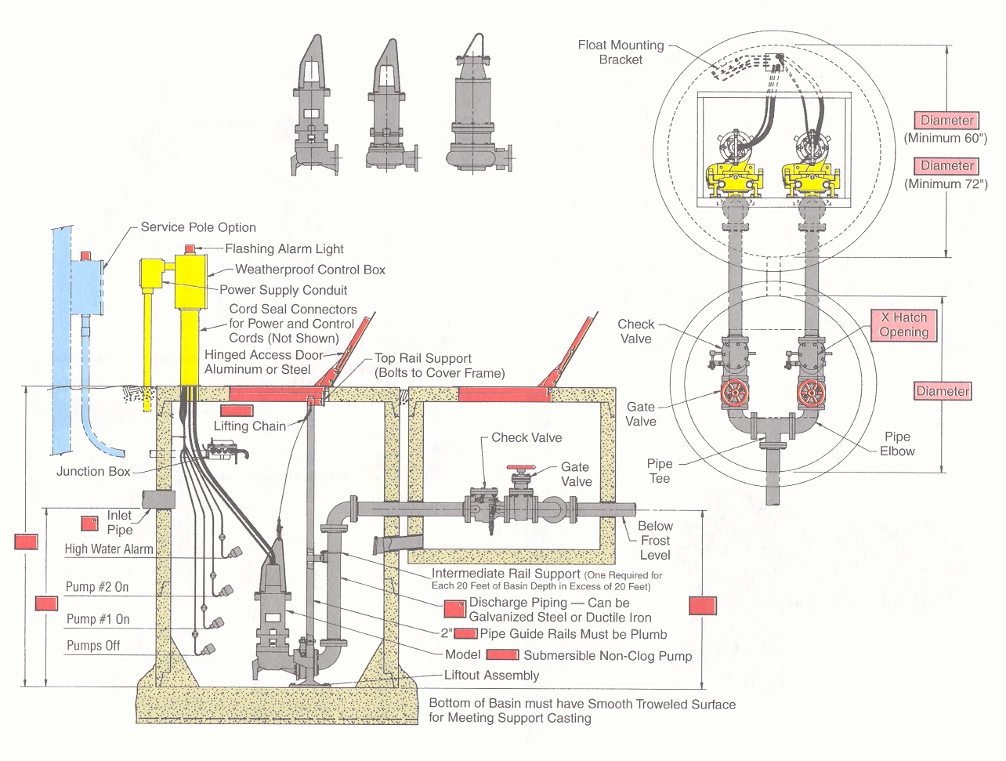
Typical duplex sewage pump

Slide 40
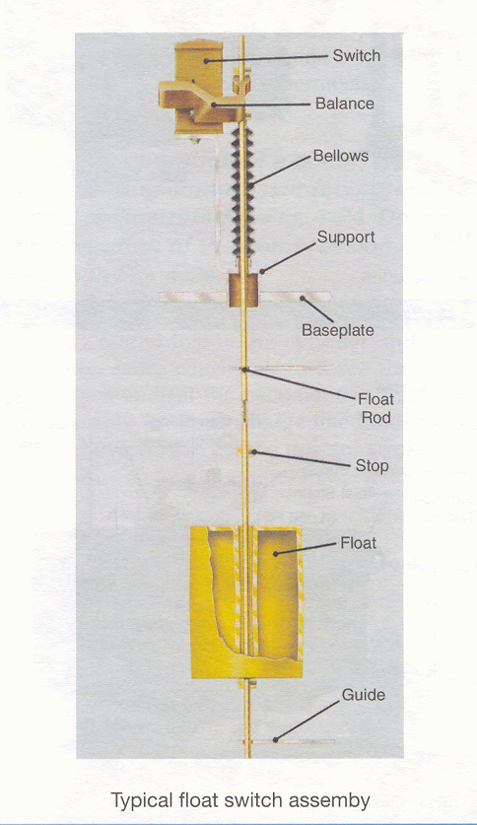

Slide 41
Boiler Feed Pumps
The function of a boiler feed pump is to supply the water to a boiler in sufficient quantity and pressure to maintain a safe water level in the boiler
The pump pressure must exceed the boiler pressure and overcome the pressure losses through piping, valves, and fittings

Slide 42
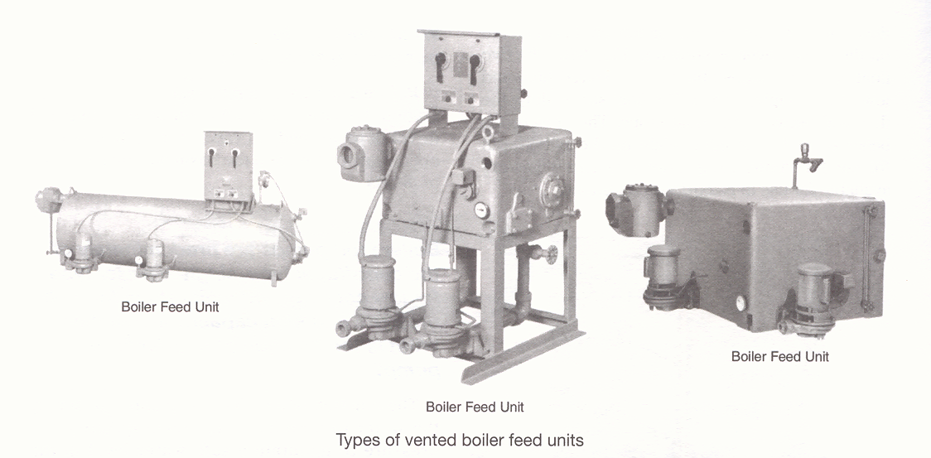

Slide 43
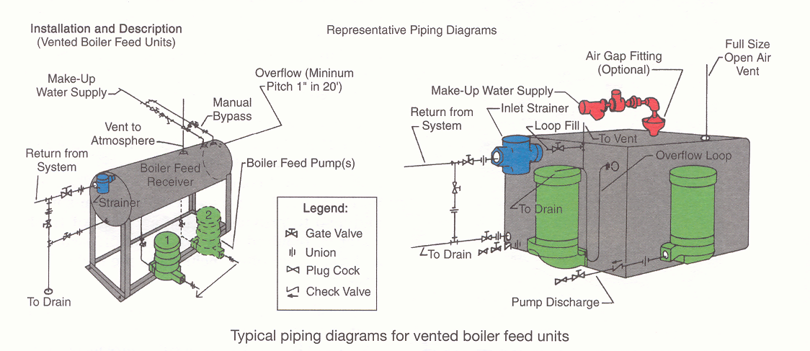

Slide 44
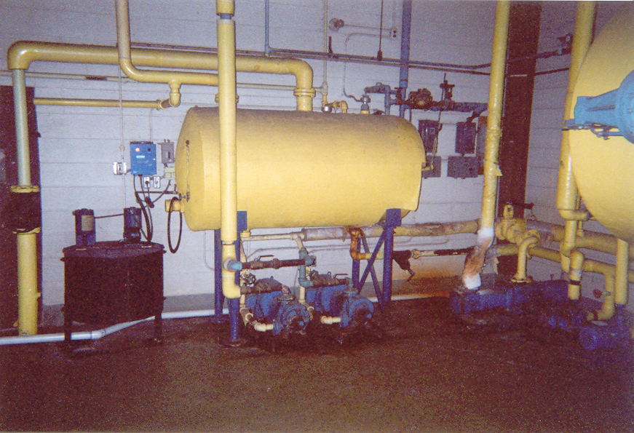
Boiler Feed Pumps

Slide 45
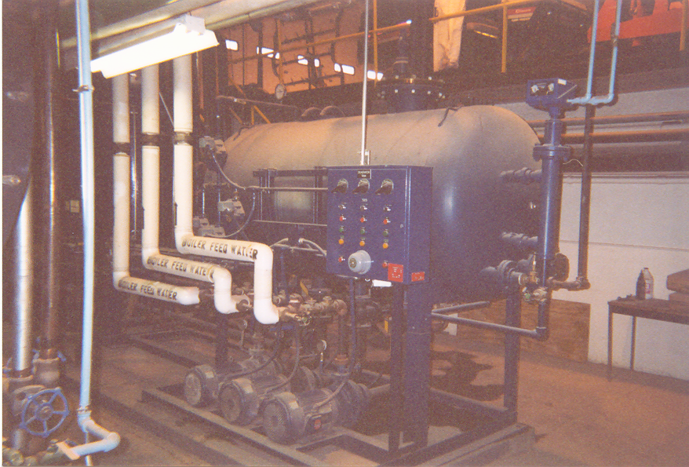
Boiler Feed Pumps

Slide 46
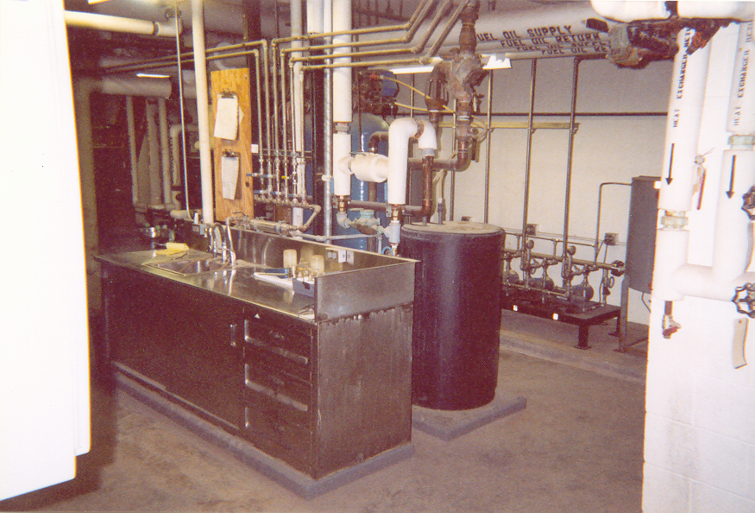
Water Treatment Station

Slide 47
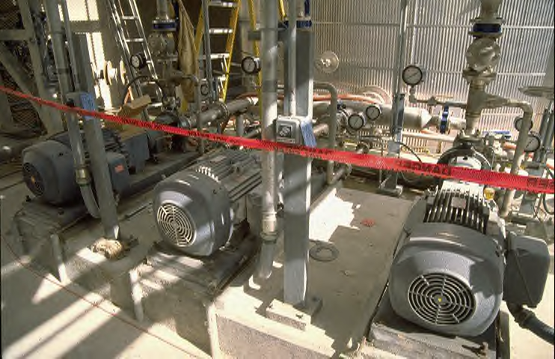
Makeup Feed water Pumps

Slide 48
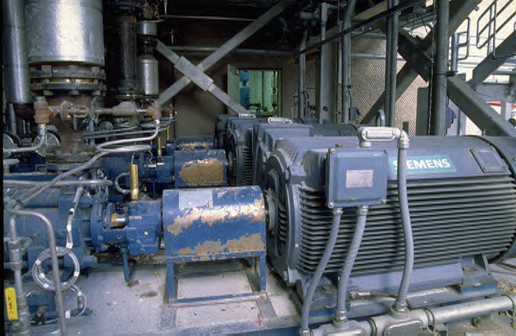
High Pressure Feed water Pumps

Slide 49
Air Compressors
Compressed air systems
Pneumatic control systems
Medical gas systems

Slide 50
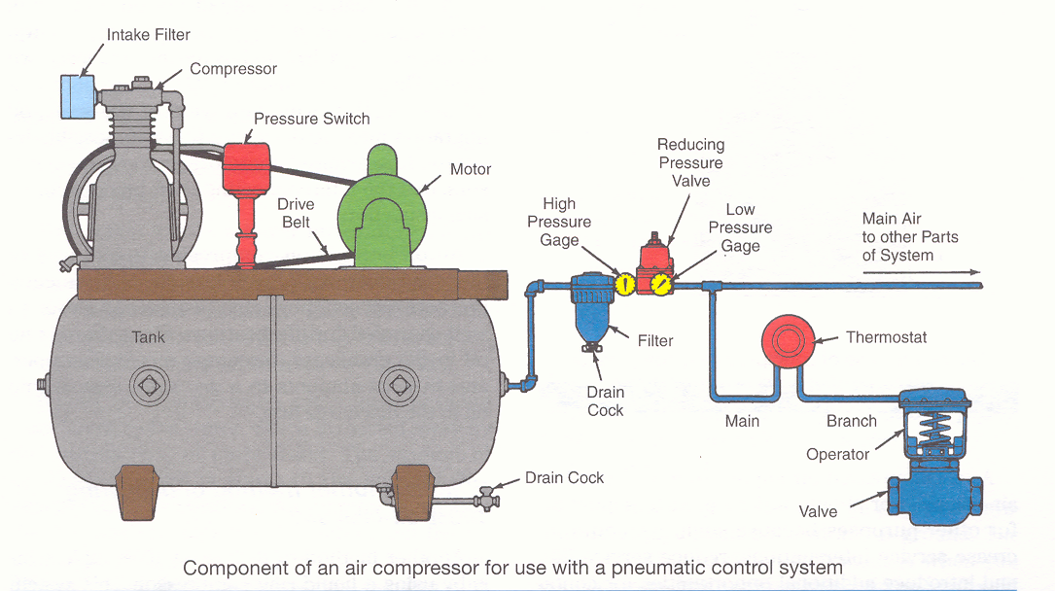

Slide 51
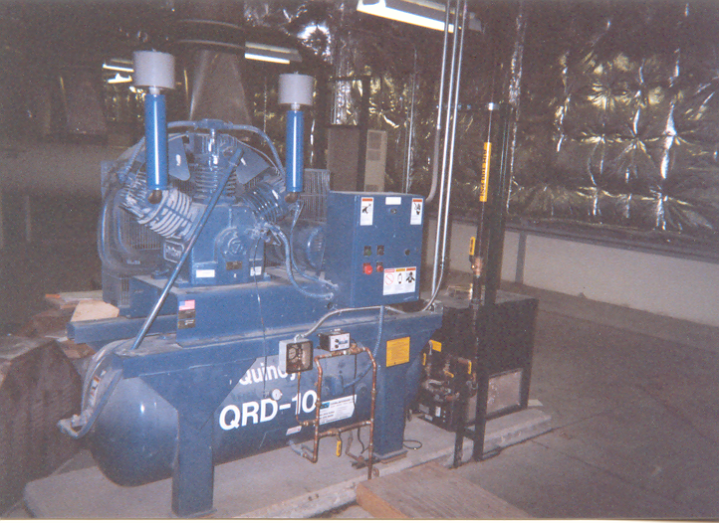

Slide 52
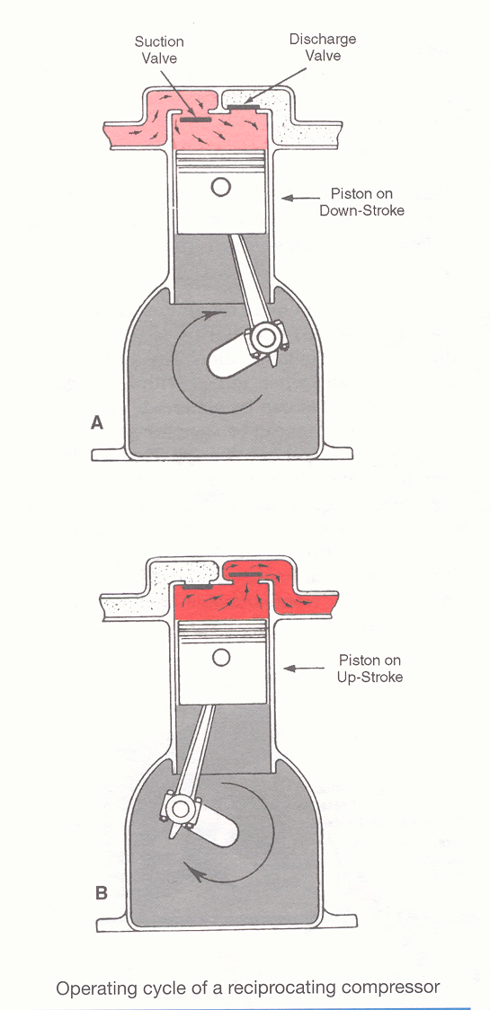
Reciprocating Compressor

Slide 53
Medical Air Compressors
Cleanliness and efficiency are critical
Used only for direct patient therapy
Installed and maintained according to NFPA 99C

Slide 54
Medical Air Compressors
Oil-less
Oil-free
Liquid ring

Slide 55
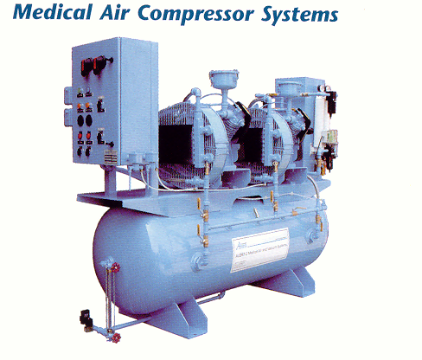

Slide 56
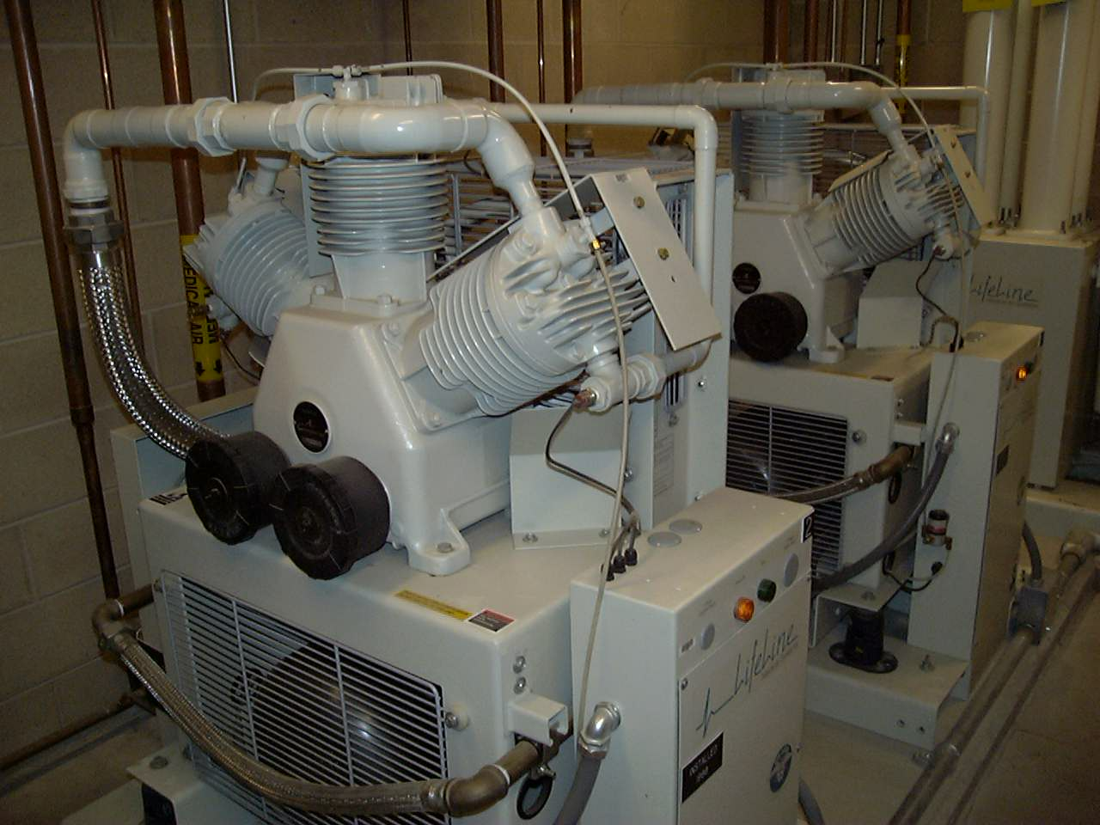

Slide 57
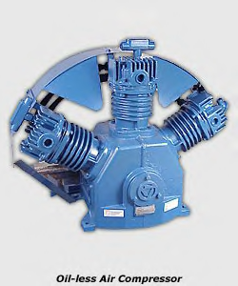

Slide 58
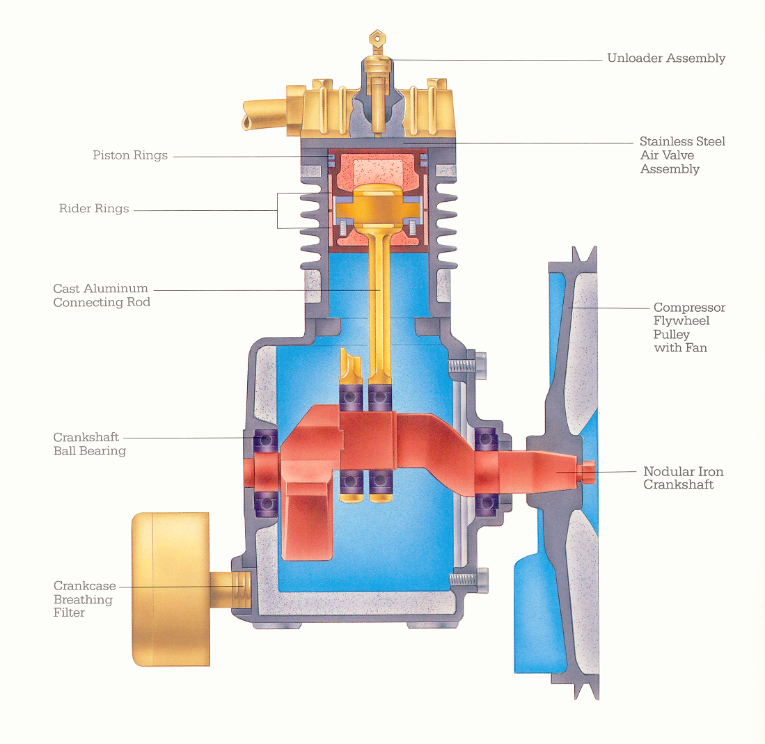

Slide 59
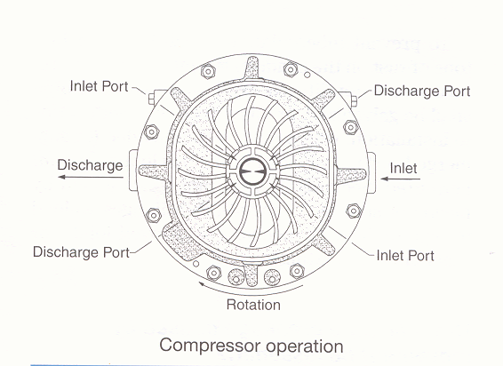
Liquid Ring Compressor

Slide 60
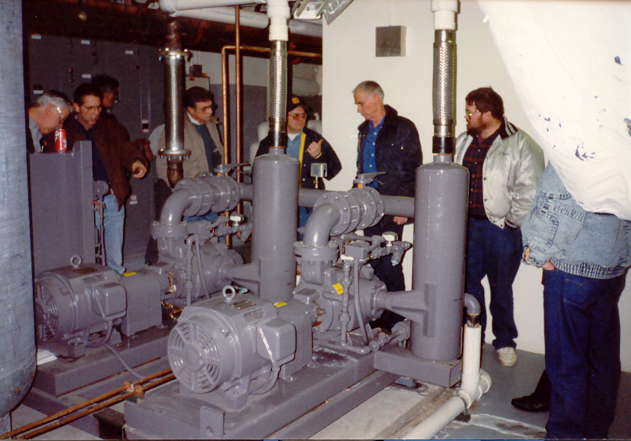

Slide 61
Medical / Surgical Vacuum Pumps
Reciprocating
Rotary
Liquid Ring

Slide 62
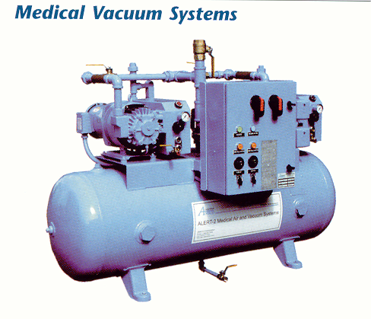

Slide 63
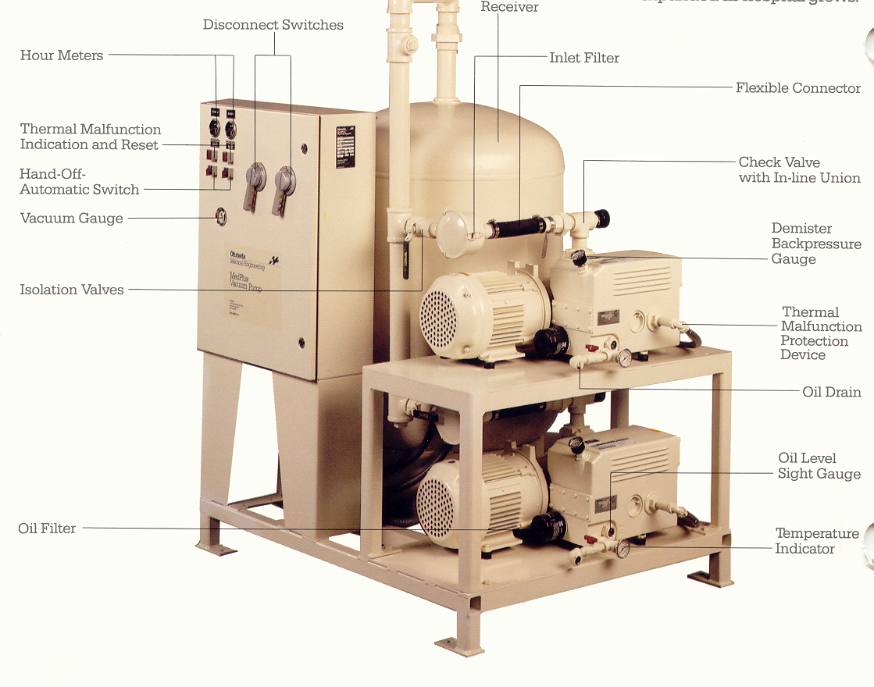

Slide 64
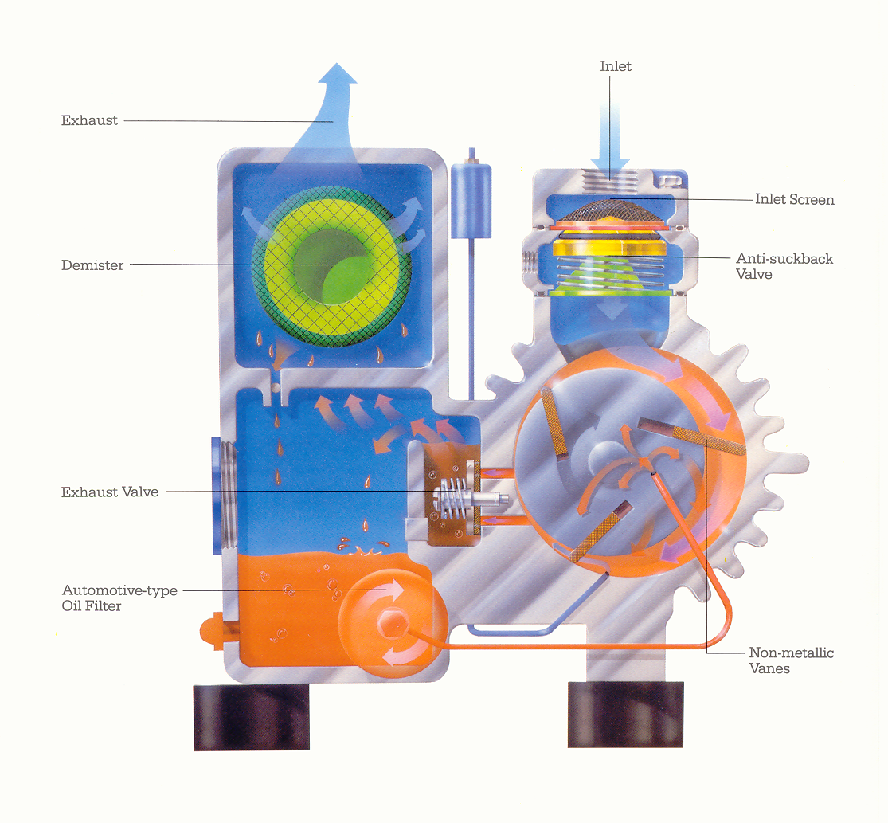

Slide 65
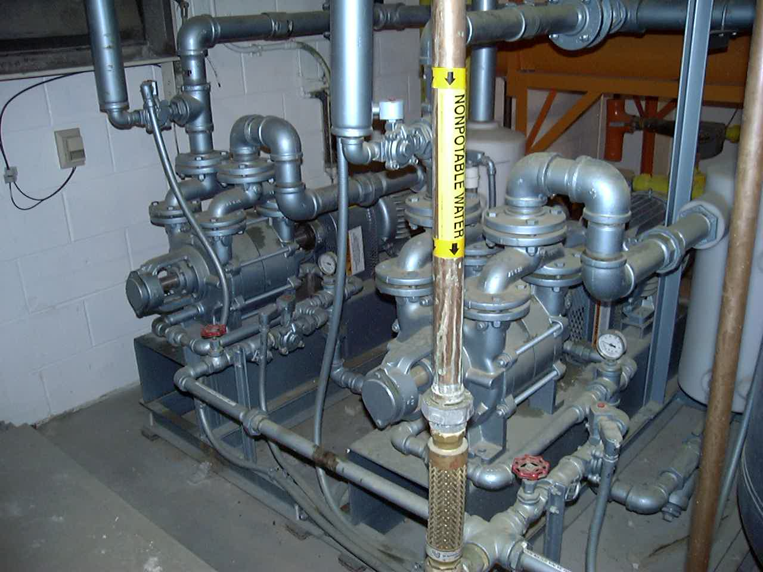

Slide 66
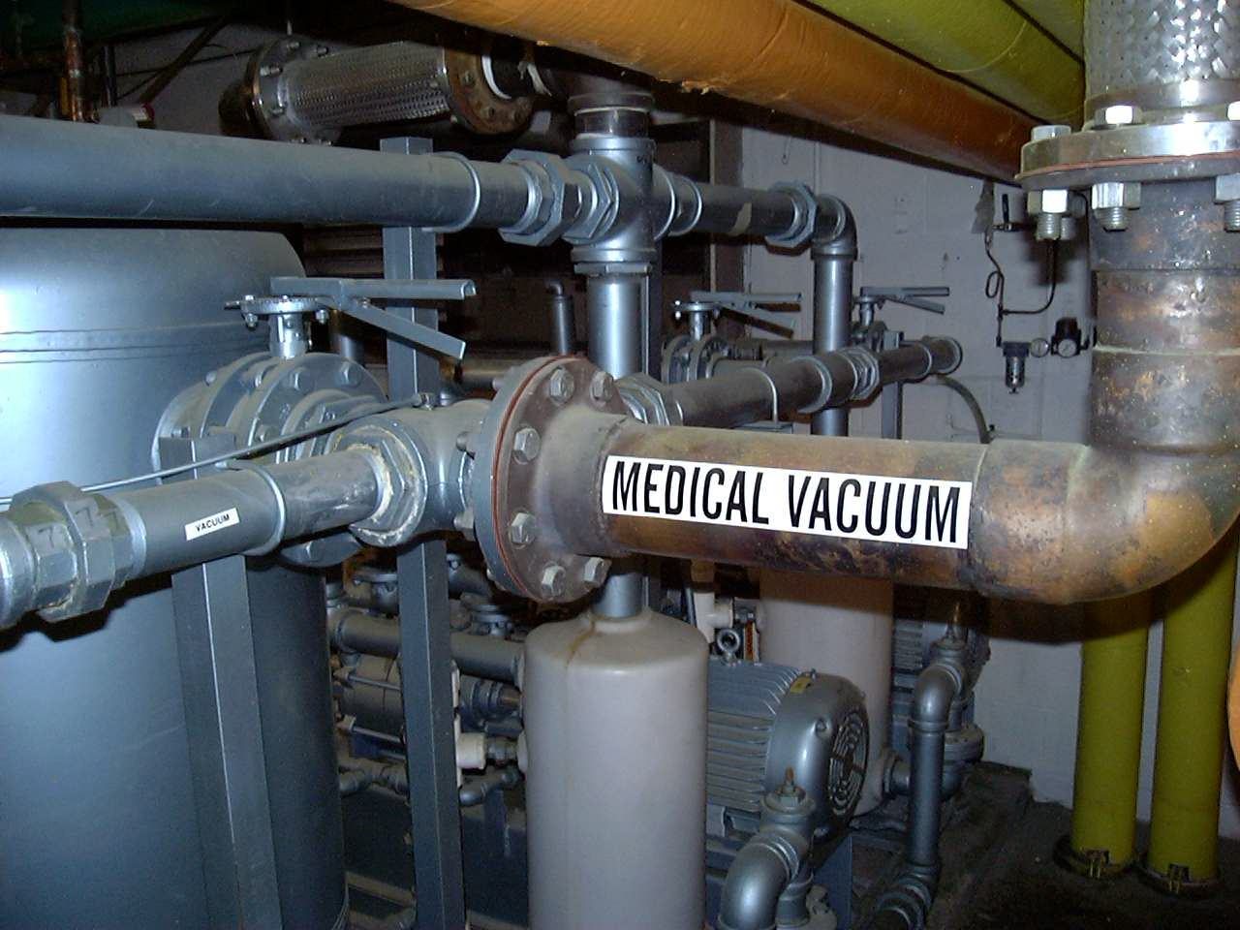

Slide 67
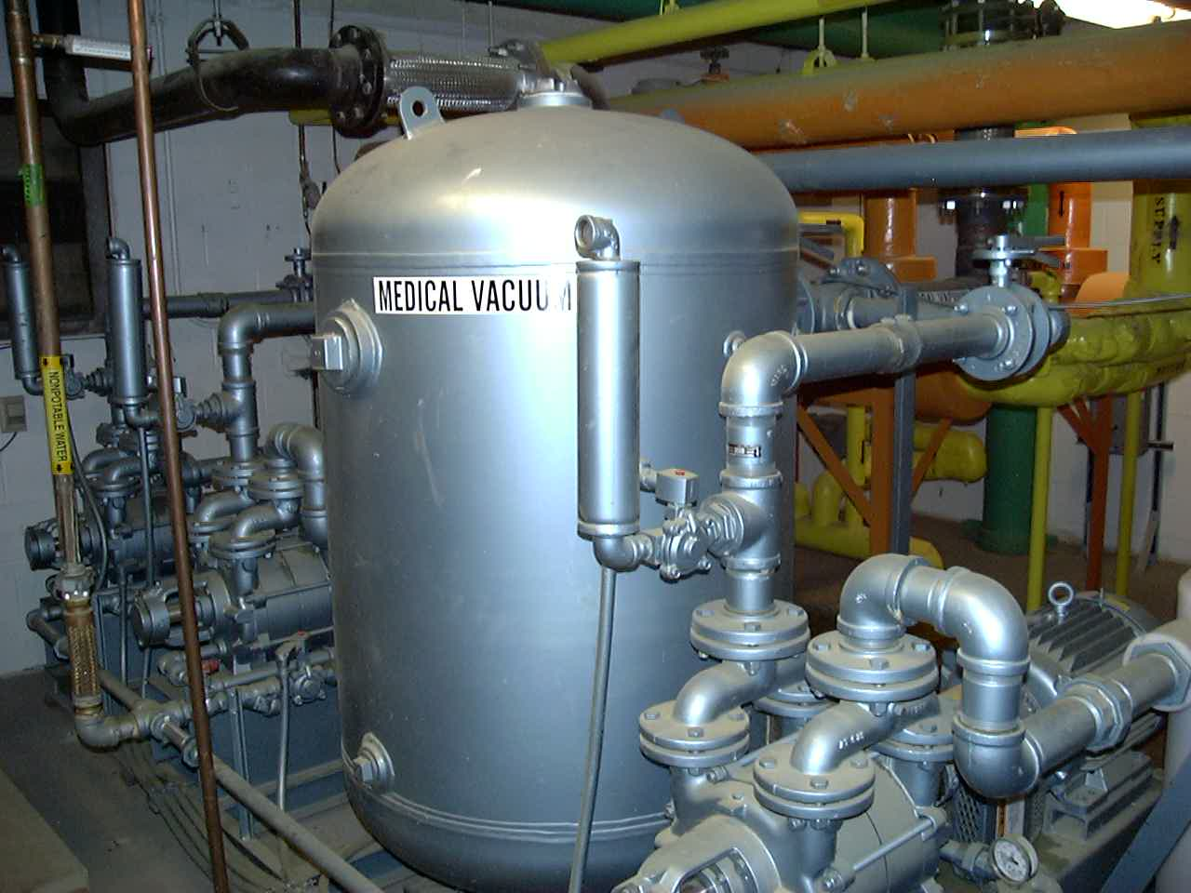

Slide 68
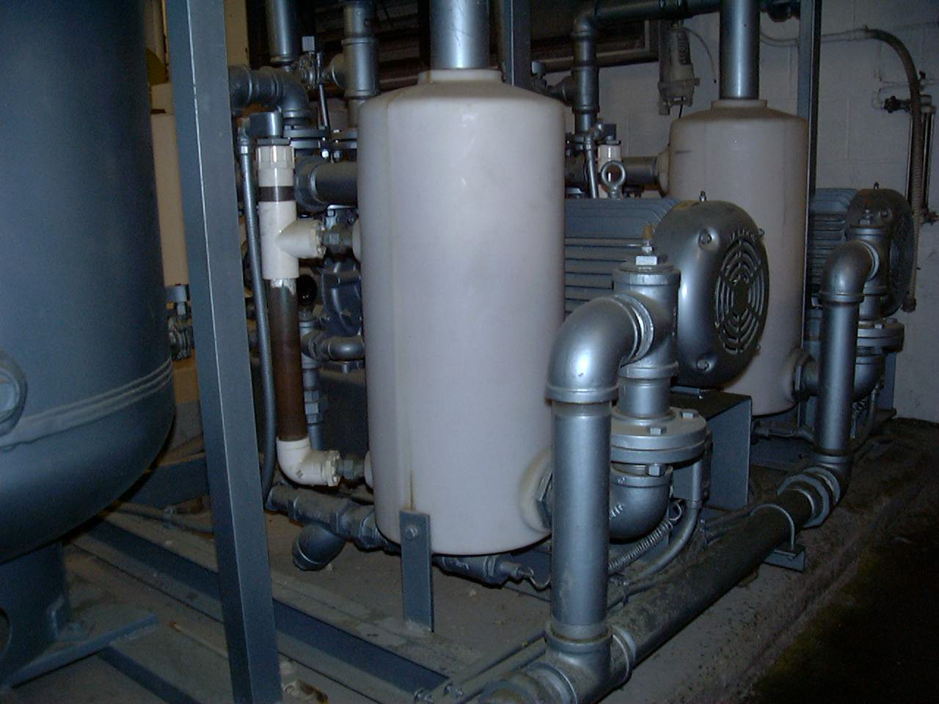

Slide 69
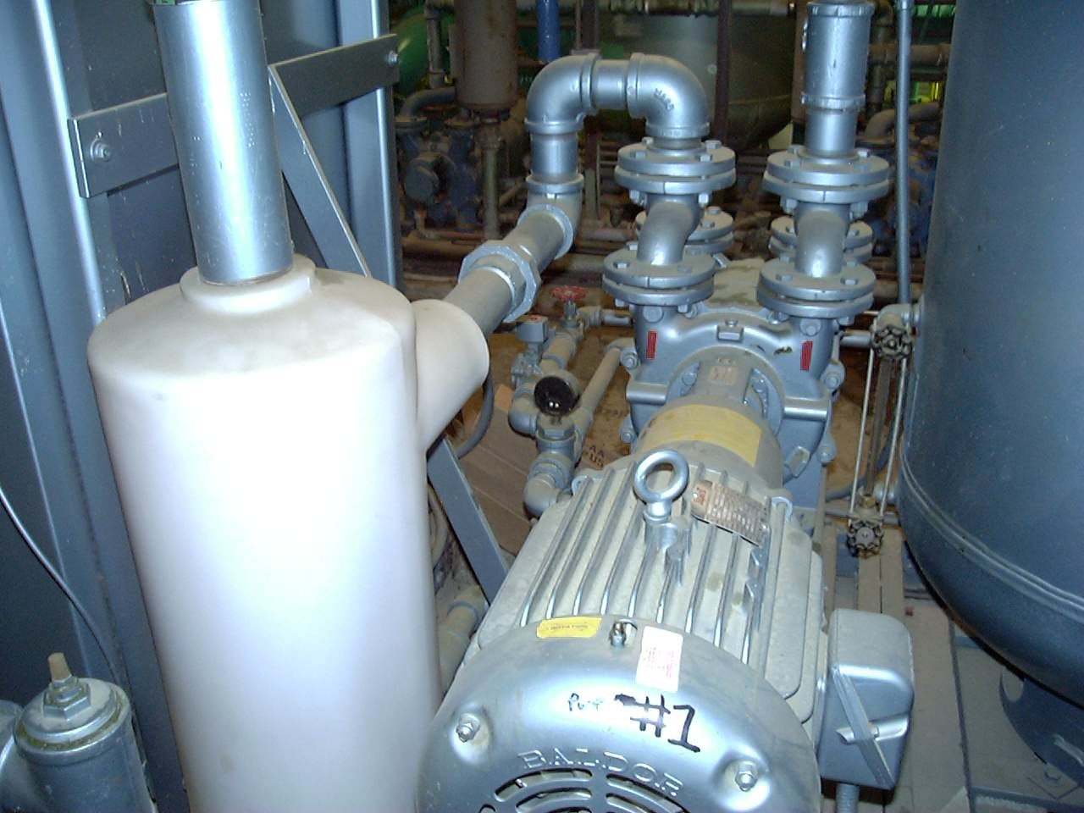

Slide 70
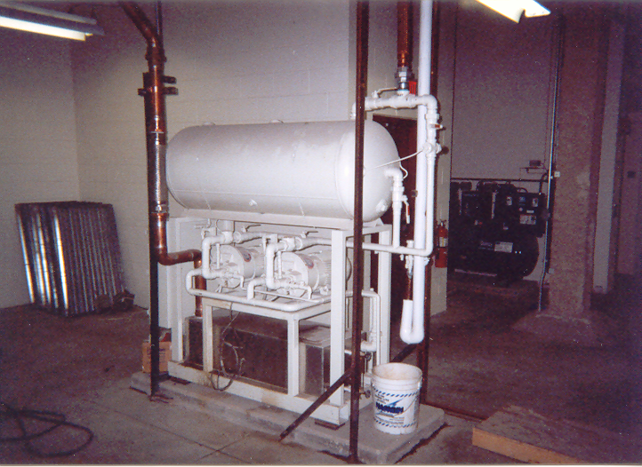

Slide 71
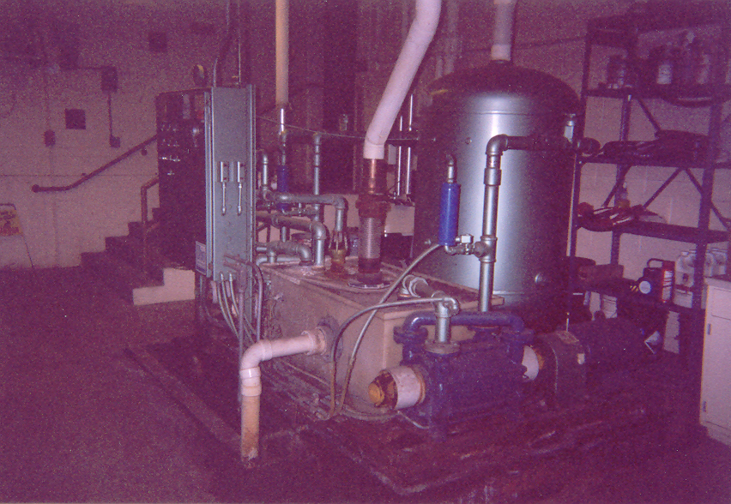
Medical / Surgical Vacuum Pumps and Receiver

Slide 72
Checkpoint 2
Pages 62 through Checkpoint 2
Pages 62 through 73

Slide 74
Installation of Fire Protection Systems
Piping is joined by screwed, flanged, mechanical grooved joints, or other approved fittings
Clearance allowed at walls and floors
Check valve to prevent water hammer when fire pump shuts down

Slide 75
Installation of a Centrifugal Fire Pump
Pressure gages
Circulation relief valve (casing relief valve)
Relief valves
Water measuring devices
Hose valves
Meters
Jockey pump

Slide 76
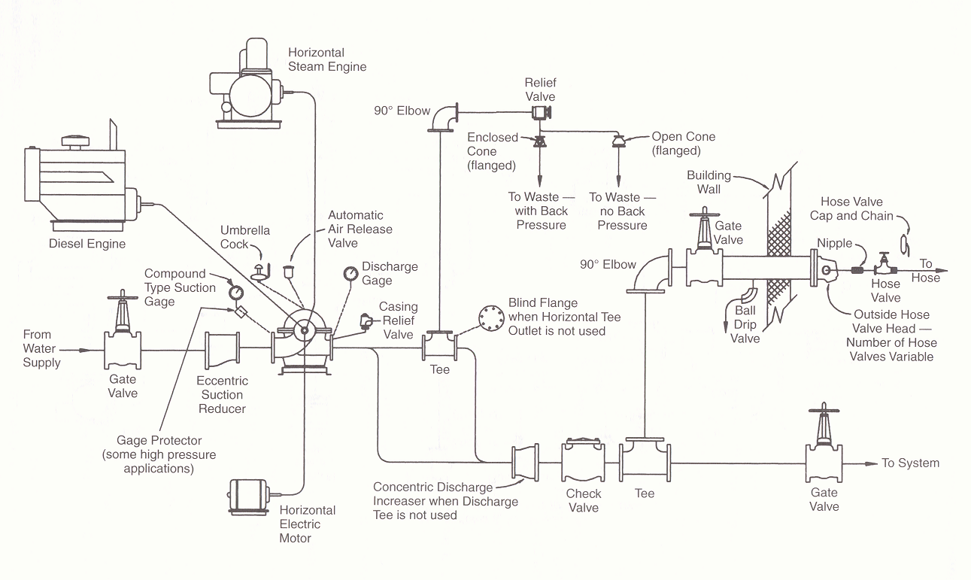

Slide 77
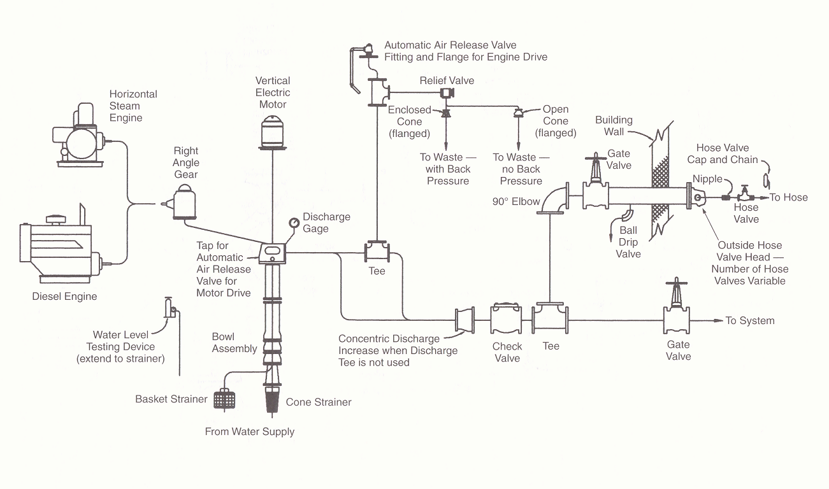

Slide 78
Horizontal Pumps used in Fire Sprinkler Systems
Horizontal-shaft split case
End-suction
In-line

Slide 79
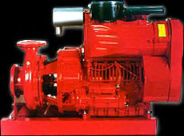

Slide 80


Slide 81


Slide 82
Suction Piping
Must be capable of maintaining a gage pressure of at least zero at the pump flange
Air pockets can seriously effect the operation of a pump
Elbows with a centerline plane parallel to the pump shaft must be avoided, unless the distance between the flange of the suction inlet and the elbow is greater than ten times the suction pipe diameter

Slide 83


Slide 84
Vertical-shaft turbine pumps
Well installation
Wet pit installation
Consist of five elements
A motor head or right-angle gear drive
A column pipe and discharge fitting
An open or enclosed drive shaft
A bowl assembly (containing the impellers)
A suction strainer

Slide 85


Slide 86


Slide 87


Slide 88



Slide 89


Slide 90


Slide 91


Slide 92
Turbine pump start-up
Check field installed electrical connections
Check discharge piping
Check coupling for proper alignment
Check motor rotation

Slide 93
Water Pressure Booster Pumps
Used to elevate domestic potable water pressure in multi-story buildings
Staged in sequence
Controlled by variable frequency motor drives

Slide 94

Water Pressure Booster System

Slide 95

Pressure Booster Pumps

Slide 96
Checkpoint 3
Pages 73 through Checkpoint 3
Pages 73 through 84

