Slide 1

Motors Bearings Seals Couplings
Extra items

Slide 2
Electric Motor
A device that takes electrical energy and converts it into mechanical energy to turn a shaft

Slide 3
Electromagnetism
Electric motors - the relationship between magnetic fields & electricity
Electromagnet - coil of wire carrying electric current

Slide 4
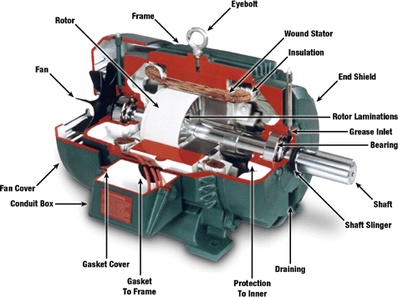
Motor Makeup
Rotor
Stator
Frame
Shaft
Bearings

Slide 5
Rotor
Consists of:
Shaft
Rotor core (steel laminations)
A squirrel cage made of aluminum which holds the laminations together

Slide 6
Stator
Magnetic structure of the motor which contains the windings
The rotor fits through the stator

Slide 7
Windings
Coil placement = 120 degrees apart
Connected to the power supply
Operate in pairs

Slide 8
Poles / RPM
Synchronous = 120 x Freq (Hz)
speed Number of poles
Example:
1800 = 120 x 60
4

Slide 9
Frame Material
Aluminum
Rolled steel
Cast iron
Stainless steel

Slide 10
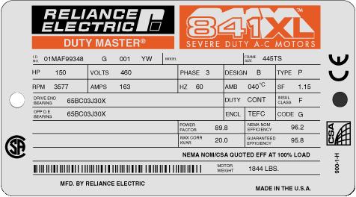
Nameplate

Slide 11
Nameplate Info
Manufacturer’s name
HP, RPM, Phase, Hz
Insulation class, ambient temp
Amps, duty cycle
Locked rotor code
Design code
Service factor
Efficiency

Slide 12
Epact
Minimum efficiencies
1-200 horsepower
Rigid base, single speed
2, 4, and 6 pole 60Hz motors
T and TS shafts
Explosion proof -1999

Slide 13
Types of Motors
TEFC
ODP
EXP
VHS & VSS
Inverter Duty

Slide 14
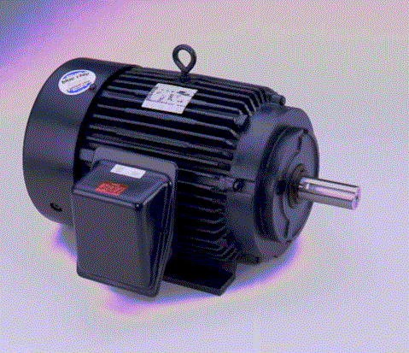
TEFC

Slide 15
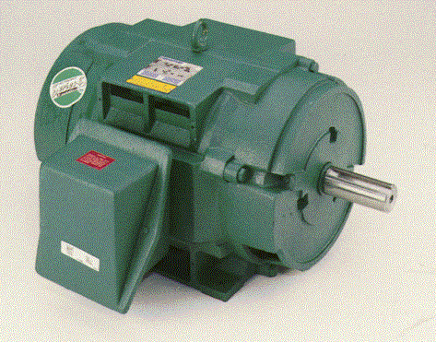
Drip Proof

Slide 16
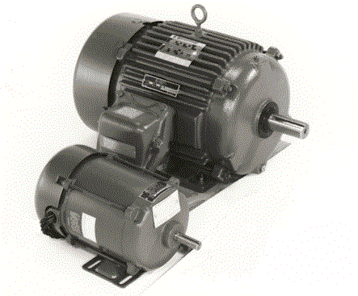
Explosion Proof

Slide 17
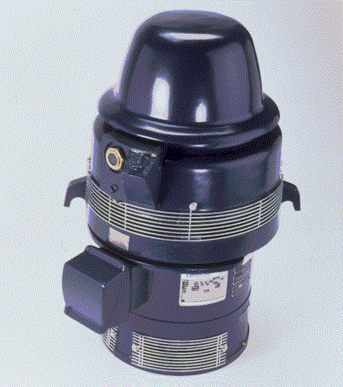
Vertical Hollow Shaft

Slide 18
Inverter Duty
Variable Torque
Spike resistant insulation
Thermostats
Class F insulation
Cable length

Slide 19
Shafts
T- Long
TS - Short
JM - Mechanical
JP - Packing
Z - Modified shaft

Slide 20
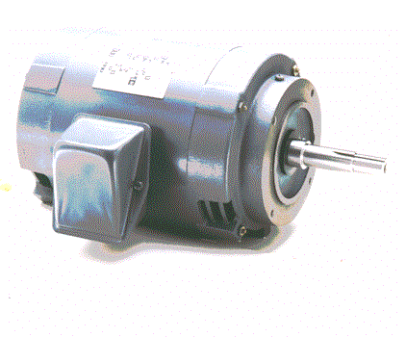
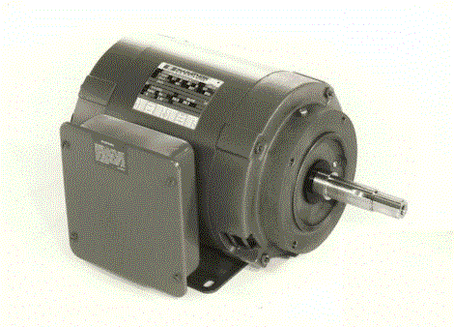
JM & JP Shafts
JM
JP

Slide 21
NEMA Service Factors

Slide 22
Insulation
Insulation Class A B F H
Ambient temperature 40 40 40 40
Temperature rise by resistance 60 80 105 125
Hot-spot allowance 5 10 10 15
Hot-spot temperature 105 130 155 180

Slide 23
Basic Motor Options
Ambient temperature
Space heaters
Thermostats
Thermistors
RTDS

Slide 24
Motor Options
PWS - Part Winding Start
Wye-Delta
Altitude
Power factor
Tropicalization
Encapsulation

Slide 25

Thermostats
Bi-metal tstats

Slide 26
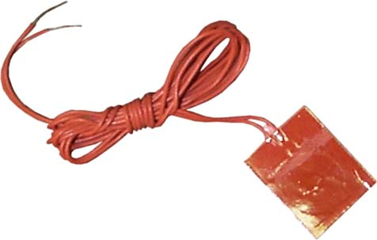
RTDS

Slide 27
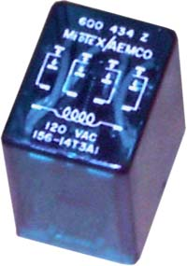
Thermistors

Slide 28
Part Winding Start
Two parallel windings
Half of the windings energized first
Second half energized after several seconds
Six or nine leads
Special starter
Starting current 65% & torque 45%

Slide 29
Wye Start Delta Run
12 leads
Special starter
Starting current and torque approximately 33%
Can be wired for ACL

Slide 30
Altitude Considerations
Use current motor and operate without service factor
Use next larger horsepower rating
Design special motor

Slide 31
Power Factor
The ratio of true power used in an electric circuit to the power which is being drawn from the source
Related to efficiency
Can be corrected to 90%

Slide 32
Tropicalization
Humid or wet conditions
Winding and stator treated

Slide 33
Encapsulation
Similar to tropicalization
Vacuum impregnation
Epoxy coated

Slide 35
Pump Bearings
Sleeve Bearings
Ball Bearings

Slide 36
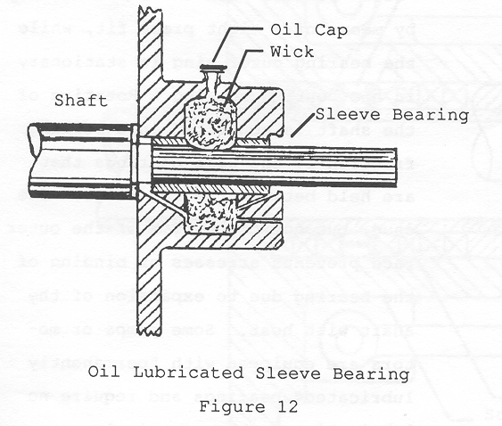

Slide 37
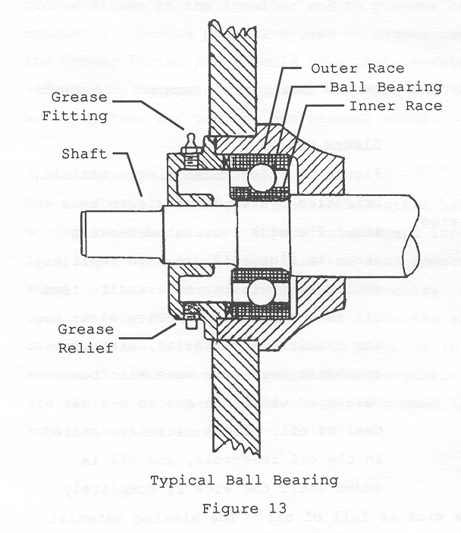

Slide 39
Pump Seals
Compression Packing Ring Type Seals
Mechanical Seals

Slide 40
Compression Packing Ring Type Seals
Compression packing is made of twisted, braided, woven, or wrapped material formed into square or round cross sections
The packing is held in place and compressed by the stuffing box gland
A continuous flow of cooling and lubricating liquid must be maintained through the stuffing box

Slide 41
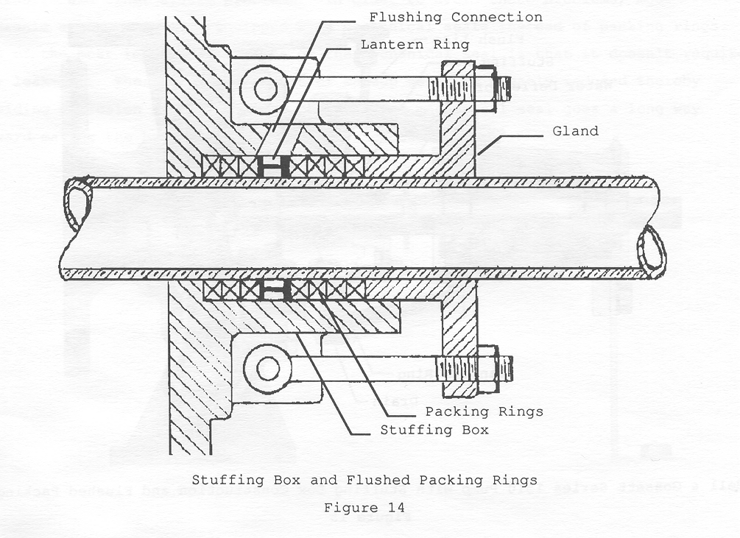

Slide 42
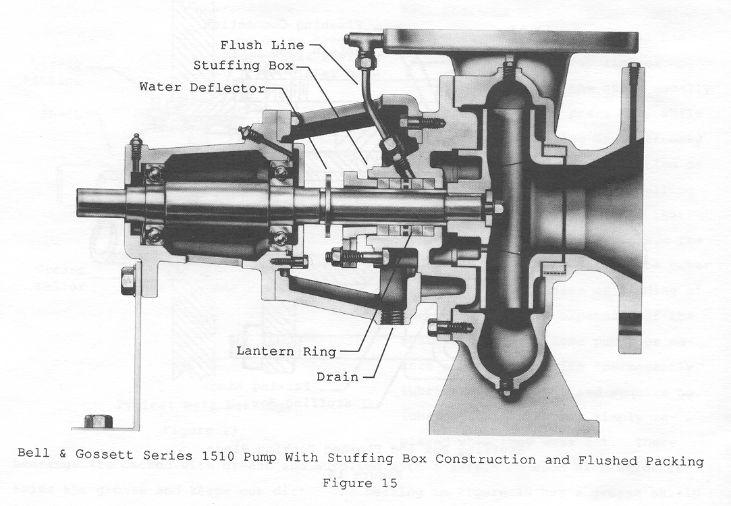

Slide 43
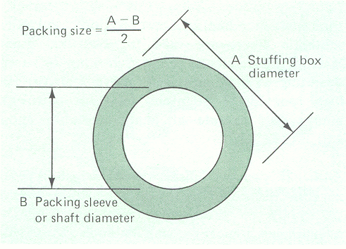

Slide 44
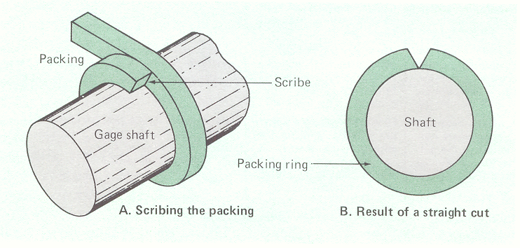

Slide 45
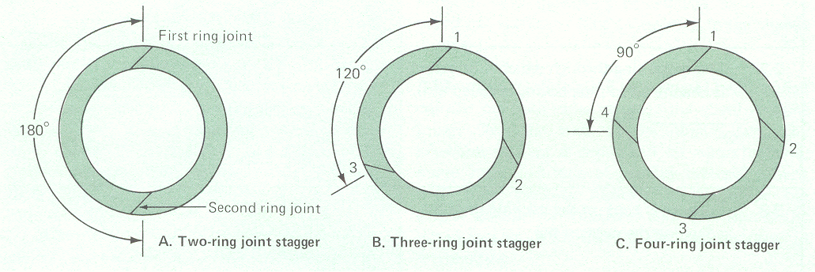

Slide 46
Mechanical Seals
Most water service pumps use carbon material or a combination of carbon and ceramic materials for the seal faces
When the seals wear out and show excessive leakage, they are replaced

Slide 47
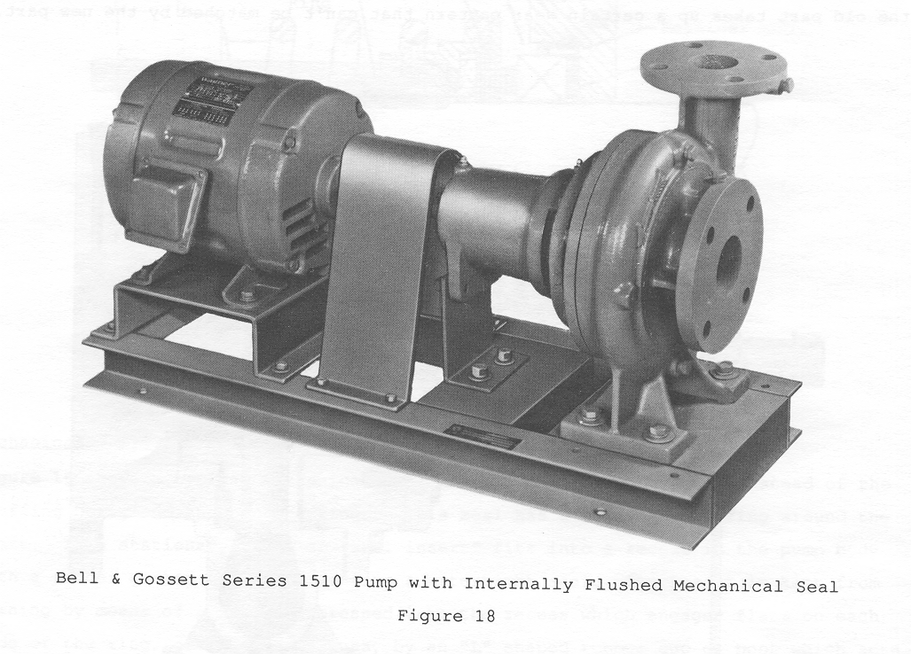

Slide 48
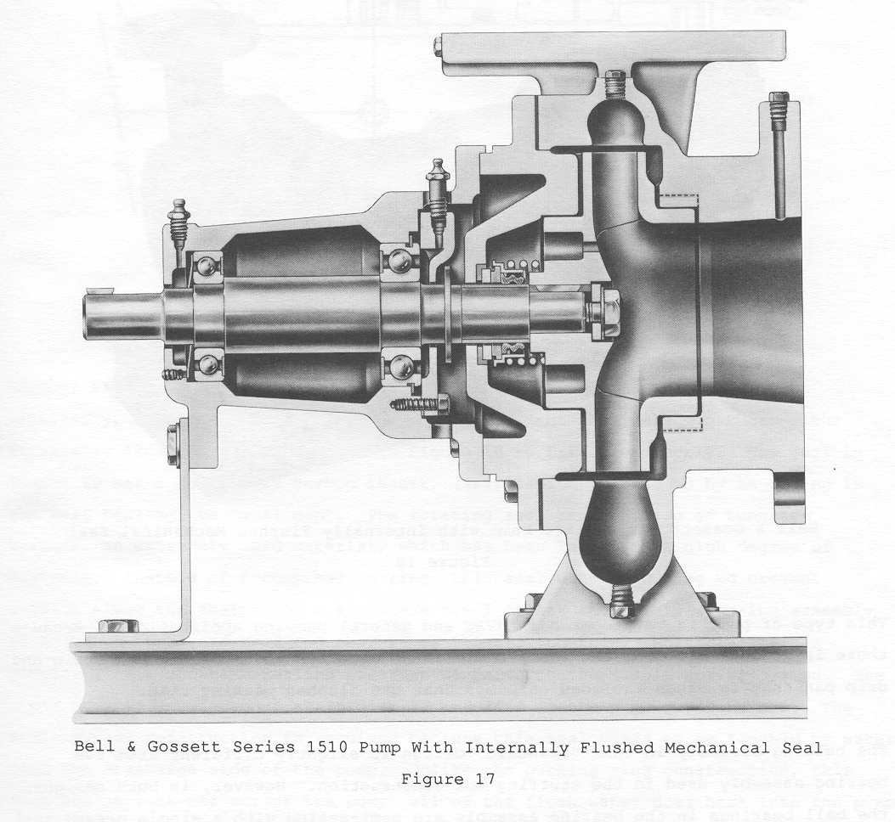

Slide 49
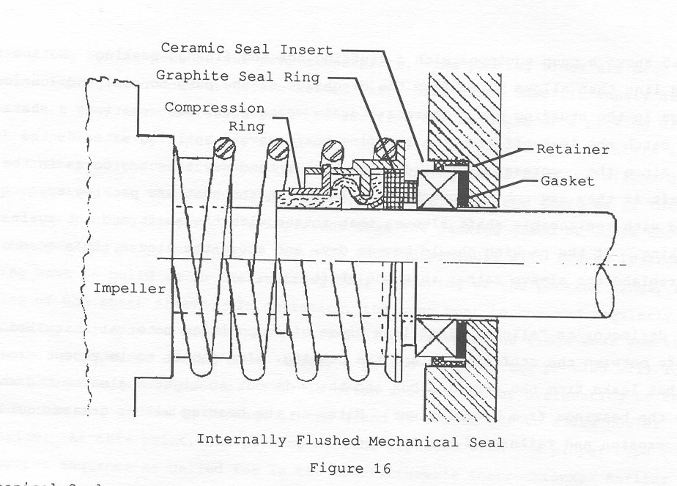

Slide 50
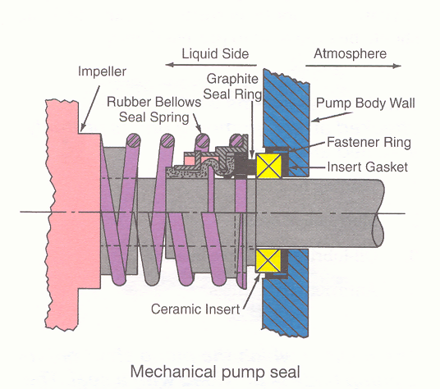
https://www.youtube.com/watch?v=m24uWL6f8K4&list=PLCC52AFC5EED3A08C

Slide 51
SEAL OPTIONS
Standard Mechanical Seal
Carbon ceramic, internally flushed
175 psi w.p., 225’F w.t.
- S type mechanical seal
externally flushed in stuffing box
250 psi w.p., 250’F w.t.
-PF type seal
externally flushed packing
175psi w.p., 250’F w.t.

Slide 52
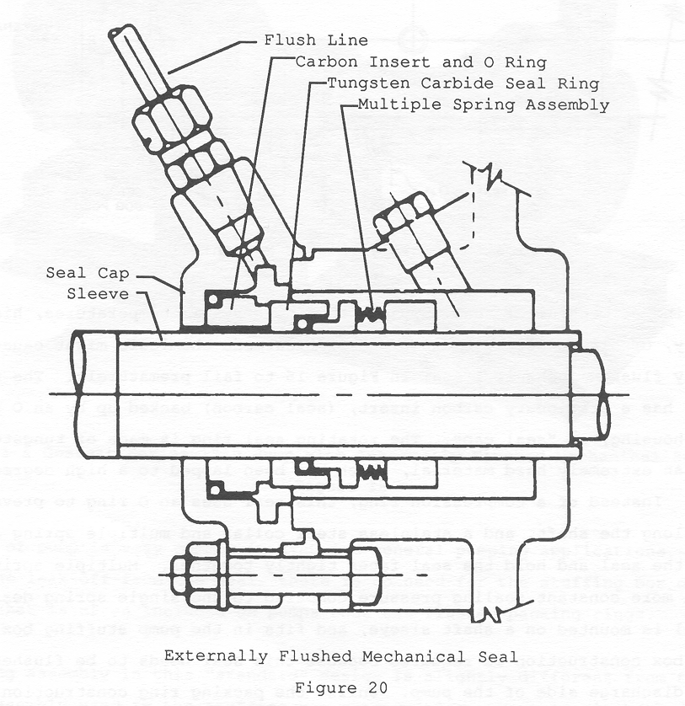

Slide 53
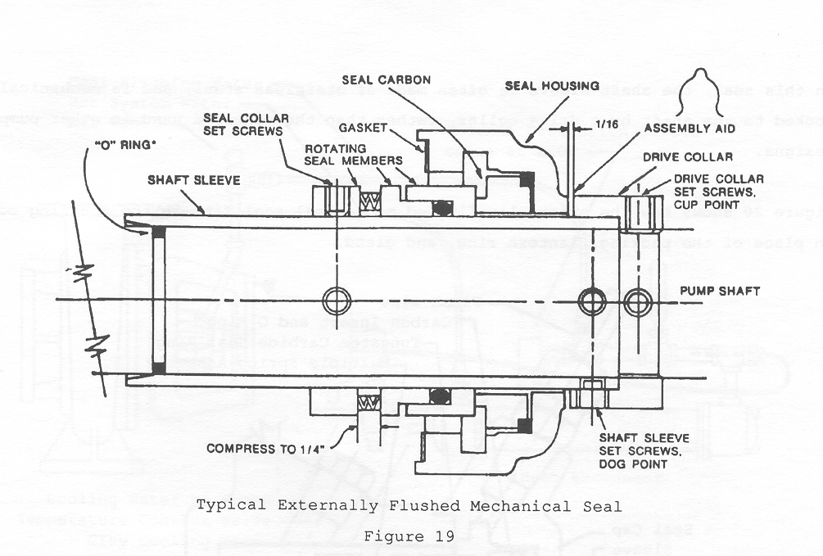

Slide 54
Encapsulation
Similar to tropicalization
Vacuum impregnation
Epoxy coated

Slide 55
SEAL ACCESSORIES
Heat exchanger cooling kit
Cuno filter kit
Sight flow indicator

Slide 56
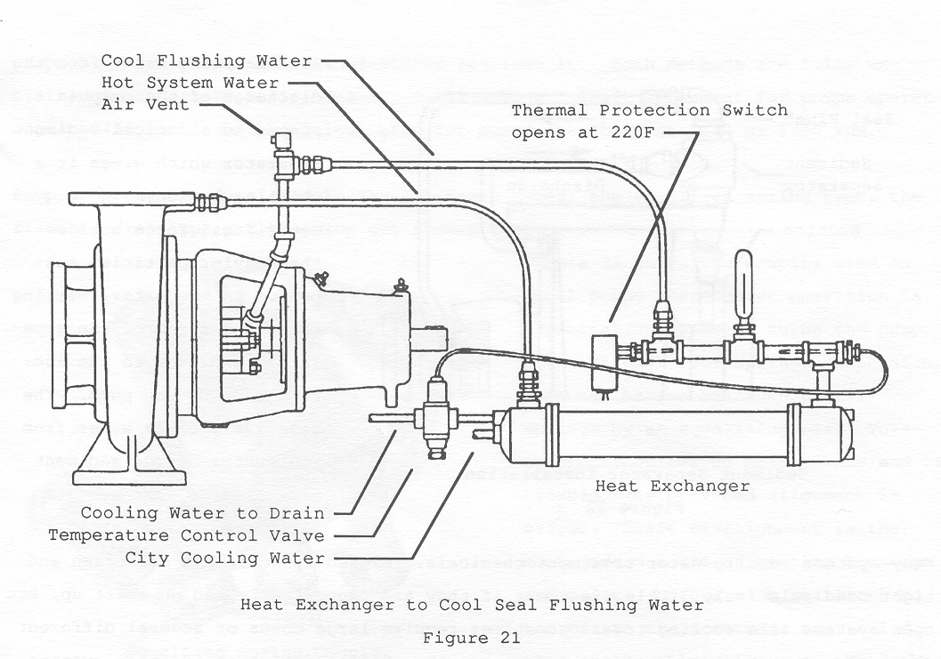

Slide 57
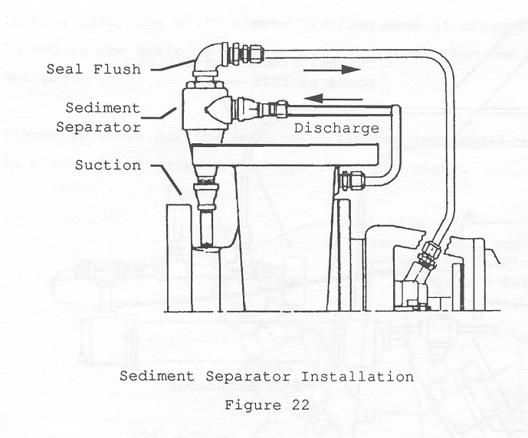

Slide 59
Pump Couplers
Clamp & Sleeve Couplings
Chain Couplings
Metallic Disk Couplings
Gear Type Couplings
Metallic Grid Couplings
Spring Type Couplings
Jaw Type Couplings
Drop Out Sleeve Type Couplings
Doughnut Couplings
Tire Couplings

Slide 60
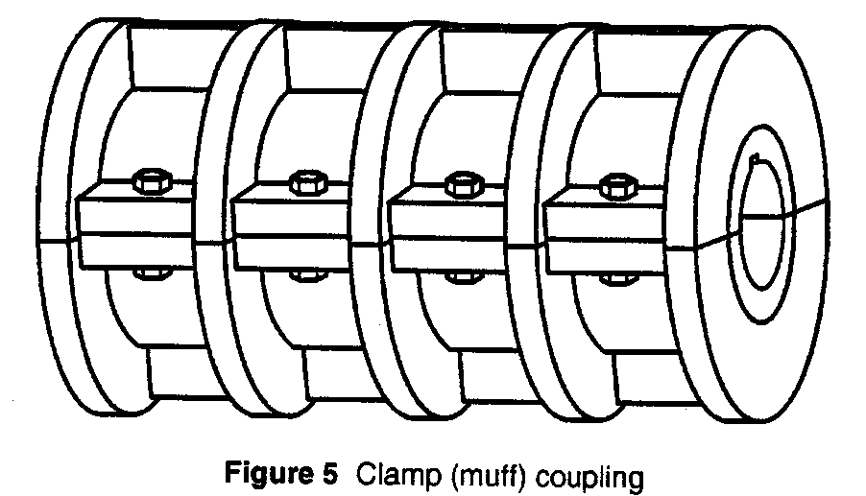
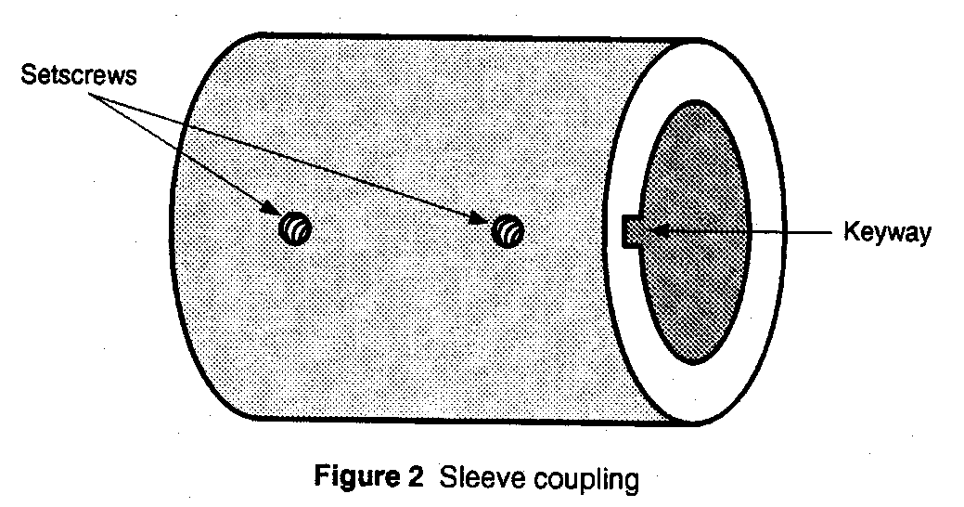
Clamp & Sleeve Couplings

Slide 61
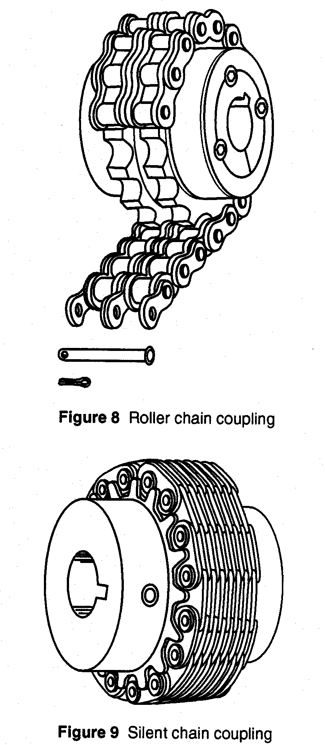
Chain Couplings

Slide 62
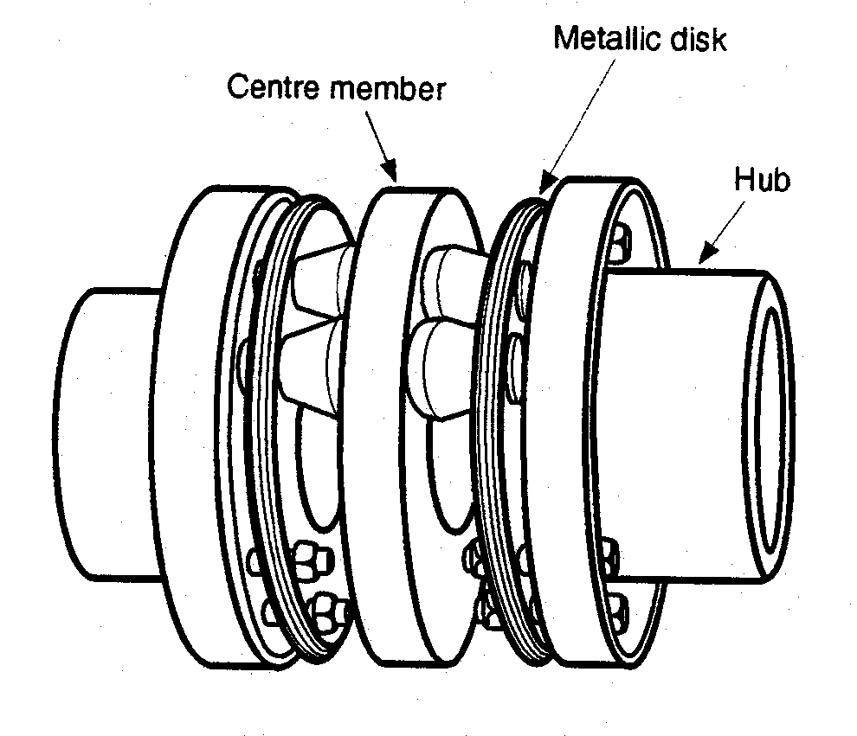
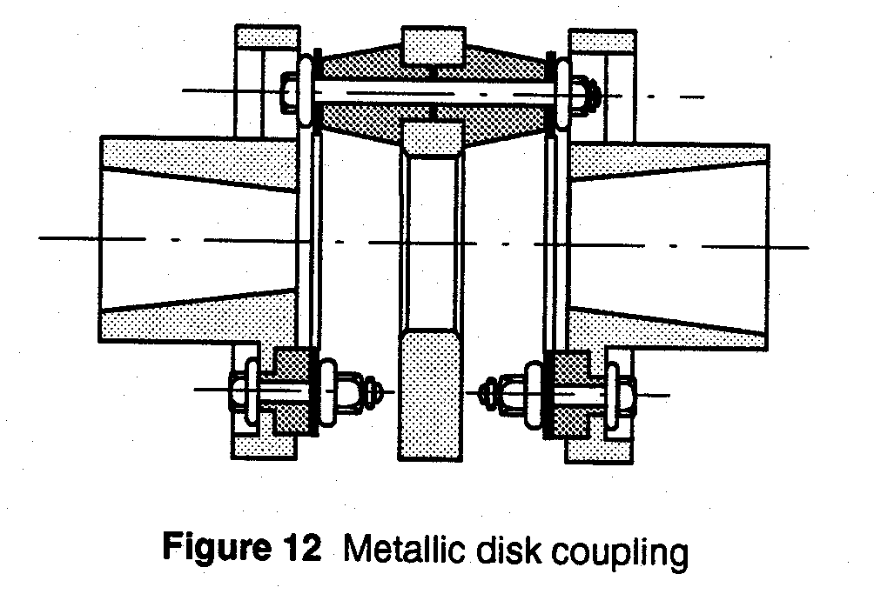
Metallic Disk Coupling

Slide 63
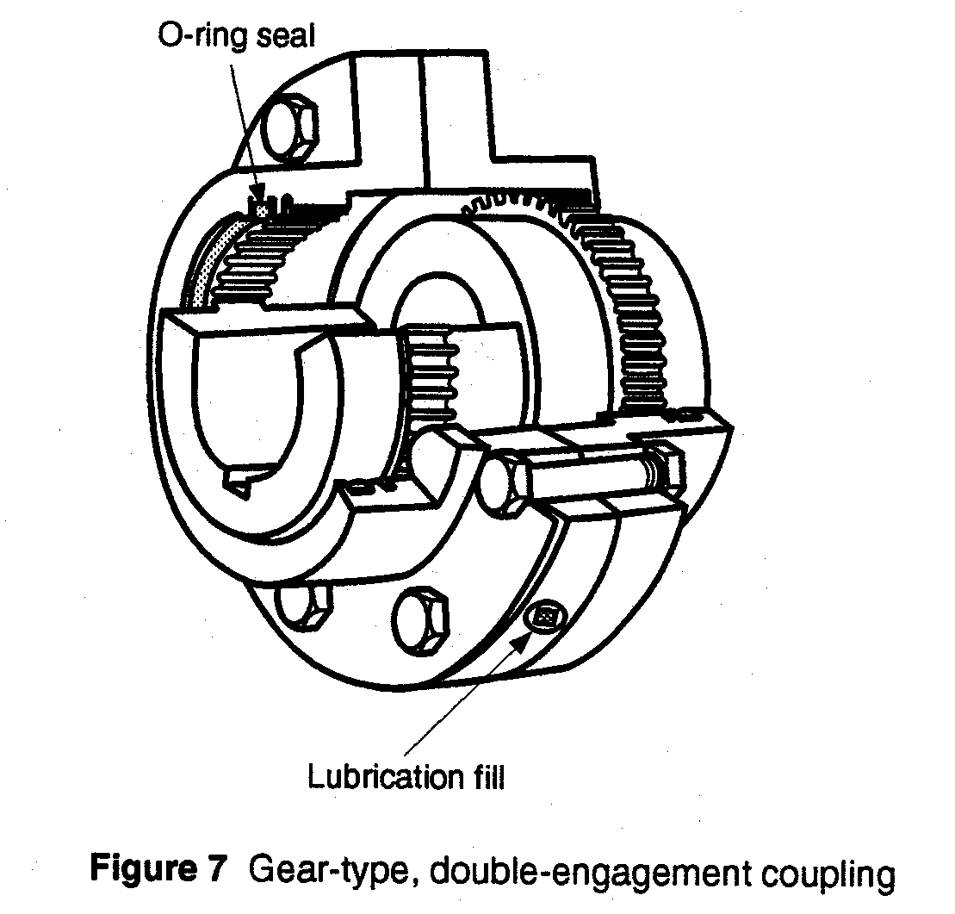
Gear Type Couplings

Slide 64
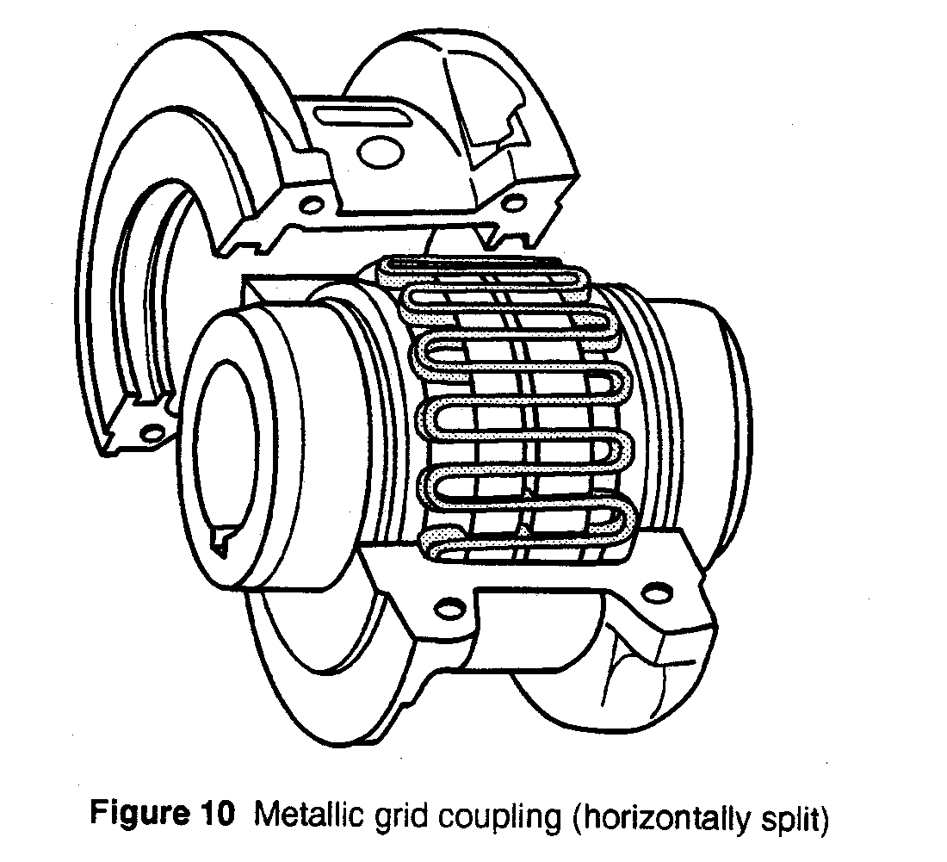

Metallic Grid

Slide 65
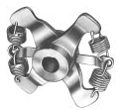
Spring Type Coupler
Equalizing Bar
Coupler Half
Coupler Spring

Slide 66
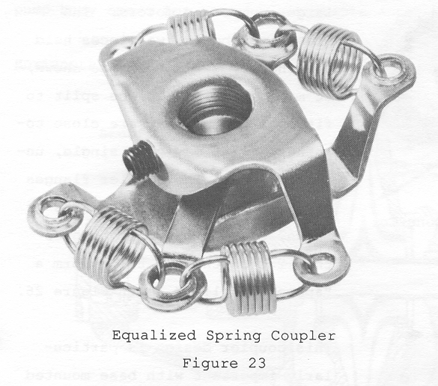

Slide 67
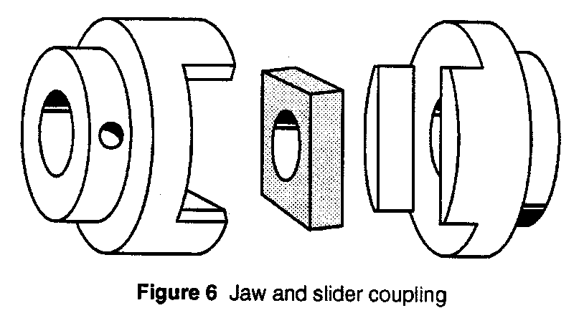
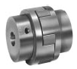
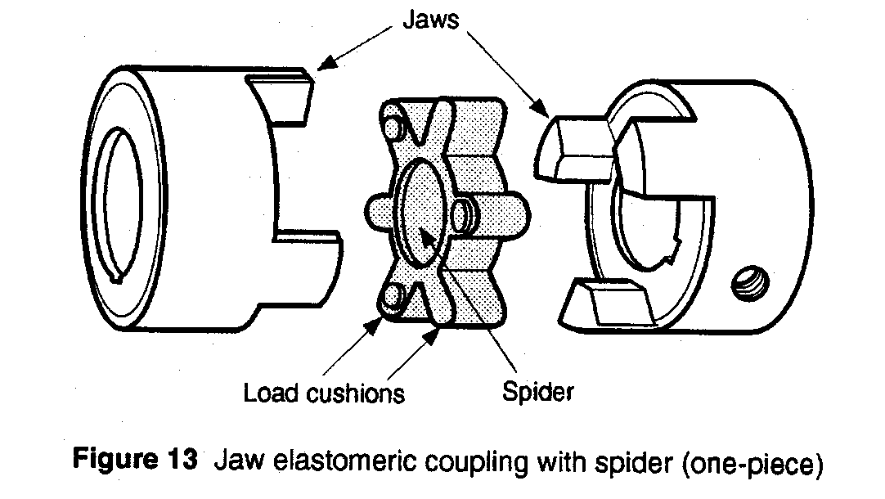
Jaw Type Couplers
Flexible Disc
Coupler Halves

Slide 68
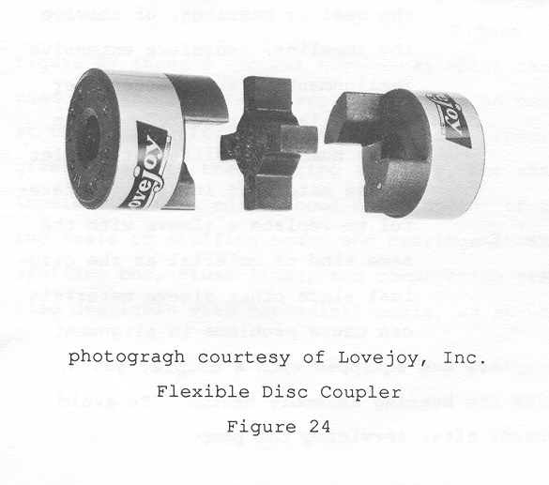

Slide 69
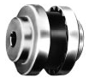
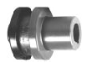
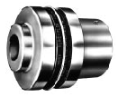
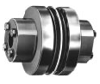
Drop Out Sleeve Type Couplers
Sleeve
Type
Type “J”
“SC” Type
S -Type

Slide 70
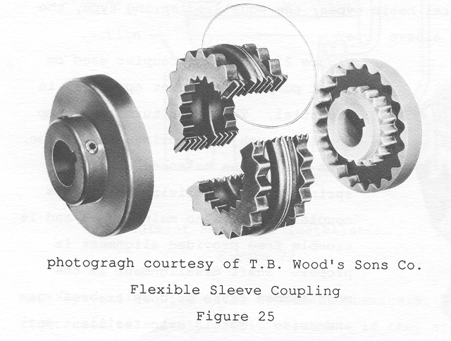

Slide 71
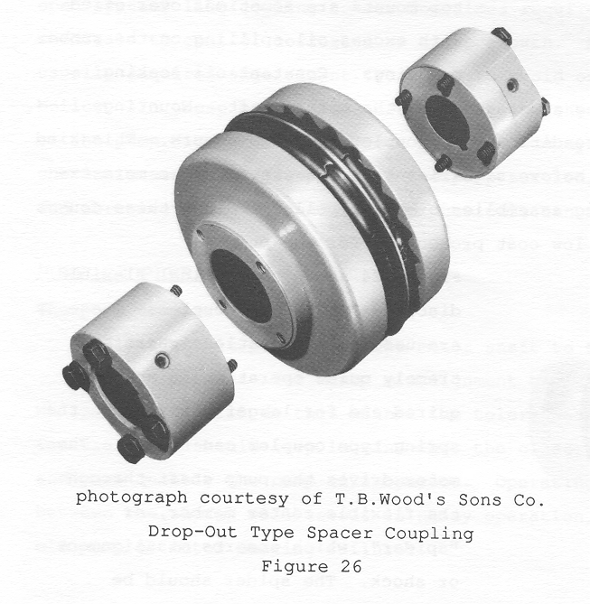

Slide 72
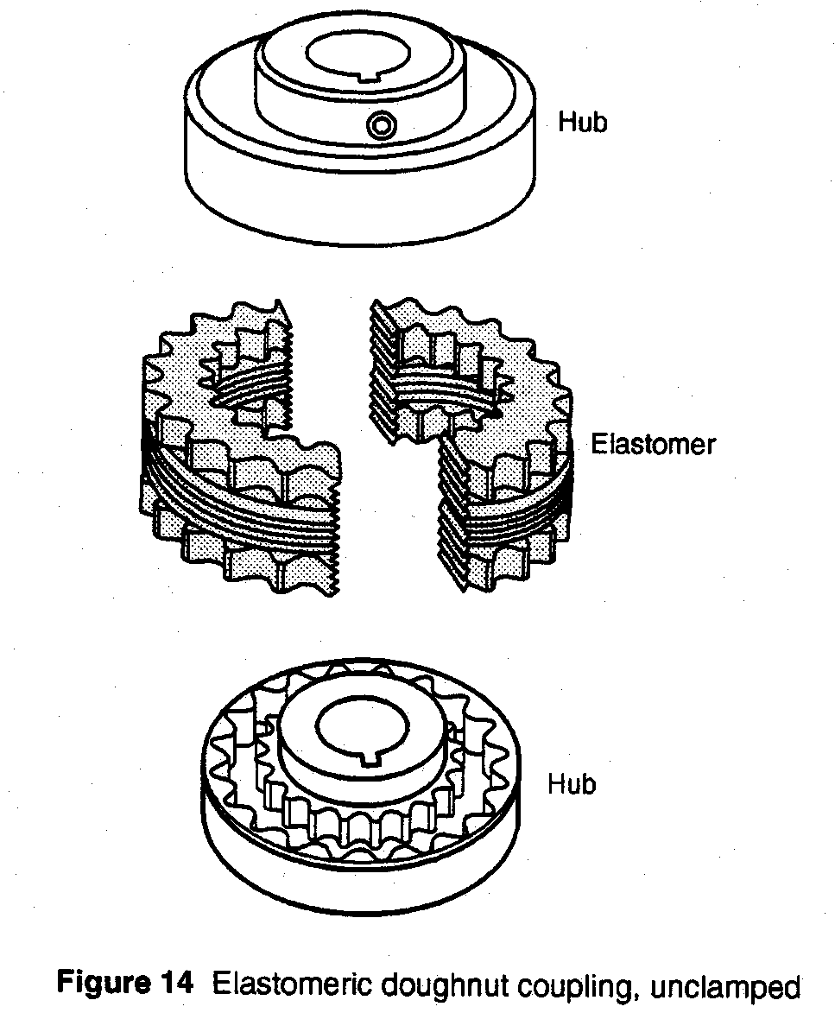
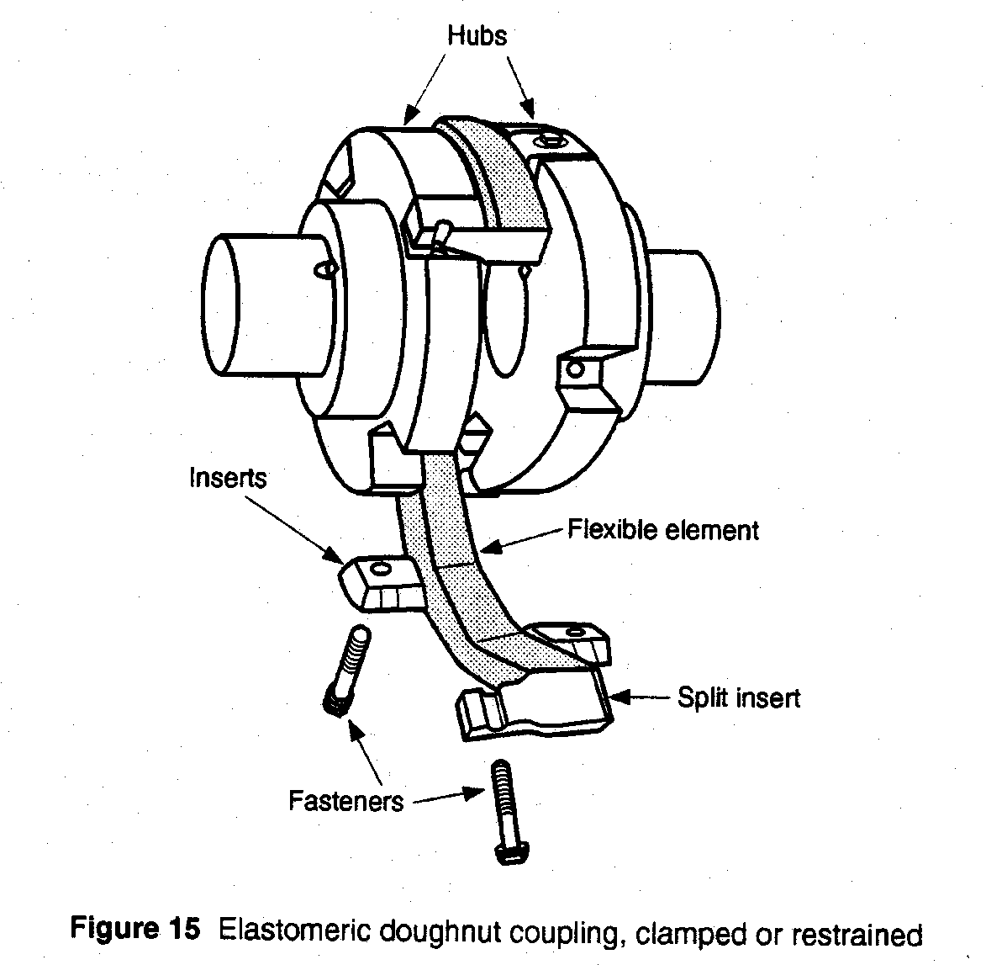
Doughnut Couplings

Slide 73
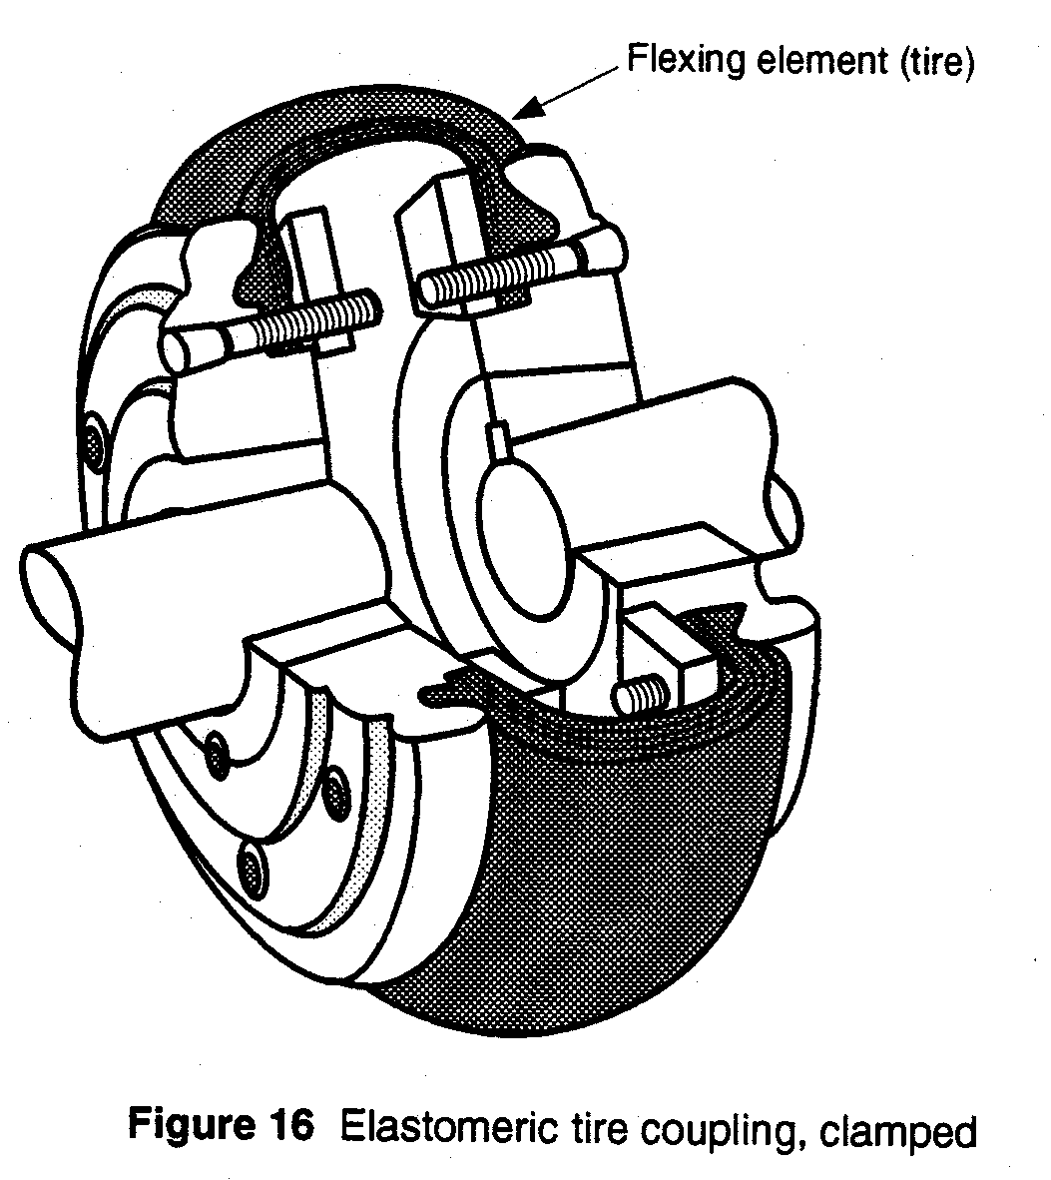
Tire Coupling

