Slide 1



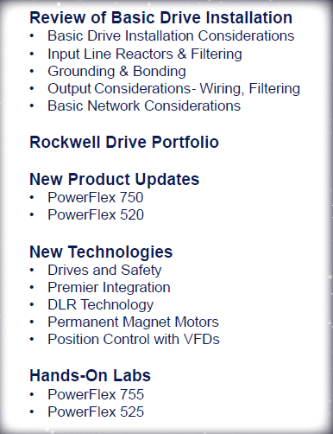

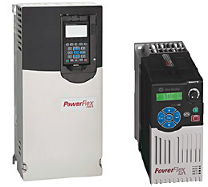



Slide 2
Name the types of speed changers (VFD’s)
Variable Speed Drives (VSD)
Adjustable Speed Controllers (ASC)
Adjustable Speed Drives (ASD)
Frequency Drives
AC drives
Microdrive
Inverters or Inverter drive
Motor drives
Variable speed motor drives
VFDs
Freak Drives

Slide 3
VFD’s Solve Problems
Advantages of VFD’s
1) Allow the load to have Speed variations
2) Reduce heavy load inertia starting
3) Reduce high starting torque
4) Longer Ramp allows for lower starting current
5) High efficiency at lower speeds (50% to 100%)
6) Higher power factor at the Line connection

Slide 4
VFD’s Solve Problems
Benefits of Variable Frequency Drives
• Improved Process Control
• Energy savings (when running below max speed)
• Higher System Reliability (less stress during Start up and Shut down)
• Reduced wear and tear on Mechanical hardware

Slide 5

VFD’s Cause Problems
The not so good that comes along for the ride.
Creation of Line Harmonics
Reflective Wave Phenomenon
Motor Winding Resonance from PWM Carrier frequency
Common Mode Noise
Circulating Bearing Currents leading to bearing failures
AC Line disturbances which affect other equipment
RFI/ EMI/ EMC emissions (which may disrupt sensitive instrumentation)

Slide 6
If they create problems….why use one?
Line Transients
A little protection
and good technique
go a long way to insure a good
drive installation
ACME INCORPORATED
Bearing Current
Tell me again
why I’m using
drives?
?
Harmonics
Reflected Wave
Grounding
&
Bonding
Notes:
The topics we are about to discuss today are not positive attributes of VFD’s
We have to know about them and be aware they can be present in your installation and application
Accept that these issue can be present
Take a close look at your VFD application and access the risk then make a decision in regards to applying a best way to prevent any issues.

Slide 7
Agenda
The VFD Tree from Line to Load
Best Practices

Slide 8
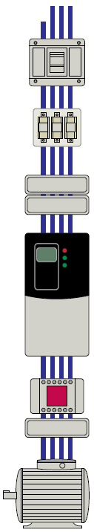
AC supply source
Input line reactor
Input fusing and circuit breakers
Isolation transformer
Drive Input filter
External EMC filter required for EMC compliance..
AC drive – PowerFlex
Drive Output
Output Reactor
DV/DT filter
Sine Wave filter
Common Mode Core

Slide 9
Fusing or Circuit Breakers?
Fuses
In general, the specified fuses are suitable for branch short circuit protection
and provide excellent short circuit protection for the drive.
The fuses offer a high interrupting capacity and are fast acting.
* Typical designations include, but not limited to:
Type CC:KTK, FNQ-R
Type J:JKS, LPJ DFJ
Type T:JJS, JJN
Circuit Breakers
The motor circuit protector or Instantaneous trip breakers also provide branch short circuit protection.
Because circuit breakers are typically slower than fuses and those listed are
magnetic trip only, they may not be as effective in offering short circuit
protection to the drive in the event of an internal drive short circuit. They may
not be as effective in limiting damage to the drive.

Slide 10
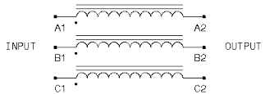
Line Reactors
KDR On The Input to AC Drives
Transient voltages, commonly caused by capacitor switching, or the switching of large load blocks, can result in an over voltage condition of the DC bus. This over voltage condition will cause the Drive to shut down in order to protect its components. These transients can sometimes be very severe and too quick for the Drive to shut down. The addition of a Line Reactor can protect components from possible damage.

Slide 11
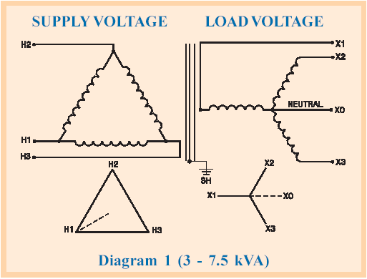
Drive Isolation Transformers
Drive Isolation Transformers are specifically designed to meet the
requirements of IGBT controlled variable speed motor drives. They are ruggedly
constructed to withstand the high mechanical forces and heat associated with SCR or Diode Bridge duty cycles. The double-wound construction isolates the line from most SCR generated voltage spikes and transient feedback.

Slide 12
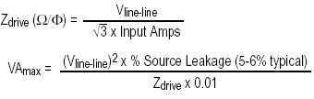
Do I need one?
The basic rules in determining whether a line reactor or isolation transformer should be considered based on the upstream Impedance of the system are as follows:
1. If the AC source experiences frequent power outages or significant voltage transients, users should calculate the VA max (see formula above). If the source transformer VA exceeds the calculated VA max and the drive is installed close to the source, it is an indication that there may be enough energy behind these voltage transients to cause nuisance input fuse blowing, over voltage faults or drive power structure damage. In these cases, a line reactor or isolation transformer should be considered.
2. If the AC source does not have a neutral or one phase referenced to ground, an isolation transformer with the neutral of the secondary grounded is highly recommended. If the line-to-ground voltages on any phase can exceed 125% of the nominal line-to-line voltage, an isolation transformer with the neutral of the secondary grounded, is highly recommended.
3. If the AC line supplying the drive has power factor correction capacitors that are switched in and out, an isolation transformer or 5% line reactor is recommended between the drive and capacitors. If the capacitors are permanently connected and not switched, the general rules above apply.
Notes:
Z drive= 480v /3Squareroot * 65amps
A VFD Rated at 50hp 65amps@480v
Lets do some math… and figure one out
Z= 4.26 ohms
VAmax= (480)^2*.05/(4.26*.01)
VAmax = 270,422va
Maximum size of Transformer upstream can be is = 270.4KVA

Slide 13
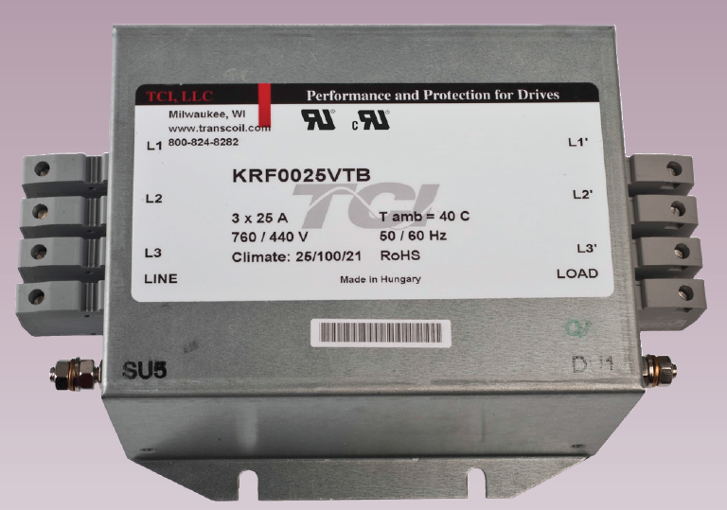
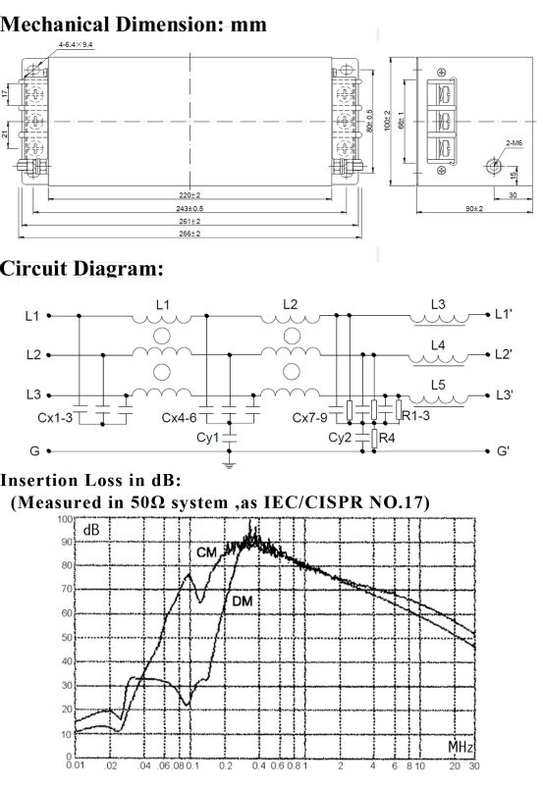
Provides compliance to EMC directives. Generally when someone wants to meet CE for their panel rating. Reduces interference from AC drives that create Common mode noise in the 150 kHz to 30 MHz frequency range.
EMI (Electro Magnetic Interference)
RFI (Radio Frequency Interference)
The terms EMI and RFI are often used interchangeably. EMI is actually any frequency of electrical noise, whereas RFI is a specific subset of electrical noise on the EMI spectrum.
Conducted EMI is unwanted high frequencies that ride
on the utility AC wave form.
Limits high frequency noise
• Reduces interference
• Protects sensitive equipment
• Helps to eliminate drive cross-talk
• Meet FCC Regulation 15, Subpart J
Line Filter

Slide 14
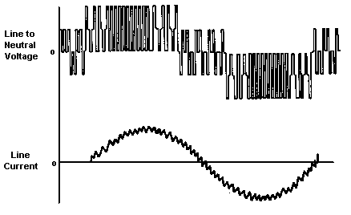
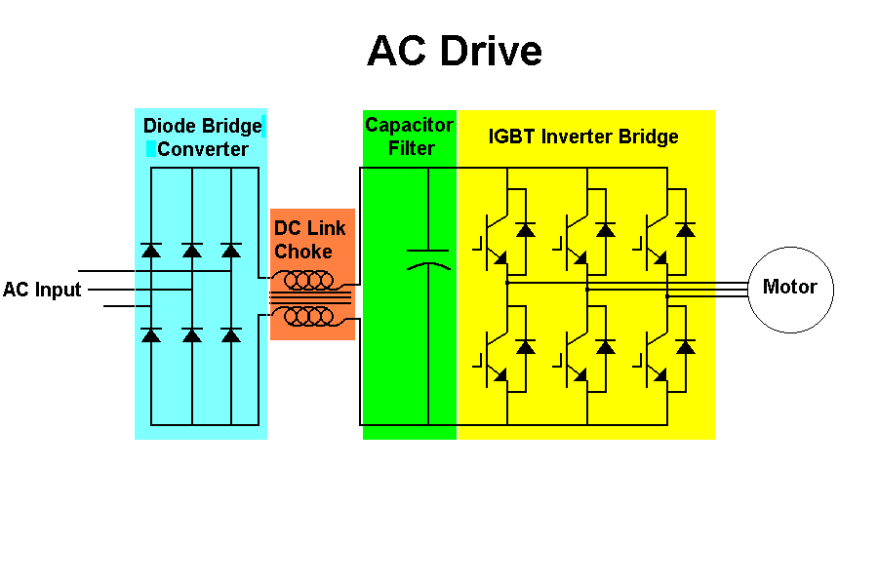
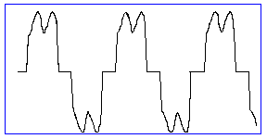
Pulse Width Modulation (PWM)
Notes:
What does the diode bridge do? The diode bridge rectifier converts AC to DC voltage.
The capacitor smooths out the bus voltage and the inductor smooths out the current on the input and reduces harmonics.
PWM Output:
Output frequency and voltage is controlled electronically by controlling the width of the pulses of voltage to the motor.
Essentially, these techniques require switching the inverter power devices (transistors or IGBTs) on and off many times in order to generate the proper RMS voltage levels.
How do you get sine wave current from PWM voltage? Motor is an inductor. I=integral of voltage with respect to time (area under the curve). Tends to smooth out current.

Slide 15
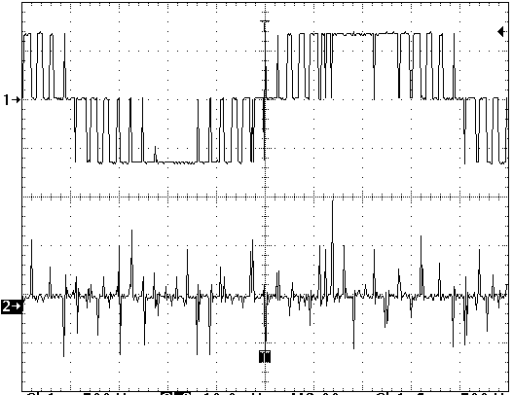
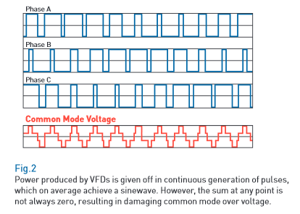
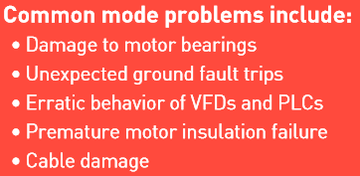
Creation of common mode current
I
lg
V
ng
4 kHz
Switching Pattern (PWM)
of Output IGBT
Common Mode Voltage pattern

Slide 16
Common Mode Choke and Common Mode Caps as a Solution
Common Mode
Choke
AC Drive
Motor Frame
A
R
Vdc bus
U
(+)
I
X
O
B
S
V
lg
Motor
T
W
C
(-)
lg-m
PE
PE
I
lg
Motor PE
GND wire
Common Mode
Bus Capacitors
PE
Common Mode
C
I
lg
I
lg
Current Path
lg-c
EARTH GROUND
Potential 4
Potential #1
Potential #2
Potential #3
Implementation of CM core in drive output, CM cores are smaller than output line reactors. CM capacitors return CM current directly to DC Bus
Notes:
In existing installations a common mode choke that reduces the common mode current levels and frequency is a solution.

Slide 17
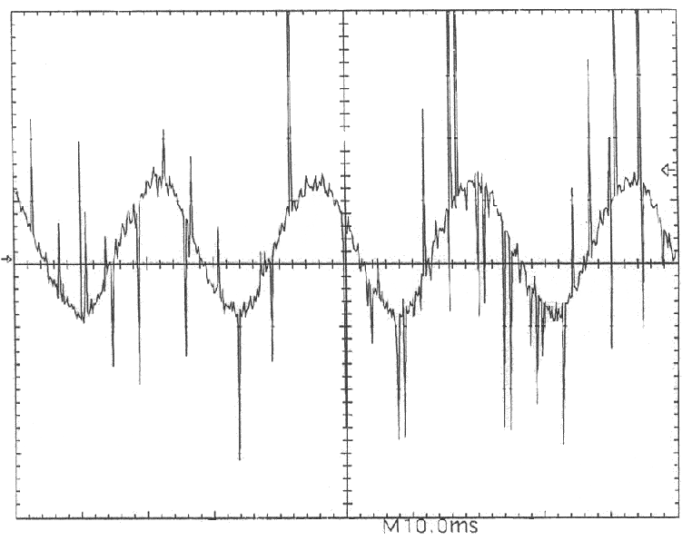
Electrical Characteristics of VFD output cable and motor showing parasitic capacitance to ground and high frequency common mode current
U
I
I
I
MOTOR
ll
lg
R
L
Motor
V
01
01
C
C
C
C
ll
lg
lg-c
ll-m
C
Drive
R
L
lg-m
W
02
02
R
L
PE
03
03
Conduit

Slide 18
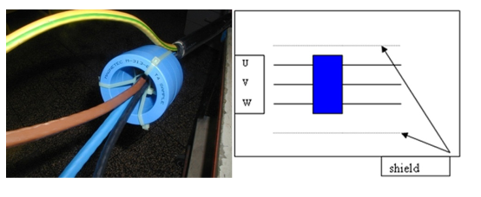
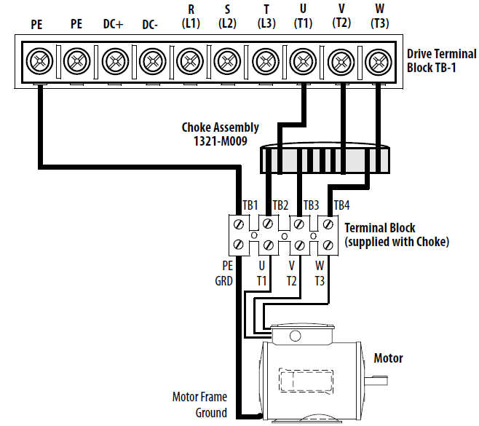
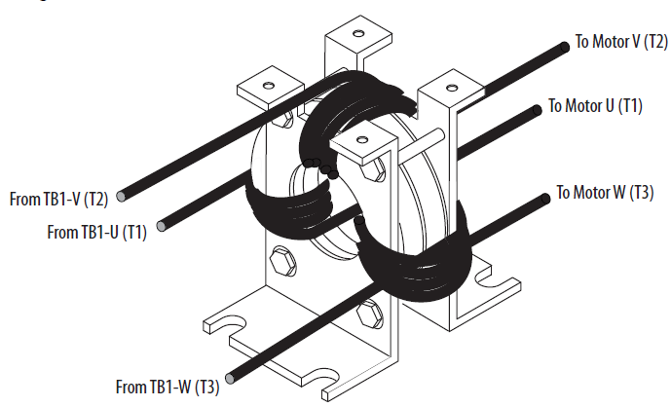
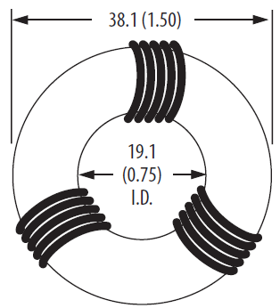
Common Mode Core or Ferrite Core
When installed at the drive output, the common mode choke helps to reduce the interference with other electrical equipment (programmable controllers, sensors, analog circuits, and so forth) caused by the drive output.
In addition, reducing the PWM carrier frequency reduces the effects and
lowers the risk of common mode noise interference.
Wrap each winding 120 degrees
apart from each other

Slide 19
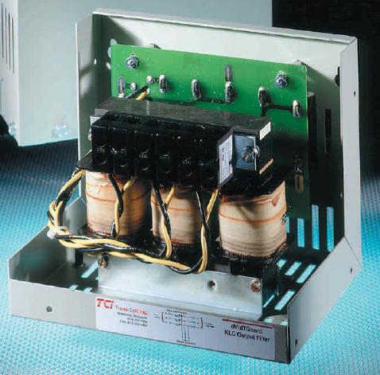
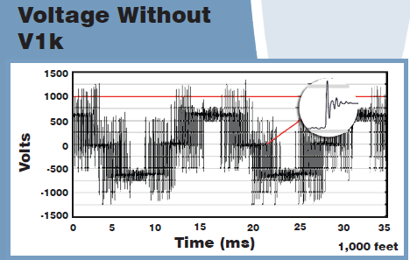
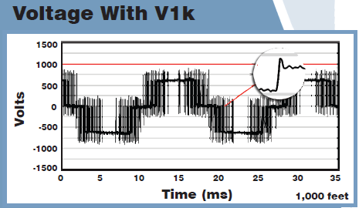
Output Reactor or DV/DT Filter
So is it ok to use a
Line Reactor as a
Load Reactor?
Yes but at 3% impedance
Not Recommended
The Output reactor’s impedance run around 1.5%
In General on an unprotected Motor:
No Output Reactor needed if VFD is less than 50 feet to Motor.
Use 1.5% Load Reactor if VFD to motor is between 50 to 100 feet.
Use Dv/Dt if VFD to motor is 100 feet or more.
Sine Wave Filter super clean output… almost a pure sine wave to the motor. But they are $$$$$

Slide 20
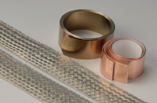
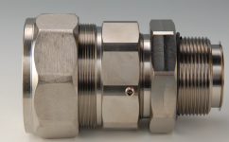
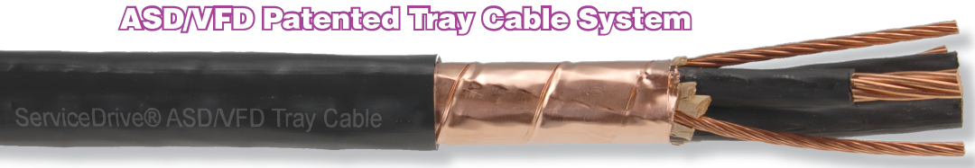
VFD Shielded Cable
High switching speeds of the IGBTs generate EMI.
Reflective Wave phenomenon can cause high voltage spikes which cause premature wire insulation failure.
Common mode noise has no clean path to ground and wreaks havoc with motor bearings and interference on the Ground system.
Proper attachment of shield is just
as important as using shielded cable.
Shielded cable helps reduce or prevent the following:
Reduces Electromagnetic Interference (EMI)… cable shield contains EMI
Reduces common mode or Ground Currents… Shield provide a low impedance path for high frequencies to ground.
Reduce Reflected Waves… done by matching impedance to the motor

Slide 21
Reflected Wave
CIV Violation where windings are destroyed by
Reflected Wave Phenomenon
Corona
Inception
Value
CIV is defined as:
The voltage at which the insulation breaks down and allows current to flow between the conductors causing a short.

Slide 22
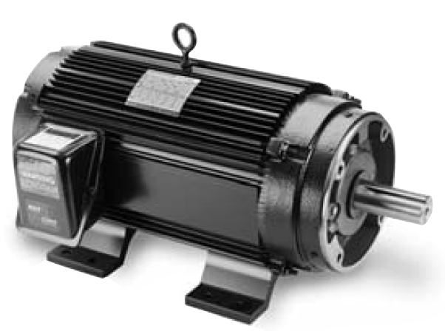
Reflected Wave
Non Inverter Rated Motor Characteristics:
No phase paper or misplaced phase paper, lower quality insulation systems, corona inception
voltages between 850 and 1000 volts.
Inverter Rated Motor Characteristics:
Properly placed phase paper, medium quality insulation systems, corona inception voltages
between 1000 and 1200 volts.
Inverter Duty Rated Motors:
These AC variable speed motors are matched for use with Allen-Bradley drives. Corona inception voltage rated at or above 1,600 volts.
Inverter Duty Rated motors are optimized for variable speed operation and include premium inverter grade insulation systems which meet or exceed NEMA MG1.Part31.40.4.2.
NEMA MG1-1993, Part 31.40.4.2
States that an inverter-fed motor should be designed for a peak voltage of 1,600 volts (V) and a minimal rise time of 0.1 microsecond for motors rated less that 600 V.

Slide 23
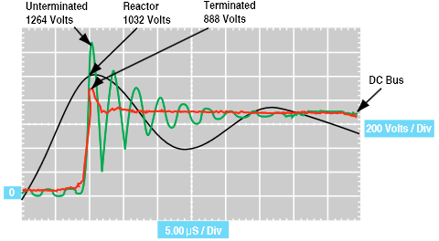
Reflected Wave
The Reflected Wave Phenomenon
The most significant impact that can occur when using an IGBT drive is the occurrence of high voltage spikes at the motor terminals which can produce potentially destructive stress on the motor insulation.
The reflected wave will add and subtract to other signals along the cable, giving rise to standing voltages often in excess of three times the system voltage. These high voltage spikes can quickly destroy cables that are not designed to withstand this sort of abuse.
The waveforms show the amplitude of
reflected wave at the motor terminals
under three conditions.

Slide 24
Reflected Wave
Motor Terminator:

Slide 25
Reflected Wave
To solve Reflected Wave Phenomenon damage to motor:
Limit distance from VFD to the motor.
Use Inverter Rated or Inverter Duty Rated motors.
Use Shielded VFD Cable.
Use Output conditioning (1.5% Load Reactor or Dv/Dt Filter).
Use motor Terminator at the motor.

Slide 26
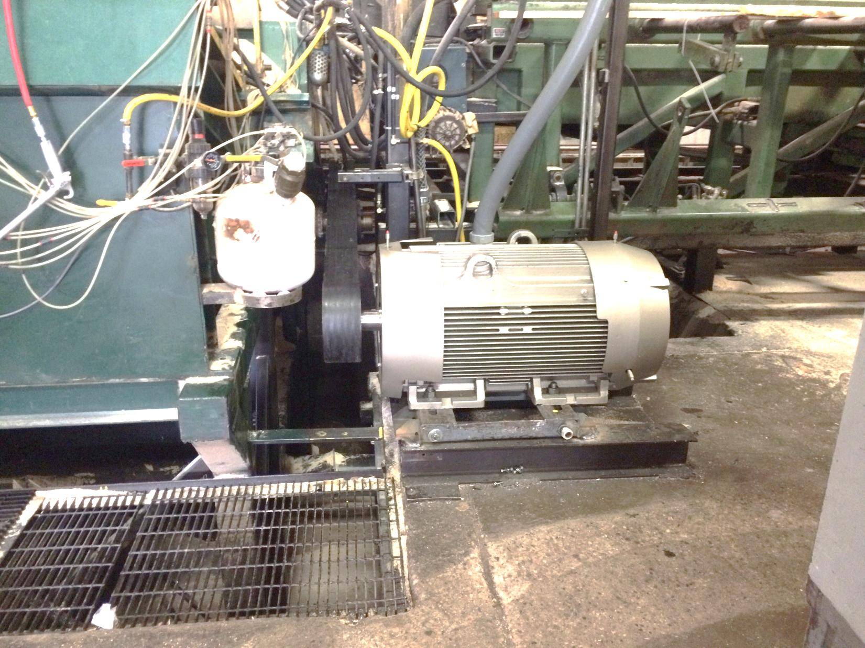
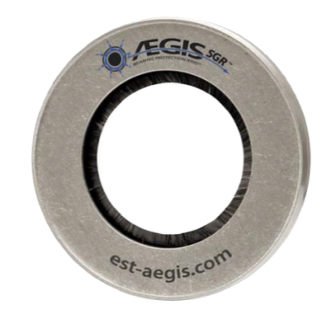
Motors
Motors should be rated for use with VFDs.
Carry a high CIV (Corona Inception Value)
Constant Torque ratings and Speed Regulation ratings should be considered before motor is selected.
Avoid open conduit to motor
pecker head from VFD when motor is in a colder environment
Which allows for condensation in the Stator cavity.
Use putty to block air flow.
Ground Brush option will allow
motor to survive longer with vfd.

Slide 27
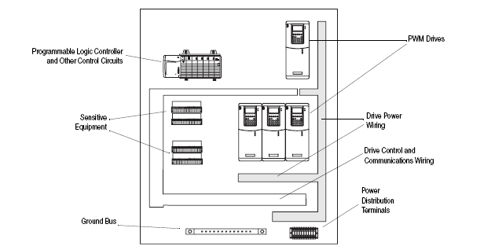
Best Practices
No more than 3 motor lead sets in a single conduit.
Control Wiring should be run in a separate conduit or isolated from high voltage conductors.
Use of Galvanized back plate for high voltage power structures
such as VFDs and Servo Drives is highly recommended.
Separate the placement of power structures in the panel
from low voltage components.

Slide 28
Before you install the Variable Frequency Drive
Review the branch circuit short circuit protection requirements (fuse size) making sure the drive is protected as per the user manual.
Consider line or load filters to see if they should be used for the application.
If near motor disconnect or Output contactor is used make sure an Aux contact in used as an interlock to the Drive enable (or stop) circuit to prevent drive from being at frequency when load is engaged.
After mounting the Drive, protect it from possible contamination (metal filings pieces of striped wire) entering into electrically sensitive components by covering the vents with plastic or removable tape.
Review the maximum and minimum wire sizes the Drive’s power terminals can accept. Over sized wire will not fit in the terminals.
Do not over tighten drive power or input terminal screws.
Avoid doubling up wires at the Drives input terminals (if the wire size larger than 18 ga.). If possible double up or jumper them at the terminal blocks where extra room is available.

Slide 29
Before you run the motor for the first time
Verify that there are no loose filings, metal chips, or debris that could have gotten into the Drives circuit boards.
Measuring resistance of the motor leads phase to phase and phase to ground before terminating to the drive is a very good idea. This will prove that the wiring and the motor do not have any obvious problems.
Confirm that all inputs are connected to the correct terminals and are secure. Verify control voltage is correct for the Drive inputs (24vdc goes to 24vdc inputs / 120vac goes to 120vac inputs).
Verify that the Stop input is present or the drive will not start.
Powering up the Drive without terminating the motor leads to verify the drive operates properly without a load is a very good idea. This will prove the Drive works out-of-the-box and the start/stop and speed reference has been assigned and wired correctly.

Slide 30
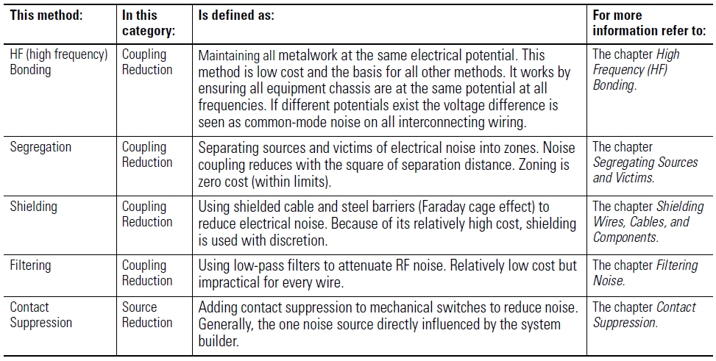
How to Mitigate Noise

Slide 31
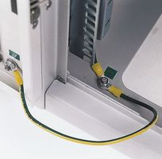
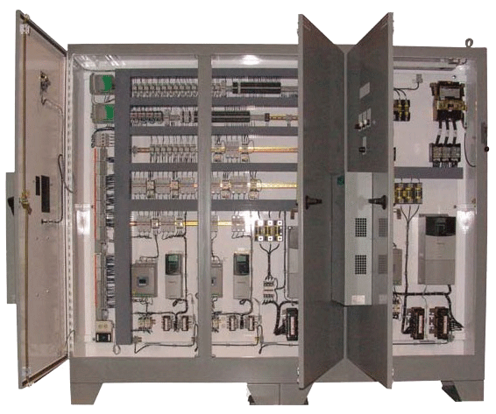
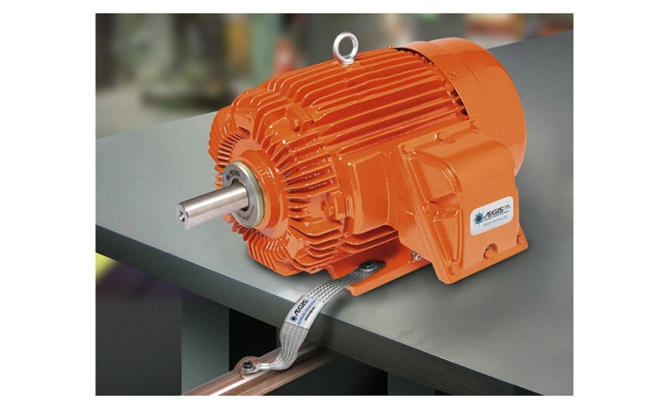
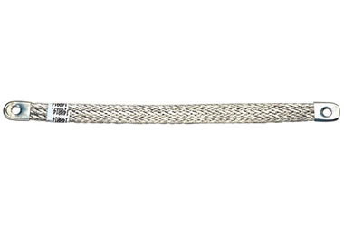
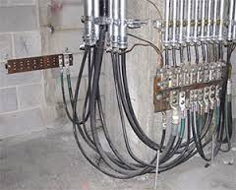
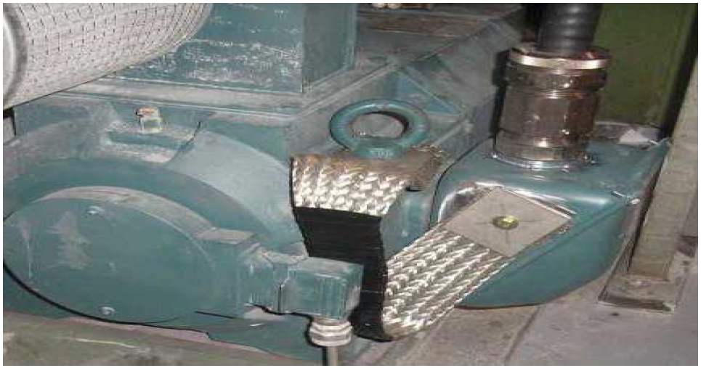
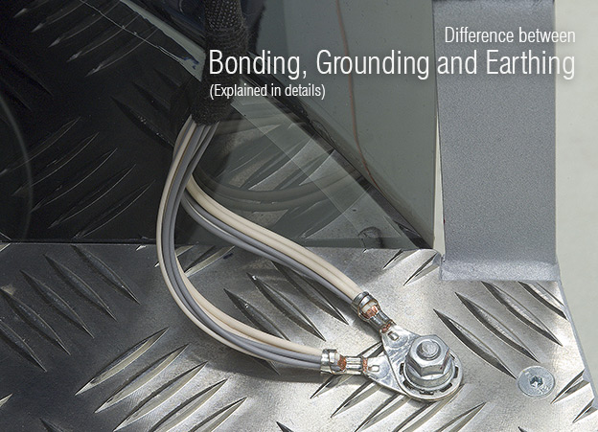
High Frequency Bonding
Use of large surface area Bonding Strap

Slide 32
Segregating
Tips for Separation of Cables
Maintain as much separation as possible between noise-susceptible cables and VFD cables–a minimum of 1 ft. for shielded instrumentation cables and 3 ft. for unshielded instrumentation cables.
If the two types of cable must lie close to each other, try to minimize the amount of parallel runs between them; it is wise to limit these stretches to 10 ft. or less to reduce the likelihood of picking up radiated noise.
Finally, if the two types of cable must unavoidably cross, it is preferable to cross them perpendicularly, at a single point.

Slide 33
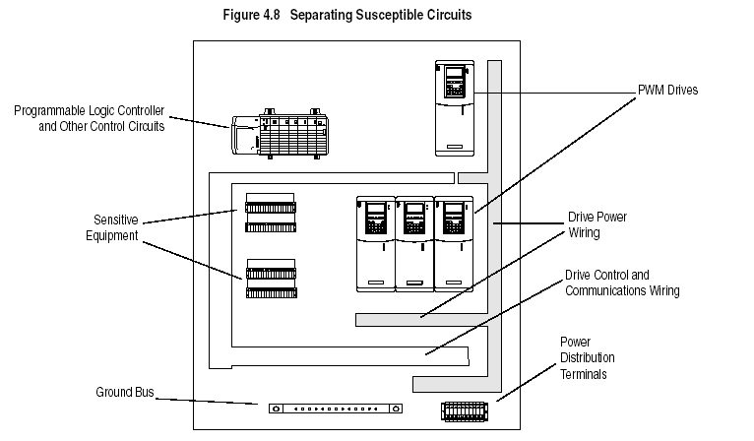
Segregating

Slide 34
Shielding
Tips for Management of Cable Noise Interference:
Unshielded VFD conductors can radiate more than 80V of noise to other unshielded communication wires and more than 10V of noise to shielded instrumentation cables.
When VFD cables are installed close to low-level communications cables and other susceptible devices, it is necessary to ensure that shielding is present in the VFD cable.
The use of unshielded cables in conduits around a VFD setup should be limited or eliminated completely, since the conduit is an uncontrolled path to ground for the noise it captures.

Slide 35
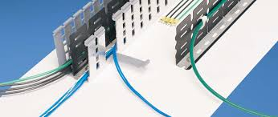
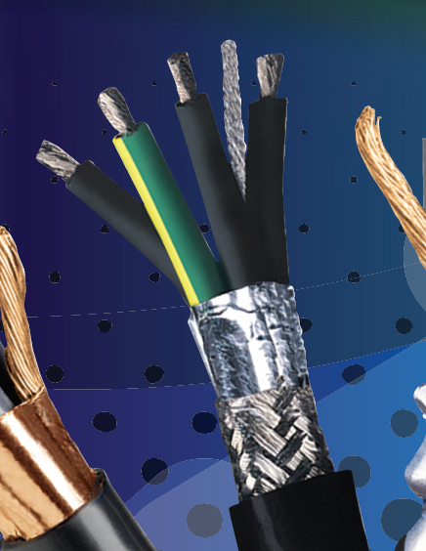
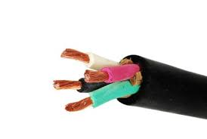
Shielding
Faraday Cage
So does SOOW
Cable use a shield?

Slide 36
Filtering
Normally Filtering used to attain a CE mark or acceptance.
Used to reduce EMI and RFI interference that may cause sensitive electronics to act strangely.
Example:
An RFID Tag is attached to the Cow’s leg.
Cow comes into the milk parlor to get milked and can only be milked 3 times a day.
RFID Reader is used to verify ok for Cow to come in.
It opens the gate into the parlor area allowing Cow to get milked.
When the VFD is running the Gate won’t open.
RFI /EMI interference is blocking the RFID reader from reading the Tag on the Cow.
Cow does not get Milked …Farmer gets Mad!
Solution :
1) Install Common Mode Cores at VFD in question (or all of them)
Install a Line Filter on the Line side of VFD
Install Shielded Cable from VFD to motor
4) Install Dv/Dt filter between VFD and motor.

Slide 37
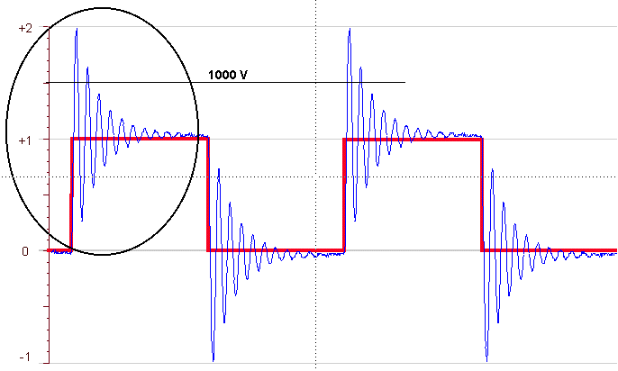
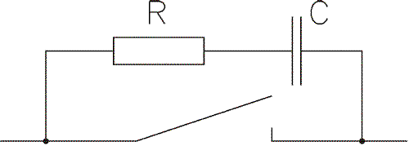
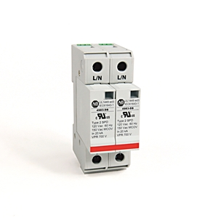
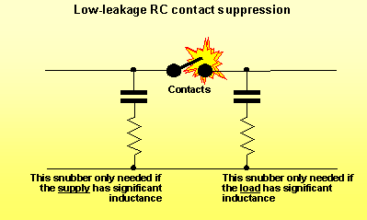
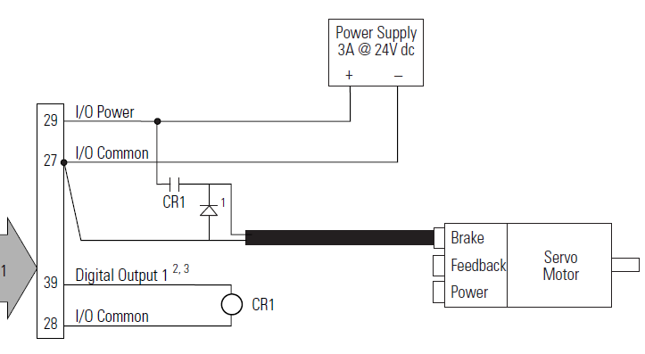
Contact Suppression
Suppression
Surge Suppression
4983-DS480-403

Slide 38
Grounding AC Variable Frequency Dives
NEC code deals with Ground Faults and is concerned with Protection of Personnel and Equipment via a 60hz ground path back to the Branch Circuit which will clear if a fault exists.
It does not “care” about Noise Mitigation
or
High Frequency grounding (150Khz - 30Mhz)
It’s Not Magic!..
It’s something you consider at the design or installation stage to avoid problems later on.

Slide 39
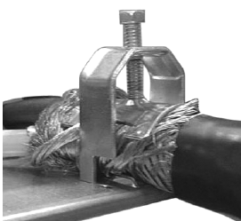
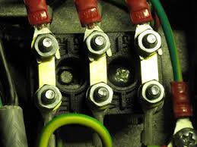
Grounding
Using an insulated grounding conductor is preferred over a non insulated conductor.
The grounding conductor is terminated both at the motor and at the drive.
If using a shielded cable the shield should be solidly bonded at both the drive and frame of the motor.

Slide 40
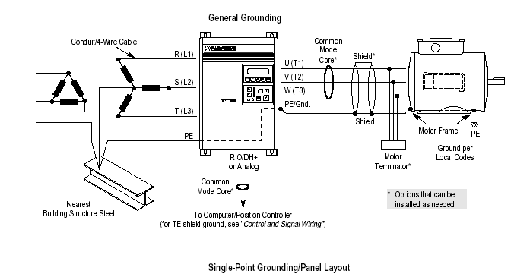
Grounding For Noise
Noise seeks the path of least resistance back to it’s source.
Motor ground and Shield is terminated at Drive not the ground bar.
Drive ground is then terminated at the ground bar.
Motor Ground and Shield is bonded to the Motor Frame.

Slide 41

Accepted Grounding

Slide 42
Useful References
www.ab.com/drives/techpapers/ieee/ieee.html
Wiring and Grounding Guidelines for Pulse Width Modulated (PWM) AC Drives
Publication : Drives-IN001-EN-P
System Design for Control of Electrical Noise
Publication : gmc-rm001A-en-p.pdf

