Slide 1

Fundamentals of AC Motors
Dykman Electrical
5 April 2013

Slide 2
Three Phase Motor Construction
Windings - Electromagnets
Rotor bars
Rotor
Stator
Notes:
If we pulled apart an induction motor, the two major parts we would see would be the rotor and the stator.
The stator is the stationary portion of the motor and is cut into thin sections of steel that are laminated and assembled in a sandwich-like manner. The fixed stator is comprised of windings of wire. When these windings are energized, they become electromagnets, and produce a magnetic field or flux.
The rotor is the rotating portion of the motor and is comprised of a steel cage covered with aluminum or copper bars, called rotor bars. The bars are shorted together on each end by an end-ring. The rotor sits inside the stator, and there is no mechanical or electrical connection between the two. When power is applied to the fixed stator, the rotor begins to turn through the stator field.
REFER TO CUT-A-WAY MOTOR TO POINT ABOVE PARTS OUT.

Slide 3
Three Phase Motor Construction
Stator Windings
Enclosure
Air Gap
Stator
Rotor
Shaft
End View
Notes:
If we took a end view of the motor, we would see the rotor positioned inside the stator and separated by an air gap. When the motor is connected to an electrical supply, a magnetic flux will be produced that will cause the motor to rotate. To understand how the flux produces rotation just remember.......

Slide 4
Three Phase Motor Construction
T1
T2’
T3’
T3
T2
End View
T1’
Notes:
Now, looking back at the end view of the motor. Each winding group is connected to a phase.

Slide 5
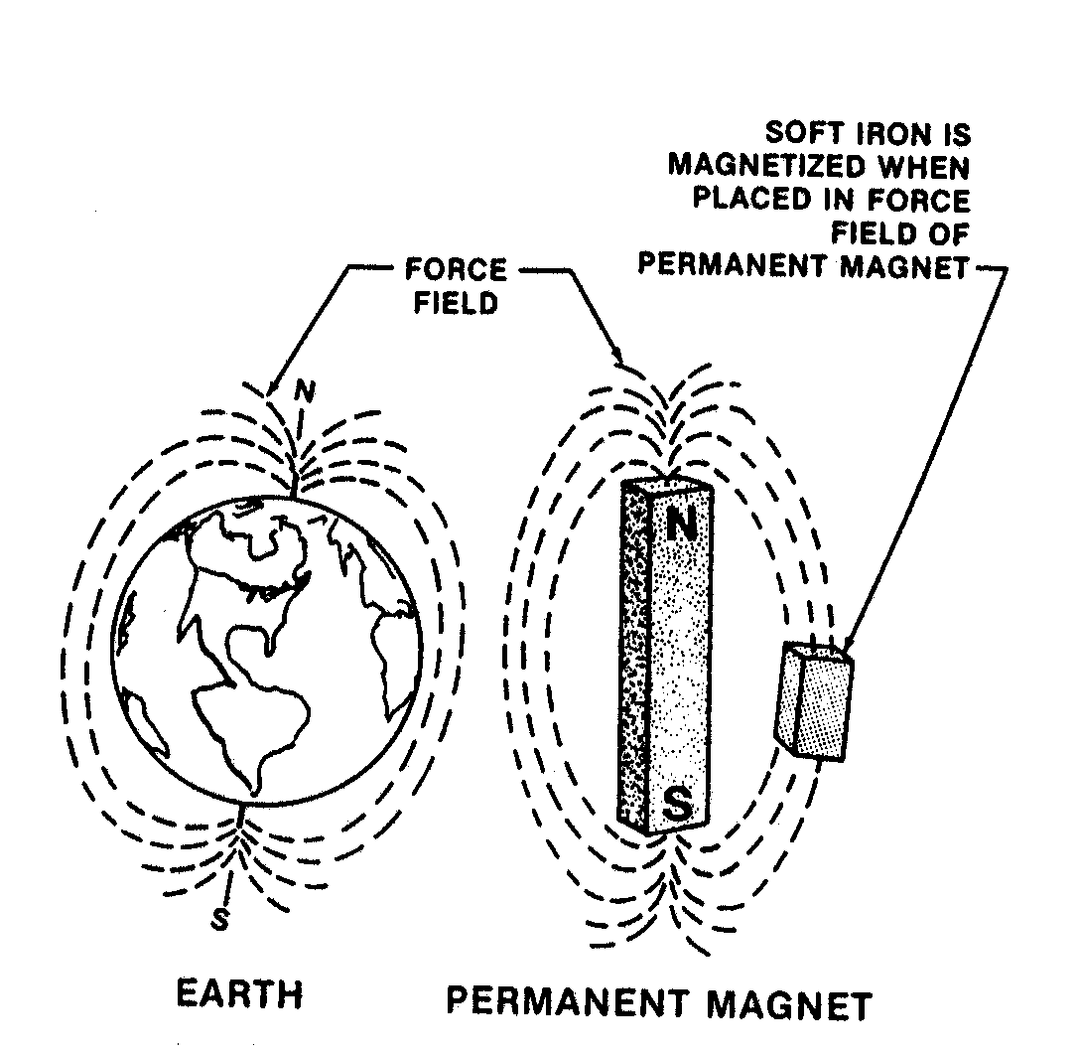
Motor Operation
Notes:
The Earth is a permanent magnet with lines of force rotating around it from the north pole to the south pole.
A piece of soft iron placed within the force field of a permanent magnet becomes magnetized.
The soft iron does not have to touch the permanent magnet to become magnetized. The soft iron then takes on the same characteristics as the permanent magnet.
This type of action in motor operation is called induction.

Slide 6
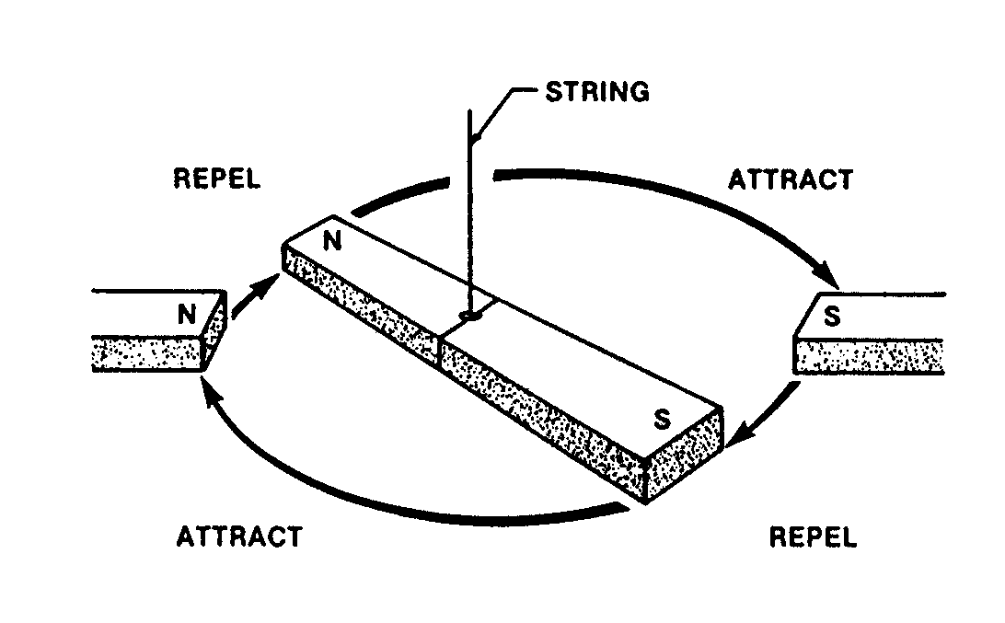
Motor Operation
Notes:
The poles of two permanent magnets either attract or repel. Unlike poles atttract each other while like poles repel each other.
If a magnet is suspended by a string, it will rotate by being attracted or repelled by a second magnet.
This is the major principle of motor operation.

Slide 7
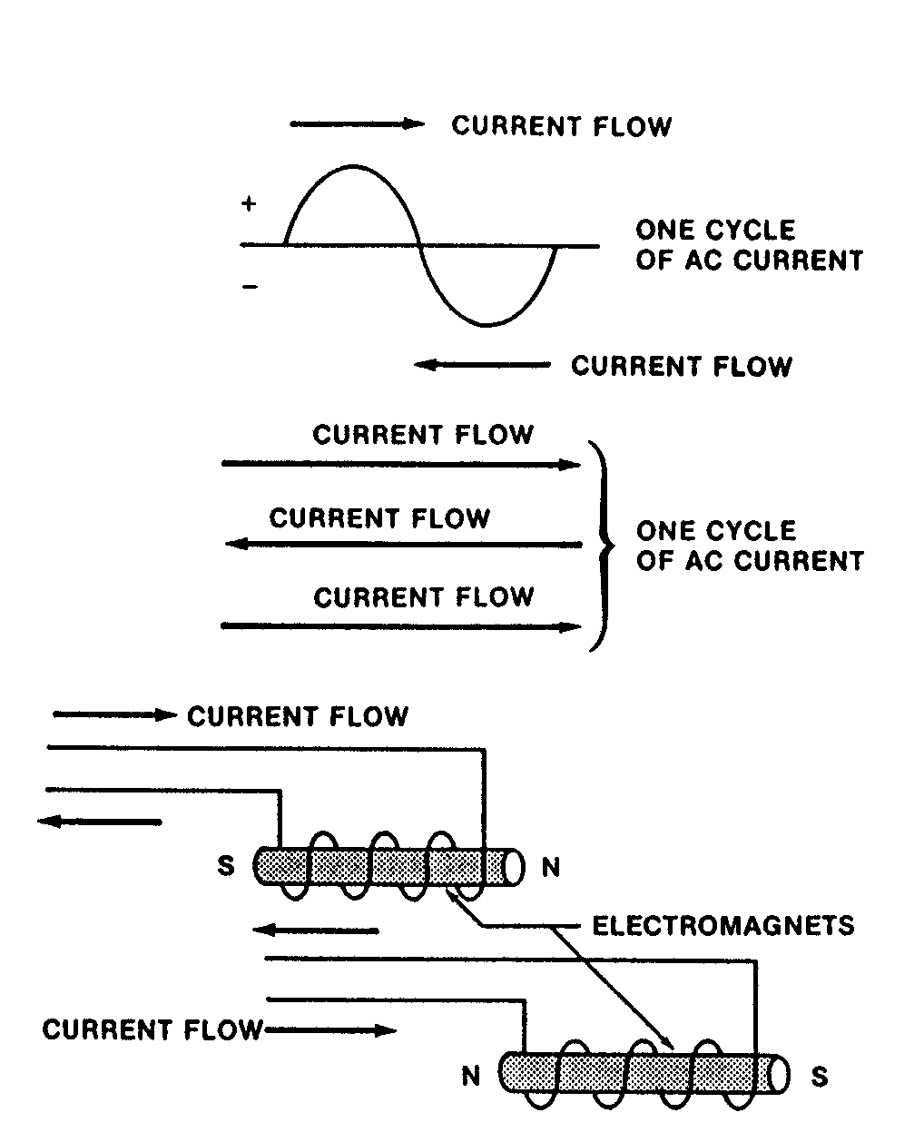
Motor Operation
Notes:
ELECTROMAGNETS
An electromagnet is a wire wound around a piece of iron. A straight conductor carrying current produces a weak magnetic field. An iron core with many turns of wire around it forms a coil and produces a strong magnetic field.
The number of turns in the coil and the amount of current flow determines the strength of the magnetic field. A coil with many turns produces a strong magnetic field while a coil with fewer turns produces a weaker magnetic field.
Reversing Poles
Reversing the current flow through an electromagnet changes the polarity of its poles. Current flow in one direction produces a south pole on one end; current flow in the opposite direction produces a north pole.
Alternating current (AC) changes the direction of the magnetic field of an electromagnet from north to south due to the current flow changing direction.

Slide 8
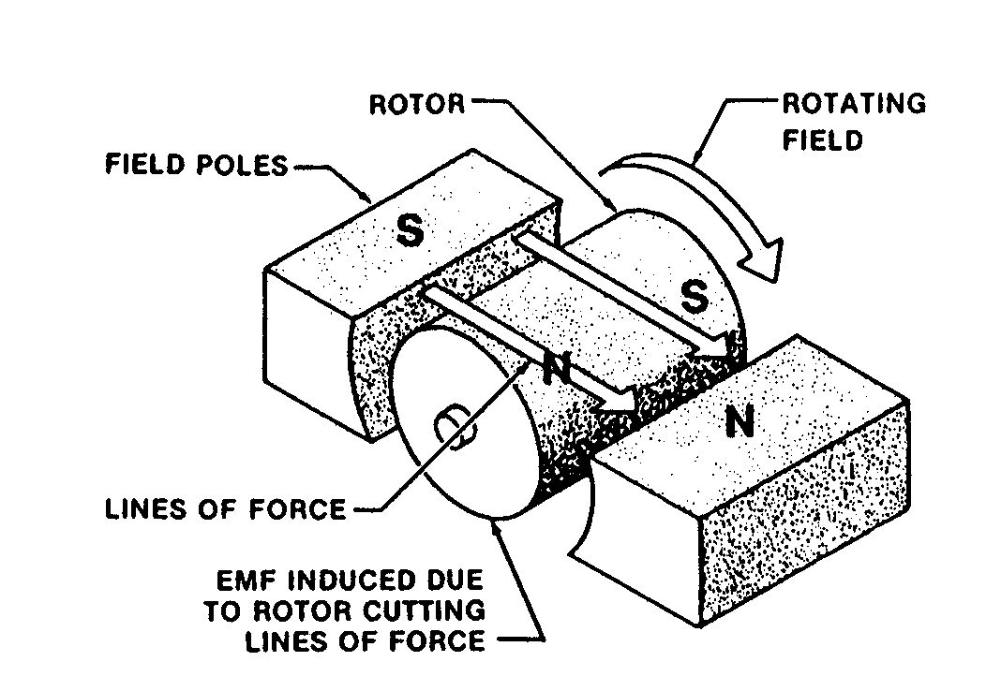
Motor Operation
Notes:
When 60Hz of alternating current is supplied to the stator, the stator poles reverse their polarity 120 times per second. This occurs every time the current changes direction. Please note that stator poles and electromagnets are basically the same.
The rotor then tries to catch the alternation of current creating the magnetic lines of force between the stator field poles.
The rotor

Slide 9
Three Phase Motor Construction
+
T1
denotes current is moving away from you
+
T2’
T3’
+
+
T3
T2
End View
denotes current is moving towards you
T1’
Notes:
When an electrical supply is connected to the motor, current will flow through the stator. The direction of current flow is shown on this diagram. The x denotes that the current is flowing away from you and the dot denotes that the current is flowing towards you.

Slide 10
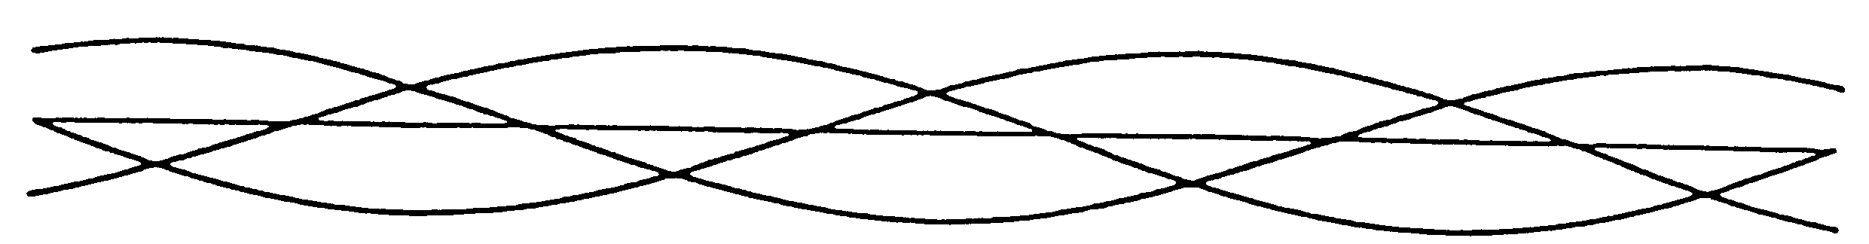
Rotation of the motor
One Cycle*
T1
T3
T2
N
+
N
+
S
+
N
S
S
* - current waveform
Notes:
This one instant of time is our zero position of one electrical cycle. This is the same diagram as on the previous page.

Slide 11
Rotation of the motor
One Cycle*
T1
T3
T2
N
+
N
+
S
+
N
S
S
+
N
+
S
S
N
N
+
S
* - current waveform
Notes:
As the three phases progress through the cycle the current will flow in different directions through the stator. This change causes the pole groups to change polarity, thus producing a rotating magnetic field. The rotating magnetic field cuts through the rotor and causes current to flow in the rotor bars and the rotor produces its own magnetic field.

Slide 12
Rotation of the motor
One Cycle*
T1
T3
T2
N
+
N
S
+
S
+
+
N
N
S
S
N
+
S
S
+
N
+
N
+
S
S
N
N
+
S
* - current waveform
Notes:
The magnetic field of the rotor attempts to oppositely line up with the stator magnetic field. But the stator magnetic field is rotating so the rotor magnetic field must chase the stator field thus causing rotation.

Slide 13
Rotation of the motor
One Cycle*
T1
T3
T2
N
+
N
S
+
S
+
+
N
N
S
S
N
+
S
S
+
N
+
N
S
S
+
N
S
S
N
N
+
+
S
+
S
N
+
N
* - current waveform
Notes:
As we progress further and further throughout the cycle, we can see the motor completes one full rotation, in a period of one cycle.

Slide 14
Rotation of the motor
One Cycle*
T1
T3
T2
N
+
S
N
S
+
S
+
+
+
N
N
N
S
N
S
S
S
+
+
N
S
S
+
N
N
+
+
N
S
S
+
N
S
S
N
N
+
+
S
+
S
N
+
N
* - current waveform
Notes:
move through this screen

Slide 15
Rotation of the motor
One Cycle*
T1
T3
T2
N
+
S
N
S
+
S
+
+
+
N
N
N
S
N
S
S
S
+
+
N
S
S
+
N
N
+
+
+
N
S
S
N
+
N
+
S
S
S
N
N
S
N
+
+
N
+
S
+
S
N
+
N
S
* - current waveform
Notes:
move through this screen

Slide 16
Rotation of the motor
One Cycle*
T1
T3
T2
N
+
S
N
+
N
S
N
+
S
+
+
+
+
S
+
N
N
N
S
N
S
S
S
+
+
N
N
S
S
+
N
N
+
S
S
+
+
N
S
S
N
+
N
+
S
S
S
N
N
S
N
+
+
N
+
S
+
S
N
+
N
S
* - current waveform
Notes:
move through this screen

Slide 17
Calculating Synchronous Speed of the Motor
Notes:
Based on this formula, to change the RPM of an AC induction motor, either change the number of poles of the motor or change the frequency of the electrical supply to the motor.
An inverter does one of these . . . Change the frequency of the electrical supply to the motor.

Slide 18
Poles & Synchronous RPM @ 60Hz
7200
= Synchronous RPM
P
7200
= P
Synchronous RPM
Notes:
Question:
Where does 7200 come from? 120 x 60 = 7200 from previous slide

Slide 19
Three Phase Motor Construction
T1
T2’
T3’
T3
T2
End View
T1’
Notes:
The three phases are wired into groups, called pole pairs inside the stator. In this diagram we see that there are 2 pole pairs T2’, T1, T3’ and T3, T1’ T2. This would be representative of what is called a two pole motor. A four pole motor would have four such pairs.

Slide 20
Three Phase Motor Construction
T1
T2’
T3’
T3
T2
End View
T1’
Notes:
The three phases are wired into pairs, called pole pairs inside the stator. In this diagram we see that there are 2 pole pairs T2’, T1, T3’ and T3, T1’ T2. This would be representative of what is called a two pole motor. A four pole motor would have four such pairs.
Each red circle represents a magnetic pole.

Slide 21
Three Phase Motor Construction
T3b
T2b’
T1b’
T1a
T3b’
T2b
Magnetic
Poles
T3b’
T2a
T1b
T1a’
End View
T2a’
T3b
Notes:
Each red circle represents a magnetic pole.
This is a four-pole motor.
QUESTION:
How many sets of north-south poles exist? 2

Slide 22

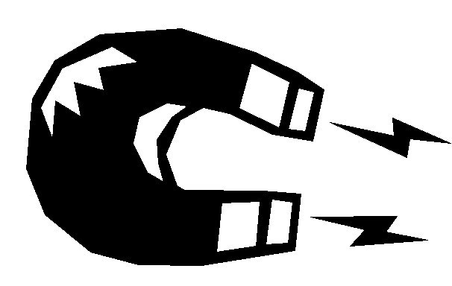

What is Slip ?
To produce torque in an induction motor, current must flow in the rotor.
To induce current flow in the rotor, the rotor speed must be slightly slower than the synchronous speed.
The difference between the synchronous speed and the rotor speed (rated speed) is called the slip.
Flux
Stator
Slip
Rotor
Notes:
Now, the formula 120xf / poles can be used to calculate the synchronous speed of the motor which represents the speed of the rotating magnetic field, not necessarily the speed of the motor shaft. For the induction motor to produce torque, current must flow through the rotor. To produce current flow in the rotor, the rotor speed must be slightly slower than the magnetic field rotation. The difference between the synchronous speed and the rotor speed is called slip. Without slip, current would not flow in the rotor and the motor not produce torque.
SHOW RUBBER BAND DEMO

Slide 23
Calculating Motor Rated Speed
Formula to find actual motor RPM
120 f
N =
( 1 - s )
P
Where:
N - RPM of the motor
f - Frequency in Hz
P - Number of poles of the motor
s - (No - N) / No
Notes:
The formula to determine actual motor speed must include the slip of the motor. Slip is usually shown as a per unit value. The slip can be calculated by taking the synchronous speed of the motor (No) and subtracting the rated speed of the motor (N) and dividing this by the synchronous speed. The actual speed of the motor will vary between close to synchronous speed when lightly loaded, to rated speed during full load. The actual amount of slip will vary with load.
Question:
Based on this formula, if a motor has a nameplate RPM of 3450 @ 60 Hz, what is the slip percentage?
Answer:
4.17%
What is the actual motor speed? 3499.88 RPM

Slide 24
Speed - Torque Curve
TORQUE
SPEED
Notes:
The next thing we want to discuss is what is called the speed torque curve. An induction motor produces different amounts of torque, (twisting force) at different speeds. On the diagram, speed is on the horizontal axis and torque and current are on the vertical axis. The motor will produce locked rotor torque, and draw 6-10 times the motor FLA amount. As the motor increases speed, the torque will move through the Pull up torque region, and motor current will drop. As the speed continues to increase, the motor then gets to the point where it produces maximum torque, called the breakdown torque, and the current continues to decrease. If this motor was running unloaded, the rotor speed would end up very close to the synchronous speed, and the current would end up about 30% of FLA. As the load was increased, the current would move back up the curve as well as the torque. And the motor speed would drop from very close to synchronous speed towards the rated speed.

Slide 25
Speed - Torque Curve
(300%)
(600%)
Slip
TORQUE
CURRENT
Breakdown Torque (200-250%)
(300%)
(200%)
Pull Up Torque (125%)
Locked Rotor Torque (150%)
Full Load Torque (100%)
No Load Current (30%)
SPEED
Rated Speed
Synch Speed
Notes:
The next thing we want to discuss is what is called the speed torque curve. An induction motor produces different amounts of torque, (twisting force) at different speeds. On the diagram, speed is on the horizontal axis and torque and current are on the vertical axis. The motor will produce locked rotor torque, and draw 6-10 times the motor FLA amount. As the motor increases speed, the torque will move through the Pull up torque region, and motor current will drop. As the speed continues to increase, the motor then gets to the point where it produces maximum torque, called the breakdown torque, and the current continues to decrease. If this motor was running unloaded, the rotor speed would end up very close to the synchronous speed, and the current would end up about 30% of FLA. As the load was increased, the current would move back up the curve as well as the torque. And the motor speed would drop from very close to synchronous speed towards the rated speed.

Slide 26
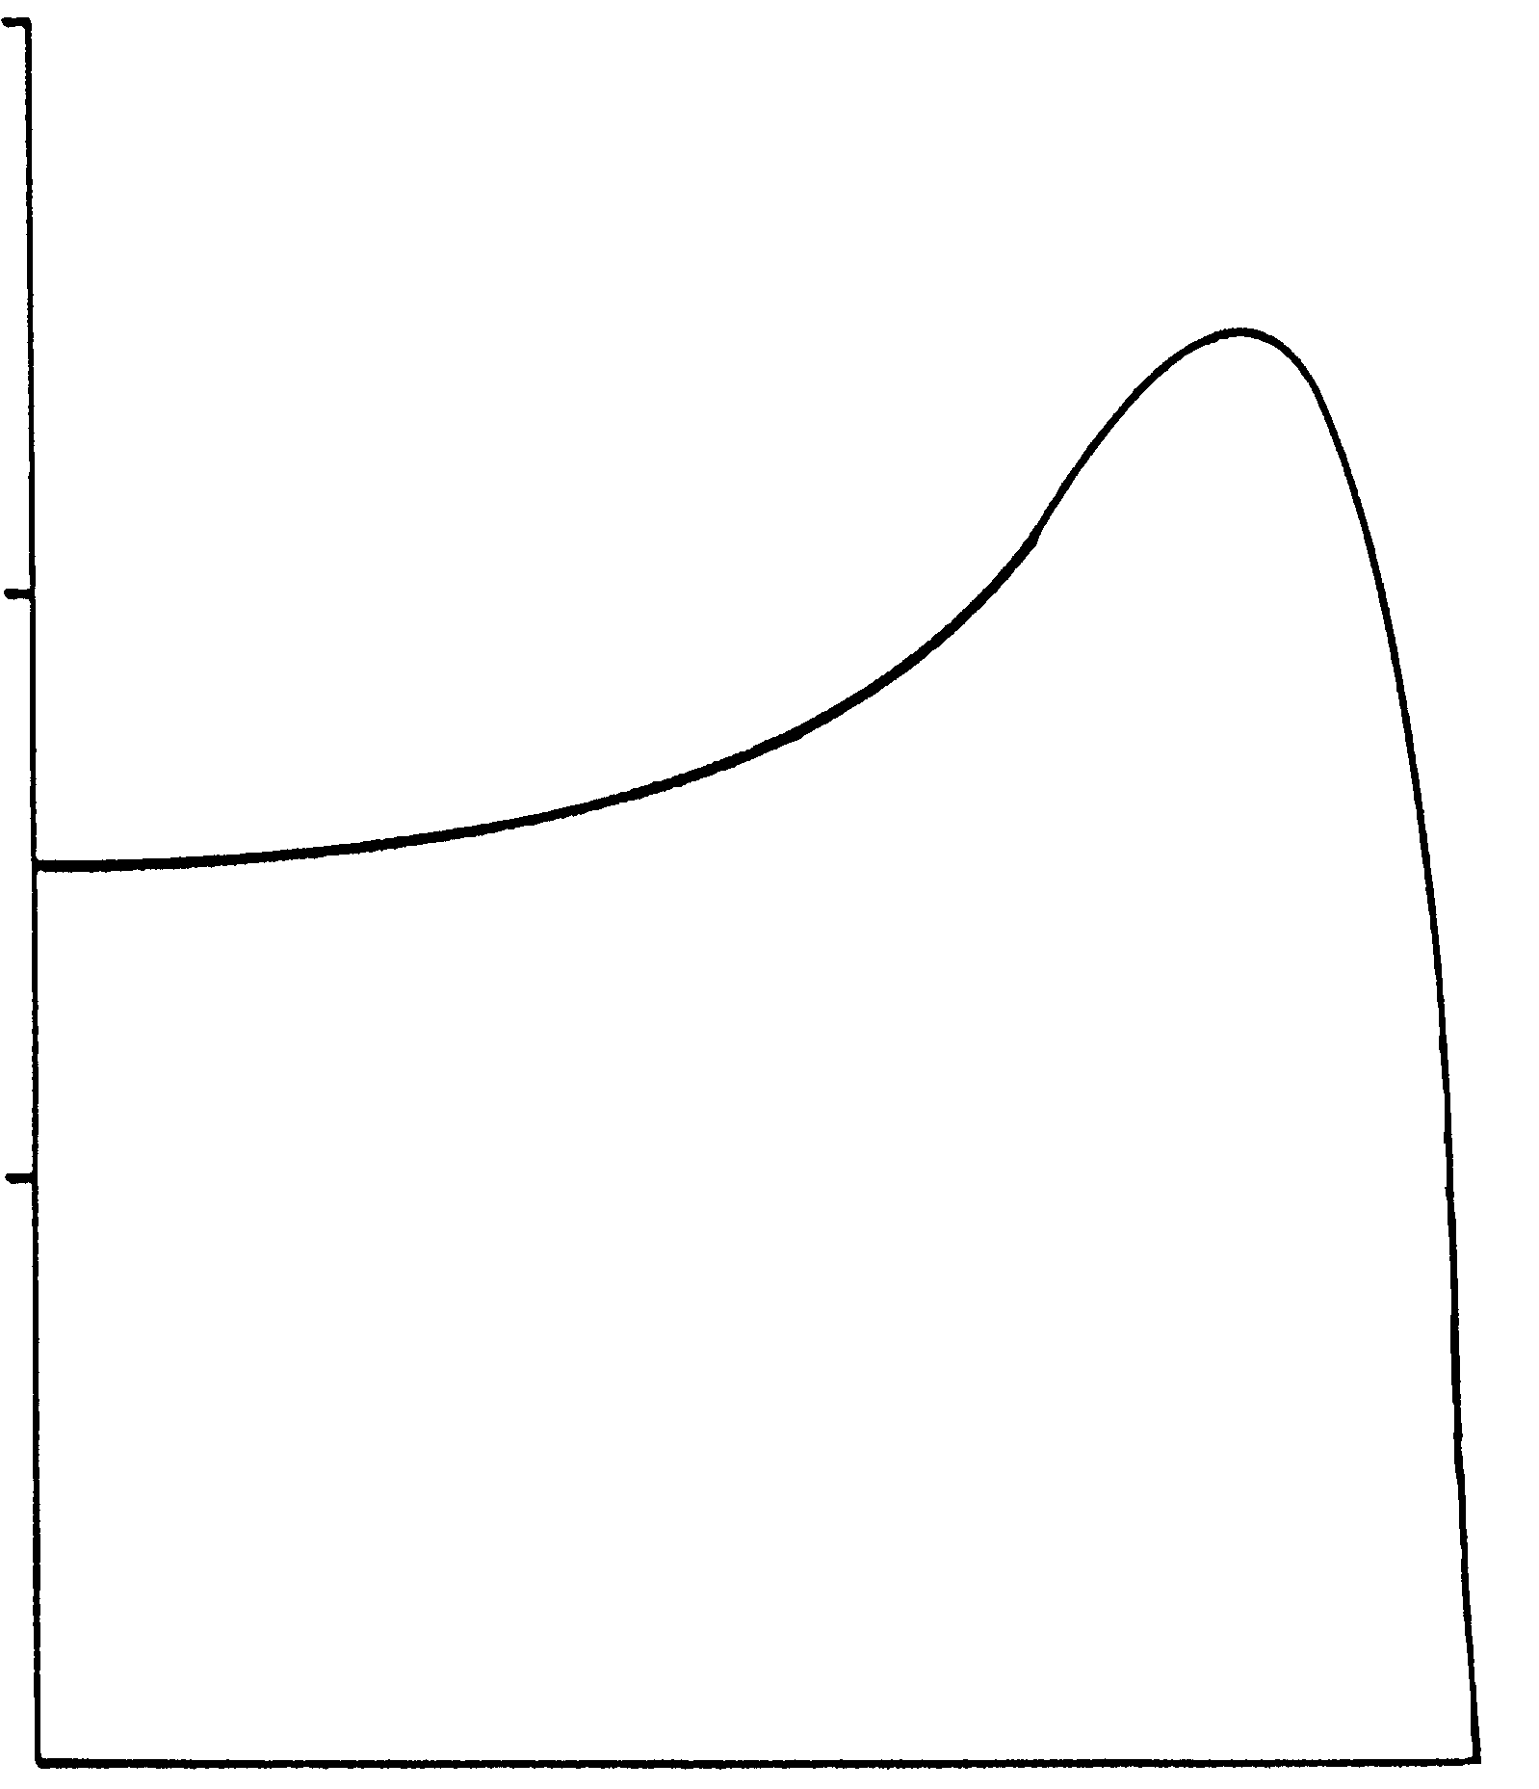
Typical NEMA Design Characteristics
NEMA Design A
High breakdown torque
Normal starting torque
High starting current
Low full load slip
Used in applications that require:
Occasional overloads
Better efficiency
300%
200%
TORQUE
100%
0
SPEED
100%
Notes:
There are four basic speed torque types. They have NEMA designations of A B C and D. A motor with a NEMA A speed torque design is characterized by .............
1.) high breakdown torque
2.) average starting torque
3.) higher than normal starting current
4.) a low percentage of slip
NEMA Design A motors are typically used in applications that have occasional overloads (because they have a higher breakdown torque) or in cases that demand better system efficiency (due to its low slip characteristics), such as HVAC fan or pump applications.
NEMA design A is a variation of Design B having higher locked rotor current and higher peak torque.
Also, many of our inverter-duty motors we offer in our catalog are NEMA Design A, built for operation with IGBT inverters and carry a 1000:1 speed range.

Slide 27
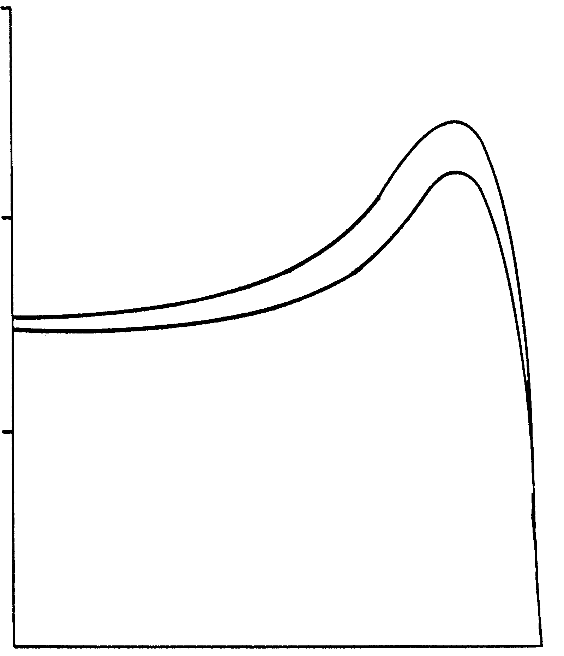
Typical NEMA Design Characteristics
NEMA Design B
Normal breakdown torque
Normal starting torque
Low starting current
Normal full load slip
less than 5%
General Purpose Motor
300%
Design A
200%
TORQUE
100%
Design B
0
SPEED
100%
Notes:
A NEMA Design B motor is used for general purpose applications. The characteristics of a NEMA Design B motor are.
1.) Normal amount of breakdown torque. ( Less then the A as seen in this diagram )
2.) Normal starting torque
3.) Low starting current
4.) Normal full load slip ( normally between 3 - 5%)
NEMA Design B motors produce 150% starting torque for fans, blowers, rotary pumps, unloaded compressors, some conveyors or metal cutting machine tools.
NEMA Design B motors are used on loads that are started and reversed infrequently and are the most common motors in the electrical industry.

Slide 28
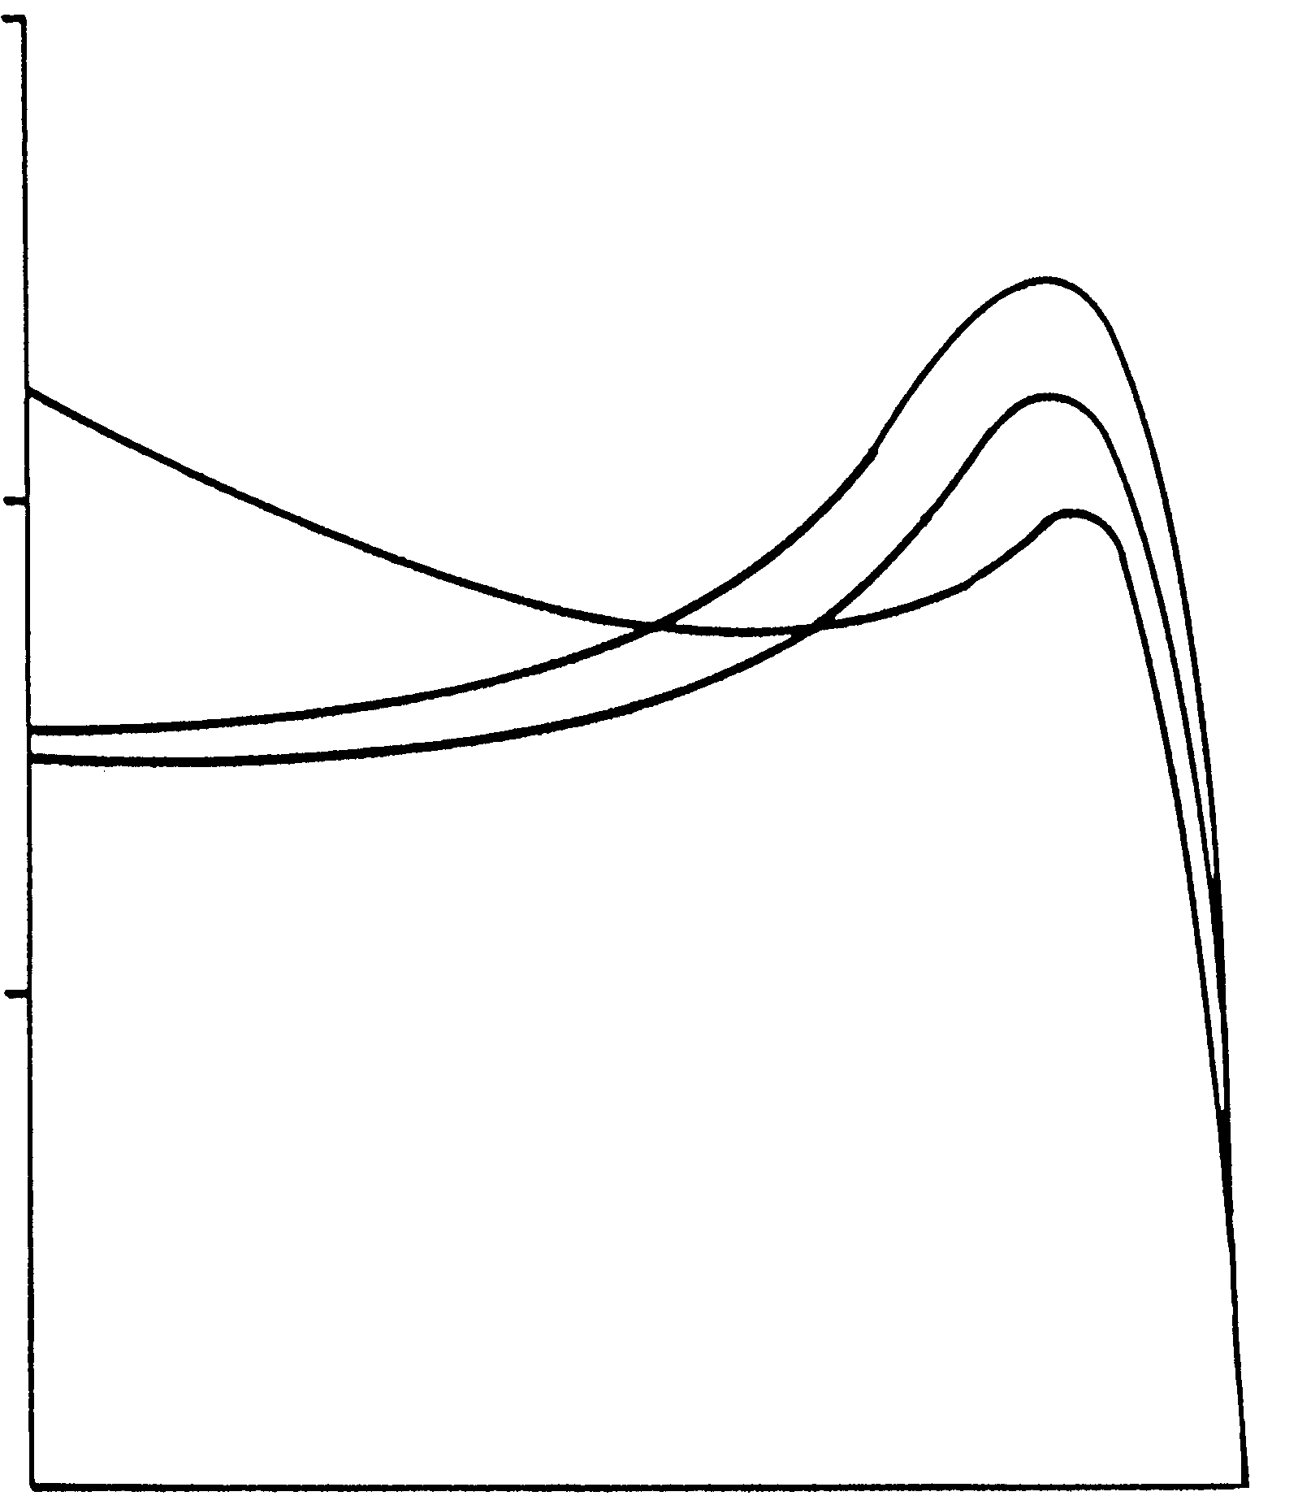
Typical NEMA Design Characteristics
NEMA Design C
Low breakdown torque
High starting torque
Low starting current
Normal full load slip
less than 5%
Used in applications that require:
high breakaway torque
300%
Design C
Design A
200%
TORQUE
100%
Design B
0
SPEED
100%
Notes:
NEMA Design C motors are not so common. They have an uncharacteristic double-squirrel cage wound rotor. They are characterized by.....................
1.) Lower then normal breakdown torque
2.) Higher then normal starting torque
3.) Low starting current
4.) A normal amount of slip ( typically between 3 - 5%)
NEMA Design C motors are used in applications that require a large amount of breakaway torque, and less running torque. Typical applications include hard-to-start loads such as conveyors, compressors, crushers and reciprocating pumps. Also, NEMA Design C is good for loaded starts, such as piston pumps.

Slide 29
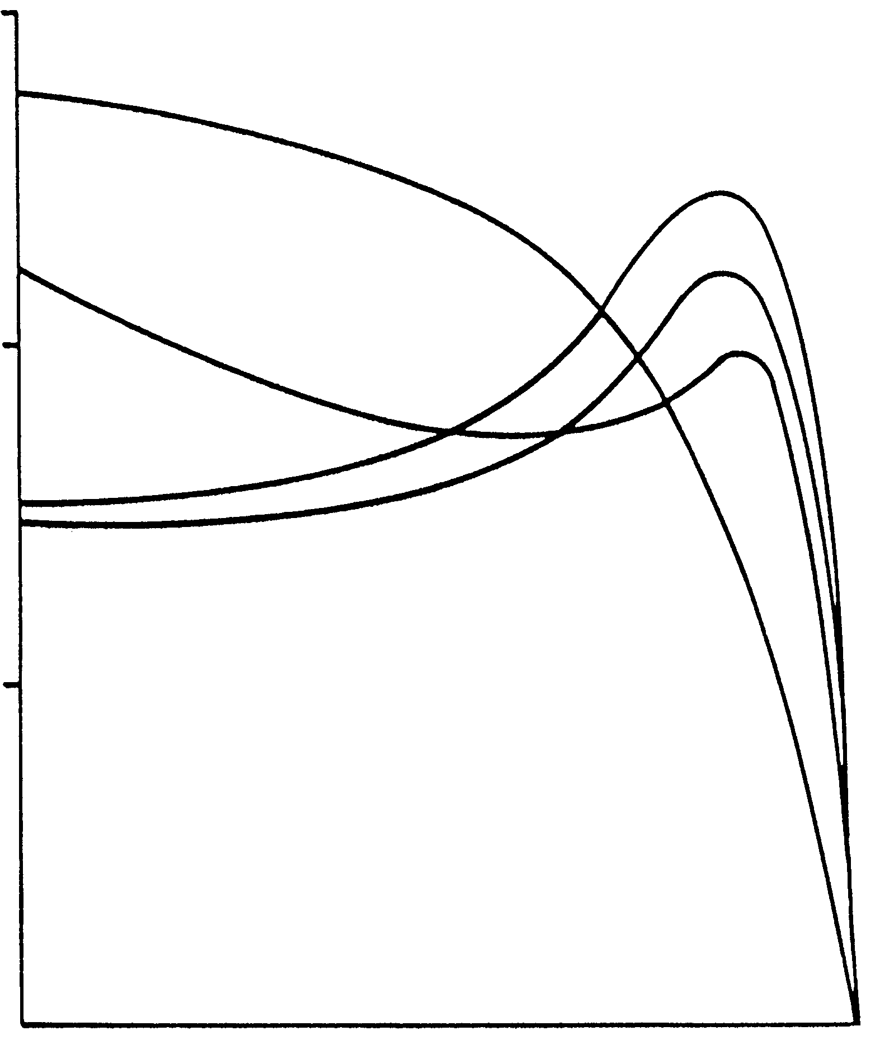
Typical NEMA Design Characteristics
Design A
NEMA Design D
High breakdown torque
High starting torque
Normal starting current
High full load slip
5 - 13%
Used in applications that require:
high breakaway torque
300%
Design D
Design C
200%
TORQUE
100%
Design B
0
SPEED
100%
Notes:
NEMA Design D motors are distinctly different from A B or C types, as can be seen by the speed torque curve shown. The NEMA Design D motor characteristics are..............
1.) Extremely high breakdown and starting torque
2.) Normal starting current
3.) Large amount of slip ( typically from 5 -13%)
NEMA Design D motors have historically been used in applications that require large amounts of starting torque and small amounts of running torque. Typical Design D applications include punch presses, shears, forming machine tools, cranes, hoists, elevators and oil well pumping jacks.

Slide 30
Rotational Horsepower Formula
The horsepower formula in simplified form
Torque x RPM
HP x 5250
HP =
OR
Torque =
5250
RPM
Where:
Torque - Amount of torque in lb.ft.
RPM - RPM of the motor
5250 - constant obtained by dividing 33,000 by 6.28
Notes:
This formula is can also be used to determine the amount of torque produced by a certain HP motor at a certain RPM.

Slide 31
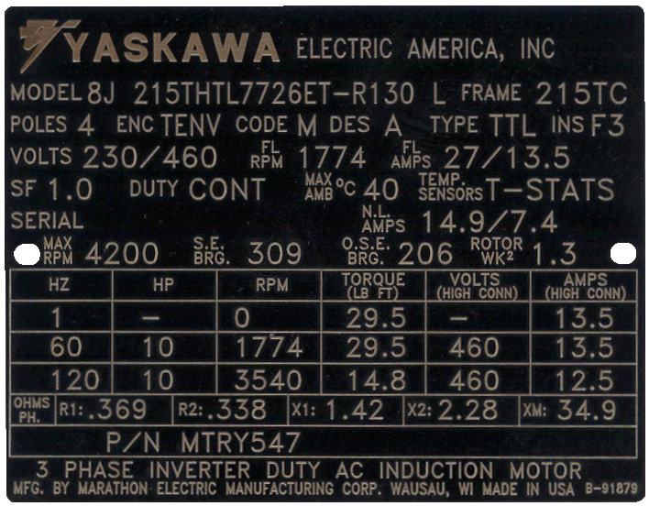
Motor Nameplate Data
Notes:
Lets take a closer look at some of the information contained on the motor nameplate. This data can give us a lot if information about the motor.

Slide 32
Understanding the Nameplate
HP- Horsepower
The horsepower figure stamped on the nameplate is the horsepower the motor is rated to develop when connected to a circuit of the voltage, frequency and number of phases specified on the motor nameplate.
Notes:
The horsepower of the motor should be listed on the nameplate. This value is the horsepower that the motor can develop if applied the rated voltage and frequency and number of phases.
Horsepower is dependent on speed. Reducing torque or frequency will reduce the horsepower the motor will produce.
Lets take a closer look at the HP formula......

Slide 33
Understanding the Nameplate
RPM - Revolutions per Minute
The RPM value represents the approximate speed at which the motor will run when properly connected and delivering its rated output
Notes:
RPM stands for revolutions per minute. This is the approximate speed that the motor is going to run under full load conditions, as long as proper voltage and frequency are applied to the motor. As you have already learned the RPM is dependent on the number of poles of the motor, the frequency applied and the amount of slip. Based on this data we can calculate the percentage of slip.
(Synch speed - rated speed / synch speed) x 100 = slip %

Slide 34
Understanding the Nameplate
Notes:
Discuss the addition of the table.
Question:
Based on this RPM number, can we figure out the NEMA design of the motor?
For example, 1750 represents what NEMA Design?
What NEMA design for 1625?

Slide 35
Understanding the Nameplate
Voltage
The rated voltage figure on the motor nameplate refers to the voltage of the supply circuit to which the motor should be connected, to produce rated horsepower and RPM.
Notes:
The voltage rating of the motor refers to the voltage that was designated to produce rated HP and RPM in the motor. Reduction of voltage will cause an increase of current and a decrease of HP, an increase in voltage will cause an increase in current and an increase in HP.

Slide 36
Understanding the Nameplate
Hz-Frequency
The frequency figure on the motor nameplate describes the alternating current system frequency that must be applied to the motor to achieve rated speed and horsepower.
Notes:
The frequency rating of the motor describes the frequency of the power system that must be connected to the motor for the motor to develop the rated RPM and horsepower. This value is not necessarily the maximum frequency that can be input to the motor. Most times the maximum frequency is dependent on the physical construction of the motor ( bearings, enclosure, rotor construction). For applications that require running at frequencies higher then the rated frequency, please consult the motor manufacture for the maximum allowable RPM of the motor.

Slide 37
Understanding the Nameplate
Amps
The amp figure on the motor nameplate represents the approximate current draw by the motor when developing rated horsepower on a circuit of the voltage and frequency specified on the nameplate.
Notes:
The amp figure on the nameplate represents the designed current draw of the motor at nameplate voltage and frequency and is fully loaded.
This value is extremely important when sizing an inverter.

Slide 38
Understanding the Nameplate
NEMA Design
The NEMA Design rating specifies the speed torque curve that will be produced by the motor.
Notes:
The NEMA Design specifies the speed torque curve that will be produced by the motor. We have already discussed the different types (A,B,C, & D).

Slide 39
Understanding the Nameplate
Insulation Class
The insulation class letter designates the amount of allowable temperature rise based on the insulation system and the motor service factor.
Notes:
The insulation class and the service factor are closely related. The insulation class of a motor indicates the allowable temperature that the motor can be run continuously based on the insulation material inside the motor and the motors service factor. The most common insulation classes are B and F.
F3 is just Class F Insulation, any number after that just signifies different insulation systems based on plant. Marathon has three different plants that use class F Insulation

Slide 40
Insulation Class Information
Most common insulation classes are class B and F
Notes:
The numerical value relates to the temperature classification of the insulation system. The temperature classification indicates the maximum (hot-spot) temperature at which the insulation system can be operated for normal expected service life.
In general, all materials used in a given insulation system should be rated for temperatures equal to, or exceeding, the temperature classification of the system.

Slide 41
Understanding the Nameplate
S.F. - Service Factor
The number by which the horsepower rating is multiplied to determine the maximum safe load that a motor may be expected to carry continuously
Example - a 10HP motor with a service factor of 1.15 will deliver 11.5 horsepower continuously without exceeding the allowable temperature rise of its insulation class
Notes:
The service factor is the ability of the motor to carry a load above its name plate rating. As in the example above, a 10HP motor can produce 11.5 horsepower continuously without exceeding temperature rating of its insulation class. So it would seem reasonable that a motor with a higher service factor (and the ability to handle overload) would have to have a higher total temperature rating.
Note! - When using an induction motor on an inverter it is recommended that the service factor of the motor be at least 1.0. Due to the harmonic content on the output of the inverter, slightly more current will be drawn by the motor to produce the rated amount of torque.

Slide 42
Understanding the Nameplate
Frame
The frame designation refers to the physical size of the motor as well as certain construction features such as the shaft and mounting dimensions.
Notes:
The frame designation of the motor refers to the physical construction of the motor. It would include the mounting dimensions, shaft dimensions and over all dimensions.
Be sure to record any prefix or suffix letter codes you may see.
This is a key piece of information when replacing an existing motor with a new motor.

Slide 43
Common Types of Motor Enclosures
Open Drip-proof (ODP)
Totally enclosed non-ventilated (TENV)
Totally enclosed fan cooled (TEFC)
Totally enclosed blower cooled (TEBC)
Notes:
The last topic that we are going to cover is the enclosure type of the motor. When applying a motor in certain environmental conditions it may be necessary to choose a motor with a different type enclosure. The four most common types of enclosure are shown above.

Slide 44
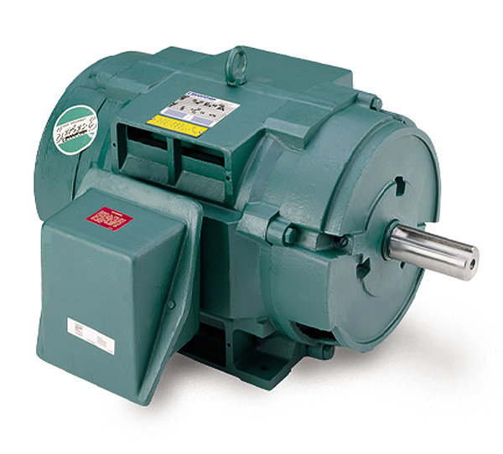
Types of Motor Enclosures
ODP
Open drip-proof
Ventilating openings permit passage of external cooling air over and around the windings of the motor. Small degree of protection against liquid or solid particles entering the enclosure.
Notes:
The open drip proof type motor has openings that allow air to flow over the windings. There is only a small degree of protection from liquid or solid particles entering the motor. These type of motors are used in industrial locations that have a clean environment, free from washdown or spray conditions, or air born oil or mist.
The ventilating openings are so constructed that successful operation is not interfered with when drops of liquid or solid particles strike or enter the enclosure at any angle from 0-15 degrees downward from vertical.

Slide 45
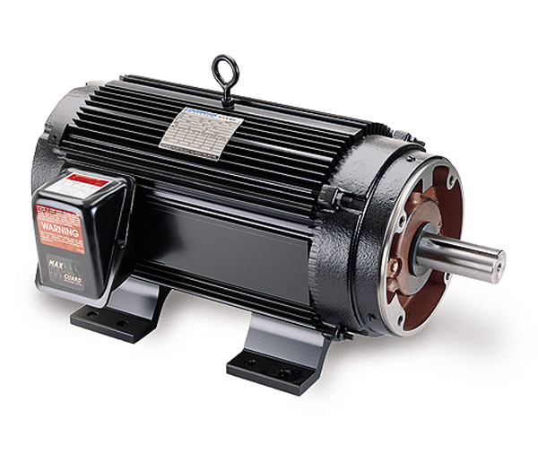
Types of Motor Enclosures
TENV
Totally enclosed non-ventilated
Totally enclosed enclosure with no means of external cooling.
Notes:
The totally enclosed non-ventilated motor has no opening for ventilation and has no means of external cooling. Many times TENV type motors are used in more hostile locations with indirect hosedowns or sprays being possible. In some cases they are used where totally enclosed fan cooled motors are physically too large and cannot fit into tight quarters.

Slide 46
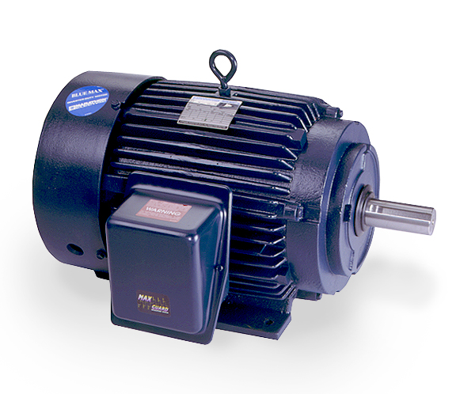
Types of Motor Enclosures
TEFC
Totally enclosed fan-cooled
Totally enclosed enclosure with external cooling means, such as a shaft connected fan
Notes:
Totally enclosed fan cooled motors are the most common in industry. It consists of a non-ventilated enclosure and a motor shaft connected cooling fan that blows cooling air over the outside of the motor. Care must be taken when applying TEFC motors with inverters because when run at slow speeds the cooling fan becomes ineffective and the motor overheats. The speed range of these motors is typically in the 4:1 range.

Slide 47
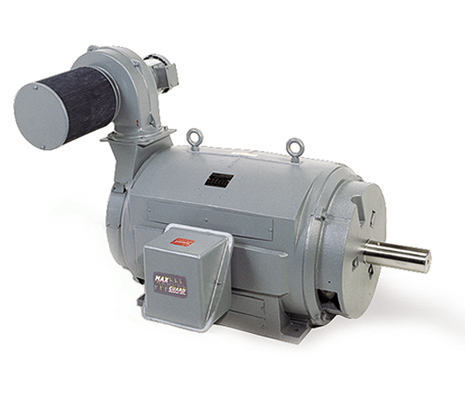
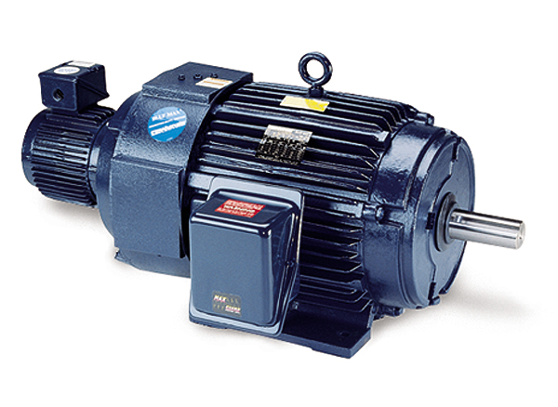
Types of Motor Enclosures
TEBC
Totally enclosed blower-cooled
Totally enclosed enclosure with external cooling means such as a separately controlled motor/blower
Notes:
The totally enclosed blower type motor is often times called an inverter duty motor. The enclosure has no ventilation openings, and is externally cooling by a separately powered motor/ blower combination. This allows the speed range of this motor to be much wider then the TEFC type motor. Typically a TEBC type motor speed range is about 10:1 and some goes a high as 1000:1. This arrangement allows continuous running at very low speeds.

Slide 48
Application Driven Enclosures
Washdown
Stainless Steel
Explosion Proof
Totally Enclosed Air Over
Weather Protected
Type I
Type II

Slide 49
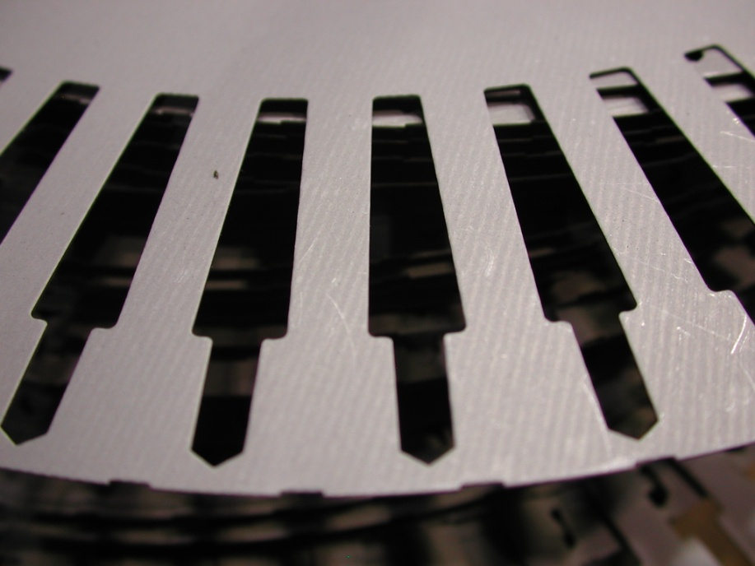
Something you can’t see
Stator and Rotor Laminations
C5 or C3 Lamination Steel
C5 rated for 1000 Degrees F
C3 rated for 750 Degrees F

Slide 50
How Does Everything Add Up?

Slide 51
Questions and Comments

