Slide 1
Induction Motor
(Asynchronous Motor)
EE389 MACHINES 2

Slide 2
Learning Outcomes
At the end of the lecture, student should to:
  Understand the principle and the nature of 3 phase induction machines.
  Perform an analysis on induction machines which is the most rugged and the most widely used machine in industry.

Slide 3
Contents
  Overview of Three-Phase Induction Motor
  Construction
  Principle of Operation
  Equivalent Circuit
    Power Flow, Losses and Efficiency
    Torque-Speed Characteristics
  Speed Control
  Overview of Single-Phase Induction Motor

Slide 4
Overview of Three-Phase Induction Motor
Induction motors are used worldwide in many residential, commercial, industrial, and utility applications.
Induction Motors transform electrical energy into mechanical energy.
It can be part of a pump or fan, or connected to some other form of mechanical equipment such as a winder, conveyor, or mixer.

Slide 5
Introduction
General aspects
  A induction machine can be used as either a induction generator or a induction motor.
  Induction motors are popularly used in the industry
  Focus on three-phase induction motor
  Main features: cheap and low maintenance
  Main disadvantages: speed control is not easy

Slide 6
Induction Motor
•Why induction motor (IM)?
  –Robust; No brushes. No contacts on rotor shaft
  –High Power/Weight ratio compared to Dc motor
  –Lower Cost/Power
  –Easy to manufacture
  –Almost maintenance-free, except for bearing and other mechanical parts

Slide 7
Induction Motor
•Disadvantages
  –Essentially a “fixed-speed” machine
  –Speed is determined by the supply frequency
  –To vary its speed need a variable frequency supply

Slide 9
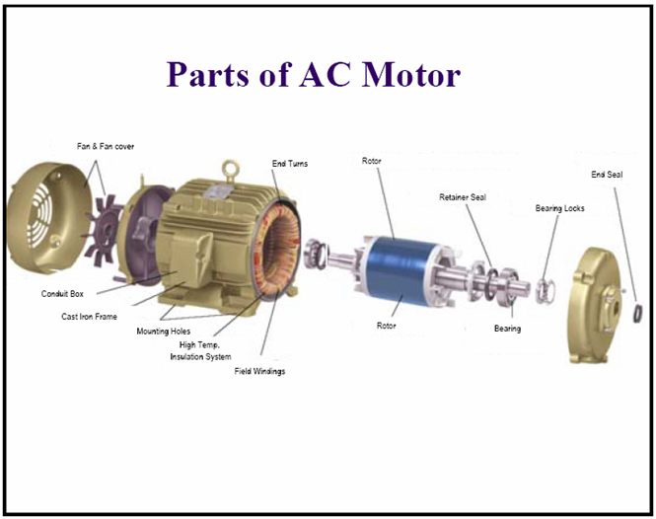

Slide 10
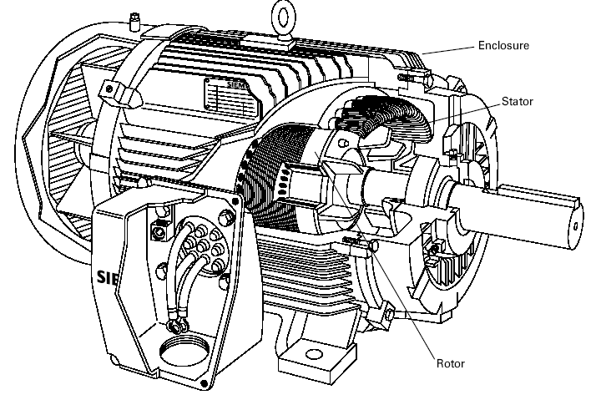
Construction
The three basic parts of an AC motor are the rotor, stator, and enclosure.
The stator and the rotor are electrical circuits that perform as electromagnets.

Slide 11
Construction (Enclosure)
The enclosure consists of a frame (or yoke) and two end brackets (or bearing housings). The stator is mounted inside the frame. The rotor fits inside the stator with a slight air gap separating it from the stator. There is NO direct physical connection between the rotor and the stator.
Stator
The enclosure also protects the electrical and operating parts of the motor from harmful effects of the environment in which the motor operates. Bearings, mounted on the shaft, support the rotor and allow it to turn. A fan, also mounted on the shaft, is used on the motor shown below for cooling.
Rotor
Air gap

Slide 12
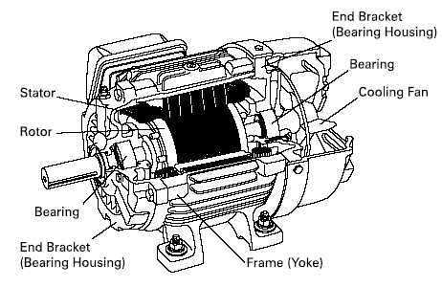
Construction (Enclosure)

Slide 13
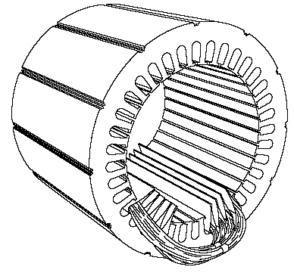
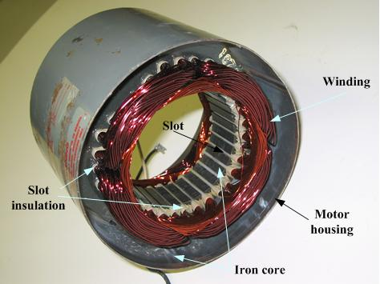
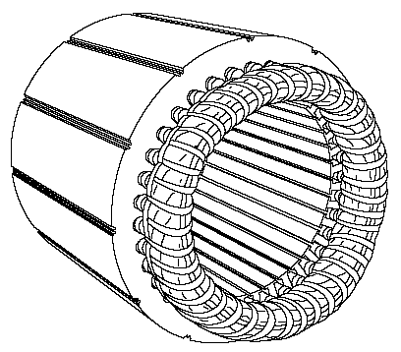
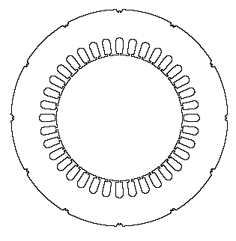
Construction (Stator construction)
The stator is the stationary electrical part of the motor.
The stator core of a National Electrical Manufacturers Association (NEMA) motor is made up of several hundred thin laminations.
Stator laminations are stacked together forming a hollow cylinder. Coils of insulated wire are inserted into slots of the stator core.
Electromagnetism is the principle behind motor operation. Each grouping of coils, together with the steel core it surrounds, form an electromagnet. The stator windings are connected directly to the power source.

Slide 14
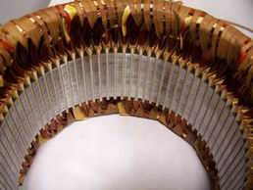
Stator.

Slide 15
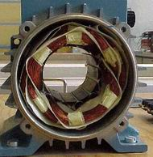

Slide 16
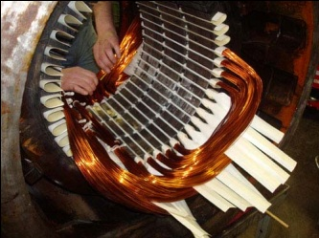

Slide 17
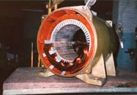

Slide 18
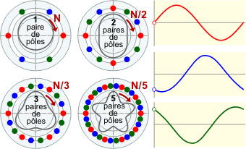
Number of stator poleS

Slide 19
Construction (Rotor construction)
The rotor is the rotating part of the electromagnetic circuit.
It can be found in two types:
  Squirrel cage
  Wound rotor
However, the most common type of rotor is the “squirrel cage” rotor.

Slide 20
Construction (Rotor construction)
Induction motor types:
  Squirrel cage type:
    Rotor winding is composed of copper bars embedded in the rotor slots and shorted at both end by end rings
    Simple, low cost, robust, low maintenance
  Wound rotor type:
    Rotor winding is wound by wires. The winding terminals can be connected to external circuits through slip rings and brushes.
    Easy to control speed, more expensive.

Slide 21
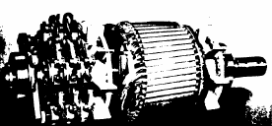
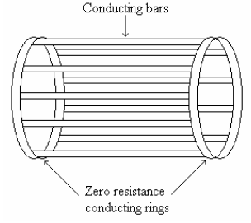
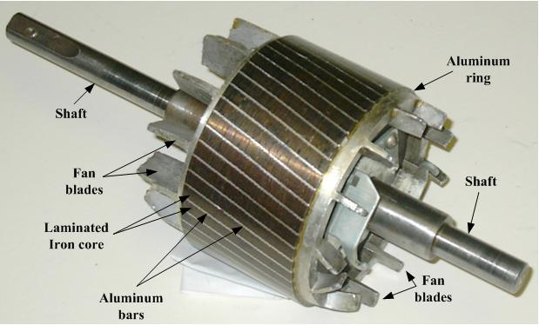
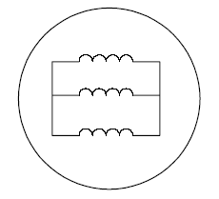
Construction (Rotor construction)
Wound Rotor
Squirrel-Cage Rotor
Short circuits all
rotor bars.
/rotor winding

Slide 22
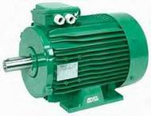
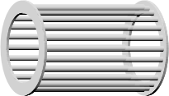

Slide 23
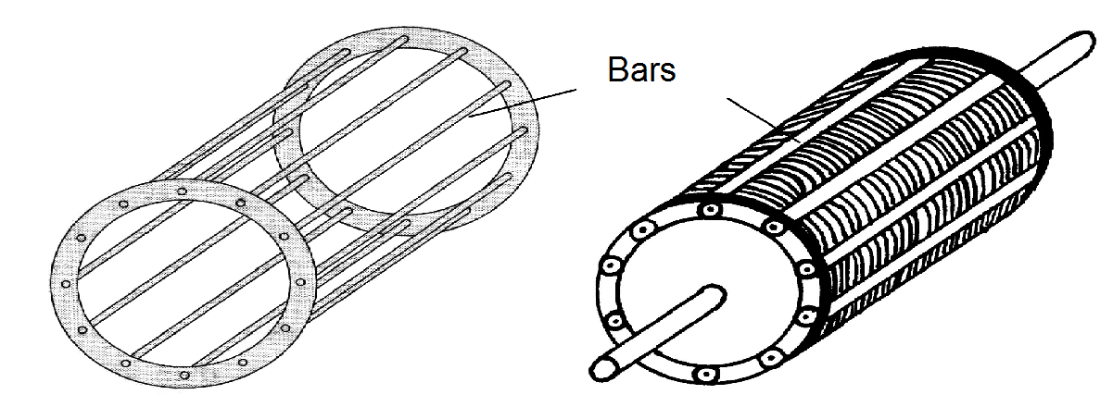
Rotor

Slide 24
