Slide 1
ELECTRONICS / VFD
Electronic Controls
FOR
HVAC
HVAC
Notes:
1

Slide 2
VARIABLE FREQUENCY DRIVES
INTRODUCTION TO VFD BASICS
OVERVIEW OF POWER SIDE COMPONENTS
FUNCTIONS OF EACH COMPONENT DISCUSSED

Slide 3
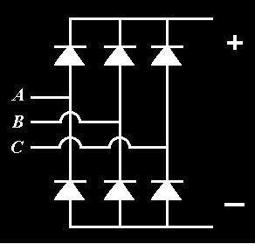
3 PHASE RECTIFIER
Made-up of six fast-acting, high voltage diodes.

Slide 4
3 PHASE RECTIFIER
As the positive half of an AC sine wave enters the rectifier, it will conduct through the respective anode on that phase, and add its potential to the positive bus...

Slide 5
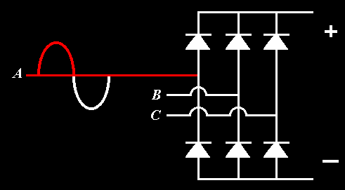
3 PHASE RECTIFIER

Slide 6
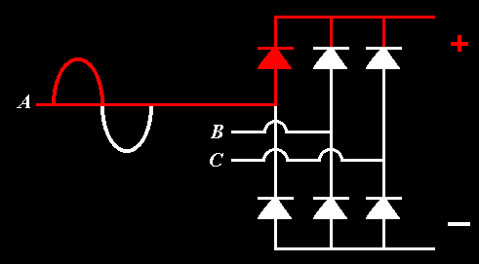
3 PHASE RECTIFIER

Slide 7
3 PHASE RECTIFIER
The negative half of the sine wave will have the exact opposite effect, conducting its potential through the respective cathode on that phase, adding to the negative bus...

Slide 8
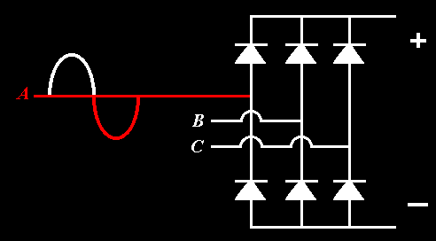
3 PHASE RECTIFIER

Slide 9
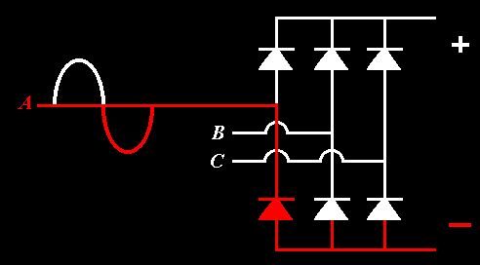
3 PHASE RECTIFIER

Slide 10
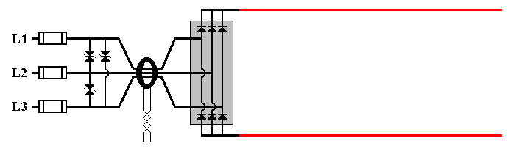
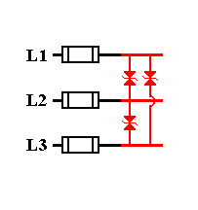
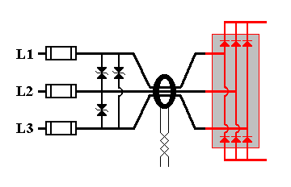
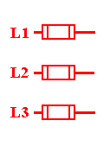
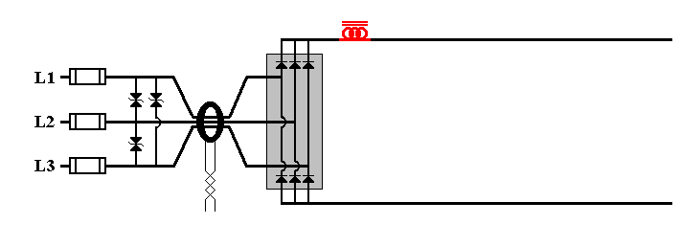
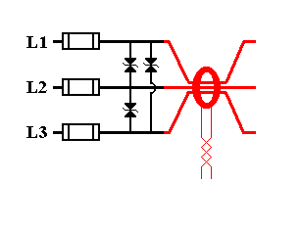
DC LINE REACTOR
> HELPS TO SMOOTHE CURRENT WAVEFORM

Slide 11
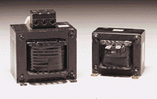
DC LINE REACTOR
Consists of an iron-core inductor, designed and sized to reduce variations in current wave from.

Slide 12
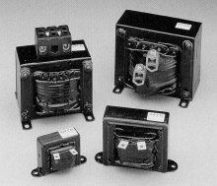
DC LINE REACTOR
Vary in sizes according to Kw, some reactors can get quite large and heavy.

Slide 13
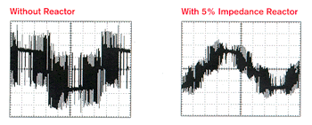
DC LINE REACTOR

Slide 14
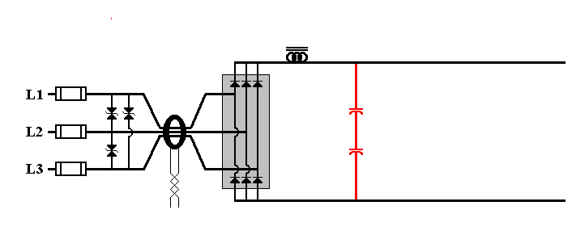
ELECTROLYTIC CAPACITORS
> CONVERT PULSATING DC INTO CONSTANT DC

Slide 15
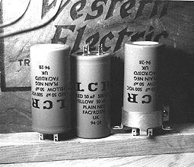
CAPACITORS
Electrolytic capacitors are polarized, which means they are sensitive to bus polarity.

Slide 16
CAPACITORS
Their maximum voltage rating is 400 volts DC, due to the properties of the dielectric material separating the plates.

Slide 17
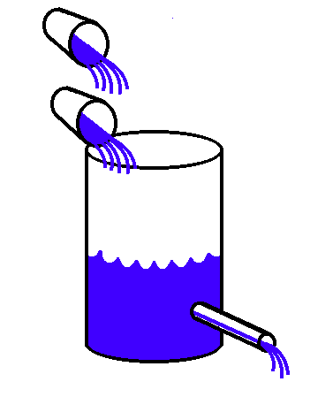
CAPACITORS
The capacitor would then resemble this image in theory. Small pulses added, and a steady stream as an output.

Slide 18


CAPACITORS
Remember!!!!! Be 100% SURE of the polarity of DC capacitors before energizing, OR ELSE…...

Slide 19
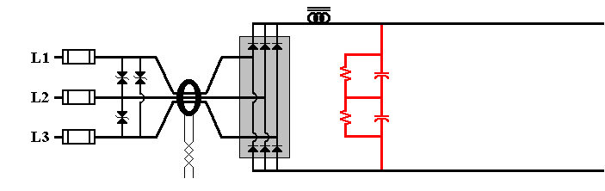
BLEED RESISTORS
> BLEED DOWN VOLTAGE HELD IN CAPACITORS
WHEN LINE VOLTAGE IS REMOVED
> ACT AS VOLTAGE DIVIDER FOR CAPACITORS

Slide 20
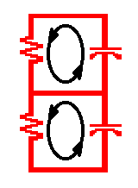
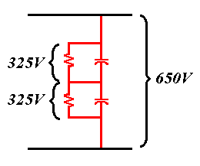
BLEED RESISTORS
Complete the necessary path to help dissipate the residual voltage held by the charged plates when power is removed.

Slide 21
BLEED RESISTORS
They also insure that the voltage drop across the capacitors will be exactly the same.
(Remember the 400 VDC rating)

Slide 22
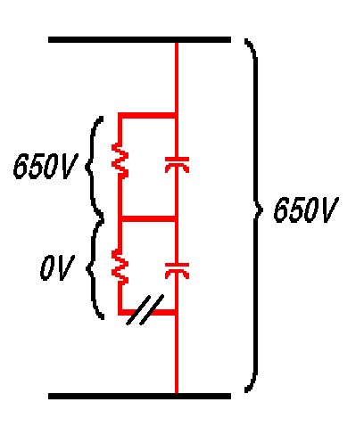
BLEED RESISTORS
If one of the resistors should open, the voltage will be applied on only one cap.

Slide 23
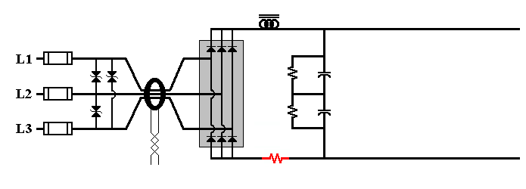
SOFT-START RESISTORS

Slide 24
SOFT START RESISTOR
What is the resistance of a discharged capacitor?
A discharged capacitor has NO resistance, this is the reason why the needle of an analog meter will jump to 0 ohm when first connected.

Slide 25
SOFT START RESISTOR
As demonstrated, an infinite amount of current will be available for the capacitors to charge to their full potential, which means any fuse or circuit breaker ahead of the caps will definitely open due to this unlimited surge.

Slide 26
SOFT START RESISTOR
How can we slow down this inrush of current to the capacitors?
A resistance must be added in series with the capacitors. The size of this resistor will determine the charging time and the available current to the caps.

Slide 27
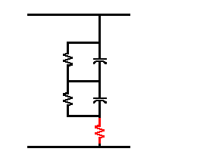
SOFT START RESISTOR
Can the soft start resistor be located in series with the caps at this location to slow down the charging current?

Slide 28
SOFT START RESISTOR
No, because it would slow down the charging and discharging effect of the capacitors.

Slide 29
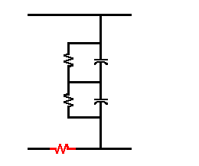
SOFT START RESISTOR
The resistor needs to be on the DC bus, since the voltage is always constant.

Slide 30
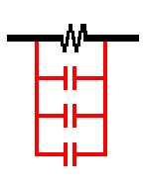
SOFT START RELAY
It is more economical to use a three pole contactor and wire its contacts in parallel, rather than use a huge single pole contactor.

Slide 31
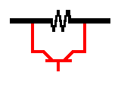
SOFT START RELAY
A transistor may also be used to bypass the resistor.

Slide 32
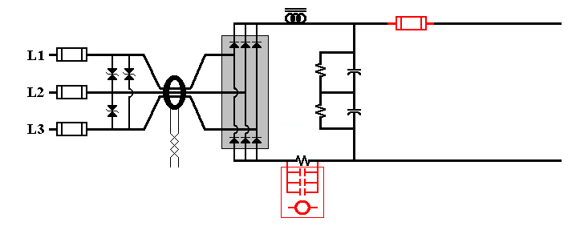
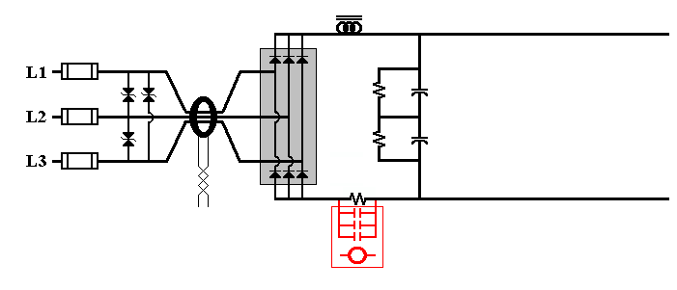
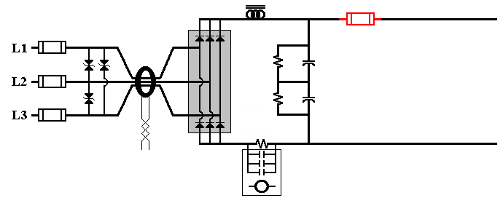
DC FUSE
> PROTECTS INVERTOR SECTION AGAINST
HIGH CURRENTS
> USUALLY FAST ACTING FUSE

Slide 33
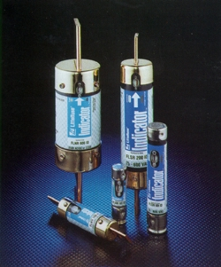
DC FUSE
Fast acting fuse, usually bolt-on type on 15 Hp drives and larger. A blown DC fuse most likely means serious and costly inverter problems.

Slide 34
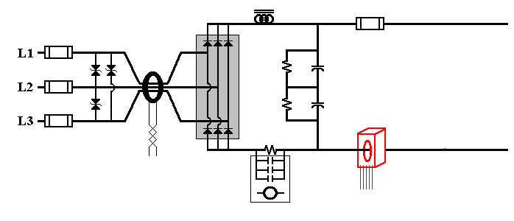
HALL-EFFECT
CURRENT TRANSFORMER
> MONITORS LOAD CURRENT AT DC BUS

Slide 35
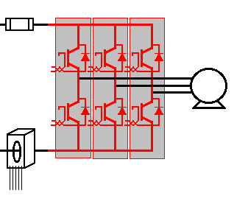
THREE PHASE INVERTOR
> PROVIDES PWM WAVEFORM TO LOAD
> FAST-FIRING IGBT TECHNOLOGY

Slide 36
Solid-State Switches
Diode
SCR
GTO
Bipolar transistor & Darlington
IGBT
Notes:
21

Slide 37
Diode
Notes:
23

Slide 38
Diode
Allows current to flow only in one direction.
The switching occurs at low voltages.
Notes:
24

Slide 39
Diode
Used In
Diode bridge rectifiers.
Circuits that automatically control drive currents and voltages.
Notes:
25

Slide 40
IGBT
(Isolated Gate Bipolar Transistor)
Notes:
36

Slide 41
IGBT
(Isolated Gate Bipolar Transistor)
Easy to turn on.
Easy to turn off.
Very fast.
Rugged.
Notes:
37

Slide 42
IGBT
(Isolated Gate Bipolar Transistor)
Used In
PWM inverters
  high frequency
  selectable frequency
  low frequency
  dynamically controlled frequency
Notes:
38

Slide 43
The Inverter Section
Notes:
13

Slide 44
Step 1
Notes:
14

Slide 45
Step 2
Notes:
15

Slide 46
Step 3
Notes:
16

Slide 47
Step 4
Notes:
17

Slide 48
Step 5
Notes:
18

Slide 49
Step 6
Notes:
19

Slide 50
The Amount of On Time Determines the Average Voltage
Notes:
64

Slide 51
PWM Drive
Output Waveform
Notes:
76

Slide 52
PWM Drive
Output Waveform
Notes:
76

Slide 53
PWM Drive
Output Waveform
Notes:
76

Slide 54
Situations to avoid
Notes:
96

Slide 55
Non-Interlocked
Output Disconnect
Notes:
97

Slide 56
Output Power Factor Capacitors
Notes:
98

Slide 57
Isolation Transformer Primary Disconnect
(without secondary disconnect)
Notes:
99

Slide 58
Input Power Factor Correction with Isolation Transformer
Notes:
100

Slide 59
POOR WIRING PRACTICES
Control, input and motor wiring not separated.
Improper drive grounding.
Improper control wire shielding.
Grounded control signal to grounded drive signal input.
Notes:
101

Slide 60
UTILITY SUPPLIED VOLTAGE
208/230 VAC OR 460 VAC, +/- 10%
INPUT LINE FUSES OR CIRCUIT BREAKER

Slide 61
MOVs
> PROTECTS AGAINTS VOLTAGE SPIKES
> CLEARS SPIKE FROM ONE PHASE TO ANOTHER

Slide 62
ZERO CURRENT TRANSFORMER
> MONITORS INCOMING LINE FOR CURRENT
> LEAKAGE TO GROUND, ACTS LIKE GFCI

Slide 63
THREE PHASE BRIDGE RECTIFIER
> CONVERTS AC POWER TO DC POWER
> OUTPUTS A PULSATING WAVEFORM

Slide 64
DC LINE REACTOR
> HELPS TO SMOOTHE CURRENT WAVEFORM

Slide 65
ELECTROLYTIC CAPACITORS
> CONVERT PULSATING DC INTO CONSTANT DC

Slide 66
BLEED RESISTORS
> BLEED DOWN VOLTAGE HELD IN CAPACITORS
WHEN LINE VOLTAGE IS REMOVED
> ACT AS VOLTAGE DIVIDER FOR CAPACITORS

Slide 67
SOFT-START RESISTORS
> SLOWS DOWN CAPACITOR CHARGING CURRENT
WHEN DC BUS IS FIRST ENERGIZED

Slide 68
SOFT-START RELAY
> REMOVES SOFT-START RESISTORS FROM CIRCUIT
ONCE DC BUS HAS REACHED FULL VOLTAGE

Slide 69
DC FUSE
> PROTECTS INVERTOR SECTION AGAINST
HIGH CURRENTS
> USUALLY FAST ACTING FUSE

Slide 70
HALL-EFFECT
CURRENT TRANSFORMER
> MONITORS LOAD CURRENT AT DC BUS

Slide 71
THREE PHASE INVERTOR
> PROVIDES PWM WAVEFORM TO LOAD
> FAST-FIRING IGBT TECHNOLOGY

Slide 72
Now if someone,
anyone,
should ask you...
Notes:
38

Slide 73
Can you
fix this
drive?
Notes:
38

Slide 74
Your line is...
"YES, I CERTAINLY CAN" !
Notes:
38

Slide 75
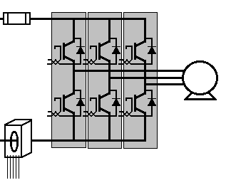
CLASS DISCUSSION

