Slide 1

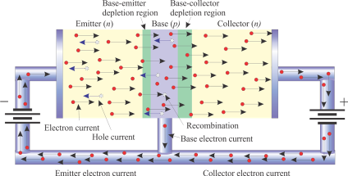
Semiconductor diodes
Lecture 3

Slide 2
Discrete Semiconductor Devices
Semiconductor Materials
  Conductor and Insulators.
  N-type, P-Type, electron, and hole current
  PN junction, depletion region, potential barrier.
Diodes
    Forward Bias, reverse bias
    Diode applications
    Light Emitting Diodes
    Zener Diodes
    Photo Diodes

Slide 3
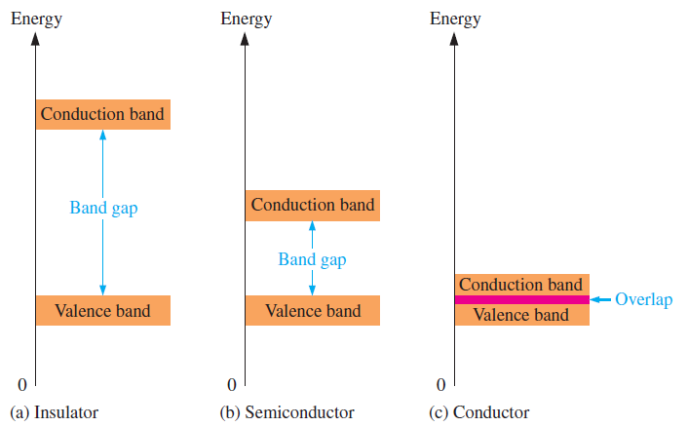
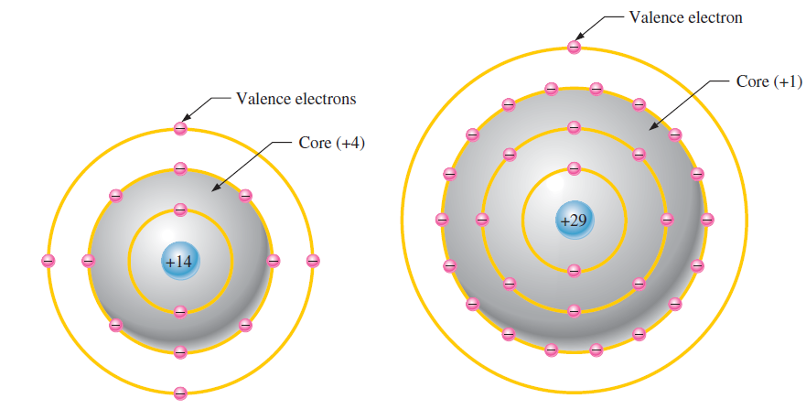
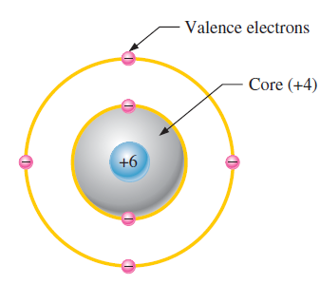
  Conductor and Insulators.
  Atomic Model
the gap can be crossed
only when breakdown
conditions occur
the gap is smaller
and can be crossed
when a photon
is absorbed
the conduction band
and valence band
overlap, so there is no gap

Slide 4
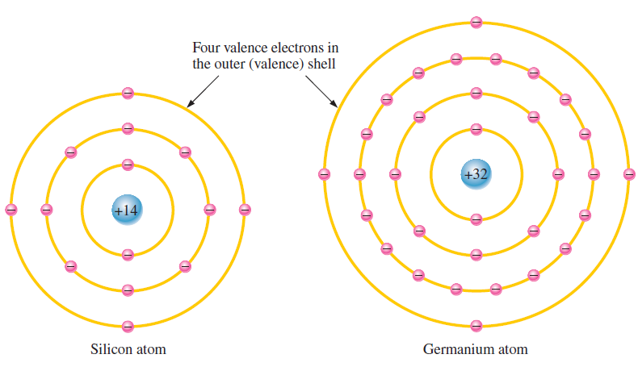
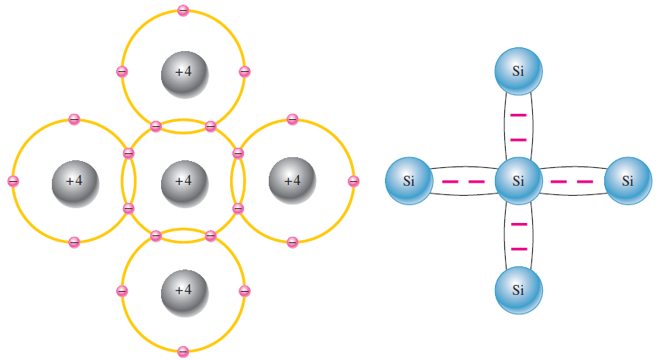
Silicon and Germanium

Slide 5
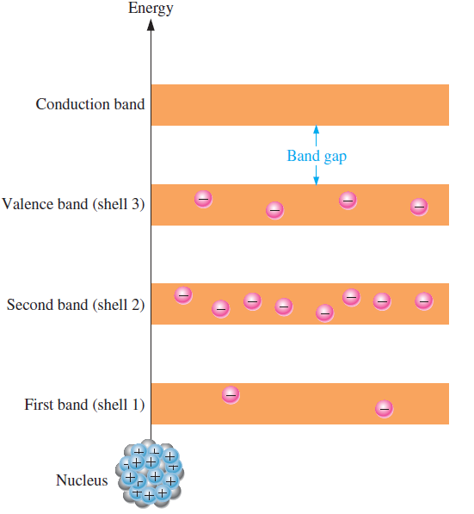
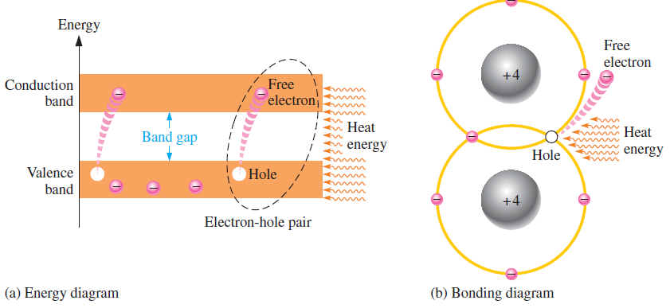
  Conduction Electron and Holes.
An intrinsic (pure) silicon crystal at room temperature has sufficient heat energy for some valence electrons to jump the gap from the valence band into the conduction band, becoming free electron called ‘Conduction Electron’
It leaves a vacancy in valance band, called hole.
Recombination occurs when a conduction-band electron loses energy and falls back into a hole in the valence band.

Slide 6
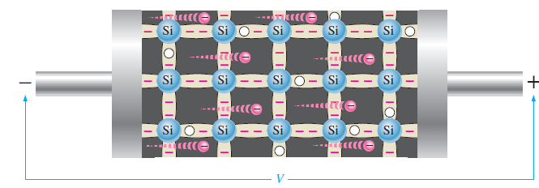
  Electron Hole Current.
In conduction band : When a voltage is applied across a piece of intrinsic silicon, the thermally generated free electrons in the conduction band, are now easily attracted toward the positive end.
This movement of free electrons is one type of current in a semiconductive material and is called electron current.
In valance band: In valance band holes generated due to free electrons. Electrons in the valance band are although still attached with atom and not free to move, however they can move into nearby hole with a little change in energy, thus leaving another hole where it came from. Effectively the hole has moved from one place to another in the crystal structure. It is called hole current.

Slide 7
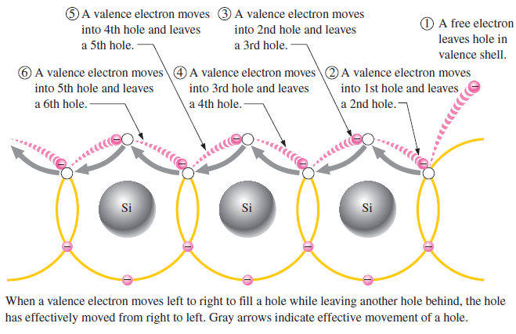
  Electron Hole Current.

Slide 8
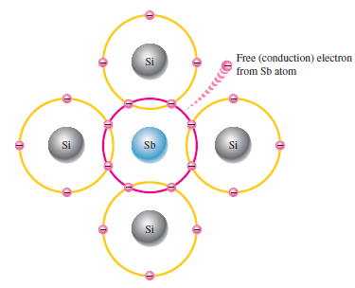
  N-type semiconductor
Electrons in the conduction band and holes in the valence band make the semiconductive material to conduct but they are too limited to make it a very good conductor..
Adding impurities in materials like Si or Ge can drastically increase the conductivity of material. The process is called doping.
Addition of a penta-valent material icnreases the number of conduction electrons.
Majority carrier: electrons
Minority carriers: holes
Material is called N-type semiconductor
An antimony
(Sb) impurity atom is shown in the
center. The extra electron from the
Sb atom becomes a free electron.

Slide 9
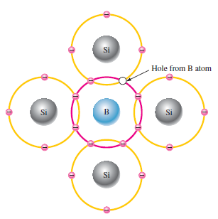
  P-type semiconductor.
Trivalent impurity atom in a silicon
crystal structure. A boron (B) impurity
atom is shown in the center.

Slide 10
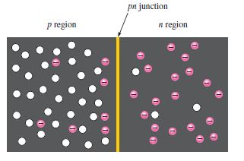
  PN Junction
Although P-type material has holes in excess and N-type material has a number of free conduction electron however the net number of proton and electron are equal in each individual material keeping it just neutral.
The basic silicon structure at the instant of junction formation showing only the majority and minority carriers.
Free electrons in the n region near the pn junction begin to diffuse across the junction and fall into holes near the junction in the p region.

Slide 11
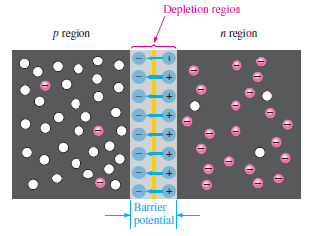
  PN Junction
For every electron that diffuses across the junction and
combines with a hole, a positive charge is left in the n region and a negative charge is created in the p region, forming a barrier potential.
This action continues until the voltage of the barrier repels further diffusion.
The blue arrows between the positive and negative charges in the depletion region represent the electric field.

Slide 12
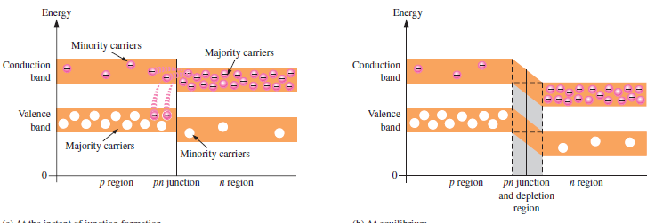
  Energy band and potential barrier

Slide 13
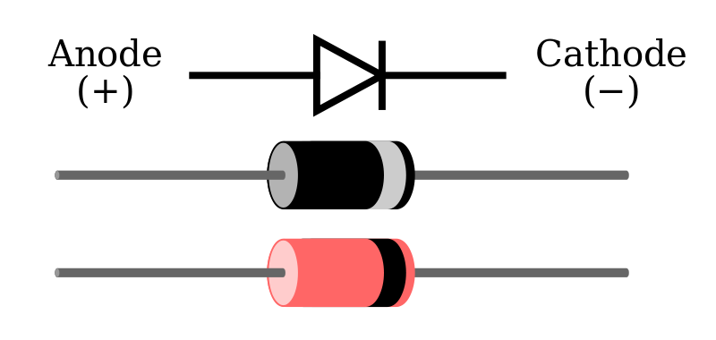
Diodes
Diode, semiconductor material, such as silicon, in which half is doped as p-region and half is doped as n-region with a pn-junction in between.
The p region is called anode and n type region is called cathode.
Diode symbol
Notes:
Random topics just for revising some concepts.

Slide 14
Diodes
Diode, semiconductor material, such as silicon, in which half is doped as p-region and half is doped as n-region with a pn-junction in between.
The p region is called anode and n type region is called cathode.
It conducts current in one direction and offers high (ideally infinite) resistance in other direction.
Diode symbol
Notes:
Random topics just for revising some concepts.

Slide 15
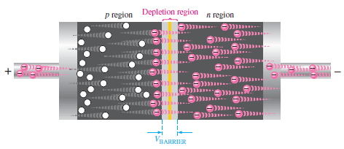
Forward Biased
  Forward bias is a condition that allows current through pn junction.
  A dc voltage (Vbais) is applied to bias a diode.
  Positive side is connected to p-region (anode) and negative side is connected with n-region.
  Vbais must be greater than ‘barrier potential’
As more electrons flow into the depletion region reducing the number of positive ions and similarly more holes move in reducing the positive ions.
This reduces the width of depletion region.
Current limiting resistance
Notes:
Random topics just for revising some concepts.

Slide 16
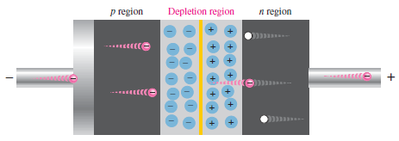
Reverse Biased
  Reverse bias is a condition that prevents current through junction.
  Positive side of Vbias is connected to the n-region whereas the negative side is connected with p-region.
  Depletion region get wider with this configuration.
The positive side of bias voltage attracts the majority carriers of n-type creating more positive ions at the junction.
This widens the depletion region.
Notes:
Random topics just for revising some concepts.

Slide 17
Reverse Current
  A small amount current is generated due to the minority carriers in p and n regions.
  These minority carriers are produced due to thermally generated hole-electron pairs.
  Minority electrons in p-region pushed towards +ve bias voltage, cross junction and then fall in the holes in n-region and still travel in valance band generating a hole current.
Notes:
Random topics just for revising some concepts.

Slide 18
Reverse Breakdown
  If the external bias voltage is increased to a value call breakdown voltage the reverse current can increase drastically.
  Free minority electrons get enough energy to knock valance electron into the conduction band.
  The newly released electron can further strike with other atoms.
  The process is called avalanche effect.
Notes:
Random topics just for revising some concepts.

Slide 19
Diode V-I Characteristic
VI Characteristic for forward bias.
  The current in forward biased called forward current and is designated If.
  At 0V (Vbias) across the diode, there is no forward current.
  With gradual increase of Vbias, the forward voltage and forward current increases.
  A resistor in series will limit the forward current in order to protect the diode from overheating and permanent damage.
  A portion of forward-bias voltage drops across the limiting resistor.
  Continuing increase of Vf causes rapid increase of forward current but only a gradual increase in voltage across diode.
Notes:
Random topics just for revising some concepts.

Slide 20
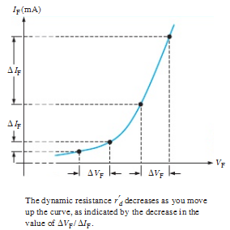
Diode V-I Characteristic
  Dynamic Resistance:
  The resistance of diode is not constant but it changes over the entire curve. So it is called dynamic resistance.

Slide 21
Diode V-I Characteristic
VI Characteristic for reverse bias.
  With 0V reverse voltage there is no reverse current.
  There is only a small current through the junction as the reverse voltage increases.
  At a point, reverse current shoots up with the break down of diode. The voltage called break down voltage. This is not normal mode of operation.
  After this point the reverse voltage remains at approximately VBR but IR increase very rapidly.
  Break down voltage depends on doping level, set by manufacturer.
Notes:
Random topics just for revising some concepts.

Slide 22
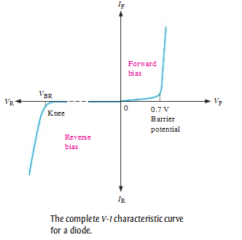
Diode V-I Characteristic
The complete V-I characteristic curve

Slide 23
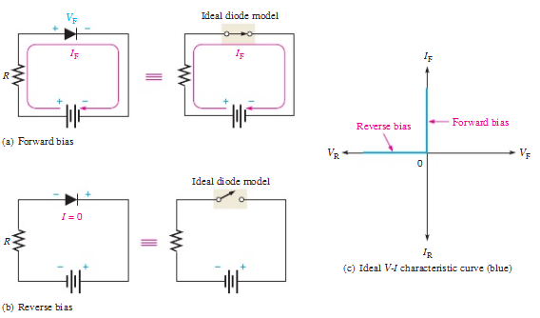
Diode models
Ideal Diode Model
Barrier potential, the forward dynamic resistance and reverse current all are neglected.
Notes:
Random topics just for revising some concepts.

Slide 24
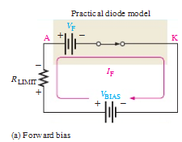
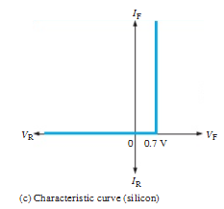
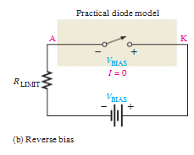
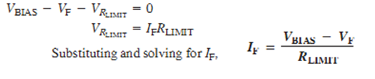
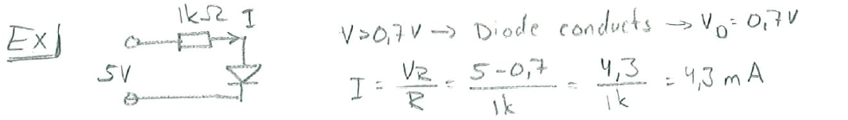
Diode models
VF = 0.7V
Practical Diode Model
Barrier potential, the forward dynamic resistance and reverse current all are neglected.
Forward current IF is determined using Kirchhoff’s voltage as follows:

Slide 25
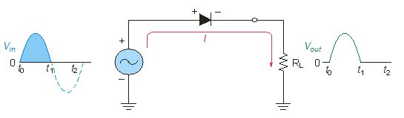
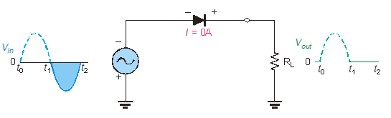
Half wave Rectifiers
As diodes conduct current in one direction and block in other.
When connected with ac voltage, diode only allows half cycle passing through it and hence convert ac into dc.
As the half of the wave get rectified, the process called half wave rectification.
    A diode is connected to an ac source and a load resistor forming a half wave rectifier.
    Positive half cycle causes current through diode, that causes voltage drop across resistor.
Notes:
Random topics just for revising some concepts.

Slide 26
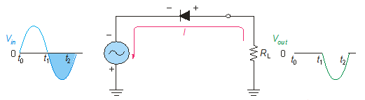
Diode as Rectifiers
Reversing diode.
Average value of Half wave output voltage:
VAVG = VP / pi
VAVG is approx 31.8% of Vp
PIV: Peak Inverse Voltage = Vp

Slide 27
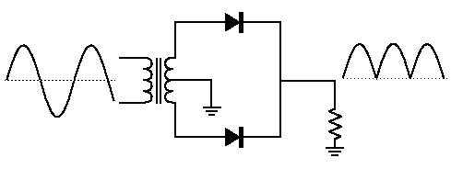
Full wave rectifiers
A full wave rectifier allows unidirectional current through the load during the entire 360 degree of input cycle.
The output voltage have twice the input frequency.
VAVG is 63.7% of Vp
Full Wave Rectifier
VAVG = 2VP / pi
Notes:
Random topics just for revising some concepts.

Slide 28
The Center-Tapped Full wave rectifiers
A center-tapped transformer is used with two diodes that conduct on alternating half-cycles.
During the positive half-cycle, the upper diode is forward-biased and the lower diode is reverse-biased.
During the negative half-cycle, the lower diode is forward-biased and the upper diode is reverse-biased.
Notes:
Random topics just for revising some concepts.

Slide 29
The Bridge Full-wave rectifiers
The Bridge Full-Wave rectifier uses four diodes connected across the entire secondary as shown.
Conduction path for the positive half-cycle.
Conduction path for the negative half-cycle.
Notes:
Random topics just for revising some concepts.

Slide 30

The Bridge Full-Wave Rectifier
Example:
Determine the peak output voltage and current in the 3.3 kΩ load resistor if V_{sec} = 24 V_{rms}. Use the practical diode model.
Solution:
The peak output voltage is:
= 32.5 V
Applying Ohm’s law,
I_{p(out)} = 9.8 mA

Slide 31
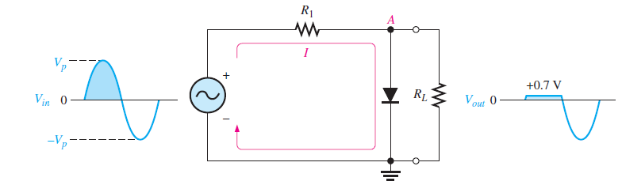

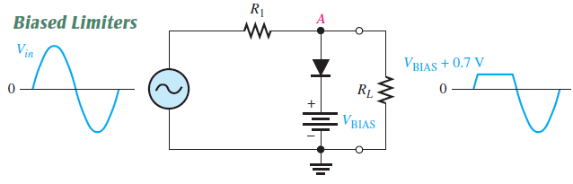
Diode Limiters
Diode circuits, called limiters or clippers, are used to clip off portions of signal voltages above or below certain levels.

Slide 32
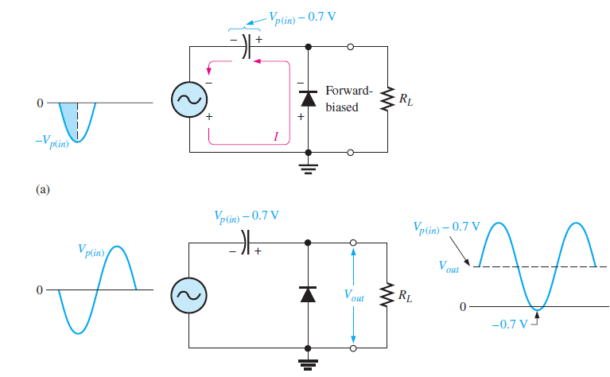
Diode Clampers

Slide 33
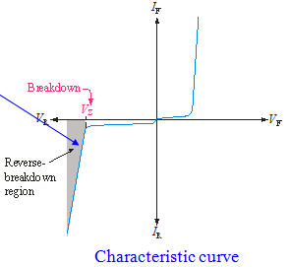
Zener Diodes
A Zener diode is a silicon pn junction that is designed for operation in reverse-breakdown region
When a diode reaches reverse breakdown, its voltage remains almost constant even though the current changes drastically, and this is key to the Zener diode operation.
Ideally, the reverse breakdown has a constant breakdown voltage. This makes it useful as a voltage reference, which is its primary application.
Notes:
Random topics just for revising some concepts.

Slide 34
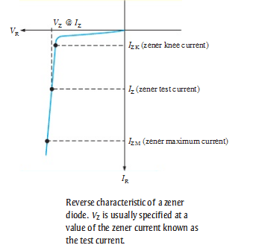
Zener Breakdown Characteristic
As the reverse voltage (VR) increases, the reverse current(IR) remains extremely small up to the knee of the curve.
Reverse current is also called Zener current(Iz).
At knee point the breakdown effect begins, the internal Zener resistance (ZZ) begins to decrease.
The reverse current increase rapidly.
The Zener breakdown (VZ) voltage remains nearly constant.

Slide 35
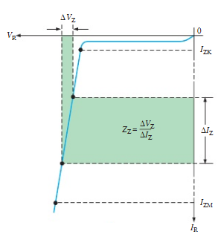
Zener Diode Impedence
The zener impedance, Z_{Z}, is the ratio of a change in voltage in the breakdown region to the corresponding change in current:
What is the zener impedance if the zener diode voltage changes from 4.79 V to 4.94 V when the current changes from 5.00 mA to 10.0 mA?
Practical model
30 Ω

Slide 36
Zener Regulation
The ability to keep the reverse voltage constant across its terminal is the key feature of the Zener diode.
It maintains constant voltage over a range of reverse current values.
A minimum reverse current IZK must be maintained in order to keep diode in regulation mode. Voltage decreases drastically if the current is reduced below the knee of the curve.
Above IZM, max current, the Zener may get damaged permanently.

Slide 37
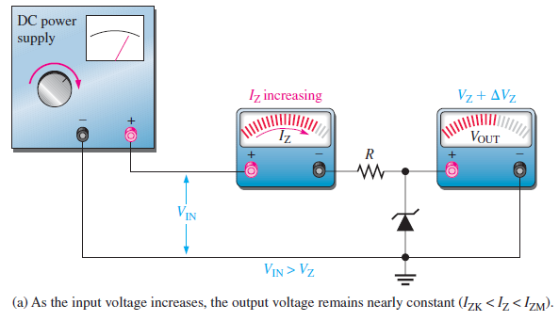
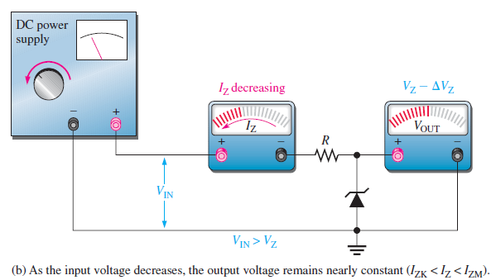
Zener Regulation
Zener Regulation with variable input voltage:
As the input voltage changes, the output voltage remains nearly constant (IZK < IZ < IZM).

Slide 38
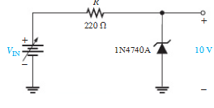
Zener Regulation
Zener Regulation with variable input voltage
  Ideal model of IN4047A
  IZK = 0.25mA
  VZ = 10V
  PD(max) = 1W
Vin(min) = 10.55V
Vin(max) = 32V

Slide 39
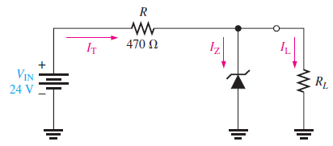
Zener Regulation
Zener Regulation with variable load
  It maintains voltage a nearly constant across RL as long as Zener current is within IZK and IZM.
VZ = 12 V,
IZK = 1 mA,
IZM = 50 mA.

Slide 40
Zener Diode Applications
Zeners can also be used as limiters. The back-to-back zeners in this circuit limit the output to the breakdown voltage plus one diode drop.
Question:
What are the maximum positive and negative voltages if the zener breakdown voltage is 5.6 V?
± 6.3 V

Slide 41
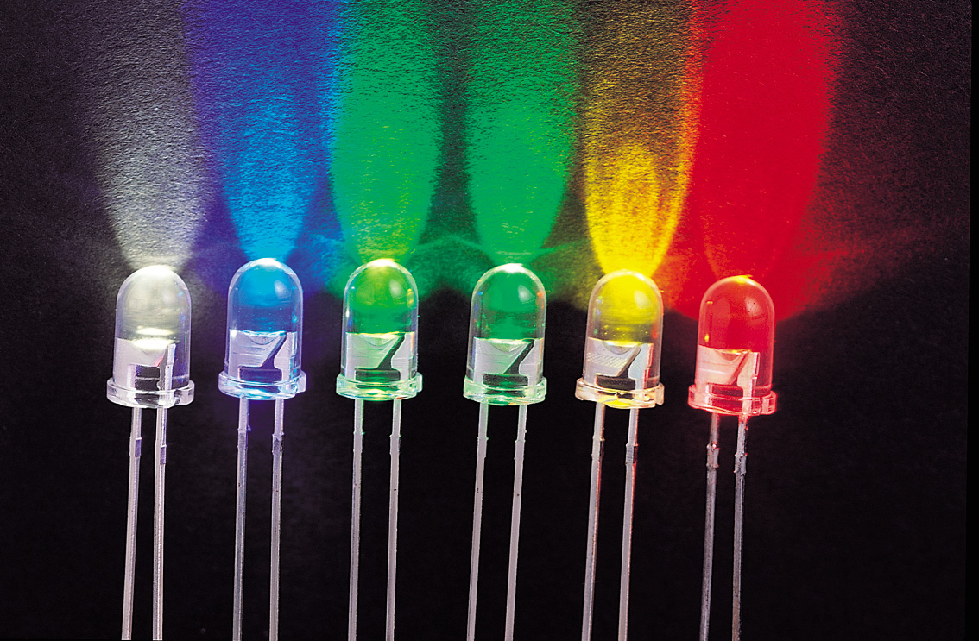

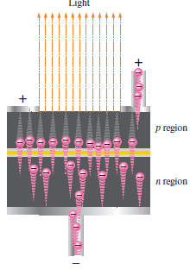
Optical Diodes
Light Emitting Diodes (LEDs): Diodes can be made to emit light electroluminescence) or sense light.
When forward biased electrons form n-region cross the junction and recombines to holes with the emission of photons.
Various impurities are added during the doping process to establish the wavelength of the emitted light.
The process is called electroluminescence.

Slide 42
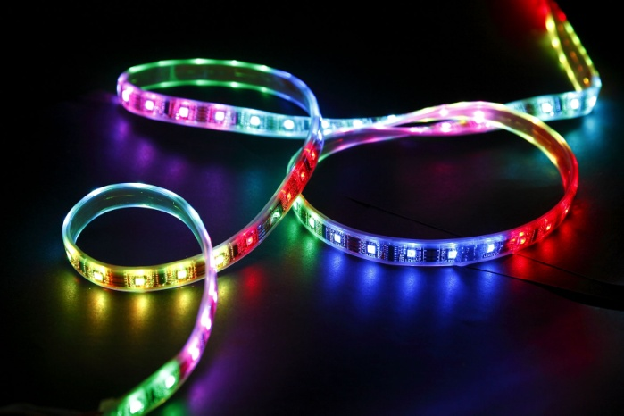
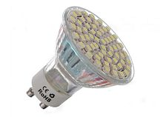

Light Emitting Diodes
LEDs vary widely in size and brightness – from small indicating lights and displays to high-intensity LEDs that are used in traffic signals, outdoor signs, and general illumination.
LEDs are very efficient light emitters, and extremely reliable, so domain of uses getting wider.

Slide 43
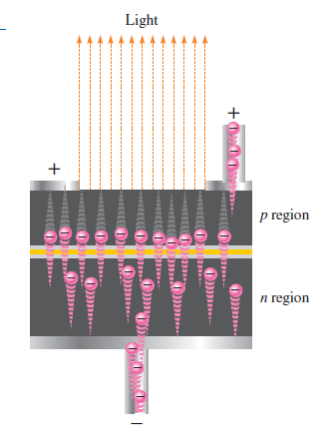
Light Emitting Diodes
When the device is forward-biased, electrons cross the pn junction from the n-type material and recombine with holes in the p-type material.
The difference in energy between the electrons and the holes corresponds to the energy of visible light.

Slide 44

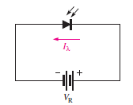
Photo Diode
A photodiode is a special light sensitive diode with a clear window to the pn junction. It is operated with reverse bias. Reverse current increases with greater incident light.
The tiny current that is present when the diode is not exposed to light is called dark current
Dark current

Slide 45

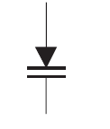
Varactor Diode
A varactor diode is a special purpose diode operated in reverse-bias to form a voltage-controlled capacitor. The width of the depletion region increases with reverse-bias.
Varactor diodes are used in tuning applications. The applied voltage controls the capacitance and hence the resonant frequency.

Slide 46
Refrences
Electronic Devices by Floyd 9th Edition
  Chapter 1,2,3

Slide 47
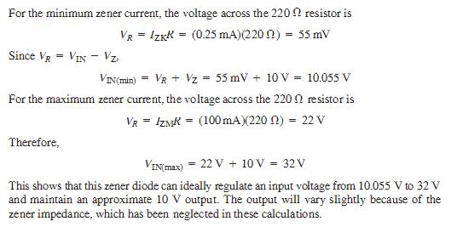
Zener Regulation
Zener Regulation with variable input voltage
  Ideal model of IN4047A
  IZK = 0.25mA
  VZ = 10V
  PD(max) = 1W, IZM = 1W / 10V = 100mA

Slide 48
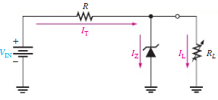
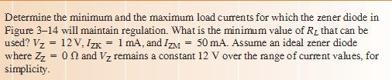

Zener Regulation
Zener Regulation with variable load
  It maintains voltage a nearly constant across RL as long as Zener current is within IZK and IZM.

