Slide 1
VFD inputs/ outputs and wiring
Notes:
VFD

Slide 2
VFD inputs/ outputs and wiring
A VFD is nothing more than a direct digital controller that can accept low voltage inputs make decisions and allow rectified output power to motors, compressors etc. to run safely and economically. Drives come with factory programmed defaults which with very little added programming will allow operation.
Notes:
VFD

Slide 3
VFD inputs/ outputs and wiring
By understanding the basics of VFD operation and the basics of VFD programming you can maneuver your way through start up and trouble shooting of the drive. How much we use the literature of the drive will allow us to fine tune our tasks.
Notes:
VFD

Slide 4
VFD inputs/ outputs and wiring
As stated previously a VFD has low voltage inputs and outputs. These are
  1. Analog inputs
  2. Analog outputs
  3. Digital inputs
  4. Digital outputs/ Relay outputs
Notes:
VFD

Slide 5
VFD inputs/ outputs and wiring
Most of the new VFD’s have two boards. One board will be the drive board and the other will be the communication or bypass board. There is a patch cord that will allow communication between them. The terminations will be manufacturer dependent between the boards.
Notes:
VFD

Slide 6
VFD inputs/ outputs and wiring
Most of the drive manufacturers use the communication or bypass boards to land all of the points except the speed signal. This is usually done at the drive board.
Notes:
VFD

Slide 7
Analog inputs
All of our four drives have at least two analog inputs.
They are usually a combination of either 0-10 vdc or 4-20 ma inputs.
They are used as an external reference signal to speed the drive up and down.
The signal will be an output from a controller or a temperature/ pressure device using the internal PID loop.
They will be shown as AI-1, AI-2 to common or ground.
Notes:
VFD

Slide 8
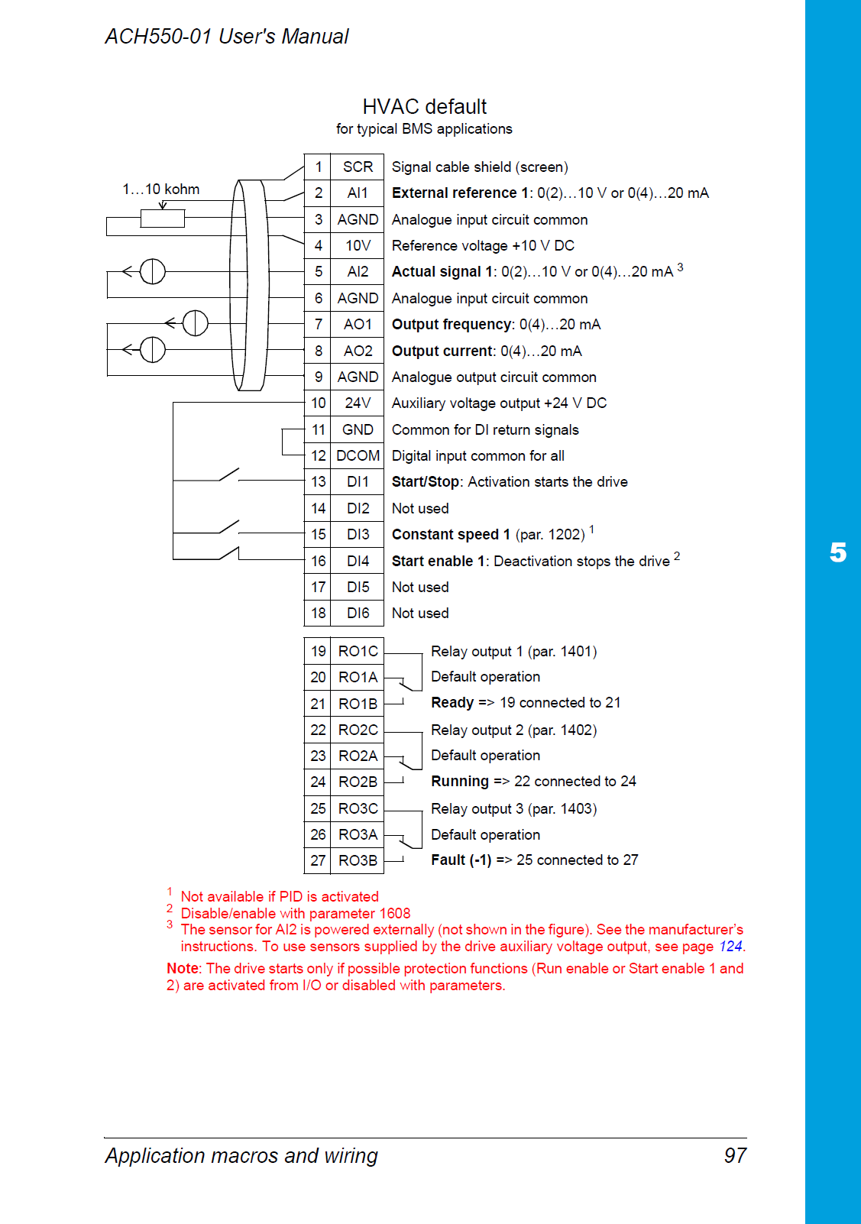
Analog inputs
Notes:
ABB drive (Analog inputs)

Slide 9
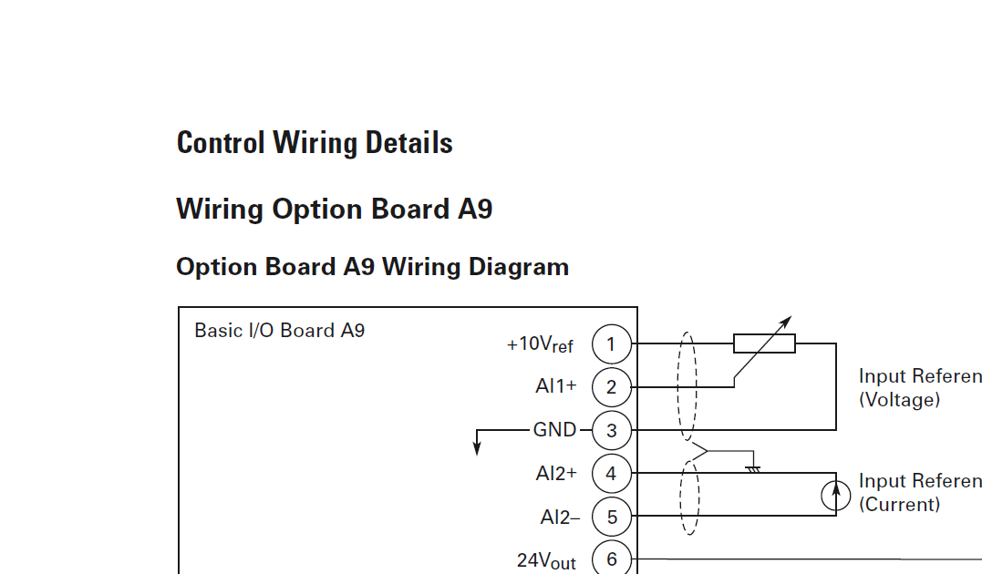
Notes:
Eaton drive (Analog inputs)

Slide 10
Analog outputs
Analog outputs convey outputs in either 0-10 vdc or 4-20 ma as a measurement of either drive hertz or drive current.
This allows a signal from the drive to be sent somewhere it can be used as information from the drive.
These points are rarely used anymore.
Usually the termination signal will be AO-1, AO-2 to common or ground.
Notes:
1. You could wire these outputs back to a building management system.

Slide 11
Analog outputs
Notes:
ABB drive (Analog outputs)

Slide 12
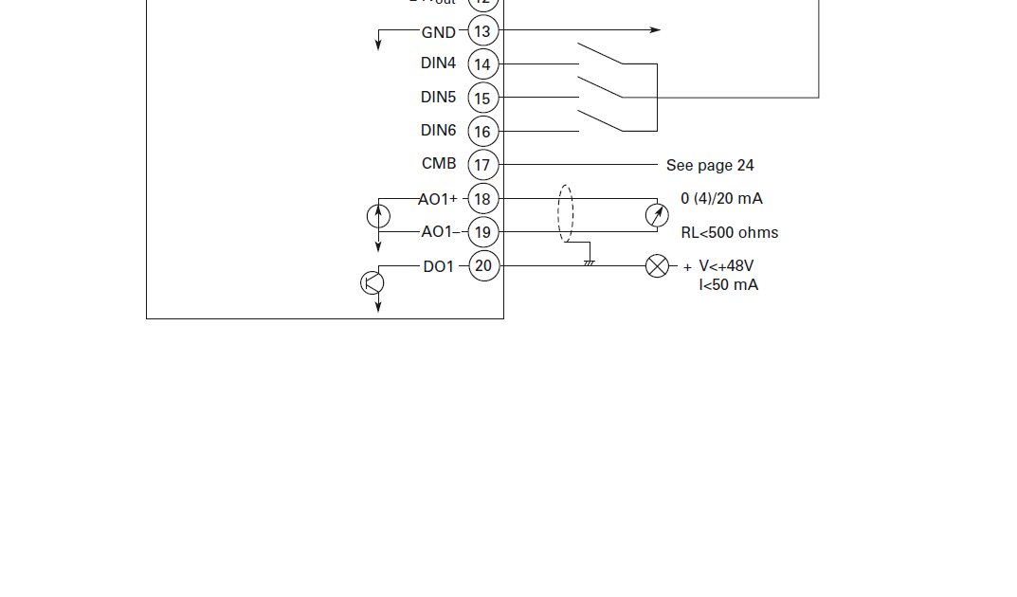
Notes:
Eaton drive (Analog outputs)

Slide 13
Digital Inputs
Digital inputs are two position input terminations which also allow the drive to make decisions.
The inputs will use a 24vdc positive powered output from the drive which will be closed or opened by a device (relay), (controller) which will by terminating at a vfd Digital Input energizing an internal triac or relay.
Notes:
VFD

Slide 14
Digital inputs
The drive is looking for a closure or open between 24 vdc and its associate Digital Input as per the parameter setup. The drive can now make decisions based on this information.
Remember sometimes it’s as easy as looking at changed parameters to understand the thought process of another tech.
Notes:
VFD

Slide 15
Digital Input
Digital inputs will be terminated from 24vdc+ to DI-1, DI-2, DI-3, DI-4 etc..
The types of inputs will be:
1. Start
2. Enable
3. External interlock/Safety
4. Reset drive
5. Reverse drive
Notes:
VFD

Slide 16
Digital inputs
6. Run permissive
7. Preset speed
8. Constant speed
9. Fireman’s override

Slide 17
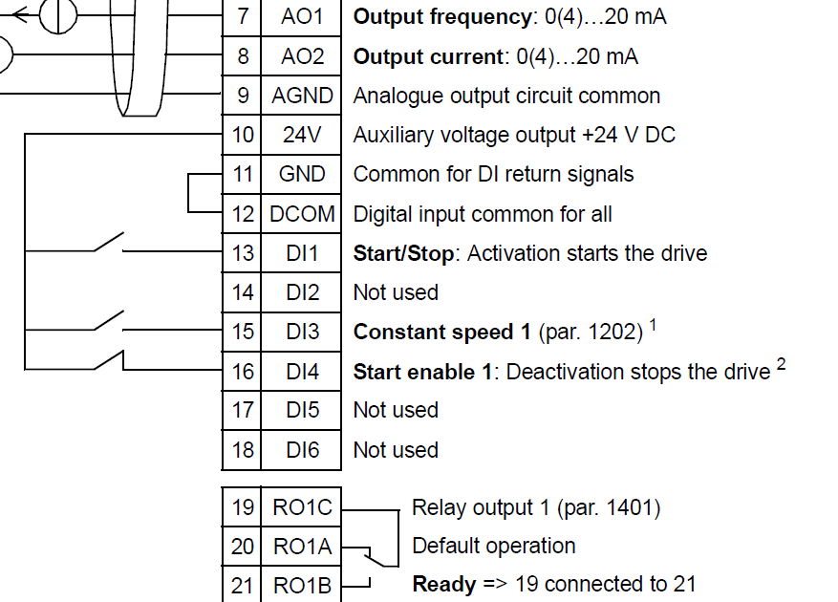
Digital inputs
Notes:
ABB drive (Digital inputs)

Slide 18
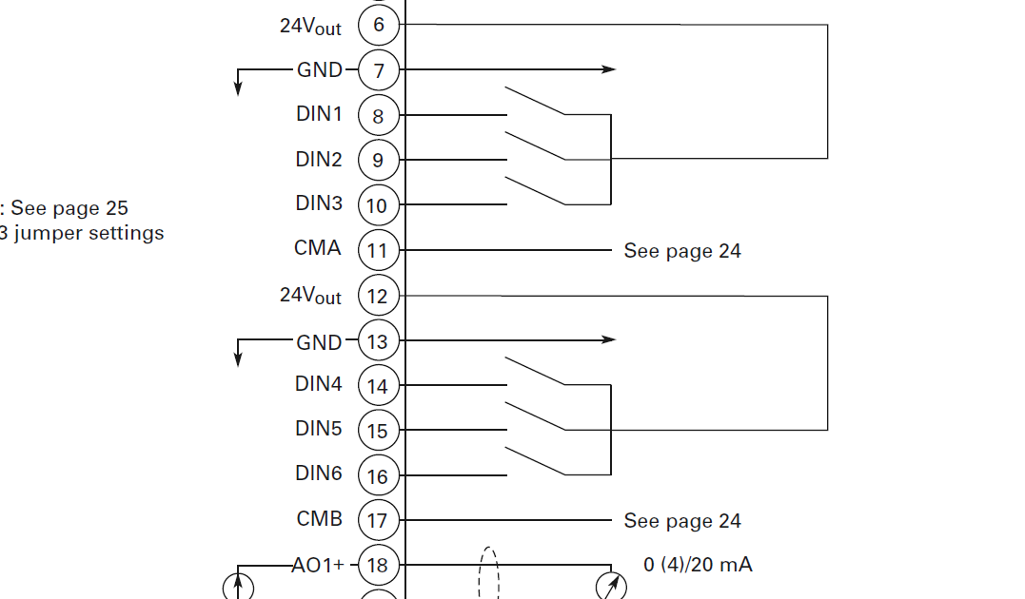
Notes:
Eaton drive (Digital inputs)

Slide 19
Relay outputs
Relay outputs on drives are triggered by the programming and reaction to digital/analog inputs and drive internal logic.
These are mostly form c contacts which have common, normally open and normally closed contacts.
Some of the factory defaults are:
Notes:
VFD

Slide 20
Relay outputs
  1. Relay switch when drive running.
  2. Relay switch when drive is in fault.
  3. Relay switch when drive is ready.
  4. Relay switch when drive start signal is present.
Notes:
VFD

Slide 21
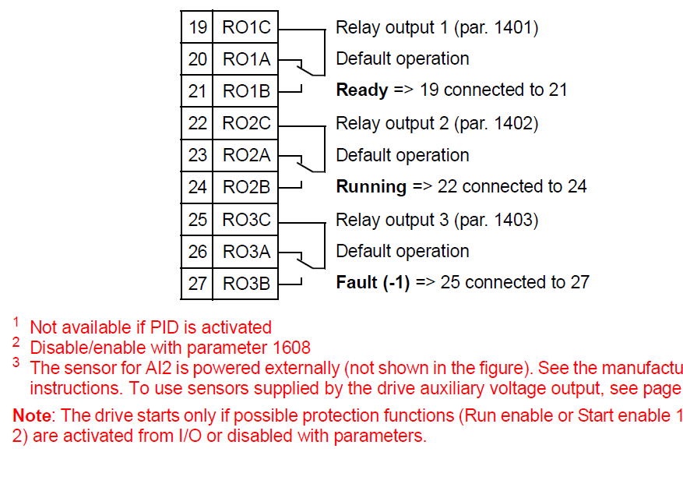
Relay outputs
Notes:
ABB (Relay outputs). Notice these are common, normally open, normally closed dry contacts.

Slide 22
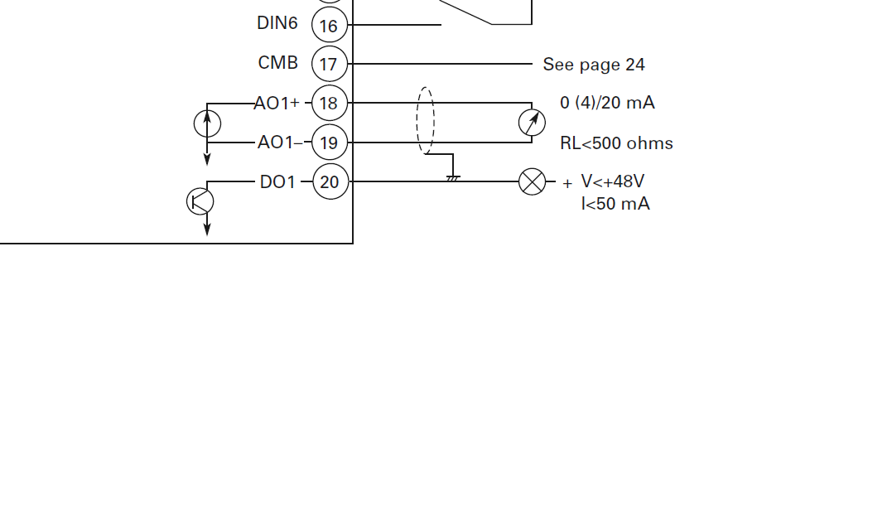
Notes:
1. Eaton drive has only one digital output.

Slide 23
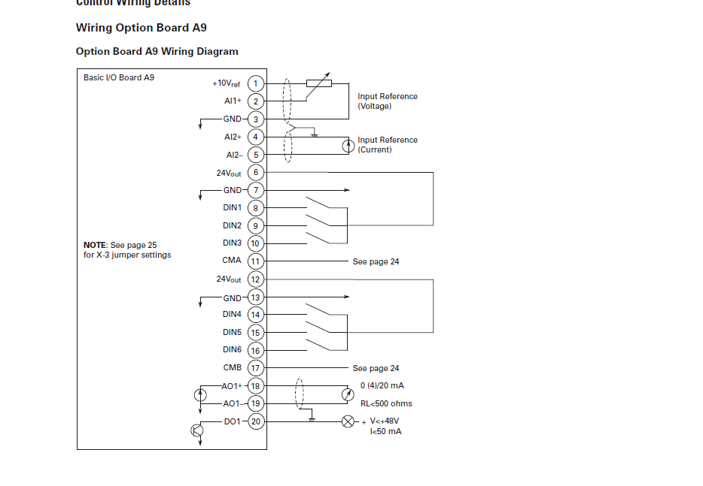
Notes:
1. Eaton Drive terminals

Slide 24
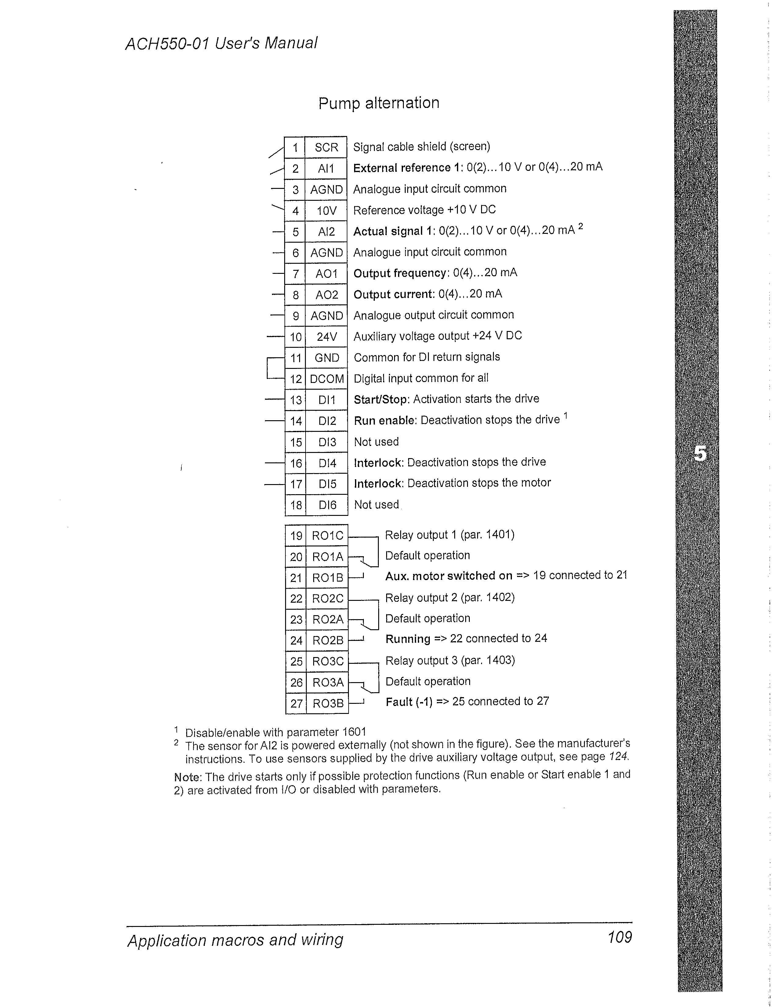

Slide 25
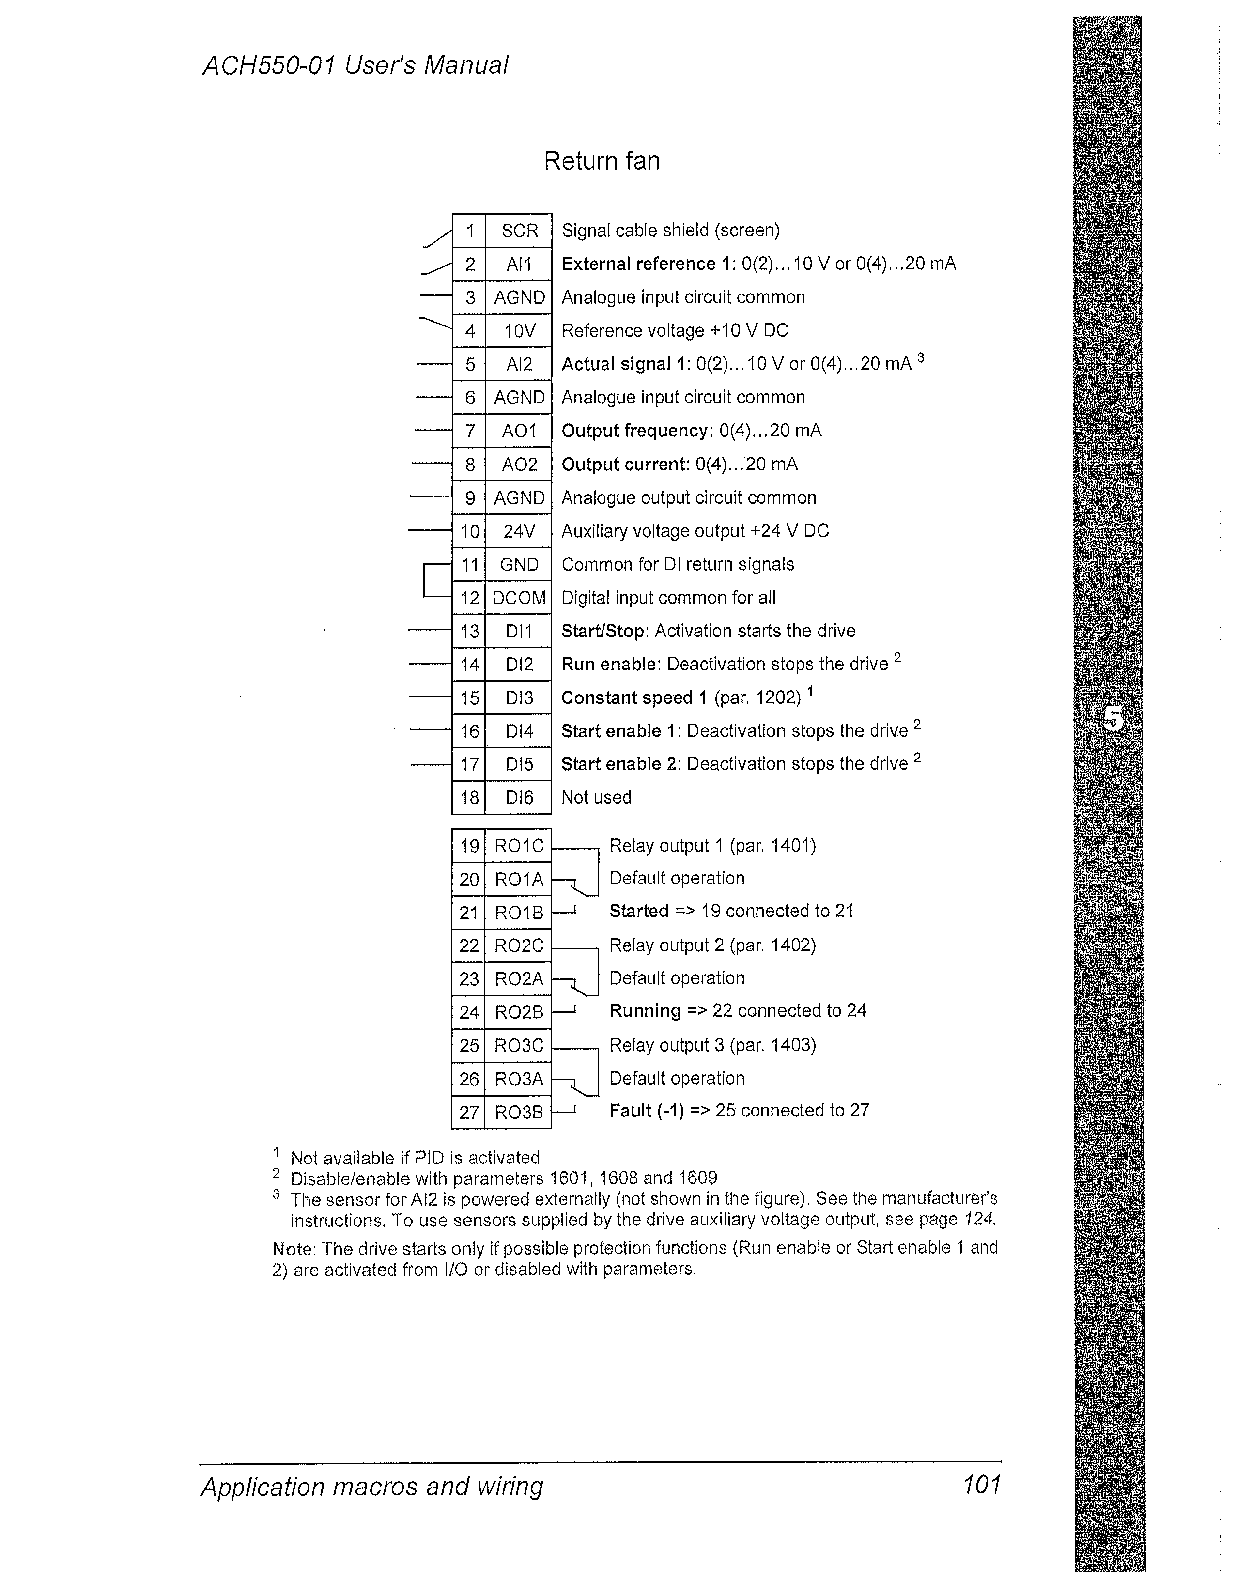

Slide 26
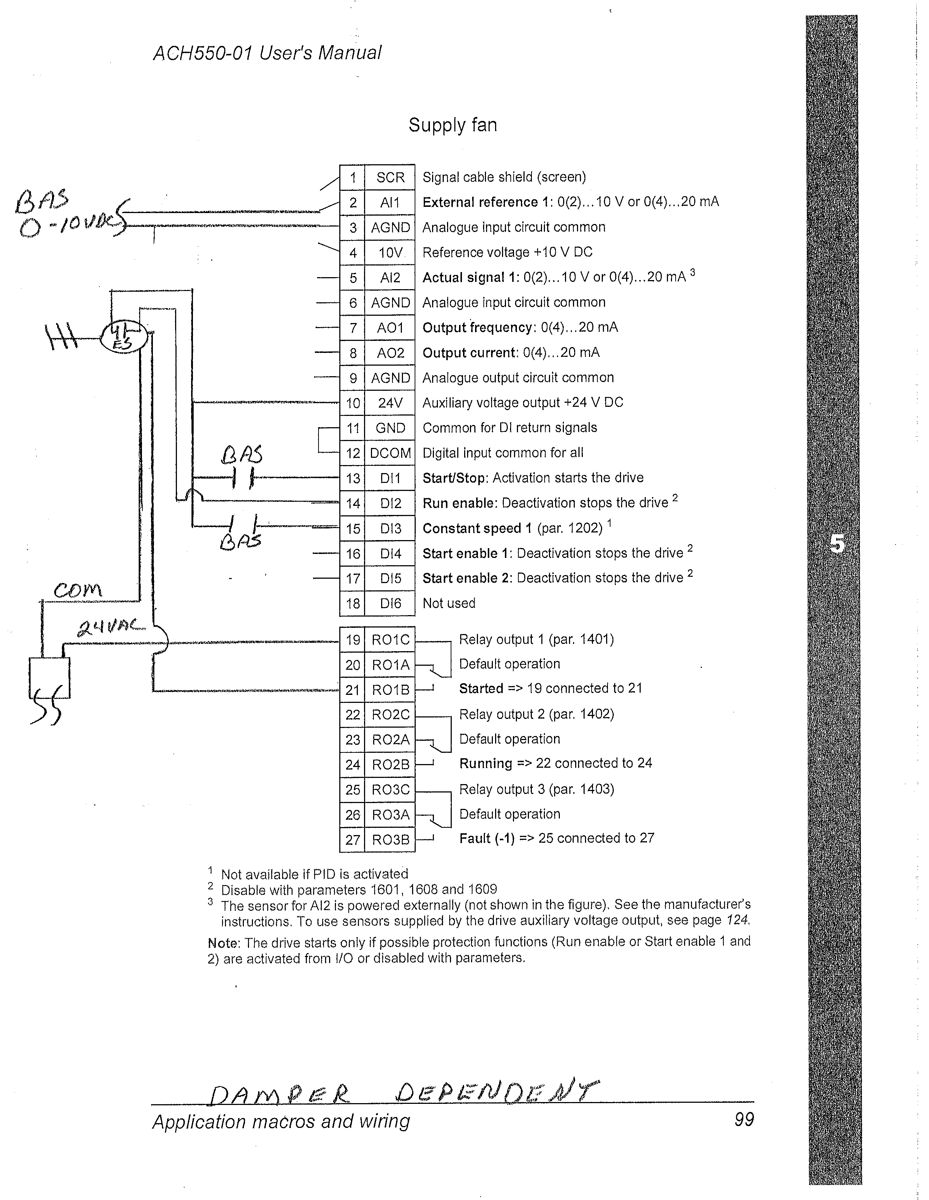

Slide 27
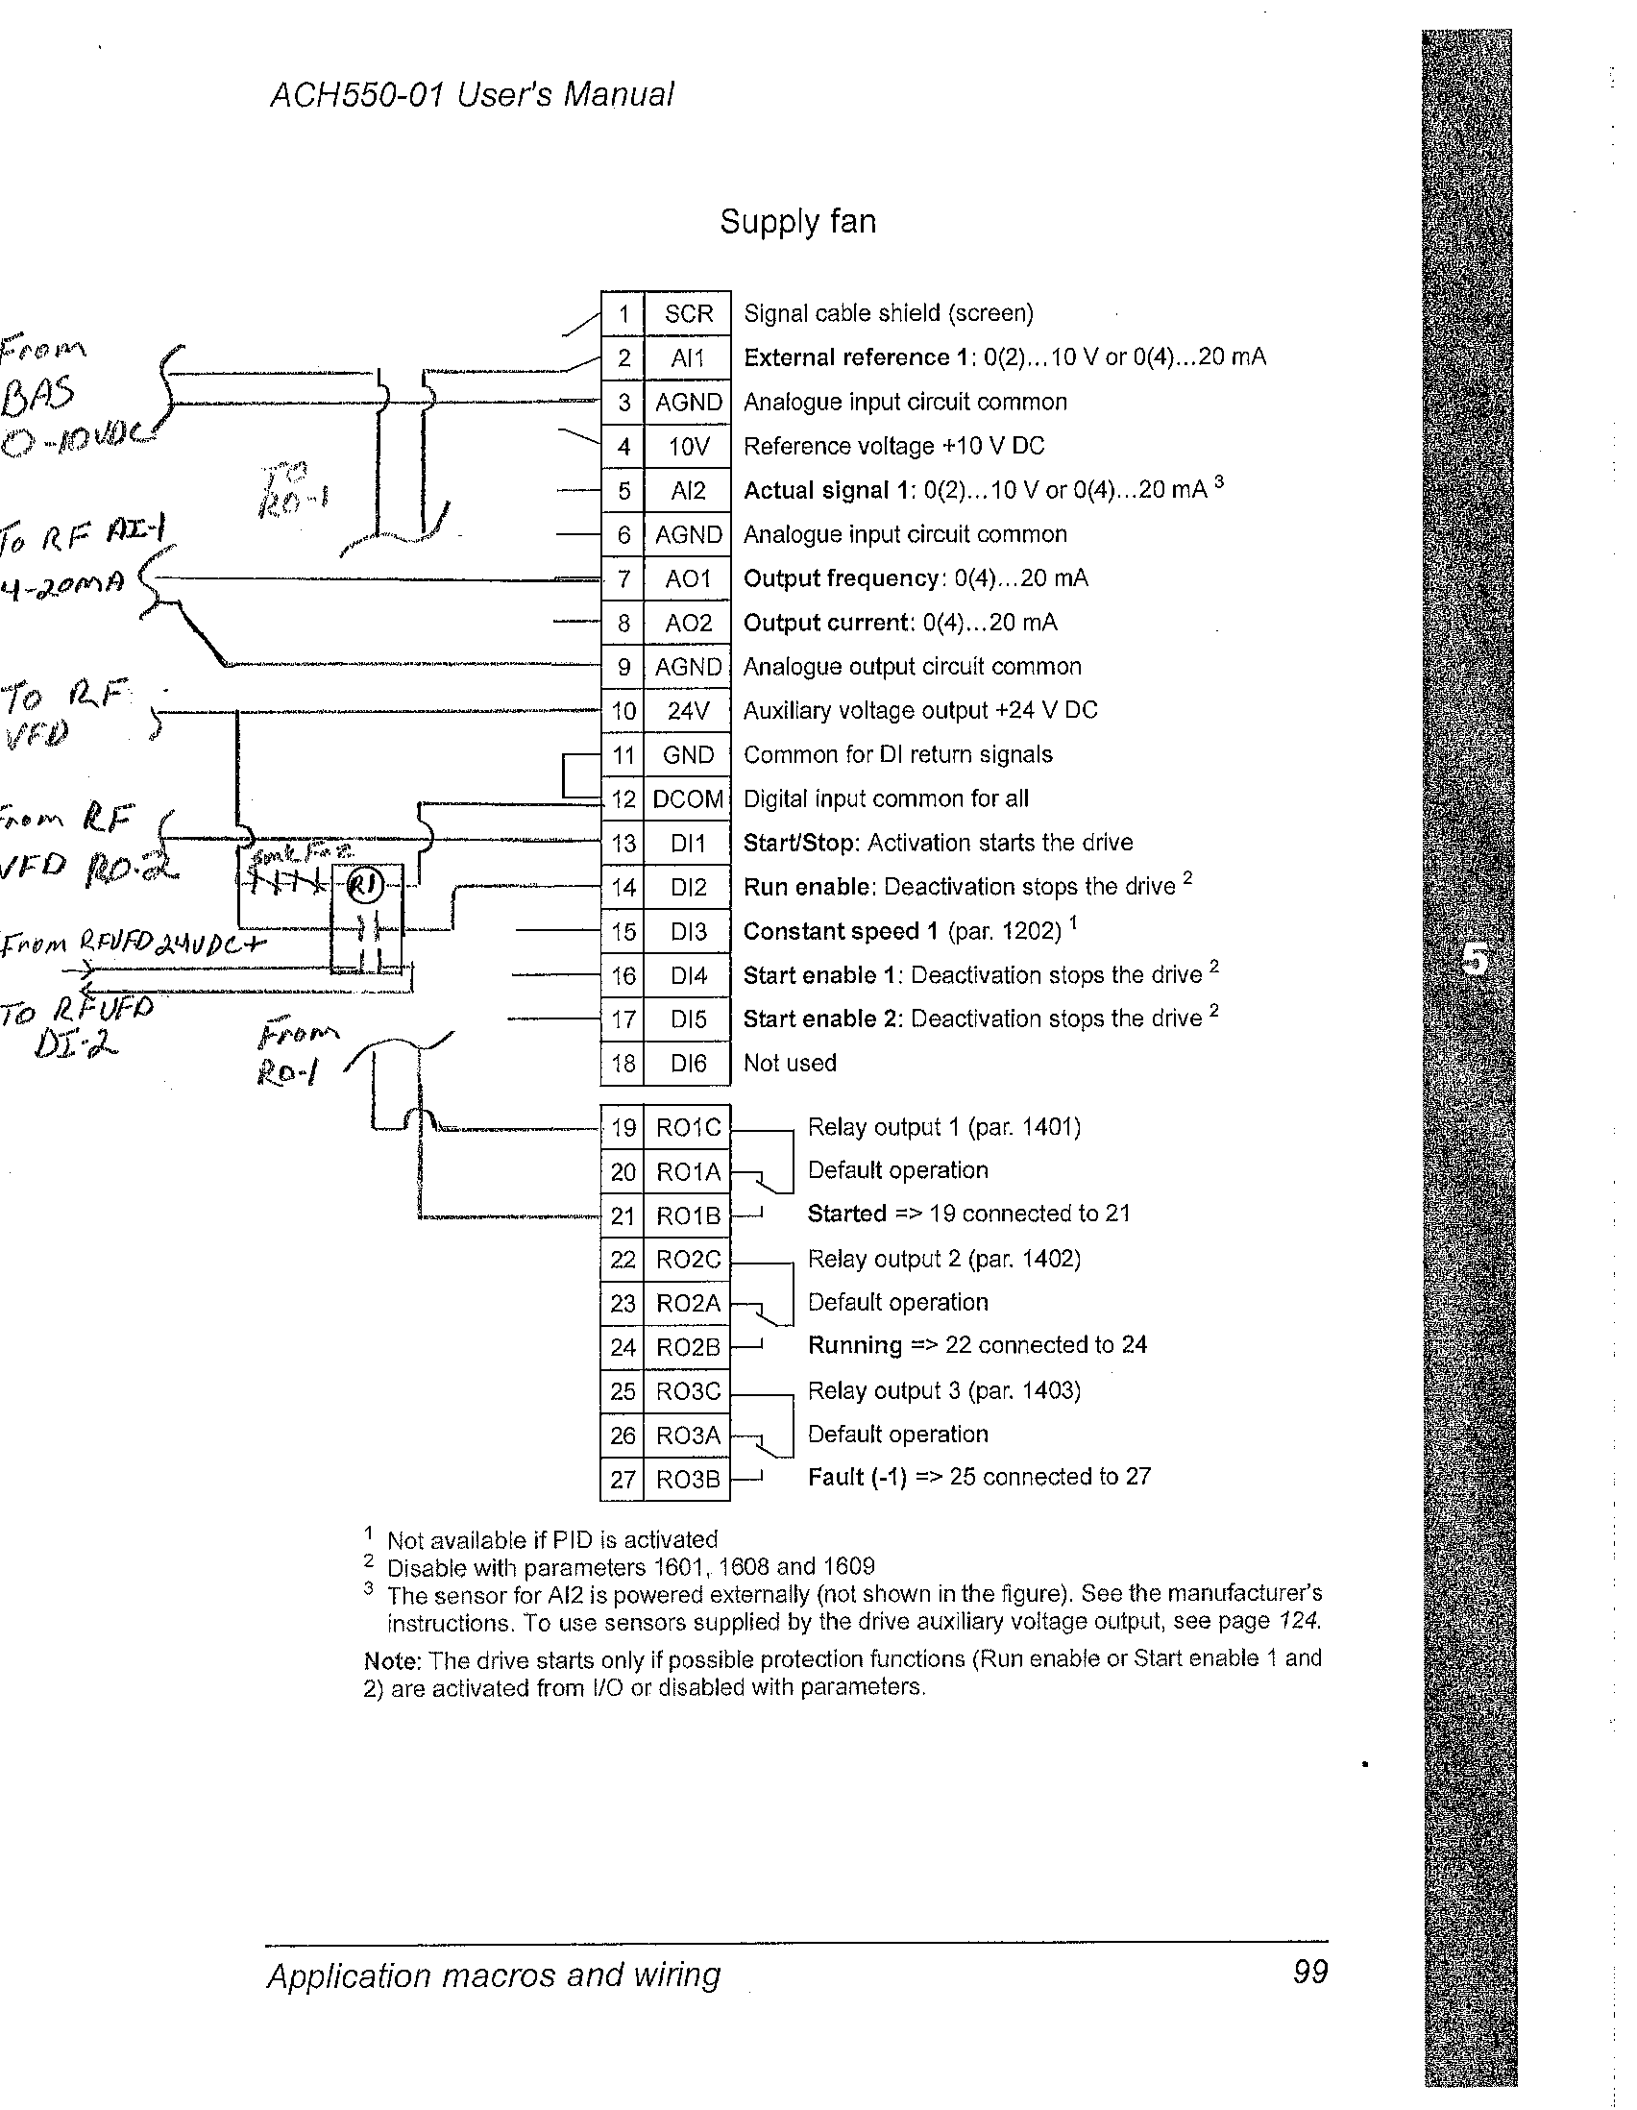

Slide 28
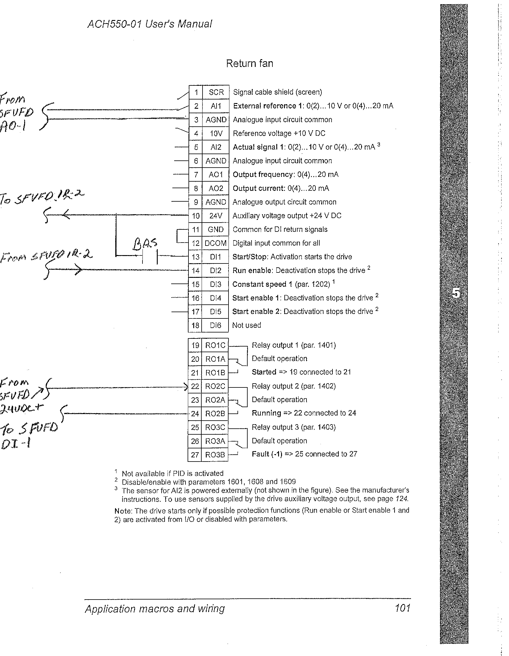

Slide 29
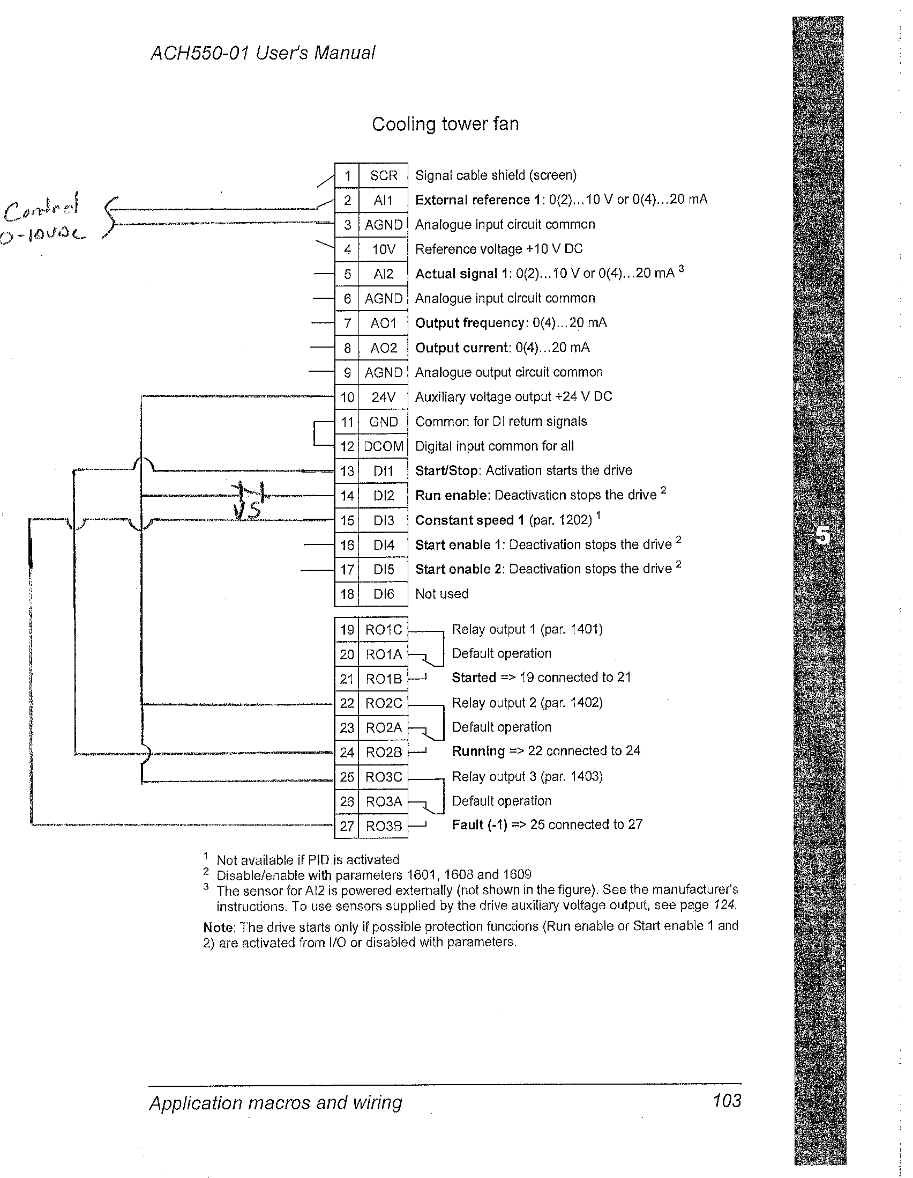

Slide 30
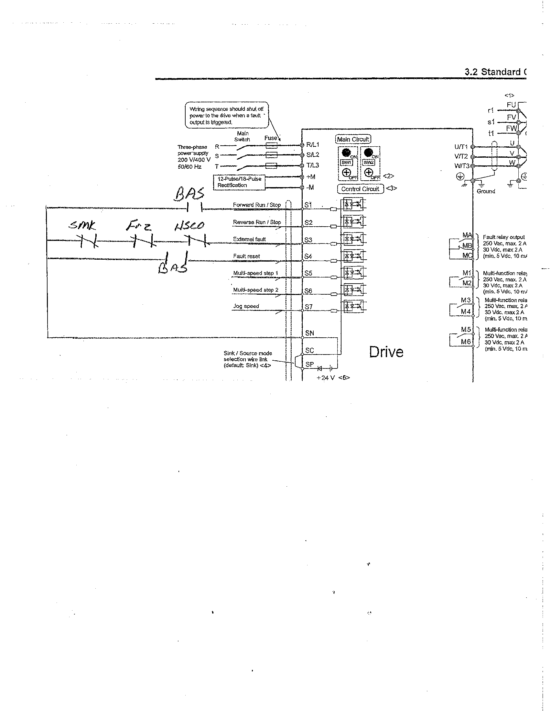

Slide 31
