Slide 1
Harmonic Distortion from Variable Frequency Drives:
ABB Low Voltage Drives, USA
Notes:
Use this section to get the audience members up to speed on both Current and Voltage distortion.
The link on [slide#2] jumps to these slides when you want to do this topic review.
The last slide in this set [slide#35] has a link to jump you back to [slide#2]
Run through the slides.
Total time should be from 7 to 10 minutes.
I Suggest a fairly quick pace so you can return to the main topic.
Make sure you have answered any specific questions and then jump back to the IEE 519-2014 review slides

Slide 2
What causes power line distortion?
Power schematic of a VFD
Rectifier Section
Diodes
DC Bus
Capacitors
Inverter Section
IGBTs
Slide 2
Notes:
Over view the sections making up a typical VFD.
The last click brings you back to the Rectifier Section.
VFDs have many positive impacts on pumping systems, including
Significantly improved part-flow system efficiency
Reduced mechanical stress due to controlled accelerations
Reduced water hammer
Controlled system pressure to reduce leaks
It is unfair to say that VFDs are the cause of power line distortion. Many modern electronic devices use the same sort of power supply. However, VFDs can make up a significantly large amount of the electrical load in a building.

Slide 3
What causes power line distortion?
How a VFD draws current
DC Bus Voltage
Input Voltage
Loads that draw current in this way are called
“Non-Linear Loads”
DC Current
Slide 3
Notes:
The key to controlling harmonic distortion is limiting the current pulses. This is generally accomplished through the use of inductor coils, which may also be called reactors or chokes, on the input of the drive.
The ACH550 design include 5% impedance using DC Chokes
The inductance of a coil creates a back electromotive force (emf), or voltage, as the current pulse passes through it. This reduces the rate of the current pulse.

Slide 4
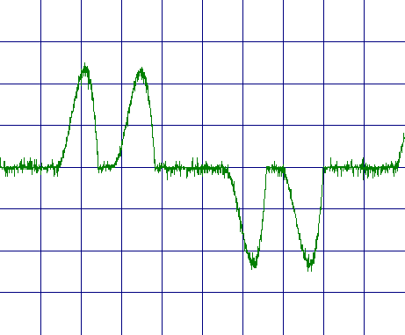
What causes power line distortion?
What does 3-phase current distortion look like?
Slide 4
Notes:
This shows the current from phase A to B (in blue)
and the current from phase A to C (in red).
If we showed the current from B to C, we would see 6 pulses.
That’s why this is called a 6-pulse rectifier.

Slide 5
What are the effects of distortion?
The effects of current distortion
Fast changing current can radiate electrical noise more easily.
Increased RMS current requires larger diameter cables.
Additional heating of transformers due to …
  higher RMS current
  greater eddy current losses
Reduced system efficiency
Unstable standby generator operation
Voltage distortion …
  in the facility
  in the public power grid
Slide 5
Notes:
Interference with other equipment.
The strength of the magnetic field that is built up around a wire is proportional to the pulse rate of current in the wire.
These fast changing current pulses transmit a stronger electrical noise signal than a normal sinusoidal current.
This can result in an audible hum in other equipment, unstable displays on monitors, unreliable data transmission, or interference with the operation of sensitive electronic equipment.
Transformers are designed to handle smooth, sinusoidal current. Short current pulses like the ones shown above cause additional heating in the transformer.
If the transformer is not designed to safely accommodate such currents, it may overheat and fail. Without harmonic distortion protection, it may be necessary to increase the current carrying capacity of the transformer.
Because the current draw occurs in pulses, and because voltage equals current multiplied by system impedance, the voltage waveform will not
be sinusoidal. It will be similar to the waveform shown in figure 7. This phenomenon is often referred to as “flat topping.”
Remote lighting control systems, clock synchronization and other systems which rely on the building’s electrical power distribution to transmit information, may operate erratically due to clipping of the carrier current voltage peaks.
The voltage regulators on emergency power generators may cause unstable generator operation as they attempt to compensate for the missing voltage peaks.
Other equipment, which depend upon a “clean” source of power to operate reliably, may also be affected.

Slide 6
What causes power line distortion?
Voltage distortion is caused by current distortion.
Current
Undistorted Voltage
Distorted Voltage
Slide 6
Notes:
The voltage “flat tops”.

Slide 7
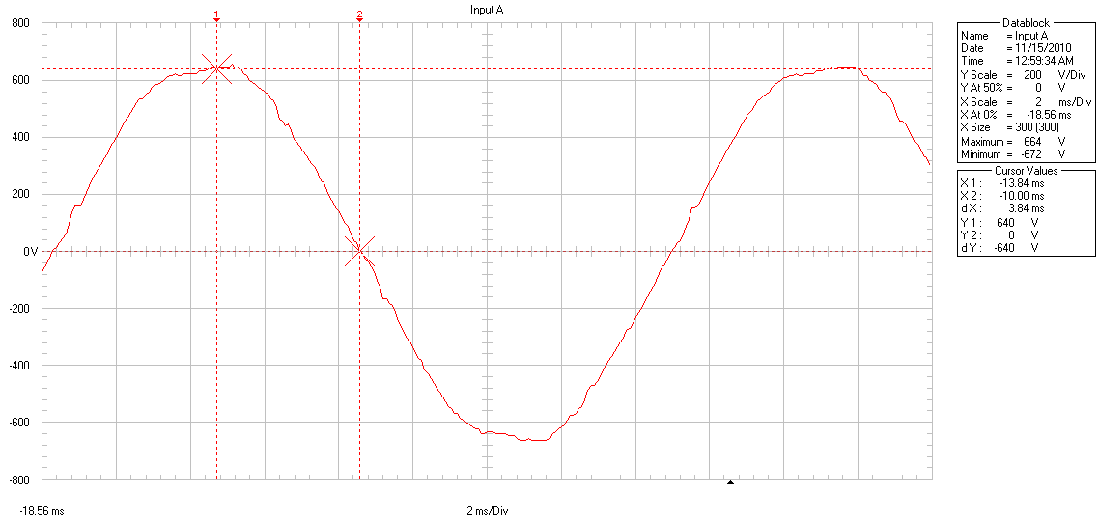
What causes power line distortion?
What does voltage distortion look like?
Slide 7

Slide 8
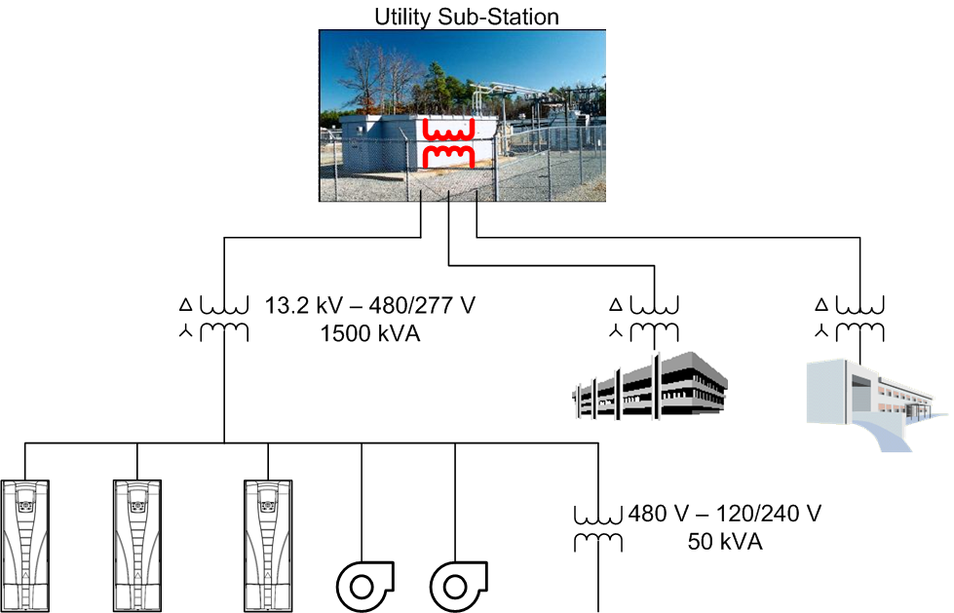
What causes power line distortion?
What determines the amount of voltage distortion?
For a facility
The current distortion
of its loads
The impedance of the medium-to-low voltage transformer
For the public utility
The current distortion from all of its customers (Common)
The impedance of its distribution system
Slide 8

Slide 9
What are the effects of distortion?
The effects of voltage distortion
Interference to sensitive equipment such as …
  Medical equipment
  Airport electronics
  Computers and monitors
  Communication equipment
  Laboratory research equipment
Interference to carrier current signals
  Lighting and other control systems
Unstable standby generator operation
Intermittent gas discharge lights
Slide 9
Notes:
The carrier current lighting controls were common for Leviton. Simplex made carrier controlled clocks.
The intermittent gas discharge lights are happening right now in areas of rural Canada where the power utility feed is weak (high impedance) and the load of modern electronic equipment is great.

Slide 10
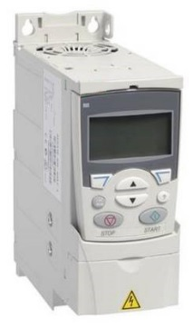
What can be done about distortion?
6-pulse rectifier
Slide 10
Notes:
These VFDs are often low horsepower and quite compact. They are often called “micro drives.”
While the harmonic level looks high, micro drives are small and very seldom make up anything close to 30% of a building’s laod.
The following calculations are based on:
400 MVA short circuit capability at the utility
13.2 kV at the utility
480 V AC at the facility
1000 kVA transformer
5.75% transformer impedance
1 50 HP VFD
1 100 HP VFD
1 200 HP VFD
The peak load on the transformer is 80% of its capacity
The VFD loads the transformer to 31.8% of its load

Slide 11
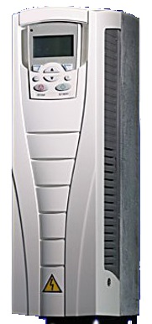
What can be done about distortion?
6-pulse rectifier with 5% input reactor
Slide 11
Notes:
From a harmonics point of view, adding equivalent coils to the VFD’s DC bus or to its AC power line are much the same.
The 6-pulse drive is significantly larger than the plain 6-pulse drive because of the coils in it and because it is generally used for larger horsepower applications.
While going from no impedance to 5% impedance reduced the harmonic current distortion by 25.8% (63% of 40.7%).
If an additional 5% AC line reactor were added, the TDD would drop to 10.9%, 4.0% lower (or a 27% of 14.9%). This would end up having a total voltage drop across the reactors of 48 V, 10% of 480 V AC. Adding impedance beyond 5% represents a case of diminishing returns.
Adding a 3% AC line reactor reduced the TDD by 2.9% (or 19% of 14.9%).

Slide 12
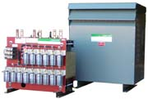
What can be done about distortion?
Passive filter
Slide 12
Notes:
These can be relatively large.
They may be built into a cabinet with the VFD or they may be in a separate enclosure that looks like a transformer’s enclosure.
They can be retrofit into an application that is experiencing power line distortion problems.
The performance shown here can range widely, depending on the design of the filter.
Many designs work well with power line imbalances, existing harmonic distortion and light loads.

Slide 13
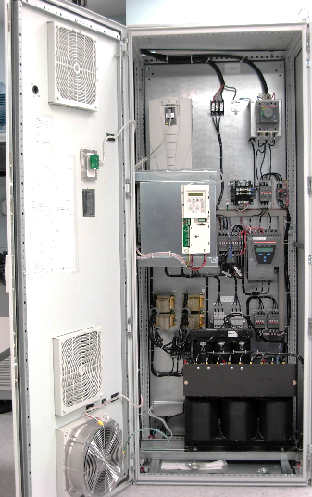
What can be done about distortion?
12-pulse rectifier
Slide 13
Notes:
The harmonics that the 12-pulse allows are the 11th, 13th, 23rd, 25th and so on: (k * 12) +/- 1.
This is theoretical based on full load and a perfectly balanced power line with no harmonic distortion.

Slide 14
What can be done about distortion?
18-pulse rectifier
Slide 14
Notes:
The harmonics that the 18-pulse allows are the 17th, 19th, 35th, 37th and so on: (k * 18) +/- 1.
This is theoretical based on full load and a perfectly balanced power line with no harmonic distortion.

Slide 15
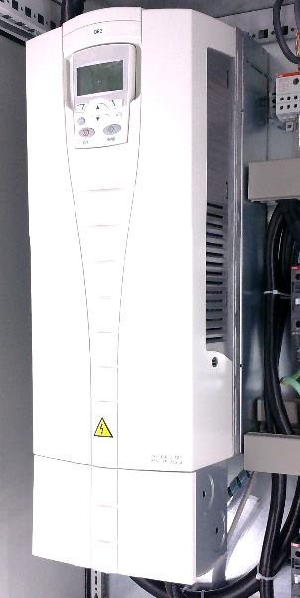
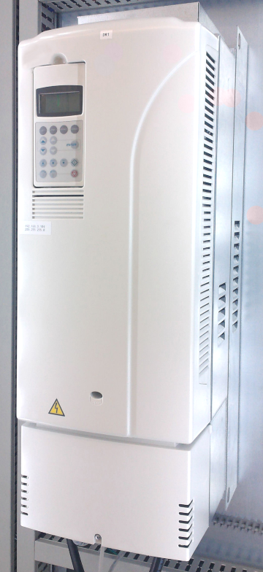
What can be done about distortion?
Active rectifier
Slide 15
Notes:
This actively filters noise generated by the VFD. This is very similar to the way that noise cancelling headphones work.

