Slide 1
HVAC Variable Torque Applications
Andy LaPointe and Dan Gaffney
For Variable Frequency Drives

Slide 2
Variable Torque Applications
Typical HVAC systems with VT Applications
Cooling Tower Fans
Secondary Hot/Chilled
Water Pumps
Supply Fan
Exhaust Fans
Condenser
Water Pump
Primary Hot/Chilled
Water Pumps
Return Fan
Slide 2

Slide 3
HVAC Applications for Variable Frequency Drives
When to use a VFD?
“When you can Optimize the energy delivered into a System by controlling Flow or Pressure”
HVAC systems are designed for worst-case situations…
  the coldest days in winter
  the hottest, most humid days in summer with the highest occupancy
At all other times, the HVAC system is Oversized
By Optimizing (Reducing) system capacity…
  Energy is saved
  System effectiveness improved
  Often…occupant comfort is improved
Slide 3
Notes:
When? To use a VFD?
When you can affect how much Energy is needed to meet the performance needs of the system
Emphasize the Oversized
You are looking for ways to operate the system efficiently when the full capacity is not required to meet the system needs
Identify what parts can be operated at a lower speeds (drives)

Slide 4
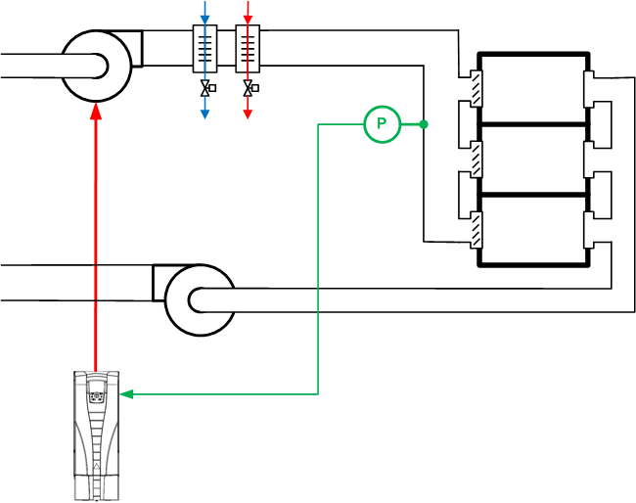
VAV Supply Fan
The static pressure sensor is well down the duct, in a section with little or no turbulent flow.
Slide 4
Notes:
Does everyone know what a VAV (Variable Air Volume) system is and how it works?
Typically the drive will be changing the speed of the fan motor to maintain a desired static pressure in the ductwork.
Sensor location is important

Slide 5
VAV Supply Fan – Over-Pressure Control
High Pressure Cut-Out
Damper
But …
This stops air flow
Requires manual reset
Slide 5
Notes:
It is more and more common to have VAV systems with Isolation Dampers or Combination Fire-Smoke dampers.
Whenever you have the potential of closing a damper in front of a fan you will want a Safety or High-Pressure cut-out to protect the duct work.
Theses are typically Manual reset devises and can be quite a nuisance if not designed and applied correctly.
ACH550 offers a nice solution here. Next Slide

Slide 6
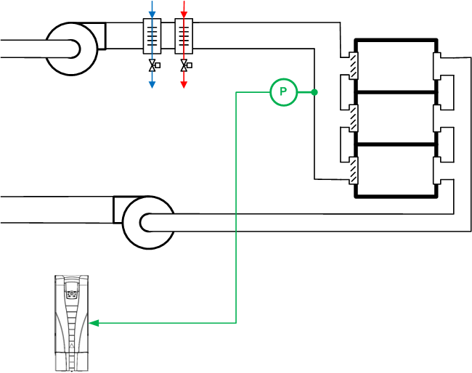
VAV Supply Fan – Damper Control
High Pressure Cut-Out
* Can also be used for
- Pump valve control
- Other interlock circuits
Prove the Air path is Open.
Use the drive’s I/O points to do local control of Fans, Dampers, Pressures, Statuses.
Insures correct operation in
local “Hand” control.
Damper
This control can be modified to allow the fan to start at a low speed first and then accelerate to the required speed when the damper is open.
Run
Slide 6
Notes:
Run Command is received at the drive
Relay Output closes and powers the damper actuator.
Damper end switch “Closes” when Air Path is proven “Open” (Run Permissive).
Drive “Starts” with the Run Permissive being true and begins to control the fan speed to maintain the Static pressure.
Commonly known as “Damper Control” (this is an application Macro on the ACH550)
Opportunity to save your BAS contractor some money and at the same time tying the Fan-Motor-Damper into a nice clean operating system.
Consider BAS failure and Manual operation.

Slide 7
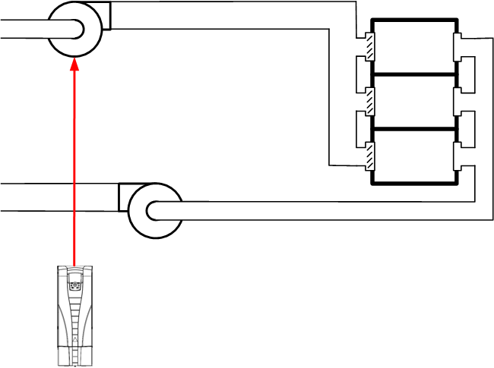
Return Fan – How to Control It?
P
?
Slide 7
Notes:
Now most systems also have a Return fan… How do we control it?

Slide 8
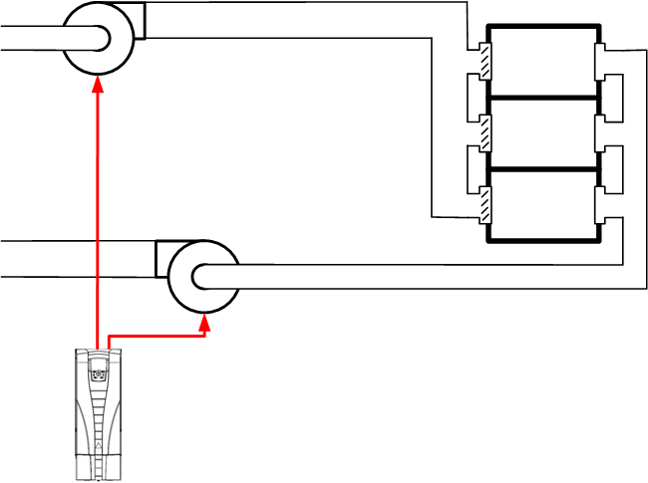
Return Fan – One Drive
☹
P
Slide 8
Notes:
You could try to control to control both motors with one drive.
Not a good idea and it is rarely attempted.
The relationship between the two fans is typically “too complicated” for this to work.

Slide 9
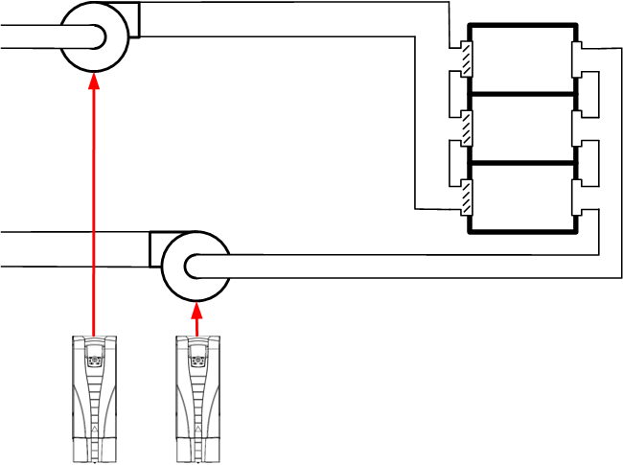
Return Fan – Follower Drive
😐
P
Slide 9
Notes:
Adding a second drive for the second motor is a step in the right direction, but having only one process variable (the Supply duct Static Pressure) is not ideal.
You can scale the Return Fan speed to be a function of the Supply Fan speed, but it is not optimal.
The return fan really needs to have its own input …NEXT SLIDE

Slide 10
Return Fan – Differential Flow
☺
F
P
F
Slide 10
Notes:
How many of you see the RF controlled by “Differential Flow” ?
The Supply Fan’s function is still too provide the required Static Pressure that will deliver the need SA Flow.
The Return Fan’s role will be to remove the amount of air from the space to allow the conditioned Supply Air to enter the space and provide the needed temperature and create the required Air Changes needed for Indoor Air Quality.

Slide 11
Return Fan – Differential Pressure
☺
P
P
P
Slide 11
Notes:
Building space pressure relative to pressure outside of the building shell.
Return Fan’s role is to move air from the space back to the intake of the Supply fan and to the Exhaust duct and dampers. Some of the Air will exhaust from the building shell and allow Outside Air to come in to the building.
This differential needs to be relatively small so as not to over-pressurize the space (Doors blowing open) or to under-pressurize the space (Can’t Open the doors).
Just a heads up! When and where exhausting air for the building shell pressure is the primary role the fan may actually be placed in the Exhaust duct and draw from the Return Air plenum.

Slide 12


Fan Arrays
Redundant drives vs. Bypass
  Up-time and Reliability
  Bypass vs.
  Variable speed required
  60 Hz (Line) or
  0-72 Hz (not 60 Hz) or
  0-48 Hz (not 60 Hz)
Can you run that system
in Bypass… at 60Hz?
Individual Motor Protection is required for a single VFD serving multiple motors.
Size motor protection (MMPs) for the actual motor FLA.
Run motor leads in separate conduits to avoid induced voltages.
Manual Motor Protection
Located at drive package
Caution with Over-speed applications.
  Motor selection and VFD sizing needs to take into account the reduced Torque of the motor when operating fans at speeds higher than the motor’s rated speed.
Slide 12
Notes:
Opportunity to retro-fit $$ We get a lot of Questions on this one
Q: Are Redundant Drive packages more expensive than a Drive w/Bypass package?
A: Yes. (~+30%) Remember a Redundant Drive package is a “Drive w/Bypass and a Drive.” Still has the Fused Input (or Service Switch) and the Output Contactors at each drive.
Q: Is Alteration of the Drives needed? Available?
A: Alternating the drive is not required. The Stand-by drive is “powered” and the capacitors are charged.
A: There are no moving parts that require exercising or that are susceptible to Run time. The output to the motor and the mechanical system are shared by the drives. Alternating the drives does not alternate the attached system. The mechanical components of the stand-by system may require alternation to maintain integrity or balanced wear and tear. i.e. Pumps w/Pump seals, Fan w/Mechanical linkages.
Single summary as a gang in series.
Wire internally to the drive Digital Input and annunciate to the BAS across BACnet.
Indication of individual MMPs
Option to wire to individual indicator lights on the enclosure door.
Individually; wire internally to the drive Digital Inputs and annunciate to the BAS across BACnet

Slide 13
Fan Arrays
Retrofitting single fan solutions to Fan Arrays using…
“One drive per motor” designs with micro-drives (ACS320)
VFD provides protections for individual motors when sized correctly.
Proper separation of Input and output power and control conduits is required.
May require Input Line reactors to meet specified Impedance.
Individual reactor at each drive or one reactor sized for all drives and located at the Input power connection.
Individual isolation disconnect.
Caution with Over-speed applications.
  Motor selection and VFD sizing needs to take into account the reduced Torque of the motor when operating fans at speeds higher than the motor’s rated speed.
Slide 13
Notes:
More drives can mean more points of failure. Increased failure potential within the system.
ACS320 MTBF/Reliability is different (lower) than the ACH550 MTBF/Reliability .
ACS320 does not have Input reactors.

Slide 14
Extended Frequency Operation of Drives
Concerns about going beyond 60 Hz
The voltage can’t increase beyond here
60 Hz
Slide 14
Notes:
The Input Voltage “is what it is” and can’t be increased by the drive. 480 is 480. 208 is 208.
The Hz can be increased and the motor will respond. However, above 60Hz the available Torque will fall off as the inverse of the speed in the extended frequency range (100% of rated speed up to ~2x the motor’s rated speed)

Slide 15
Extended Frequency Operation of Drives
Concerns about going beyond 60 Hz
Available motor torque drops
Torque
Slide 15
Notes:
The power available from the motor during extended frequency operation is roughly constant.
The total current drawn by the motor when it is run at full load is relatively constant
When increasing the speed of the fan the power “required” will increase αs the cube of the load’s speed.
It will take more energy to move the fan or pump at a higher speed when operating the motor above its rated RPM.
Ever have a balancer want to increase the drive speed to get more air from the fan? If the fan CFM is short or at the design 100% at 60 Hz… increasing the drive Max RPM and increasing the Hz will not produce the desired increase in CFM.
While the motor’s output power will remain roughly constant.
The Torque the motor can develop will drop off.
Valid for VFD frequencies up to about twice the rated frequency of the motor.
Caution! As rotational speed increases ↑ Centrifugal force increases ↑
Can the connected equipment handle the increased speed and forces?

Slide 16
Extended Frequency Operation of Drives
Extended frequency and Variable Torque loads
For fans and centrifugal pumps, a
10% speed increase can result in a
33% increase in “required” Power $$
Torque available from the motor
Torque needed by the load
The motor has to be sized and selected properly to deliver the required Torque without stalling
60 Hz
72 Hz
84 Hz
Slide 16
Notes:
"Field weakening operation“ or “Constant Power - Extended Frequency operation”:
When considered from the physical perspective, field weakening of a motor
starts if the output voltage of the frequency inverter is no longer increased
(can no longer be increased)  however, its frequency is increased.
Generally, "field-weakening operation" is involved when a motor is operated
above the rated motor frequency and the supply voltage remains the same.
For this operating mode, the frequency inverter is parameterized for a
maximum frequency greater than the rated frequency (e.g. 80Hz / 400V).
As the frequency inverter frequency is increased, the output voltage
remains constant, the speed increases, however, the torque decreases.
The torque decreases… because the flux in the motor decreases.
At constant power, the torque decreases inversely proportional to the
speed.
Engineering information:
When operating a motor above the rated motor frequency (speed), then
the frequency inverter and motor must be appropriately selected,
dimensioned and parameterized. The motor must be dimensioned for
this type of operation. The following should be carefully observed:
– the mechanical limit speeds
– the increased thermal load
– the increased voltage stress on the motor (the motor insulation)
– the modulation depth of the frequency inverter 1
In order to achieve higher speeds, it is generally more practical to select
a motor whose rated speed is close to the operating speed.
Example: In order to reach an operating speed of 1800 rpm, it should
be considered as to whether a 4-pole motor with 1500 rpm synchronous
motor speed - and a correspondingly higher frequency - or a 2-pole
motor with 3000 rpm synchronous motor speed and a correspondingly
lower frequency - is the better fit for the particular application.

Slide 17
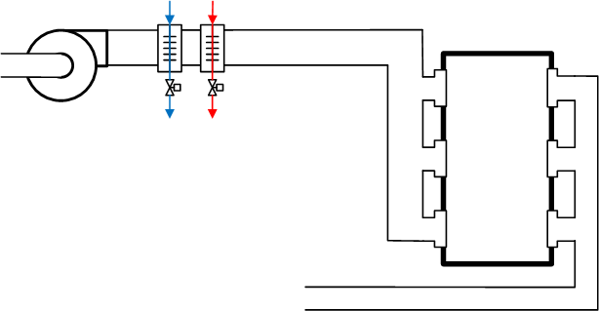
CAV Supply Fan Retrofit – Before
Single zone – no VAV boxes
Supply fan runs
continuously at
full speed
External controller
measures space
temperature and
controls the hot and
chilled water valves
Temperature Controller
T
Slide 17

Slide 18
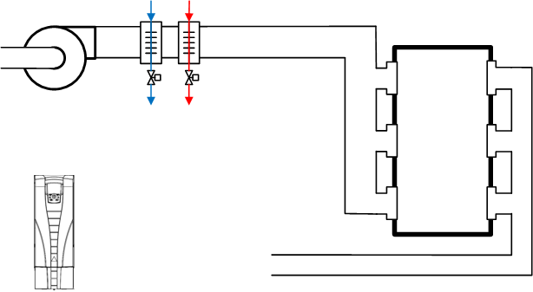
CAV Supply Fan Retrofit – After
No VAV boxes
ACH550 controls the fan’s speed based on the
space’s temperature
A second temperature sensor measures the temperature of the
supply air
The ACH550 controls the hot and chilled water valves to maintain the desired supply temperature
T
T
Slide 18

Slide 19
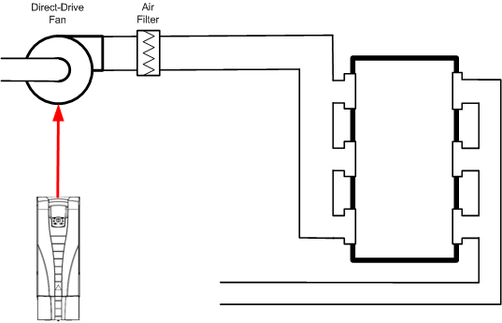
CAV Supply Fan – Clean Room
Drive replaces belt drive
Velocity pressure sensor to maintain constant flow
or
Static pressure sensor to maintain pressure in the space
Fan speeds up as the filter loads
Drive can indicate when the filter needs attention
P
P
Slide 19

Slide 20
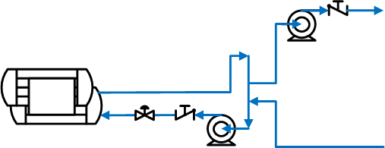

Primary Pump
In a De-Coupled Primary/Secondary System
The primary loop maintains constant flow through the chiller …
while the secondary loop
provides the varied flow
needed in the system
A VFD can be useful in such a
system to …
  set the primary flow for the desired ΔT without closing the throttling valve
  work with a flow meter or differential pressure across the chiller bundle to maintain constant flow in the chiller
Slide 20

Slide 21
Secondary Pump
In a De-Coupled Primary/Secondary System
The secondary loop provides the flow needed in the system to serve the Coils and exchangers in the building.
A VFD can be useful in such a
system to …
  Control the pump speed to generate the pressure needed to support the flow at the furthest coil or exchanger.
Slide 21

Slide 22
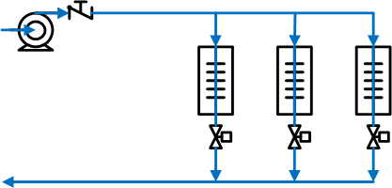
Secondary Pump
In a De-Coupled Primary/Secondary System
Using a VFD to reduce pump speed to manage the pressure needed by the system.
Sensor location is key in order to accurately reflect to the differential pressure needed at the worst case coil in the system.
Slide 22

Slide 23
Secondary Pump
Using Discharge Pressure control reset by Remote DP sensor
In some cases the far end DP sensor is too far away and the DP value or setpoint is transmitted via a Building Automation System (BACnet network).
A good practice would be to control the pump speed to achieve a pump Discharge Pressure setpoint… that is,
in turn, reset by the remote coil DP value.
P
BAS
Slide 23

Slide 24
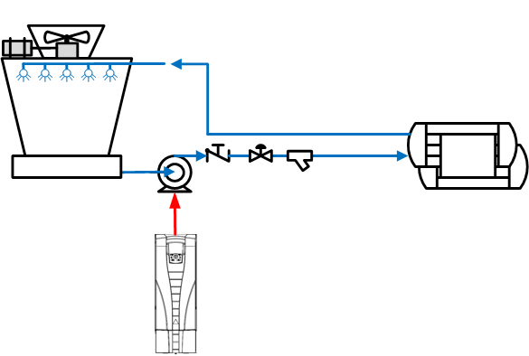
Condenser Water Pumps
Reducing the rate of
condenser water flow can …
  keep the spray nozzles
  from covering the fill
  cause problems for the
  chiller
The pump speed can be controlled to maintain a constant flow as the strainer loads
The drive can also indicate when the strainer needs to be cleaned
If a throttling valve was used to adjust the flow, the VFD can save additional energy
F
Slide 24

Slide 25
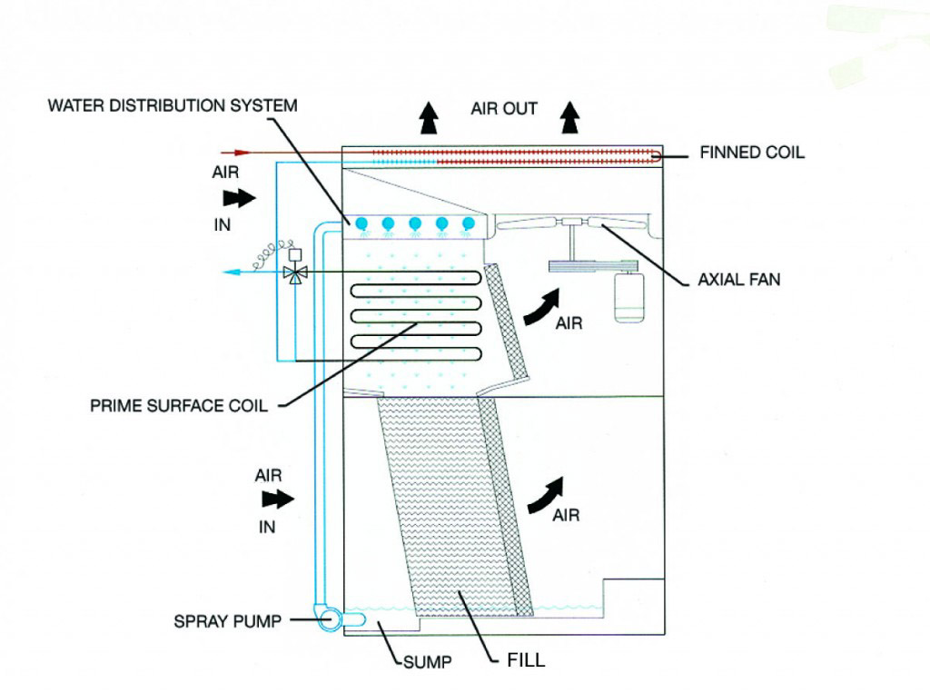
Fluid Cooler with Spray pump
Spray pump starter can be sequenced by VFD
VFD typically controls fan motor speed to maintain leaving fluid/water temperature.
Bypass is a typical option for Fan at 60 Hz (line)
Fluid temperatures monitored/controlled by VFD
Basin Heater control can be controlled by the VFD
Slide 25

Slide 26
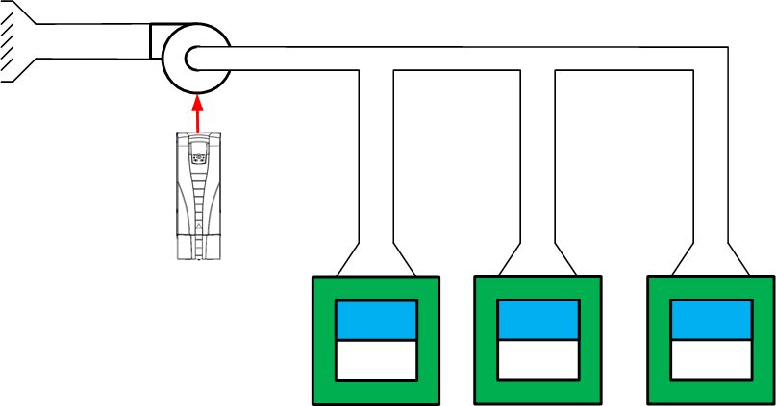
Fume Hood Fan
Can be controlled in a number of ways
  Sash position
  Air flow monitoring
  Pressure
  Manually
In small systems, pre-set speeds may be used
Slide 26

Slide 27
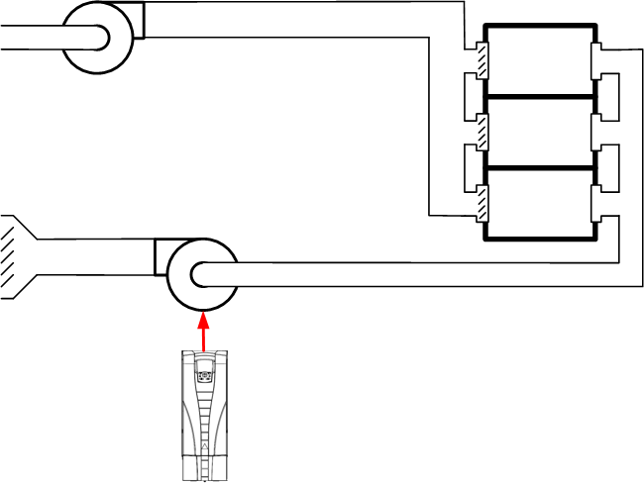
Powered Exhaust – Low Speed Detection
Sleep Mode is also used to keep pumps from “dead heading”.
VFD “sleeps” at night to keep from causing negative pressure
Slide 27

Slide 28
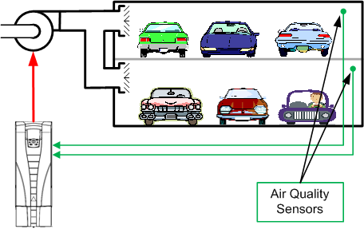
Parking Garage Ventilation Fan
Automatically adjusts the amount of ventilation based on the air quality
Can be tied into a fire system to control the air flow as required
Good application for the ASC355 micro-drive since it has a NEMA 4X rating
Slide 28

Slide 29
HVAC Variable Torque Applications for VFDs
Other Exhaust Fan Applications
Exhaust Fans
  Dual 50% fans with Isolation dampers
    TEFs, toilet exhaust
    GEFs, general exhaust
  N+1, Lead/Lag progression with Isolation dampers
    Increasing and decreasing demand
Slide 29

Slide 30
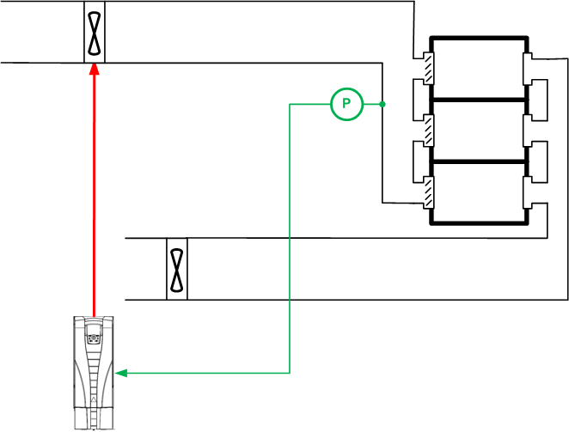
Supply Fan – Smoke Extraction
For use with axial fans
During normal operation, the fan turns forward
When a smoke exhaust command is given, the VFD decelerates the fan to a stop
The VFD smoothly accelerates the fan in the opposite direction
Smoke Exhaust Command
Slide 30
Notes:
Vane Axial Fans required!!

Slide 31
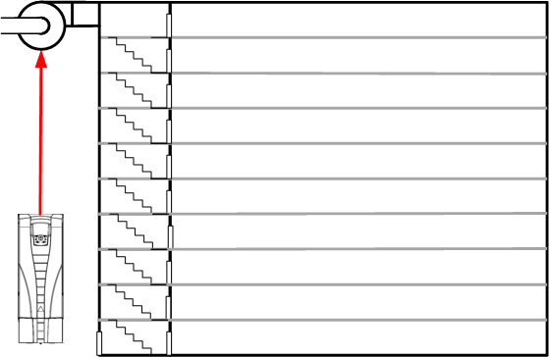
Stairwell Pressurization – Fire Mode
Is also used with some elevators for fire service
Fire mode is used to keep the motor running, ignoring other interlocks, alarms and other inputs
Stairwell pressurization keeps this escape path from being a chimney
Full speed operation is not a good idea, since the pressure may make it impossible to open the exit doors
Other Fire Mode applications include …
  Zone pressurization
  Smoke exhaust
For tall buildings, multiple fans and pressure control loops may be needed.
Slide 31
Notes:
No Bypass. A 60 Hz line Voltage response from the system could create pressure imbalance that would/could prevent doors from opening in or out of Stairwell Fire exits and Areas of refuge.

Slide 32
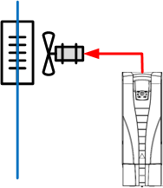
Condenser Fan
For a DX System
Controlling the speed of the condenser fans is used to improve system efficiency
The temperature of the refrigerant is controlled by adjusting the air flow across the condenser coils
Refrigerant pressure is easier to measure, so it is commonly used
In some systems, the difference between the outdoor temperature and the refrigerant temperature is used
T
P
T
Slide 32
Notes:
Condenser coils are fundamentally a dry cooling tower. Controlling the forced draft applied to them can improve system performance and reduce its energy consumption.
Generally these motors are quite small. Until recently it hasn’t been economical to use a drive to save energy. As drives become smaller and less expensive this is becoming a more attractive application.
While other motors in HVAC applications are generally three phase induction motors, electronically commutated (also known and brushless DC) motors are becoming more common or such applications. The adjustable frequency drive must be specially designed to control this type of motor.

