Slide 1
Energy Efficiency - Pumps VFD or Not?
HVAC Sales School

Slide 2
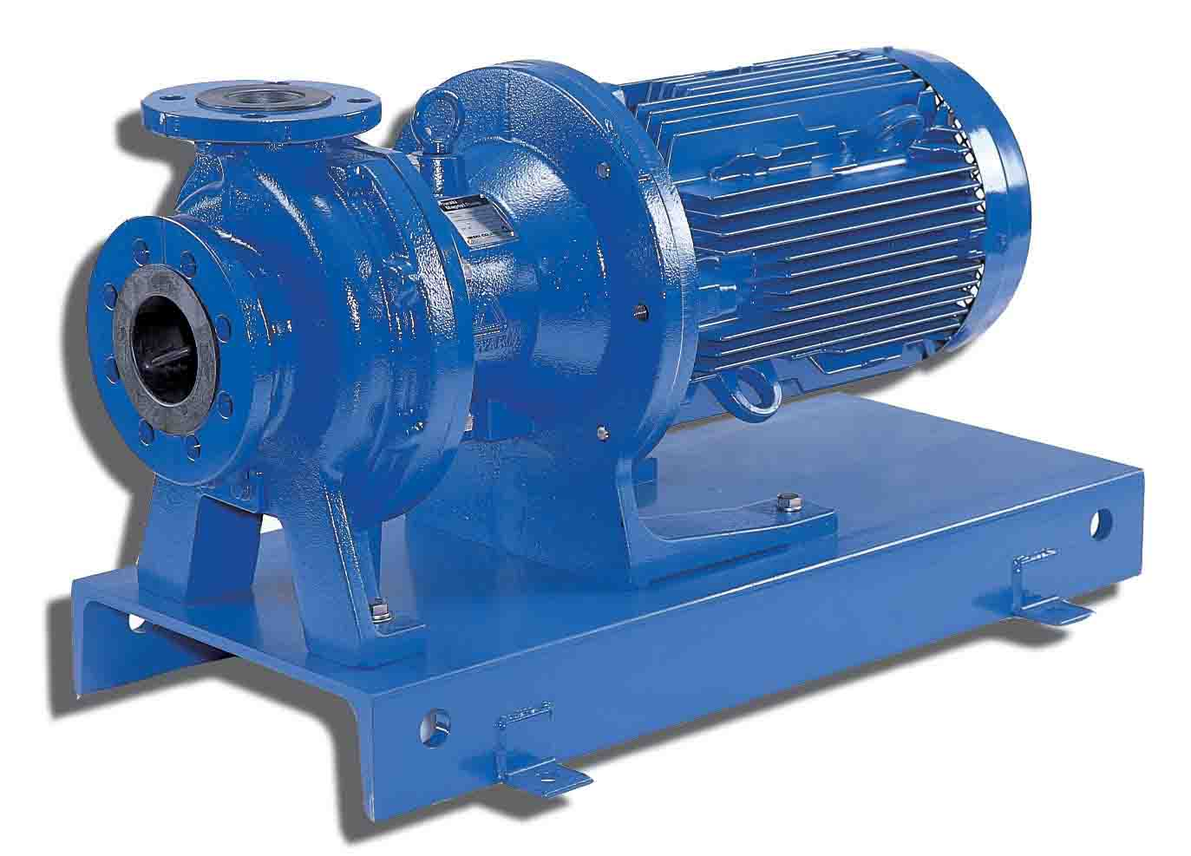
VFD or Not? Scenario 1 Energy Efficiency
On/Off Control (365 days/year)
Monday through Friday
6:00 AM to 6:00 PM the pump cycles 10 minutes on and 10 minutes off.
6:00 PM to 6:00 AM the pump is off.
Saturday & Sunday
The pump is off

Slide 3
VFD or Not? Scenario 2 Energy Efficiency
On/Off Control (365 days/year)
Monday through Friday
6:00 AM to 6:00 PM the pump cycles 90 minutes on and 10 minutes off.
6:00 PM to 6:00 AM the pump is off.
Saturday & Sunday
The pump is off

Slide 4
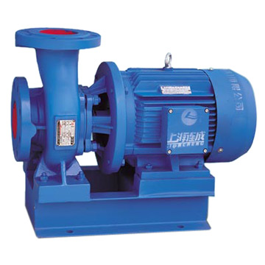
VFD or Not? Scenario 3 Energy Efficiency
On/Off Control (365 days/year)
Monday through Friday
7:10 AM to 4:45 PM the pump cycles 14 minutes on and 6 minutes off.
4:45 PM to 7:10 PM the pump cycles 10 minutes on and 10 minutes off.
7:10 PM to Midnight the pump cycles 8 minutes on and 12 minutes off.
Midnight to 7:10 AM the pump cycles 4 minutes on and 16 minutes off.
Saturday & Sunday
The pump is off

Slide 5
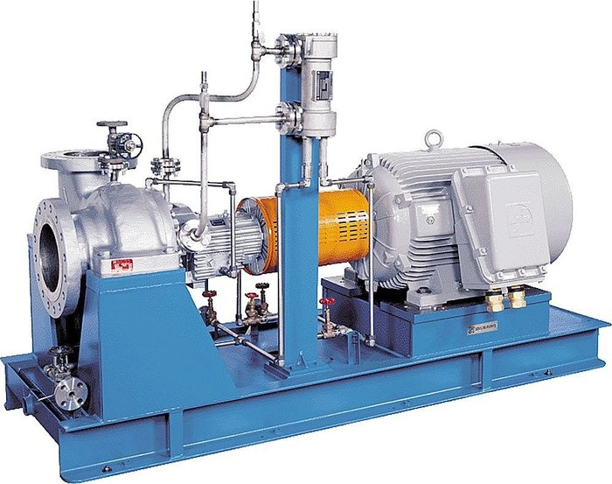
VFD or Not? Scenario 4 Energy Efficiency
Throttling Control (365 days/year)
Monday through Friday
7:10 AM to 4:45 PM the demand averages 70%
4:45 PM to 7:10 PM the demand averages 50%
7:10 PM to Midnight the demand averages 40%
Midnight to 7:10 AM the demand averages 20%
Saturday & Sunday
The pump is off

Slide 6
VFD or Not? Scenario 5 Energy Efficiency
On/Off Control (365 days/year)
Two identical pumps of equal capacity
Monday through Friday
6:00 AM to 6:00 PM pump one runs continuously and pump two cycles 40 minutes on and 10 minutes off.
6:00 PM to 6:00 AM pump one runs continuously. Pump two is off.
Saturday & Sunday
6:00 AM to 6:00 AM pump one cycles 40 minutes on and 10 minutes off. Pump two is off.

Slide 7
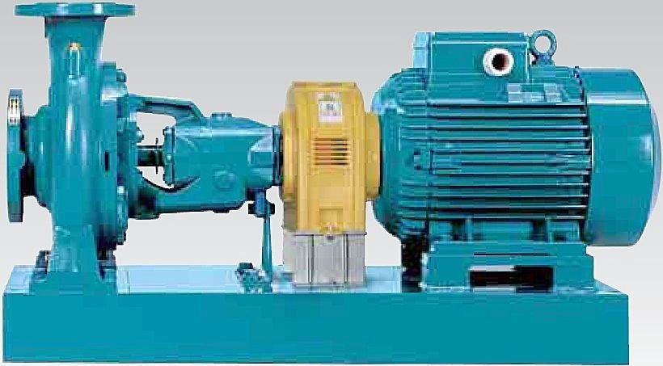
VFD or Not? Scenario 6 Energy Efficiency
Throttling Control
Monday through Friday
Throughout an average day the demand varies between 30% and 100% flow Full Flow 5% 90% Flow 10% 80% Flow 15% 70% Flow 20% 60% Flow 20% 50% Flow 15% 40% Flow 10% 30% Flow 5%
Saturday & Sunday
The pump is off

Slide 8
VFD or Not? Energy Efficiency
System Data
Liquid Density 62
Static head 20
Pump Data
Nominal Flow Volume 1200
Nominal head 200
Maximum head 240
Efficiency 90
Motor & Supply Data
Motor Power 75
Supply Voltage 460
Motor Efficiency 95
Improved Flow Control by
ABB Drive series: ACH550
CO2 emission/unit 0.5
Economic Data
Currency $
Energy Price (per kWh) 0.1
Investment Cost 7.3K
Interest Rate (%) 4
Service Life (years) 10

Slide 9
VFD or Not? Energy Efficiency
System Data
Liquid Density 62
Static head 20
Pump Data
Nominal Flow Volume 2400
Nominal head 200
Maximum head 240
Efficiency 90
Motor & Supply Data
Motor Power 150
Supply Voltage 460
Motor Efficiency 95
Improved Flow Control by
ABB Drive series: ACH550
CO2 emission/unit 0.5
Economic Data
Currency $
Energy Price (per kWh) 0.1
Investment Cost 12.5K
Interest Rate (%) 4
Service Life (years) 10

Slide 10
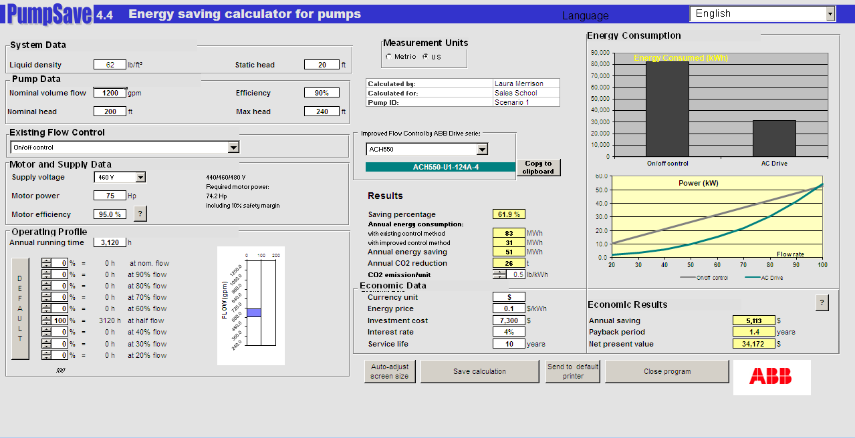
1

Slide 11

2

Slide 12
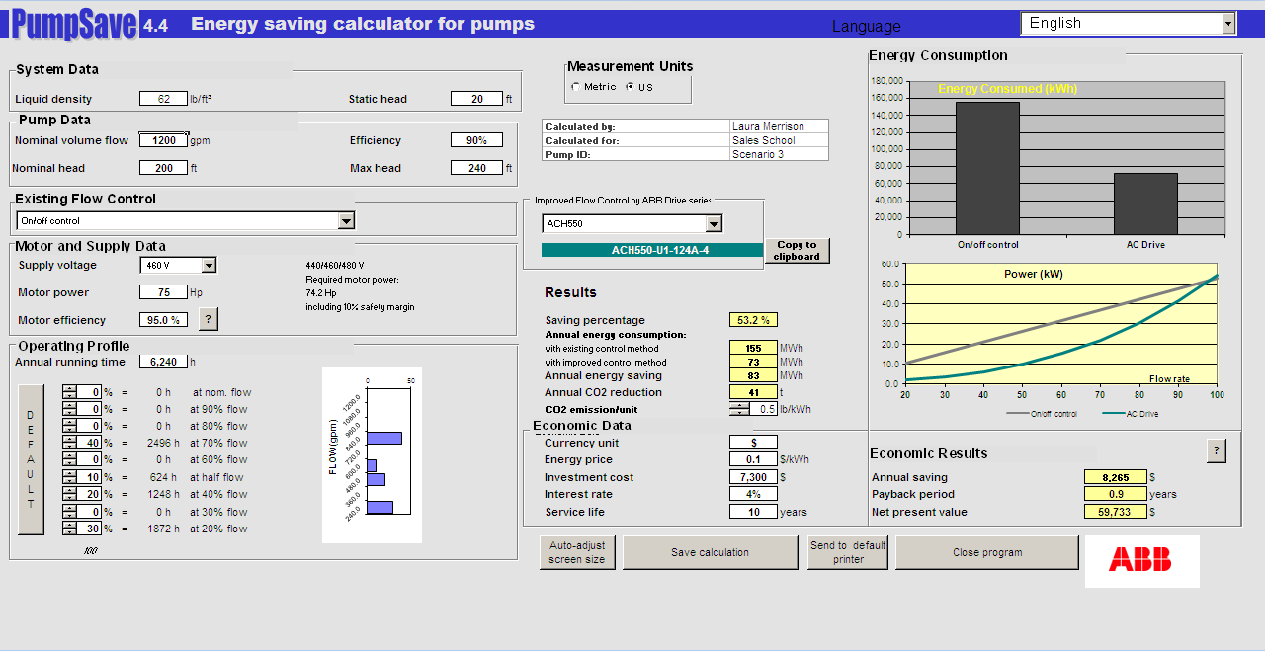
3

Slide 13

4

Slide 14
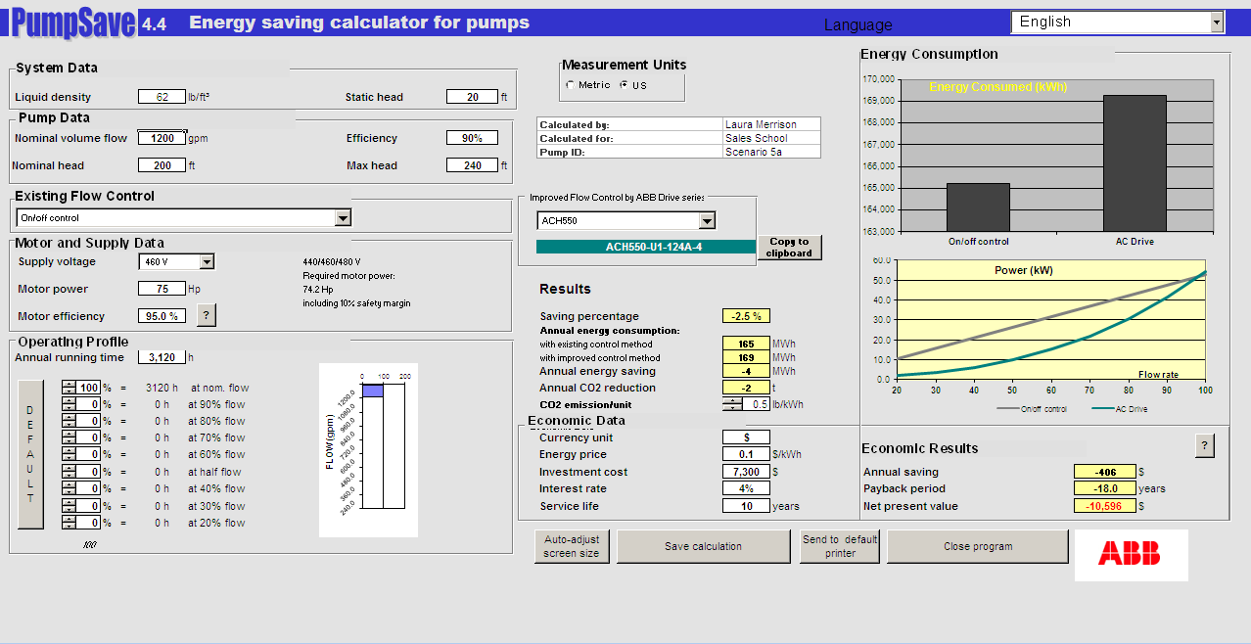
5a

Slide 15
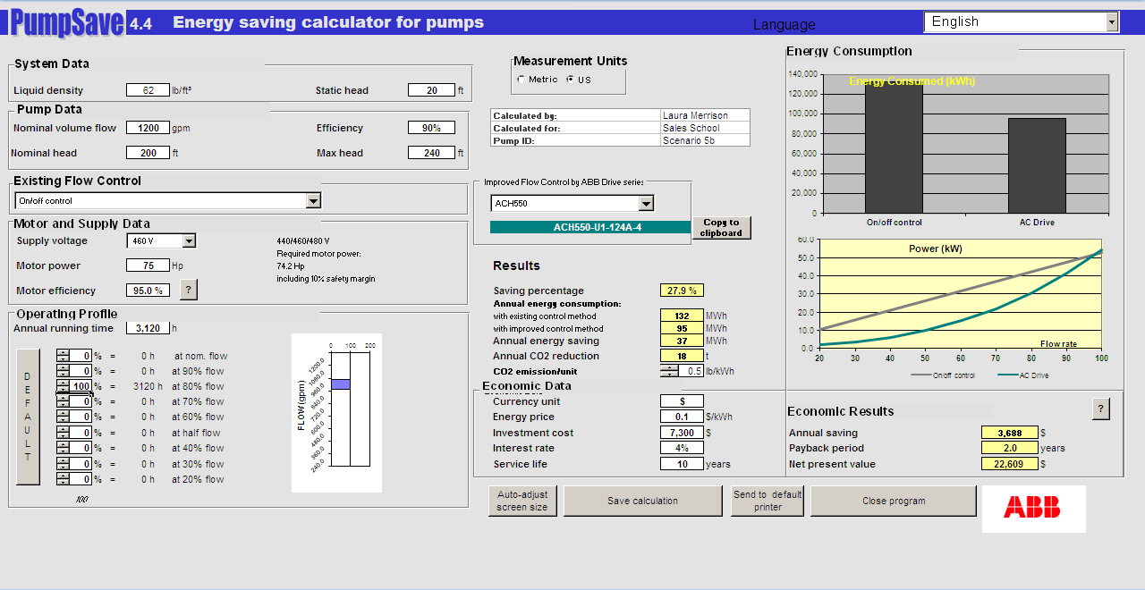
5b

Slide 16
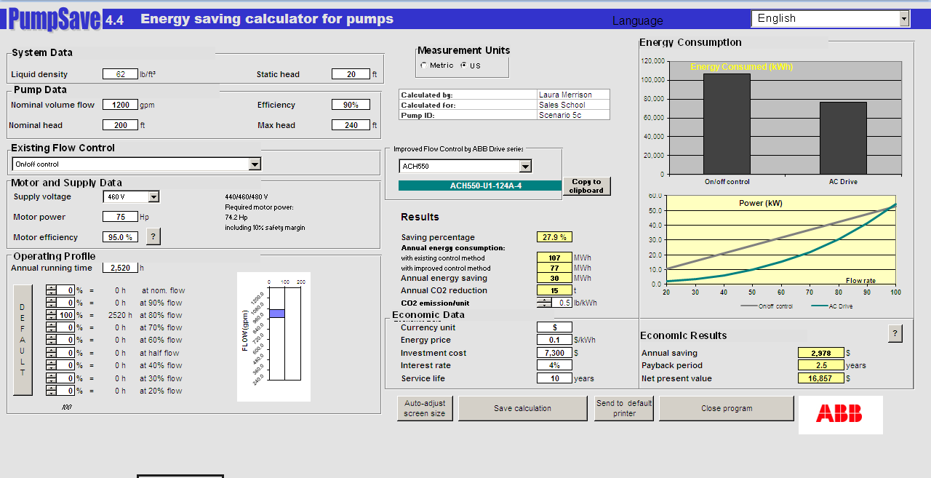
5c

Slide 17
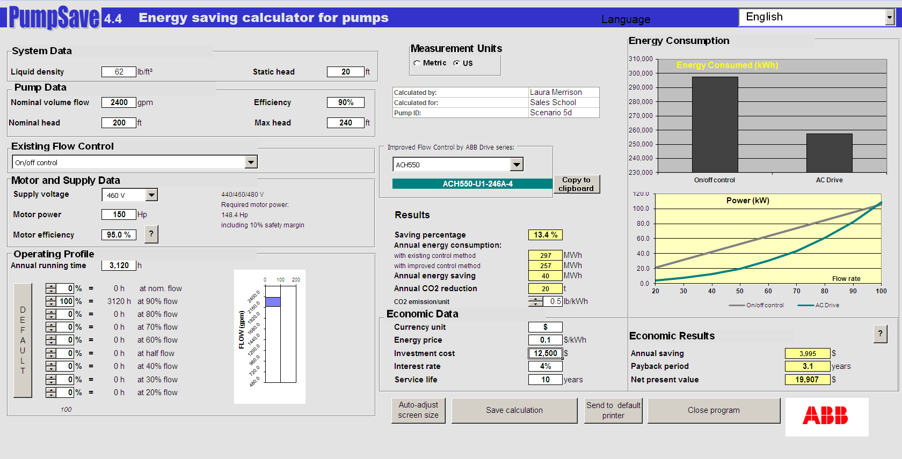
5d

Slide 18

5e

Slide 19

5f

Slide 20
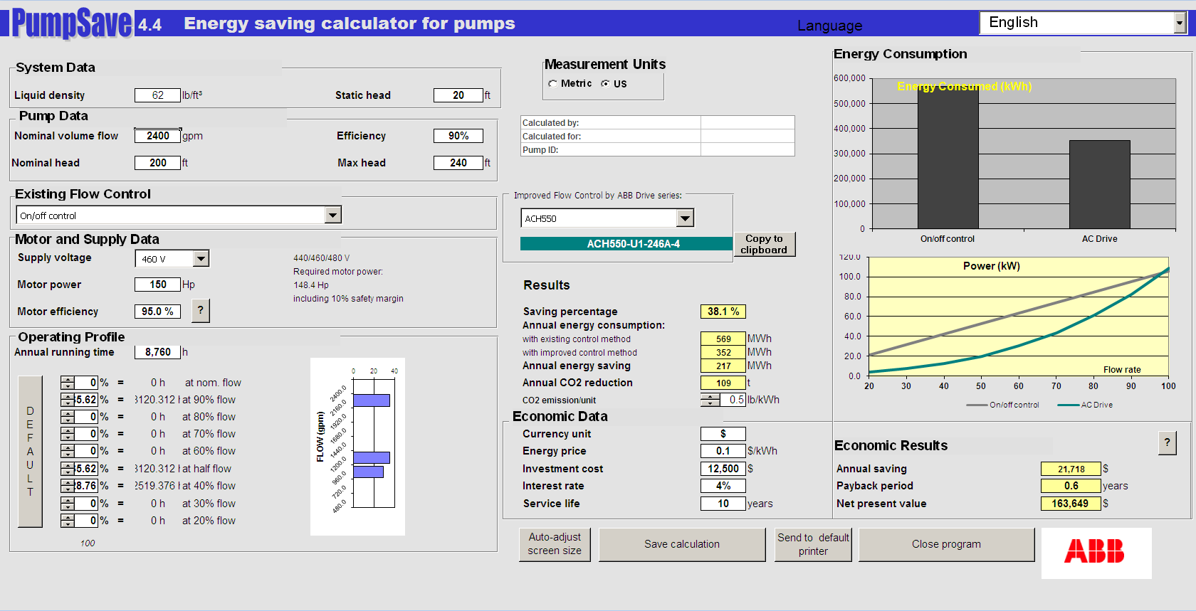
5g

Slide 21
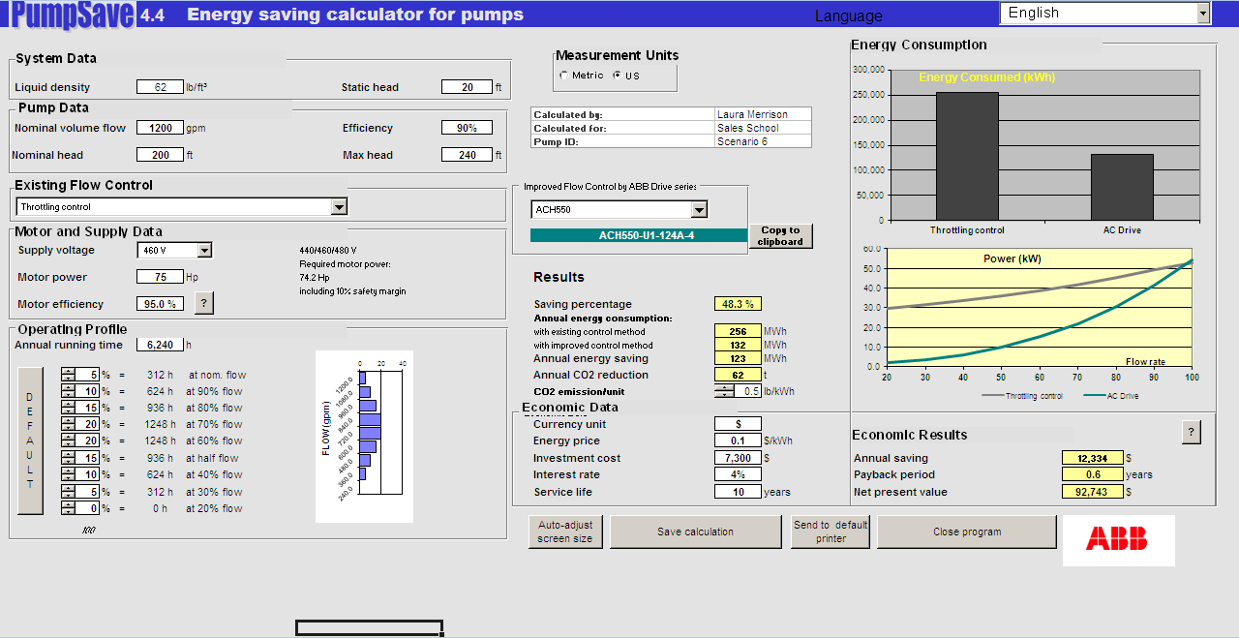
6

Slide 22


