Slide 1
Energy Efficiency
FanSave
HVAC Sales School

Slide 2
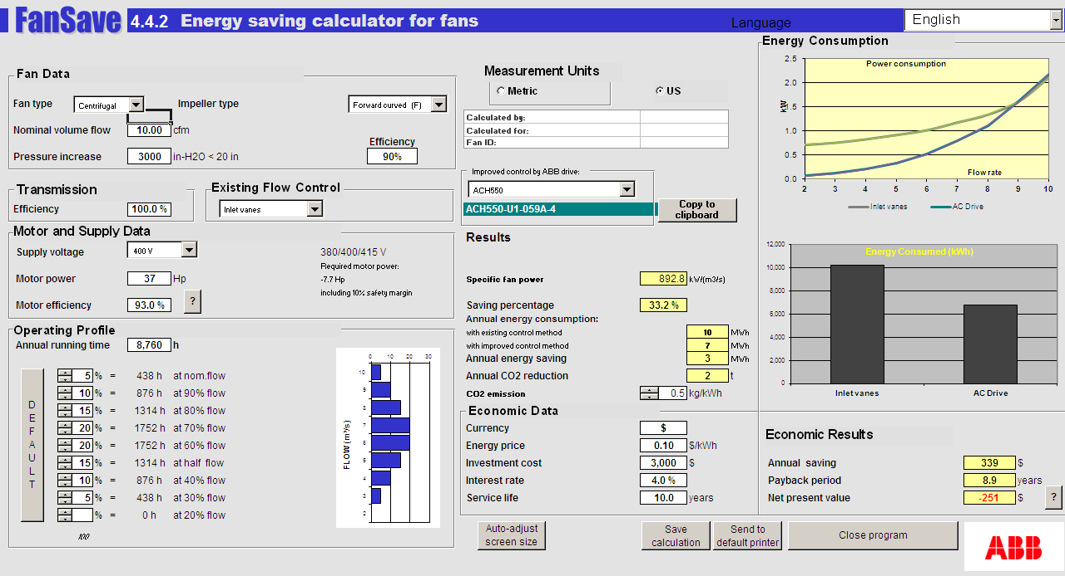
Energy Saving Calculator for Fans
FanSave

Slide 3
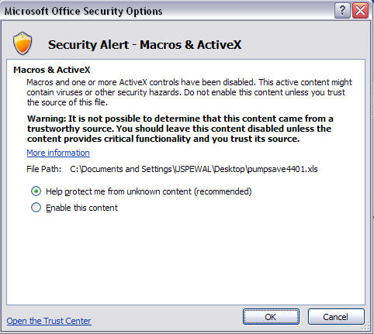
Opening the Workbook
FanSave

Slide 4
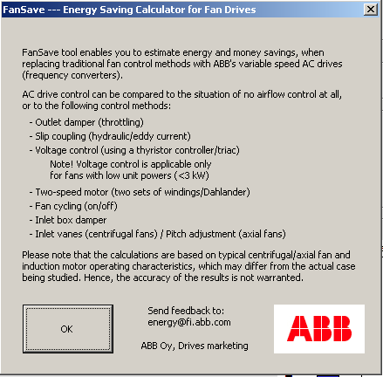
Opening the Workbook
FanSave

Slide 5
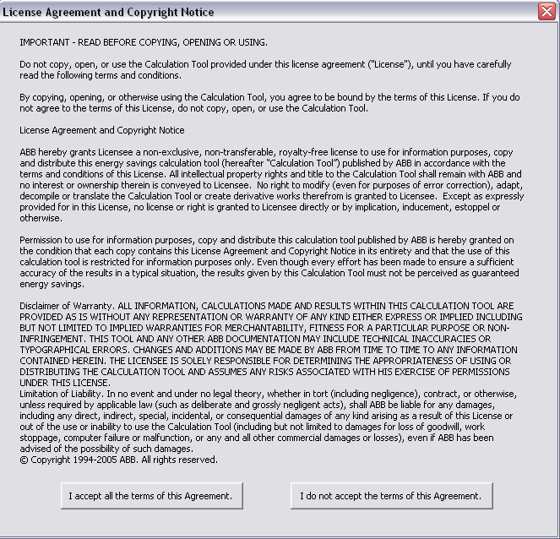
Opening the Workbook
FanSave

Slide 6
Input Data
FanSave

Slide 7
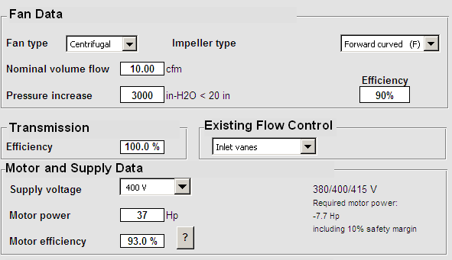
Input Data
FanSave
Fan Data
  Fan Type
  Impeller Type
  Nominal Volume Flow
  Pressure Increase
  Efficiency
Transmission
  Efficiency
Motor & Supply Data
  Supply Voltage
  Motor Power
  Motor Efficiency

Slide 8
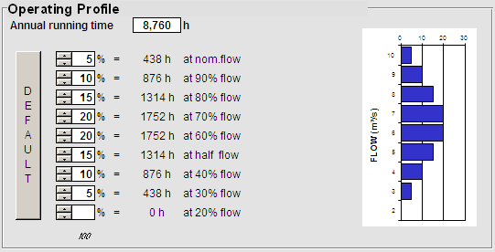
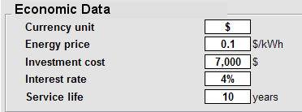
Input Data
FanSave
Operating Profile
  Annual Running Time
  Operating Time at Different Flow Rates (%)
Economic Data
  Currency
  Energy Price (per kWh)
  Investment Cost
  Interest Rate (%)
  Service Life (years)

Slide 9
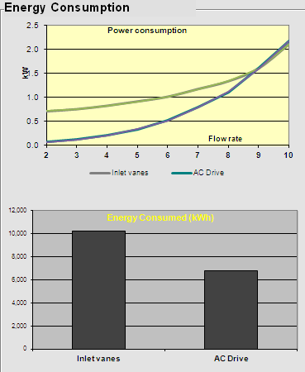
Results
FanSave
Energy & Environmental
  Energy Consumed – Graph (kWh)

Slide 10
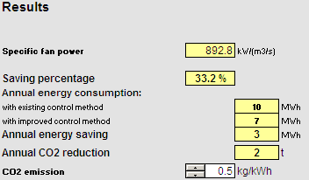
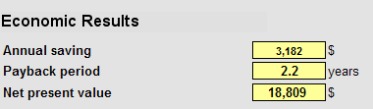
Results
FanSave
Energy & Environmental
  Saving Percentage (%)
  Annual Energy Consumption (kWh)
  Annual Energy Saving (kWh)
  Annual CO2 Reduction (kg)
Economic Results
  Annual Money Saving
  Payback Period
  Net Present Value

Slide 11
Rules of Thumb
FanSave
For Nominal Volume Flow use ~ 1,500 CFM per HP
  CFM = HP x 1,500
For Pressure Increase use the following:
  1 to 25 HP ≤ 2 inches
  30 to 75 HP ≤ 2.5 inches
  100 to 125 HP ≤ 3 inches
  150 to 200 HP ≤ 4 inches
  250 HP and up = 5 inches
Look to Motor and Supply Data for calculated motor HP requirement and make sure it is ≤ actual motor HP

Slide 12


