Slide 1
Energy Efficiency - Fans VFD or Not?
HVAC Sales School

Slide 2
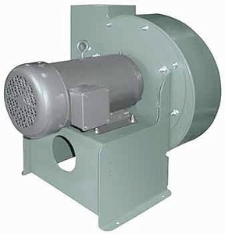
VFD or Not? Scenario 1 Energy Efficiency
No Flow Control on Supply Fan (365 days/year)
Monday through Friday
6:00 AM to 6:00 PM the flow required averages 50%.
6:00 PM to 6:00 AM the flow required averages 0%.
Saturday & Sunday
The flow required averages 0%.

Slide 3
VFD or Not? Scenario 2 Energy Efficiency
No Flow Control on Supply Fan (365 days/year)
Monday through Friday
6:00 AM to 6:00 PM the flow required averages 90%.
6:00 PM to 6:00 AM the flow required averages 0%.
Saturday & Sunday
The flow required averages 0%.

Slide 4
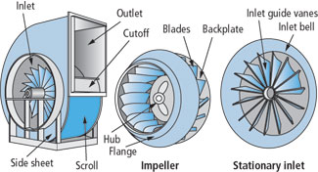
VFD or Not? Scenario 3 Energy Efficiency
Inlet Vane Control (365 days/year) on Air Handler
Monday through Friday
7:10 AM to 4:45 PM the flow required averages 70%
4:45 PM to 7:10 PM the flow required averages 50%
7:10 PM to Midnight the flow required averages 40%
Midnight to 7:10 AM the flow required averages 20%
Saturday & Sunday
The flow required is 0%

Slide 5
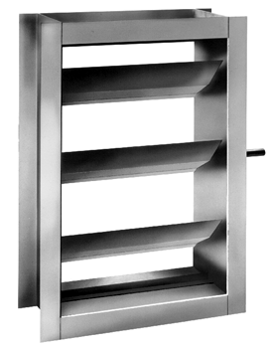
VFD or Not? Scenario 4 Energy Efficiency
Outlet Damper Control (365 days/year) on Air Handler
Monday through Friday
70% Flow 40%
50% Flow 10%
40% Flow 20%
20% Flow 30%
Saturday & Sunday
The fan is off

Slide 6
VFD or Not? Scenario 5 Energy Efficiency
Inlet Vane Control (365 days/year) on Air Handler
Monday through Friday
Throughout an average day the flow required is: Full Flow 5% 90% Flow 10% 80% Flow 15% 70% Flow 20% 60% Flow 20% 50% Flow 15% 40% Flow 10% 30% Flow 5%
Saturday & Sunday
The fan is off

Slide 7
VFD or Not? Scenario 6 Energy Efficiency
Outlet Damper Control (365 days/year) on Air Handler
Monday through Friday
Throughout an average day the flow required is: Full Flow 5% 90% Flow 10% 80% Flow 15% 70% Flow 20% 60% Flow 20% 50% Flow 15% 40% Flow 10% 30% Flow 5%
Saturday & Sunday
The fan is off

Slide 8
VFD or Not? Energy Efficiency
Fan Data
Fan Type Centrifugal
Impeller Type Backward Curved
Nominal Volume Flow 75000
Pressure Increase 2.5
Efficiency 78
Transmission
Efficiency 100
Motor & Supply Data
Supply Voltage 460
Motor Power 50
Motor Efficiency 95
Improved Flow Control by
ABB Drive series: ACH550
CO2 emission/unit 0.5
Economic Data
Currency $
Energy Price (per kWh) 0.1
Investment Cost 5.7K
Interest Rate (%) 4
Service Life (years) 10

Slide 9


