Slide 1
Energy Efficiency PumpSave
HVAC Sales School

Slide 2
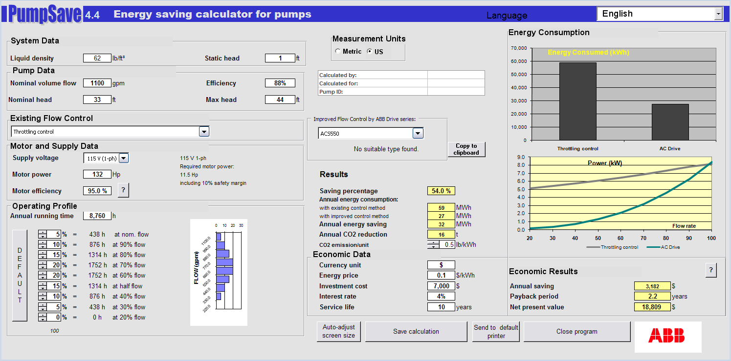
Energy Saving Calculator for Pumps PumpSave
System Data
Liquid Density
Static head
Pump Data
Nominal Flow Volume
Nominal head
Maximum head
Efficiency
Existing Control Method
Motor Data
Motor Power
Supply Voltage
Motor Efficiency

Slide 3
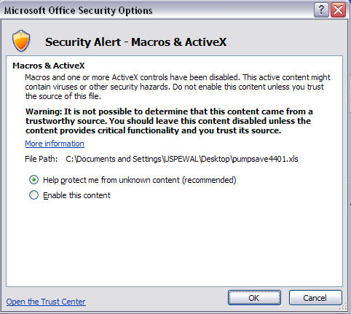
Opening the Workbook PumpSave

Slide 4
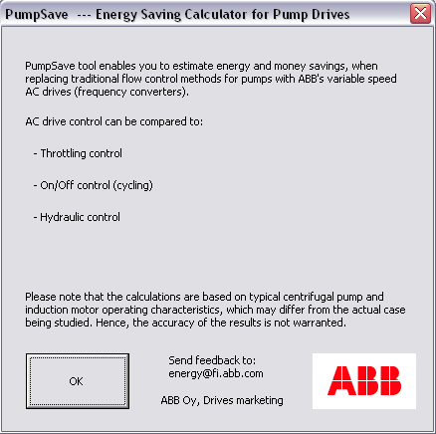
Opening the Workbook PumpSave

Slide 5
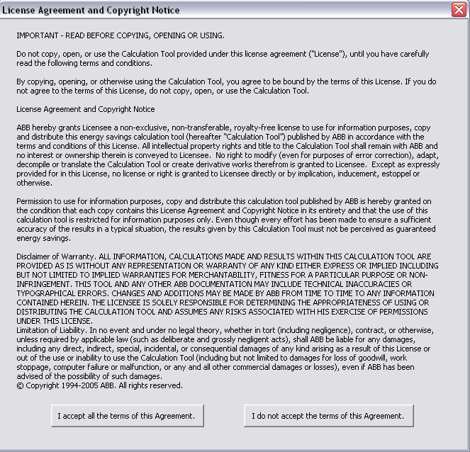
Opening the Workbook PumpSave

Slide 6
Input Data PumpSave
System Data
Liquid Density
Static head
Pump Data
Nominal Flow Volume
Nominal head
Maximum head
Efficiency
Existing Control Method
Motor Data
Motor Power
Supply Voltage
Motor Efficiency

Slide 7
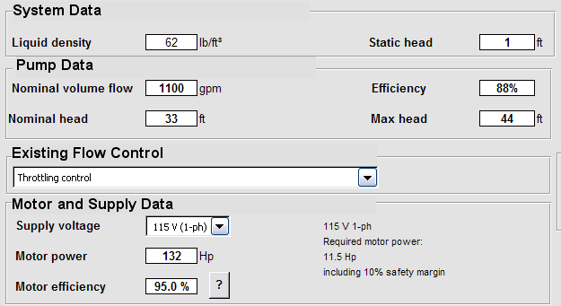
Input Data PumpSave
System Data
Liquid Density
Static head
Pump Data
Nominal Flow Volume
Nominal head
Maximum head
Efficiency
Existing Control Method
Motor Data
Motor Power
Supply Voltage
Motor Efficiency

Slide 8
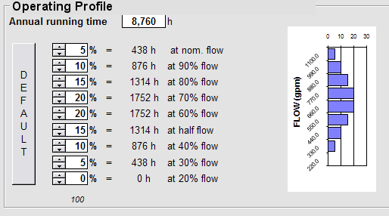
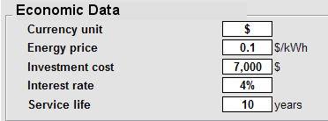
Input Data PumpSave
Operating Profile
Annual Running Time
Operating Time at Different Flow Rates (%)
Economic Data
Currency
Energy Price (per kWh)
Investment Cost
Interest Rate (%)
Service Life (years)

Slide 9
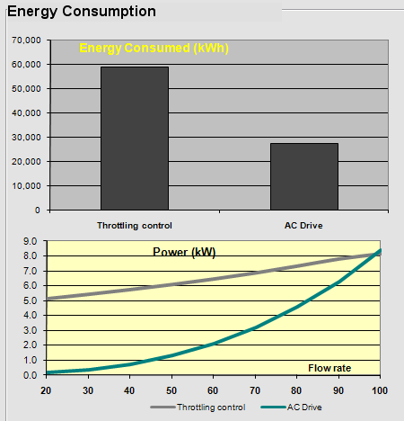
Results PumpSave
Energy & Environmental
Energy Consumed – Graph (kWh)

Slide 10
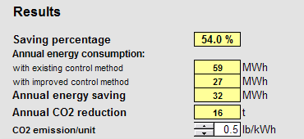
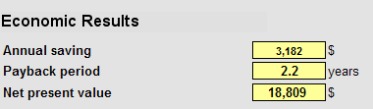
Results PumpSave
Energy & Environmental
Saving Percentage (%)
Annual Energy Consumption (kWh)
Annual Energy Saving (kWh)
Annual CO2 Reduction (kg)
Economic Results
Annual Money Saving
Payback Period
Net Present Value

Slide 11
Rules of Thumb PumpSave
For Nominal Volume Flow use ~ 40 GPM per HP
GPM = HP x 40
For Pump Efficiency use ~ 75%
For Nominal Head start with 60 feet
For Maximum Head start with 70 feet
For Static (Friction) Head, start with 20 feet
Look to Motor and Supply Data for calculated motor HP requirement and make sure it is ≤ actual motor HP
If not, you can try adjusting Nominal Head and/or Nominal Flow to get closer

Slide 12


