Slide 1

Introductions & Housekeeping Wesley W. Wilcox II
ACH550 Certified Start-Up Coarse

Slide 2
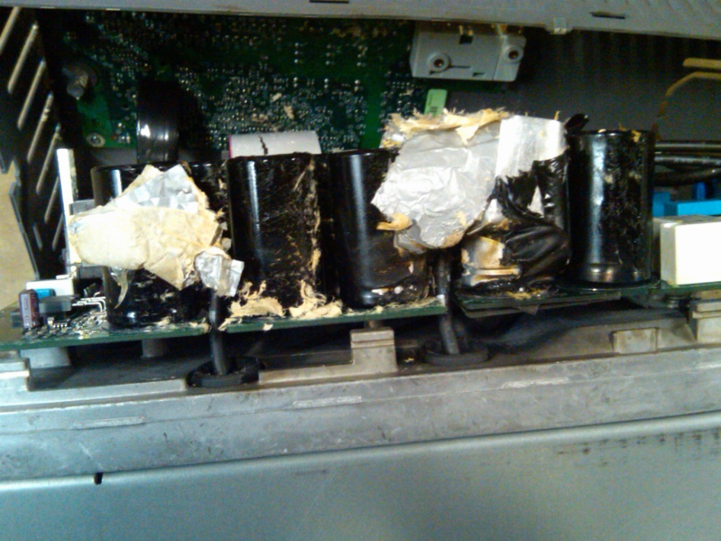
Emergency Exit Locations
Restrooms
Breaks
Smoking
Agenda
Notes:
Discuss Day Agenda, Safety and Expectations of the class.

Slide 3
Instructor Introduction
Wes Wilcox, Air treatment Corp.
ABB Drive Specialist
Cell Phone: 909-450-3963
Email: wwilcox@airtreatment.com
Website: WWW.ABB.US/Drives
Training Help: DrivesTraining@US.ABB.COM
Tech Support/Drives Registration DrivesSupportLine@US.ABB.Com
Http://installedbase.it.abb.com/drivesregistration
Phone Warranty/Technical Support
1-800-Help 365 24/7 Warranty Support
Notes:
Discuss about self and give work history and credentials. Discuss how to contact self, tech support and training group.

Slide 4
Instructor Introduction
Drive Windows Light Software
www.vfdhelp.com
Download & Install Software
Free Software does not come with ABB technical support
Notes:
Give information about VFDHelp and how to locate software and download.

Slide 5
Class Introduction
Name
Job Title
Experience with ABB Drives
Have you used before.
Are you familiar with Product line and use.
Do you know what makes a VFD a VFD…
What Do You Want To Walk Away From Here Knowing?

Slide 6
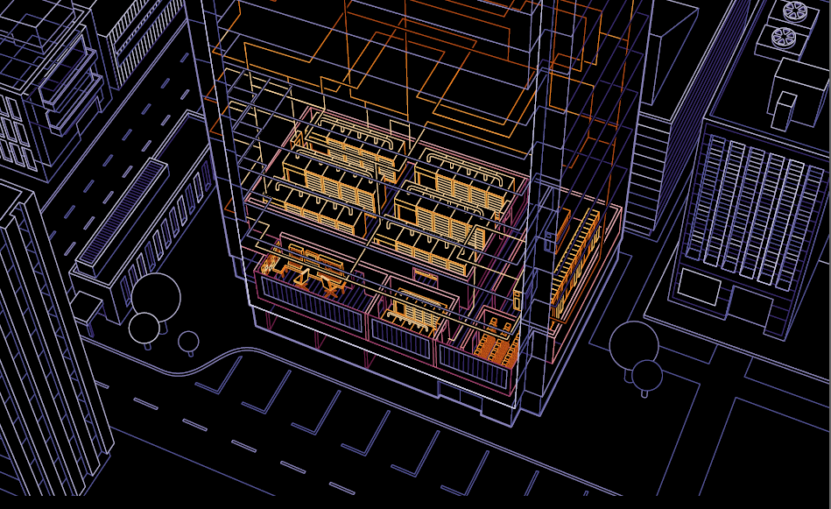
Drive Basics

Slide 7
Variable Torque Drive
Applications - Types
Variable Torque
Flow varies linearly
with speed
Torque requirement varies
as the square of speed
Power requirement varies as the cube of speed
Notes:
Variable Torque Versus Constant Torque Applications.
HVAC/Industrial Systems and Drive Capabilities.

Slide 8
How Drives change motor speed
Input
Fixed Voltage
Fixed Frequency
60hz
230/460V
Converter/AC to DC
6 pulse Diode Bridge
DC Bus
Single or Dual DC Link Choke
Inverter
IGBT’s
Input Converter
Diode Bidge
AC to DC
Reconstruct the Sinewave
DC Bus
Filters and smooths waveform
Inverter output-IGBT’s
Switch DC Bus on and off at different intervals
Notes:
Explain raw components of drive and give comparison of each device to check valves, expansion tanks and relays/ solinoid valves.

Slide 9
PWM Drive, Motor Flux
Applied Voltage vs. Frequency of Operation
60 Hz Motor
Flux constant below 60 Hz
Reduced flux above 60 Hz
Voltage
Constant Volts per Hertz
(up to 60 Hz)
3.83 V per Hz @ 230 VAC
7.67 V per Hz @ 460 VAC
Notes:
V/HZ Explanation and calculations

Slide 10
PWM Output to Motor
AC Voltage and Frequency Control
Switching Frequency = 1000 -20kHz
100%
Effective Output
60 Hz
Low duty cycle
near zeros
50%
0%
0 5 10 15 20 25 30 35 40
Milliseconds
-50%
High duty cycle
near peaks
-100%
Line to ‘Neutral’ Output Voltage of Inverter
The longer the power device stays on, the higher the voltage
Notes:
PWM Output and motor interpretation.

Slide 11
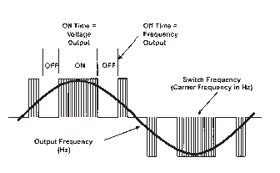
PWM Output to Motor
On time-voltage output Off time-frequency output

Slide 12
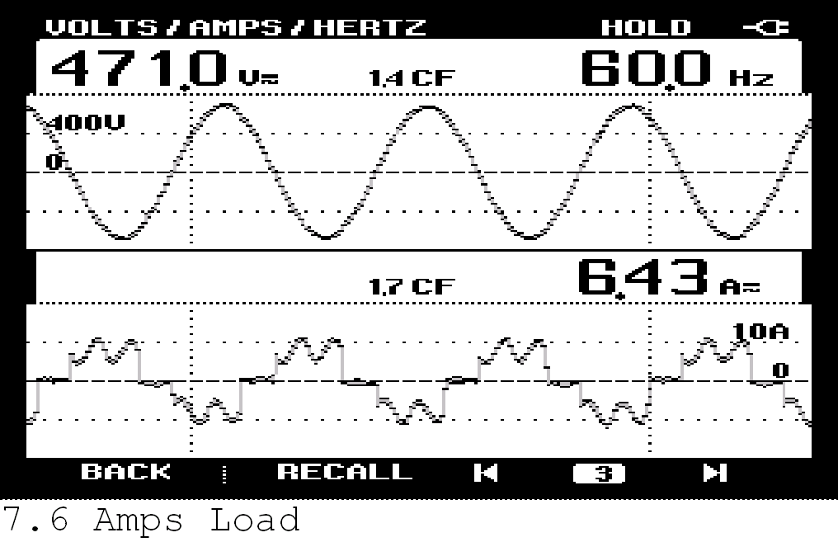
ABB ACH550
ACH550 - Input Voltage & Current
Notes:
Input Current Waveform and Harmonics

Slide 13
Front End (Converter of VFD)-What to look for
Coordinated System that protects the VFD
Metal Oxide Varistors (MOV’s)
Rated for 120 Joules
Shock Absorbers that dampen voltage surges coming into the VFD
Industrially Rated Diode Bridge
1600V
Option for AC Line Reactors
MOV
(Metal Oxide Varistors)
Notes:
EMI/RFI Filter and High Frequency Noise.

Slide 14
VFD must have Reactors
Input
Fixed Voltage
Fixed Frequency
60hz
230/460V
Output
Variable Voltage
Variable Frequency
DC Bus
Single or Dual DC Link Choke
Converter/AC to DC
6 pulse Diode Bridge
Inverter
IGBT’s
Motor
Reactors
(design specific)
Notes:
Harmonic reduction with AC and DC line reactors

Slide 15
Reactors, AC Line or DC Link
Different design techniques
Equal harmonic reduction for same normalized % reactance
Typical full load THD (current) at drive input terminals 28% → 46%

Slide 16
Reactors (Chokes)
Simplest and least expensive harmonic reduction technique
May be included in base drive package
Greatly aids in not having to oversize branch circuit cables to comply with NEC requirements for VFD’s
May be implemented with AC line reactors or with DC link reactors
Both types provide similar harmonic benefits
IEEE states that drives with reactors in HVAC typical applications can represent 20% of the system load and comply with 519 levels

Slide 17
Input Current Rating of VFD’s
Upstream Wiring-Branch Circuit Protection
NEC Code
430.120: Adjustable Speed Drives: The incoming branch circuit or feeder to power conversion equipment included as part of an adjustable speed drive system shall be based on the rated input to the power conversion equipment.

Slide 18
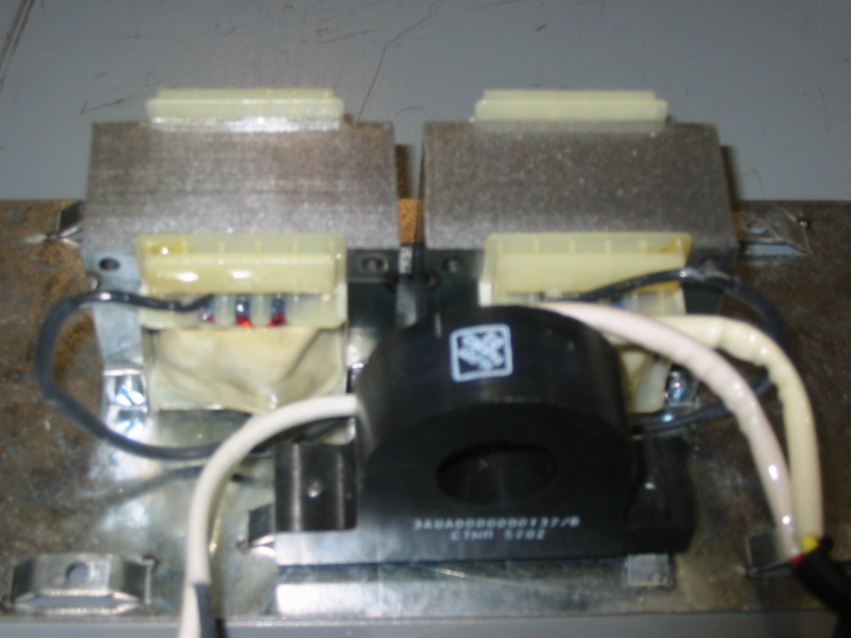
Reactors
Most efficient means of:
Limiting Harmonics
Control input current
Protect the VFD from line transients
Specify either 5% dual DC or 3-phase AC
3-5% of base VFD cost

Slide 19

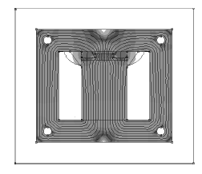
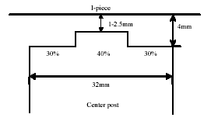
Swinging DC Link Choke
Provide increased inductance at partial loads
Perfect for variable torque centrifugal loads
Equivalent to 5% line reactor
Reduce harmonics up to 30% more than traditional designs
Notes:
This is the first of our Unique Saleable Features
The patent pending swinging choke provides unique harmonic reduction advantages compared to previous ACS 400 designs
All chokes are swinging (saturable) by design but what’s important is where this saturation occurs
The saturation point for the ACS 550 choke is beyond the nominal speed range
A step in the lamination changes the flux density as current increases which changes its inductance
This design provides the equivalent of a 5% reactor with the same size and weight of previous ACS 400 3% chokes
A common mode filter is also used with this design

Slide 20
Swinging Choke Vs. Fixed Choke
Increased impedance
at intermediate loads

Slide 21

Mid Section of the Drive-DC Bus
DC Link Reactors
Single DC Link
Dual DC Link
1.5%-3% Commonly
5% by some
What do they Do?
Provide protection
Reduce Harmonics
DC Link Reactors
Single or Dual

Slide 22
Harmonic Reduction Summary
Remember!
Even an 80% THD nonlinear load will result in only 8% TDD if the nonlinear load is 10% and the linear load is 90%.
(80%•(10%/(10%+90%))=8%)

Slide 23
Summary – Practical Advice
With a main distribution transformer, 20% of its load on non-linear loads will typically comply with IEEE 519-1992 (assuming 5% reactors on the VFD’s)
Mix VFD loads when multiple transformers are available
5% reactors address 90+% of typical applications. They also provide protection against line transients and keep input currents low to avoid oversizing power wiring to comply with NEC.
Make the VFD vendor perform a harmonic distortion calculation with the submittals. They will need the distribution transformer(s) size in KVA, % impedance and cabling information as well as the VFD schedule

Slide 24
Output of VFD
IGBT
Insulated Gate Bi-Polar Transistors
Switch on and off thousands of times a second
Measured in kHz
.5 kHz – 20 kHz (per cycle)
Simulates an AC sign wave
Introduced in the mid 80’s
Created problems on motors initially
Every VFD manufacturer uses these today
IGBTs

Slide 25
ACH550 Product Review
Notes:
Welcome to the ACH550 Basic Overview webmodule. In this webmodule, we will look at the standard features of the ACH550 AC drive – including some basic features of the E-clipse bypass unit. Keep in mind, this is a basic overview of the product. For further details on hardware, options or programming, consult the appropriate technical or User manual.

Slide 26
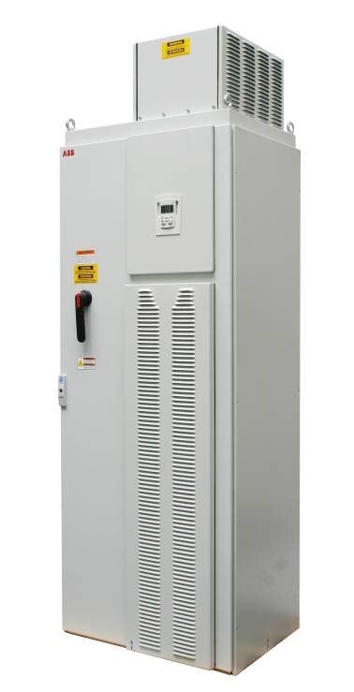
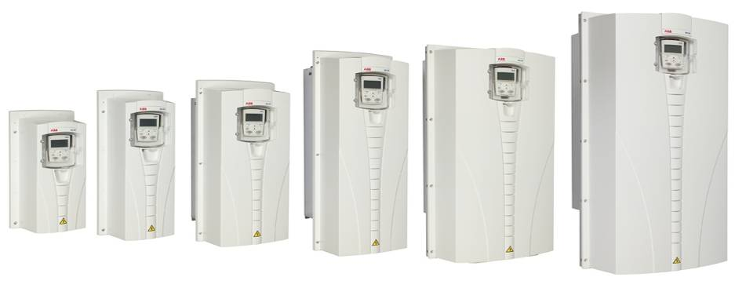
Family Frame Sizes
IP21 / UL Type 1: 1 - 550 HP
IP54 / UL Type 12: 1 - 550 HP
IP32 / UL Type 3R: 1 – 200HP w/ Bypass
R1 1-7.5 Hp
R2 10-15 Hp
R4 40-75Hp
R3 20-30Hp
R5 100 Hp
R6 125–200 Hp
R8 250-550 Hp
Notes:
The family of drives is shown in this slide. Frames R1-R6 comprise the wall mount sizes, which are available up to 200 Hp. The R8 floor standing cabinet models range from 250 – 550 HP.
The ACH550 Drive is available in a NEMA 1 configuration (that is UL Type 1 or IEC IP21) up to 550 HP. It is also available in a NEMA 12 configuration (UL Type 12 or IEC IP54) also up to 550 HP. The latest entry into the family includes a NEMA 3R configuration (which is IP32) up to 200HP with Bypass.

Slide 27
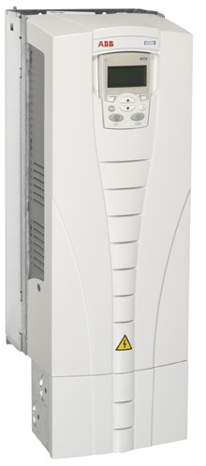
Product Features
Power Range, wall mount
1.0 to 100HP @ 240Vac
1.5 to 200HP @ 480Vac
2.0 to 150HP @ 600Vac
Power Range, packaged in enclosure
1.0 to 100HP @ 240Vac
1.5 to 550HP @ 480Vac
2.0 to 150HP @ 600Vac
Enclosure
UL Type 1 (NEMA 1) standard
UL Type 12 (NEMA 12) optional
UL Type 3R (NEMA 3R) optional
Motor Control – Scalar (V/Hz) and Sensorless Vector
Output frequency range 0 to 500Hz
Switching frequency choices of 1/2/4/8/12 kHz
15 language choices
EMC Filter for CE compliance (First Environment – restricted through 200HP Wall-Mount)
Notes:
As previously mentioned, the ACH550 product is available in both wall and floor mount configurations. A frame break occurs at 200 HP. Above 200HP, the ACH550 product is available in a free-standing enclosure. As indicated earlier, the enclosures are listed in both a NEMA or UL rating.
The motor control method used by default is “Scalar.” However, the drive can simply be programmed for sensorless vector control if higher end performance is needed for a given application. The output frequency range is from 0 to 500 Hz. Switching frequency of the output motor waveshape is adjustable at 4, 8 or 12 kHz, with 4 kHz as the default setting, which offers the best drive efficiency.
15 languages are available to address installations for a variety of global locations and First Environment – restricted, CE compliance is standard through 200HP. First Environment, Unrestricted Distribution, is available with the optional RFI Filter installed.

Slide 28
Product Certifications
IBC 2006 & IBC 2009 Seismic Certification
All Standard Factory Products
OSHPOD Certification
American Recovery and Reinvestment Act of 2009
All Standard Factory Products
100K Short Circuit Current Rating
Standard on all Circuit Breaker Units
Standard on all Disconnect Models when Class J Fuses Installed Upstream of VFD
Standard on Drive Module
Certified EMI/RFI Filter
2nd Environment Rated for Commercial/Industrial Usage
1st Environment Rated for Residential Usage
Notes:
As previously mentioned, the ACH550 product is available in both wall and floor mount configurations. A frame break occurs at 200 HP. Above 200HP, the ACH550 product is available in a free-standing enclosure. As indicated earlier, the enclosures are listed in both a NEMA or UL rating.
The motor control method used by default is “Scalar.” However, the drive can simply be programmed for sensorless vector control if higher end performance is needed for a given application. The output frequency range is from 0 to 500 Hz. Switching frequency of the output motor waveshape is adjustable at 4, 8 or 12 kHz, with 4 kHz as the default setting, which offers the best drive efficiency.
15 languages are available to address installations for a variety of global locations and First Environment – restricted, CE compliance is standard through 200HP. First Environment, Unrestricted Distribution, is available with the optional RFI Filter installed.

Slide 29
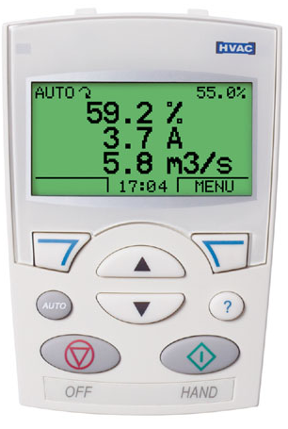
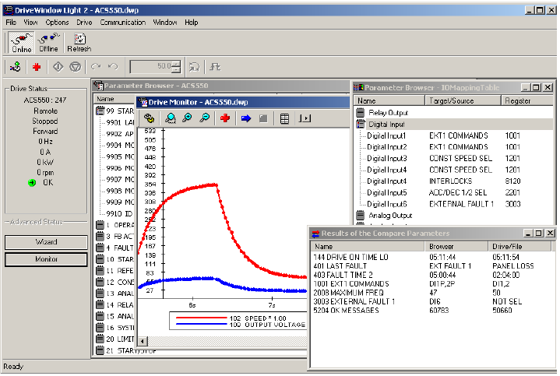
Human Interface
Advanced Control Panel (Standard)
Full-featured and alpha-numeric graphic display
Real-time clock
Allows for back-up, Assistant menus & Diagnostics
Fifteen (15) languages
Dedicated help key
DriveWindow Light
Easy tool for commissioning and maintenance
Clear, graphical presentation, with on-line & off-line modes
Back-up of drive values, and data trending
Notes:
The Advanced Control Panel has all the features that a customer requires and is therefore included as “standard” with every drive. The keypad is detachable and connects to the drive with a standard computer cable - an Ethernet, CAT-5 cable available from any computer or office store. (Note that this cable is a “straight-through” or “in-line” version - - it is not a “crossover” cable). The Control Panel features a three signal display with a real time clock. The panel buttons work on the principles of cell phone technology, encorporating “soft keys” to perform functions - making it very user friendly.
DriveWindow Light is an optional PC Tool that allows control, programming and monitoring of the drive through a computer. This software program is a flexible tool to be used during commissioning, troubleshooting and maintenance. It offers a clear graphical representation of what is actually occurring with the drive – in either on-line or off-line modes of operation. Application programs can be saved as a backup through the use of the “parameter & signals” tool.

Slide 30

Fieldbus Interfaces – Standard Embedded
ACH550 has the following HVAC fieldbus protocols embedded as standard – Group 53 and Group 98:
BACnet MS/TP (B-ASC)
FLN APOGEE, Siemens Building Technologies
Metasys N2, Johnson Controls
Modbus RTU
EIA-485 (RS-485) baud rate up to 115k
Provide compatibility
Fieldbus technology makes more cost-effective installation possible
Feedback and local I/O advantages to Building Management Systems
Notes:
The ACH550 has 4 embedded fieldbus protocols. They are BACnet, Siemens FLN (Floor Level Network), Johnson N2 Bus and Modbus RTU (Remote Terminal Unit). These protocols all have connectivity through the RS-485 connection terminal on the Main Control Board. It should be noted that the BACnet protocol is Master Slave / Token Passing and is BACnet Testing Labs listed as an Application Specific Controller.
The use of a fieldbus interface makes installations more cost-effective. Control and monitoring of the drive are both possible. Control can also be programmed to allow any mix of I/O vs. fieldbus control – for example hard-wired building safeties and Start/Stop & speed reference through communications.
Group 53 works in conjunction with Group 98 (Communications Options). Group 53 sets up the embedded fieldbus communications values. This Group allows the user to set baud rate, station ID, parity and other values specific to a protocol.
Group 98 allows the user to “energize” the embedded fieldbus terminal block or tell the drive it has an external Fieldbus Module. The setting of one parameter, 9802, provides the drive with information vital to connecting to outside world communications. There is a “Communications Assistant” that steps the user through all the required start-up values.

Slide 31
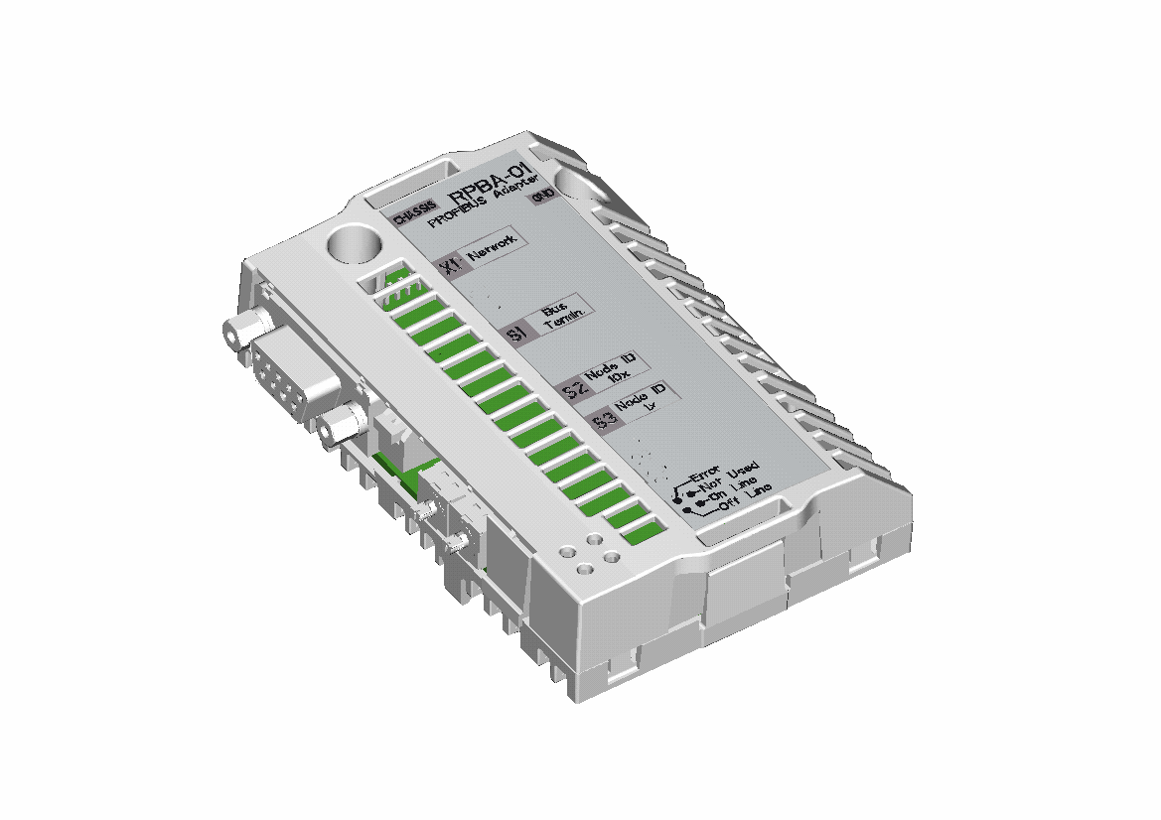
Fieldbus Interfaces – Option Modules
Protocols available as internal options – Group 51
“R” series modules can plug into the fieldbus connector
Module power is provided by the drive – no external power supply needed
Multitude of Protocols:
LonWorks
Ethernet IP
BACnet/IP
Provide compatibility
Fieldbus technology makes more cost-effective installation possible.
Compatible with Industrial Protocol option modules
“R” Series Module
Notes:
The ACH550 has the capability of several optional fieldbus modules. The external fieldbus modules are available in the “R” series version, which plug directly into option slot 2 on the Main Control Board (SMIO board). Even though LonWorks and Ethernet IP may be the more common modules for use in HVAC applications, the ACH550 can also communicate on the same fieldbus network used in some Industrial applications – such as Devicenet or Profibus.
Group 98 allows the user to “energize” the embedded fieldbus terminal block or tell the drive it has an external Fieldbus Module. The setting of one parameter, 9802, provides the drive with information vital to connecting to outside world communications. There is a “Communications Assistant” that steps the user through all the required start-up values.

Slide 32
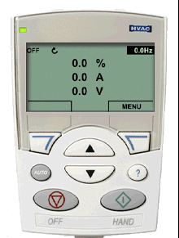
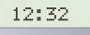
Control Panel (Advanced) - Features
Advanced Control Panel
Assistants: Start-up, maintenance, and diagnostic assistants
Real Time Clock
Displays (3) Group 01 parameters
Parameters are Alphanumeric
Dedicated Help key (built-in manual)
Key functions change (soft keys)
Back-up and Restore
Changed Parameter Display
Soft Key 1
Soft Key 2
Notes:
The Advance Control Panel offers the most capability when programming the ACH550. A “Basic” Panel is available, but has far less functionality. The features and benefits of this panel are listed here. Notice that there are no “function codes” with this panel – all values and parameter names are listed in alpha-numeric fashion.
Several other key features include the “Back-up and Restore” function. Pressing the “Menu” button (the soft key in the Red circle), allows the user to scroll up and down using the Arrow Up and Down buttons. Finding the “Par Back-up” group is where Backup and Restore is located. Once there, you will have several options of uploading to the Panel, and downloading to the drive. The “Changed Par” group, also one of the main parameter groups, contains a running list of all changes made to the drive from default values. This is a handy list of values, that may help in software troubleshooting, comparing the default macro setting to what is currently in the drive. “I/O settings” is another one of the main groups, and indicates all the function assignments for each of the Inputs and outputs.

Slide 33
Control Panel (Advanced) – Button Functions
Full Graphic Display Back-lit LCD & Real Time Clock
Soft key 2 Function
Soft key 1 function
Soft key 1
Soft key 2
Down button (for scrolling parameters and changing their value)
Up button (for scrolling parameters and changing their values)
Auto button
Help button
Off button
Hand button
Notes:
All of the button functions are indicated in this picture. The basic concept of programming this drive, is the use of the two soft keys. The description of the button changes depending on what operation you are performing - just like in a standard cell phone. The basic button functions speak for themselves, and once you have a few minutes with the Panel, you will surely find that programming this drive is as easy as using a cell phone. If you get stuck at any time, the ? (Question Mark) Help Button can assist you. Pressing this button allows you to enter a modified User Manual. It gives helpful hints during programming as to what a parameter does. In addition, it indicates how to correct an alarm or fault, after it occurs. The Real Time clock in the middle of the display gives accurate time and date of faults when performing diagnostics, and allows the user to program any of (4) internal timers.

Slide 34
Control Panel (Advanced) - Assistants
Assistants simplify all functions of Drive Operation
Start-Up Assistant - guides the user through all essential settings without going directly into the parameter list
Maintenance Assistant - can be used to insert preventative maintenance functions using run time, motor revolutions or events
Diagnostic Assistant - activated with a fault and provides suggestions to correct fault based on the most common causes
Soft Key 1
Soft Key 2
Notes:
There are (3) different assistants located within this drive Panel. Their functions are listed here, with the “Start-up Assistant” being the most useful during a full drive commissioning. The maintenance assistant can be used for a “pre-programmed” time interval as to when to perform preventative maintenance. The Diagnostic Assistant is really part of the ? Help Button. It gives corrective actions to be taken to reduce the potential for the fault in the future.

Slide 35
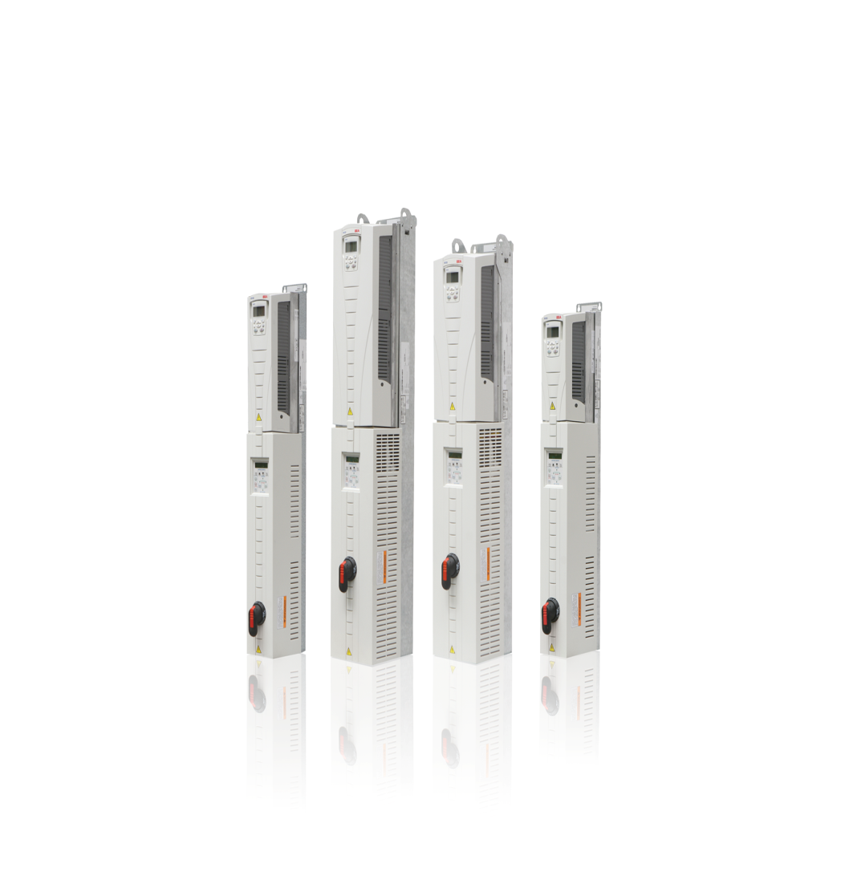
ACH550 Specifications
Internal Power Supply
For Use with Digital Inputs & Analog Sensors
24VDC, Max. 250ma
Short Circuit Protected
Digital Inputs
6 Selectable
Optically Isolated
Input Current Consumption 15ma @ 24VDC
4ms Refresh Rate
Maximum Input Voltage 30VDC
Accepts AC or DC inputs
Can Use with OHDI-01-KIT 115/230VAC Interface Adapter

Slide 36
ACH550 Specifications
Relay Outputs
3 Programmable (Form C) Relays (Standard)
Option to Add An Additional 3 More
Max. Continuous Current 2 Amps RMS
4,000 VAC Isolated Relays
12ms Refresh Rate
Silver Cadmium Oxide Contacts
Keypad
8 Button Removable Keypad
Alpha-Numeric Backlit Display
Dual-Color LED Indicators
Real Time Clock with Battery Backup
Copy/Restore Capability

Slide 37
ACH550 Specifications
5% Equivalent Impedance
DC Swinging Bus Chokes on Drives 75HP and Lower
Three Phase AC Swinging Chokes Above 75HP
Conformal Coated Circuit Boards (Level 3)
Increases ability to withstand airborne contaminants
40° C Standard ambient operation at full load 24/7
50° C Ambient with 10% derate from drives full load rating
With new high efficiency motors need to increase drive size not always needed.
110% Overload for 1 min with variable torque load
135% Overload for 2 sec with variable torque load

Slide 38

E-Clipse Product Review

Slide 39
E-Clipse Specifications
Agency Approval
UL, cUL, CE, BTL, IBC-2006 (Seismic) & IEC 61000-3-12
Ambient Operation & Storage Conditions
Identical to ACH550
Protection
Reverse Input Phasing
Over/Under Voltage
Over Current
Ground Fault
Phase Loss
System Fault

Slide 40
E-Clipse Specifications
Internal Power Supply
For Use with Digital Inputs
24VDC, Max. 250ma
Short Circuit Protected
Digital Inputs
5 Selectable & 1 Fixed Inputs (Fireman’s Override)
Optically Isolated
Input Current Consumption 15ma @ 24VDC
4ms Refresh Rate
Maximum Input Voltage 30VDC
Accepts AC or DC inputs
Can Use with OHDI-01-KIT 115/230VAC Interface Adapter

Slide 41
E-Clipse Specifications
Relay Outputs
5 Programmable (Form C) Relays
Max. Continuous Current 2 Amps RMS
4,000 VAC Isolated Relays
12ms Refresh Rate
Silver Cadmium Oxide Contacts
Keypad
9 Button Keypad
32 Character 2 Line Alpha-Numeric Backlit Display
4 Dual-Color LED Indicators

Slide 42
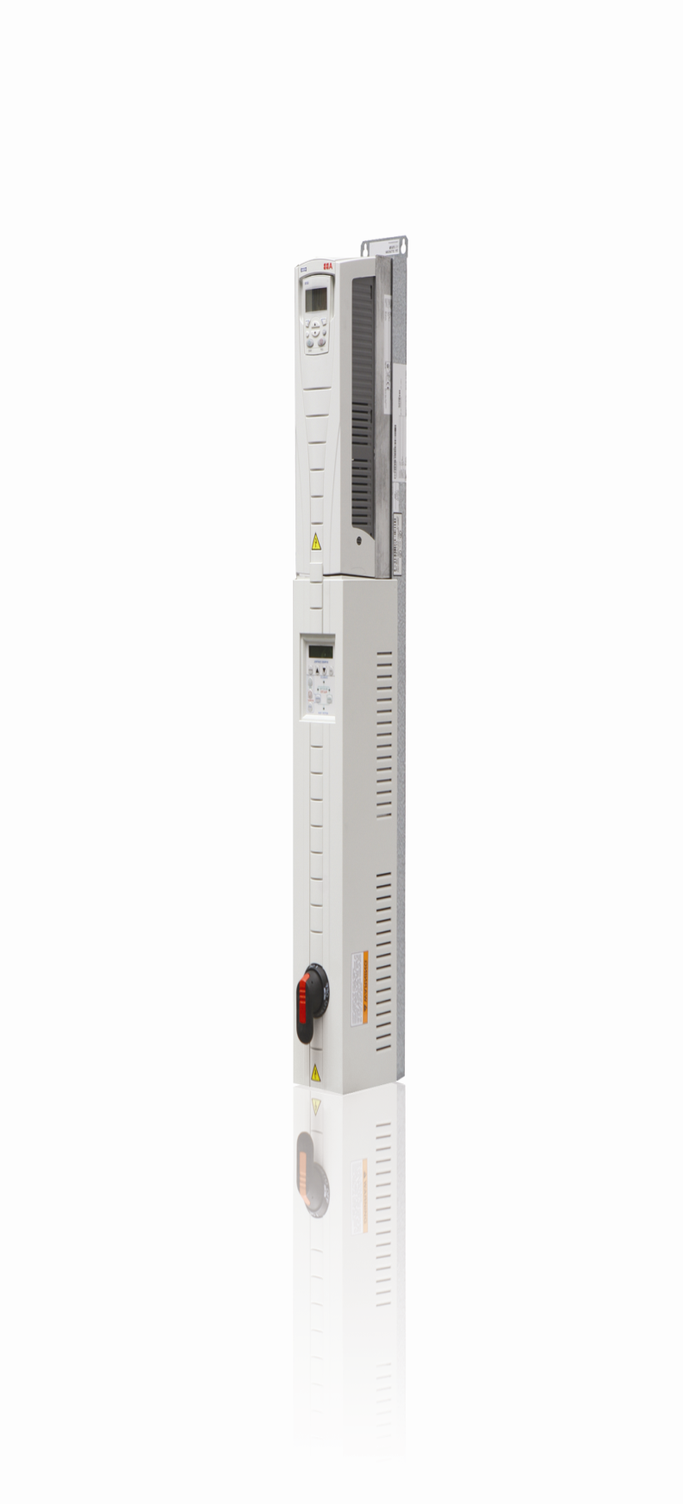
E-Clipse Specifications
Bypass Configurations
2 Contactor Bypass
2 Contactor Bypass with Service Switch
3 Contactor Bypass Does Not Meet NEC 430.103
A disconnect device cannot be part of a motor control circuit.
Bypass Contactor Diagnostics
Open, Shorted & Stuck Indication for Each Contactor
Abnormal Current Usage of Contactors

Slide 43
E-Clipse Specifications
Custom Plain Text Indication
Up to four (4) safeties can be used, each with plain text display of effected device. IE… Smoke Detector, FireStat, FreezeStat…………
Run Enable can be programmed for plain text display of effected device. IE … Damper Switch
Automatic Transfer to bypass
Enable/Disable based on fault type.
Control of bypass through building automation system
Without drive installed
Without drive keypad
Without drive power supply

Slide 44
E-Clipse Components

Slide 45
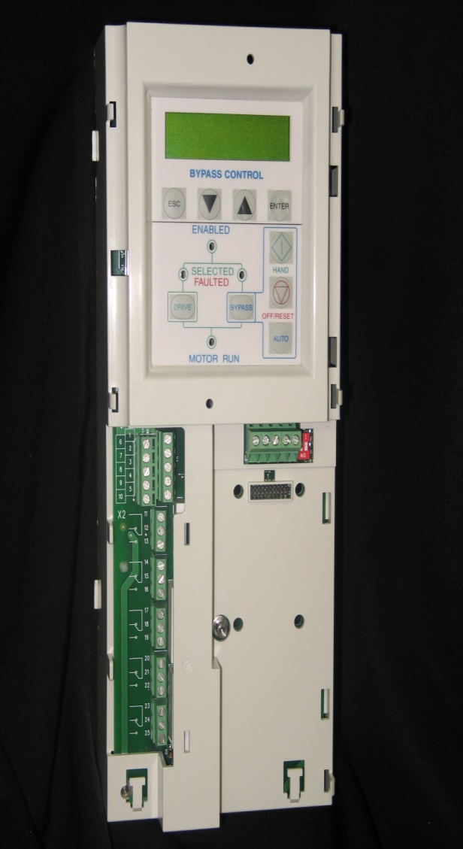
E-Clipse Components
RBCU – Redwood Bypass Control Unit
Main Circuit Board (RBIO)
Power Supply
Terminal Strips
Keypad
Communications Port
Single Part For All Drive Sizes
3AUA0000014860
Only For Connectors to Remove for Replacement.
No Removable Keypad
Can Not Perform Copy/Paste Function

Slide 46
E-Clipse Components
RCSA – Redwood Contactor Sub Assembly
Bypass Contactors
Must Use Specified Contactor for Drive Size
Wrong Contactor Will Produce Faults
120 VAC Coil
RCTR – CT and Fuse Block Board (Drives 30 Amps and Smaller)
Drives Over 30 Amps
Fuse Block
CT’S – Current Transformers
Terminal Blocks

Slide 47
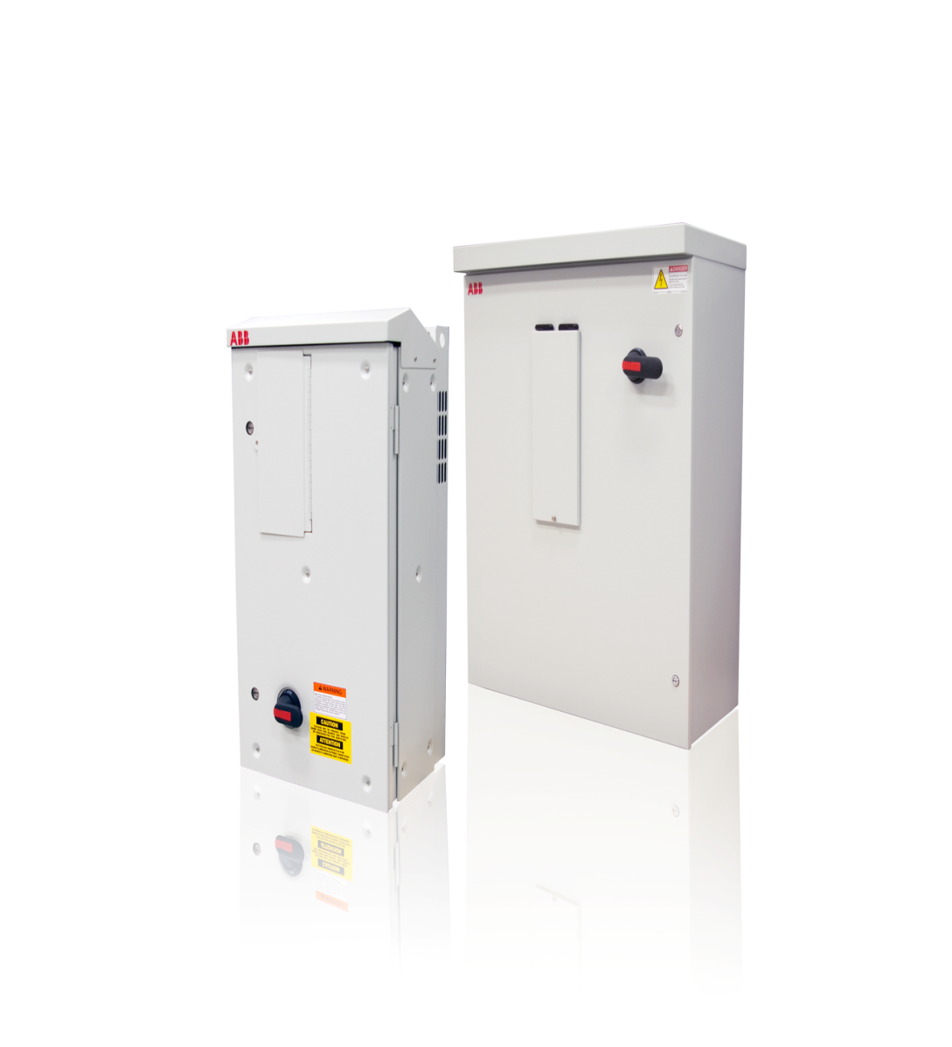
E-Clipse Components
RHTR – Redwood Heater Control Board
Used on NEMA 3R Only
Controls Cabinet Cooling Fan
Controls Cabinet Heater Element
Fed By Dedicated Power Supply
Cabinet & Drive Fans

Slide 48
E-Clipse Operation

Slide 49
E-Clipse Operation
The E-Clipse bypass is a microprocessor controlled system that has the ability to operate individually from the VFD.
The bypass communicates and shares information with the VFD through MODBUS communications.
The VFD is no longer the termination point for Building Automation Systems communications. The bypass will handle all BAS communications and route data between the drive and bypass.
When using the E-Clipse on a BAS, the user has the ability to create two devices on the network. The drive and bypass will have individual addresses and share detailed operation data.
When the bypass is powered up, it will read all motor data from the drive. This will program motor and voltage overload parameters for bypass mode.

Slide 50
E-Clipse Operation
The E-Clipse bypass will not operate until the system has been run in drive mode first. The VFD will sense any ground faults and prevent irreparable damage from occurring to bypass components.
The E-Clipse bypass becomes the termination points for all digital inputs and relay outputs. Depending on mode of system (Drive or Bypass), the safeties, run enable and start/stop signals will be routed accordingly.
Start/Stop
Run Enable
Start Enable 1, 2, 3 & 4
Override

Slide 51
E-Clipse Operation
The E-Clipse bypass has predefined macro’s that will perform an initial configuration of the bypass IO’S.
The VFD must remain at all times programmed with the E-Clipse Macro!
If programming on the VFD for Start/Stop, Run Enable or Start Interlocks have been altered, the bypass keypad will display “Drive Setup”
The VFD must remain at all times programmed as MODBUS Communications.
If the communications programming has been altered on the VFD, the bypass keypad will display “Drive Link Error”

Slide 52
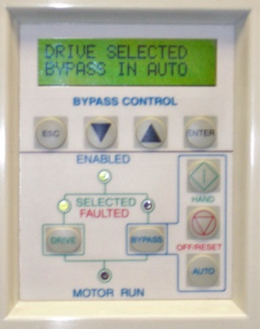
E-Clipse – Override 1 (Smoke Control)
Override 1 (Smoke Control) – Source of the “Start” Command is internal, but engaged by DI6
Unaffected by external stop commands
Bypass ignores all commands from either the drive or bypass control panels, Digital Inputs & Communications
Motor “RUN” LED flashes Green to signify Override
System responds to “high priority” safeties (e.g. static pressure, damper end-switch)
System will always respond to electronic OL protection in the Bypass
When DI6 is open, the system returns to previous operating mode
Cannot alter programming of this override!!!
Notes:
Slide indicates the main points and explanations.
Smoke Control (Override 1) is fixed in the drive firmware and cannot be “re-programmed.” Currently there are no requirements set by UL for VFDs (e.g. UL864 or UUKL smoke control devices). VFDs are considered an end device – therefore the ACH550 does not carry any UUKL or UL864 certifications.
Note to the students, that this control ignores the drive or bypass control panel commands or low priority safeties (e.g. freezestats and return duct smoke detectors).

Slide 53
E-Clipse – Override 2
Override 2 (Bypass Override) – Motor is powered by AC line power through the bypass contactor – most commonly used
Source of the start command is internal and unaffected by external Stop commands
User can switch to Bypass Override mode by closing Bypass Override input contact (DI5 if programmed)
When Bypass Override contact is closed:
System is forced into bypass – does not respond to “Drive” and “Bypass” keys, Digital Inputs and Communications
System responds to bypass overloads and programmed faults
Motor Run LED flashes green when in override
System can be custom programmed to acknowledge or disregard certain safeties, faults and enables (default is to ignore external safeties and run enables (Group 17 parameters)
When “Bypass Override Contact” is open, system switches to “Drive” mode (Drive and Bypass Keys are operational) Note: System remains in “Smoke Control” (Override 1 if engaged)
Notes:
Override 2 can be assigned to a specific Digital Input (typically it is assigned to DI5). As indicated on the slide, when engaged, the E-Clipse does not respond to Drive or Bypass keys, but does respond to bypass overloads, underloads and programmed faults. This is the most commonly used “Override” due to it’s ability to be “programmed.”
Emphasize to students that the “blinking” green Motor LED indicates an “override” condition. Group 17 (Override Group) allows the user to assign what contacts are acknowledged or disregarded during the override condition. In addition, certain faults can be disregarded.
Note: In Override 2, the unit is default programmed to ignore all external safeties and enables. The programmability of Group 17 provides a fully flexible Override program that can be customized to the users needs.
Note: In Override 1 (Smoke Control), the “Drive” and “Bypass” keys are not operational (DI6 is Closed) The unit remains in “Smoke Control Mode” when DI6 is closed. The unit will remain in “Smoke Control” mode, however, if DI6 is closed at any time. (Smoke Control “overrides” any digital input programming).
In “Bypass” Override 2, the default parameters ignore all safeties – and “run to destruction” is possible. The User can re-program parameters to acknowledge or disregard safeties as listed in Group 17.

Slide 54

E-Clipse Keypad Features – Display and Keys
Bypass product has a display & menu structure similar to the drive (programming is done through the keypad)
Programmable relays, fault transfers, DIs, etc.
Press “Escape” to cancel programming choice
“Ready Indication”
(Display Illuminated)
LCD Display
Down
Up
Escape
Enter
Enabled LED
Drive and Bypass Selected/Faulted LED’s
On/Hand Key
OFF/Reset Key
Auto Key
Drive/Bypass Select Keys
Motor Run LED
Notes:
The E-Clipse Keypad operates similar to an ACH550 keypad. However, there are only (2) lines of display and some “truncated” words in order to fit in the available 16 X 2 line segment display.
Display indicates what the user is looking at – and the value of that item (e.g. drive is selected in “auto bypass” as an example). Pressing the “Enter” key allows entry into the parameter groups – and using the UP or DOWN arrows will allow scrolling through the parameter groups. Once a group is identified, pressing “ENTER” again will allow entry into the parameter section (again using the UP or DOWN will allow moving to a specific parameter number. Once that parameter is identified, pressing “ENTER” will call-up the programming Brackets [ ]. Any value inside the brackets can be changed (use the UP or DOWN arrows). When a value is identified, pressing “ENTER” will save the value. Pressing “ESC” several times will allow the user to “escape” out of the programming mode and go back to the “main display” mode. Those parameter groups available in the E-Clipse are identical to that of the ACH550 (not all parameters in the drive are available in the E-Clipse).
Pressing the “DRIVE” key will allow the unit to be operated through the Drive. Pressing the “BYPASS” key will transfer control to the Bypass – with either “Auto ” or “Hand” Bypass control available. The OFF/RESET key has the dual purpose of OFF in Bypass or allow “reset” of a fault in Bypass operation.

Slide 55
E-Clipse Keypad Features - Indicators
E-Clipse Bypass keypad
LCD illumination of Ready on E-Clipse Bypass
“Automatic Transfer to Bypass” is LCD text message
“Ready Indication”
(Display Illuminated)
LCD Display
Down
Up
Escape
Enter
Enabled LED
Drive and Bypass Selected/Faulted LED’s
On/Hand Key
OFF/Reset Key
Auto Key
Drive/Bypass Select Keys
Motor Run LED
Notes:
LEDs indicate the status of the E-Clipse. Green LEDs indicate the flow of power through the unit - - - to the Drive or to the Bypass. (indicated on the slide is main power to the Drive, with no faults or alarms, and “Bypass in Auto” is selected).
Enable LED - Blinking Green LED’s indicate an “Alarm” condition or that a function has been requested, but the drive or Bypass is not enabled (Run Enable contact is open, Safety Interlocks are closed and Start Command is present). LED glows RED when the Safety Interlock contact is open. Solid Green LED indicates OK (Safety Interlocks and Run Enable contacts are closed OR Safety Interlocks are closed but no START command).
Motor Run LED – Solid Green when the motor is running in either Drive or Bypass Mode. The LED is blinking green when the system has been placed in “Override.”
Essentially – Solid Green indicates OK status, Blinking Green indicates a function has been selected, but possibly not all conditions are met, and solid RED indicates a Fault. When LEDs indicate a condition – that condition will be indicated on the Drive Keypad, and typically on the E-Clipse Display (for enables, safeties and system faults).
Consult the “Overview of the Bypass Functionality” section of the E-Clipse User’s Manual for further details

Slide 56
E-Clipse Features – Auto Transfer & Pass-Through I/O
Conditional Auto-Transfer to Bypass Capability
Faults that can cause auto-transfer:
Overcurrent (P1609)
Overvoltage (P1610)
Undervoltage (P1611)
Loss of analog input (P1612)
System Pass-Through I/O
Bypass & Drive I/O controlled by communications (Group 50)
2 additional relays available (5 total) (compared to a “drive only” capability of 3-relay outputs)
Controlling of the Relay Outputs is set-up through Group 14 parameters and mapped by the Building Automation Controller
Pass-Through I/O:
5 Relay Outputs can be controlled in the E-Clipse
6 Relay Outputs can be controlled in the Drive (3 plus 3 optional OREL)
Notes:
Just because the drive can be set-up to automatically transfer to bypass, doesn’t mean it’s an appropriate procedure. Students should be encouraged to always consult with the building owner to determine the best course of action – after a drive fault. Many owners may wish to “manually” engage Bypass after some type of fault – just to verify the serious nature of the fault.
The Bypass section can be separately controlled through Group 50 (e.g. communications can control the drive only, the bypass only, or the entire system – drive and bypass together). Controlling Relay Outputs through communications is easily accomplished, whether through FBA or EFB. The relay function must be set to “COMM CTRL” (e.g. P1401 or P1404, or P1407. etc.) and mapped correctly in the Building Automation Controller by the temperature control contractor (as an example, Relay Output 1 is controlled by Modbus register 40134, or 00033 in the DCU profile, or B07 in the N2 Bus, or 40 in Siemens FLN or BO0 in BACnet). Consult the “E-Clipse Bypass Embedded Fieldbus Control” User’s Manual for further details.
Though seldom used, communications can control the E-Clipse Relay Outputs (5-total) AND the Drive Relay Outputs (Group 14 parameters in the drive which allows 3-standard with another 3-optional through the OREL option board). The mapping of the Relay Outputs must be done in the Building Automation Controller – assigning the correct points to the drive relay output parameters.

Slide 57
E-Clipse Features – Safeties, Interlocks & Alarms
Distinct Annunciation of Safety Interlocks
Up to four (4) independent safeties (P1603 through P1606)
Selectable annunciation: Firestat; Freezestat; Damper end-switch; Over pressure; Vibration trip; Low suction; Safety open (P1620 through P1624)
Note: Parameter 1613 BP DISABLE (Bypass Disable) will disable bypass operation in any mode
Note: Parameter 1616 DISP ALRMS (Display Alarms) will keep several alarms silenced
Notes:
The Safety Interlock conditions can be annunciated through the E-Clipse Display. The programming of the Safeties are through parameters 1603 through 1606 indicated on the slide, with the function assigned to Digital Inputs (DI2, DI3, DI4 and DI5). As indicated, parameters 1620 through 1624 are the parameters where the annunciations are selected (they can be set to annunciate. A value of “0” (zero) is “not selected.”
The use of Bypass can be completely disabled as indicated in P1613 and the display alarms can be suppressed (not displayed) by parameter 1616 (note: not all alarms will be suppressed (see E-Clipse Bypass User’s Manual for further details – under P1616).

Slide 58
Installed Base, StartUp Registration Forms & Requirements
US1027p_InstallBaseRegis_B, Aug 2009

Slide 59
Certified StartUp Registration
Certified StartUp is available for drives purchased and installed in the US and Canada only, drives installed outside the US or Canada do not qualify for Certified StartUp or Certified StartUp warranty extension
Certified StartUp registration of LV Drives is performed through one of two methods
On-Line: Just Released to new registered users!!!
Http://installedbase.it.abb.com/drivesregistration
Electronic – Email Registration to Drivesupportline@us.abb.com with Excel Sheet as an attachment.

Slide 60
Certified StartUp Registration
Complete the Certified StartUp registration form while performing the certified startup. The form is in excel so it is easy to complete and repeat for multiple drives commissioned during the same site visit
Complete all information in the YELLOW sections to the best of your ability (plus check boxes)
The form is “locked” so the non-yellow areas cannot be edited, for the check boxes - simply point and click
As the authorized Certified StartUp agent for ABB, it is your responsibility to:
perform the start-up to the best of your ability
notify the user of any installation or environmental issues that must be corrected
document issues not corrected / compliant with requirements
Be responsible and act in the best interest of ABB and the user

Slide 61
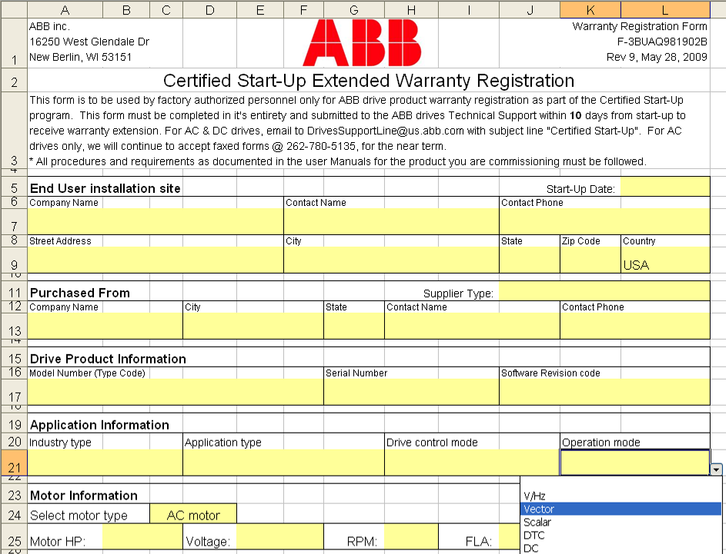
Certified StartUp Registration
Complete all areas shaded in yellow
Incomplete forms will be rejected and returned
Do not forget the start-up date
Note: some areas are controlled with drop down boxes

Slide 62
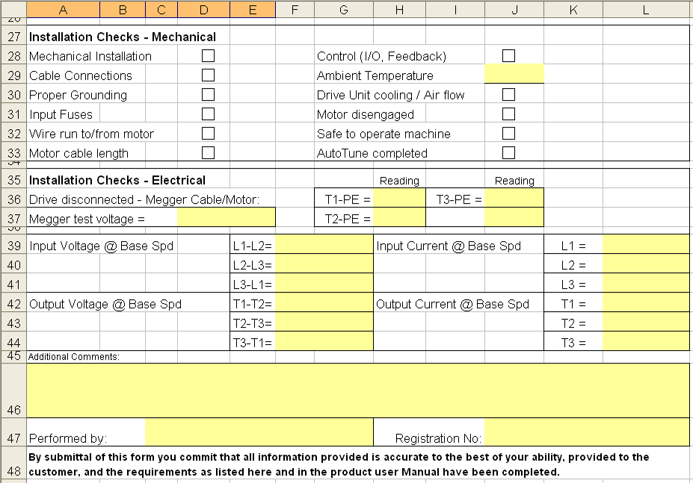
Certified StartUp Registration
Click on check boxes to select
Megger measurement – drive motor leads must be disconnected
Meggering the drive will damage the drive
Meggering is no longer required – field may be left blank
Complete all voltage and current measurements
Note any issues to be addressed;
Installation
Cooling
Moisture
Wiring
Grounding
etc

Slide 63
StartUp Registration – Paper
If you are not an ABB authorized channel partner you will be required to submit certified start-up product serial number registration via email
This “paper” format functionally allows for product registration and Certified Start-Up warranty extension
The serial number registration will take significantly more time to be processed through the system
Track-ability is limited in the “paper” system and installed base reports are not available
Parameter settings are not backed up or available for future reference or for use during technical support calls

Slide 64
StartUp Registration – Paper
Complete the start-up registration form as detailed at the beginning of this presentation (electronic completion)
Email the electronic file to DrivesSupportLine@us.abb.com with the subject line of “Certified Start-Up”
Include the start-up registration form as an attachment (not an image)
Include your complete contact information in the email:
Name
Phone Number
email
Your company name
Your company address

Slide 65
Installed Base Website
Available to registered individuals ONLY!!
Just Released!!!–
Http://installedbase.it.abb.com/drivesregistration
Multiple Uses:
Drive Registration
Customer Documentation
Customer by Area Reports
Database for existing equipments parameter files.

Slide 66
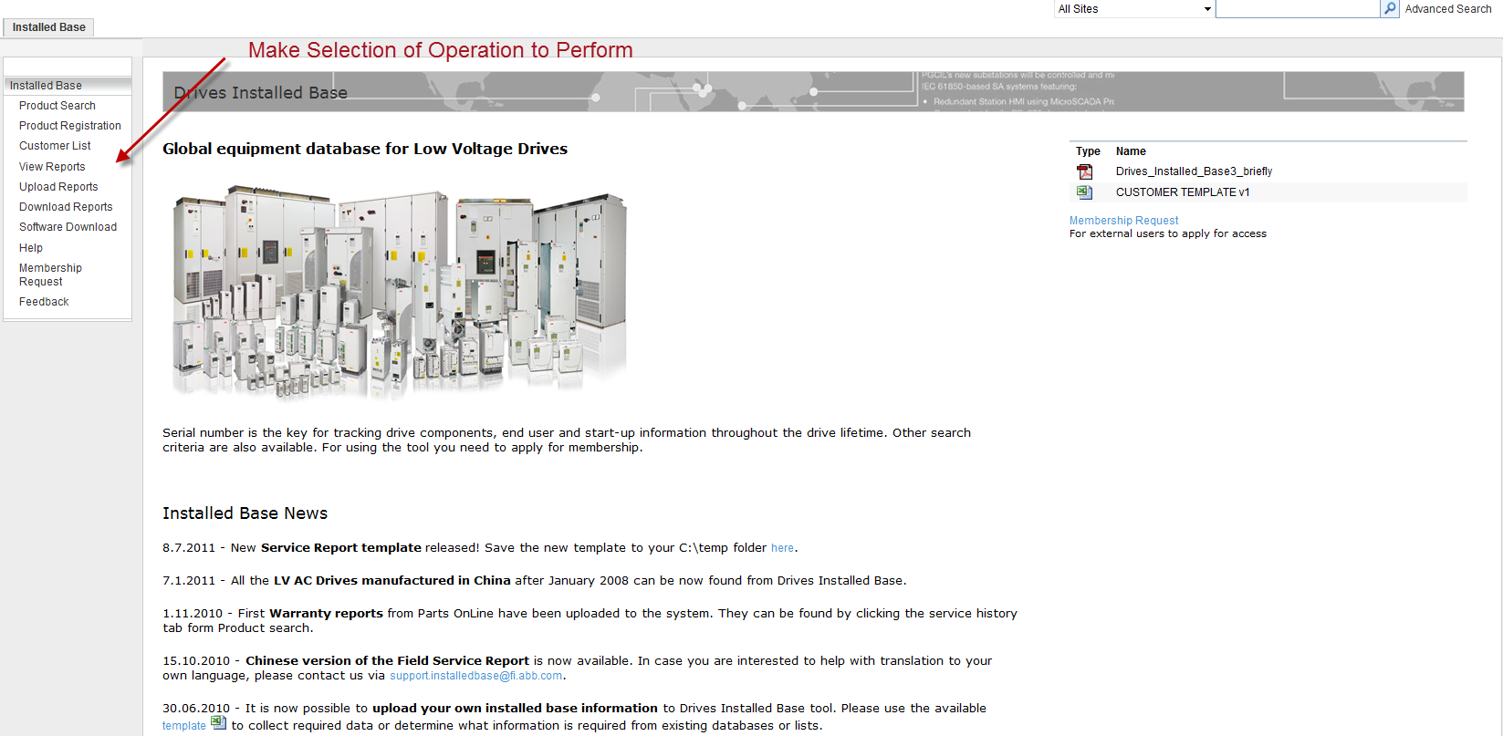
Installed Base Navigation

Slide 67
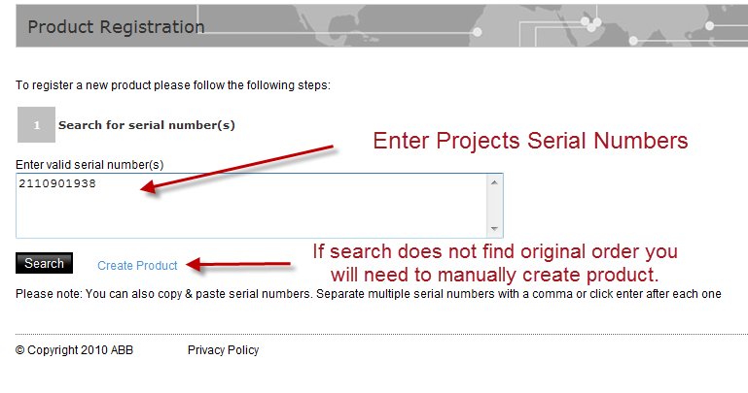
Drive Registration

Slide 68
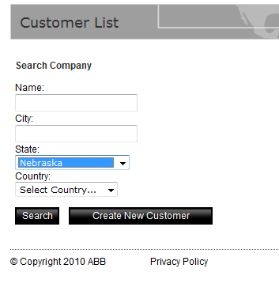
Run Reports to Locate Customers in Territory

Slide 69
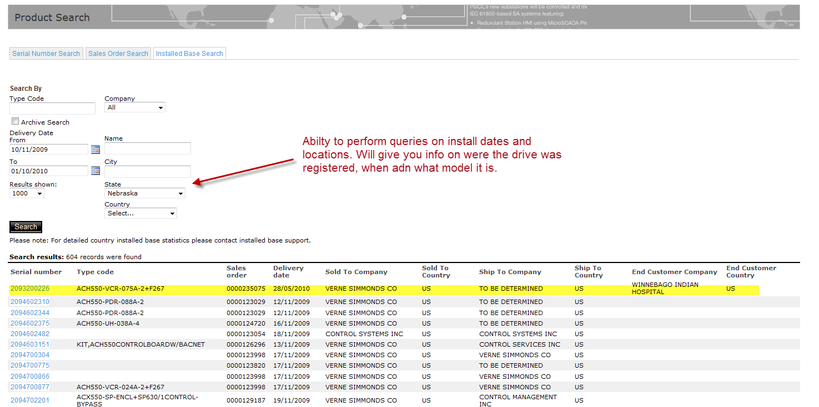
Product Search Queries

Slide 70
StartUp Registration – Paper
Questions ?

Slide 71

ACH550 Installation & Wiring
US1011p_ACH550InstWiring-F_D, December, 2010
Notes:
Welcome to the „ACH550 Installation & Wiring“ module. In this module, we will look at the standard requirements for power and control wiring the ACH550 drive. Also included is the E-Clipse Bypass unit and communications control – both embedded fieldbus and fieldbus adapters. For further details on hardware, control or power wiring, consult the “ACH550 User Manual.”

Slide 72
Objectives
After completing this module, you will be able to
List the main steps of the installation
Describe different installation methods
Read and explain power and control cable connection diagrams
Describe the right methods for grounding the cables
Perform the insulation resistance measurement for the motor cable
Use the installation checklist
Find technical data for fuse and cable ratings
Notes:
Review the main points presented in this module.

Slide 73
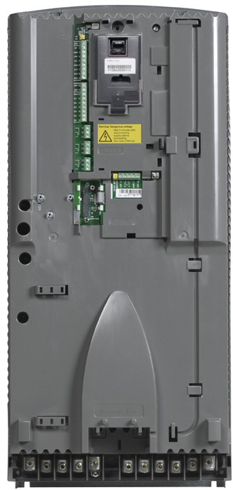
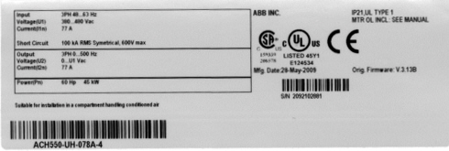
Drive Identification
To determine the type of drive you are installing, refer to:
Serial number label attached on upper part of the chokeplate between the mounting holes
Type code label attached on the heat sink – on the right side of the unit cover (Note: On an E-Clipse drive, find the nameplate of the entire unit, not “Base Drive”)
Base Drive serial number and Catalog number are listed on a sticker under the keypad
Notes:
Review the main points of this slide and emphasize the type code location of an E-Clipse drive. (Ensure that the catalog # and Serial Number are for the entire E-Clipse unit not just the base drive.). Note the location of the drive ID under the keypad location.

Slide 74
Drive/Motor Compatibility
The motor, drive, and supply power must be compatible
Ratings and Frame Size - Lists technical specifications, and identifies the drive’s frame size – significant, since some instructions vary depending on the drive’s frame size.
Notes:
It is always a good practice to ensure the motor, drive and supply are compatible. Meaning the supply drive and motor are all rated for example @ 480Volt.
This section of the type code identifies the drive frame size. This is especially important when referencing installation instructions as they vary based on the drive frame size.
A complete list can be found in the drive user manual

Slide 75
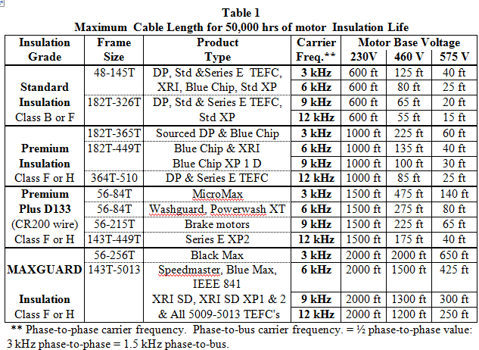
Drive/Motor Compatibility
The motor should be of voltage insulation strength to comply with MG1-Part 31 standards, or use a DV/DT Filter
The table below indicates suggested motor cable distances
Notes:
Note the indication of MG1-Part 31 reference. Check the User manual in the “Motor Connections” section (back of the manual).
NEMA MG1-Part 31 indicates: 3.1 X Nameplate Volts = 1426Volts (@ 460V). Consult the motor manufacturer for specific motor type and specs – if it can be used connected to a VFD without filtering.
If cable distance is longer than what is indicated, a DV/DT output filter is recommended to protect the motor from possible peak voltage spikes.

Slide 76
Bearing Currents
Rotor charge builds up until it exceeds the insulation level of the bearing’s oil film .
Oil film is 1 micron thick: Cannot support much voltage; (3 - 4 Volts)
The stored energy produces an arc as the rotor voltage collapses
It arcs from the inner race through the rolling elements to the outer race, then to ground.
Current flow is concentrated in a pinpoint-sized area where the ball meets the races.
Such high energy concentration melts the bearing metal, creating microscopic pits.
Notes:
Note the indication of MG1-Part 31 reference. Check the User manual in the “Motor Connections” section (back of the manual).
NEMA MG1-Part 31 indicates: 3.1 X Nameplate Volts = 1426Volts (@ 460V). Consult the motor manufacturer for specific motor type and specs – if it can be used connected to a VFD without filtering.
If cable distance is longer than what is indicated, a DV/DT output filter is recommended to protect the motor from possible peak voltage spikes.

Slide 77
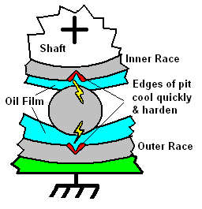
Bearing Currents
Adjacent bearing mass cools the blast area quickly
Edges of pit become brittle & hardened
Metal behind the pit edge cools slower
Becomes annealed & softened

Slide 78
Bearing Currents
Switch open: Oil insulates, voltage builds up
Switch closed: Oil breaks down & arc occurs
Very difficult to predict when these switches will open or close
Bearing impedance changes with load, speed, & wear of races & balls
At low speeds (~ 150 RPM) oil film is very thin or non-existent: switches remain closed
Current will flow through bearing with out arcing

Slide 79
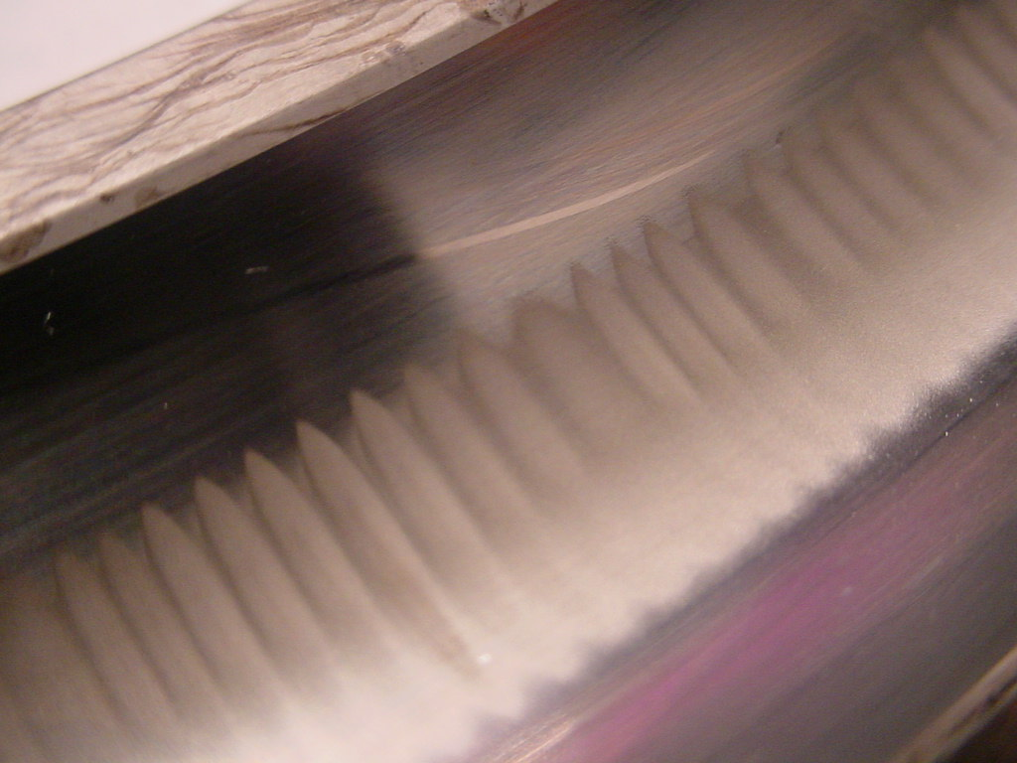
Fluting
Steady-state operation creates this pattern

Slide 80
Prevention
Proper motor cabling should provide a significantly lower impedance, ground return path for high frequency; through direct paths rather than through indirect paths.

Slide 81
Insulated and Ceramic Bearing
They will block ~ 90-98% of currents, but will still pass high frequency (2 MHz) capacitive currents
Very expensive
Standard 6218 ball bearing =~$35
Insulated-race 6218 ball bearing = ~$550
Ceramic ball 6218 bearing = ~$1200 ea.
In ‘Machine tool OEM market’ volume, standard 6203 = ~ $0.75
Ceramic ball 6203 = ~$10 in same market

Slide 82
Prevention Methods
Reduce / cancel the common mode voltage at the source
Output Filter (Output Reactor, ΔV/ΔT filter, sine filter)
Costly, especially when installed in VFD enclosure
They reduce CM voltage by sloping the rise time of the individual phase voltages.
Use of just a reactor can make problem worse by changing tuning of output circuit.

Slide 83
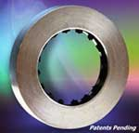
Aegis Grounding Ring
Shaft Grounding Ring:
Installs easily on drive end or opposite drive end
100,000 plus micro fibers make contact on shaft and provide a pathway to ground
Guaranteed for Life of the Motor
No Maintenance Required

Slide 84
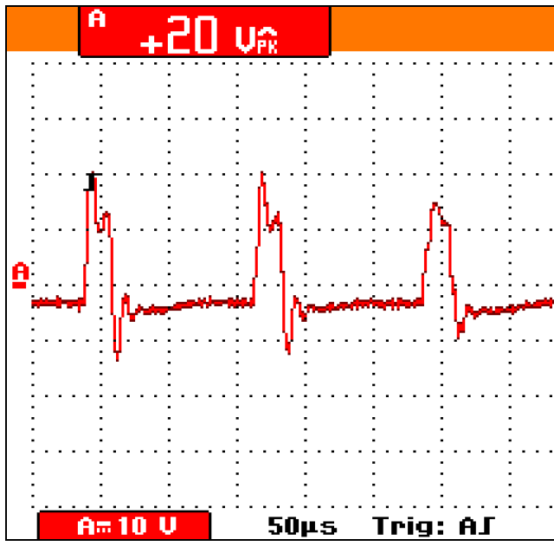
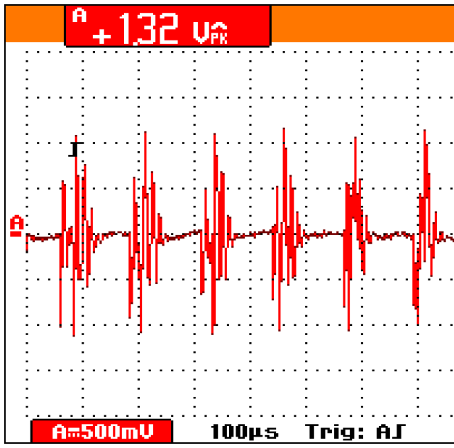
Scope Measurements with Ring Installed
20 Volt Peak:
Shaft to GND
1.32 Volt Peak:
Shaft to GND

Slide 85
Motor Cable Length - Recommendations
The distance between the motor and the drive is limited by the maximum motor cable length. See "Motor Connection Specifications,” back of the User Manual
Notes:
The maximum motor cable length is listed here, and in the “Motor Connections” section of the User Manual (back of the book). Capacitive Coupling can occur in motor cable distances longer than that indicated. This can cause erroneous drive overcurrent trips as well as possible drive damage.

Slide 86
Drive (Output) Disconnects / Power Factor Capacitors
Output Disconnect allows a technician to service HVAC equipment
Confirm that the Output Disconnect is correctly wired to the VFD Run Enable circuit (drive shuts down when motor disconnect is open)
Verify that no Power Factor Correction Capacitors are located between the drive and motor
Upstream Circuit Breaker
VFD
VFD Run Enable (P1601)
Late Make/Early Break Aux Contact
Motor Disconnect
Motor
Notes:
Output disconnects are typical in HVAC installations. Stress that an Auxiliary Contact must be connected to the disconnect and that this contact is an “Late Make / Early Break” type. (the contactor opens after a pre-determined time, after the Auxiliary Contact opens causing the drive Enable circuit to be disabled).
Power Factor Correction Capacitors must be removed if installed between the drive and motor. These can cause immediate overcurrent trips and possible drive damage. There is no reason for PF Capacitors upstream from the drive, as the drive is inherently a power factor correction device.

Slide 87
Suitable environment & enclosure
Confirm that the site meets the environmental requirements.
No dripping water (liquid)
Proper clearances around the drive per manual
Follow the guidelines in the User Manual
IP 21 / UL type 1 enclosure: The site must be clean and have minimal to no airborne dust, corrosive gases or liquids, and conductive contaminants
IP 54 / UL type 12 enclosure: This enclosure provide a degree of protection from airborne dust, falling dirt and dripping non-corrosive liquids
UL type 3R enclosure:
Notes:
In order to prevent damage to drive & equipment, confirm that the environment meets the following conditions.
Confirm that the enclosure is appropriate, based on the site contamination level - - and review the IP and UL classifications and what protection is intended for each class.

Slide 88
Suitable mounting location
Confirm that the mounting location meets the following constraints:
The drive must be mounted vertically on a smooth, solid surface, and in a suitable environment as defined in the suitable environment and enclosure section.
The floor or wall location must be strong enough to support the weight of the unit and made of a non-flammable material
The minimum space requirements for the drive are the outside dimensions (see "Outside Dimensions"), plus air flow space around the unit (see "Cooling").
Cooling (adequate ventilation)
Standard temperature rating is 32 – 104ºF (0 – 40ºC)
Temperature de-rating is 1% Amps for every 330Ft above 3300 Ft ASL
Notes:
Review mounting location requirements.
Indicate the temperature de-rating factor indicated. Also point out that drives should be de-rated based on altitude and switch frequency. Refer to the “Technical Data” section of the User manual (back of the book).

Slide 89
Drive Input Protection Devices
An input disconnect device must be installed between AC input power and the VFD
It is best practice for all VFDs to be installed with input fuse protection (strongly recommended for VFDs 75HP and above)
Fast-acting fuses provide rapid protection compared to circuit breakers (limits collateral damage due to a: ground fault, output short, or DC Bus short)
Consult “Input Power Connections” section of User Manual
Notes:
Emphasize that ABB recommends fuses ahead of the drive in all installations. Presently, the ACH550 User Manual does not indicate a “strong encouragement” related to using fuses. Point out that fuses are faster than circuit breakers (even the newest circuit breaker versions are up to 5 times slower to react in an over current condition). Refer students to the reasons for using fuses (limits collateral damage due to a: ground fault, output short, or DC Bus short). There currently is no set policy for all ABB drives, regarding fusing, and in some cases, warranty claims have been rejected due to lack of fuse protection.
Some form of protection ahead of the drive is required (fuses or circuit breaker) – but the preferred method is fusing. A “certified start-up” must have some sort of protection installed – period.

Slide 90

Control cables General recommendations
Note! Never mix 24 VDC and 115/230 VAC signals in the same cable.
Use multi-core cables with a braided copper wire screen, temperature rated at 60 °C (140 °F) or above:
At the drive end, twist the screen together into a bundle not longer than five times its width and connected to terminal X1-1 (for digital and analog I/O cables) or to either X1-28 or X1-32 (for RS485 cables).
Route control cables to minimize radiation to the cable:
Route as far away as possible from the input power cables, motor cables and the sides of the drive (at least 20 cm (8 in)).
Where control cables must cross power cables make sure they are at an angle as near 90° as possible.
Use care in mixing signal types on the same cable:
Do not mix analog or digital signals with 120V control wiring, input power cables or motor power cables.
Run relay-controlled signals as twisted pairs (especially if voltage > 48 V). Relay-controlled signals using less than 48 V can be run in the same cables as digital input signals.
Notes:
Emphasize:
Route as far away as possible from the input power and motor cables (at least 20 cm (8 in)).
Where control cables must cross power cables make sure they are at an angle as near 90° as possible.
Stay at least 20 cm (8 in) from the sides of the drive.
Do not mix analog and digital input signals on the same cable.
Run relay-controlled signals as twisted pairs (especially if voltage > 48 V). Relay-controlled signals using less than 48 V can be run in the same cables as digital input signals.
Note! Never mix 24 VDC and 115/230 VAC signals in the same cable. Emphasize this.

Slide 91
Control cables
Analog Cables
Recommendations for analog signal runs:
Use shielded, twisted pair cable
Use one individually shielded pair for each signal
Do not use a common return for different analog signals
Digital Cables
Recommendations for digital signal runs:
A double shielded cable is the best alternative, but single-shielded, twisted, multi-pair cable is also usable
Control Panel Cable
If the control panel is connected to the drive with a cable, use only Category 5 Patch ethernet cable
Notes:
Analog Cables – follow the recommendations listed
Digital Cables – follow the recommendations listed. Recommendations for digital signal runs: A double shielded cable is the best alternative, but single-shielded, twisted, multi-pair cable is also usable.
Control Panel Cable – if a cable is purchased from a source other than ABB, a shielded cable is recommended – straight-through, in-line Cat 5 cable.

Slide 92
Control cables
Drive’s Control Connection Terminals
The following table provides specifications for the drive’s control terminals
Serial Communications
Terminals 28…32 provide RS485 serial communication connections used to control or monitor the drive from a fieldbus controller. (This topic will be covered in greater detail later in this module)
Notes:
Drive’s Control Connection Terminals – review the table indicated
Serial Communications can be separate from standard “hard-wired” control connections or in conjunction with “hard-wired” control. (e.g. use serial communications for monitoring of signals, fault reset, etc. but use digital inputs for hard-wired safeties, start/stop, analog speed reference, etc.)

Slide 93
Power and control wiring
Open the appropriate knockouts in the conduit box
Install thin-wall conduit clamps (not supplied)
Install conduit box
Connect conduit runs for input power, motor and control cables to the box
Route input power and motor wiring through separate conduits
Strip wires
Connect power, motor, and ground wires to the drive terminals
Notes:
Review this “step-by-step procedure for wiring.
Emphasize again the separation of input, output power and control wiring.

Slide 94
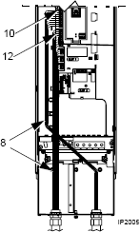
Power and control wiring
Route the control cables through the conduit (not the same conduit as either input power or motor wiring).
Use available secure points and tie strap landings to permanently secure control wiring at a minimum distance of ¼” from power wiring.
Strip the control cable sheathing and twist the copper screen into a pig-tail.
Connect the ground screen pig-tail for digital and analog I/O cables at X1-1. (Ground only at drive end.)
Wire tie together the RS-485 in and out shield (screen) conductors (Do not ground at the drive terminal block)
Strip and connect the individual control wires to the drive terminals.
Install the conduit box cover (1 screw).
Notes:
Pay particular attention to where the control cables are located (not in power conduit or near power wiring – using secure tie wrap points as a “control wiring cable trough”
Emphasize that the shield needs to be grounded at one end only (to prevent circulating currents or ground loops). In most cases, ground at the drive “SCR” connection point, and not at the signal source (cut back the screen and electrical tape to prevent contact with the metal conduit). If the controller manufacturer requires grounding of the shield at the controller end, then do not ground at the drive end also.
Do not ground the RS-485 conductor shields at the RS-485 terminal block – wire-tie together and leave hanging in the terminal block area (avoid any contact with the grounded drive chassis)
Note: For UL Compliance, Low Voltage and Communication Wiring must be attached to wire guides.

Slide 95
Input Configurations
You can wire the digital input terminals in either a PNP or NPN configuration
Input Selection type
Notes:
Digital inputs can be configured as a sinking or sourcing configuration based upon the selection of the grounding jumper location.

Slide 96
Analog Inputs/Outputs
Notes:
This slide indicates the configuration ability of your Analog inputs & outputs. The jumper J1 setting will determine if you are in a voltage or current mode configuration for your analog inputs.

Slide 97
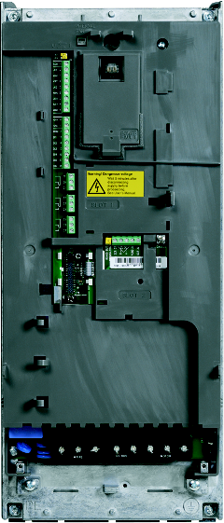
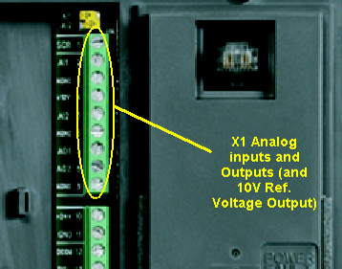
Analog Inputs/Outputs R1-R6
Notes:
This is the physical location of Analog inputs & outputs for an R1-R4 drive.

Slide 98
Digital Inputs
Notes:
This slide indicates the configuration ability of your digital inputs. The jumper placement within terminals 10, 11 & 12 will determine if these inputs are a sinking or sourcing input.

Slide 99
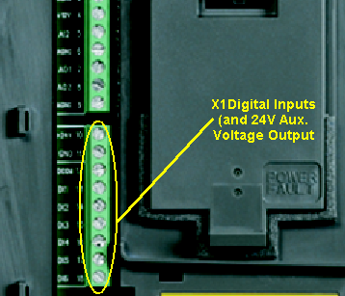
Digital Inputs R1-R6
Digital input impedance 1.5 kΩ. Maximum voltage for digital inputs is 30 V.
Notes:
This is the physical location of digital inputs for an R1-R6 drive.
Note that the DI indications on this slide are meant for an example. (Safety Interlock on DI4 can be used for safeties, or vibration or overpressure switch or all of these components - wired in series to DI4). Typically, DI2, Run Enable, is wired to the Damper End Switch, with the appropriate programming assignment to DI2.

Slide 100
Relays Outputs
Max. contact voltage: 30 V DC, 250 V AC
Max. contact current / power: 6 A, 30 V DC; 1500 VA, 250 V AC
Max. continuous current: 2 A rms (cos ϕ = 1), 1 A rms (cos ϕ = 0.4)
Minimum load: 500 mW (12 V, 10 mA)
Contact material: Silver-nickel (AgN)
Isolation between relay digital outputs, test voltage: 2.5 kV rms, 1 minute
Notes:
Review the ratings stated on the slide – emphasize the maximum contact rating of the relays and state that if these ratings are exceeded, the contacts cannot be replaced (sealed relay units – the Control Board will need to be replaced)

Slide 101
Relays Outputs
Notes:
This slide indicates the configuration of your programmable relay outputs.

Slide 102
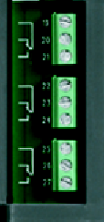
Relays Outputs R1-R6
Digital input impedance 1.5 kΩ. Maximum voltage for digital inputs is 30 V
Notes:
This is the physical location of relay outputs for an R1-R4 drive. Note that the relay designations are programmable (what is listed is a default value. E.g. Ready, Running or Fault -1).

Slide 103
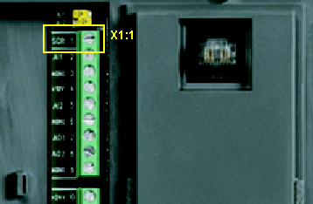
Control Cables I/O Screen
At the drive end, twist the screen together into a bundle not longer than five times its width and connected to terminal X1-1 (for digital and analog I/O cables)
Notes:
This is the physical location of the control cable screen wire (at the SCR terminal – indication for “screened” wire or shield).

Slide 104
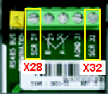
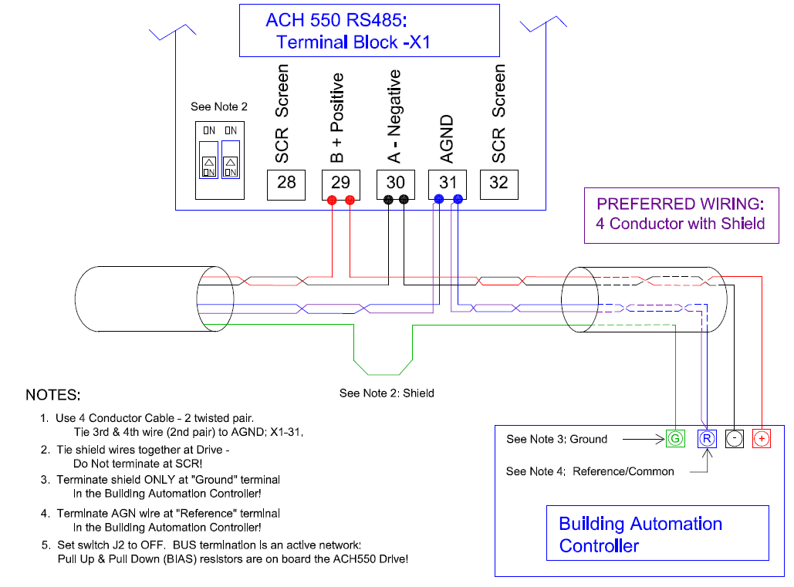
Control Cables Screen RS-485 – Embedded Fieldbus (EFB)
At the drive end, twist the screen together into a bundle not longer than five times its width and connect together
Recommended wire types:
Belden dual twisted shielded pair #9842
Lo-Capacitance Communications cable: P/N 04210029-S or WCW-22/3BLU-WC-S Available from: Windy City Wire, Cable & Technology Products, LLC
Communications Cable, P/N W223C-2560 Available from: Connect-Air International, Inc.
Do not use, Set to OFF
Note: Cable is (2) twisted pair. Tie 3rd/4th wire to “AGND”
From Building Automation Controller (N2, FLN, BacNet)
Notes:
This is the physical location of the control cable screen wire for an RS485 connection. The communications controller ground and shield connections are used, instead of the on-board drive shield connection. Interference is caused when the drive shield connection (SCR, X28 and X32) is used in an external Building Automation Controller system. The Termination DIP switch is left in the OFF position, because the ACH550 has “active termination (bias, pull-up & pull-down resistors).
Emphasize the recommended control (communications) cable types. Also indicate that a 3-wire scheme is preferred.
Note: 3-conductor communication wire is available (e.g. Windy City Wire, Cable & Technology Products #WCW-22/3BLU-WC-S referenced in the slide). This eliminates the need to tie the 3rd and 4th wire together as indicated on the slide.

Slide 105
Overview wiring - power
As you install the wiring, observe the following:
There are two sets of wiring instructions – one set for each enclosure type IP21 / UL type 1 (NEMA 1) and IP54 / UL type 12 (NEMA 12). Be sure to select the appropriate procedure.
Use separate conduit runs to keep these three classes of wiring apart:
Input power wiring.
Motor wiring.
Control/communications wiring.
No PVC Conduit
Notes:
Note that there are (2) sets of wiring instructions – one for UL Type 1 and one for UL Type 12
Again emphasized the separation of control and power wiring.

Slide 106
Cable Connections
Wiring IP21 / NEMA 1 drives requires a conduit or gland kit, these are included with the drive.
When installing a NEMA 1 drive in another enclosure the conduit or gland kit is typically not required
Instructions in the manual
For different enclosures and wiring types (conduit or cable)
Connecting the power, control and motor cables
Notes:
Review - Wiring drives with the IP 21 enclosure requires a conduit or gland kit.
If the drive is mounted in an enclosure, a conduit or gland kit is not required, but separation of power and control wiring is still required (e.g. 8” separation of control and power wiring minimum, if placed in a plastic raceway or wire way

Slide 107

Cable connections
The drive must be disconnected from the input power during installation. If the drive is already connected to the input power, disconnect the input power and wait for 5 min.
Floating network: Disconnect RFI filter
Prepare and install the Conduit/Gland box
Connect the supply cable
Check the insulation resistance level of motor and motor cable
Connect the motor cable
Connect the analogue and digital control cables
Make the control cable connection according to your planned macro
Notes:
Note - - -Warning – the drive has to be disconnected from any input power during wiring process.
Meggering a motor is not “required” for a certified start-up. (drive technology is rapid enough to catch any short circuit in output cabling or motor windings). However, many technicians still recommend checking insulation levels as a precautionary procedure.

Slide 108
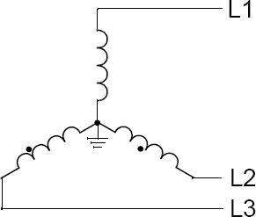
Network Identification
Take a measurement from
Phase A (L1) to Ground
Phase B (L2) to Ground
Phase C (L3) to Ground
If measurement is within 2-3% (~10Vac) of each other the power network is a grounded WYE network.
This is the most common network in North America.
It is a good practice to install the RFI/EMC filter on critical applications (e.g. Hospitals) Note: Insert EMC grounding screws only if installed on a grounded system.
Should any phase to ground measure near zero it is a corner grounded Delta network. You should verify that the EMC filter screws are removed.
Notes:
Prior to connecting supply power you must first identify the type of network the drive is being installed on. To accomplish this take a voltage measurement across the three supply phases to ground. Comparing the phase voltages to each other typically you will find the voltages to be within 10 volts of each other on a 480volt supply. This would indicate that the supply configuration is a grounded WYE. The most common configuration in North America. In this case it is a recommended practice to install the EMC filter.
If any phase is at or near 0 Volts the network is a corner ground Delta in this case the EM3 screw must be removed. The drives are shipped with this screw removed. Verify that the screw is removed.
If the measurements are not closely balanced (within 10 volts for a 480V supply). The network is likely a floating network. It may be difficult to determine if this is a Delta or a WYE network. Regardless of the network configuration, if the line voltages are not balanced DO NOT INSTALL THE EMC FILTER.
It is always good practice to install the RFI/EMC filter in critical applications such are hospitals or airports, but ONLY if the drive is connected to a grounded power network

Slide 109
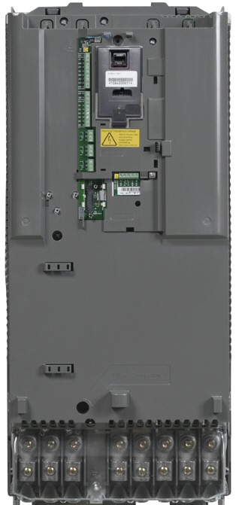
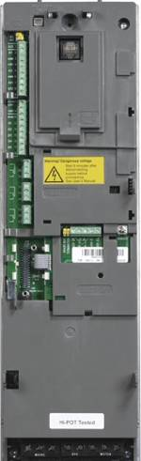
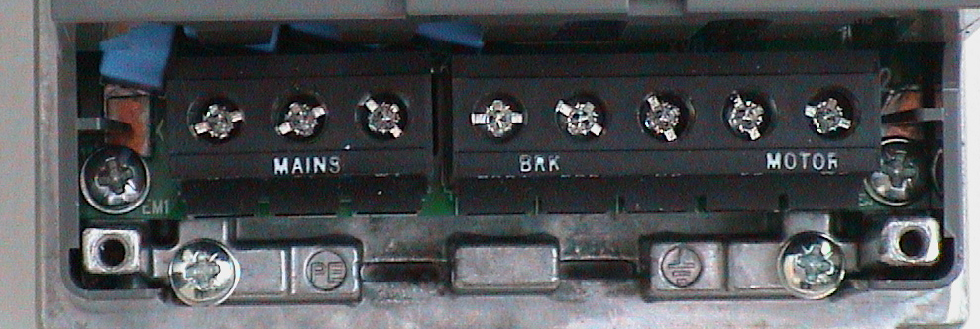
RFI filter
Warning!
Do not attempt to install or remove EM1, EM3, F1 or F2 screws while power is applied
For floating networks disconnect internal RFI filter (default configuration)
EM1/EM3 on frame size R1-R4 (insert plastic screws in place of metal)
F1/F2 on frame size R5-R6 (remove metal screws and replace with plastic)
Plastic screws are the default for all ACH550 drives (always confirm)
R1…R4
R5
F2
R6
F1
F1
F2
EM1
EM3
Notes:
For floating networks, also known as IT, ungrounded, or impedance/resistance grounded networks:
Verify that the ground screw is disconnected to the internal RFI filters:
For frame sizes R1 to R4: Remove both the EM1 and EM3 screws.
For frame sizes R5 to R6: Remove screws at F1 and F2.

Slide 110
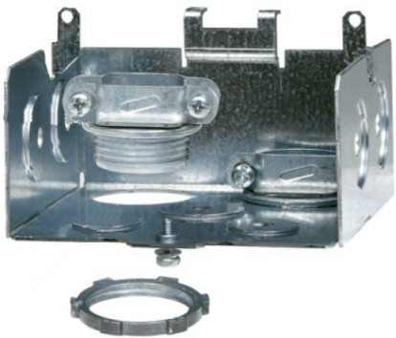
Preparation of Gland box and clamps IP21/UL Type 1 (NEMA 1)
Open the appropriate knockouts in the gland box
Install the cable clamps for the cables
Install the gland box to the drive and tighten the cable clamps
2
1
The gland box with two power cable and two control cable clamps
Notes:
Review the gland box and clamping procedures. Note that gland boxes are standard with various size knockouts.

Slide 111
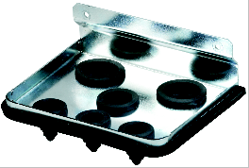

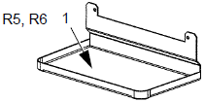
Preparation of Gland box and clamps IP54/UL Type 12 (NEMA 12)
Frame Sizes R1…R4: Remove and discard the cable seals where conduit will be installed. (The cable seals are cone-shaped, rubber seals on the bottom of the drive.)
Frame Sizes R5 and R6: Use punch to create holes for conduit connections as needed. Install the cable clamps for the cables
For each conduit run (input power, motor and control wiring must be separate), install water tight conduit connectors (not supplied).
The gland box with two power cable and two control cable clamps
Notes:
Review procedures to prepare a gland box,
Remove the appropriate seal glands, punch or drill the appropriate knockouts. This step will be dependant upon the drive you are installing
Then, install the water tight conduit connectors & cable clamps for the cables.
Finally, fix the gland box to the drive, but do not fasten it with screws.

Slide 112
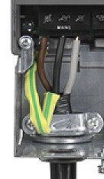

Supply cable connection
D
3
< 5xD
1
2
Cable pictures courtesy of Draka NK Cables Oy
Strip the cable. If a screened cable is used, twist the screen into a pigtail.
Route cable through the clamp
Connect the supply wires and the ground wire to the drive terminals
Notes:
To connect the supply cable, follow the steps indicated
Strip the shield as indicated in preparation for connection to the ground connection (shielded input power cable)

Slide 113

Motor cable connection
D
3
< 5xD
1
2
Cable pictures courtesy of Draka NK Cables Oy
Symmetrical 3-conductor cable with a concentric PE conductor (or a 4-conductor cable with a concentric shield) is recommended for best installation
Dedicated conduit with secure grounding and a dedicated ground cable from the drive to motor is also acceptible
Strip the sheathing and twist the screen into a pig-tail.
Route the cable through the clamp.
Connect the wires to the terminals
Notes:
For EMC compliance, the motor cable connections, the motor cable must be a symmetrical three conductor cable with a concentric PE conductor or a four conductor cable with a concentric shield. However, a symmetrical constructed PE conductor is always recommended.
On the motor cable, strip the sheathing back far enough to expose the copper wire screen so that the screen can be twisted into a pig-tail. Keep the pig-tail short to minimize noise radiation.
Route the cable through the clamp.
Connect the phase wires and the ground wire to the drive terminals. Then, connect the pigtail created from the motor cable screen to the ground.
You can ground the cable by twisting the shield so that the length of the shield is less than 5 times the diameter, or, another option is to ground the cable shield 360 degrees at the lead-through of the motor terminal box.
Use a separate grounding cable if the conductivity of the cable shield is insufficient (smaller than the conductivity of the phase conductor) and there is no symmetrically constructed grounding conductor in the cable.
Before proceeding, fasten the Gland box and clamps.

Slide 114


Installing Options
Install the module(s) to the correct slot(s)
Slot 1 : Relay Output Extension
Slot 2: Fieldbus Adapter
Tighten the connection with a locking screw
Connect the control cables to the option module according to its manual.
Slot 1
Slot 2
An installed Fieldbus adapter
Notes:
To install options:
First, place the modules in the correct slots. The Relay Output Extension is placed into slot 1, and the Fieldbus Adapter into slot 2.
After placing the option, tighten the connection with a locking screw.
Next, connect the control cables to the module with the guidance of the manual. The required manual can be found in the HVAC InfoGuide CD-ROM.

Slide 115
Installation Checklist
Installation environment conforms to the drive’s specifications for ambient conditions.
No dripping water
Correct ambient temperature
The drive is mounted securely.
Space around the drive meets the drive’s specifications for cooling (Adequate ventilation).
The motor and driven equipment are ready for start.
For floating networks: The internal RFI filter is disconnected (screws EM1 & EM3 or F1 & F2).
The drive is properly grounded.
The input power (mains) voltage matches the drive nominal input voltage.
The input power (mains) connections at U1, V1, and W1 are connected and tightened as specified.
The input power (mains) fuses and the mains switch are installed.
The motor connections at U2, V2, and W2 are connected and tightened as specified.
The input power, motor and control wiring are through separate conduit runs.
NO power factor compensation capacitors are in the motor cable.
NO tools or foreign objects (such as drill shavings) are inside the drive.
NO alternate power source for the motor is connected and no voltage is applied to the output of the drive.
Notes:
Before applying power, perform the following checks. Check the mechanical and electrical installation of the drive before start-up. Go through the checklist here or in the User’s Manual together with another person.

Slide 116

Applying Power
The ACH550 will start up automatically at power-up if the external run command is on.
Before increasing the motor speed, check that the motor is running in the desired direction.
Always re-install the front cover before turning power on
Apply input power
When power is applied to the ACH550, the green LED is lit
Notes:
Always re-install the front cover before turning the power on.
Once the the front cover is attached, apply input power to the drive. Once power is applied to the ACH550, the green LED is lit.
Note, that the ACH550 will start up automatically at power-up if the external run command is on.
Also, before increasing the motor speed, check that the motor is running in the desired direction.

Slide 117

Vertical E-Clipse Bypass V1/V2, V3/V4
ACH550 Vertical E-Clipse Bypass units are configured for wiring access from the bottom only.
The figure shows the Vertical E-Clipse Bypass major components.
Control connections are made at the “E-Clipse Bypass Control Unit” (exception is Analog signals).
ACH550 drive
E-Clipse Bypass Control
Service Switch (Optional)
Disconnect Switch
Input Power Terminals
Notes:
In this section we will discuss the ACH550 being used installed with the E-Clipse bypass.
There are 4 models of the vertical bypass designated as V1, V2, V3, V4 essentially based on size.
As you can see from the pictures here they are configured and very similar in configuration.
These units are designed to be configured for wiring access from the bottom only.
Note that all safeties, control wiring, relay outputs are all connected to the “E-Clipse Bypass Control” unit - - - not to the “base drive.”
The Bypass Control Unit acts as a “go-between” – moving signals between the base drive and external world control or communications. (essentially all control goes through the Bypass Control Unit with exception of Analog signals (these are wired directly to the drive AI1 or AI2 terminals).

Slide 118
Control Cables E-Clipse and Base Drive
All Analog signals are wired directly to the Base Drive (AI1 & AI2)
Control connections are made at the “E-Clipse Bypass Control Unit” (RBIO Board)
Start / Stop
Safeties
Relay Outputs
Overrides
Communications

Slide 119

Communication Cables Screen RS-485 – Embedded Fieldbus (EFB)
At the Bypass Control Unit, twist the screen together into a bundle not longer than five times its width and connect together
Recommended wire types:
Belden dual twisted shielded pair #9842
Lo-Capacitance Communications cable: P/N 04210029-S or WCW-22/3BLU-WC-S Available from: Windy City Wire, Cable & Technology Products, LLC
Communications Cable, P/N W223C-2560 Available from: Connect-Air International, Inc.
Do not use Termination DIP SW (Set to OFF)
Bypass Control Unit (RBCU)
Note: Cable is (2) twisted pair. Tie 3rd/4th wire to “AGND”
From Building Automation Controller (N2, FLN, BacNet)
Notes:
This is the physical location of the control cable screen wire for an RS485 connection. The communications controller ground and shield connections are used, instead of the on-board drive shield connection. Interference is caused when the drive shield connection (SCR, X28 and X32) is used in an external Building Automation Controller system. The Termination DIP switch is left in the OFF position, since the drive SCR connection is not used.
Emphasize the recommended control (communications) cable types. Also indicate that a 3-wire scheme is preferred.
Note: 3-conductor communication wire is available (e.g. Windy City Wire, Cable & Technology Products #WCW-22/3BLU-WC-S referenced in the slide). This eliminates the need to tie the 3rd and 4th wire together as indicated on the slide.

Slide 120
Communication Cables Fieldbus Adapters (FBA)
At the Bypass Control Unit, twist the screen together into a bundle not longer than five times its width and connect together
Recommended wire types are similar to any used for embedded fieldbus
Bypass Control Unit (RBCU)
Fieldbus Adapter Connection - FLON (LonWorks)
- FENA (Ethernet)
Notes:
This is the physical location of the Fieldbus Adapter connection.
Emphasize that all communications from a fieldbus adapter is connected to the RBCU - - not directly to the Base Drive, Slot 2. These modules are specifically designed for the E-Clipse Bypass units (and other new generation drive products)
Emphasize the recommended control (communications) cable types are the same as the embedded fieldbus. Also indicate that a 3-wire (actually 4-wire) scheme is preferred (refer to the embedded fieldbus section). As indicated, the 3rd and 4th wire of the two pair twisted cable are tied together.

Slide 121


Vertical E-Clipse Bypass Input power connection V1/V2, V3/V4
Connect the input power to the terminals at the bottom of the disconnect switch or circuit breaker as shown here.
Connect the equipment grounding conductor to the ground lug near the input power connection point.
V3/V4
Disconnect Switch
Input Power Cable Terminals
Input Power
Notes:
The input power should be wired to the terminals at the bottom of the disconnect switch or circuit breaker.
The ground wire is wired to the grounding lug to the left of the disconnect or circuit breakers.

Slide 122
Vertical E-Clipse Bypass Motor connection V1/V2, V3/V4
Connect the motor cables to the terminals at the bottom of the bypass section as shown in the figure here.
Connect the motor grounding conductor to the ground lug near the motor cable terminal block connection point.
Notes:
Connect the motor cables to the terminals at the bottom of the bypass section as shown in the figure here.
Connect the motor grounding conductor to the ground lug near the motor cable terminal block connection point

Slide 123
Standard E-Clipse Bypass (wall mounted) B1 (Component Locations)
ACH550 Standard E-Clipse Bypass units are configured for wiring access from the top.
The figure shows the Standard E-Clipse Bypass (wall mounted) wiring connection points.
Control connections are the same as previously explained.
Notes:
The ACH550 Standard E-Clipse Bypass units are configured for wiring access from the top.
The following figure shows the Standard E-Clipse Bypass (wall mounted) wiring connection points.
Control connections are the same as previously explained.

Slide 124

Standard E-Clipse Bypass (wall mounted) B2 (Component Locations)
ACH550 Standard E-Clipse Bypass units are configured for wiring access from the top.
The figure shows the Standard E-Clipse Bypass (wall mounted) wiring connection points.
Control connections are the same as previously explained.
User Power Cable Guides
E-Clipse Bypass Control
Input Ground Lug
Disconnect Switch
Input Power Terminals
Motor Terminals
Output Ground Lug
Notes:
Likewise the B2 configuration is also configured for wiring from the top as was done with the B1 unit
In this picture please notice the power cable guides for supporting the power wiring

Slide 125
Standard E-Clipse Bypass (wall mounted) B3 (Component Locations)
ACH550 Standard E-Clipse Bypass units are configured for wiring access from the top.
The figure shows the Standard E-Clipse Bypass (wall mounted) wiring connection points.
Control connections are the same as previously explained.
Notes:
This is an example drawing of the B3 configuration (wiring is the same as the B2)

Slide 126
Standard E-Clipse Bypass (wall mounted) Input connection B1/B2/B3 (wire routing)
Connect input power to the terminals of the disconnect switch or circuit breaker.
Connect the equipment grounding conductor to the ground lug at the top of the enclosure.
The figure here shows the connection points for Standard E-Clipse Bypass configurations.
Notes:
In these drawings you can see the routing for the power connections regarding a B1 – B3 configuration

Slide 127


Standard E-Clipse Bypass (wall mounted) Motor connection B1/B2/B3 (wire routing)
Connect the motor cables to the output terminal block as shown in the figure here.
The motor grounding conductor can be connected to the ground lug near the terminal block.
Note! Route cables through the cable guides on the left side of the enclosure. Use separate conduits for input power and motor cables. Follow the guides to separate the cables from each other.
Notes:
In this diagram you can see the routing and connection points for the motor connections of a B1 – B3 configuration

Slide 128
Standard E-Clipse Bypass (floor mounted) B4
Ground Lug Bar
Power Module
ACH550 Standard E-Clipse Bypass units are configured for wiring access from the top.
The figure shows the Standard E-Clipse Bypass (floor mounted) wiring connection points.
Control connections are the same as previously explained.
Motor Terminals
Input Power Terminals
E-Clipse Bypass control
Input Disconnect
Service Switch (optional)
ACH550 control board
Notes:
Lastly we have the drawings illustrating the connection for a B4 unit. The B4 unit is a floor standing unit.
The wiring connections within this unit are designed for top entry and exit.

Slide 129
Commissioning the ACH550
US1024p_ACH550Commision_E, December, 2010
Notes:
Welcome to the Commissioning training for the ACH550 ABB Standard Drives designed for HVAC applications.

Slide 130
Objectives
After completing this module, you will be able to
List product specific safety issues
Show how to startup the product in a basic application using parameters with the HVAC Control panel, DriveWindow Light and FlashDrop tool
Make backups of the system settings
Notes:
After completing this module, you will be able to
list product specific safety issues,
show how to startup the product in a basic application using parameters with the HVAC Control panel, DriveWindow Light and FlashDrop tool, and
make backups of the system.

Slide 131
Prerequisites
Before taking this module
You should have completed the following modules:
LV Drive Safety
ESD Awareness
ACH550 Product Overview
ACH550 Installation & wiring
Notes:
This module is designed for people who have already completed the listed training modules. Indicate that these modules are “on-line” and can be viewed again at any time.
LV Drive Safety
ESD Awareness
ACH550 Product Overview
ACH550 Installation & wiring

Slide 132

Drive Parameters
Open the ACH550 User Manual (3AUA0000081823)
Section 1-67 Parameters Red Tab
Notes:
All VFDs need a certain amount of information to effectively match the drive diagnostics and operation to the motor that’s connected. This is done through a unique parameter group called “Start-up Data.” In all ABB drives, Group 99 is called Start-up Data, and requires the same information, no matter what the product type or HP.
In addition to motor information, Start-up Data also includes a parameter called a “macro.” (this is parameter 9902)
As seen in this picture, the ACH550 contains a variety of macros to match any HVAC application. A macro is simply a pre-determined set of parameter values – it’s like a computer program that contains all the information to effectively run the system. An “Application Macro” sets all the parameter values to a default setting that closely matches the need of an application. For example “Hand” control or Supply Fan or PID Control.
In addition to the standard macros, the drive contains two blank locations of memory that is “User Defined.” These are macros User 1 and User 2, and allow the user to save two customized macros or two back-up programs. In HVAC, the user can conveniently set-up a “Summer” and “Winter” mode of operation.
One point to note. There are not 9 thousand, 9 hundred and 9 parameters in this drive. The parameter number is read: Group 99, parameter 9. The first two digits always indicate the group # and the last two digits indicate the parameter number

Slide 133

Safety
The start-up may only be carried out by a qualified electrician.
The safety instructions given in the Safety chapter of the User’s Manual must be followed during the start-up procedure.
Even when the motor is stopped, dangerous voltage is present at the Power Circuit terminals. After disconnecting the supply wait at least 5 min. measure AC input and DC bus voltages before working on equipment.
Always follow safe lock-out procedures
Check the installation. See the checklist in chapter Installation checklist.
Check that the starting of the motor does not cause any danger.
De-couple the driven machine if there is a risk of damage in case of incorrect direction of rotation.
Notes:
Review the safety precautions listed here. Emphasize that even when a motor is stopped, dangerous voltage is present at the power circuit terminals.
Review Lock-out / Tag-out.

Slide 134

Check the Start-up Parameters
Before start-up, check:
Motor data
Motor nominal voltage
Motor nom. Current
Motor nom. Frequency
Motor nom. Speed
Motor nom. Power
Application data
The most suitable Application Macro
Speed or frequency limits
Acceleration and Deceleration times
Notes:
Before any start-up operations, check the motor and application data:
Motor Data
The motor data on the ratings plate may differ from the defaults in the ACH550.
The drive provides more precise control and better thermal protection if you use the motor rating plate data.
Application data
Use the Application macro that best fits the system needs and control circuit diagram.
Review the macro descriptions in the User’s Manual chapter "Application Macros and wiring“
Gather the application data like Speed or frequency limits, acceleration times and so on.

Slide 135



Set the Start-up Parameters
Set the start-up parameters with alternatives:
Start-up Assistant in the HVAC Control Panel
Manually in the HVAC Control Panel
PC with installed DriveWindow Light tool
Notes:
There are three recommended ways to set the drive start-up parameters. Indicate the benefits of each way.
(1) By using the Start-up Assistant in the HVAC Control Panel.
(2) By setting start-up parameters manually in the HVAC Control Panel (3) With the DriveWindow Light and/or it’s Wizards

Slide 136


Start-up Assistant
Upon first power-up, verify the display is activated
Use the Start-up Assistant to configure the drive. With the HVAC Control Panel, the Start-up Assistant runs automatically at the first power-up Activate the Assistant manually if required)
OFF
MAIN MENU
2
OFF
ASSISTANTS
2
PARAMETERS
Spin the motor
OFF
PAR EDIT
ASSISTANTS
Commission drive
9905 MOTOR NOM VOLT
Application
220 V
CHANGED PAR
References 1 & 2
Start/Stop Control
EXIT
ENTER
EXIT
SEL
EXIT
SAVE
Notes:
Use the Start-up Assistant to configure the drive. With the HVAC Control Panel, the “Start-up Assistant” runs automatically at the first power-up.
If the Start-up assistant is needed later on, activate it separately. Check the section “Assistant mode” in the chapter Start-up and control panel in the User’s Manual.
The Start-up assistant will ask for all necessary data, such as motor nominal value, maximum/minimum speed, acceleration and deceleration times.

Slide 137

Setting parameters with the HVAC Control Panel
Use the parameters mode in the main menu to set parameters manually
The User’s manual provides instructions on setting parameters.
Notes:
Use the Parameters mode to set parameters manually. Use the up and down keys simultaneously to replace the displayed value of a parameter with the default value.
To complete the control connections by manually entering the parameters, see the chapter Parameter listing and descriptions in the User’s Manual.

Slide 138

Initial power up and data entry
1. Apply power to the drive.
— The drive Control Panel display should illuminate
— A green light should be displayed on the upper left corner of the Control Panel
2. Enter the desired macro in Group 99, Start-Up Data, P9902, APPLIC MACRO. The procedure as documented herein assumes that the HVAC DEFAULT macro is selected. Note: Verify I/O assignments in Operating Data (P0118-0123)
3. Enter all motor parameters in Group 99, Start-Up Data. Enter motor data exactly as it appears on the motor nameplate.
— 9905, MOTOR NOM VOLT
— 9906, MOTOR NOM CURR
— 9907, MOTOR NOM FREQ
— 9908, MOTOR NOM SPEED
— 9909, MOTOR NOM POWER
Notes:
Review the procedures listed - - after Initial power up and data entry.
Note: Operating Parameters (P0118 through 0123), could be considered “I / O Status.” That is, these parameters provide a read-out status of Inputs and outputs to/from the drive. Emphasize that these parameters are a quick way to determine if the drive has the correct inputs in order for the selected macro to operate properly. (Refer to the User Manual “Application Macros” section to determine the proper I/O assignments).

Slide 139
Verify motor rotation
4. Press OFF on the ACH550 Control Panel to place the drive in OFF mode so that the panel reference can be adjusted prior to applying power to the motor.
5. Set the Control Panel speed reference to approximately 3 Hz.
6. Press HAND on the Control Panel. Verify that the motor rotates and that rotation is in the correct direction.
Note! If the Control Panel displays an OVERCURRENT or EARTH FAULT, disconnect and lock out power to the drive. Wait at least 5 minutes. Disconnect the motor leads from the drive output and Megger each motor lead to ground to determine if the motor is good. Check the power leads from the drive to the motor for damaged or improper wiring. If the Control Panel displays any other drive faults, correct the fault condition before proceeding to the next step.
Notes:
Verify motor rotation by performing the steps listed in this slide.
By setting the Control Panel speed reference to approximately 3 Hz, this reduces the risk of equipment issues, if the motor is wired causing reverse rotation – when it should be forward.
Press HAND on the Control Panel and verify rotation (the keypad “rotating shaft indicator” must match the motor direction of rotation. (if not, see next slide)
Review the Note!

Slide 140

Verify motor rotation
7. Press OFF on the Control Panel. If rotation direction was correct go to step 8. If rotation direction was incorrect then:
— Disconnect and lock out power to the drive
— Wait 5 minutes for DC link to discharge
— Switch two motor leads as shown above
— Reapply power to the drive
— Repeat step 6
Notes:
Verify motor rotation and review the procedure when a motor rotates incorrectly.
Indicate that the picture is the standard locations for power into / out of the ACH550. (drives are not phase sensitive, therefore changing input cables will not change the direction of motor operation)

Slide 141
Check motor current
8. Ensure that the Control Panel is displaying motor frequency (or % SP) and motor current. By default these are displayed as the first and second signals. If needed, use group 34 parameters to change the displayed signals.
9. Press HAND on the Control Panel. While monitoring the displayed motor current, increase the motor speed slowly until full speed is reached. Initially motor current should be between 20% and 50% of the motor’s nameplate current value. As speed increases motor current should slowly increase. For most applications motor current should not exceed full motor current even when full speed is reached.
10. Press OFF on the Control Panel. The motor will coast to a stop.
11. Press HAND on the Control Panel. The motor should accelerate linearly up to full speed in 30 seconds (default value of parameter 2202, ACCELER TIME 1). Motor current should smoothly increase as speed increases.
12. Press OFF on the Control Panel. The motor will coast to a stop.
Notes:
Check motor current
Ensure that the Control Panel is displaying motor frequency (or % SP) and motor current.
If needed, use group 34 parameters to change the displayed signals.
Press HAND on the Control Panel. While monitoring the displayed motor current, increase the motor speed slowly until full speed is reached. Note that motor will coast to a stop by default. Accel time of 30 seconds is default but can be changed. (typically not less than 30 seconds should be used for fan or pump applications).

Slide 142

Enable / Set Up Communication (if used)
13. If the application is designed to utilize serial communication then continue with step 14. Otherwise go to step 23.
14. Set parameter P9802, COMM PROT SEL, to the applicable protocol. Note: If using FBA (a Fieldbus Adapter), continue with Step 15. If using EFB (Embedded Fieldbus), continue with Step 16.
15. For FBAs, set the following in Group 51 - P5101 set to Protocol type (e.g. LonWorks, Ethernet, etc.) - P5102 through P5126 – refer to the specific protocol manual and consult with the appropriate controls technician (determine station ID, baud rate, parity, etc.) - Perform a “FBA Par Refresh” with P5127 - Verify that P5131 indicates “On-Line” status - Continue with Step 20 for Start/Stop, Speed Reference, etc.
16. For EFB, verify the protocol selected in P9802 is visible in P5301 (e.g. Std Modbus, FLN, N2 or BACnet)
17. Set P5302 through P5305 - refer to the specific protocol manual and consult with the appropriate controls technician
Notes:
Review the “Enable and Set Up Communication” procedures (if used)
Note that P9802 starts the communications programming process. No communication can be completely programmed without the help of the controls technician and documentation as to what drive ID, baud rate, etc. is needed.
Review FBA (fieldbus adapters) and EFB (embedded fieldbus) connection schemes.
For Fieldbus Adapters, programming is found in Group 51. (These are the “R” type modules available, and fit under the drive cover in wall-mounted drives)
Review that P5127 is a “parameter refresh” – basically saves all the communications changes to permanent memory. The same effect can be obtained by cycling power to the drive (wait 10 seconds or so for the changes to be written to permanent memory)
For EFB, review the direct wire connections to the RS-485 terminal block (note there are 4 embedded fieldbus protocols available through RS-485)

Slide 143
Enable / Set Up Communication (if used)
18. If the protocol used is BACnet, P5311 (Lower Global ID), and P5317 (Higher Global ID) must also be set. See the “Embedded Fieldbus” section of the ACH550 User’s Manual for further details. Note: MAC IDs (=“local” ID) must be unique on the wire (P5302), and Device Object Instance IDs (“Global” ID) must be unique per the entire BACnet network (P5311 & P5317)
OWS
Operator Work Station
Ethernet
Building Controller
BC
Ethernet
BC
Routers
4th Floor
R
VSD
401
(BOI-ID)
VSD
402
(BOI-ID)
VSD
403
(BOI-ID)
EIA-485
R
VSD
301
(BOI-ID)
VSD
302
(BOI-ID)
VSD
303
(BOI-ID)
3rd Floor
EIA-485
2nd Floor
R
VSD
201
(BOI-ID)
VSD
202
(BOI-ID)
VSD
203
(BOI-ID)
EIA-485
Notes:
Enable and Set Up Communication (if used)
Emphasize the need for setting both the Lower and Upper Global ID if using BACnet. Therefore, (3) ID numbers are needed for BACnet set-up (Local MAC ID, Lower Global ID and Higher Global ID)
The controls contractor will have documentation on what ID numbers are designed into the system.
Review the graphic to give students perspective on the ID requirements.

Slide 144
Enable / Set Up Communication (if used)
19. Cycle power to the ACH550-UH drive and verify P5309 indicates “On-Line” status
20. If the drive speed reference is provided by serial communication then set drive parameter 1103 to COMM.
21. If motor start and stop is commanded via serial communication then set parameter 1001, EXT1 COMMANDS, to COMM.
22. Set additional parameters after consultation with the appropriate controls technician.
Notes:
Enable and Set Up Communication (if used)
As part of troubleshooting, verify that P5309 indicates “On-Line” status - - or the drive is not communicating with the building automation system.
Two requirements for a drive to operate effectively - - - Start command and Speed Reference. Indicate that the parameters listed must be set properly for control to come from the communications network.

Slide 145



Enable and Set Up PID Control (if used)
23. If the application is designed to utilize the drive’s internal PID process controller to control motor speed then continue with step 24. Otherwise go to step 25.
24. Select the PID Control Assistant. As basic starting points, the following values can be used for the indicated applications. Supply Fan Static Pressure: Gain (P4001) Integration Time (P4002) Under 15HP 1.0 30.0 sec. w/Accel/Decel of 15-30 sec. 15-50HP 1.0 60.0 sec. w/Accel/Decel of 30-60 sec. 60HP+ 1.0 90.0 sec. w/Accel/Decel of 60-90 sec.
Notes:
Enable and Set Up PID Control (if used)
The PID Assistant does an impressive job of setting the values required to effectively set-up a PID loop. Indicate the need to use this assistant so that all appropriate parameter values are set. Basic starting points for PID Gain and Integration time are indicated on this slide. Most of the HVAC applications can be pre-set to these values and operate effectively. Beyond these values, an operator can review the module on “PID Loops” on-line and perform the mathematical calculations.

Slide 146
Enable and Set Up PID Control (if used)
Secondary Pump Control: (differential Pressure control of heating or chilled water recirculating systems): Gain (P4001) Integration Time (P4002) 1.0 10.0 sec. Domestic Booster Pumps: Gain (P4001) Integration Time (P4002) w/o buffering bladder tank 1.0 – 2.5 3.0 sec. with buffering bladder tank 1.5 – 3.0 6.0 sec.
Notes:
Enable and Set Up PID Control (if used)
This is a continuation of the basic starting points. Review these values with students and ask for questions.

Slide 147
Enable and Set Up PID Control (if used)
Cooling Tower: Gain (P4001) Integration Time (P4002) w/o sump (storage) tank 5.0 180.0 sec. with sump (storage) tank 5.0 360.0 sec.
Follow the screen prompts using the PID Control Assistant:
— Select Yes to activate the PID controller
— Select the desired set point source
— Select the desired process measurement units
— Set the number of digits to display after the decimal point (UNIT SCALE)
— Set the minimum output rating of the process transducer (typically the output associated with a 4 ma transducer output)
— Set the maximum output rating of the process transducer (typically the output associated with a 20 ma transducer output)
Notes:
Enable and Set Up PID Control (if used)
A continuation of the basic starting points for PID set-up
This slide also indicates the various screens that will be seen by the operator when using the “PID Control” Assistant. This assistant provides a step-by-step procedure for the set-up of PID

Slide 148
Enable and Set Up PID Control (if used)
— If an internal set point is being used set the desired set point value
— Select the transducer’s electrical output range
— Select whether drive speed should increase or decrease with an increasing feedback signal
— If desired PID tuning values are known select “Yes” to the “change PID tuning question, otherwise select “No.” This document assumes that “No” is selected
— Select whether to enable the sleep function. This document assumes that the sleep function is not enabled
Notes:
Enable and Set Up PID Control (if used)
If desired PID tuning values are known select “Yes” which will allow the user to input the appropriate Gain and Integration times. If “No” is selected, then default values are used which may, or may not be close to what is actually needed. This document assumes that “No” is selected
Review the characteristic of the sleep function. Parameters 4022 through 4026 are related to the PID sleep function. Indicate that the power structure of the drive shuts down during “sleep” with only the control electronics active.

Slide 149
Confirm Auto mode operation
25. Select AUTO mode on the Control Panel.
26. Start the drive. By default this requires that DI1 go high. If serial communication is implemented, the start command may come over the fieldbus (P1001 or P1002 PID dependent).
27. If PID is not in use, verify that the speed of the motor follows the speed reference. By default the speed reference is connected to AI1. If serial communication is implemented, the speed reference may come over the fieldbus (drive P1103 dependent). If PID is in use verify that the motor speed varies in a manner that regulates the process value. By default the process transducer is connected to AI2 on the ACH550 drive. The source of the process set point is drive parameter P4010 dependent.
Ext1 = Ref1 = Speed Reference Mode (e.g. 50% Speed = 30Hz)
Ext2 = Ref2 = PID Mode (e.g. 50% = 1.5 inH₂O)
Notes:
Confirm Auto mode operation
Selecting the AUTO mode starts the drive typically by external means (not keypad). By default this requires that DI1 go high. If serial communication is implemented the start command may come over the fieldbus (parameter 1001 dependent).
If PID is not in use, verify that the speed of the motor follows the speed reference – wherever the reference is coming from. If PID is in use verify that the motor speed varies in a manner that regulates the process value.
Emphasize that Ext 1 is Ref1 which is Speed Reference Mode
Ext 2 is Ref 2 and is PID Auto mode (a set point value relates to some other quantity - - - such as inches of water column)

Slide 150
Set other needed parameter values
28. Drive parameter values requiring change are application specific; however, the following drive parameters are typical of those that may need adjustment:
— P2007, MINIMUM FREQ
— P2202, ACCELER TIME 1
— P2203, DECELER TIME 1
— P2606, SWITCHING FREQ (verify that drive is sized to support the higher frequency)
— Group 34 to display different signal values
— Group 40 process tuning values (if PID is used)
For descriptions of other macros and full parameter descriptions consult the ACH550 UH User’s Manual.
Notes:
Set other needed parameter values
There are typical values that would need changing during a start-up. There are additional ones such as Critical Frequency, IR compensation, etc. and are application dependent.
For descriptions of other macros and full parameter descriptions consult the ACH550 UH User’s Manual.

Slide 151
Commissioning the E-Clipse
US1024p_ACH550Commision_E, December, 2010
Notes:
Welcome to the Commissioning training for the ACH550 ABB Standard Drives designed for HVAC applications.

Slide 152
Eclipse Bypass Parameters
Open the ACH550 User Manual (3AUA0000081823)
Section 2-57 Parameters Blue Tab
Notes:
All VFDs need a certain amount of information to effectively match the drive diagnostics and operation to the motor that’s connected. This is done through a unique parameter group called “Start-up Data.” In all ABB drives, Group 99 is called Start-up Data, and requires the same information, no matter what the product type or HP.
In addition to motor information, Start-up Data also includes a parameter called a “macro.” (this is parameter 9902)
As seen in this picture, the ACH550 contains a variety of macros to match any HVAC application. A macro is simply a pre-determined set of parameter values – it’s like a computer program that contains all the information to effectively run the system. An “Application Macro” sets all the parameter values to a default setting that closely matches the need of an application. For example “Hand” control or Supply Fan or PID Control.
In addition to the standard macros, the drive contains two blank locations of memory that is “User Defined.” These are macros User 1 and User 2, and allow the user to save two customized macros or two back-up programs. In HVAC, the user can conveniently set-up a “Summer” and “Winter” mode of operation.
One point to note. There are not 9 thousand, 9 hundred and 9 parameters in this drive. The parameter number is read: Group 99, parameter 9. The first two digits always indicate the group # and the last two digits indicate the parameter number

Slide 153
ACH550 E-Clipse Bypass startup
The following start-up procedure assumes full knowledge of ACH550 E-Clipse Bypass Panel operation. Instructions to enter parameter values don’t include specific keystroke steps. If further information on E-Clipse Bypass Panel usage is needed see the “Start-up, HVAC Bypass Control Panel Operation” section of the ACH550 E-Clipse Bypass User’s Manual.
Note! The settings for ALL external serial communication between the ACH550 with E Clipse Bypass and any Building Automation System are configured using the E Clipse Bypass operator panel. DO NOT attempt to configure the external serial communication connection using the ACH550 operator panel!
Note! Run the motor from the drive before attempting bypass operation. The drive will automatically check to ensure that no fatal power wiring errors, ground faults, or motor wiring short circuits are present. Any attempt to run a noncommissioned E-Clipse Bypass unit in bypass mode prior to first running it in drive mode will generate a DRIVE FIRST START fault.
Notes:
ACH550 E-Clipse Bypass startup
The following start-up procedure assumes full knowledge of ACH550 E-Clipse Bypass Panel operation. See the “Start-up, HVAC Bypass Control Panel Operation” section of the ACH550 E-Clipse Bypass User’s Manual.
Note! Review the two notes listed on this slide. The only items that need to be set on the Drive keypad are motor data, macro select and analog speed scaling. Other than that, all other programming is done through the Bypass Keypad. The last section of this module reviews the procedure for getting back to bypass values so the drive and bypass will communiucate. DO NOT attempt to configure the external serial communication connection using the ACH550 operator panel!
Ground fault protection engaged by starting the unit in “drive” mode first before any bypass is engaged. As indicated, the drive will automatically check to ensure that no fatal power wiring errors, ground faults, or motor wiring short circuits are present. Any attempt to run a noncommissioned E-Clipse Bypass unit in bypass mode prior to first running it in drive mode will generate a DRIVE FIRST START fault.

Slide 154
Verify input power phase sequence
1. Apply power to the E-Clipse Bypass unit.
— Both the drive Control Panel display and the E-Clipse Bypass Control Panel display should illuminate
— A green light should be displayed on the upper left corner of the ACH550 Control Panel
2. If the E-Clipse Bypass Control Panel displays “START DRIVE 1ST” then proceed to step 4. If the E Clipse Bypass Control Panel displays “PHASE SEQ”, remove power, wait at least 5 minutes, and then swap any two input phase wires.
3. Re-Apply power to the E-Clipse Bypass unit.
Notes:
Verify input power phase sequence
Review the Control Panel and Bypass keypad displays and the functions of each.
Note the “Start Drive 1st” and “Phase Seq” indications and what causes each to be enunciated on the display.

Slide 155
Enter motor data and verify motor rotation
4. Using the ACH550 Control Panel enter all motor parameters in Group 99, Start-Up Data. Enter motor data exactly as it appears on the motor nameplate.
— 9905, MOTOR NOM VOLT
— 9906, MOTOR NOM CURR
— 9907, MOTOR NOM FREQ
— 9908, MOTOR NOM SPEED
— 9909, MOTOR NOM POWER
5. The ENABLED LED on the E-Clipse Bypass Control Panel should be lit solid green. If the ENABLED LED is lit solid red and the second line of the display indicates START ENABLE 1, then ensure that Start Enable 1 is high on E-Clipse Bypass terminal X2:7 (DI3).
Notes:
Enter motor data and verify motor rotation
Note that all motor data and the E-clipse macro are set in Group 99. Review the LEDs on the Bypass keypad as indicated on the slide. (what causes the LED to be solid RED, solid GREEN).
The ENABLED LED on the E-Clipse Bypass Control Panel should be lit solid green. If the ENABLED LED is lit solid red and the second line of the display indicates START ENABLE 1, then ensure that Start Enable 1 is high on E-Clipse Bypass terminal X2:7 (DI3).

Slide 156
Enter motor data and verify motor rotation
Note! E-Clipse Bypass units are shipped with a jumper installed between terminals X2:2 and X2:7. Verify this jumper has been removed and that only the real safety interlock is wired to X2:7. If no real safety interlock exists, then the jumper may be left in place.
6. The DRIVE SELECTED LED on the E-Clipse Bypass Control Panel should be lit solid green. If it is not, press the Drive Select key on the panel.
7. Press OFF on the ACH550 Control Panel to place the drive in OFF mode so that the panel reference can be adjusted prior to applying power to the motor.
8. Set the ACH550 Control Panel speed reference to approximately 3 Hz.
9. Press HAND on the ACH550 Control Panel. Verify that the motor rotates and that rotation is in the correct direction.
Notes:
Enter motor data and verify motor rotation
Note: The DRIVE SELECTED LED on the E-Clipse Bypass Control Panel should be lit solid green. If it is not, press the Drive Select key on the panel.
Also note: E-Clipse Bypass units are shipped with a jumper installed between terminals X2:2 and X2:7. Verify that this jumper has been removed and that only the real safety interlock is wired to X2:7. If no real safety interlock exists then the jumper may be left in place. For a standard HVAC Macro (as is indicated on the graphic), all safeties are wired into DI3 of the Bypass Control Unit.
Use a low speed (about 3Hz) to bump the motor (in case the direction of rotation is incorrect). With the keypad in HAND, a safe direction of rotation check can be accomplished.

Slide 157
Enter motor data and verify motor rotation
Note! If the ACH550 Control Panel displays an OVERCURRENT or EARTH FAULT, disconnect and lock out power to the E-Clipse Bypass unit. Wait at least 5 minutes. Disconnect the motor leads from the E-Clipse Bypass unit and Megger each motor lead to ground to determine if the motor is good. Check the power leads from the Drive / Bypass to the motor for damaged or improper wiring. If the ACH550 Control Panel displays any other drive faults, correct the fault condition before proceeding to the next step.
10. Press OFF on the ACH550 Control Panel. If rotation direction was correct go to step 11. If rotation was incorrect, then:
— Disconnect and lock-out power to the E-Clipse Bypass
— Wait 5 minutes for DC link to discharge
— Swap any two motor leads connected at the E-Clipse Bypass output terminals
— Reapply power to the E-Clipse Bypass
— Repeat step 9
Notes:
Enter motor data and verify motor rotation
Note the procedure for any types of faults that could occur during start-up.
Also review the procedure for incorrect rotation is swapping any (2) output motor leads. After swapping is complete – verify operation.

Slide 158

Check motor current
11. Ensure that the ACH550 Control Panel is displaying motor frequency (or % SP) and motor current. By default these are displayed as the first and second signals. If needed, use group 34 parameters to change the displayed signals.
12. Press HAND on the ACH550 Control Panel. While monitoring the displayed motor current, increase the motor speed slowly until full speed is reached. Initially motor current should be between 20% and 50% of the motor’s nameplate current value. As speed increases motor current should slowly increase. For most applications motor current should not exceed full motor current even when full speed is reached. Note motor direction of rotation.
13. Press OFF on the ACH550 Control Panel. The motor will coast to a stop.
14. Press HAND on the ACH550 Control Panel. The motor should linearly accelerate up to full speed in 30 seconds (default value of parameter 2202, ACCELER TIME 1). Motor current should smoothly increase as speed increases. Note: You must run the motor in drive mode before attempting bypass operation. If not, you will receive fault: 3013 “Drive 1st Start” (Reset the fault and run the motor in “drive” mode)
Notes:
Check motor current
Review the procedures for changing the display using Group 34. The display can be customized per the user’s preference. Indicate that the display automatically changes to reflect typical engineering units when a macro is changed (ex. InH20 when PID is engaged for the Supply Fan macro).
Current should slowly increase when the motor is accelerated in HAND mode.
As previously indicated, the unit must be operated in “drive” mode prior to attempting bypass operation.

Slide 159
Verify motor operation in bypass mode
15. Press OFF on the ACH550 Control Panel. The motor will coast to a stop.
16. Press the OFF / RESET key on the E-Clipse Bypass Control Panel.
17. Press the BYPASS select key on the E-Clipse Bypass Control Panel. The BYPASS SELECTED LED should illuminate solid green.
18. On the E-Clipse Bypass Control Panel, press the HAND key and then quickly press the OFF key to “bump” the motor. Check that the motor rotates in the correct direction. Note: If rotation direction is correct, go to step 19. If rotation direction is incorrect in both “Drive and Bypass Mode,” Swap any two motor leads. If the motor runs one direction in “Drive Mode,” and the other direction in “Bypass Mode,” a “Phase Seq” Fault (Fault 3020) will occur. Swap any two “Input” power leads.
Notes:
Verify motor operation in bypass mode
Review the buttons on the Bypass Keypad. (ex. the OFF / RESET key, the BYPASS select key). The BYPASS SELECTED LED should illuminate solid green. Review any solid RED fault or blinking GREEN alarm indications that could occur.
Notice the procedure for both “drive and bypass” operating in the incorrect direction. (swap any two motor leads).
The procedure for drive and bypass operating in opposite directions is different than a class bypass (Phase Sequence fault will occur - - - remove power from the unit and swap any “INPUT” power leads.

Slide 160

Enable and Set Up Communication (if used)
19. On the E-Clipse Bypass Control Panel press the HAND key. The motor should instantly accelerate to full speed. Press OFF. The motor should coast to a stop.
20. If the application is designed to utilize serial communication then continue with step 21. Otherwise go to step 30.
Note! Steps 21 through 24 below are made on the E-Clipse Bypass Control Panel. Step 25 is made on the ACH550 Control Panel. Make sure you are changing the indicated parameters on the correct panel.
21. On the E-Clipse Bypass Control Panel, set bypass parameter 9802, COMM PROT SEL, to the applicable protocol. Note: If using EFB (Embedded Fieldbus), continue with Step 23. If using FBA (a Fieldbus Adapter), continue with Step 22.
Notes:
Enable and Set Up Communication (if used)
Verify that the Bypass keypad works correctly – with smooth acceleration in bypass mode.
If the application is designed to utilize serial communication then continue with step 21. Otherwise go to step 30.
Note! Steps 21, and 22 through 24 below are made on the E Clipse Bypass Control Panel. Step 25 is made on the ACH550 Control Panel. Make sure you are changing the indicated parameters on the correct panel.
Parameter 9802, COMM PROT SEL, kicks off the communication set-up (all communications is disconnected without this parameter being set)
EFB and FBA are essentially the same on the E-Clipse as with the Base Drive.

Slide 161


Enable and Set Up Communication (if used)
22. For FBAs, set the following in Group 51 of the E-Clipse Keypad - P5101 set to Protocol type (e.g. LonWorks, FLON, Ethernet, FENA, etc.) - P5102 through P5126 – refer to the specific protocol manual and consult with the appropriate controls technician (determine station ID, baud rate, parity, etc.) - Perform a “FBA Par Refresh” with P5127 - Verify that P5131 indicates “On-Line” status - Continue with Step 25 for Start/Stop, Speed Reference, etc.
23. For EFB, verify the protocol selected in P9802 is visible in P5301 (e.g. Std Modbus, FLN, N2 or BACnet)
24. Set P5302 through P5305 - refer to the specific protocol manual and consult with the appropriate controls technician
25. If the drive speed reference is provided by serial communication then set drive parameter 1103 to COMM with the ACH550 Control Panel.
26. If motor start and stop is commanded via serial communication then set bypass parameter 1601, START / STOP, to COMM with the E-Clipse Bypass Control Panel. If motor start and stop isn’t commanded via serial communication then go to step 29.
Notes:
Enable and Set Up Communication (if used)
When using a Fieldbus Adapter, verify that Group 51 parameters are set appropriately per the protocol used. The controls contractor will have the appropriate documentation available (no complete drive set-up can be accomplished without this documentation). Also review the need for a “P5127 Parameter Refresh” when programming is done (cycling power to the entire unit will also accomplish the same procedure of loading values into permanent memory).
Note that the Embedded Fieldbus parameters are located in Group 53, with (4) protocols available in the drive firmware. Again, consultation with the controls contractor is essential to proper set-up.
Start-command and speed reference parameters must be set if these are controlled through communication. (Note that P1601 in the Bypass Unit is where Start/Stop is programmed.).

Slide 162
Enable / Set Up Communication (if used)
27. If the protocol used is BACnet, P5311 (Lower Global ID), and P5317 (Higher Global ID) must also be set. See the “E-Clipse Bypass Embedded Fieldbus Control” Manual for further details. Note: MAC IDs (=“local” ID) must be unique on the wire (P5302), and Device Object Instance IDs (“Global” ID) must be unique per the entire BACnet network (P5311 & P5317)
OWS
Operator Work Station
Ethernet
Building Controller
BC
Ethernet
BC
Routers
4th Floor
R
VSD
401
(BOI-ID)
VSD
402
(BOI-ID)
VSD
403
(BOI-ID)
EIA-485
R
VSD
301
(BOI-ID)
VSD
302
(BOI-ID)
VSD
303
(BOI-ID)
3rd Floor
EIA-485
2nd Floor
R
VSD
201
(BOI-ID)
VSD
202
(BOI-ID)
VSD
203
(BOI-ID)
EIA-485
Notes:
Enable and Set Up Communication (if used)
Pay particular attention to the Lower and Higher Global ID numbers. This information was listed in the Base Drive set-up instructions.
Therefore, (3) ID numbers are needed for BACnet set-up (Local MAC ID, Lower Global ID and Higher Global ID)
(6) ID numbers may be needed if you want to see the E-Clipse 53 points of data in addition to the VFDs 73 points.
Note: Up to (3) or (6) IDs. If the BOI ID is >65,535, you do not need to enter anything into P5317.

Slide 163

Enable and Set Up Communication (if used)
28. If only the drive (not the bypass) is started and stopped by serial communication, then set bypass P1625, COMM CTRL, to DRIVE ONLY with the E-Clipse Bypass Control Panel. (Refer to the following figure for further details)
Notes:
Enable and Set Up Communication (if used)
The graphic on this slide gives and example of a set-up where only the drive START/STOP is controlled by communications - - not the bypass. As indicated, P1625 makes this distinction.
This example would apply to any other protocol, using embedded fieldbus (terminal block X2: Terminals 27, 28, 29).

Slide 164

Enable and Set Up Communication (if used)
If both the drive and the bypass are started and stopped by serial communication then set P1625 to SYSTEM, with the E-Clipse Bypass Control Panel. (Refer to the following figure for further details)
Notes:
Enable and Set Up Communication (if used)
The graphic on this slide gives and example of a set-up where both the drive and bypass START/STOP are controlled by communications - - not just the drive. As indicated, P1625 makes this distinction.
This example would apply to any other protocol, using embedded fieldbus (terminal block X2: Terminals 27, 28, 29).

Slide 165
Enable and Set Up PID Control (if used)
29. Cycle power to the E-Clipse Bypass unit.
30. If the application is designed to utilize the drive’s internal PID process controller to control motor speed then continue with step 31. Otherwise go to step 33. (Refer to the Base Drive “PID Control Assistant” basic starting points previously mentioned in this module)
31. On the ACH550 Control Panel, select the PID Control Assistant, to activate PID. (Note: After activating PID, manually set the parameters indicated to avoid an “Alarm 4008” drive set-up alarm)
— Select Yes to activate the PID controller (PID Assistant)
— Select the desired set point source (P4010 or P4011)
— Select the desired process measurement units (P4006)
— Set the number of digits to display after the decimal point (P4007, UNIT SCALE)
— Set the minimum output rating of the process transducer (P4008, typically the output associated with a 4 ma transducer output)
— Set the maximum output rating of the process transducer (P4009, typically the output associated with a 20 ma transducer output)
Notes:
Enable and Set Up PID Control (if used)
Once communications values are set, power must be cycled to the entire E-Clipse unit (there is no “Par Refresh” parameter).
If PID is to be set-up on the E-Clipse unit, it is done through the Drive keypad – not the E-Clipse Bypass keypad. Note that the “PID Assistant” in the drive can be effectively used and that general starting points for Gain and Integration Time can be used (see previous references to PID for the Base Drive). Also indicate that after the “PID Assistant” is used, it is suggested that the drive/bypass communication be reviewed (only necessary if a “Drive Link Fault” or Drive Link Error” or “Drive Set-up” alarm activates - - check the “Drive Link Recovery Procedure” listed in the E-Clipse Bypass User’s Manual.

Slide 166
Enable and Set Up PID Control (if used)
— If an internal set point is being used set the desired set point value (P4011)
— Verify the process transducer’s electrical output range (4-20ma is typical or 0-10VDC)
— Select whether drive speed should increase or decrease with an increasing feedback signal (P4005)
— If desired PID tuning values are known, select “Yes” to the “change PID tuning question, otherwise select “No” (P4001 through P4004, P2202, P2203. Also refer to basic PID starting points indicated earlier in this module).
— Select whether to enable the sleep function. (P4023 through P4026)
32. On the ACH550 Control Panel set parameter 1002, EXT2 COMMANDS - for always in PID control set = EXT2 - for controlled selection of Set Speed or PID set = COMM this would be used for example, to run a set slow speed at night just for air circulation
Notes:
Enable and Set Up PID Control (if used)
This is a continuation of the PID set-up.
Emphasize that EXT2 COMMANDS mean PID – with the drive display giving and indication of %. The setting depended on the control operation desired. If the system should always run in PID control, then the simplest setting is EXT2. If the system will need to sometimes operate in speed control and sometimes PID control, set for COMM. This will allow for mode selection via the communications (Note: this is typically used for night set-back at a constant speed).

Slide 167
Confirm ACH550 Drive Auto mode operation
33. On the ACH550 Control Panel select AUTO mode.
34. On the E-Clipse Bypass Control Panel select DRIVE mode.
35. Start the drive. By default this requires that E-Clipse Bypass terminal X2:7 (DI1) goes high. If serial communication is implemented the start command may come over the fieldbus (bypass parameter 1601 dependent).
36. If PID is not in use, verify that the speed of the motor follows the speed reference By default the speed reference is connected to AI1 on the ACH550 drive. If serial communication is implemented the speed reference may come over the fieldbus (drive parameter 1103 dependent). If PID is in use verify that the motor speed varies in a manner that regulates the process value. By default the process transducer feedback is connected to AI2 on the ACH550 drive. The source of the process set point is drive parameter 4010 dependent.
Notes:
Confirm ACH550 Drive Auto mode operation
Note that in order for the Bypass section to operate, the drive keypad must be “Auto” control. Then, all control of the unit is done through the Bypass Keypad (Start/Stop, Safeties, etc.). The only connection to the Base Drive unit is an analog speed (or feedback) signal through AI12 or AI2 (analog signals are direct wired to the Base Drive).
Make note of the speed signal location, which will dictate how the unit reacts (if PID is, or is not in use).

Slide 168
Set other needed parameter values
37. Drive parameter values requiring change are application specific; however, the following drive parameters are typical of those that may need adjustment:
— 2007, MINIMUM FREQ
— 2202, ACCELER TIME 1
— 2203, DECELER TIME 1
— 2606, SWITCHING FREQ (verify that drive is sized to support the higher freq)
— Group 34 to display different signal values
— Group 40 process tuning values (if PID is used)
For descriptions of other bypass macros and full bypass parameter descriptions consult the E-Clipse Bypass User’s Manual.
Notes:
Set other needed parameter values
For descriptions of other bypass macros and full bypass parameter descriptions consult the E-Clipse Bypass User’s Manual. In addition, the “E-Clipse Bypass Embedded Fieldbus (EFB) User’s Manual is helpful in communications set-up.

Slide 169
Manual errata / gotchas
Default drive frequency indication
Historically drive output frequency has always been displayed directly in “Hz”. Recently a firmware update revised the frequency display to default to “% SP”. The signal displayed is still frequency; however, it is now formatted to display as a percentage where 60 Hz represents 100.0%. For example when the motor is operating at 30 Hertz it will display as “50.0 % SP” (50% of 60 Hz).
If the previous “Hz” display is desired simply change drive parameter P3404 to DIRECT.
Direction control in ACH550 Hand mode
The ACH550 User’s Manual implies that direction control is possible in HAND mode. This is not correct. HAND mode doesn’t allow the direction of the drive to be changed. Direction change is possible in AUTO mode provided drive parameter P1003 is set to REQUEST.
Notes:
Manual errata / gotchas
Default drive frequency indication
Review the information regarding display indication. Re-state that the display can be customized using Group 34 (customize any or all three lines of display values)
Direction control in ACH550 Hand mode
Make note of the information. Reverse is rarely used in HVAC, but is possible - - - but only through “external” or Auto Control. (drive parameter 1003 is set to REQUEST).

Slide 170
Manual errata / gotchas
ACH550 macro descriptions
The ACH550 User’s Manual macro descriptions and macro connection diagrams imply that many of the macros implement PID operation as their default configuration. This is not correct. Every macro selection with the exception of DUAL SP PID CS (12) sets parameter 1102 (EXT1/EXT2 SEL) to EXT1. PID control is not in effect when 1102 is set to EXT1. If PID is required, use the PID Assistant to activate and configure PID operation.
These terms really mean the same function
EXT1 = REF1 = Follower
EXT2 = REF2 = PID
Notes:
Manual errata / gotchas
ACH550 macro descriptions
The predecessor drive (ACH400) included PID when the PID macro was installed. The ACH550 is different in that you must engage the PID control, it is not inherent. The easiest means of engaging PID is to turn it on through the “PID Assistant.” (an operator can turn on PID through the assistant, then exit, and manually assign values to the gain, integration time, etc. if desired). It is recommended that the operator use the PID Assistant to activate and configure PID operation (reduces the possibility of items being forgotten or incorrectly assigning values).

Slide 171
Manual errata / gotchas
E-Clipse bypass drive link recovery procedure
If the ACH550 Drive communication settings are unintentionally changed during setup a “Drive Link Fault”, “Drive Link Error” or “Drive Setup” alarm may be displayed. Should this occur, perform the following steps in order on the ACH550 Control Panel:
1. Set Parameter 9802 to “STD MODBUS”
2. Set Parameter 9902 to “E-CLIPSE”
3. Cycle Power
Following the above steps should restore proper communications between the ACH550 Drive and the E-Clipse Bypass. Should the E-Clipse Bypass Control Panel continue to display a “Drive Link Fault”, “Drive Link Error” or “Drive Setup” alarm, follow the procedure as provided in the next section “Using other ACH550 macros with E-Clipse Bypass”.
Notes:
Manual errata / gotchas
E-Clipse bypass drive link recovery procedure
This is a valuable process to keep in mind, should someone incorrectly assign a value that “disconnects” communications between drive and Bypass Control Unit. The Bypass Control Unit is the “middle man” that transfers signals to and from the drive to and from the outside world. Internal communications within the E-Clipse is done through Modbus.
Should the E-Clipse Bypass Control Panel continue to display a “Drive Link Fault”, “Drive Link Error” or “Drive Setup” alarm, follow the procedure as provided in the next section “Using other ACH550 macros with E-Clipse Bypass”. (this is the information listed in the “Drive Link Recovery Procedure” listed in the E-Clipse Bypass User’s Manual).

Slide 172
Manual errata / gotchas Using other ACH550 macros with E-Clipse Bypass
The E-CLIPSE macro is the only ACH550-UH drive macro that provides the proper default configuration settings for communication between the drive and Bypass. If any other macro is used, that macro should be selected after completing the initial tests. When using any other macro, the following drive parameter values must be set on the drive keypad, and then power must be cycled to the unit. This will allow the E-Clipse Bypass to function properly:
Param 9802 = “STD MODBUS”
Param 1001 = “COMM”
Param 1002 = “COMM”
Param 1601 = “COMM”
Param 1608 = “COMM”
Param 5303 = “76.8 kb/s”
Param 5305 = “DCU PROFILE”
Param 5304 = “8 EVEN 1”
Param 5310 = “103”
Param 5311 = “104”
Power must be cycled
Notes:
Manual errata / gotchas
Using other ACH550 macros with E-Clipse Bypass
This is the “get out of jail free” card that will re-establish communications between drive and Bypass Control Unit. These parameters should be verified if any alarms continue to re-occur (e.g. a “Drive Link Fault”, “Drive Link Error” or “Drive Setup” alarms).

Slide 173
Summary checklist
Equipment is securely mounted using properly sized hardware.
Mounting arrangement meets recommended minimum spacing
Expected ambient temperature range is OK (correct ambient temp.) (no dripping water).
Drive is sized correctly for site altitude.
Cooling air is sufficiently clean and free from unacceptable chemical contaminants.
Cooling airflow pattern is acceptable (adequate ventilation).
All foreign objects have been removed from electrical and mechanical areas
All rotating equipment is ready for operation
All electrical equipment is properly grounded
Short circuit, ground fault, and overload protective devices of the recommended size and type are present
Notes:
Summary checklist
Emphasize spacing - - and general environment around the drive. (de-rating for temperature, altitude, switching frequency)
Also review the grounding procedures listed in the wiring practices previously presented.
Indicate that the drive does have an Electronic Overload built-in. If properly set, this eliminates the need for external mechanical overloads. (review parameters 3005 – 3009, with detailed instructions listed in the ACH550 User’s Manual).

Slide 174
Summary checklist
Motor cables of a recommended type and acceptable length are correctly installed
No power factor correction devices are connected with drive motors
Control cabling is properly routed and separated from all power cables
Any motor disconnection equipment present includes drive Enable interlocking
All temporary wiring has been removed
Line voltage has been confirmed correct for the connected equipment
EM1, EM3, F1, and F2 grounding screws are correctly removed or installed
All dip switches are correctly set
Notes:
Summary checklist (continued)
Review motor cables – proper shielding and grounding practices, etc.
Separation between input power, output power and control wiring is required for a Certified Start-up.
Re-emphasize that any output disconnects must have some sort of “enable interlock” logic programmed in and wired to the drive. (refer to the Wiring Presentation)
Removal of the RFI/EMI filter is needed on floating or intermittent grounded drives.

Slide 175
Summary checklist
Motor internal wiring connections checked and correct for voltage present
Drive motor data entry completed and confirmed (Group 99)
Drive motor rotation and direction confirmed
Correct motor speed and current confirmed
PID control adjustments complete and PID operation confirmed (if applicable)
E-Clipse Bypass input power phase sequence confirmed (if applicable)
Notes:
Summary checklist (continued)
Best practice indicates that all measurements taken on the drive are done during rated speed and load conditions. There may be times when this is just not possible. At those times, readings can be taken, but note on the start-up document the lack of normal operating conditions. Measurements and operations indicated on the “Warranty Registration” document are very minimum requirements. Anything beyond the minimum requirements are between the start-up technician and the end-user (e.g. static loads perfectly balanced, programming of the Siemens system to track certain points, etc.)

Slide 176
Basic Analog StartUp Lab – US8016, please turn to the back of this book for the lab
&
E-Clipse Bypass Basic Analog Start-up Lab – US8020, please turn to the back of this book for the lab

Slide 177
ACH550 Startup Faults & Troubleshooting Basics
US1023p_StartUpFltsACH550_C, June, 2010
Notes:
Welcome to the ACH550 Startup Faults and Troubleshooting Basics Presentation.

Slide 178
Objectives
After completing this module, you will be able to:
Correctly assess and identify missing control input signals
Avoid some common commissioning mistakes
Directly address minor start-up issues
Understand the interaction between specific start-up parameters
Activate the PID regulator (Base Drive Only)
Notes:
The purpose of this module is to make the student familiar with start-up issues which have been identified. In so doing the student will be able to correctly assess and identify missing input control signals. By completing this module the student will be able to avoid some common mistakes when commissioning the ACH550 & E-Clipse Bypass. One will be able to directly address minor start-up issues. This will be accomplished by understanding the interaction of specific start-up parameters. Also the student will be able setup the PID Process Controller.

Slide 179

Startup/Commissioning Issues General Overview
HVAC Default Macro in drive
Most customers use the HVAC Default macro in the Base drive; or HVAC macro in the E-Clipse Bypass Control Unit
E-Clipse Bypass Control Board
Be sure J1 switches are set properly Off = Voltage, On = mA
Notes:
A major portion of our customers who use the ACH550 Drive will utilize HVAC Default Macro, if the drive is used without bypass control. If the E-Clipse Bypass is used with the drive, then the E-Clipse Macro is utilized in the drive, so it can communicate to the bypass properly. Special note should be given to J1 jumper settings so they are set properly for either a 0-10V or 4-20 mA input.
Note that the DI’s on the E-Clipse Bypass Control Board are listed as Start/Stop, Safeties and Smoke Control. All wiring to the E-Clipse unit are done at the Bypass Control Board (nothing is connected to the Base Drive itself, except for AI1 or AI2).

Slide 180
Issue #1 – Core Drive Programming without E-Clipse bypass
Generally programming issues are related to the following drive groups with associated parameters ( Refer to ACH550-UH HVAC Drives User Manual for definition)
Group 10 start/stop
P1001 Ext 1 (Auto) Start/stop
P1002 Ext 2 (PID) Start/Stop
Group 11 referencing
P1103 Ext ref1 (Note: Ext 1= Ref1; this is the “Auto” mode control location)
P1106 Ext ref2 (Note: Ext 2= Ref2; this is the “PID” mode control location)
Group 12 constant speeds general setup (not commonly used)
P1201 selects how many constant speeds will be used, up to seven
P1202 – P1208 actual constant speed values are loaded
P1209 timed mode selection of constant speeds
Notes:
When programming the drive several key groups of parameters need further explanation. Parameter 1001 is always identified as the EXT1 Auto Start/Stop. Parameter 1002 is EXT2 PID mode Start/Stop. Think of EXT1 as control location 1 and EXT2 as control location 2. Parameter 1103 is better known as the Auto Reference. Parameter 1106 is the PID reference. EXT1 = REF1 and EXT2 = REF2.
Parameter Group 12 is utilized to set up constant speeds (preset speeds). Parameter 1201 selects how many constant speeds need to be used. Parameters 1202-1208 contain the actual constant speed values. Parameter 1209 can be utilized for timed mode selection of constant speeds.

Slide 181
Issue #1 – Core Drive Programming without E-Clipse bypass
Drive programming issues (continued)
Group 13 analog inputs scaling procedure
P1301 is the minimum AI1 % (For example 4 mA is equivalent to 20 %).
P1302 is the maximum AI1 % ( for example 20 mA is equivalent to 100%)
The PID assistant does an excellent job in prompting for these entries
Group 14 relay outputs
The operator can be very creative utilizing the 3 drive relay outputs. There are over 30 choices.
The E-Clipse has 5 relays to use as well (This will be mentioned later in the E-Clipse area)
Group 15 analog outputs span & scaling procedure
Content minimum (such as speed HZ) is set in P1502 i.e. 15HZ
Content maximum (such as speed HZ) is set in P1503 i.e. 60HZ
The analog output minimum mA signal is then set in P1504 (i.e. 4 mA)
The analog output maximum mA signal is then set in P1505 (i.e. 20 mA)
So for example 4mA is equivalent to 15HZ
Notes:
Group 13 contains analog input programming. Proper scaling needs to be programmed in P1301 & P1302 so the signal represents (is scalable to ) P1104 the reference minimum and P11.05 maximum respectively. The PID Assistant prompts for these entries, which makes it very user friendly.
The drive has 3 standard relays which are programmable to over 30 individual functions. In addition there are 3 optional relays available for the drive with the OREL option module. And beyond that the E-Clipse Bypass has 5 relay outputs which are programmable to nearly 30 individual functions as well.
Group 15 contains programming for the two drive analog outputs. Span and scaling are programmed so that an actual signal is scaled to a mA output signal. As an example, if one is looking at referencing speed with an analog output signal, simply take the speed range (span) and make that equivalent to a mA range of signal. 15 – 60HZ = 4 – 20 mA.

Slide 182
Issue #1 – Core Drive Programming without E-Clipse bypass
Drive programming issues (continued)
Group 16 system control inputs
P1601 Run enable as utilized for damper end switch, not safeties
P1608 Start enable 1 as utilized for a given safety (Alarm 2021)
P1609 Start enable 2 as utilized for a given safety (Alarm 2022)
Group 34 process variables
How to display in a given control panel signal display slot (P3401 for slot 1)
How to assign a desired process variable (P3405)
How to span & scale to achieve proper display results for a given application (P3402/3403 signal min/max = P3406/3407 output process variable min/max)
Groups 40 & 41 PID 1 control
How to properly set up PID in a macro such as HVAC Default
How to enable activation of the PID controller, since it is not done for you (P1102)
How to choose the setpoint source (P4010)
PID assistant usage can be beneficial (under Main Menu)
Notes:
System control inputs are points of numerous calls to Technical Support. In the ACH550 Drive, run enable is programmed in P1601. Run enable is intended to be used with the damper end switch to make sure dampers are open on an air handling system, before the drive starts. As an example in the Supply Fan macro of the drive run enable is assigned to DI2. There are 2 start enables which are programmable in P1608 & P1609. HVAC Default macro has start enable 1 assigned to DI4 by default. Start enables are intended to be used with safeties such as firestat, freezestat, etc. Run enables & start enables are commonly overlooked upon commissioning of the drive.
Process variables are programmable in group 34. This feature allows any actual signal to be displayed in any of the three signal slots on the Advanced Control Panel. Any signal from group 1 can be chosen in P3401 as a reference signal. Special engineering units (78 choices) can actually then be chosen in P3405 and displayed as an output signal on the display. The three process variables are actually stored in P0137, P0138 & P0139. The inputs in P3402 & P3403 are scalable and then associated with outputs P3406 & P3407 which are also scalable. Up to 3 decimal places can be programmed in the output display via P3404 and optionally a bar meter can be displayed as well.
Groups 40 & 41 are used for programming the PID1 process controller. In this controller there are 2 sets. So PID1 contains Set 1 & Set 2, two separate PID process controllers. PID process control can be utilized in most macros of the ACH550 drive. However, the drive macros (such as HVAC Default) is not programmed by default to allow turning on the PID controller. This can be accomplished by programming P1102 (EXT1/EXT2 Select) to a digital input or by programming to EXT2. A setpoint can then be assigned in P4010. A PID Assistant via the control panel Main Menu is a very user friendly tool to step through the setup the PID controller.

Slide 183
Issue #1 – Core Drive Programming without E-Clipse bypass
Drive programming issues (continued)
Group 51 Fieldbus Adapters
P5127 “Parameter Refresh” must be done to establish communications
P5131 “FBA Status” indicates if the module is actually on-line
Group 53 Embedded Fieldbus
P5302 – 5304 Correct values set for ID, Baud Rate, Parity
P5305 “EFB CTRL Profile” typically set to DCU Profile for ACH550 drives
P5306 Valid messages received by the drive (should normally be increasing constantly)
P5307 EFB CRC Errors (Base Drive) - contains a count of CRC errors received by the drive/bypass – rapid increasing of count indicates issues (duplicate addresses, too many drives on-line, noise on the RS-485 network)
P5308 EFB UART Errors (Base Drive) – contains a count of messages with character errors received by the drive – rapid increasing of count indicates issues (duplicate addresses, swapped wires, incorrect baud rate or parity, too many devices on-line, noise on the RS-485 network, failed transceiver)
Notes:
The programming issues listed are related to the “base drive only.”
Group 51 relates to external Fieldbus Adapters. Many times, a “Par Refresh” is forgotten, thereby not allowing the drive to download Station ID, Baud rate, etc. (the drive reads it’s communications settings upon power-up or during a forced parameter refresh – either procedure has the same effect). P5131 is the ultimate indicator is the drive is talking to the controller.
Focus on P5306 – P5308 as “troubleshooting” for communications. These parameters are read-out only and give the user a quick understanding of the operation of the communications network.

Slide 184
Issue #2 – E-Clipse macro default settings Drive parameters with E-Clipse bypass
When E-Clipse macro is selected in the drive the following drive parameters are set for you
Group 10 start/stop
P1001 Ext 1 (Auto) Start/stop is set to “COMM”
This allows communication between the E-Clipse Bypass & Drive via the Modbus link for Auto Start/Stop
P1002 Ext 2 (PID) Start/Stop is set to “COMM”
This allows communication between the E-Clipse Bypass & Drive via the Modbus link for PID Start/Stop
Group 11 referencing
P1102 EXT 1/2 is set to “EXT1”
This is the “AUTO MODE/ PID MODE” selector. By the setting of “EXT 1” the drive is fixed in “Auto” mode
Auto Mode is also the same as Speed Mode
ie. EXT1 = REF1 = Auto Mode = Speed Mode
Notes:
When E-Clipse Macro is loaded in the drive, the parameters shown above are set automatically. P1001 which is the Auto Start/Stop is set to “COMM” which allows communication between the E-Clipse Bypass & drive via the Modbus link for the Auto Start/Stop. The same setting applies to P1002 which is the EXT2 PID Start/Stop. P1102 EXT 1/2 is set to EXT1 which fixes the drive in AUTO mode. This is essential information to understand for the next slide.

Slide 185
Issue #3 – Programming the E-Clipse bypass Parameters in the E-Clipse bypass
Programming issues related to E-Clipse are as follows:
Group 14 relay outputs
The 5 Bypass relays have 28 choices for assignment. Keep in mind the drive has 3 standard relays (+3 optional relays) which can be utilized as well.
Group 16 system control inputs
P1601 - Start/stop
P1602 - Run enable
P1603 – P1606 Start enables as utilized for given safeties
P1608 – P1612 Auto transfer to bypass upon specific functions
P1613 - Bypass disable
P1620 - P1624 Run enable and start enable text choices
P1625 – Select comm control mode. “System” allows control of bypass or drive through bypass points
Group 50 Bypass embedded fieldbus
P5002 Bypass unique node address which is different from the drive
256 is the default node address which = not seen
Notes:
The hotspots for programming issues in the E-Clipse bypass are listed here. The E-Clipse has 5 relay outputs programmable with 28 choices. So these relays are defaulted to choices made by each macro as we saw in previous slide #17. In addition there are 3 standard relays in the drive that can be utilized as well. Optionally an OREL option module can be installed in the drive with 3 additional relay outputs.
System control inputs are programmed in Group 16. Very importantly this is the core area in the programming of the E-Clipse where problems can occur. P1601 is the Start/Stop. This is assigned to DI1 by default. P1602 is assigned to run enable. A common area for problems are start enables. There are 4 programmable start enables. When they are assigned to a DI for activation, be sure a contact such as a safety will close to activate. Auto transfer to bypass can be accomplished upon various functions such as overcurrent, overvoltage, undervoltage or AI loss. The bypass can be disabled in P1613. Run enable and start enable text choices are programmable in P1620 – P1624. Parameter 1625 selects the system communication control mode. When “system” is chosen one can control the bypass or drive through bypass points.
Group 50 is where the programming for bypass embedded fieldbus is done. P5002 is the bypass unique node address which must be different from the drive. 256 is the default node address which means it is not seen by the building automation system.

Slide 186
Issue #3 – Programming the E-Clipse bypass Parameters in the E-Clipse bypass
Drive programming issues (continued)
Group 51 Fieldbus Adapters
P5127 “Parameter Refresh” must be done to establish communications
P5131 “FBA Status” indicates if the module is actually on-line
Group 53 Embedded Fieldbus
P5302 – 5304 Correct values set for ID, Baud Rate, Parity
P5305 “Profile” typically set to DCU Profile for ACH550 drives
P5306 Valid messages received by the drive (should normally be increasing constantly)
P5307 EFB CRC Errors (EFB on the Bypass – for Drive Only) P5007 BP CRC Err (separate Bypass on Bypass Control Unit) – contains a count of CRC errors received by the drive/bypass – rapid increasing of count indicates issues (duplicate addresses, too many drives on-line, noise on the RS-485 network)
P5308 EFB UART Errors (EFB on the Bypass – for Drive Only) P5008 UART Error (separate Bypass on Bypass Control Unit) – contains a count of messages with character errors received by the drive – rapid increasing of count indicates issues (duplicate addresses, swapped wires, incorrect baud rate or parity, too many devices on-line, noise on the RS-485 network, failed transceiver)
Notes:
The programming issues listed are related to the E-Clipse Bypass Control Unit (these are identical to the Base Drive, but are annunciated/programmed on the Bypass display).
Group 51 relates to external Fieldbus Adapters. Many times, a “Par Refresh” is forgotten, thereby not allowing the drive to download Station ID, Baud rate, etc. (the drive reads it’s communications settings upon power-up or during a forced parameter refresh – either procedure has the same effect). P5131 is the ultimate indicator is the drive is talking to the controller.
Focus on P5306 – P5308 as “troubleshooting” for communications. These parameters are read-out only and give the user a quick understanding of the operation of the communications network.
Notice that P5007 and P5008 relate to the Bypass Control Unit - - - when the Base Drive and Bypass are controlled separately by an external controller.

Slide 187
Issue #4 – Wiring mistakes and issues Most of the control wiring is connected to the E-Clipse bypass
E-Clipse with E-Clipse Default Macro loaded:
Only the Analog reference and/or PID feedback is connected to the Drive SMIO Control board!
Drive Control Board
DCOM/GND Jumper & START EN 1 Jumper installed at the factory
All system wiring is connected to the E-Clipse Control Board (RBCU Module = the RBIO Board + Power supply Board)
Notes:
The purpose of this slide is to familiarize you with the wiring schematic of the E-Clipse Bypass with E-Clipse Default Macro loaded. Start/Stop is done on DI1. Start Enable 1 is done on DI3. Override 1 (Smoke Control) is fixed on DI6. Note that 24VDC is used to activate the DI’s just as on the drive if it would be used alone. The only signals going to the drive are the analog signals to AI 1(reference or set point) and to AI2 (process feedback)

Slide 188
Issue #4 – Wiring mistakes and issues Correct wiring for serial communications to the drive
NEW: Recommended wiring for EIA485 Comm port
Do not use, Set to OFF:
Add 120Ω res across A-B if last (end) position on network
Notes:
This is the latest wiring diagram of the EIA485 communication port on the ACH550 drive. Pay special attention to the listed notes. Note the terminal numbers are slightly different than on the E-Clipse Bypass terminal. It is very important to properly terminate serial communications. In the standard serial communications on the ACH550 drive DO NOT use the J2 terminating switch. The bias of this termination can cause communications issues. If the ACH550 drive is at the end of this communications network (no additional connections to other equipment), terminate with a 120ohm resistor between B & A (terminal 29 to 30).

Slide 189

Issue #4 – Wiring mistakes and issues Correct wiring for serial communications to the E-Clipse bypass
NEW: Recommended wiring for EIA485 Comm port
Notes:
This is the latest wiring diagram of the E-Clipse Bypass EIA485 terminal block. A common problem encountered upon startup is swapped wires of B+ & A -. Always remember B is “Bositive”. No communication will happen with swapped wires Pay special attention to the notes 1-4 to prevent communication problems. The terminating switch on the E-Clipse bypass communications port is not biased and may be used to terminate the communications network if it is the last connection on either end of the network (no other equipment connected past this point).

Slide 190
Issue #5 – Common mistakes / issues Changing parameters in the Drive with E-Clipse
Generally only the analog reference signal feeds into the drive & is to be configured in the drive if needed
In general, any adjustments related to motor data and motor speed are entered in the drive keypad; all other adjustments are entered via the bypass keypad
Adjustment of Reference Group 11 may be necessary in drive
Adjustment of Analog Input Group 13 may be needed in drive
DO NOT adjust Group 16 in the drive, this is set properly by the E-Clipse Macro
Enter minimum frequency (if needed) in P2007 of the drive
Adjust accel/decel rates (as needed) in P2202 / P2203 in drive
Adjust PID loop if used (Group 40 in drive)
Do Not adjust Groups 51/53, these are set by E-Clipse macro, Communication failure will result
Notes:
This is a checklist of do’s and don’ts guidelines for changing parameters in the drive with explanation. It is quite self explanatory.
Generally only the analog reference signal feeds into the drive & is to be configured in the drive if needed
In general, any adjustments related to motor data and motor speed are entered in the drive keypad; all other adjustments are entered via the bypass keypad
Emphasize:
Don’t adjust Groups 51/53, these are set by E-Clipse macro – Communication failure will result

Slide 191
Issue #5 – Common mistakes / issues Changing Drive parameters to work with E-Clipse bypass
Selection of E-Clipse bypass macro is done in drive group 99 if necessary
If serial communications is to be used, P9802 must be set for the embedded protocol to be used (i.e. N2, FLN, Bacnet, Ext FBA) in the bypass
Then core functions that will be controlled by serial communications must be set in the drive
P1103 REF 1 Select = Comm
P1102 EXT1/EXT2 SEL = Comm or EXT2
P4010 SET POINT SEL = Comm
If starting and stopping via serial communication then bypass parameter 1601 must be set to choice #2: Comm
Notes:
Selection of bypass macro is done in drive group 99 if necessary. If serial communications is to be used, 9802 must be set for the embedded protocol to be used (i.e. N2,FLN,Bacnet,Ext FBA) in the Bypass Keypad
Then core functions that will be controlled by serial communications must be set in the drive, as indicated
1103 REF 1 Select = Comm
1102 EXT1/EXT2 SEL = Comm or EXT2
4010 SET POINT SEL = Comm
It is possible to set-up control (Start/Start, etc) separately in the drive, and separately in the Bypass. If starting and stopping the drive unit via serial communication is desired, then bypass parameter 1601 must be set to choice #2: Comm.

Slide 192
Issue #5 – Common mistakes / issues Changing parameters in the E-Clipse
If starting and stopping via serial communication then bypass parameters need to set appropriately:
P1601 Start/Stop = Comm
P1625 Comm CTL 0 = Drive Only 1 = System ( Drive & Bypass)
If P1625 is set to Drive Only mode the bypass can only be started in local mode with the bypass Hand Key
If P1625 is set to System both the drive and bypass can be started via serial communications
Set up drive external communications (through bypass)
Set Network ID in P5302 to a unique ID number (must be different than bypass node number)
If using BACnet make sure to also set 5303 and 5311 per the system
Set up bypass external communications (if needed)
Set desired unique Network ID node address in P5002 (different than drive)
Then CYCLE POWER
Notes:
This slide is a step by step procedure or checklist for changing parameters in the E-Clipse Bypass in addition to the previous slide. If starting and stopping via serial communication then bypass parameters need to set appropriately. These are the parameters and steps required to start/stop the drive through communications.
Note that any external communications is done directly on the Bypass Control Unit terminal block - - - not the Drive Control Board.
Set Network ID in 5302 to a unique ID number (must be different than bypass node number)
Set up bypass external communications (if needed)
Set desired unique Network ID node address in 5002 (different than drive)
Then CYCLE POWER
Communications should now be successful!

Slide 193
Issue #6 – PID Assistant in the drive control panel
If the PID Start-Up assistant is used after E-Clipse macro is set, the PID assistant modifies the above parameters to:
Group 10 start/stop
P1001 Ext 1 (Auto) Start/stop is set to “COMM”
This allows communication between the E-Clipse Bypass & Drive via the Modbus link for Auto Start/Stop
P1002 Ext 2 (PID) Start/Stop is set to “DI1” (Must be set back to “COMM”)
This allows communication between the E-Clipse Bypass & Drive via the Modbus link for PID Start/Stop
Group 11 referencing
P1102 EXT 1/2 is set to “EXT2”
This is the “AUTO MODE/ PID MODE” selector. By the setting of “EXT 2” the drive is fixed in “PID” mode
Parameter 1102, when set to EXT2, works properly. However when parameter 1002 is set to DI1, the drive will ignore all start/stop commands from the E-Clipse RBCU control unit.
Notes:
If the PID Start-Up assistant is used after the E-Clipse macro is loaded, one must be aware the assistant modifies parameters 1001, 1002 & 1102 as shown. P1001 is set to “Comm”, this is the same as default setting so this works fine. P1002 is set to DI1, this will need to be set back to “Comm” , otherwise the drive will ignore all start/stop commands from the E-Clipse RBCU control unit. P1102 is set to “EXT2” which locks the drive in PID mode. This works fine since PID control is the intent.

Slide 194
Issue #6 – PID Assistant in the drive control panel
A “Drive Setup” alarm 4008 will display (Note: When using an E-Clipse, this alarm will activate when activating PID, using the “PID Assistant” in the drive keypad. PID must be manually set-up using the drive keypad.)
The PID Assistant in the ACH550 is very user friendly. Follow these steps:
Select set point source (Keypad or Internal) = P4010
Transmitter measurement units (i.e. H₂O) = P4006
Unit scaling (1 is default) = P4007
Transmitter output range (i.e. 0-3 inH₂O) = P4008 & P4009
Transmitter range (i.e. 4-20 mA)
As feedback increases drive speed should (decrease or increase)
Notes:
A “Drive Setup” alarm 4008 will display to alert the user once the “PID Assistant” in the drive is used to set-up PID (the PID Assistant re-programs the drive which causes a loss of communication between the drive and bypass). Note that the PID Assistant cannot be used for set-up on an E-Clipse Bypass (it must be done manually).
The PID Assistant in the drive systematically steps the user through all steps necessary to set-up the PID controller. It first asks you to choose a set point source. Then you choose the transmitter units, in other words, you are choosing the process variable units. You are then prompted for scaling factor ( value of 1 is default). Then the span is set for the transmitter and the scaling is set for the mA range accordingly. Once these are set, the drive reaction to feedback is set. The next thing to do is set the P gain, I time and D time, along with a D filter if necessary. Accel and Decel times are then adjusted to suit the application.

Slide 195
Issue #6 – PID Assistant in the drive control panel
Do you want change PID tunings (yes or no)?
P4001 Proportional gain
P4002 Integral time
P4003 Derivation time
P4004 Derivation filter
Accel time = P2202
Decel time = P2203
PID Assistant (continued)
Do you want to use the Sleep function? (Yes or No)
PID sleep level (i.e. 25 HZ) = P4023
PID sleep delay (i.e. 60 sec.) = P4024
Wave-up deviation (i.e. .1 inH2O) = P4025
Wake-up delay (i.e. .5 sec) = P4026
Assistant finished!
The PID process loop is now ready to operate!
Notes:
As a continuation of the PID Assistant it asks if you want the sleep function. If so, you set the sleep level and sleep delay time if necessary. Then wake up deviation and wake up delay time are set.
The PID setup process is done. The PID process loop is now ready to operate.

Slide 196

Issue #7 – PID Setup Wizard (Base Drive Only) DrivesWindow Light – Screen 1
PID Wizard entry screen with Wizard choices
Wizard entry button
The DWLight PID Assitant is a systematic, intuitive tool to aid in PID process loop setup
Notes:
Another method to setup the PID process loop is to utilize The PID Setup Wizard in the Drives Window Light. There are 14 wizards, of which 1 is set aside for PID process control.
The tool is very systematic and intuitive to use. Following are several screen shots of the PID setup steps.
Again, note that the Wizard only is appropriate on a Base Drive Only - - - not an E-Clipse (same issue as previously indicated - - - The PID Wizard re-programs the Base Drive - - which causes it to lose communications to the Bypass Control Unit).

Slide 197

Issue #7 – PID Setup Wizard (Base Drive Only) DrivesWindow Light – Screen 2
DWL PID wizard is an excellent tool to use for process PID setup
Group 40 Parameters that the Wizard guides you through
Helpful Graphics
Notes:
Once PID wizard is chosen, this is the first screen to appear. It provides a graphic showing a basic block diagram of a PID process loop. The relationship of Proportional gain and Integration time is shown, along with a graphic description of Derivation time are shown. PID control settings are input for P, I, D and Derivative filter. The choice of process units and scaling factors are also setup on this screen.

Slide 198

Issue #7 – PID Setup Wizard (Base Drive Only) DrivesWindow Light – Screen 3
Group 40 Setpoint Select
Notes:
Screen 3 provides the setpoint selection choice in P4010. If one selects “Internal” as the choice, it prompts for the % setpoint you want to enter in P4011.

Slide 199

Issue #7 – PID Setup Wizard (Base Drive Only) DrivesWindow Light – Screen 4
PID Sleep Function Setup
Sleep / Wakeup graphics
Notes:
Screen 4 allows the operator to setup the sleep and wakeup functions. Sleep activation source selection is done in P4022. Sleep level and sleep delay time are set in P4023 & P4024. Wake-up deviation and delay time are set in P4025 & P4026. Feedback offset selection is also done on this screen (2V or 4mA instead of zero). Once completed, pressing the “Finish” button concludes the wizard.

Slide 200
Issue #8 – Faults and Warnings Faults and Warnings in the Drive
Faults (are identified as 1-1999 series in the drive)
Fault 7 or 8, AI1 loss or AI2 loss: signal is less than a minimum
P3001 sets fault functionality (not select, fault, constant speed 7, last speed)
P3021 sets AI1 minimum (default is 0%)
P3022 sets AI2 minimum (default is 0%)
Fault 28, Communications fault (Serial 1 ERR): can be adjusted via P3018 & P3019
Warnings (are identified as 2000-2999 series in the drive)
Alarm 2021 & 2022, Start Enable(s) missing: typically used for safeties and interlocks
P1608 is programming location of Start Enable 1
P1609 is programming location of Start Enable 2
Run Enable missing (indicated by control panel status light): usually dedicated for damper end switch
P1601 is programming location of Run Enable
Notes:
Listed are common faults and warnings that occur in the drive. AI1 loss or AI2 loss may occur if the reference signal is less than minimum. The settings for minimum are adjustable in parameters in P3021 and P3022. The fault functionality is chosen in P3001. Faults are listed in the 1000 series (different from bypass).
Warnings that commonly occur are for start enables, Alarms 2021 & 2022. These are programmable in P1608 & P1609. Parameter 1601 is the drive run enable. Typically run enable is used for damper end switch. Warnings are identified in 2000 series (different from bypass).

Slide 201
Issue #9 – Faults and Warnings Faults and Warnings in the E-Clipse bypass
Faults (are identified as 3000-3999 series messages)
Fault 3010, Input Phase A loss (all 3 phases measured)
Fault is generated when bypass contactor is closed & voltage is not detected)
Fault 3011, Input Phase B loss (all 3 phases measured)
Fault 3012, Input Phase C loss (all 3 phases measured)
Fault 3013, Drive 1st Start
Tried to operate in Bypass mode before operating in Drive mode
Needs to be run in drive mode first for protection if a ground fault is present, since only the drive detects ground fault
Fault 3016, Earth Fault
Attempt to run in Bypass mode when the Drive has detected a ground fault
Check for faulted motor, shorted motor cables, bad connectors
Fault 3017, Motor Underload (broken belt)
Bypass has detected an underload condition
Perhaps adjustment of Bypass parameter UL TRIP % P30.03 is necessary
Notes:
Fault messages are in the 3000 series. The E-Clipse checks for all three power phases being present. Fault 3013 indicates the drive needs to pull current before the bypass will operate. The drive checks for ground fault, the bypass does not. Fault 3016 is related to 3013 as explained above. 3017 (Broken Belt) is underload which is adjustable in the programming as indicated.

Slide 202
Issue #9 – Faults and Warnings Faults and Warnings in the E-Clipse bypass
Faults are 3000 series messages (continued)
Fault 3019, Drive Link
Communication between bypass & drive is lost during supervisory control
Check EIA485 cable connection (formerly called RS485)
Drive parameter P9802 must be set to Modbus (drive communicates via Modbus to Bypass)
Drive parameter P9902 must be set to list #15 (E-Clipse macro)
Fault 3020, Phase Sequence
Sequence of 3 phase input such that motor will run in reverse in Bypass mode
Swap any two of the three input power wires to the Bypass
Fault 3039, FBA Par Conf
Non embedded fieldbus has detected an error in Group 51 parameters
Settings in Group 51 parameters are suspect, verify the correct settings
Notes:
Additional Faults in the Bypass are 3019 which is Drive Link. It indicates the drive & bypass are not talking. Check the items listed. Keep in mind the drive communicates to the E-Clipse Bypass via a ModBus link.
The bypass checks for proper power sequence, if fault 3020. Swap any 2 input power wires to correct.
Fault 3039 only looks at non-embedded external fieldbus parameters in group 51. Check for proper settings in group 51 to correct.

Slide 203
Issue #9 – Faults and Warnings Faults and Warnings in the E-Clipse bypass
Warnings – (are identified as 4000-4999 series messages) These 3 warnings account for up to 50% of the tech support calls
Warning 4006, Run Enable condition is not satisfied
Damper end switch not made (or other permissive if used as such)
Warning 4008, Drive Setup
Drive functionality controls not set to “Comm” such as P1001
Warning 4013, Drive Link Error
Modbus communication has failed between Drive/E-Clipse
Correct by the following:
In the drive set P9802 to Modbus
In the drive set P9902 to E-Clipse
Cycle power
Communication should now be good
Notes:
Warnings in the E-Clipse are in the 4000 series. The warnings listed above are extremely common. Warning 4006 indicates the Run Enable is missing. Check both the programming in P16.02 of the E-Clipse and the damper end switch if used. Warning 4008 indicates a parameter in the drive functionality controls is not set to “COMM” such as start/stop in P10.01.
And the third warning is 4013 which indicates the drive is not talking to the E-Clipse via the Modbus communication link. Use the above procedure to correct.
Beyond that refer to the E-Clipse User’s manual for more detail.

Slide 204
Issue #9 – Faults and Warnings Faults and Warnings in the E-Clipse bypass
Warnings – 4000 series messages (distinctive from drive)
Warning 4021, Start Enable1 condition not satisfied
Safety as assigned not made
Warning 4022, Start Enable 2 condition not satisfied
Safety as assigned not made
Warning 4023, Start Enable 3 condition not satisfied
Safety as assigned not made
Warning 4024, Start Enable 4 condition not satisfied
Safety as assigned not made
Notes:
Listed are 4 different warning messages related to the same topic, missing start enables. Check safeties for integrity and be sure start enable programming is correct in group 16 of the E-Clipse to suit the application (P1603 – P1606)

Slide 205
Issue #10 – General issues and questions
Always start the drive first (do not start bypass first) Why? – the drive will catch ground faults and shut down
Ensure motor information loaded into Group 99 is accurate and “First Start” ID run has been performed
J1 dip switch settings for analog input signal (V/mA) on the drives SMIO board
Questions relating to operation of Fireman’s override
Set up is in drive Group 17
The ACH550 User Manual documentation is quite thorough
Notes:
Always start (commission) the drive first. Commission the bypass after the drive has operated the motor. Why? The drive is fast enough to detect ground faults and protect the equipment. Other common mistakes that have occurred are listed on this slide. Be sure motor data is entered properly and a “First Start” ID Run has been performed. The J1 dip switch settings on the AI’s must be set properly for a voltage or mA inputs. These are on the SMIO circuit board of the drive. Operation of Fireman’s override in the drive alone has been questioned. Group 17 in the drive describes proper setup and what it will do. It is sometimes described as “Run to Destruction.”

Slide 206
Issue #10 – General issues and questions
Single phasing of the E-Clipse Bypass input has been questioned
The RBCU senses voltage for all three phases of input power
Phase sequence is also checked
It is very rare that hardware fails during start-up. Only a couple instances of contactor malfunction have occurred
Circuit board seating in RBCU (Bypass Control Unit)
The RBCU contains the display, control board & electronics power supply for the bypass
This was only an issue on early units & should now be almost non-existent
Notes:
Questions have been received concerning single phasing the power input to E-Clipse. The E-Clipse bypass checks for all 3 power phases being present and in proper sequence, otherwise a fault occurs ( Faults 3010, 3011,3012). Hardware failures are generally very rare upon startup. Look for other causes of faults, warnings and failures to operate. Circuit board seating in the RBCU was only an issue on early units and should now be nearly non-existent.

Slide 207
Startup/Commissioning Issues Summary
In this presentation troubleshooting issues have been presented which:
Have been logged by Technical Support
Have been documented in Technical Notes
Have been presented and discussed in Service Classes
These issues are a large percentage of known Start-up/Commissioning problems
Documentation is quite thorough, any other issues can be researched in the:
ACH550-UH HVAC Drives User Manual (3AUA0000004092)
E-Clipse Bypass User’s Manual (3AUA0000016461)
E-Clipse Bypass Embedded Fieldbus (EFB) User’s Manual (3AUA0000031267)
Notes:
The information in this module was gleaned from phone logs from Technical Support, documented Technical Notes and from Service Class sources. Refer to the documentation listed for further detail. When all else fails read the manual!

Slide 208

Notes:
Thank you for your attention to this Startup Faults & Troubleshooting Basics module.

