Slide 1
Johnson Controls Repair Center Louisville, KY
Helping the Service Organization increase EBIT

Slide 2
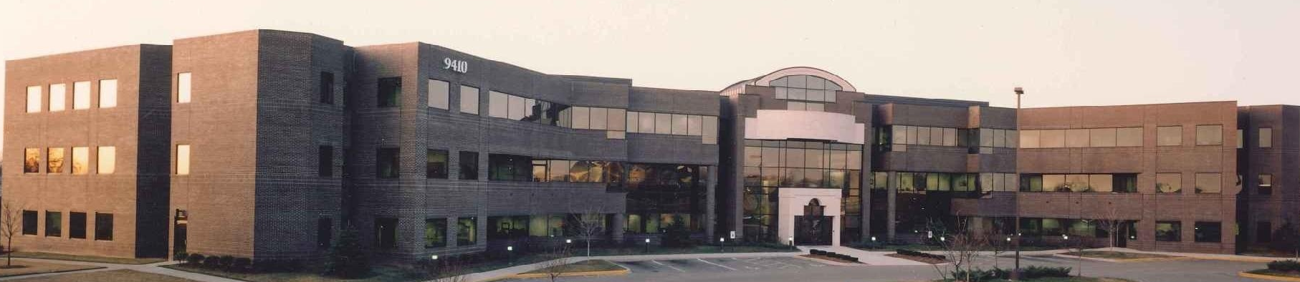
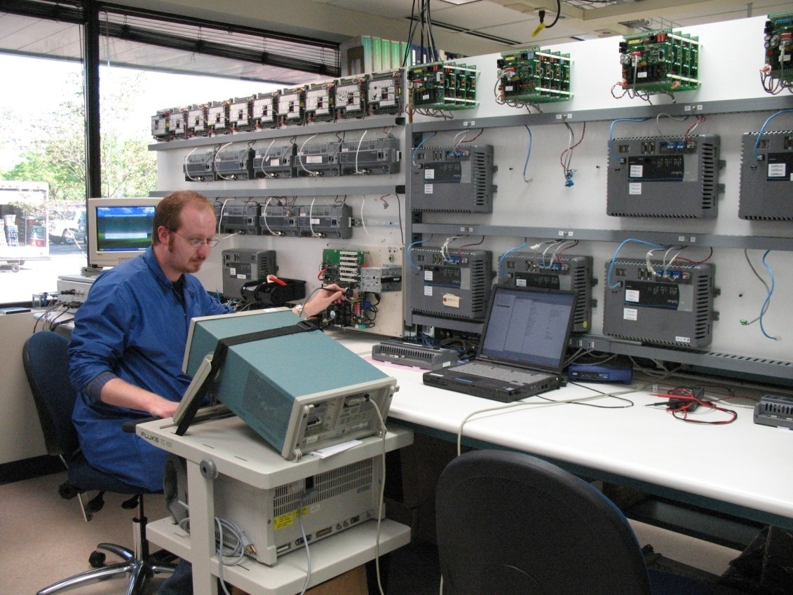
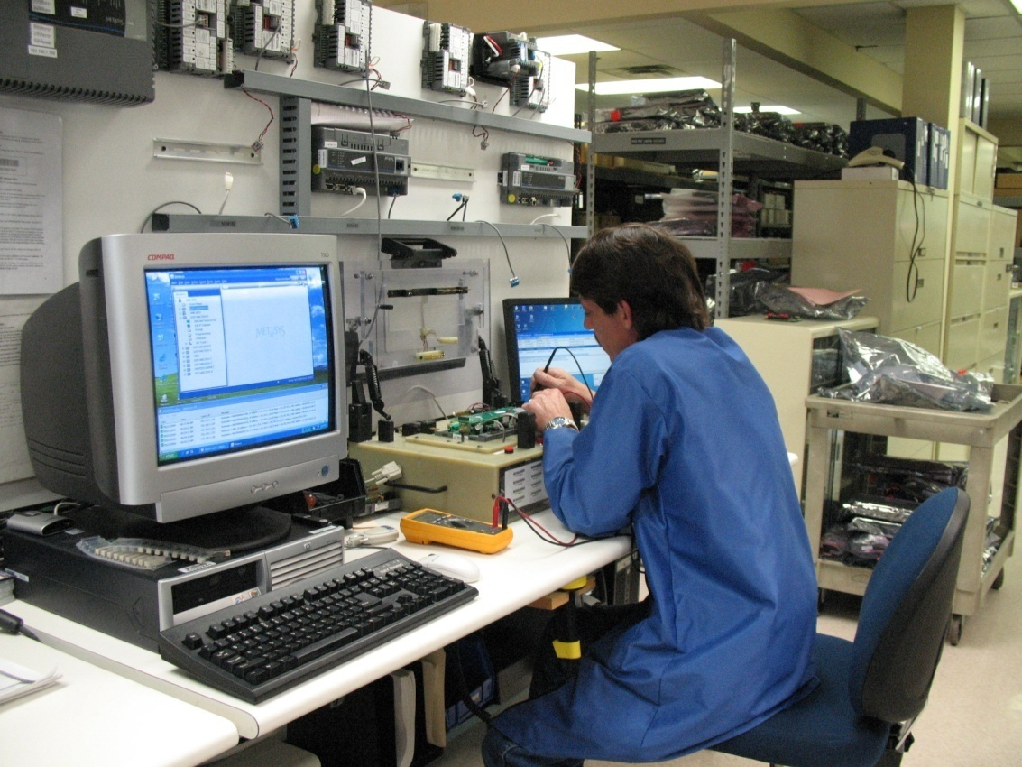
Johnson Controls Repair Center Louisville, KY

Slide 3
What do we do?
Repair and Return of Customer Product, both JCI and other manufacturers (Honeywell, Siemens, Simplex, etc.)
Sale of reconditioned parts to branches
Manufacture and sale of JCI new parts, normally small volumes
JCI legacy (integration products)
Server platforms (MS-NIE8500-0, MS-LCS8520-0)
Digital Video Network (DVR)
Some custom panel assembly

Slide 4
How can the Repair Center help the Service Branches ? We offer MSEA parts at a 20% discount, with a three year warranty, in a like new condition.
On PREMIUM coverage contracts, reduce PSA Spend by ordering discounted MSEA parts.
Use discounted parts to introduce the JCI Metasys product to new customers. For example, offer parts to the potential customer at a 10% discount and the Service branch keep 10% savings.
Use discounted parts to increase your Service + Rewards payout.
Get MSEA parts quickly by ordering discounted reconditioned parts.

Slide 5
Recycling parts and systems: Keeping the program going
Collect out of warranty defective parts at branch and periodically return to Repair Center. This includes N2 products like the UNTs, and VMAs which will be discontinued at the end of 2012.
When you remove a system, call the Repair Center at 502-671-7398 or 502-671-7312 to see if there is a need for the parts.
Make sure you return in warranty defective parts on an RMA.
Help move forward the Sustainability goals of our company by purchasing reconditioned parts instead of new. GO GREEN and keep bad parts out of the landfill.

Slide 6
List available on the Repair Center Homepage
SAME THREE YEAR WARRANTY, LIKE-NEW CONDITION
Jan. 2011
NEW PART | NEW PART COST |  | RECOND PART | RECOND COST |  | SAVINGS
DX-9100-8454 | 1061.98 |  | DX-9100-7454 | 828.20 |  | 233.78
MS-NAE3510-2 | 1332.24 |  | MS-NAE3510-702 | 1045.35 |  | 286.89
MS-NAE3511-2 | 1405.45 |  | MS-NAE3511-702 | 1102.92 |  | 302.53
MS-NAE3514-2 | 911.51 |  | MS-NAE3514-702 | 717.10 |  | 194.41
MS-NAE3515-2 | 981.63 |  | MS-NAE3515-702 | 772.65 |  | 208.98
MS-NAE4510-2 | 2582.74 |  | MS-NAE4510-702 | 2030.10 |  | 552.64
MS-NAE4511-2 | 2694.22 |  | MS-NAE4511-702 | 2121.00 |  | 573.22
MS-NAE4520-2 | 2299.82 |  | MS-NAE4520-702 | 1807.90 |  | 491.92
MS-NAE4521-2 | 2412.01 |  | MS-NAE4521-702 | 1893.75 |  | 518.26
MS-NAE5510-1 | 3906.12 |  | MS-NAE5510-701 | 3070.40 |  | 835.72
MS-NAE5511-1 | 4059.22 |  | MS-NAE5511-701 | 3186.55 |  | 872.67
MS-NAE5520-1 | 4342.47 |  | MS-NAE5520-701 | 3408.75 |  | 933.72
MS-NAE5521-1 | 4495.58 |  | MS-NAE5521-701 | 3535.00 |  | 960.58
MS-NIE5510-1 | 3906.12 |  | MS-NIE5510-701 | 3065.35 |  | 840.77
MS-NIE5511-1 | 4059.22 |  | MS-NIE5511-701 | 3186.55 |  | 872.67
MS-NCE2510-0 | 807.61 |  | MS-NCE2510-700 | 636.30 |  | 171.31
MS-NCE2516-0 | 896.73 |  | MS-NCE2516-700 | 707.00 |  | 189.73
MS-NCE2560-0 | 807.61 |  | MS-NCE2560-700 | 636.30 |  | 171.31
MS-NCE2566-0 | 896.73 |  | MS-NCE2566-700 | 707.00 |  | 189.73
MS-NCM4510-2 | 3326.91 |  | MS-NCM4510-702 | 2585.60 |  | 741.31
MS-NCM4520-2 | 4400.68 |  | MS-NCM4520-702 | 3232.00 |  | 1168.68

Slide 7
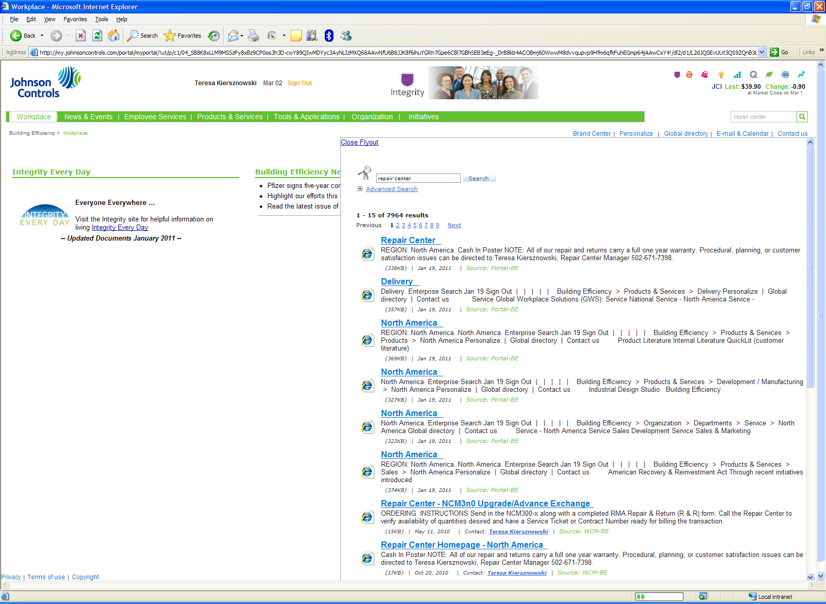
Repair Center Homepage Type “Repair Center” into Portal Search Engine

Slide 8
How do we change the culture of parts ordering?
Remind team of discounted parts at monthly safety meetings
Send out weekly text messages to the field
Keep an updated list of discounted parts readily available (anyone who orders parts)

Slide 9
When should Service order reconditioned parts instead of new?
Replacing defective units in field: Always!
PREMIUM Coverage PSA: Always!
BASIC Coverage PSA: When customer does not spec new
L&M: When customer does not spec new
Projects: When customer does not spec new

Slide 10
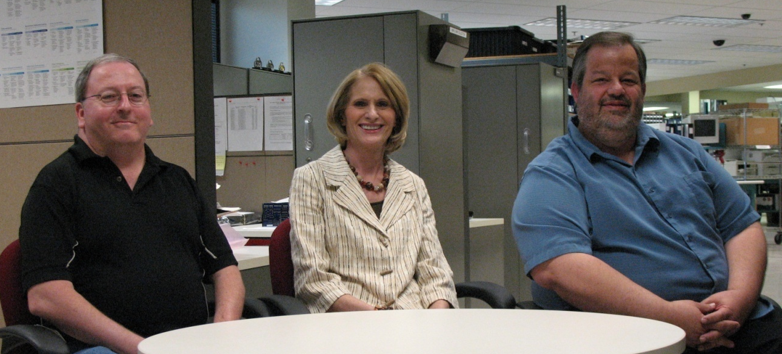
Repair Center Contacts
James Brown – Operations Supervisor (502) 671-7444
Teresa Kiersznowski – Repair Center Manager (502) 671-7398
Kenneth “JR” Ranes – Field Liaison (502) 671-7312

