Slide 1
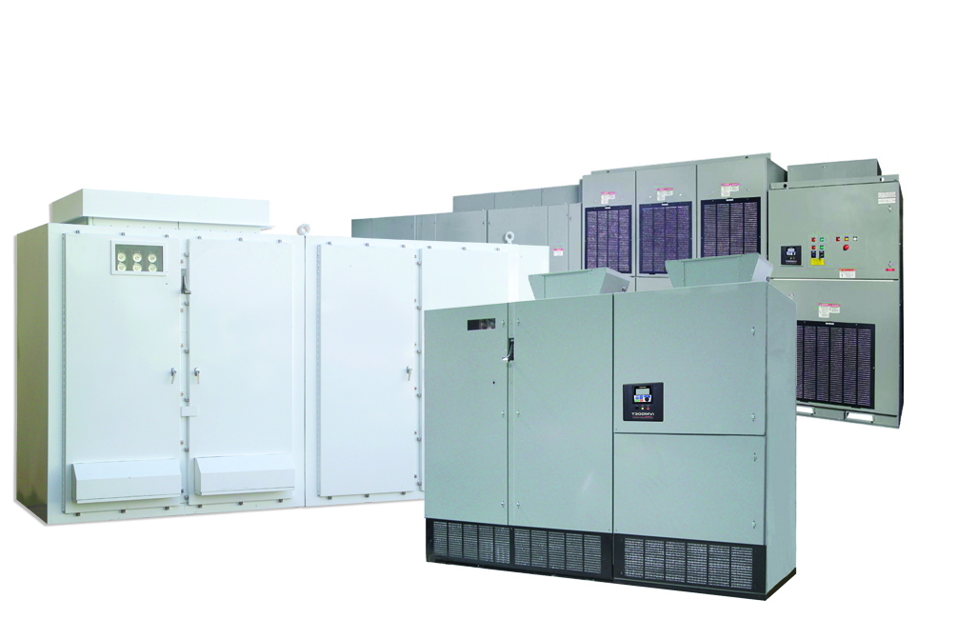
If my Drive Goes Down, How do I get support from Toshiba ???
  Record Nameplate Data
  Download TraceSave Data
  Describe Application
  Descibe Events Leading to Fault
  Email to Toshiba

Slide 2
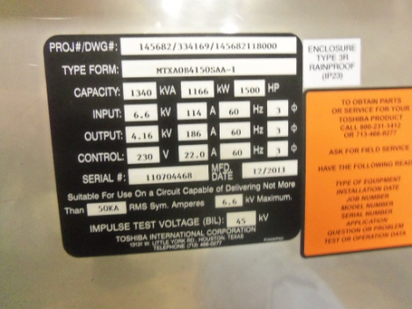
Preparations before call
Name Plate Information
  Project Number / Dwg #
  Type Form #
  Capacity_____KVA/HP
  Input V ______
  Output V _____
  Serial # __________

Slide 3
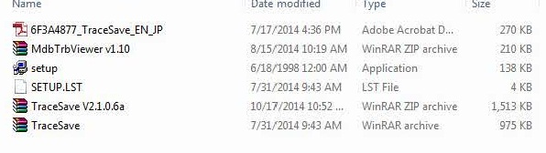
TraceSave Software Installation
Extract installation files from Tracesave .zip installation
Click

Slide 4
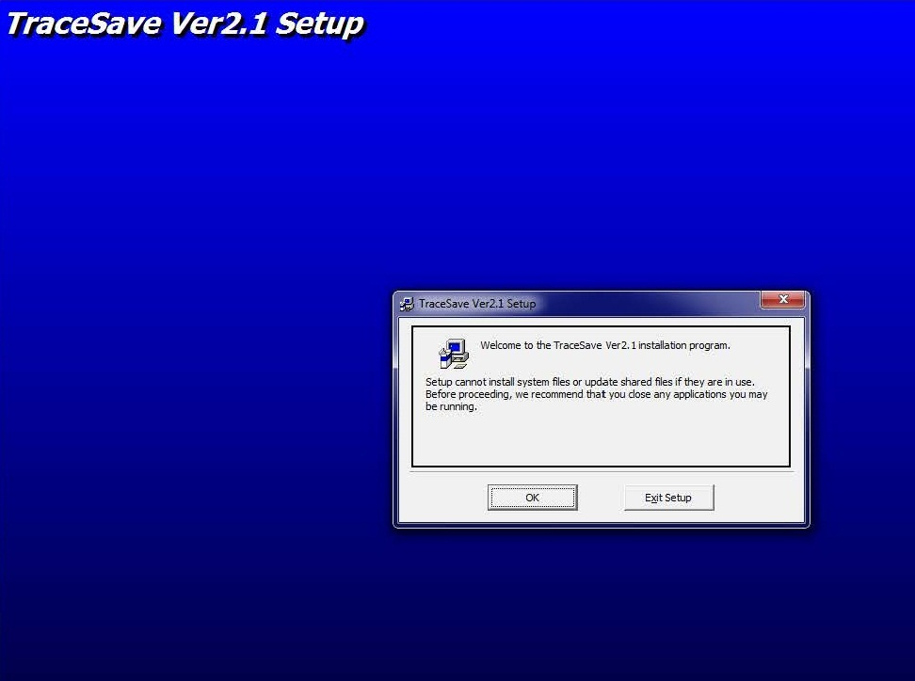
TraceSave Software Installation
Click

Slide 5
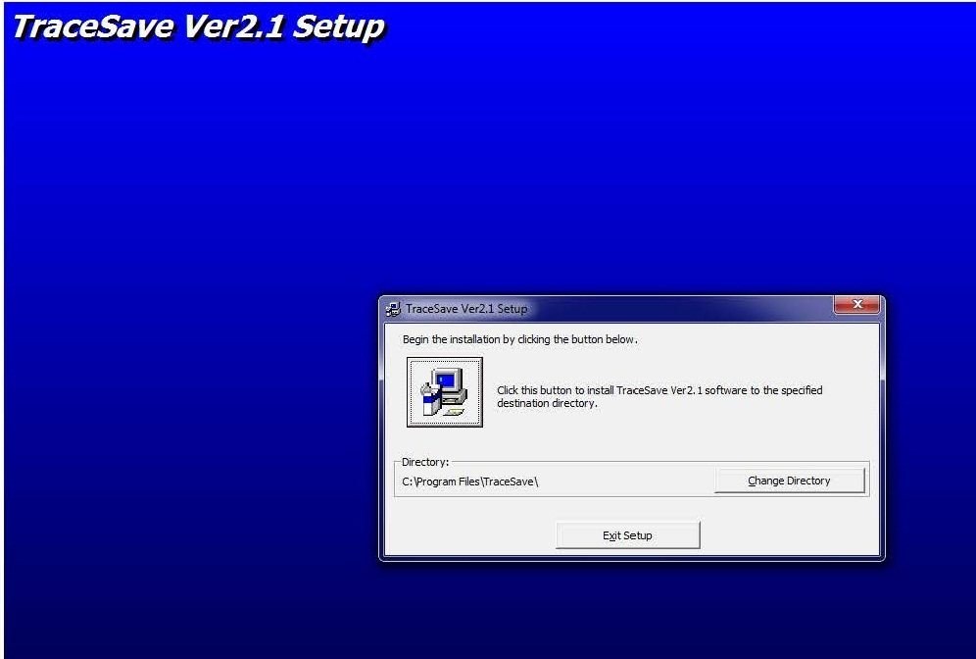
TraceSave Software Installation
Click

Slide 6
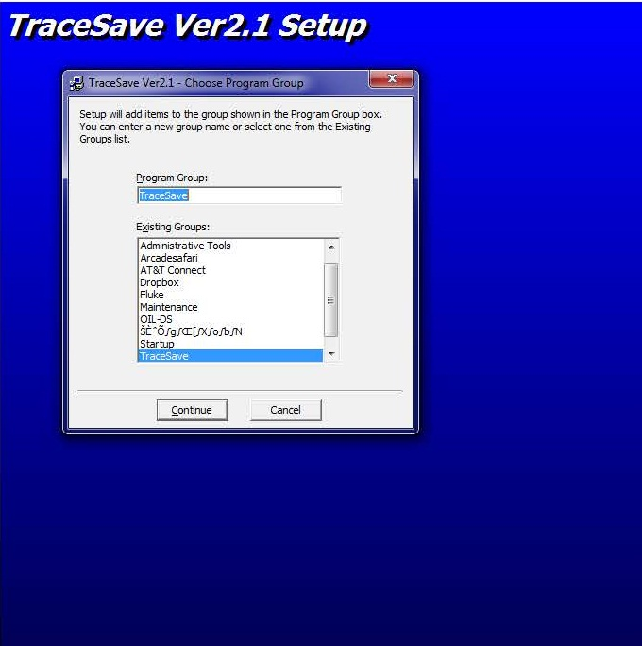
TraceSave Software Installation
Click

Slide 7
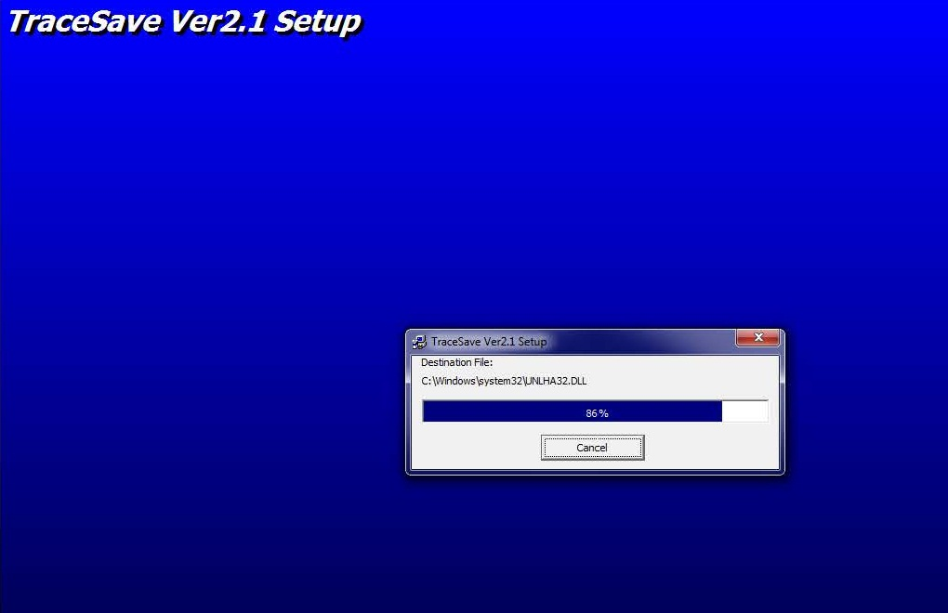
TraceSave Software Installation

Slide 8
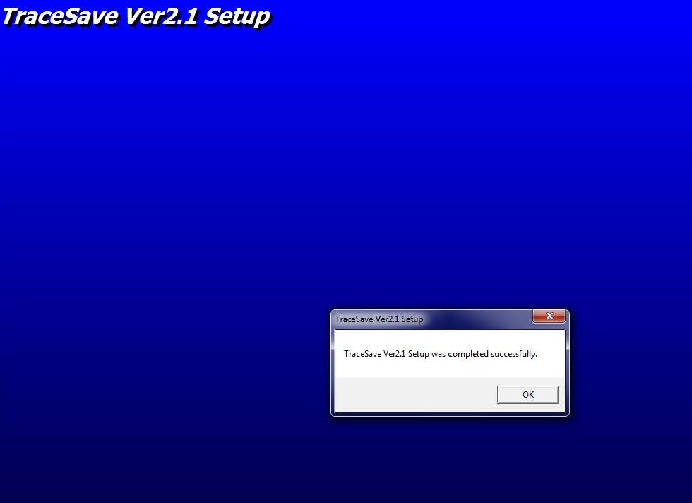
TraceSave Software Installation

Slide 9
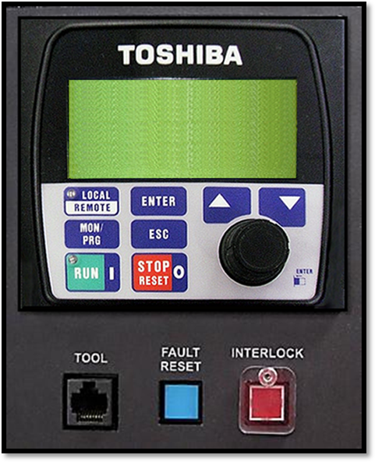
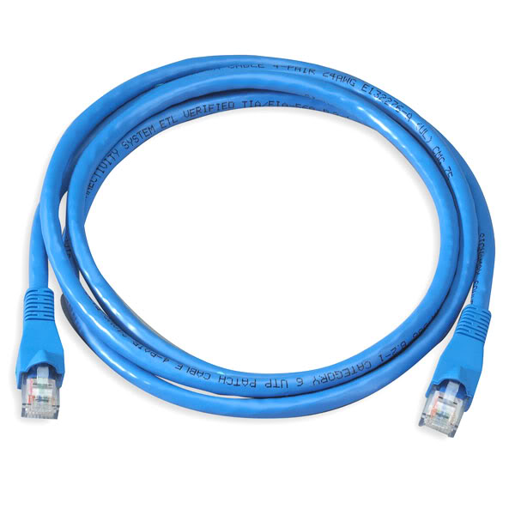
Connecting to Drive
In order for you to download TraceSave Fault Data from your drive, you will need to connect your computer to the CN2 Tool Port on the Keypad using an:
RJ45 Cat 5 or 6 Ethernet Cable

Slide 10


Connecting to Drive
In order for you to download TraceSave Fault Data from your drive, you will need to connect your computer to the CN2 Tool Port on the Keypad using an:
RJ45 Cat 5 or 6 Ethernet Cable
You need to ensure to disconnect any Wi-Fi or Bluetooth signal on your computer. Any outside signal will interfere with communication between the drive and your computer

Slide 11
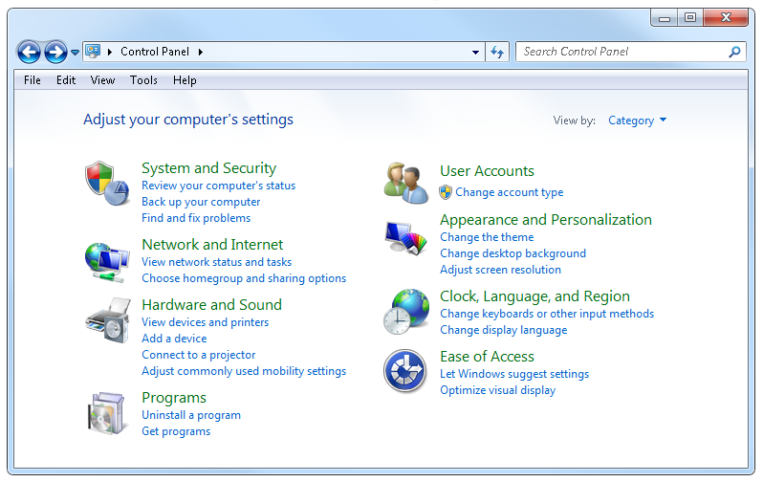
Connecting to Drive
On a Windows 7 or 10 machine, to disconnect your Wi-Fi and or Bluetooth services go to your Control Panel and click on “View Network Status and Tasks”

Slide 12
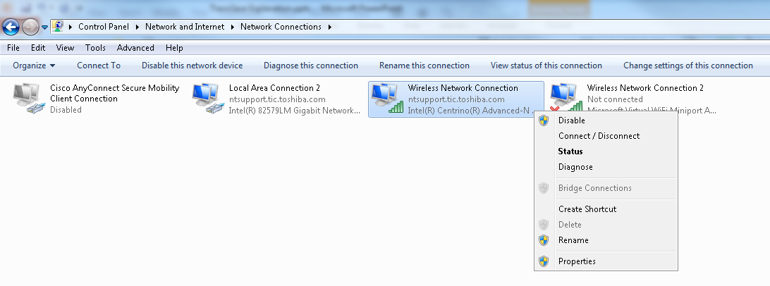
Connecting to Drive
Once you are on “Network and Sharing Center” click on “Change adapter settings” where you will be directed to your network connections
Simply right click on the “Network Connection” that your computer utilizes and click on “Disable”

Slide 13
Connecting to Drive
Once you have disabled your Internet connection your computer will begin to search for the drive, and this will take about 2-3 minutes.
You will know that your computer is communicating with the drive by looking at the bottom right hand corner of your display where you will see a yellow triangle with a black “!” inside it.

Slide 14
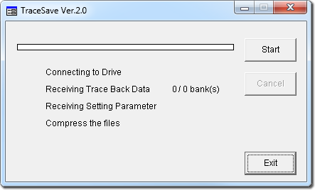
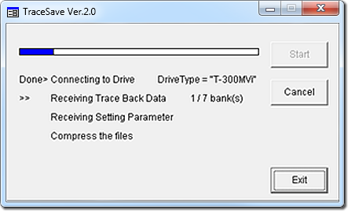
Tracesave Download
Once your computer and drive are connected open up the TraceSave software and click on “Start”
Once you click “Start”, the software should begin to immediately download the fault data

Slide 15
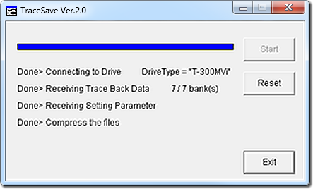
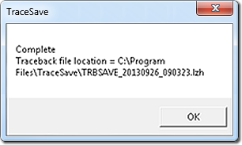
Tracesave Download
Upon completion of the download, the software will have a “pop-up” message appear showing the location of the TraceSave file.
Please make note of this location and retrieve the TraceSave file and email the .lzh file to
tic-casd-tracesavesupport@toshiba.com
so that we may evaluate your drive’s condition.

Slide 16
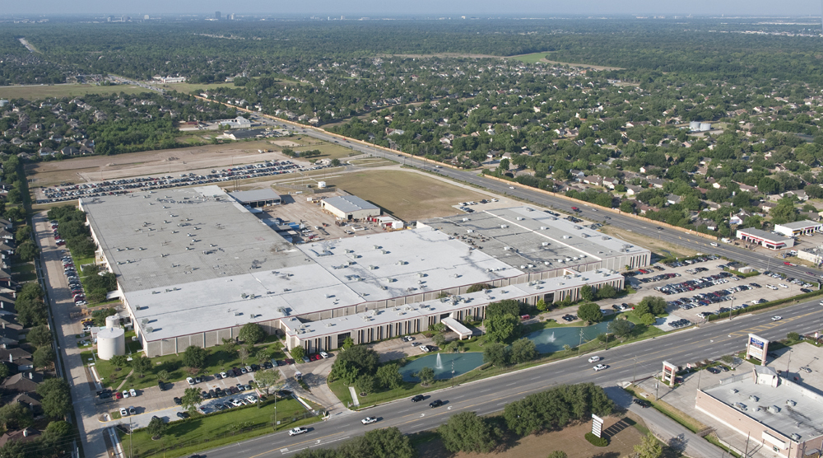
What Support is Available from Toshiba
Request Field Service Engineer
Call 24 hr Tech Support Line

Slide 17
Field Service MV Technical Support:
855-803-7092
MV Marketing Technical Support:
855-803-7090
After Hours Support:
Contact either of above numbers

