Slide 1
JCI 796 Fan & Pump Course Objectives
Introduce the student to predictive technologies including vibration analysis, balancing & precision alignment.
Provide you with a general understanding of vibration analysis and the JCI offering.
Reinforce the basic information you need to understand when looking at the vibration spectrum.
How to operate the Microlog.
How to collect reliable data.
How to perform single plane and dual plane balancing.
How to perform precision alignment of direct coupled and belt driven equipment.
How to communicate results and benefits to your customers.

Slide 2
JCI 796 Fan & Pump Course Outline
Day 1:
Maintenance Strategies
The JCI Offering
Precision Alignment of Direct Coupled Machines
Day 2:
Precision Alignment of Direct Coupled Machines (cont)
Precision Alignment of Belt Driven Machines
Basics of Vibration Analysis
Data Collection
Reviewing data to learn more about vibration analysis

Slide 3
JCI 796 Fan & Pump Course Outline
Day 3:
Balancing
Day 4:
The Predictive Diagnostic Team
JCI offerings for you
Putting it all together
Day 5:
Review
Practice
Final Case

Slide 4
Maintenance Strategies
“Learning vibration analysis has made me a better mechanic.”
“I’ve learned that its not the big things that matter, but the
hundreds of little things that make the difference.”
Tim Sorensen
Lead Mechanic
GSA Commonwealth of Virginia
1991

Slide 5
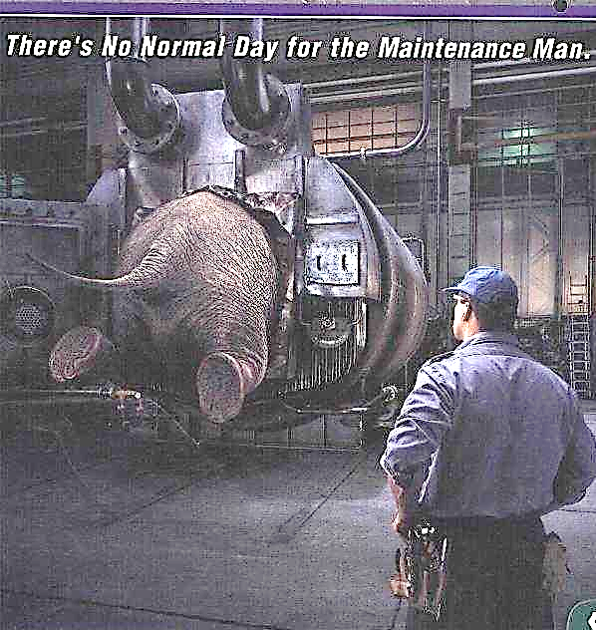
Maintenance Strategies Reactive Maintenance
Run it until it dies!

Slide 6
Maintenance Strategies Reactive Maintenance
Advantages
• Low apparent cost.
• Low training costs.
Disadvantages
• Increased cost due to unplanned downtime of equipment.
• Increased labor cost, especially if overtime is needed.
• Possible secondary equipment or process damage from equipment failure.
• Inefficient use of staff resources.

Slide 7
Maintenance Strategies Preventive (time based) Maintenance
Advantages
• Estimated 12% to 18% cost savings over reactive maintenance program.
• Flexibility allows for the adjustment of maintenance periodicity.
• Increased component life cycle.
• Energy savings.
• Reduced equipment or process failure.
Disadvantages
• Catastrophic failures still likely to occur.
• Labor intensive.
• Includes performance of unneeded maintenance.
• Potential for incidental damage to components in conducting unneeded maintenance.

Slide 8
Maintenance Strategies Predictive Maintenance
Machine condition determines when maintenance is scheduled.
Plant management in control of maintenance programs. Overall condition of plant equipment is a known.
Plant has better control of schedule.

Slide 9
Maintenance Strategies Pro-active Maintenance
Looks at equipment failures to determine the exact (root) cause of failure
Gradually design problems out of plant
Natural extension of predictive maintenance

Slide 10
Maintenance Strategies Where are we today?
Greater than 50% of maintenance hours are spent in reactive mode
Less than 40% spent in preventive maintenance
Less than 10% in predictive Maintenance
Less than 1% in Pro-active maintenance

Slide 11
Maintenance Strategies Repair Cost Estimates

Slide 12
Maintenance Strategies Bearing Life Equation
When bearings fail, secondary damage is eminent.
3
16700
dynamic capacity x load rating
L₁₀ =
= Hours of life
rpm
force

Slide 13
Maintenance Strategies Practical Maintenance
Constantly gather information
Identify that equipment that contributes to the majority of reactive maintenance calls.
Target basic maintenance practices that:
Extend potential machinery life cycles
Contribute to reductions in vibrations
Require only small investments in tools and equipment
Train personnel in performing those practices.
Expose personnel to technologies that will enhance those practices.

Slide 14
Maintenance Strategies Practical Maintenance
Common machinery problems we easily can control
Improper lubrication
Worn pulleys & belts
Misalignment of pulleys to shafts
Misalignment of direct coupled machines
Imbalance
Structural looseness

Slide 15
Activity 1 The JCI Predictive Offering
You will find Activity 1 in the Day 1 folder.
The document is a report in PDF format.
The report illustrates a typical vibration report produced by the PDT in Milwaukee.
Instructions:
Your instructor will break you into groups of 2 or 3.
Read the report & discuss it with your team.
List the 3 machines in the worst shape.
List 3 machines in good condition.
List 5 machinery faults that can be determined using vibration predictive services.
If you were to repair the worst machine, what revenue would that produce?

