Slide 1
Vibration Basics Vibration Causes
Imbalance
Worn pulleys and belts
Misalignment of pulleys to shafts
Misalignment of pulleys to one another
Looseness
Improper fit between races and shafts (internal looseness)
Bearing Damage
Improper lubrication
Aerodynamic forces
Hydraulic forces
Improper loading of resilient mounts
Inadequate motor mount support
Resonance
VFD’s: operating at or near a natural frequency

Slide 2
Vibration Basics What is Vibration?
Any physical process characterized by cyclic variations in amplitude, intensity, or frequency
Vibration is usually not the direct cause of a problem, rather it is the symptom of the problem.
Notes:
In simple form out machine is nothing more that a series of springs and masses.

Slide 3
Vibration Basics The Vibration Signal
A vibration sensor is mounted at or near a machine bearing support.
Mounting methods include magnets, extension probes, and hard mounts.
If the mount is good the sensor is “coupled” to the bearing support, and therefore vibrates just as the machine does.
The sensor produces voltage that is proportional to the vibration.
Notes:
In simple form out machine is nothing more that a series of springs and masses.

Slide 4
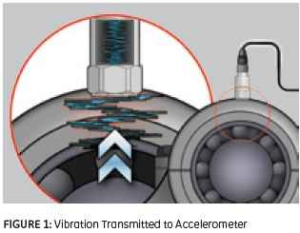
Vibration Basics The Accelerometer
Notes:
In simple form out machine is nothing more that a series of springs and masses.

Slide 5
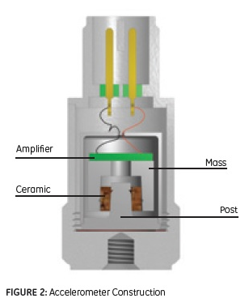
Vibration Basics The Accelerometer
Notes:
In simple form out machine is nothing more that a series of springs and masses.

Slide 6
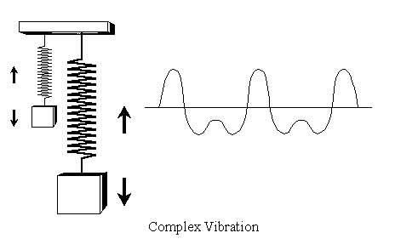
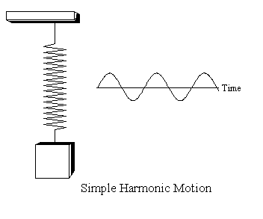
Vibration Basics The Vibration Signal
Notes:
In simple form out machine is nothing more that a series of springs and masses.

Slide 7

Vibration Basics The Vibration Signal
M01-Periodic and Harmonic Motion- Spring
Notes:
In simple form out machine is nothing more that a series of springs and masses.

Slide 8
Vibration Basics Amplitude, Frequency & Phase
Amplitude
The amount of vibration
Indicates the severity of combined problems.
Frequency
How often the vibration event occurs.
Used to determine specific problems.
Phase
Phase is the measure of timing between two events.
The phase angle describes the position of a mark (on the shaft) to fixed reference point when the vibration is at it’s peak.

Slide 9
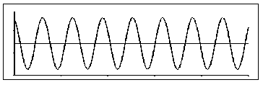
Vibration Basics The Time Waveform
Amplitude Vs Time
The raw sensor signal.
Notes:
In simple form out machine is nothing more that a series of springs and masses.

Slide 10
Vibration Basics The Time Waveform
M02-How the waveform is created
Notes:
In simple form out machine is nothing more that a series of springs and masses.

Slide 11
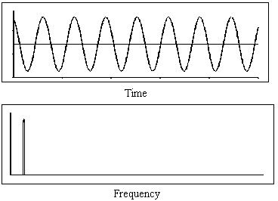
Vibration Basics The Vibration Spectrum
The waveform is converted and presented as a spectrum (Amplitude VS Frequency).
Notes:
In simple form out machine is nothing more that a series of springs and masses.

Slide 12
Vibration Basics The Vibration Spectrum
M03-FFT from the waveform explanation
Notes:
In simple form out machine is nothing more that a series of springs and masses.

Slide 13
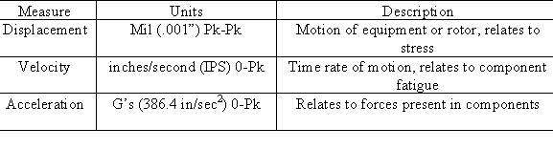
Vibration Basics Units of Amplitude

Slide 14
Vibration Basics Units of Amplitude

Slide 15
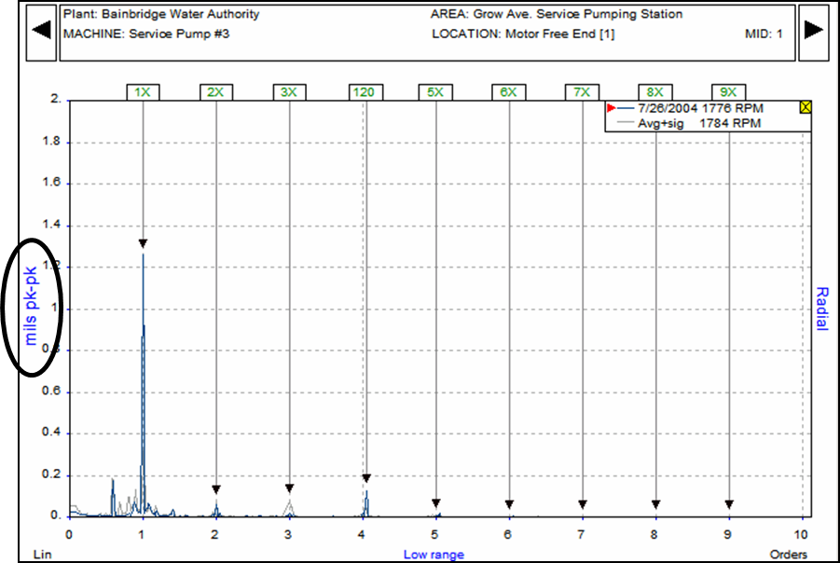
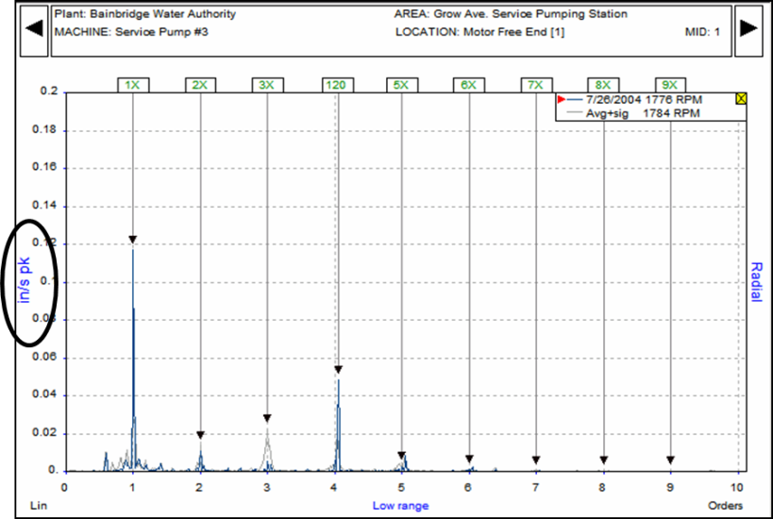
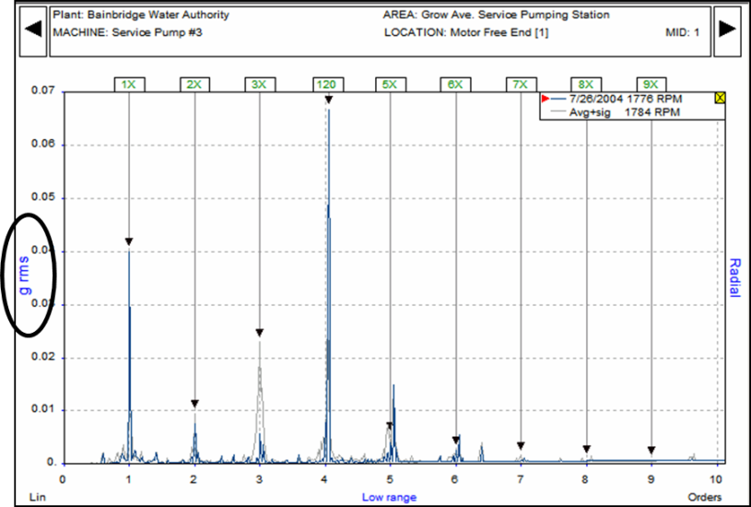
Vibration Basics Units of Amplitude
Displacement: Mils
Velocity: IPS
Acceleration: G’s

Slide 16
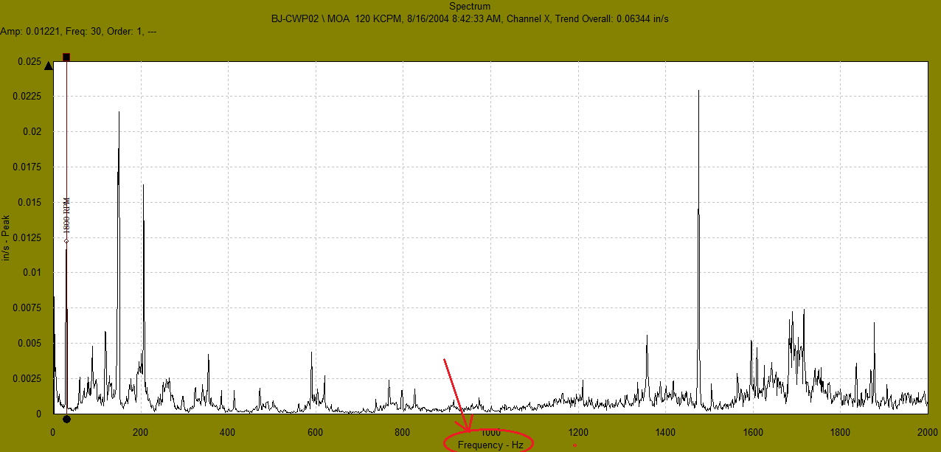

Vibration Basics Units of Frequency
Hertz(Hz)
Cycles per second
Typically used in chiller analysis & high
speed machines
CPM
Cycle per minute which is the same as RPM.
Used in fan and pump equipment analysis.

Slide 17
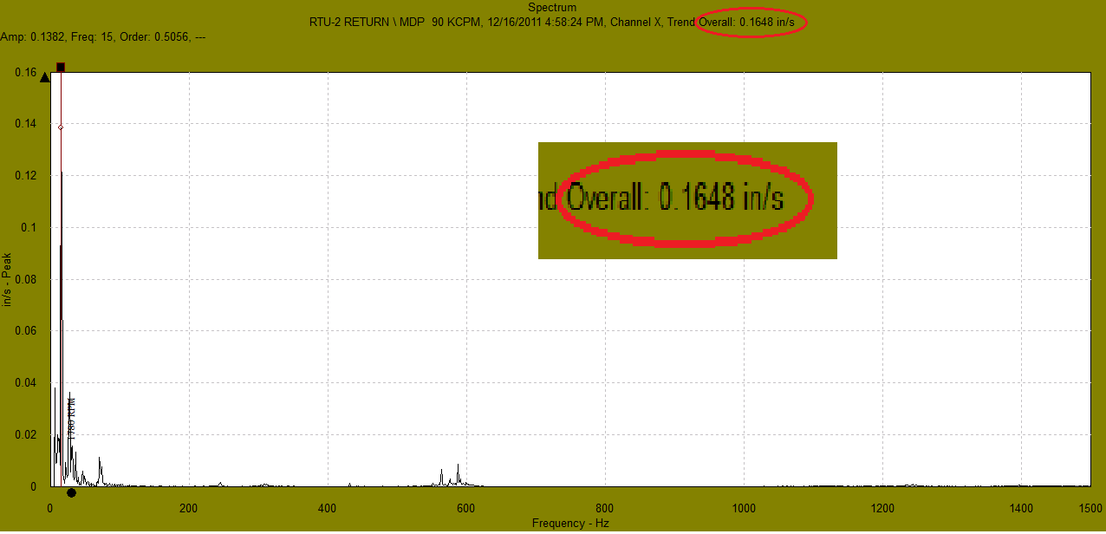
Vibration Basics Overall Amplitude
Overall Amplitude
The RMS of the total energy in the spectrum.

Slide 18
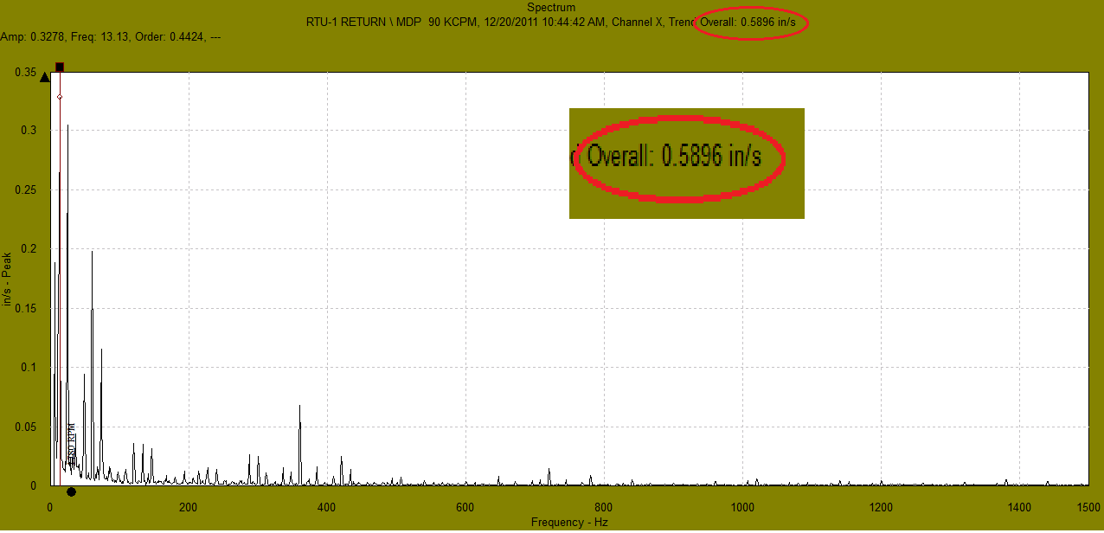
Vibration Basics Overall Amplitude
Overall Amplitude
The RMS of the total energy in the spectrum.

Slide 19
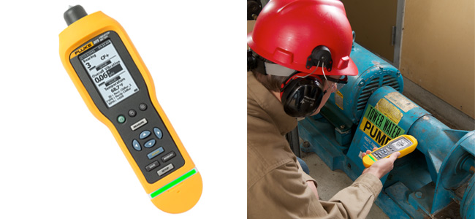
Vibration Basics Overall Amplitude

Slide 20
Vibration Basics Severity Guides

Slide 21
Vibration Basics Severity Guides

Slide 22
Vibration Basics Severity Guides

Slide 23
Vibration Basics Severity Guides

Slide 24
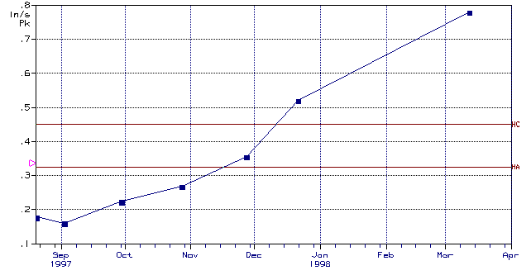
Vibration Basics Trending Overall Amplitude

Slide 25
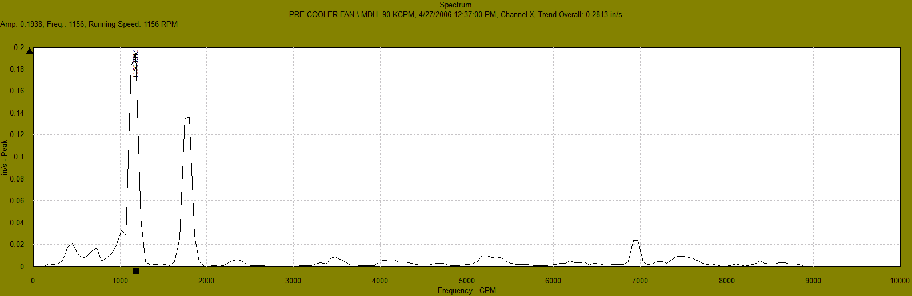
Vibration Basics Overall Amplitude

Slide 26
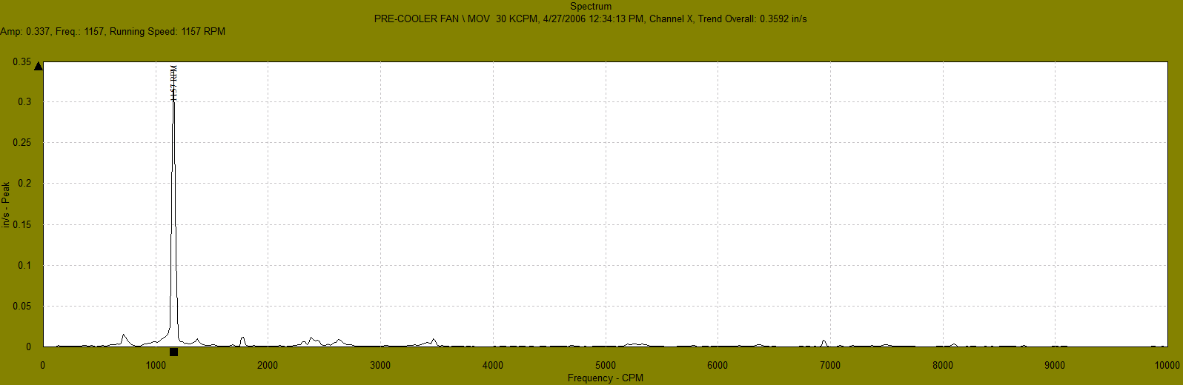
Activity 2 The vibration spectrum
What is the full scale amplitude?
Approximate the amplitude of the vibration spike.
What is the overall amplitude?
Name the units of amplitude.
Approximate the frequency of the vibration spike.

Slide 27
Vibration Basics Amplitude, Frequency & Phase
Phase (Phase Angle):
Phase is the measure of timing between two events.
Compares the motion of a vibrating part with a fixed reference or compares the motion between two vibrating parts.
Parts that are in phase move together, parts the are 180 degrees out of phase move opposite each other.
The phase angle describes the position of a mark (on the shaft) to fixed reference point when the vibration is at it’s peak.
Phase angles are used in balancing.

