Slide 1
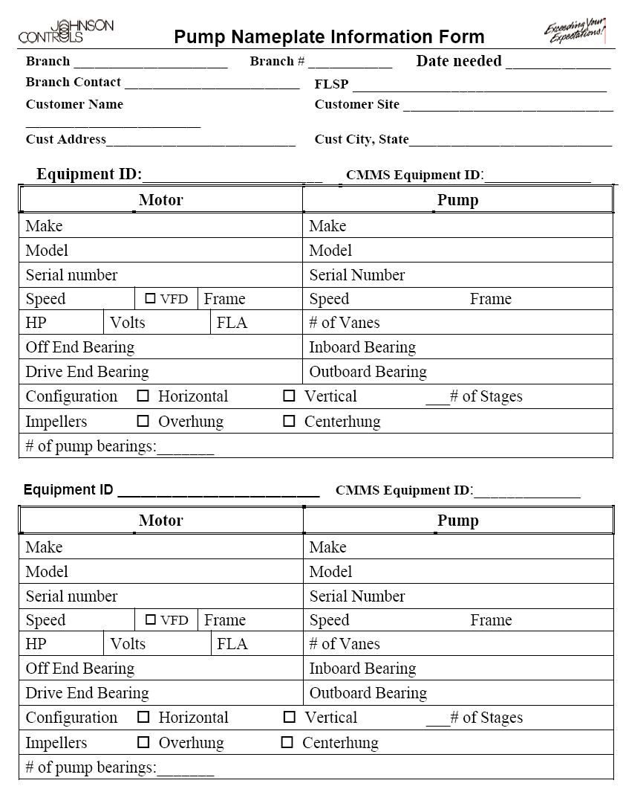
Collecting Data 1. Collect Nameplate Data
You collect Nameplate Data and Fax it to the Predictive Diagnostics Team.
The Predictive Diagnostic Team will create a database for your machines.
Allow 2 days to 1 week for the databases to be completed.
Your routes will be downloaded into the Microlog.

Slide 2
Collecting Data 1. Collect Nameplate Data
Accurate Speed
You can use a tachometer.
Contact
Photo
Strobe
Or, you can calculate the fan speed.
Fan RPM
Motor pulley diameter
X
Motor RPM
Fan pulley diameter

Slide 3
Activity 3 Calculating Fan Speed
Calculate the fan speed #1:
The motor pulley diameter is 4”
The fan pulley diameter is 12”
Fan speed =
Calculate the fan speed:
The motor pulley diameter is 10”
The fan pulley diameter is 5”
Fan speed =
Fan RPM
Motor pulley diameter
X
Motor RPM
Fan pulley diameter

Slide 4
Activity 4: (Optional) Using a strobe to determine machinery RPM
Your Instructor will demonstrate the use of the strobe as a tachometer.
You will be asked to determine the RPM of a machine simulator.

Slide 5
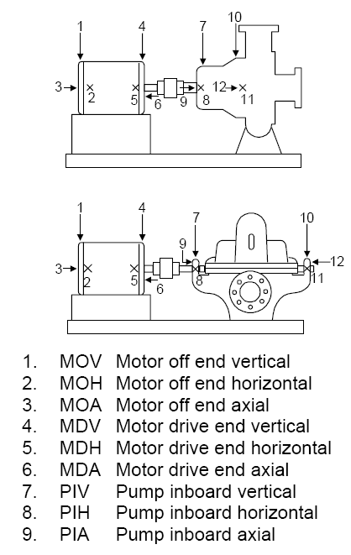
Collecting Data Where You Take Measurements Pumps:
Bearing Labels:
MO
MD
FI
FO
Three directions at each bearing:
IL- In line with belts
P- Perpendicular to belts
A- Axial

Slide 6
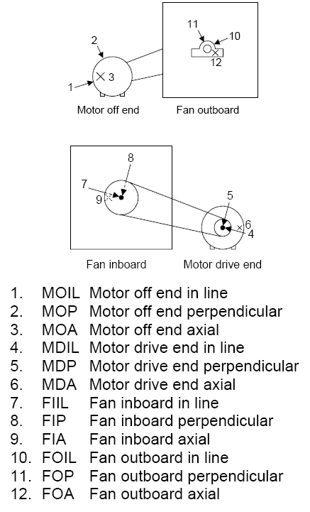
Collecting Data Where You Take Measurements Fans:
Bearing Labels:
MO
MD
FI
FO
Three directions at each bearing:
IL- In line with belts
P- Perpendicular to belts
A- Axial

Slide 7
Collecting Data Safety:
Lock out tag out
PPE
Cables secure?
Confined Space?
Be aware of surroundings.
If it feels wrong, IT IS!

Slide 8
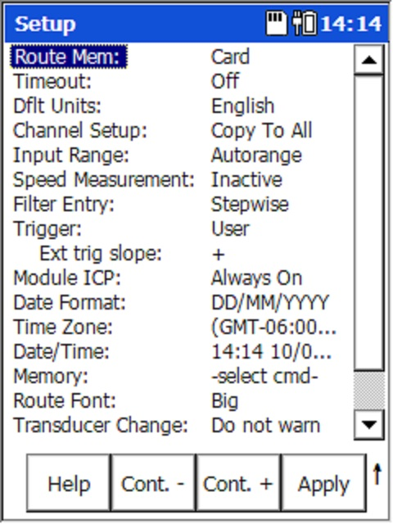
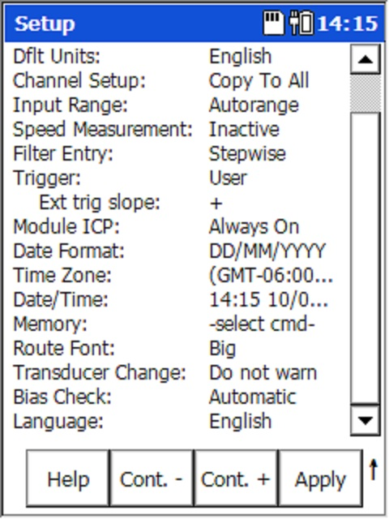
Collecting Data Configuring the Microlog, Main Setup

Slide 9
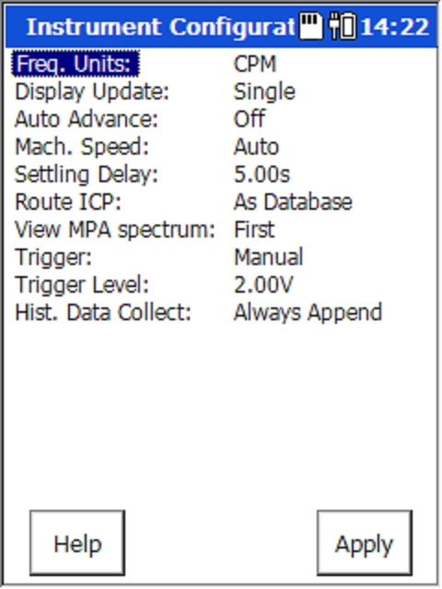
Collecting Data Configuring the Microlog, Route Setup

Slide 10
Activity 5: Collecting Vibration Data
Collect vibration data for Fump #1.

