Slide 1
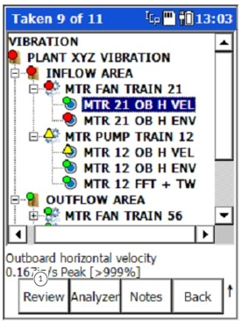
Reviewing Data
To review stored Microlog single channel spectra:
From the Route Mgr screen, use the up/down arrow buttons to highlight the ROUTE containing the POINT whose data you would like to review, and
Press the right arrow to open the ROUTE hierarchy.
When a POINT is highlighted, a Review function button becomes available.
Touch review.
.

Slide 2
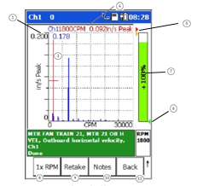
Reviewing Data
Overall value
POINT info area; machine name, POINT ID, POINT description, alarm condition
Cursor
Current cursor frequency and amplitude
alarm indicators
Previous measurement indicator
% difference from previous measurement
set cursor frequency as running speed
Retake meas.
View / add coded and type-in notes
escape without storing data
.

Slide 3
Reviewing Data Verifying that the data is accurate
Expanding the Display
F_{max} is established when the route is created.
The F_{max} that you see can be minimized so that the data appears to be expanded.
Touch the Expand Display Button (to turn the function on).
Press the right arrow the reduce the F_{max} .
.

Slide 4
Reviewing Data
Lines of resolution
Every spectrum is made up of a series digital values.
Resolution choices may include: 100,200,400,800,1600,3200, etc.
The resolution is set when the route is created.
The cursor movement is determined by the resolution of the spectrum.
.

Slide 5
Reviewing Data
The Cursor
The cursor move to the right when you touch the right arrow..
When the cursor is being used the overall amplitude is no longer displayed.
The amplitude that is displayed is that digital value for the line of resolution of the cursor location.
In other words, you will see a frequency value and an amplitude value.
.

Slide 6
Reviewing Data Data Inaccuracies
Data Inaccuracies
Bad data usually appears in the first 3 lines.
Looks like a “ski slope”.
Other data inaccuracies.
.

Slide 7
Reviewing Data More about the spectrum
1X
Spectral analysis always requires the determination of 1X .
1X will NOT always be the highest or the first significant peak in the spectrum.
1X frequency in the spectrum will not be exactly the same as the tachometer speed.
.

Slide 8
Reviewing Data More about the spectrum
Synchronous Peaks
Any peak which is a even order integer or fraction of a fundamental frequency is synchronous.
Even multiples are often called “harmonics”.
Even fractions are called “sub-harmonic”.
The marker button will identify multiples of whatever frequency the cursor is tuned.
If the cursor is tuned to 1X, the marker button will highlight harmonics of running speed.
.

Slide 9
Reviewing Data More about the spectrum
High Harmonics
For radial measurements only.
If any harmonic amplitude is ½ of the 1X amplitude (or greater), it is considered high.
.

Slide 10
Reviewing Data More about the spectrum
High Axial
If at any bearing, the axial1X is greater than ½ of the lowest radial amplitude, it is considered high
.

Slide 11
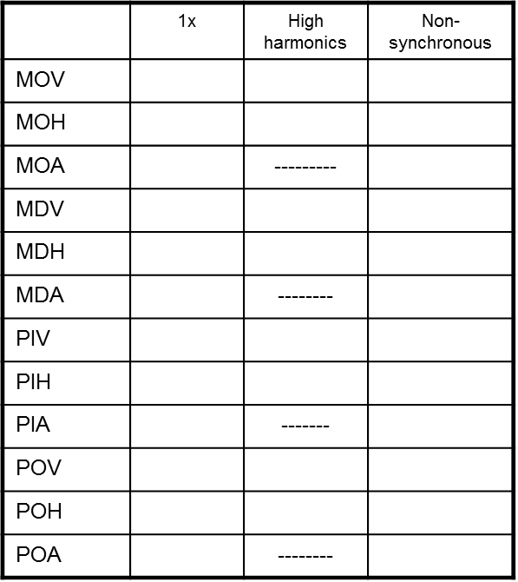
Reviewing Data Reviewing the data
Use this format to tabulate the vibration data.
.

