Slide 1
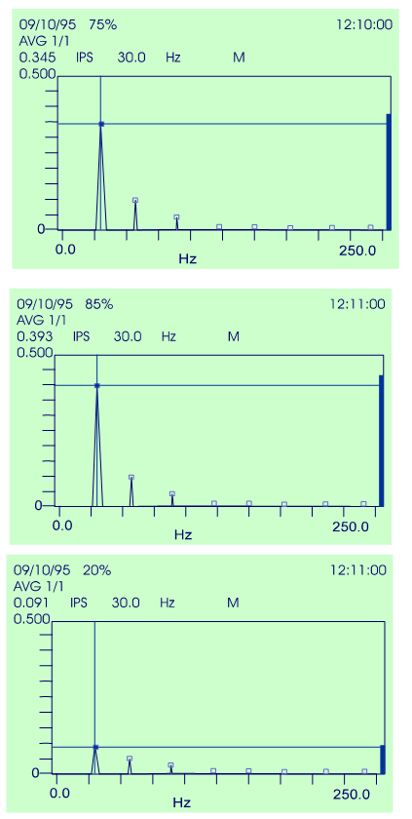
Analysis Rules Imbalance
.
Always at 1X RPM
Similar radial amplitude
Low axial
Low harmonics

Slide 2
Analysis Rules Misalignment
.
Dis-similar radial amplitude
High axial
High harmonics

Slide 3
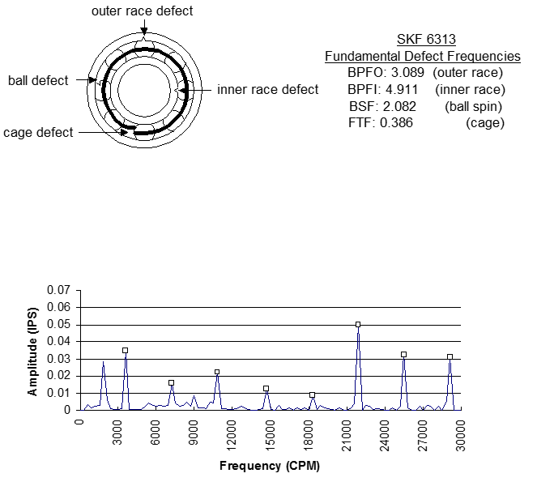
Analysis Rules Bearing Damage
.
Low amplitude can be serious
Many possible frequencies
Non-harmonic frequencies
Unrelated to 1X RPM
“Broad band

Slide 4
Analysis Rules Resonance
.
Grossly Dis-similar 1X amplitude
The larger radial 1x amplitude is greater than five times the smaller radial 1x amplitude at any bearing.
Or…the axial 1x shaft RPM amplitude is greater than two and one half times the larger radial 1x shaft RPM amplitude at the same end of the machine.

Slide 5
Analysis Rules Looseness
.
Radial harmonics are greater than half the 1x.
½x shaft RPM harmonics are present.

Slide 6
Analysis Rules Looseness
.
The axial 1x shaft RPM amplitude is greater than half the smallest radial 1x shaft RPM amplitude at the same end of the machine.
1x motor RPM amplitude is usually the dominant vibration.
Often the highest amplitude on the motor is at 1x fan shaft RPM and the highest amplitude on the fan is at 1x motor .
The 2x amplitude is greater than half the 1x amplitude at any bearing.

