Slide 1
Balancing Overview
We use the vibration analyzer to perform mechanical balancing.
Imbalance only occurs @1X RPM.
We use amplitude and phase data.
The initial readings are called the Reference Run.
Weight is added or subtracted from the rotor to change the amplitude or the phase.
When we add or subtract weight to make the change, we call that a Trial Run.
After making changes to the imbalance, the analyzer will specify how much weight and what angle to correct the imbalance.

Slide 2
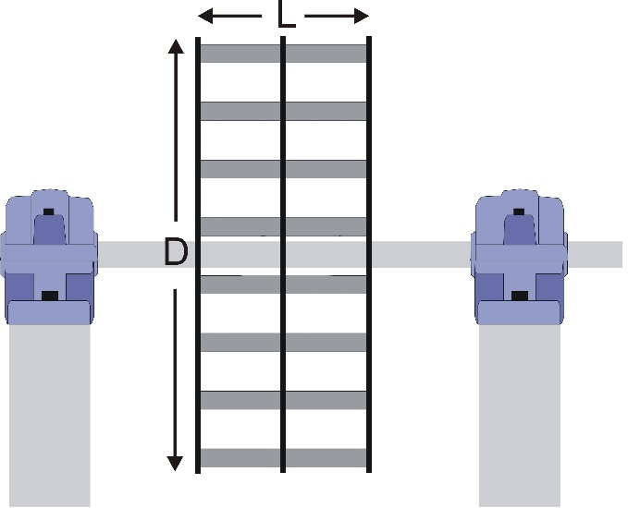
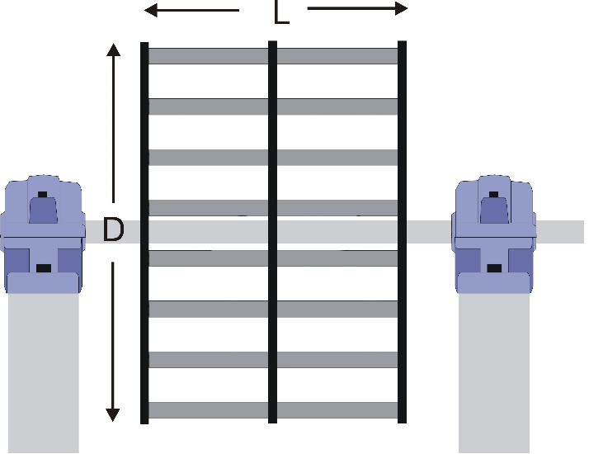
Balancing Center Hung Fans
Determine single or two plane.
If L/D < 0.50, single plane.
If L/D is greater than .50, two plane.
single plane
two plane

Slide 3
Balancing Single Plane
For single plane balancing:
Reference Run
Trial Run #1
Correction Run
single plane

Slide 4
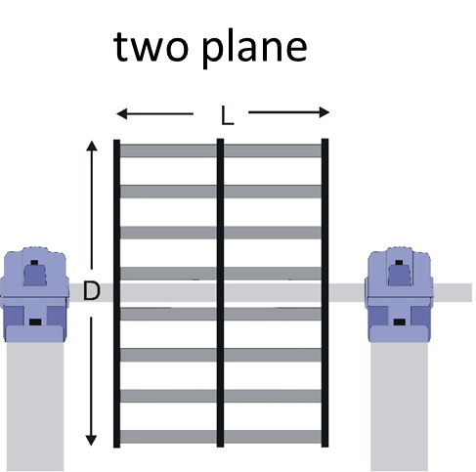
Balancing Two Plane
For two plane balancing:
Reference Run
Trial Run #1
Trial Run #2
Correction Run
Trim Run (perhaps)

Slide 5
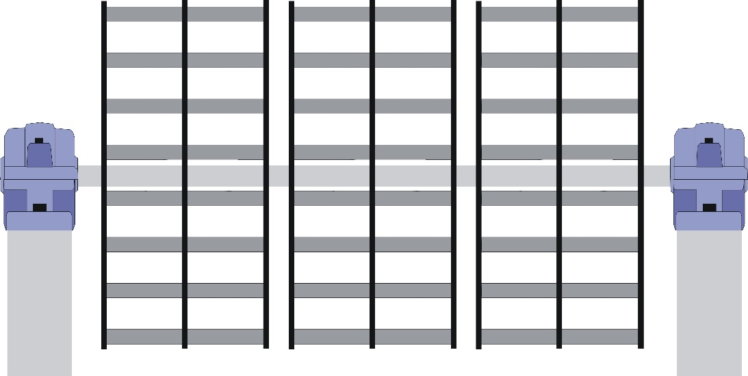
Balancing Center Hung Fans
A fan rotor with several wheels is treated as ONE fan.
Most likely two plane.

Slide 6
Two Plane Balancing Measurement Points
A
B

Slide 7
Two Plane Balancing Correction Planes
Plane separation is good!
A
B
Plane 1
Plane 2

Slide 8
Two Plane Balancing Correction Planes
Angles and weight placement
Degrees increase in the opposite direction of rotation.

Slide 9
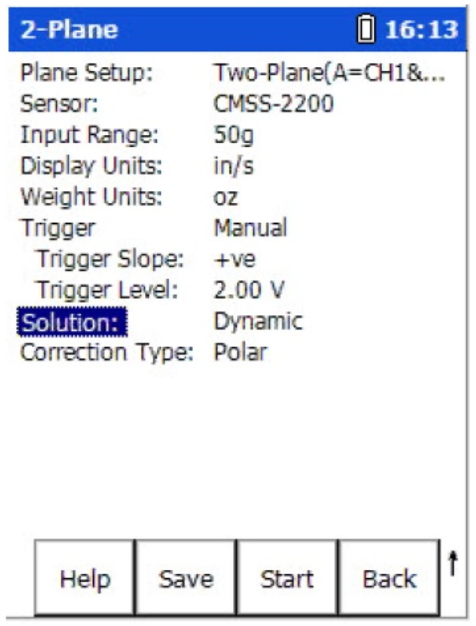
Two Plane Balancing Configuration
Main Screen
Setup

Slide 10
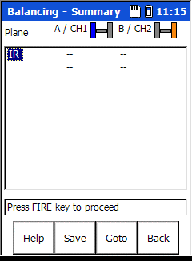
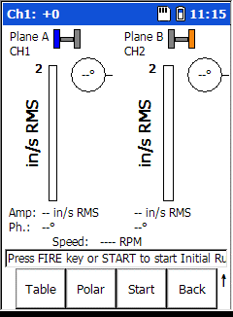
Two Plane Balancing Reference Run
Press fire
Press Fire

Slide 11
Two Plane Balancing Reference Run
The reference run is the initial set of balance data.
All subsequent data is compared to the reference run.
Press Fire

Slide 12
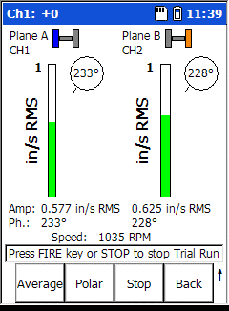
Two Plane Balancing Trial Run #1
Press Fire
Enter trial weight Data

Slide 13

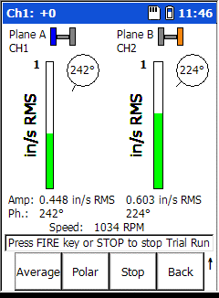
Two Plane Balancing Trial Run #2
Press Fire

Slide 14
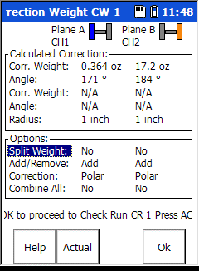
Two Plane Balancing Results
Results

Slide 15
Two Plane Balancing Correction Run
Correction Run

Slide 16
Two Plane Balancing Trim Run
Trim Run

