Slide 1


Slide 2

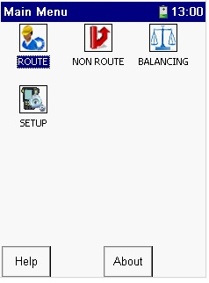

Slide 3
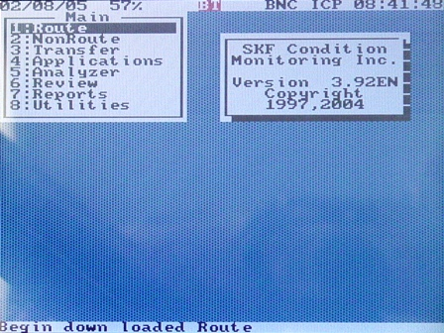
How to Operate the Microlog Navigating the Menus
The Main menu is navigated with the Arrows.
The Enter Key selects an item.
The Menu Key offers “pull down” selections.

