Slide 1

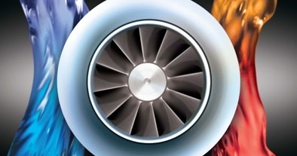
Hot Water Solutions by Johnson Controls
Company Confidential
Notes:
HOT WATER SOLUTIONS
Presentation Summary- This presentation highlights the benefits of heat pump and heat recovery chiller applications. It also presents YORK equipment that is ideal for these types of applications.
Audience- Consulting Engineers and Owners (this presentation can also be used for internal training)
Length of Presentation- approximately 45- 60 minutes.
Version 3- July 14, 2010 (update from version 2 February 12, 2010)
Presentation Creator- Dan Aja (daniel.a.aja@jci.com)
Feedback- If you have any comments or suggestions for this presentation, please contact Jill Hugus (jill.k.hugus@jci.com)
Note to the Presenter- Depending on the customer’s experience, specific interests, and/or global region you may choose to hide some of the slides in this presentation.

Slide 2

It’s estimated that 5% of the world’s daily energy consumption is expended on fuel for heating water!
Notes:
According to the Environmental Protection Agency (EPA), it’s estimated that 5% of the world’s daily energy consumption is expended on fuel for heating water.
This really is an especially astounding number when you consider all the other things in the world that require energy. Not to mention the environmental effects associated with this energy consumption! Let’s focus today’s time on how we can drive this number down by heating water with another option other than boilers.

Slide 3
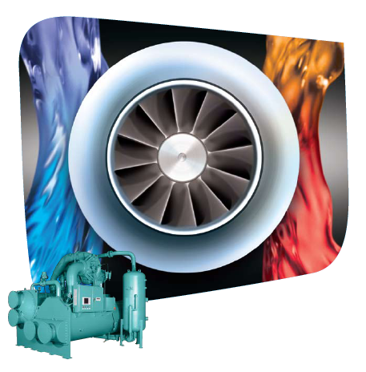
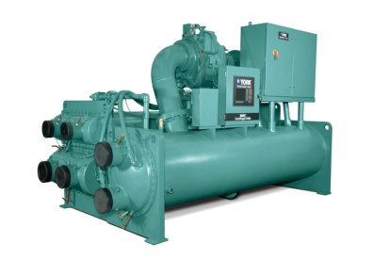
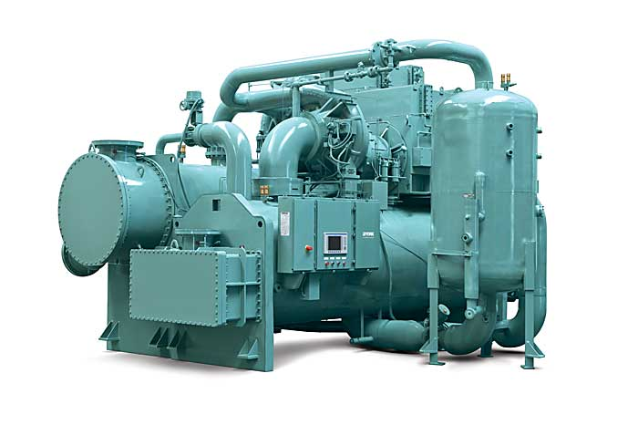
Agenda
Introduction
What is a heat pump?
What is heat recovery?
Benefits
Control and Sizing
Application Considerations
JCI Offerings
Conclusion
3
Notes:
The following objectives will be covered in this presentation:
Define the basics of hot water solutions
Explain what exactly is meant by a heat pump and heat recovery unit.
Then we will look at the benefits of hot water solutions
And how to control and size these units
What the best applications for hot water solutions are
And finally we will look at the Johnson Control products that best fit these applications

Slide 4
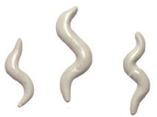
Traditional Building Configuration
Logic:
Cooling tower rejects
building heat via condenser
Boiler provides heat to
meet building heating
requirements
Cooling Tower
Condenser
Motor
Compressor
Expansion Valve
Advantages:
Evaporator
Independent circuits
Simple control logic
Conventional
Disadvantages:
Lower system efficiency
High operating expenses
Boiler
4
Notes:
Let’s start by reviewing a traditional building configuration. In this system the building’s chillers supply cooling to meet the required cooling load, and the building’s boilers supply hot water to meet the building’s heating needs. In this configuration the chiller rejects buliding heat to the atmosphere via a cooling tower.
CLICK
The primary advantage with this time-tested, conventional configuration are that both the cooling and heating circuits are independent of one another which allows for simple control logic.
CLICK
The major disadvantage of this configuration is its lower efficiency (85-90%) which results in higher than necessary operating expenses.

Slide 5
Increase Efficiency & Lower Your Operating Costs
Logic:
Building heat is USED, not
rejected via cooling tower
Heat pump and / or heat
recovery chillers provide
simultaneous heating & cooling
Cooling Tower
Condenser
Motor
Compressor
Expansion Valve
Evaporator
Advantages:
Reduced operating costs
CO₂ reductions
Reduced water consumption
LEED points
Boiler
Boiler
5
Notes:
Fortunately there are options for increasing system efficiency and lowering operating expenses.
Specifically what makes the most sense to us it to use the building heat that is being rejected via the cooling tower for beneficial purposes.
CLICK
There are two ways to do this: heat pumps and heat recovery. Both of which can provide all or a portion of the building’s heating and cooling needs more efficiently than the traditional system configuration we just reviewed. Then, if needed, supplimental heating and cooling can be supplied from additional building equipment.
CLICK
The major advantages of using heat pump and heat recovery configurations include:
Reduced operating costs
CO₂ reductions
Reduced water consumption and chemical
LEED points
Each of these will be discussed in more detail further into the presentation.

Slide 6

Options for Improving Building Efficiency
Heat Pump
Heat Recovery
Intent:
Intent:
Specifically designed to provide 100% of heat as hot water
→ Typically 120-170ºF (49-77ºC)
Designed to chill water and provide a percentage of heat as warm water
→ Typically 95-115ºF (35-46ºC)
Control:
Control:
Compressor capacity is controlled by Leaving Condenser Water set point
Compressor capacity is controlled by Leaving Chilled Water set point
Compound Centrifugal (CYK) Chiller
600-2200 Tons
(2115-7740 kW)
Double Bundle YORK Heat Recovery Chiller
280-2800 Tons
(880-9850 kW)
6
Notes:
So, what do I mean by heat pump and heat recovery technology? Here’s a snap shot.
Heat pumps are specifically designed to provide hot water to a building, typically above 120ºF (49ºC). Heat pumps are controlled off of leaving condenser water set point.
Heat recovery chillers differ in that they are specifically designed to provide chilled water, as they are controlled by the leaving chilled water set point, but they also provide warm water via the chiller’s second condenser bundle.
We will get into more detail on each of these shortly, however first let’s talk about typical applications where these are applied…

Slide 7




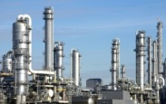
Best Applications-
Heat Recovery and Heat Pump
Office Buildings
Hotel/ Casino
Hospitals
Universities
Process / Manufacturing
Quickest Payback:
Applications where there are large simultaneous heating and cooling loads!
7
Notes:
7
As previously stated, heat recovery chillers make sense in applications that have requirements for warm water, say 105ºF (40.5ºC), where heat pumps make sense in applications that have hot water needs, say 150FºF (65.5ºC) So, let’s take a look at the most common applications we’ve come across, (obviously these are not rules that are set in stone, but this is what we have seen most often.)
OFFICE BUILDINGS: Offices typically don’t have high hot water needs, so heat recovery chillers make a lot of sense for applications like perimeter reheat or domestic hot water preheat.
HOTEL/CASINO: Hotels and casinos are great applications for high efficiency heating equipment. In particular heat pumps typically make the most sense as there is always a large need for cold water for space cooling and a large need for hot water processes, like laundry.
HOSPITALS: We’ve applied heat pumps to hospitals and medical centers more than anywhere else. Again, like hotels, hospitals have a large, continuous, simultaneous heating and cooling needs which is a perfect heat pump application. We’ve received feedback from customers that based on their energy savings they’ve had simple paybacks on the heat pump investment of less than a year! St. Michaels Hospital in Toronto is an example of this, where their system is saving $900,000 per year, which provided them a payback of about 6 months! (case study located in the Appendix of this presentation)
UNIVERSITIES: Similarly we have several university heat pump installations saving money and the environment around the world.
PROCESS/MANU: Lastly, heat pumps make sense in many process applications, typically for boiler preheat, to cut down on the energy consumption inefficient boilers.
The last thing I wanted to note is that heat recovery and heat pump chillers make sense in almost every application, new construction or retrofit, that has a simultaneous heating an cooling need. All applications should be individually investigated to determine whether a heat pump or heat recovery chiller makes the most sense.

Slide 8
Think in Terms of COP for Hot Water Applications
Full Load Cooling kW/Ton
Lower
is
Better
Electrical Power Input
kW
=
0.576 kW/Ton
Refrigeration Capacity
Ton
COOLING
Higher
is
Better
Full Load Cooling Coefficient of Performance (COP)
Refrigeration Capacity
kW
=
6.1 (unitless)
Electrical Power Input
kW
Full Load Heating Coefficient of Performance (COP)
Higher
is
Better
HEATING
Desired Heat Power Output
kW
=
Electrical Power Input
kW
8
Notes:
However, before we get into the details, it should be noted that when we talk about heat pump performance, we are not going to talk in terms of kW/ton but rather in COP (coefficient of performance).
For a chiller you are likely familiar with the ASHRAE 90.1 std of 0.576 kW/ton, from 300 to 600 ton, but in reality, 90.1 specifies chiller performance in terms of COP. Therefore the 0.576 kW/ton is equivalent to a COP of 6.1. Where COP is defined as the beneficial output, whether it be cooling or heating, over the power input. Therefore, the higher the COP, the better.
To convert from kW/Ton: COP = 1 / (kW/Ton X 0.284)

Slide 9
Heat Pump Systems
9
Notes:
So, let’s now take a closer look at heat pump systems and better define what they are.

Slide 10
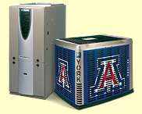
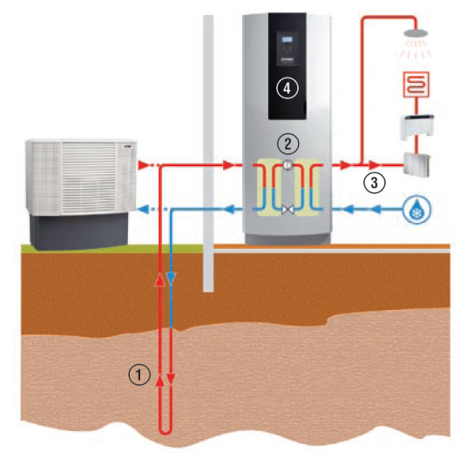
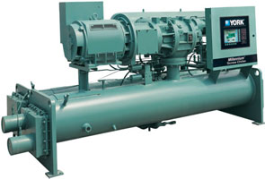
What is a Heat Pump?
ASHRAE Handbook (2008):
“A Heat Pump extracts heat from a source and transfers it to a sink at a higher temperature”
“In engineering, however, the term Heat Pump is generally reserved for equipment that heats for beneficial purposes, rather than that which removes heat for cooling only”
System Designs:
Air-Source
Ground-Source
Water-Source
YORK Screw Chiller (YS)
YORK Affinity Series
YORK Geysir Series
10
Notes:
Ok, so let’s start by first answering the question, what is a heat pump?
According to ASHRAE:
“A Heat Pump extracts heat from a source and transfers it to a sink (for example: heating coils) at a higher temperature”
“In engineering, however, the term Heat Pump is generally reserved for equipment that heats for beneficial purposes, rather than that which removes heat for cooling only.”
When discussing heat pumps there are 3 primary system designs:
CLICK
Air-source – An example of this is the heat pump you may have in your home
CLICK
2) Ground-source – This system uses the ground as the heat source, and it’s often used in residential or light commercial applications, like schools
CLICK
3) Water-source – This system uses a building’s water to transfer heat and is the focus of today’s discussion

Slide 11

What is a Heat Pump?
Typical Building Configuration
Boiler provides 100%
of building heating
Note: All boilers have
a COP less than 1
Cooling Tower
95ºF
85ºF
(35.0ºC)
(29.4ºC)
Condenser
Motor
Compressor
Expansion Valve
Evaporator
54ºF
44ºF
(12.2ºC)
(6.7ºC)
180ºF
(82.2ºC)
Boiler
160ºF
(71.1ºC)
11
Notes:
So, again we have pictured our traditional building configuration with its traditional temperatures, where the inefficienct boilers are providing 100% of the building’s hot water...

Slide 12
What is a Heat Pump?
Building with Heat Pump heating
Heat pump is employed to utilize
building heat that would otherwise
be rejected by the cooling tower
→ COP typically greater than 6!
Boiler provides supplemental
heating if required
150ºF
130ºF
(65.5ºC)
(54.4ºC)
Condenser
Motor
Compressor
Expansion Valve
Evaporator
54ºF
44ºF
(12.2ºC)
(6.7ºC)
Boiler
12
Notes:
...and when we add a heat pump chiller to the installation we are able to utilize heat that would other wise be rejected to the atmosphere via the cooling tower, and raise our heating COP; therefore, reducing energy costs.

Slide 13
What is a Heat Pump? – Refrigerant P-H Diagram
Heat Rejection Factor (HRF)
Heat Pump 1.25
to 1.45 X
Evaporator Heat
Heat Rejected
Liquid Line
Vapor Line
Pressure
Evaporator Input
Comp Input
Energy / Enthalpy
13
Notes:
To start to understand why heat pumps offer higher efficiencies than traditional boilers lets take a quick look a chiller’s refrigerant P-H diagram.
Pictured is a typical chiller in cooling mode, with the blue line representing the evaporator, the red diagonal line the compressor, the red horizontal line the condenser and the green vertical line the expansion device.
With this configuration you can see that the heat rejected, or the heat going to the cooling tower, is the horizontal equivalent of both the evaporator and compressor heat inputs.
(CLICK)
Now in heat pump mode (the diagram grows because of higher operating pressures) you can see we’ve listed what is called the Heat Rejection Factor (HRF). Or the equivalent of the evaporator heat input plus approximately 25-45% more to account for the heat of compression. This factor varies based on many inputs like operating conditions, size of the equipment, etc., but it is always within this range. This extra 25-45% is exactly what heat pumps take advantage of. In other words, whenever a chiller is operating it is producing this extra heat, but it’s typically rejected through the cooling tower. What we want to do is take advantage of it and use it!

Slide 14

Heat Recovery Systems
14
Notes:
Ok, now that we’ve covered heat pumps, lets take a quick look at heat recovery systems.

Slide 15
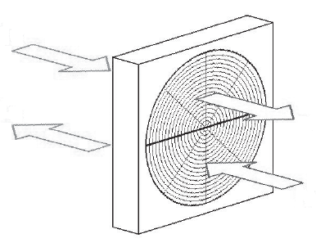

What is Heat Recovery?
ASHRAE Handbook (2008):
“In many large buildings, internal heat gains require year-round chiller operation. The chiller condenser water heat is often wasted through a cooling tower”…“[Heat recovery] uses otherwise wasted heat to provide heat at the higher temperatures required for space heating, reheat, and domestic water heating”
System Designs:
Air-Source
Water-Source
Outside Air
Exhaust Air
Supply Air
Return Air
YORK Double Bundle Heat Recovery Chiller
15
Notes:
So, again let’s define what we mean by heat recovery.
Here is the ASHRAE definition:
“In many large buildings, internal heat gains require year-round chiller operation. The chiller condenser water heat is often wasted through a cooling tower”…“[Heat recovery] uses otherwise wasted heat to provide heat at the higher temperatures required for space heating, reheat, and domestic water heating”
CLICK
There are 2 primary system designs when talking about heat recovery:
Air-source – Specifically Energy Recovery Wheels, which many buildings employ to save energy
Water-source – Similar to heat pumps this system uses a building’s water to transfer heat, and this is what we will be discussing

Slide 16
What is Heat Recovery?
Typical Building Configuration
Boiler provides 100%
of building heating
Cooling Tower
Condenser
Motor
Compressor
Expansion Valve
Evaporator
Boiler
16
Notes:
So, let’s again go back to our traditional building system configuration where boilers are providing 100% of the building’s heat...

Slide 17
What is Heat Recovery?
Building with Heat Recovery
Cooling Tower
Heat recovery is employed to utilize a portion of the building heat that the cooling tower would otherwise reject
Boiler provides supplemental heating if required
105ºF
95ºF
(40.5ºC)
(35ºC)
105ºF
95ºF
(40.5ºC)
(35ºC)
Heat Recovery
Condenser
Motor
Compressor
Expansion Valve
Evaporator
54ºF
44ºF
(12.2ºC)
(6.7ºC)
Boiler
17
Notes:
...and when we add heat recovery to the installation we are able to utilize a portion of the building’s heat that would other wise be rejected to the atmosphere.
CLICK
You’ll notice by the temperatures shown the focus here is on warm water applications, not hot water as we reviewed with heat pumps. Again, the primary job of a heat recovery chiller is providing chilled water, and accordingly it is controlled by the leaving chilled water. However, like heat pumps, there is an opportunity to take advantage of otherwise wasted chiller heat by adding a second bundle of chiller tubes to the condenser. By doing this recovered heat can then be sent to bulding processes that can utilize these warm water temperatures like domestic water preheat or perimeter reheat.

Slide 18



Benefits
Why use heat pumps or a heat recovery chiller?
Economic Advantages
Operational savings
Social / Environmental Advantages
CO₂ reductions
Reduced water consumption
Compliance with Industry Programs
LEED
18
Notes:
Let’s talk benefits. There are 3 main reasons to use hot water solutions.
CLICK
First and foremost we’ll take a look at the economic advantages.
CLICK
Secondly, we’ll run through the social and environmental advantages,
CLICK
and finish up with how hot water solutions can help get LEED points.

Slide 19

Benefits – Economic Advantages
1.35 unit
150ºF
130ºF
0.35 unit
Useful Heating
(65.5ºC)
(54.4ºC)
Input
Work
Condenser
Motor
Compressor
Expansion Valve
Evaporator
Useful Cooling
Cooling COP = 1.00 / 0.35 = 2.9
54ºF
44ºF
Heating COP = 1.35 / 0.35 = 3.8
1 unit
(12.2ºC)
(6.7ºC)
Combined COP = 2.35 / 0.35 = 6.7
19
Notes:
First let’s tackle the economic benefit of the heat pump chiller.
CLICK
Again, we are showing our heat pump chiller schematic in which we have input work of 0.35 units for every 1 unit of beneficial cooling. The resulting cooling COP is 2.9.
Remember that the higher the COP the better, and when we compare this with our ASHRAE 90.1 COP of 6.1 and we can see that the heat pump chiller is not an efficienct chiller in this configuration. Why not? Because we are artificially rasing the condenser water temperature beyond what is needed and thus the power requirement is much higher. In other words, when a chiller is only doing cooling keep the condenser water temperature as low as possible. This will drive higher COPs.
CLICK
Now if we look at the beneficial heating we can get out of the heat pump chiller, the resulting COP is 3.8. When we can compare this to an 85% efficient (COP=0.85) boiler, which is typical, you can see that it is a very efficient hot water heater.
CLICK
Finally, let’s look at the case where we have simultaneous heating and cooling. In this case, the beneficial output is 2.35 units and the resulting COP is 6.7! Based on this high COP, we can now start to see why the heat pump chiller in a simultaneous heat and cooling configuratoin has such compelling economic advantages. Let’s complete the economic analysis with the example in the next slide.

Slide 20
Benefits – Economic Advantages
What is the overall system COP?
Capacity Ratio (Heating/Cooling) = 1.35
This heat pump is five times as efficient as the
conventional system using chillers and boilers!
20
Notes:
This slide is comparing a chiller and a boiler to a simultaneous heating and cooling heat pump. The resulting total system COP for the cooling and heat system is 1.34 for the chiller and boiler and 6.71 for the heat pump. This is again calculated by useful energy over input energy. The result is that a heat pump is FIVE times as efficient as the traditional heat and cooling system with a boiler and chiller.

Slide 21



Benefits – Economic Advantages
How much would it cost to produce 1 therm (100,000 BTUs) of heat?
$2.52
$2.46
Fuel Oil
Electric
$3 / gal
$0.08 / kW.hr
$1.18
$0.60
$1 / therm
$0.08 / kW.hr
$0.08 / kW.hr
Natural
$0.35
Gas
Traditional Boiler Heating
Heat Pump
(Heating Only)
Heat Pump
(Simultaneous Heating & Cooling)
21
Notes:
So now that we understand the performance advantages of heat pumps, especially when providing simultaneous heating and cooling, lets translate it to a cost comparison. To do this lets answer the question, how much would it cost to produce 1 therm of heat?
First, lets look at the yellow bars which represent traditional methods for heating. As you can see, economically, a natural gas boiler is the best solution with a cost of $1.18 per therm. Now, you may be wondering why the facility cost is $1.18 per therm, when the utility cost is $1 per therm. Remember that on average boilers are about 85% efficient. Therefore the boiler will be consuming more gas to achieve the desired 1 therm output.
When you compare these traditional heating methods to heat pumps you can see that the heat pump makes more economic sense. For an apples to apples comparison we’re showing a heat pump only providing heating, with no cooling credit. Even in this situation and electric heat pump costs about half as much as a natural gas boiler, and about a quarter of the cost of an electric boiler.
Take it one step further and include the cooling credit associated with doing simultaneous heating and cooling and you get a cost of about $0.35, which is a substantial improvement over traditional methods. Lets look at a real life example…

Slide 22

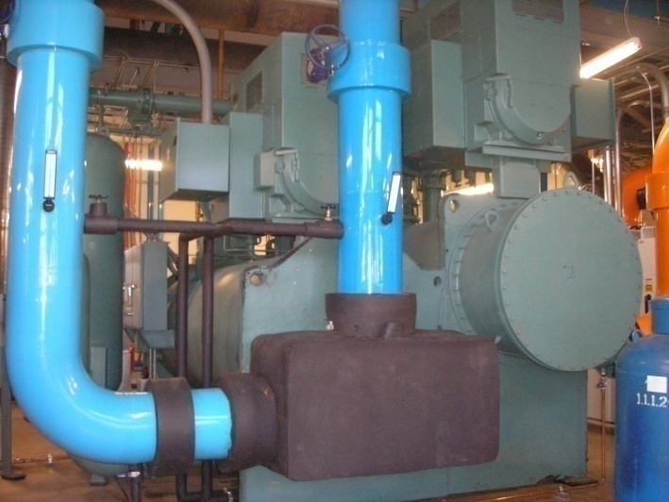
University of Arkansas Medical School
Arkansas, USA
JCI Centrifugal (CYK) Heat Pump:
1,000 Tons (3515kW) Cooling
17,000 MBH Heating
38ºF (3.33ºC) chilled water supply
155ºF (68.3ºC) hot water supply
Simple Payback < 1 year:
$2.59 per MMBTU heating cost
for heat pump
$10.63 per MMBTU heating
cost for gas boiler
$12.31 per MMBTU heating
cost for electric boiler
22
Company Confidential
Notes:
The University of Arkansas Medical School is one of our best heat pump installations. Based on the energy saving, this customer saw a payback of less than a year with one of our CYK, or compound YK, centrifugal heat pumps. This CYK provides this facility simultaneous heating and cooling at the temperatures shown.
As we have shown on the previous slide when you compare the energy costs of their onsite boilers with their new heat pump there really is no comparison. The heat pump provides them massive savings. In fact a university representative had the following to say…

Slide 23
University of Arkansas Medical School
“Last night the cooling load dropped below 1,000 tons and the system automatically stopped all of the cooling only water chillers and the entire tower water system. The water chiller bypass valve (3-way valve) changed positions such that CH-1 (heat pump) was directly serving the entire chilled water system (as well as the heating water system as there were no boilers on-line).
At 6:00 AM this morning, everything appeared to be working properly. The heat pump was producing slightly more than 800 tons of cooling with slightly less than 80% of full load current on both compressors. The entering and leaving chilled water temperatures were 54ºF and 45ºF, respectively. The entering and leaving heating water temperatures were 146ºF and 155ºF, respectively.
Under these conditions, when the heat pump is operating at near full load and producing 100% of the system’s heating and cooling requirements the energy cost savings are in the range of $100 to $150 per hour depending on the gas and electricity rates.”
Testimonial
“when the heat pump is operating at near full load and producing 100% of the system’s heating and cooling requirements the energy cost savings are in the range of $100 to $150 per hour”
23
Company Confidential
Notes:
Here is a customer testimonial of how their heat pump chiller is operating. Essentially what he’s saying here is that he was able to shut down all supplementary heating and cooling equipment, including the entire cooling tower system, and only run his heat pump. His heat pump was meeting all of the facilities heating and cooling needs by itself and when it does that he is getting savings in the range of $100 to $150 per hour, depending on utility rates! These are monster saving and quickly cut down on the payback period.
Remember when we said that the heat pump chiller should be the first chiller on and the last one off, well this is a prime example why. UAMS knows to run their heat pump as hard they can and that’s how they are seeing the full benefit.

Slide 24

Benefits – Social / Environmental
How much water would a 600 Ton Heat Pump (at 65% average load) save by not sending it to the cooling tower?
Over 8 million gallons (31 million L) annually!
+ Water treatment
& sewer savings
Assumptions:
Cooling tower consumption per evaporation rate of 1% & blow-down of 0.3% (4 cycles of concentration)
3 gpm/ton (0.054 L/s) condenser water flow
24
Notes:
Let’s look at the social and environmental advantages associated with heat pumps. First, as we previously stated, when a heat pump is operating we’re keeping heat within the building and not rejecting heat to the atmosphere. In other words, we’re saving condenser water from evaporating.
So when we look at our same 600 Ton heat pump example again, how much water are we saving by not expelling heat to the atmosphere from the cooling tower?
CLICK
Well with the evaporation and blow-down rates shown, as well as the assumption of a 3 gpm/ton (0.054 L/s) condenser water flow, were saving more than 8 million gallons (31 millionL) per year! (math shown below) Translating that into dollars, assuming $0.02 per cubic foot, your saving approximately $19,700 per year. Not to mention the savings you’d see from decreased chemical water treatment and sewer usage.
Also, another key point to mention is that by diverting a large portion of heat away from the cooling tower you can likely downsize your cooling tower and realize those savings as well.
Math
make up = blow down + evaporation
4 cycles of concentration
evaporation rate = 1%
water flow = 1800 gallons per minute
therefore, water is evaporating at 18 gallons per minute
blow down = (evaporation)/(cycles of concentration – 1)
blow down = (18)/(4-1) = 6 gallons per minute
make up = 6 gallons per minute + 18 gallons per minute = 24 gallons per minute
gallons per day at 100% heat pump utilization = (24 gallons per minute) x (60 minutes per hour) x (24 hours per day) = 34,560 gallons per day
heat pump at 65% utilization rate = (34,560) x 0.65 = 22,464 gallons per day
22464 gallons per day* 365 days per year= 8,212,500 million gallons annually

Slide 25

Benefits – Social / Environmental
How much CO₂ would a 600 Ton Heat Pump (at 65% average load) offset, compared to a natural gas boiler?
1467 Tons of CO₂ annually
Natural Gas Boiler
(COP 0.85)
13.0 lbs of CO₂ per
100,000 BTU
Heat Pump
(COP 6.70)
7.7 lbs of CO₂ per
100,000 BTU
This is the equivalent of removing 244 cars from the road!
* - CO₂ calculator: http://www.epa.gov/cleanrgy/energy-resources/calculator.html
25
Notes:
Secondly, let’s look at the CO2 savings you will see with heat pumps.
CLICK
As an example lets take a 600 Ton heat pump, operating at about 65% load, and compare it to a natural gas boiler. Again, when you compare the efficiency of a boiler to a heat pump, the heat pump comes out way ahead. In fact 1467 Tons of CO2 ahead, or about the equivalent of removing 244 cars from the road!
* - CO₂ calculator: http://www.epa.gov/cleanrgy/energy-resources/calculator.html

Slide 26

Benefits – Industry Program Compliance
Acquire LEED points with Heat Pumps!
Potential Impact
WATER EFFICIENCY (WE)
WE Credit 4 – Process Water Use Reduction (1 Point)
Reduce process water use by 20% with a heat pump
Couple with closed circuit cooling towers and could receive Innovation Credit for exemplary performance! (1 additional Point)
ENERGY & ATMOSPHERE (EA)
EA Credit 1 – Optimize Energy Performance (1-21 Points)
Heat pumps will deliver several points toward the 21 possible points for energy improvements beyond the baseline
EA Credit 4 - Enhanced Refrigerant Management (1-2 Points)
The combination of environmentally friendly R134a and low refrigerant charges deliver credit compliance
26
Notes:
Finally, heat pumps will help you and your customers get LEED points.
CLICK
First, within water efficiency, as we just went through on the previous slide you will be reducing your process water needs. Depending on the installation you may be able to achieve this credit alone with a heat pump, or you will at least be well on your way to achieving it. Secondly, if you get creative and do something like couple a heat pump system with closed circuit cooling towers you maybe able to achieve a 40% reduction in process water; therefore demonstrating exemplary performance and achieving an innovation in design credit.
CLICK
Heat pumps also apply to the energy and atmosphere section on LEED. Specifically, credits 1 and 4. Credit 1 for energy improvements over the building baseline, which we can certainly help you calculate, and secondly refrigerant management compliance as all of our heat pumps are operated with environmentally friendly 134a.

Slide 27


Control & Sizing
ASHRAE Minimum Requirements:
6.5.6.2.1 (ASHRAE 90.1-2004)
Condenser heat recovery systems shall be installed for heating or preheating of service hot water provided all of the following are true:
The facility operates 24 hours a day
The total installed heat rejection capacity of the water cooled systems exceeds 500 Ton of heat rejection
The design service water heating load exceeds 85 tons
27
Notes:
This next section is identifying the best method to control and size a heat pump or heat recovery unit.
ASHRAE does provide minimum building design requirements for when heat pump units or heat recovery chillers should be installed for service water heating. But, here is our perspective…
27

Slide 28
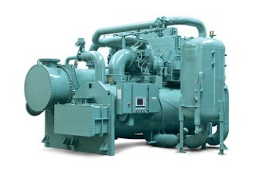
Heat Pump Control & Sizing
Example Building Load Profile
7,000
6,000
5,000
kW
4,000
3,000
2,000
1,000
-
0-6
6-12
12-
18-
0-6
6-12
12-
18-
0-6
6-12
12-
18-
0-6
6-12
12-
18-
18
24
18
24
18
24
18
24
Winter Day
Spring Day
Summer Day
Fall Day
Chiller/Heat Pump
Heating Load
Cooling Load
28
Notes:
Let’s first take a look at a typical building load profile. Shown are both the seasonal heating and cooling loads of a hospital in California. As you can imagine this will greatly vary depending on the installation type and the geographic location. So the obvious question we want to answer is how do we size our heat pump to satisfy all or a portion of both the heating and cooling loads?...

Slide 29
Heat Pump Control & Sizing
Cooling Control
Heating Control
Heat available from cooling load
Heating Load
Cooling Load
Supplemental Heating
HP Design Capacity
Load
Supplemental Cooling
Heat Pump Operation
Cold
Ambient Temp
Hot
29
Notes:
Here is a simplified explanation: Suppose that we construct a facility load plot as shown. The ambient temperature is shown on the x axis and the building requirement capacity, or load, is on the Y axis. The facilities cooling requirement is shown, obviously increasing as the ambient temperature increases. As we have already discussed, there is heat available from the condenser as a result of the cooling duty. The dashed red line represents this available heat. Remember the HRF (heat rejection factor) is about 1.35 times the cooling load, that’s what we are talking about.
CLICK
Okay now we also draw the buildings heat requirement as a solid red line. Obviously the heat requirement is highest on the coldest days and lowest on the warmer days.
CLICK
The heat pump should approximately be sized at this point – the intersection of the heat available from a heat pump and the heat required. I say approximately because we are missing a critical piece of information in this elementary example. Does anyone know what we need to know besides a load vs temperature graph? Bin hours. We need bin hours to look at the economics.
CLICK
Anyway, we now have an approximately sized heat pump chiller. Now we can see that during colder days the unit should be operated as a chiller as it can satisfy the complete chilled water requirement.
CLICK
Whatever heating that you get from that cooling load will need to be supplemented from a boiler or other heat source to meet the facility’s heat requirement.
CLICK
Now take a look at the middle of the plot and you’ll notice that both the heating and cooling needs of this facility are satisfied by the heat pump chiller and no supplemental support is required. This is typically seen during the shoulder months of the year. The University of Arkansas Medical Center is a good example of this.
CLICK
During this same seasonal time period it makes sense for the heat pump to be switched to heating control. This way the unit will supply all of the required hot water and a portion of the chilled water demand. Here additional (supplemental) chillers will be required to meet the building entire load. The great thing about out equipment is that it monitors both the leaving chilled water and the leaving condenser water temperature and automatically switches from heating mode to cooling mode as required.

Slide 30
Hospital Example
30
Notes:
This slide and the following is an actual example of a heat pump that is installed at a southwest United States hospital.

Slide 31
Conventional Plant - Chiller Model
31
Notes:
This slide and the next 5 are hidden. If your audience wants more detail, feel free to share these slides with them.

Slide 32
Conventional Plant - Boiler Model
32

Slide 33
Operating Summary for Conventional System
Heating/Cooling Plant System - Annual Operating Cost Summary
 | Conventional System
Chillers | $472,402
Boilers | $1,156,894
Chiller/Heat Pump | NA
Total | $1,629,296
33

Slide 34
Chiller/Heat Pump Plant - Chiller Model
34

Slide 35
Chiller/Heat Pump Plant - Boiler Model
35

Slide 36
Chiller/Heat Pump Plant - Chiller/Heat Pump Model
36

Slide 37
36% Cost Savings with the Heat Pump
Heating/Cooling Plant System - Annual Operating Cost Summary
 | Conventional System | With Chiller/Heat Pump
Chillers | $472,402 | $380,659
Boilers | $1,156,894 | $252,043
Chiller/Heat Pump | NA | $417,049
Total | $1,629,296 | $1,049,752
36% Savings!
37

Slide 38
Heat Pump Control & Sizing
Typical Arrangement:
Hot water loop
130°F
150°F
Boiler
(54.4°C)
(65.6°C)
150°F
CH1
(65.6°C)
Heat Pump
CH2
CH3
42°F
(5.6°C)
CH_{n}
58°F
50°F
42°F
(14.4°C)
(10°C)
(5.6°C)
Chilled water loop
38
Notes:
This schematic shows a typical arrangement (sometimes called a side-car) of how a heat pump chiller is piped in a system. This arrangement is called a side car arrangement.
The heat pump chiller is piped to both the chilled water and the hot water loops upstream of the supplemental heating and cooling equipment. In this example, the HPC is meeting the entire hot water load by producing 150ºF (65.6ºC) and therefore bypassing the boiler. If 180ºF (82.2ºC) were needed the heat pump would be used to preheat the boiler feed water; ultimately cutting the system energy consumption by reducing the work the boiler has to do.
Also in this example, the cooling side of the heat pump is producing chilled water at 42ºF (5.6ºC). When mixed with the main chilled water loop the resulting temperature is 50ºF (10ºC). Therefore, to meet the required 42ºF (5.6ºC) set point additional supplemental chillers are needed.
Ultimately what you should pick up from this slide is that the heat pump chiller should be the first on and the last off in all cases. Run the heat pump as much as possible! This will maximize the system energy savings.

Slide 39
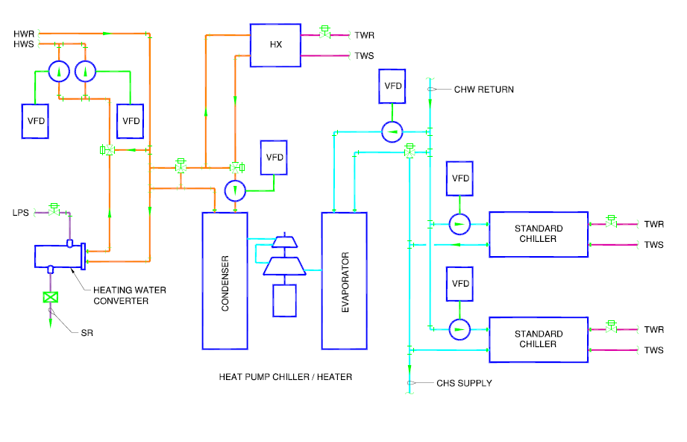
Heat Pump Piping Example
Hot Water
Return
Hot Water
Supply
Tower Water Return
Tower Water Supply
Heat Exchanger
Chilled Water Return
Chilled Water Return
Chilled Water Supply
Hot Water Heater
Chilled Water Return
Chilled Water Supply
Heat Pump
Chilled Water Supply
39
Notes:
This is a heat pump piping example of a hot water system at a large medical center. This example shows the advantage that depending on how you size the heat exchanger you can have the heat exchanger take the whole heat load allowing the heat pump chiller to function as an N plus 1 chiller. (a CYK chiller would need to be used in this instance).

Slide 40
Heat Recovery Control & Sizing
Recommended Arrangement:
Cooling Tower
Cooling Tower
65ºF
55ºF
105ºF
95ºF
(18.3ºC)
(12.7ºC)
(40.5ºC)
(35ºC)
CH_{n}
Heat Recovery
Boiler
105ºF
95ºF
(40.5ºC)
(35ºC)
Perimeter Reheat Loop
40
Notes:
This is a heat recovery piping example. It is our recommendation that buildings with heat recovery chillers be connected with a separate, individual, cooling tower loop. The reason being that the water going to the building from the heat recovery chiller will be at the same temperature as it is going to the cooling tower. So in order to see benefit, for a process like perimeter reheat, the customer needs to keep the chiller lift elevated so that warm water is being sent to the building. So on a chiller basis, the heat recovery chiller by itself isn’t operating as efficiently as a standard chiller, but the benefit seen from not utilizing the boiler to produce warm water outweighs the higher chiller operating costs.
Accordingly we need to make sure the non-heat recovery building chillers operate as they would in any other building installation with low entering condenser water temperatures. By keeping the two cooling tower loops separate we can keep the chiller lift very low for the standard chillers, delivering optimum chiller plant performance.

Slide 41
Application Considerations
vs.
41
Notes:
So, let’s take a look at some application considerations…

Slide 42
Application Considerations-
Heat Recovery and Heat Pump
Hotel/ Casino
- Laundry
- Showers
- Swimming pools
Office Buildings
- Perimeter reheat
- Domestic HW preheat
Universities
- Dorms
- Boiler preheat
Hospitals
- Laundry
- Boiler preheat
Process / Manufacturing
- Boiler preheat
42
Notes:
42
You’ve already seen this slide, but just to reemphasize we generally recommend heat recovery chillers for applications that have warmer water temperature requirements, say 105ºF (40.5ºC); where we recommend heat pumps for applications with water temperature requirements over 120ºF (48.9ºC). As far as specific keys to a successful application we have a few general rules…

Slide 43
Application Considerations for Hot Water Usage
Keys to Success:
Remember that every application is different. Understanding what the facility’s heat loads are (required temperatures and MBH) and when they occur is paramount
Remember that properly applied heating solutions save energy and
the environment in almost every situation (new construction & retrofit)
3) Fastest return on investments are seen when utility rates are high and there is a consistent need for simultaneous heating and cooling
For buildings that require hot water at 170ºF (76.7ºC) use a heat pump
5) For buildings where heat recovery should be used, the heat recovery condenser circuit should have its own independent cooling tower loop
→ see Heat Recovery application document 160.75-AD2)
43
Notes:
43
CLICK
…first as previously stated remember that every application is different. Specifically understanding what the facility’s heat loads are, being required process temperatures and MBH, and when they occur; what time of day, are they seasonal, etc?
CLICK
Secondly, boilers are inefficient. In almost every situation that we’ve evaluated we’ve seen benefits from applying a heat pump or heat recovery chiller. This includes both new construction and retrofits.
CLICK
Thirdly, the fastest ROIs are seen when utility rates are high and there is a consistent need for simultaneous heating and cooling.
CLICK
Lastly, in facilities that require hot water at or near 180F, use a heat pump. High temperature heat pumps will dramatically reduce the need for boiler heating.

Slide 44

JCI Hot Water Equipment Solutions
44
Notes:
Let’s finish up by taking a quick look at the hot water products we have to meet the required heating and cooling duty we’ve been discussing.

Slide 45

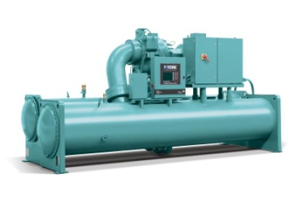
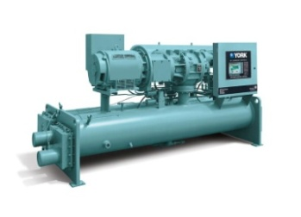
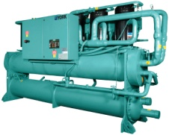

Johnson Controls Offerings
CYK Centrifugal Heat Pump
YK Centrifugal Heat Pump (Low Lift)
YS Screw Heat Pump
YCWL Scroll Heat Pump
Max Leaving Hot Water Temp
YK Centrifugal Heat Recovery
90
100
110
120
130
140
150
160
170
180
ºF
(32.2)
(37.8)
(43.3)
(48.9)
(54.4)
(60.0)
(65.6)
(71.1)
(76.7)
(82.2)
(ºC)
45
Notes:
Here is a snap shot of our products and what their maximum hot water capabilities are. We have 4 heat pump machines and 1 heat recovery machine. You will note that the certain units of the CYK and YK chillers can have the max leaving hot water temperature up to 170° F (76.7° C). Let’s take a closer look at each…

Slide 46
YORK Heat Recovery Solutions
YK Centrifugal Heat Recovery
Max leaving hot water = 110ºF (43.3ºC)
Max Lift = 65ºF (36.1ºC)
Max heat per unit = 40,000 MBH
(11,725 kW)
Simultaneously Cooling & Heating
Single centrifugal compressor package
Evap Tons 280-2800 Tons
(985-9850 kW)
46
Notes:
For heat recovery applications we have again made upgrades to our flagship product the YK so it can be applied in this manor. As you can see from the picture the condenser has 2 sets of nozzles. The top set is the heat recovery set, while the bottom set is for the cooling tower loop. This chiller is sized so that it can provide hot water up to 110ºF (43.3ºC) and provide heat up to 40,000 MBH.
There are 5 models (Q4, Q7, H9, K2, K7) for heat recovery covering the 250-2800 Ton capacity range.
46

Slide 47
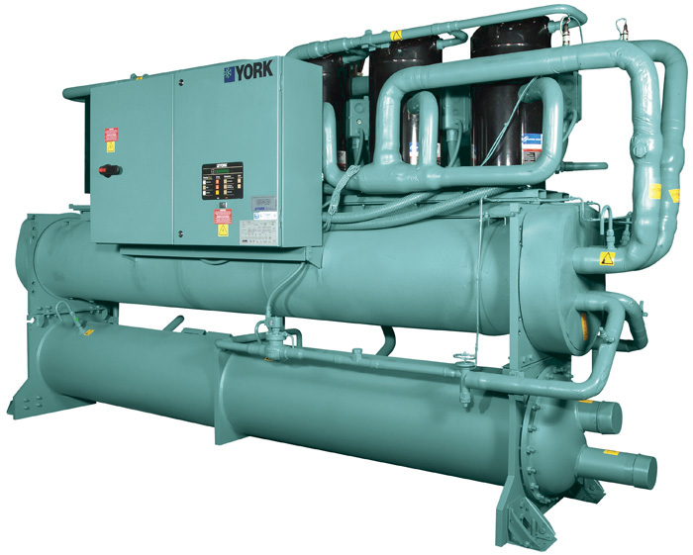
YORK Heat Pump Solutions
YCWL Scroll Heat Pump
Max leaving hot water = 125ºF (52ºC)
140ºF (60ºC) for some models
Max Lift = 85ºF (47ºC)
98ºF (54ºC) for some units
Max heat per unit = 3,200 MBH (940 kW)
Simultaneous heating & cooling
Multiple scroll compressor package
Evap Tons 50-200 Tons
(175-705 kW)
47
Notes:
First we have our YCWL heat pump. This product line is ideal for smaller facilities with higher temperature water needs as it has models that go up to 140ºF (60ºC) by SQ request. It is capable of providing up to 3,200 MBH and delivering simultaneous heating and cooling.

Slide 48

YORK Heat Pump Solutions
YS Screw Heat Pump
Max leaving hot water = 140ºF (60ºC)
Max Lift = 100ºF (55.6ºC)
Max heat per unit = 5,300 MBH (1,560 kW)
Simultaneous heating & cooling
Single screw compressor package
Evap Tons 100-330 Tons
(350-1160 kW)
48
Notes:
Next we have our YS screw heat pump chiller. We have applied this to many different applications. We have one installed in our LEED platinum corporate center in Milwaukee and even a ground-source application in California. This chiller is a top seller for us as it can handle lift up to 100ºF (37.8ºC). In other words, it can supply 140ºF (60ºC) hot water to the building as well as simultaneously supplying 44ºF (6.7ºC) chilled water.

Slide 49

YORK Heat Pump Solutions
YK Centrifugal Heat Pump
Max leaving hot water = 155ºF (68.3ºC)
Max Lift = 65ºF (36.1ºC)
Max heat per unit = 30,000 MBH (8,800 kW)
Heating only
Single centrifugal compressor package
Best suited for non- simultaneous
heating and cooling systems
Evap Tons 250-2800 Tons
(880-9850 kW)
49
Notes:
We also have our YK product line. This is has been our flagship product for cooling applications and we now have models capable of providing hot water up to 155ºF (68.3ºC). The YK is best suited for systems that can handle a low lift machine. See the next slide for an example.

Slide 50
YK Heat Pump Example- Process Heating
Hot Water
Heat Pump
Cooling Tower
Recovery Bypass Line
To Cooling Tower
From Cooling Tower
Preheat Heat Exchanger
Makeup Water
50
Notes:
The YK heat pump is best suited for non-simultaneous heating and cooling applications. Industrial low lift applications are best because they require no chilled water or can handle higher chilled water temperatures.
For example, an ideal YK heat pump application would be a huge gas turbine where instead of taking to the cooling tower, it can go directly into the evaporator of the YK heat pump.

Slide 51
YORK Heat Pump Solutions
CYK Compound Centrifugal Heat Pump
Max leaving hot water = 155ºF (68.3ºC)
170ºF (76.7ºC) for some models
Max Lift = 140ºF (77.8ºC)
Max heat per unit = 38,000 MBH (11,000 kW)
Simultaneous heating & cooling
Two compressors in series
Evap Tons 600-2200 Tons
(2115-7740 kW)
51
Notes:
Finally we have the CYK; our most versatile product. It is an extension of the YK line with the major difference being that this chiller can do very high head as it has two centrifugal drivelines in series. This is the top seller for applications like hospital complexes and universities as it consistently has provided quick paybacks.

Slide 52

Remember:
Many economic and environmental advantages with
heat recovery and heat pump chillers
Simultaneous heating and cooling applications offer
the greatest paybacks
Every potential application should in individually
investigated
52
Notes:
In conclusion we want you to remember a few key items. One, remember that there are many economic and environmental advantages with applying heat pumps and heat recovery. Two, remember to look for simultaneous heating and cooling applications as they offer the greatest payback. Lastly, look at all applications individually to truly understand were major savings can be realized.

Slide 53



Reduce your energy costs today!
With our extensive track record of success, Johnson Controls is well matched to meet your hot water needs by delivering flexible, innovative, and sustainable equipment for efficient and long lasting operation.
53

Slide 54
54
Notes:
The following hidden slides showcase an additional example: St. Michael’s Hospital

Slide 55

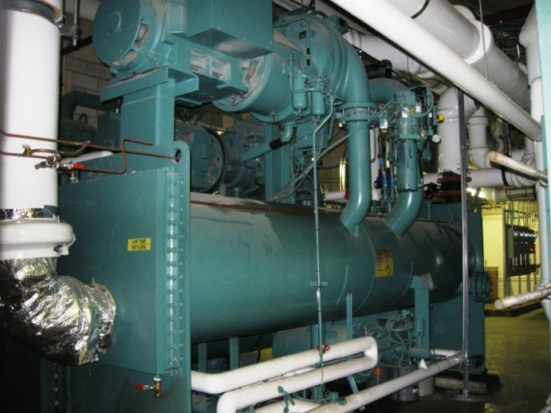
St. Michael’s Hospital
Toronto, Canada
Purpose:
Utilize exhaust air to heat
incoming fresh air
Compound CYK Heat Pump:
Inlet air heated from -40ºF to 70ºF (-40ºC to 21.1ºC)
Dual duty operation
Winter – Heat Pump
Summer – Chiller
55
Company Confidential
Notes:
An example of a successful heat pump solution installation is at St. Michael’s Hospital in Toronto.
This machine is both environmentally friendly and cost effective. The chiller offers dual duty operation, for both cooling and heating loads. The heat pump solution limits the use of a boiler during the winter and in some situations can completely eliminate the need for a boiler during the summer.
At this installation, exhaust air is used to heat incoming air.
Heat pump chillers are more efficient because of the combined ability to cool and heat. Heat pumps can offer combined heating and cooling COP values, coefficient of performance up to 6.7 which is a very substantial difference between the COP of traditional boilers which is 0.85.
Because they are more efficient they also reduce CO₂ emissions and therefore reduce the carbon footprint of facilities. Another advatnage to heat pump solutions is that they can save water with a closed water loop.
Also important, heat pump chillers can save a substantial amount of money- providing a very quick return on investment.
The St. Michael’s Hospital received a simple payback for the chiller in 6 months. And saved over $1 million in a year.

Slide 56



St. Michaels Hospital
Heated to 70°F
Cooled exhaust air
Outside air
Exhaust air
(21.1°C)
130°F
115°F
(54.4°C)
Heat
(46.1°C)
Pump
40°F
52°F
(11.1°C)
(4.4°C)
Winter
Operation
56
Notes:
This schematic is showing how this chiller is works during the winter when the outside temperature is colder.

Slide 57

St. Michaels Hospital
Hot outside air
Cooled to 55°F
Exhausted to ambient
Exhaust air
(12.8°C)
Domestic or Reheat Hot Water
Heat
Pump
40°F
52°F
(11.1°C)
(4.4°C)
Summer
Operation
Energy Savings - $900,000 / yr
Simple Payback - 6 months!
57
Notes:
CLICK for payback values to appear

