Slide 1


HVAC – Product & Technology
PTK Monthly HVAC Call
January 2015
Notes:
Ask for the presence of the presenters:
Carlos Herrer
Usman Muhammad (or Nick)
Alan Hinton
Morten Pedersen
Jorge de la Torre
Hello everyone, welcome to our monthly HVAC Product & Technology update call.
This is the first call of 2015 so first of all HAPPY NEW YEAR. I hope you enjoyed your Christmas holidays and you came back with your batteries recharged. Now it’s time to work again!!
It looks like we have a good group of people on the call this morning. As a reminder if you were not able to get the Lync presentation working, please follow along with the presentation I emailed to you a few minutes ago. As always please keep you phone on mute as a courtesy to others on the call and we can discuss any questions you might have at the end of our session.
We have this month several interesting news and topics that we hope interest you.
Ok, so let’s go ahead and get into the details for this month…
Let’s get started with the review of the Agenda.
TEL: 91.414.40.75
Leader: 3220214
Participant: 7033966
*4 Mute the participants

Slide 2
AGENDA
WRAP UP- PREVIOUS CALL
PRODUCT NEWS
CHILLERS: -Thermal Expansion Valve obsolescence affecting YLAA, YCWL and YCRL
-E-Link – New Contact for enquiries and support
-MLP1013e - New LTC multipliers
AIR SYSTEMS - Phase Out D4IG 360 and 480
- Air to Air System transfer to Manisa
AIRSIDE: - Airside - general
MARKETING TOOLS
- Commercial & Industrial HVAC 2015
- Product Line Card 2015
TIPS & TRICKS – FAQ’s
- How to do a remote Start/Stop in a Rooftop ACTIVA
TRAININGS
Upcoming Product Training Sessions –Feb, March and April
Relevant Training Sessions - Feb
Train the Trainers Program
TRENDING TOPIC
Manisa Status
Q&A
Notes:
So on slide 2 you will see our list of topics for this month…
The first thing that we are going to do is to look at the wrap up of the previous call with the answers of the questions that you have sent to us.
Then we’ll move to the Product News section where Carlos Herrer will present us some slides about a modification on the expansion valves used in Tempo and YCWL. For some models the TEV will not be available.
Carlos will present as well some news about E-Link accessory.
We have also a new price list received by Usman and he will do a reminder on this topic
Another points of this section are dedicated to the Phase Out of the Gas Rooftop R407C D4IG 360 and 480. We also will comment here the ESI received regarding the Air to Air Systems transfer to Manisa.
Finally, Alan Hinton will update us on the Airsides
In the next section “MARKETING TOOLS” we have two interesting news for all of you.
The first one is that the 2015 Commercial & Industrial Catalog is finally completed
And the other one is that the product line card is also completed and available in Virtual Branch.
Then will move to the FAQ section where we will explain a typical question regarding how to do a remote start-stop in an Activa Rooftop. We will remind here the product forums that we have available at SharePoint site.
After that, Jorge de la Torre, Craig and Alan will update us on Trainings. What training are coming in the next monts and also he will present us a new program that is call TRAIN THE TRAINERS.
Finally we will dedicate the Trending Topic section to speak about the situation in Manisa Factory. Morten Planck Pedersen will cover this part and he will show you some pictures of the facility.
In the end of the call we will dedicate the remaining minutes to answer the possible questions that you might have. I hope you enjoy the call…so let’s get started….

Slide 3
AGENDA
WRAP UP- PREVIOUS CALL
PRODUCT NEWS
CHILLERS: -Thermal Expansion Valve obsolescence affecting YLAA, YCWL and YCRL
-E-Link – New Contact for enquiries and support
-MLP1013e - New LTC multipliers
AIR SYSTEMS - Phase Out D4IG 360 and 480
- Air to Air System transfer to Manisa
AIRSIDE: - Airside - general
MARKETING TOOLS
- Commercial & Industrial HVAC 2015
- Product Line Card 2015
TIPS & TRICKS – FAQ’s
- How to do a remote Start/Stop in a Rooftop ACTIVA
TRAININGS
Upcoming Product Training Sessions –Feb, March and April
Relevant Training Sessions - Feb
Train the Trainers Program
TRENDING TOPIC
Manisa Status
Q&A

Slide 4
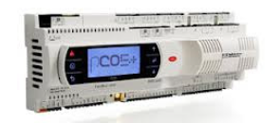
WRAP UP - PREVIOUS CALL
Christiaan Duijst
Request for YMWA Eliwell controller training
We have some YMWA chillers in operation now but it costed alot of money and effort
because the controls are quite different than the Carel microchiller.
In my opinion special attention should be made to the set up for BMS control during the training. Not only for the
YMWA but for all non-York controls chillers (YCSE, YMWA, YLRA).
Jorge de la Torre answer: we are building up the mini chiller training and YMWA/YMRA with Eliwell controlling is
planned to be added to the future training and extend from a 2 to a 3 days training.
Christiaan Duijst
In the presentation it looked like the YLRA will have a Carel controller, but is this correct?
Craig Woods answer: The YLRA has a pC05+ Carel controller.
Notes:
During the call of the previous Month we received the following questions in the Lync chat coming from Christian Duijst. He was asking about the controls used in some of our chillers and training on that. It seems that his team has found some troubles when setting BMS for YMWA controller because these controls are quite different than Carel.. We are using Eliwell controllers on that chillers so he would like to have some training on that.
Jorge answered to Christian explaining that we are working on a 2-3 days training for minichillers where Craig Woods could explain that kind of things to simplify the start-up process of these chillers
On another question, Christian wanted to know which is the control of the new heat pump YLRA and Craig answered that the control is a Carel pC05

Slide 5
AGENDA
WRAP UP- PREVIOUS CALL
PRODUCT NEWS
CHILLERS: -Thermal Expansion Valve obsolescence affecting YLAA, YCWL and YCRL
-E-Link – New Contact for enquiries and support
-MLP1013e - New LTC multipliers
AIR SYSTEMS - Phase Out D4IG 360 and 480
- Air to Air System transfer to Manisa
AIRSIDE: - Airside - general
MARKETING TOOLS
- Commercial & Industrial HVAC 2015
- Product Line Card 2015
TIPS & TRICKS – FAQ’s
- How to do a remote Start/Stop in a Rooftop ACTIVA
TRAININGS
Upcoming Product Training Sessions –Feb, March and April
Relevant Training Sessions - Feb
Train the Trainers Program
TRENDING TOPIC
Manisa Status
Q&A

Slide 6
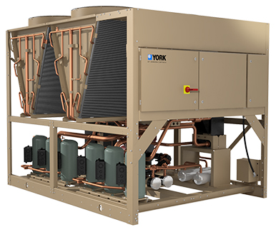
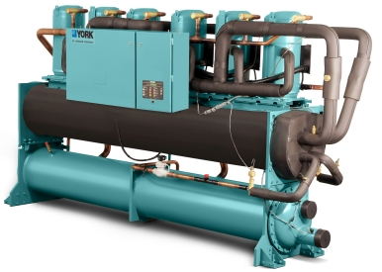
PRODUCT NEWS
Thermal Expansion Valve obsolescence affecting YLAA, YCWL and YCRL
Thermal Expansion Valves used in some of our chillers (YLAA, YCWL and YCRL) are not available anymore.
YLAA and YCWL already applied in GCSS with 14.05b update.
YCRL will be updated in GCSS with 14.05c update.
Models affected:
An ESI will be distributed within today.

Slide 7


PRODUCT NEWS
E-Link – New Contact for enquiries and support
Chiller Product Management team (Carlos Herrer) is taking the responsibility of E-Link product:
Support for standard E-Link deployment, selection, future development.
Customized E-Link solutions continue to be supported by System Integration Services Europe & Africa. SIS-Europe@jci.com
E-Link product information is available to download from the Virtual Branch:
http://be-ebusiness.eu.johnsoncontrols.com/vb/pages/series.jsp?seriesId=566
All ESI documents available through Virtual Branch
Click here to access

Slide 8
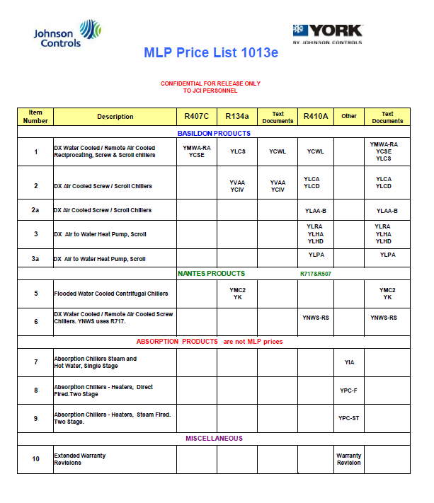
PRODUCT NEWS
MLP1013e - New LTC multipliers
New MLPs and multipliers (MLP1013e.pdf; Multipliers1013e) distributed by Usman Muhammad on 7th of January’14
Including latest MLPs and corresponding multipliers with the main following changes:
a) Nantes LTC multipliers increased by 2% as was announced during FY14.
b) Some corrections made to YK MLP, please refer to last page of MLP
Important Note: Due to some technical problems YORKworks (YW) release containing BTP changes, as was announced August last year, has been delayed. YW team is working to resolve the issues and will release the patch as soon as all issues have been addressed. New BTP multipliers shall be distributed after the YORKworkshas been released.

Slide 9

PRODUCT NEWS
Phase Out D4IG 360 and 480
R407C Rooftops gas version D4IG 360 and D4IG 480 won’t be available anymore. No sales for these models during 2014
Transfer to Manisa – Only R410A units
Gas version for Rooftops above 100 kW are not available at that moment.
Large Activa Rooftops gas version (ARG and ARD models) are still under development.
There is no launch date for these new models but it will be during FY15 once the new Manisa lab test facility will be running in the normal way.
An ESI document will be released to inform about the phase out of these products.

Slide 10
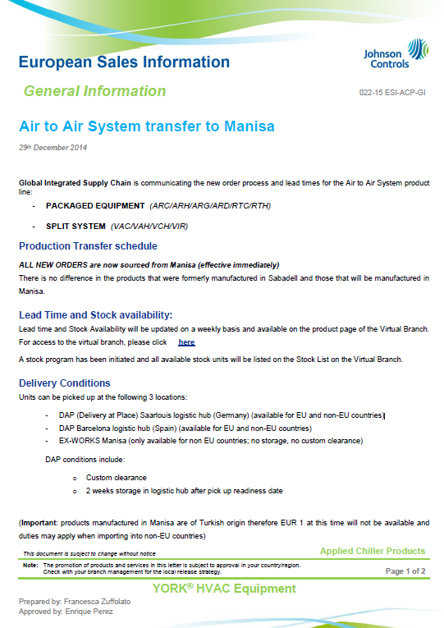
PRODUCT NEWS
Air to Air System transfer to Manisa
Global Integrated Supply Chain is communicating the new order process and lead times for the Air to Air System product line:
PACKAGED EQUIPMENT (ARC/ARH/ARG/ARD/RTC/RTH)
SPLIT SYSTEM (VAC/VAH/VCH/VIR)
ALL NEW ORDERS are now sourced from Manisa (effective immediately)
There is no difference in the products that were formerly manufactured in Sabadell and those that will be manufactured in Manisa
Lead time and Stock Availability will be updated on a weekly basis and available on the product page of the Virtual Branch. For access to the virtual branch, please click here
A stock program has been initiated and all available stock units will be listed on the Stock List on the Virtual Branch.
All ESI documents available through Virtual Branch
Click here to access

Slide 11
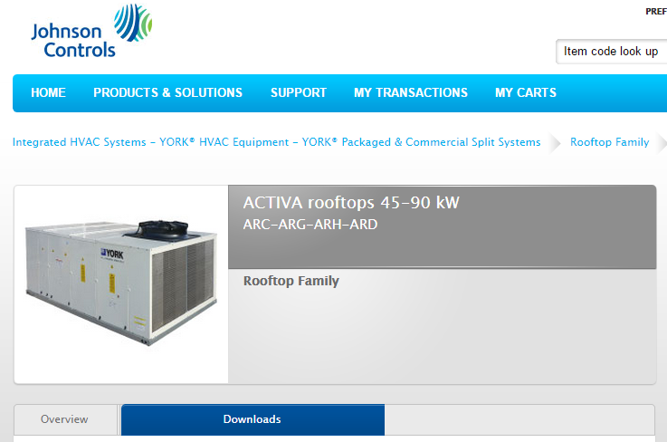
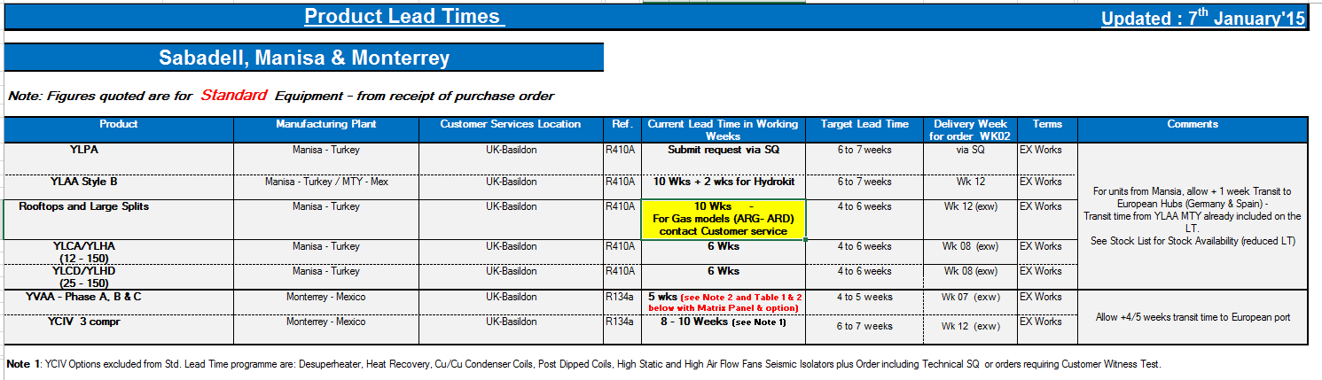
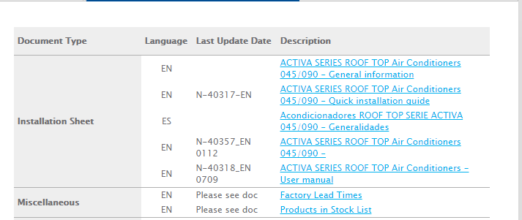
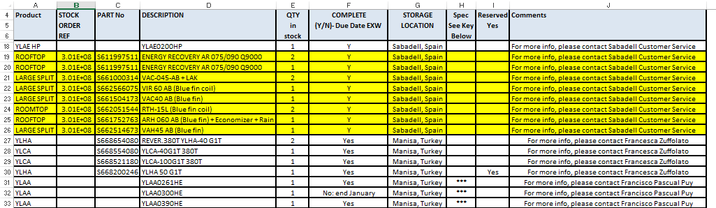
PRODUCT NEWS
Air to Air System transfer to Manisa
Lead time and Stock Availability in VB click here

Slide 12

PRODUCT NEWS
Air to Air System transfer to Manisa
Delivery Conditions
Units can be picked up at the following 3 locations:
DAP (Delivery at Place) Saarlouis logistic hub (Germany) (available for EU and non-EU countries)
DAP Barcelona logistic hub (Spain) (available for EU and non-EU countries)
FCA Manisa (only available for non EU countries; no storage, no custom clearance) – Not Ex-Works at it’s mentioned in the ESI (mistake)
DAP conditions include:
Custom clearance
2 weeks storage in logistic hub after pick up readiness date
IMPORTANT:
Products manufactured in Manisa are of Turkish origin therefore EUR 1 at this time will not be available and duties may apply when importing into non-EU countries)
All ESI documents available through Virtual Branch
Click here to access

Slide 13
PRODUCT NEWS
Air to Air System transfer to Manisa
Order Process:
New orders and leadtime queries should be sent to Francisco Pascual
Francisco.Pascual @jci.com
Phone nr: +34 93 748 9056
All purchase orders must be issued to UK Basildon as supplier (ORG 495) and the desired pick up point must be clearly specified: Saarlouis, Barcelona or Manisa.
Transfer Price
Currently published BTP’s will remain unchanged, and does not depend on delivery conditions.
Warranty
No changes to our policy. Warranty claims will be handled by the European Warranty Department. Terms and conditions of the Global warranty policy (17-16.101.BEQ) will apply.
All ESI documents available through Virtual Branch
Click here to access

Slide 14
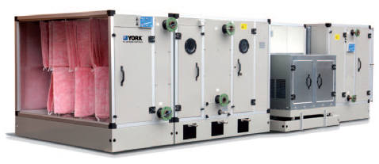

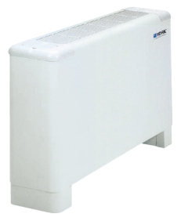
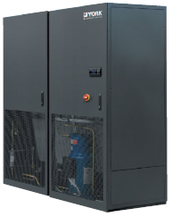
PRODUCT NEWS
Airside - general
Air Handling Units (AHU)
Lead times still typically 7 weeks
Eurovent Certification extended for YMA – certificates on Intranet
Fan Coil Units (FCU)
No major updates. Lead times 2 – 3 weeks
No price increases for FY15 (applies to Laser, YEFB ranges)
Close Control Units (CCU)
No major updates. Lead times still typically 7 weeks

Slide 15
AGENDA
WRAP UP- PREVIOUS CALL
PRODUCT NEWS
CHILLERS: -Thermal Expansion Valve obsolescence affecting YLAA, YCWL and YCRL
-E-Link – New Contact for enquiries and support
-MLP1013e - New LTC multipliers
AIR SYSTEMS - Phase Out D4IG 360 and 480
- Air to Air System transfer to Manisa
AIRSIDE: - Airside - general
MARKETING TOOLS
- Commercial & Industrial HVAC 2015
- Product Line Card 2015
TIPS & TRICKS – FAQ’s
- How to do a remote Start/Stop in a Rooftop ACTIVA
TRAININGS
Upcoming Product Training Sessions –Feb, March and April
Relevant Training Sessions - Feb
Train the Trainers Program
TRENDING TOPIC
Manisa Status
Q&A

Slide 16


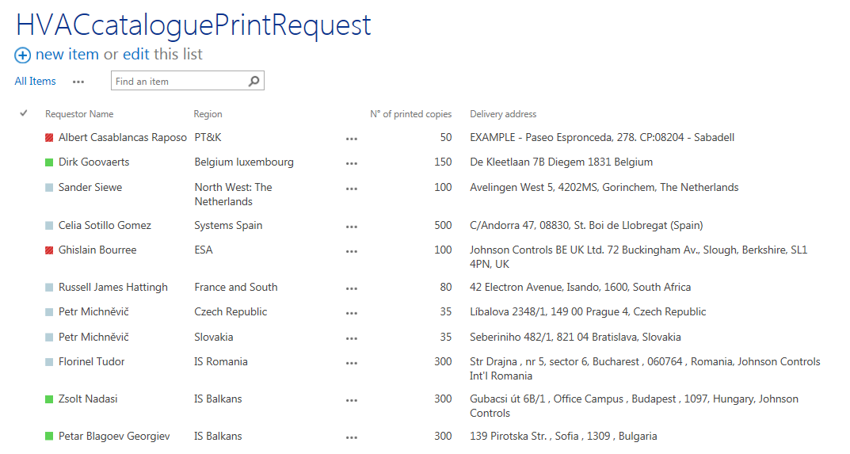
Marketing Tools
Commercial & Industrial HVAC 2015
New Commercial & Industrial HVAC Catalogue 2015 - ALREADY AVAILABLE IN VIRTUAL BRANCH – LINK
*Controls Catalogue also available in same VB page
Tomorrow (16th of January) is the deadline to enter the printing needs in Sharepoint site – LINK
So far 1950 printed copies requested by several countries.
The more printed catalogues the better the price. If you need printed catalogues don’t miss out the opportunity.

Slide 17
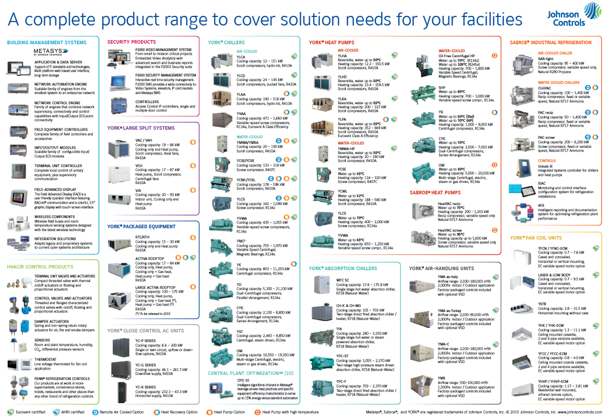
Marketing Tools
Product Line Card 2015
New Product Line Card 2015 - ALREADY AVAILABLE IN VIRTUAL BRANCH – LINK
Including information for:
BUILDING MANAGEMENT SYSTEMS
HVAC/R CONTROL PRODUCTS
SECURITY PRODUCTS
YORK® LARGE SPLIT SYSTEMS
YORK® PACKAGED EQUIPMENT
YORK® CLOSE CONTROL AC UNITS
YORK® CHILLERS
YORK® HEAT PUMPS
YORK® ABSORPTION CHILLERS
YORK® AIR-HANDLING UNITS
SABROE® INDUSTRIAL REFRIGERATION
YORK® FAN COIL UNITS

Slide 18
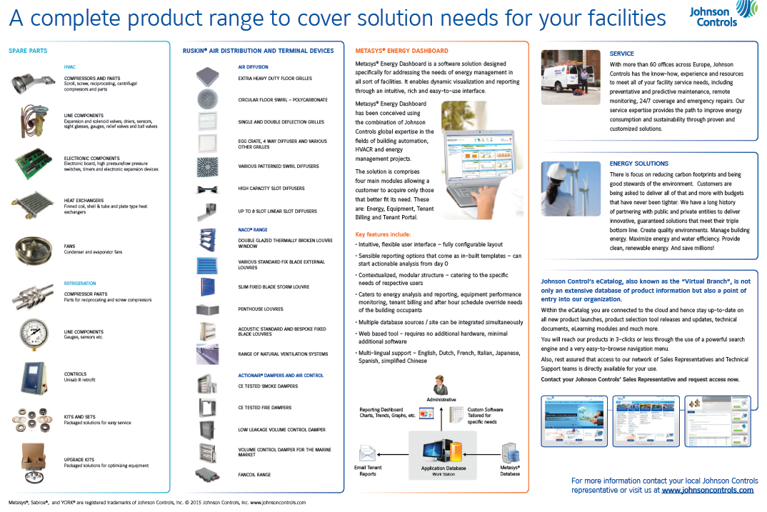
Marketing Tools
Product Line Card 2015
New Product Line Card 2015 - ALREADY AVAILABLE IN VIRTUAL BRANCH – LINK
Including information for:
SPARE PARTS
RUSKIN® AIR DISTRIBUTION AND TERMINAL DEVICES SECURITY PRODUCTS
METASYS® ENERGY DASHBOARD
SERVICE
ENERGY SOLUTIONS
VIRTUAL BRANCH E-Catalogue
High Resolution document suitable to be printed locally in DIN A3 size.
For localization needs please contact Jan-Peter Pfaff
...Back Side of the Line Card

Slide 19
AGENDA
WRAP UP- PREVIOUS CALL
PRODUCT NEWS
CHILLERS: -Thermal Expansion Valve obsolescence affecting YLAA, YCWL and YCRL
-E-Link – New Contact for enquiries and support
-MLP1013e - New LTC multipliers
AIR SYSTEMS - Phase Out D4IG 360 and 480
- Air to Air System transfer to Manisa
AIRSIDE: - Airside - general
MARKETING TOOLS
- Commercial & Industrial HVAC 2015
- Product Line Card 2015
TIPS & TRICKS – FAQ’s
- How to do a remote Start/Stop in a Rooftop ACTIVA
TRAININGS
Upcoming Product Training Sessions –Feb, March and April
Relevant Training Sessions - Feb
Train the Trainers Program
TRENDING TOPIC
Manisa Status
Q&A

Slide 20
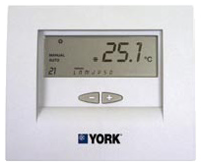
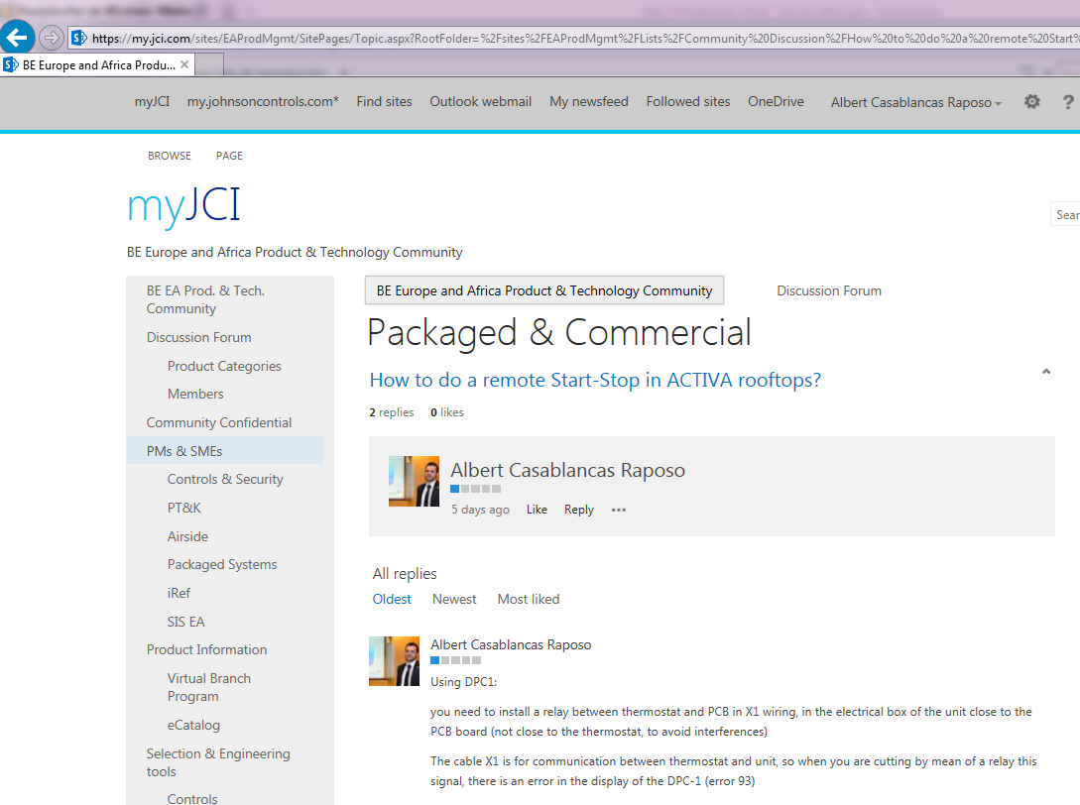
TIPS & TRICKS – FAQ’s
How to do a remote Start/Stop in a Rooftop ACTIVA
How it’s possible to do a remote Start/Stop in an ACTIVA Rooftop
Using DPC1:
You need to install a relay between thermostat and PCB in X1 wiring, in the electrical box of the unit close to the PCB board (not close to the thermostat, to avoid interferences)
The cable X1 is for communication between thermostat and unit, so when you are cutting by mean of a relay this signal, there is an error in the display of the DPC-1 (error 93)
- when relay is closed, there is communication between unit and thermostat and the unit works
- when relay is open, there is no communication between thermostat and rooftop and it stops
- you'll read error 93 in the thermostat (no communication)
- when the relay is closed again, the unit will start again (there is a checking of signal each minute)
There is a possibility to make that the error is not displayed in the DPC1screen: change program P4 of the DPC1 from C-Y to C-n. See technical literature of DPC1 (P4 is in pg 13-14).
Using another thermostat Idem as above, but putting the relay in the R phase you are sending from our board to your thermostat.
...Info available in Discussion Forum – click here to link
Notes:
This is a recurrent question that we use to receive regarding how to do a remote start-stop in Activa and Vitality units…so the units that are using YKN2Open board and DPC1 Thermostat. It’s possible to do it by installing a relay between the thermostat and the YKN2Open main board in X1 wiring. I don’t want to enter in too many details as you can see in this slide some other comments about how to remove the error that you get in the thermostat when you are doing this action, It’s also possible to do the remote start/Stop by using a thermostat different tan our DPC-1
What I would like to remind you is that we have the possibility to enter in the Product Discussion Forums that we have available in Sharepoint Site. By using these fórums you will have the possibility to look for solutions looking at the historical of the fórum and also you will be able to raise new questions when you cannot find it.

Slide 21
AGENDA
WRAP UP- PREVIOUS CALL
PRODUCT NEWS
CHILLERS: - YLAA stock program (Monterrey) – Current Situation
- New YCWL Low Head Range
- Sabadell Production Extension – Current Situation
AIRSIDE: - Airside - general
MARKETING TOOLS
- Commercial & Industrial HVAC 2015
TIPS & TRICKS – FAQ’s
- YVWA rating ESEER problem solved
TRAININGS
Upcoming Product Training Sessions –Feb, March and April
Relevant Training Sessions - Feb
Train the Trainers Program
TRENDING TOPIC
Manisa Status
Q&A

Slide 22
Product Training
Upcoming Product Training Sessions – Jan, Feb, March
February
March
April
PTK-HVAC-22
YORK® YCIV, YVAA, YVWA Screw Chillers (Nantes, France)
PTK-HVAC-38
YORK® Fan Coil Units Selection Tools Training (Net Session)
PTK-HVAC-21
YORK® Scroll and Screw Chillers YLAA,YLCS,YCWL/RL Air and water Cooled Chillers and YLPA heat Pump (Nantes, France)
PTK-HVAC-31
YORK® Scroll Carel Control Eco Frio Chillers YLCA/CD/HA/HD and YLRA Heat Pump (Nantes, France)
PTK-HVAC-24
​YORK® Centrifugal YK compressor and Optiview panel (Nantes, France)
PTK-HVAC-28
YORK® Advanced VSD Technical Chiller (Nantes, France)
PTK-HVAC-26
YORK® YMC2 Centrifugal Compressor (Nantes, France)
FY15 Product Training Calendar: https://my.jci.com/sites/EAProdMgmt/ProductTraining/

Slide 23
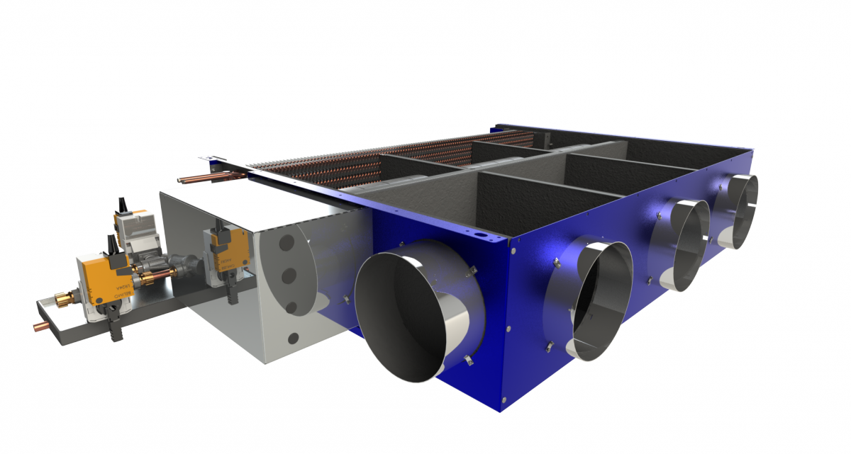


Product Training
Relevant Training Sessions – New Dates
YORK® Fan Coil Units Selection Tools Training
PTK-HVAC-38
Course Details
Course Type: Virtual Instructor-Led Net session
Audience: HVAC Sales Personnel
Duration: 2 x 1hr sessions
Cost: Free
Dates: 17th February & 24th February
Start Time: 10:00 CET
Language: EN
Available for: Employees & Partners
Aim of the Webinar is to:
Use Laser / YEFB selection tool for Eurapo OEM products
Use YHK/YFCN/YHVP selection tool for Sabiana OEM products Optimize selections for technical performance
Optimize selections for cost reductions
Module 1 - 17th February
Module 2 - 24th February

Slide 24

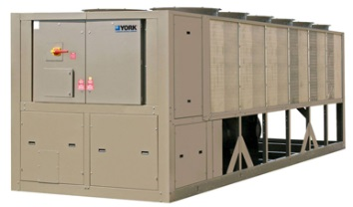
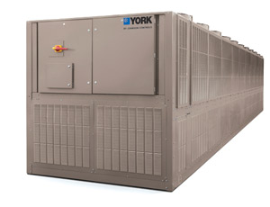
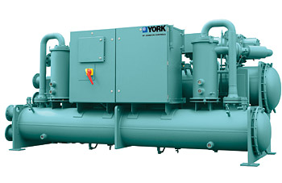
Product Training
Relevant Training Sessions – Current Dates
YORK®
YCIV, YVAA, YVWA Screw Chillers
PTK-HVAC-22
Feb, 3nd – 5th
Aims and Contents:
Understand the operation and characteristics of these chillers to improve maintenance
Understand the basics of the panel and operation
Introduction to the chiller: difference about chilled water/brine water
Explanations about the different components: air condenser, flash tank, screw compressor, evaporator, expansion valves
Operation, flow diagram YCIV, YVAA, YVWA unit, oil circuits…
Variable speed drive: study of all the electrical components and different electronics cards
Cooling of the VSD
Description of the panel
Adjustments of the parameters
Part load running, limits
Starting sequence
Control of the fans speed
Communication: Micro gateway card and e-link card
Connection with a laptop for the storage of data, faults…
Course Details
Course Type: Instructor-Led
Audience: HVAC Service Techs. and/or
Tech. Orientated Personnel
Duration: 2.5 day(s)
Cost: 975 Eur/Trainee
*Discounts available depending on number of trainees enrolled within the same branch
3 attendees: 15%
5 attendees: 20%,
10 attendees: 30%
Start: Tuesday Feb. 3rd @ 8:30h CET
End: Wednesday Feb. 5th @ 17:30h CET
Venue: Nantes, France
Language(s): EN
Available for: Employees & Partners

Slide 25
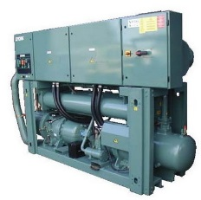
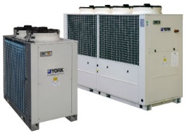
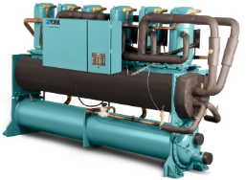
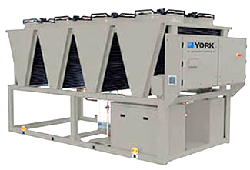
Product Training
Relevant Training Sessions – New Dates
YORK® Scroll and Screw
YLAA, YLCS, YCWL/RL Air and Water Cooled Chillers and YLPA Heat Pump
PTK-HVAC-21
Mar, 2nd – 4th
YORK® Scroll Carel Control Eco Frio Chillers YLCA/CD/HA/HD and YLRA Heat Pump
PTK-HVAC-31
Mar, 5th – 6^{h}
Course Details
Course Details
Course Type: Instructor-Led
Audience: HVAC Service Techs. and/or
Tech. Orientated Personnel
Duration: 3 day(s)
Cost: 975 Eur/Trainee
*Discounts available depending on number of trainees enrolled within the same branch
3 attendees: 15%
5 attendees: 20%,
10 attendees: 30%
Start: Monday Mar 2nd @ 8:30h CET
End: Wednesday Mar 3rd @ 15:00h CET
Venue: Nantes, France
Language: EN
Available for: Employees & Partners
Course Type: Instructor-Led
Audience: HVAC Service Techs. and/or
Tech. Orientated Personnel
Duration: 2 day(s)
Cost: 975 Eur/Trainee
*Discounts available depending on number of trainees enrolled within the same branch
3 attendees: 15%
5 attendees: 20%,
10 attendees: 30%
Start: Thursday Mar 5th @ 8:30h CET
End: Friday Mar 30th @ 15:00h CET
Venue: Nantes, France
Language: EN
Available for: Employees & Partners

Slide 26
Train the Trainers Program FY15
Product and Technology Knowledge
Strategic Programs and Innovations
Building Efficiency Europe & Africa

Slide 27

Train the Trainers Program Today
In our businesses we count with very few trainers by profession*
A common practice is to use employees with high subject knowledge to train our workforce
For many trainers using Tools to help the training deployment is not even an option
How are local trainers aligning training with business goals?
Subject
Knowledge
Training
Skills
Our trainers normally have a very good level of subject knowledge however there’s no certainty on training delivery skills
*Product & Technology Related

Slide 28
We believe that developing the skills of our trainers eventually help our businesses to be more competitive and efficient

Slide 29
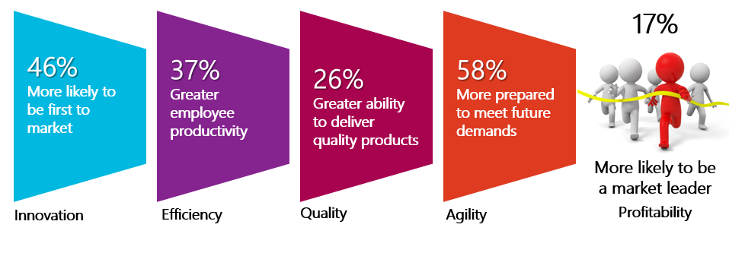
Train the Trainers Program Facts
“Organizations with strong learning cultures significantly outperform their peers”
Source: Bersin by Doloitte, Building the Borderless and Agile Workplace, Bersin & Associates Predictions for 2012

Slide 30



Train the Trainers Program How we will level up the scale?
Module 1
Training Facilitation
Targeted Audience
Technical oriented personnel in EA delivering training as a full or part-time job. Either belonging to the businesses or to centralized teams.
Module 2
Communication Skills: Keeping the Customer Focus
Sales Oriented Technical Trainer
Technical Oriented Trainer
Training dynamics
Subject
Knowledge
Training
Skills
Combining theory, role plays, and open discussions, the facilitator will create thought- provoking to inspire the professional potential of the participants.
Number of participants per session: 10 max

Slide 31
Train the Trainers Program Modules
Module 1
Training Facilitation
Module 2
Communication Skills: Keeping the Customer Focus
March 3rd – 5th
April TBD
Learning the techniques and gaining confidence to deliver highly effective training courses.
Content Overview
Introduction to adult learning
Psychology of learning
Learning styles
Building competences
Preparing and facilitating adult learning
Using Learning Management tools to deploy training
Audience: Trainers
Improving communications skills and learning how to create sales arguments based on technical features.
Content Overview
Value Selling
The JC Sales Process
Communication principles
Presentation Skills
Audience: Trainers + Sales-oriented personnel
“All modules are delivered in the form of highly dynamic workshops”

Slide 32
AGENDA
WRAP UP- PREVIOUS CALL
PRODUCT NEWS
CHILLERS: -Thermal Expansion Valve obsolescence affecting YLAA, YCWL and YCRL
-E-Link – New Contact for enquiries and support
-MLP1013e - New LTC multipliers
AIR SYSTEMS - Phase Out D4IG 360 and 480
- Air to Air System transfer to Manisa
AIRSIDE: - Airside - general
MARKETING TOOLS
- Commercial & Industrial HVAC 2015
- Product Line Card 2015
TIPS & TRICKS – FAQ’s
- How to do a remote Start/Stop in a Rooftop ACTIVA
TRAININGS
3M Training Plan
Train the trainers
TRENDING TOPIC
Manisa Status
Q&A

Slide 33
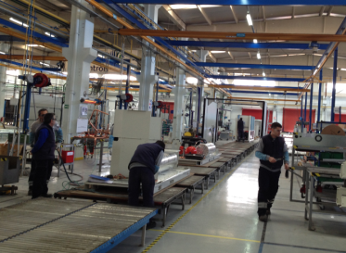
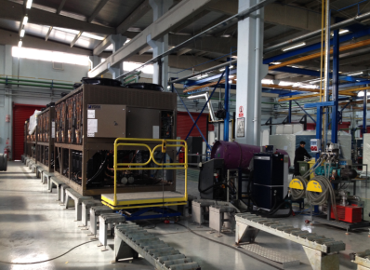
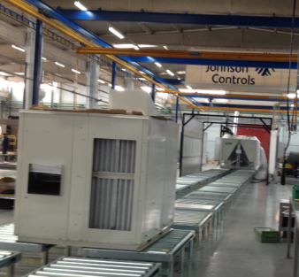
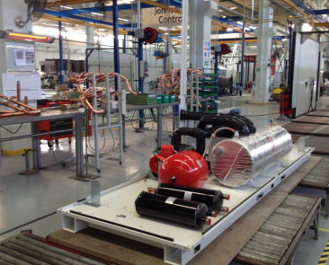
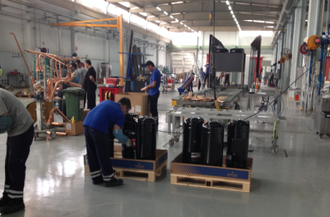
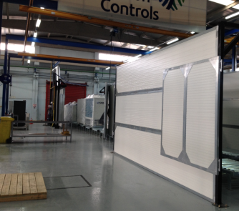
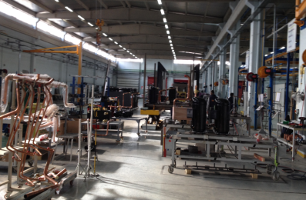
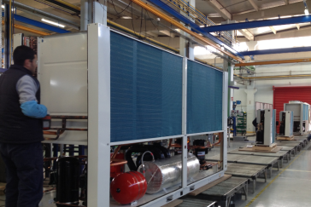
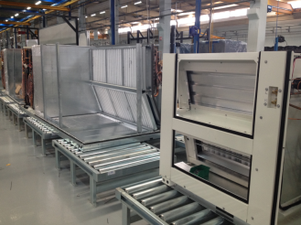
Manisa Status
Ecofrio
Tempo
RTU / LS
Very low backlog
Empty line
5- 6 week Lead time today, down to 5 weeks end Jan.
Introducing quick shipment program (build inventory).
Very low backlog
8 week lead time today, down to 6 weeks first week of Mar.
17 units in inventory (14 MTY, 3 Manisa)
Line is ready, trial builds done, stock production started.
First customer shipment in beginning of Feb – on track
9 week Lead time, down to 6 week end Mar.
How to get the back log full again
How to get the back log full again

Slide 34
Manisa Status
Ecofrio Stock Unit Production in Manisa
Model | Qty | Expected Completion
REVER.380T YLHA-40 G1T | 2 | In stock
YLCA-40G1T 380T | 2 | In stock
YLCA-100G1T 380T | 1 | In stock
YLHA 50 G1T | 1 | In stock
YLCA-100G1TP 380T | 1 | In stock
YLCA 120-TP-380T | 1 | In stock
YLHA 120-TP-380T | 1 | In stock
REVER.380T YLHA PLUS 27G1TC | 2 | In stock
YLCA-12 G1TC 380T | 1 | 16-jan
YLCA-20G1TC 380T | 1 | 16-jan
REVER.380T YLHA PLUS 15 G1TC | 2 | 16-jan
YLCA-100G1TP 380T | 1 | 16-jan
YLCA-40G1TP 380T | 1 | 16-jan
YLCA 150-TP-380T | 1 | 16-jan
YLCA-60G1TP 380T | 1 | 23-jan
YLCA-80 G1TP 380T | 1 | 23-jan
YLCA 120-TP-380T | 1 | 23-jan
REVER 380T YLHA-80 G1TP | 1 | 06-feb
YLHA 120-TP-380T | 1 | 06-feb
YLHA 150-TP-380T | 1 | 06-feb
REVER 380T YLHA-60 G1TP | 1 | 06-feb
YLCA-50G1TP 380T | 1 | 06-feb
REVER.380T YLHA PLUS 27G1TC | 1 | 06-feb

Slide 35

QUESTIONS?
Notes:
Ok, so at this point I’d like to open the call up to anyone who has questions. If you do, please go ahead and ask them now.
Thanks everyone for joining us today and we’ll close the call. As always please contact me or the subject matter experts (contact information in the appendix as needed for each product group.
) if there are questions you think of after today. Thank you and have a great day. Bye now.

Slide 36
APENDIX
Product Contact
Information
36
Notes:
Ok, so a mentioned a pretty quick session today. A lot of good information was discussed. Before I open the call for questions I wanted to mention a couple things. First we will not be having this call in August, and the next session is scheduled for mid-September, so please contact myself or any of the subject matter experts directly for updates on product and marketing materials in the mean time. Secondly, as a reminder please utilize the contact information in the appendix as needed for each product group.
Ok, so at this point I’d like to open the call up to anyone who has questions. If you do, please go ahead and ask them now.
Thanks everyone for joining us today and we’ll close the call. As always please contact me or the subject matter experts if there are questions you think of after today. Thank you and have a great day. Bye now.

Slide 37


PRODUCT NEWS CONTACT PEOPLE
º
Albert Casablancas
HVAC Product & Technology Manager
Mobile: +34.663.84.20.09 E-Mail: Albert.Casablancas@jci.com
Johnson Controls Building Efficiency Paseo Espronceda, 278. 08204
Sabadell (Barcelona)
Alan Hinton
Airside Product & Technology Manager Manager
Mobile: +44 7771973896 E-Mail:
Alan.Hinton@jci.com
Johnson Controls 72 Buckingham Avenue
Slough POST-B SLI4PN
United Kingdom
37

Slide 38
PRODUCT CONTACT INFORMATION
Airside
Product Group | Product | Supplier (Location) | Customer Service Contact Name(s) | Customer Service Contact | Discounts/Product Questions/Special Quotes
Close Control Units | YC-P | TECNAIR (Italy) | Elena Franchi | +39 029699111 | Alan Hinton
 |  |  |  | Elena.Franchi@tecnairlv.it
Fan Coil Units | YFCN | SABIANA (Italy) | Antonella Grazzani | +39 02972031 | Alan Hinton
 |  |  |  | a.grazzani@sabiana.it
 | YHVP | SABIANA (Italy) | Antonella Grazzani | +39 02972031 | Alan Hinton
 |  |  |  | a.grazzani@sabiana.it
 | YHK | SABIANA (Italy) | Antonella Grazzani | +39 02972031 | Alan Hinton
 |  |  |  | a.grazzani@sabiana.it
 | LASER | EURAPO (Italy) | Claudia Basso | +39 0434572552 | Alan Hinton
 |  |  |  | claudia@eurapo.it
 | YGFC | JCI (Guangzhou, China) | Alan Hinton | +44 7771973896 | Alan Hinton
 |  |  |  | alan.hinton@jci.com
 | YEFB | EURAPO (Italy) | Claudia Basso | +39 0434572552 | Alan Hinton
 |  |  |  | claudia@eurapo.it

Slide 39
PRODUCT CONTACT INFORMATION
Airside
Product Group | Product | Supplier (Location) | Customer Service Contact Name(s) | Customer Service Contact | Discounts/Product Questions/Special Quotes
Air Handling Units | YMA (ex-Italy) | Saiver (Italy) | Paolo Garanzini | +39 03928283 | Alan Hinton
 |  |  |  | paolo.garanzini@saiver.com
 | YMA (ex-Turkey) | JCI (Izmir, Turkey) | Mehmet Gungor | +90 2362140004 Ext:220 | Alan Hinton
 |  |  |  | Mehmet.gungor@jci.com
 | YMA-C | Saiver (Italy) | Paolo Garanzini | +39 03928283 | Alan Hinton
 |  |  |  | paolo.garanzini@saiver.com
 | YMB | VBW (Poland) | Anna Kuleczka | +48 586690573 | Alan Hinton
 |  |  |  | anna.kuleczka@vbw.pl

Slide 40
PRODUCT CONTACT INFORMATION
Chiller Equipment
Product Group | Product | JCI Factory | Customer Service Contact Name(s) | Customer Service Contact | Product Questions/Support/Special Quotes
Air-Cooled Chillers | YLCA / YLHA YLCD / YLHD | Manisa, Turkey | Francisco Pascual Francesca Zuffolato | +34 937489613 +44 1268246059 | Roberto De Paco
 |  |  |  | Francisco.Pascual@jci.com Francesca.Zuffolato@jci.com
 | Non CE YCAE –Modular Chillers | Guangzhou, China | Francisco Pascual | +34 937489613 | Roberto De Paco
 |  |  |  | Francisco.Pascual@jci.com
 | YLRA | OEM | Francisco Pascual | +34 937489613 | Carlos Herrer
 |  |  |  | Francisco.Pascual@jci.com
 | YLPA | Sabadell, Spain | Francisco Pascual | +34 937489613 | Roberto de Paco
 |  |  |  | Francisco.Pascual@jci.com
 | YVAA | Monterrey, Mexico | Francesca Zuffolato | +44 1268246059 | Roger Smeed / Cedric Seignard
 |  |  |  | Francesca.Zuffolato@jci.com
 | YCIV | Monterrey, Mexico | Francesca Zuffolato | +44 1268246059 | Roger Smeed / Cedric Seignard
 |  |  |  | Francesca.Zuffolato@jci.com
For YORKworks software support please contact Ivo Eiermann or Carlos Herrer
For San Antonio sourced chillers please contact Patricia Stoeckard (Patricia.C.Stoeckard@jci.com)
For Wuxi sourced chillers please contact Ricky Choy (Ricky.Wing-Kei.Choy@jci.com )

Slide 41
PRODUCT CONTACT INFORMATION
Chiller Equipment
Product Group | Product | JCI Factory | Customer Service Contact Name(s) | Customer Service Contact | Product Questions/Support/Special Quotes
Water-Cooled Chillers SCROLL & SCREW | YMWA / YMRA | OEM | Francisco Pascual | +34 937489613 | Roberto De Paco
 |  |  |  | Francisco.Pascual@jci.com
 | YCSE / YCRE | OEM | Francisco Pascual | +34 937489613 | Roberto De Paco
 |  |  |  | Francisco.Pascual@jci.com
 | YCWL / YCRL | Nantes, France | Togo Pras | +33240306257 | Roger Smeed
 |  |  |  | togo.pras@jci.com
 | YLCS | Nantes, France | Togo Pras | +33240306257 | Eric Colin
 |  |  |  | togo.pras@jci.com
 | YVWA | Nantes, France | Togo Pras | +33240306257 | Roger Smeed
 |  |  |  | togo.pras@jci.com
For YORKworks software support please contact Ivo Eiermann or Carlos Herrer
For San Antonio sourced chillers please contact Patricia Stoeckard (Patricia.C.Stoeckard@jci.com)
For Wuxi sourced chillers please contact Ricky Choy (Ricky.Wing-Kei.Choy@jci.com )
* See Nantes organigram for LTC products in the next slide

Slide 42
PRODUCT CONTACT INFORMATION
Chiller Equipment
Product Group | Product | JCI Factory | Customer Service Contact Name(s) | Customer Service Contact | Product Questions/Support/Special Quotes
Water-Cooled Chillers CENTRIFUGAL & INDUSTRIAL | YMC² | Nantes, France | Emmanuel Dayon | +33 240306294 | Eric Colin
 |  |  |  | Emmanuel.Dayon@jci.com
 | YK | Nantes, France | Emmanuel Dayon | +33 240306294 | Eric Colin
 |  |  |  | Emmanuel.Dayon@jci.com
 | CYK | Nantes, France | Emmanuel Dayon | +33 240306294 | Eric Colin
 |  |  |  | Emmanuel.Dayon@jci.com
 | OM | Nantes, France | Emmanuel Dayon | +33 240306294 | Eric Colin
 |  |  |  | Emmanuel.Dayon@jci.com
 | YIA | Durango, Mexico | Celia Velasquez | +1 7177716119 | Ivo Eiermann
 |  |  |  | Celia.I.Velasquez@jci.com
 | YPC | Durango, Mexico | Celia Velasquez | +1 7177716119 | Ivo Eiermann
 |  |  |  | Celia.I.Velasquez@jci.com
 | WFC SC / CH-K & CH-MG | OEM | SQ Only | - | Ivo Eiermann
 |  |  |  | -
 | HITACHI Absorption Chillers | OEM | SQ Only | - | Ivo Eiermann
 |  |  |  | -
For YORKworks software support please contact Ivo Eiermann or Carlos Herrer
For San Antonio sourced chillers please contact Patricia Stoeckard (Patricia.C.Stoeckard@jci.com)
For Wuxi sourced chillers please contact Ricky Choy (Ricky.Wing-Kei.Choy@jci.com )

Slide 43
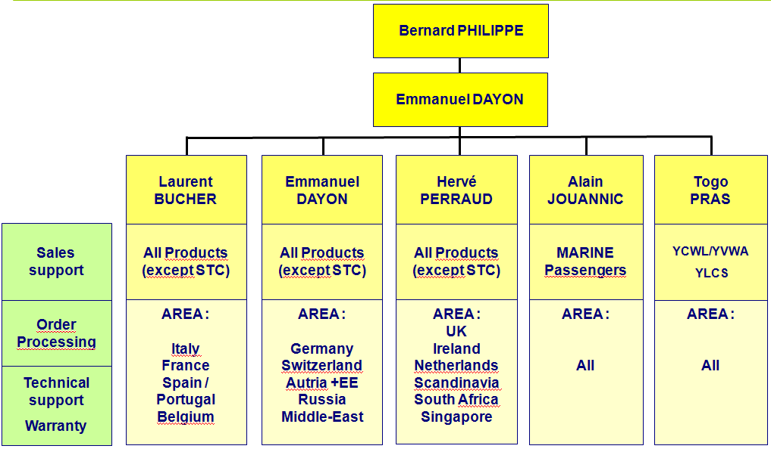
PRODUCT CONTACT INFORMATION
NANTES ORGANIZATION
Bernard Philippe : Nantes Plants Manager
Emmanuel Dayon : Std product Contract / Test lab Manager

Slide 44
PRODUCT CONTACT INFORMATION
Large Split Systems & Packaged Equipment
Product Group | Product | JCI Factory | Customer Service Contact Name(s) | Customer Service Contact | Product Questions/Support/Special Quotes
Large Split Systems | VAC / VAH | Sabadell, Spain | Francisco Pascual | +34 937489613 | Albert Casablancas
 |  |  |  | Francisco.Pascual@jci.com
 | VCH | Sabadell, Spain | Francisco Pascual | +34 937489613 | Albert Casablancas
 |  |  |  | Francisco.Pascual@jci.com
 | VIR | Sabadell, Spain | Francisco Pascual | +34 937489613 | Albert Casablancas
 |  |  |  | Francisco.Pascual@jci.com
Roomtop Units | RTC / RTH | Sabadell, Spain | Francisco Pascual | +34 937489613 | Albert Casablancas
 |  |  |  | Francisco.Pascual@jci.com
Activa Rooftop Units | ARC / ARG / ARH / ARD | Sabadell, Spain | Francisco Pascual | +34 937489613 | Albert Casablancas
 |  |  |  | Francisco.Pascual@jci.com

Slide 45
PRODUCT CONTACT INFORMATION
Sabroe Chiller Equipment
Product Group | Product | JCI Factory | Customer Service Contact Name(s) | Product Questions/Support/ Special Quotes
Water-Cooled Chillers | ChilPAC – R717 | Holme , Denmark | Bjarne Elo Christophersen Sales & Operations Director +45 87367621 Bjarne.Elo.Christophersen@jci.com | Morten Deding Product Manager +45 8736 7361 Morten.Deding@jci.com
 | HeatPAC – R717 | Holme , Denmark
 | SABlight – R290 | Holme , Denmark

Slide 46

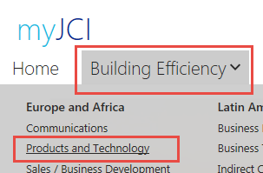
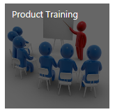
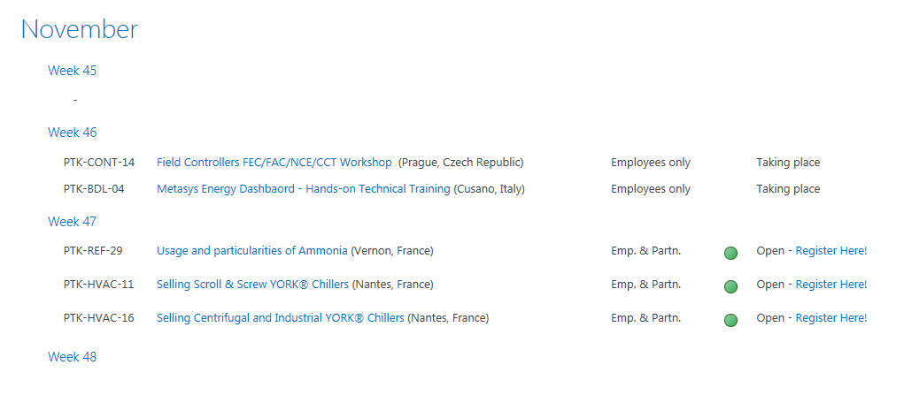
Product Training
Upcoming Product Training Sessions
FY15 Product Training Calendar available in SharePoint
How to access?
1
Go to my.jci.com and then under the “Building Efficiency” Menu click on the Products and Technology Community site
2
Scroll down till you see “Product Training” Tile. Click there.
FY15 Product Training Calendar: https://my.jci.com/sites/EAProdMgmt/ProductTraining/

Slide 47
Before We Begin
Telephone Noise
Please mute your phone line to reduce background noise by pressing *6
(check to make sure you are on mute)
To un-mute your phone to ask a question simply press *6 once more
Please DO NOT put us on hold

Slide 48

Product & Technology Knowledge

