Slide 1


YLAA Air Cooled Scroll Chiller Refresh Overview 50 – 150 Tons 175 – 540 kW
Finding the right balance for improved performance
Latin America Update
July 20, 2012

Slide 2
Agenda
Presenter introductions
YLAA product and market review
“Refresh project” overview & technical details
YORKworks “Global Chiller Selection Software” demonstration
New Sales Tools:
Customer presentation, Sales Guide, Engineering guide
Questions

Slide 3
YLAA & Market Review

Slide 4
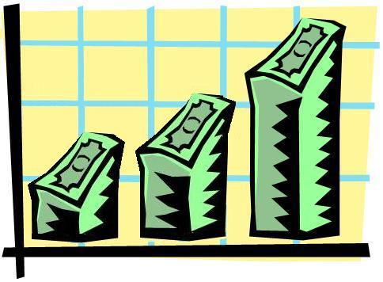
YLAA Overview A brief history…
2007…YLAA launched
Replaced R-22 chillers with R-410A, market leading performance
Led the market globally for 3 years – hospitals, education, light commercial top segments
Enabled significant growth in Latin America
Multi-tier strategy proven successful
SE benefits footprint, low first cost, performance
HE offers a high efficiency value proposition
Sales Trends:
Globally: 60% SE, 40% HE
LA: 75% SE in 2011
NA: 65% SE
Europe: 75% HE
Asia: only offers HE
Successful Options:
Efficiency tiers
Multiple sound levels
Scalable option strategy
Integrated pump kits

Slide 5
YLAA Overview Industry Trends
Industry Trends, past and future:
Green buildings and energy costs… …raise efficiency, reduce sound & refrigerant charge quantity
Brazed Plate Evaporators, Microchannel… …technologies improve, reduce charge
Pump kits… …add application range, options
Fan sound levels… …improve industry-wide
VSD fans… …improve part load efficiency
Summary:
New technologies offer opportunity for improvement
No major competitive changes expected until next round of efficiency legislation (2015)

Slide 6
YLAA Overview Competitive Landscape
Globally:
Competitors offer wider range of applications
New Trane CGAM performance higher, but with larger footprint
Some new European competitors have good part load and footprint, but lack application range
Carrier lags market and due for a product refresh
Latin America:
YLAA “SE” full load efficiency lags market
was tightly optimized for footprint at launch
HE full load lags Trane 3 – 4% (CGAM larger footprint units)
Pump kits lack specifiable options

Slide 7
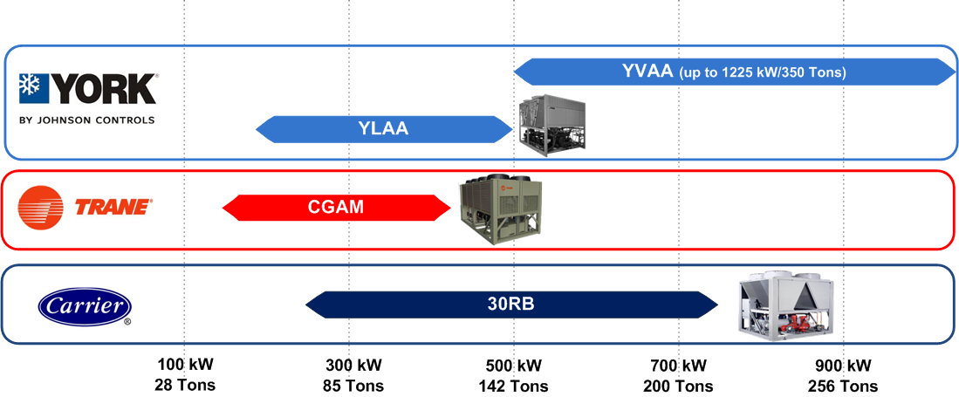
YLAA Overview Competitive Landscape (Current YLAA)
A challenging segment, also local manufacturers

Slide 8
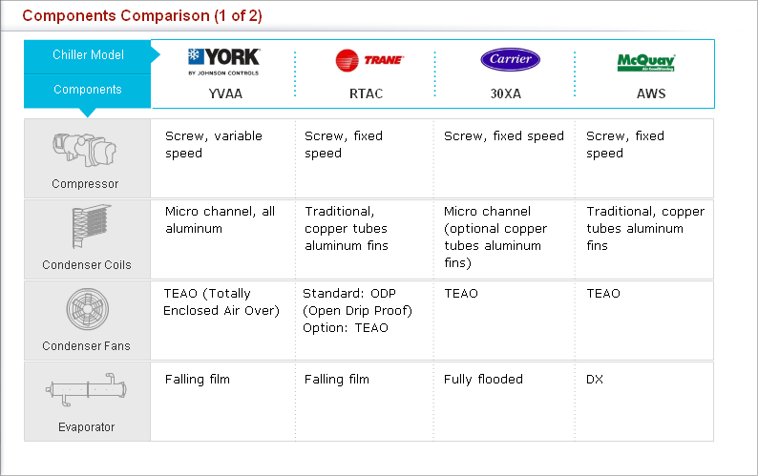



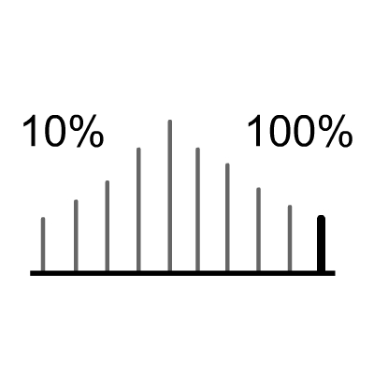
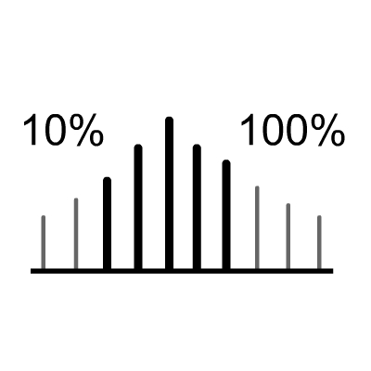


YLAA – YORK Air-Cooled Scroll Chiller Competitive benchmarking – Where we are today
Above Average
Average
Below Average
 | YLAA | CGAM | 30RB
(heat recovery, low ambient, high ambient)
Trane CGAM good performance but large footprint & charge.
Carrier 30RB lags market and due for design refresh.

Slide 9
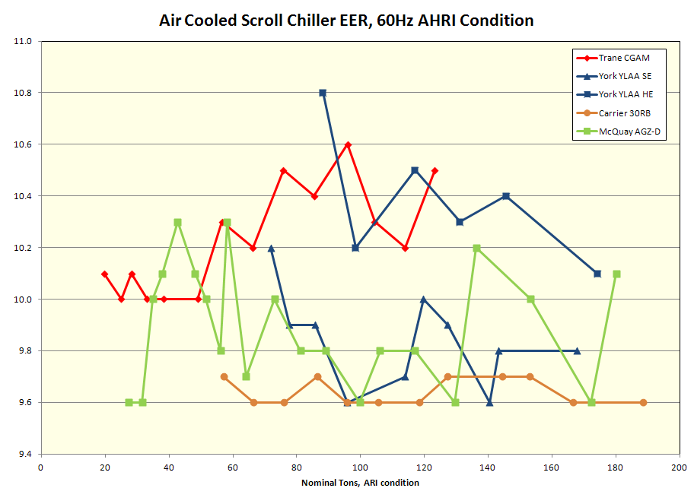
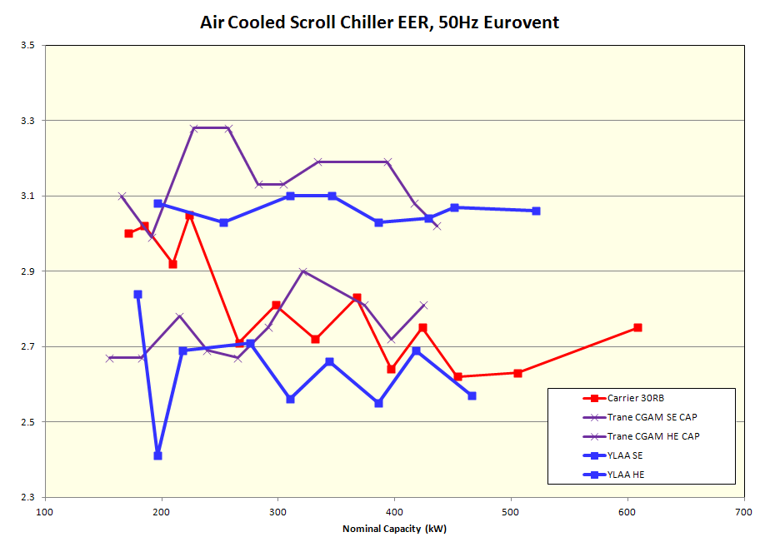
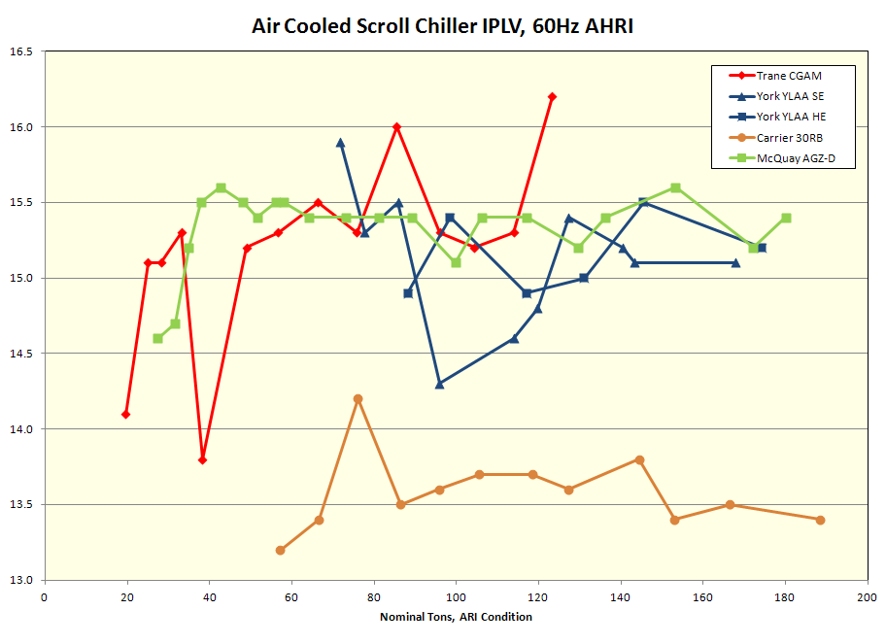
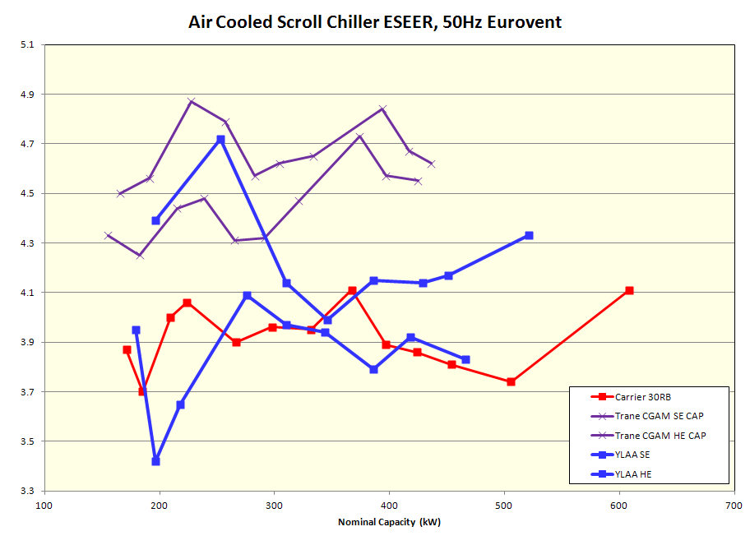
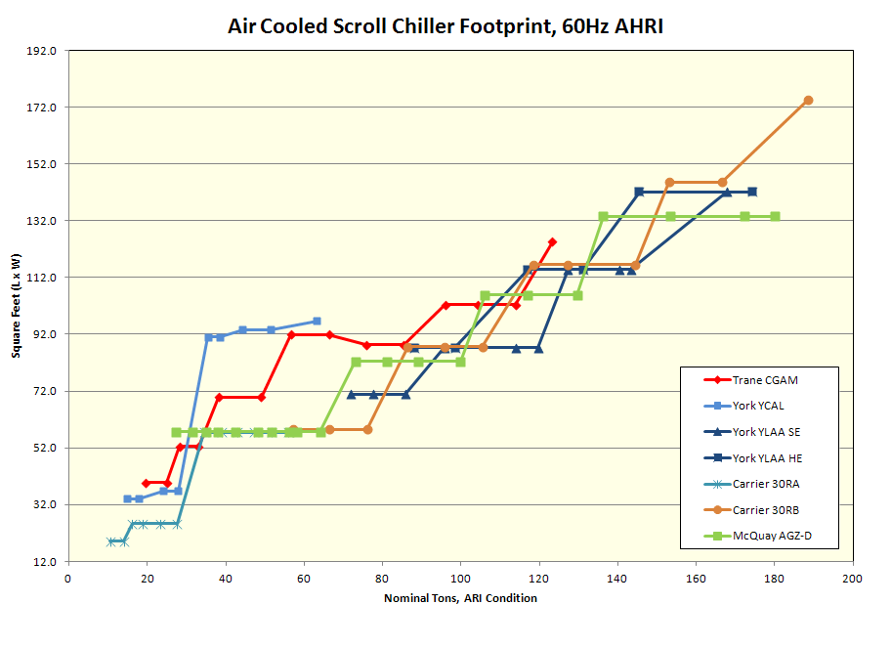
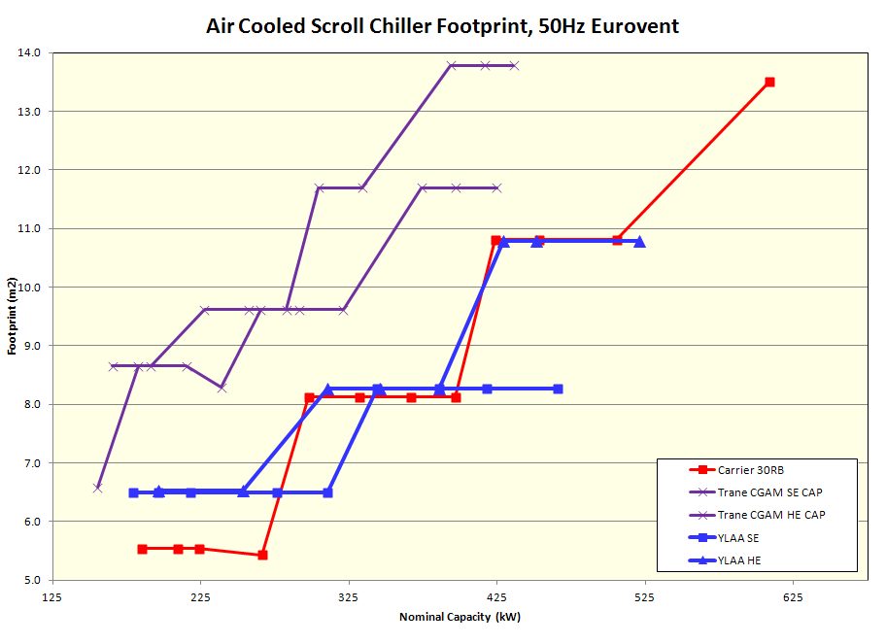
YLAA Overview Competitive Landscape…where we are today
YLAA still a good balance of efficiency, sound, charge and footprint, but competitors have closed the gap

Slide 10
YLAA Refresh Project

Slide 11
Refresh Project What, Why, How?
We have talked about where we are today, the market, and the competition
We must continue to develop to remain competitive
A product line refresh was mapped out with several steps:
New Options – industry leading glycol and heat recovery options
Controls and technology to operate better
Structure as options – only pay for it when it’s needed
Brazed Plate Evaporators less weight, less volatility to Copper, price reduction
Combined with microchannel for a low refrigerant charge
New 50Hz SE models with higher efficiency, 50Hz HE range extension to 550kW
New VSD fan option for HE part load improvement
New Pump options and range
New Premium Efficiency with low footprint
A large investment, including focus on 50Hz gaps.
Technical hurdles passed, drafting and implementation in progress.

Slide 12
YLAA Schedule

Slide 13

Refresh Project Schedule
New Options: Glycol & Heat Recovery
Launched August 2011
New Brazed Plate Models
First stage (4, 5, 6 fan) in YORKworks now
Remaining units available in October
New 50Hz SE models
Early 2013 (calendar year)
VSD Fan Option
SQ today, early 2013 option
Pumps
Staged with new BPHX models
VSD pump design pending, can SQ today
Premium Efficiency
2013 development
2014 release
New Sales Tools!
New Sales Guide
New Customer Presentation
New Engineering Guides

Slide 14
YLAA Sales Tools

Slide 15
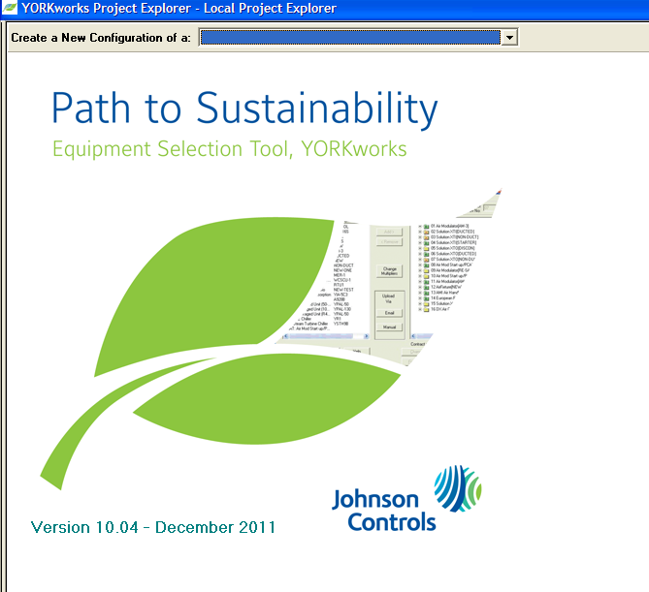
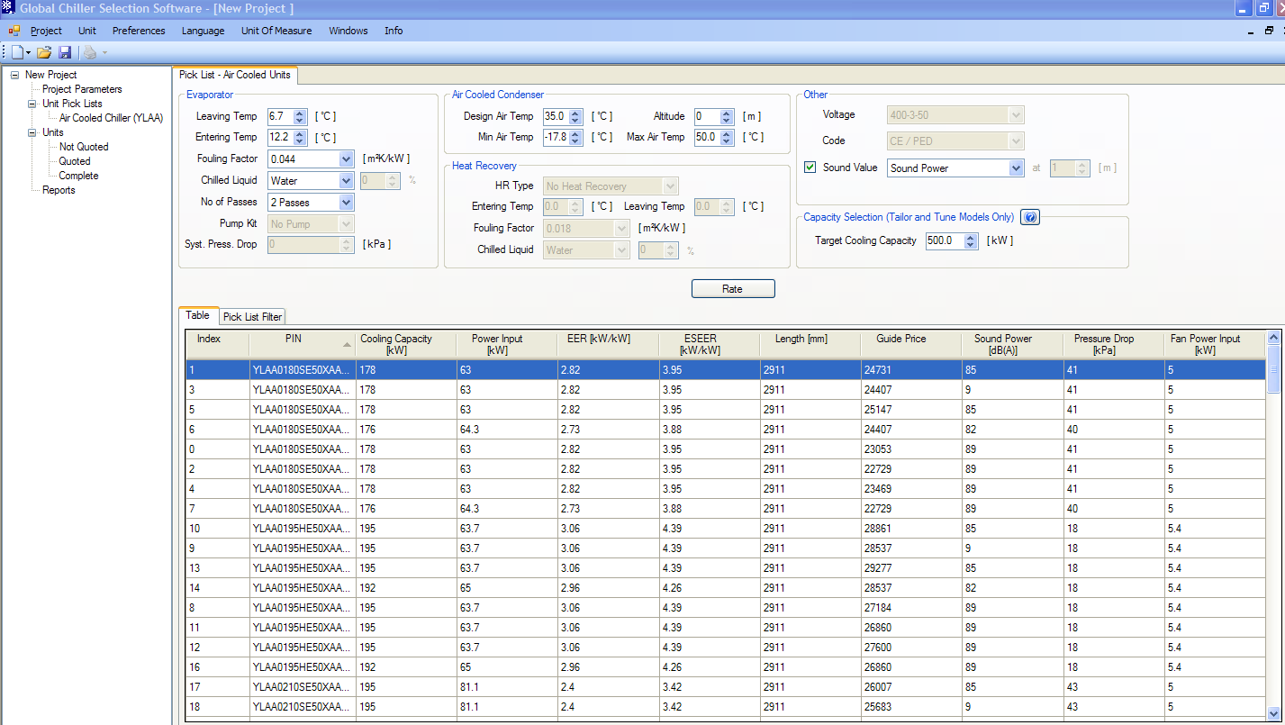
YORKworks GCSS Global Integration
GCSS is the global selection tool, transitioning products during 2012
More consistent documentation, ratings, reports, implementation timing
Demonstration of new options, features during demonstration later

Slide 16

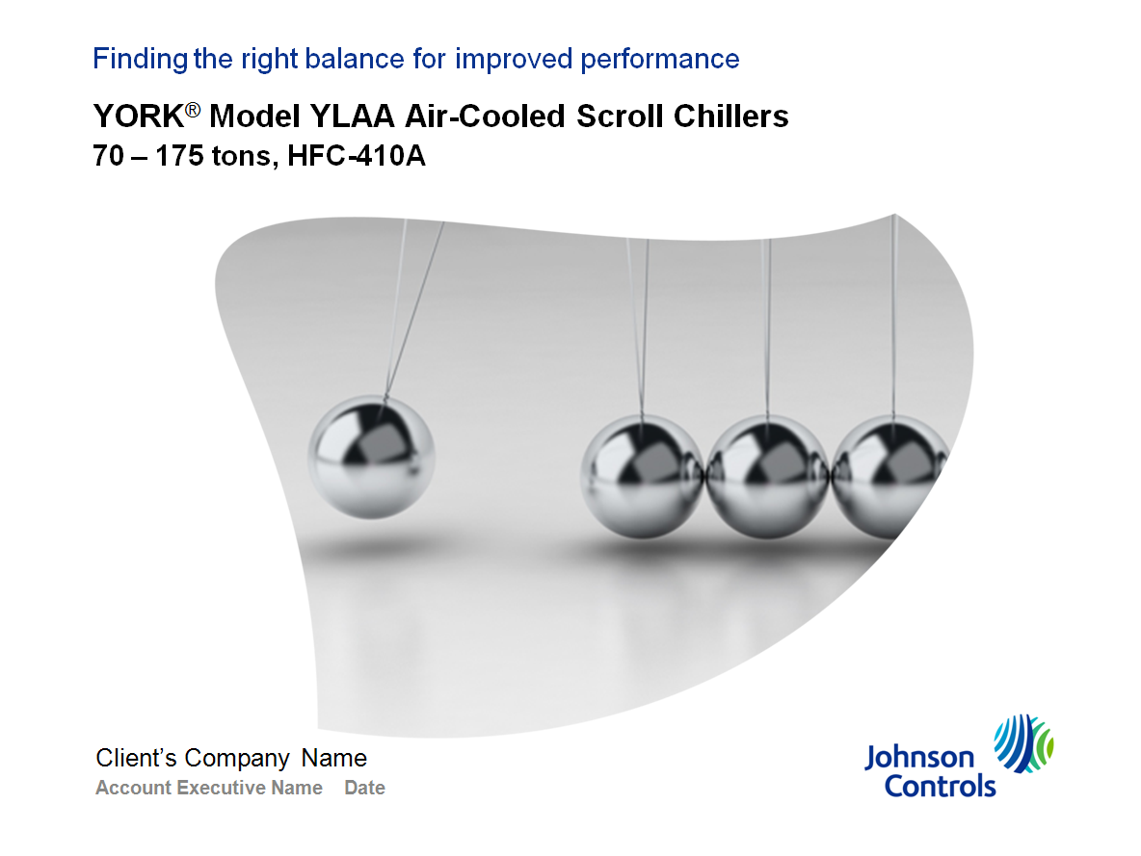

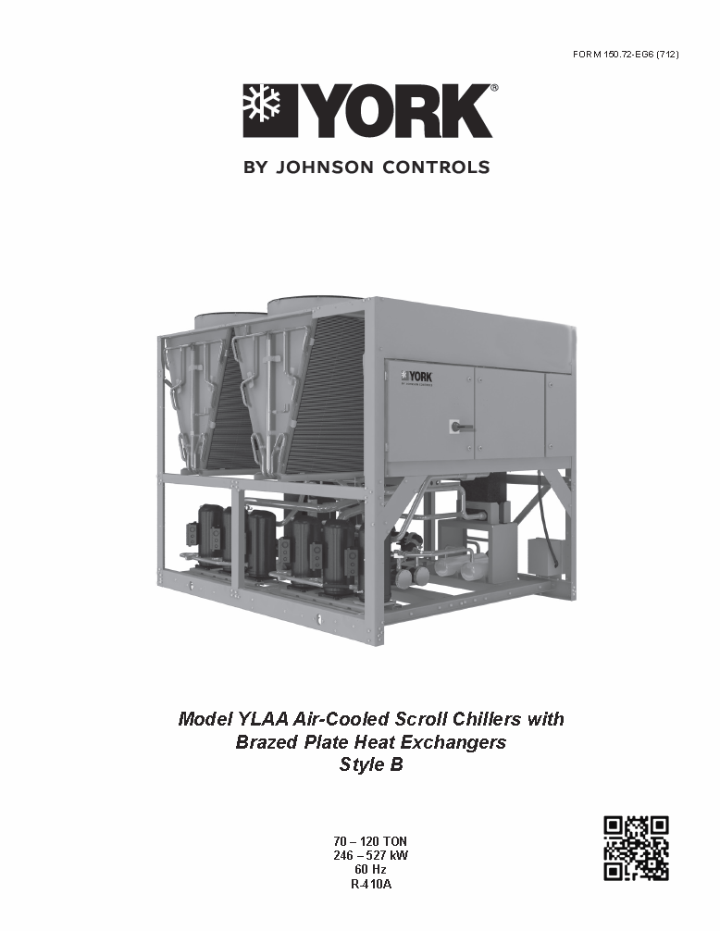
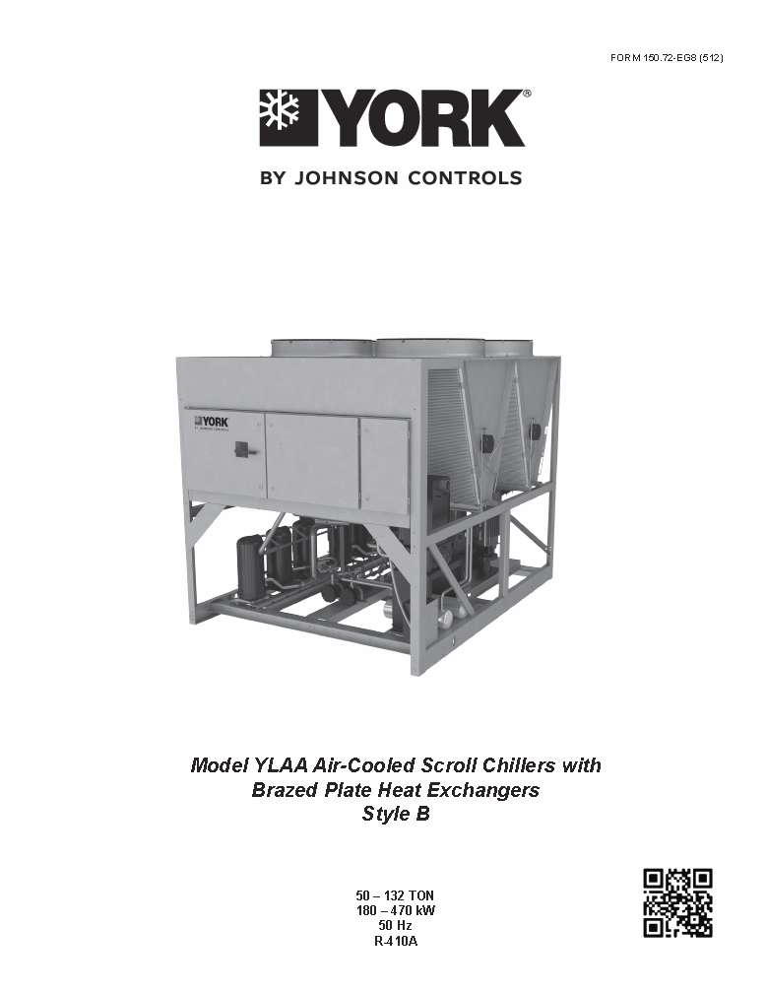
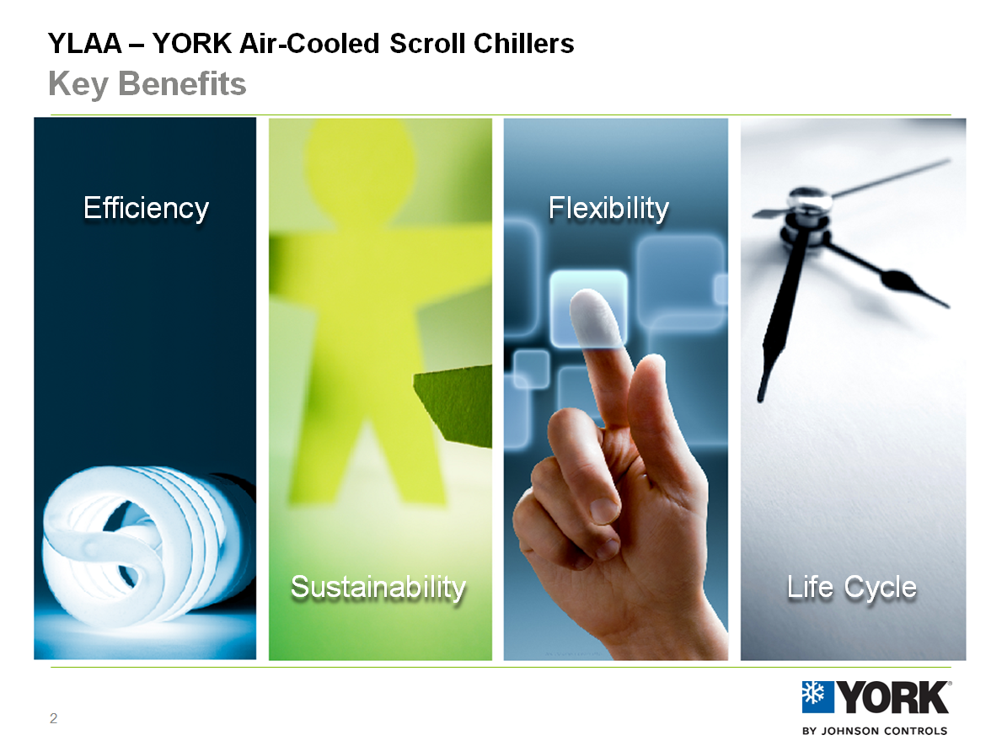
Sales Tools
60Hz Engineering Guide
Form: 150.72-EG6
Sales Guide
Form: PUBL-6886
Customer Presentation
Available on portal (review later)
50Hz Engineering Guide
Form: 150.72-EG8

Slide 17
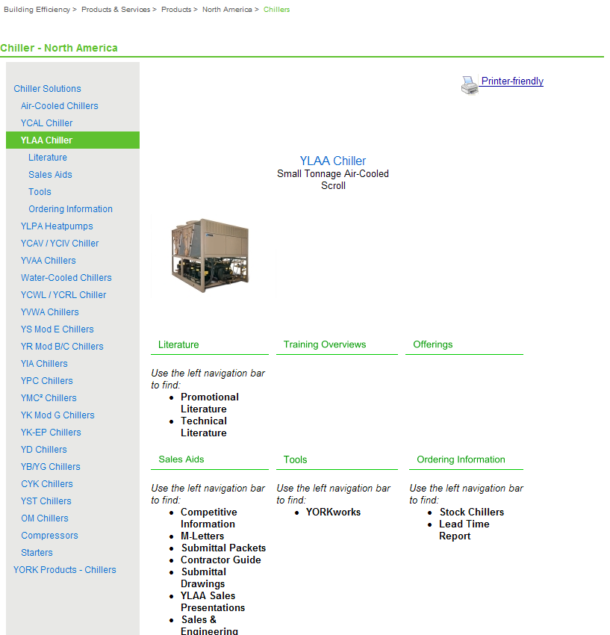
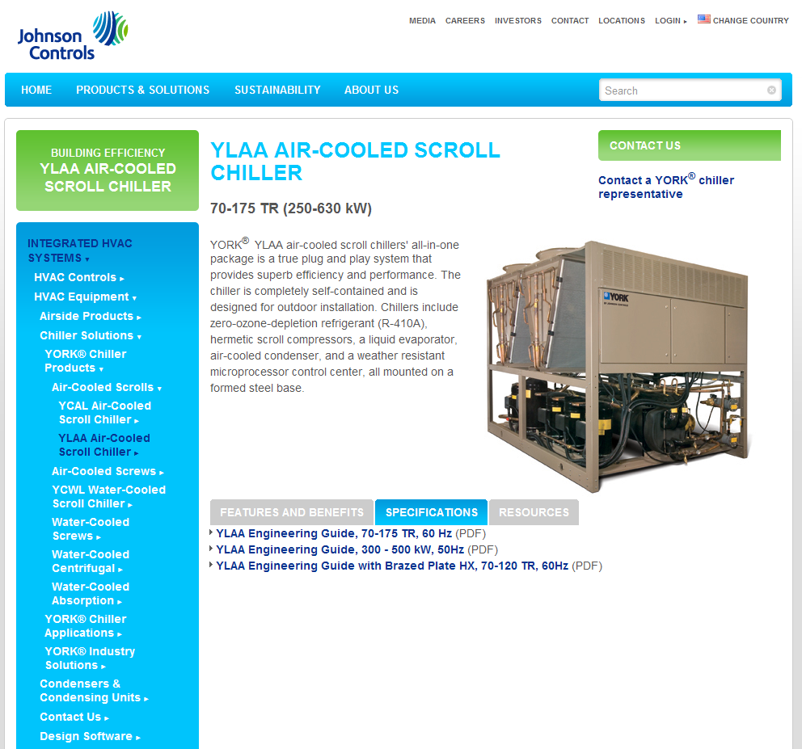
Information Access
Internal Portal
Products & Services >
Products > North America > Chillers
External Website
BPHX will be added in a few days

Slide 18
YLAA Technical Details

Slide 19
Points to remember
Five important items to remember:
Our glycol chiller can stay loaded at higher ambient
Heat Recovery makes more usable heat, offers flexible performance range
Brazed plate reduces weight, has price advantage
VSD fan option on HE to improve part load, where chillers operate 97% of the time
Two levels of pump kits, match to customer needs

Slide 20
Refresh Project Overview 1. Glycol and Heat Recovery (Options)
Glycol Chilling Option: 10F (-12C) low limit
YLAA keeps making more capacity at higher ambients due to intelligent control
Heat Recovery Condenser Option: “Partially Condensing”
up to 85% heat recovered – much more usable heat than desuperheater (10%)
temperature to 60C (up to 20% HR at this condition)
global design leverages volume
Differentiators:
Glycol lower than all but Trane CGAM (matches); YLAA stays loaded intelligently
Partially condensing heat recovery makes more usable heat

Slide 21
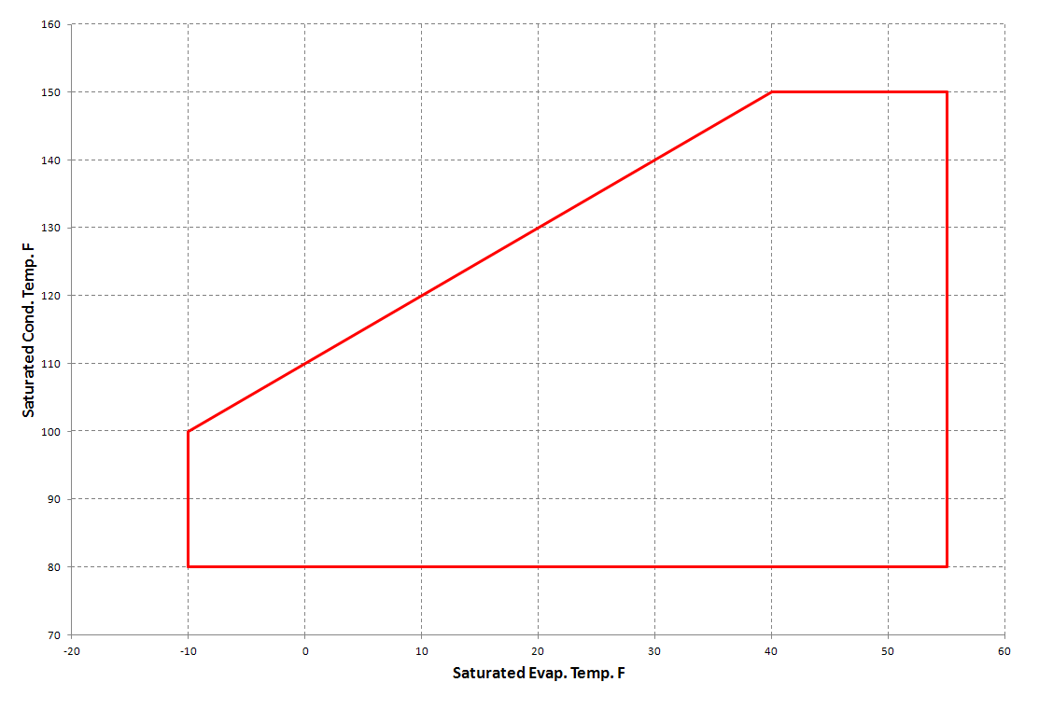
Technical Details 1. Glycol – maximum capacity, colder glycol at higher ambient
Low temperature needs smaller expansion valve
YLAA glycol option uses Electronic Expansion Valve (EEV)
EEV also facilitates changeover duty with no derate at comfort cooling
At low temperatures, compressor envelopes are small
YLAA engineers designed an unload feature to keep the chiller making as much capacity as possible, even when ambient is high
Condenser Temperature
Maximum capacity & colder glycol at higher ambient
No capacity penalty in changeover applications
Suction Temperature

Slide 22
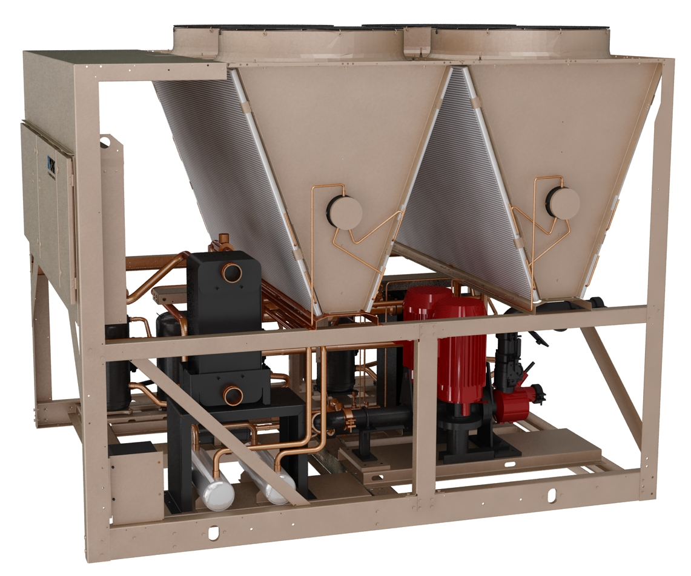
Technical Details 1. Heat Recovery – more heat, more flexibility
“Partially Condensing Heat Recovery”
Best balance of total heat recovered, temperature, and cost
Flexibility to dial performance to customer needs
YLAA design a global standard, shared components keeps cost competitive
Recovery Type | What is it? | HR Capacity | HR Temp. | Notes
Partially Condensing | Medium BPHX in discharge line | up to 85% | High (60C), Medium (40-50C) | YLAA design Excellent balance of performance, flexibility and price
Desuperheater | Small BPHX in discharge line | up to 10% | High (60C) | Used by Trane, Carrier and others
Secondary Condenser | Water-cooled condenser in parallel with air-cooled | 100% (no less) | Low (35-40C) | Unique to Carrier High price Refrigerant system complexities
Partially condensing heat recovery offers wide range of capacity and temperatures, at competitive cost

Slide 23
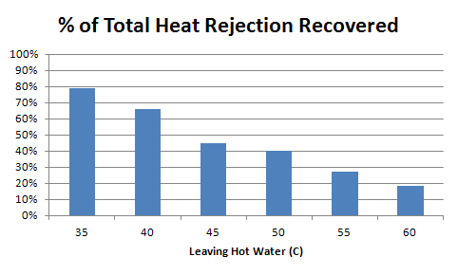
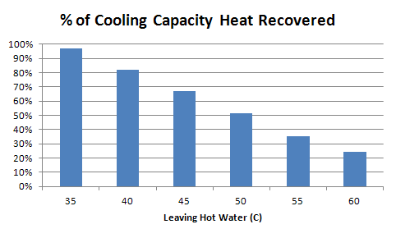
Technical Details 1. Heat Recovery – more heat, more flexibility
Amount of heat recovered depends on leaving hot water temperature
Recovery potential is cooling load plus work input
some competitors choose to ignore work input – to show higher heat recovery percentage
Heat recovery increases chiller efficiency slightly (depending on air temperature)
THR is what matters to our customers

Slide 24
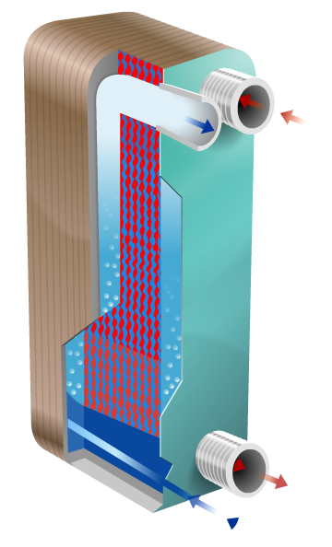
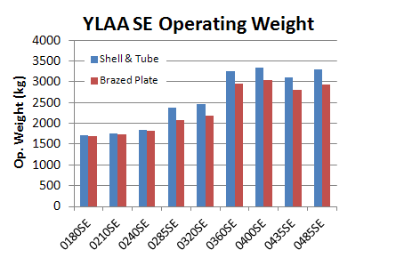
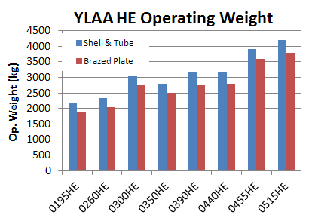
Refresh Project Overview 2. Brazed Plate Evaporators (4-6 fan available now, 8-10 fan 2013)
A weight savings of 10-15%
Less structural steel, crane costs required on site
Reduced copper use – price reduction
Shell & tube still available today; phase out plan to be determined in next few weeks

Slide 25
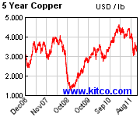
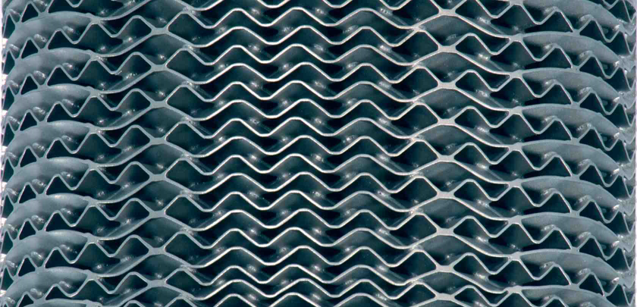
Technical Details 2. Brazed Plate Evaporator (4-6 fan available now, 8-10 fan 2013)
Why Now?
Performance lacking 5 years ago
copper costs driving development
technology now competitive to 700 kW
No performance impact
Changes Required:
Testing, testing, testing….
Multiple sizes, full and part load, extreme conditions
Performance meets or exceeds shell & tube
Drafting
Unique opportunity to incorporate best practices
New pump kits, piping, sheet metal
Shell & tube still available today; phase out plan to be determined in next few weeks

Slide 26
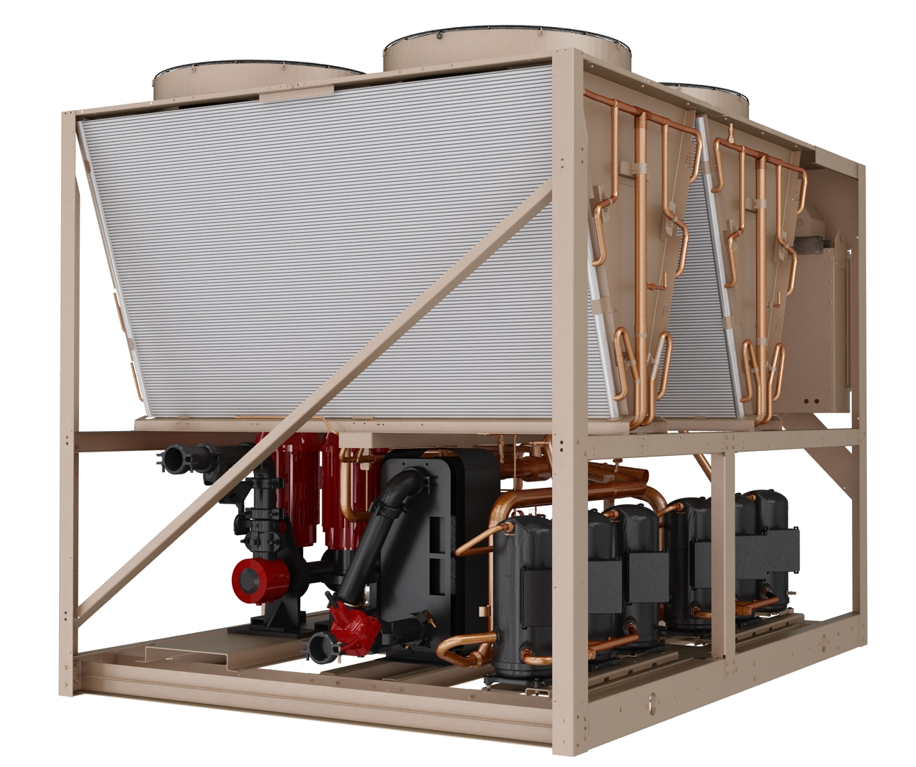
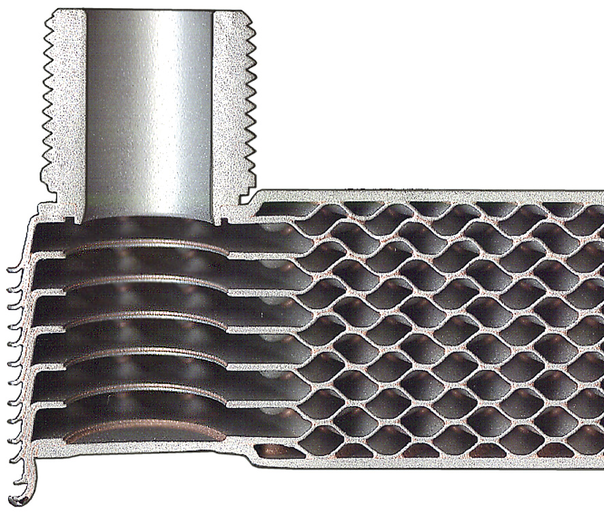
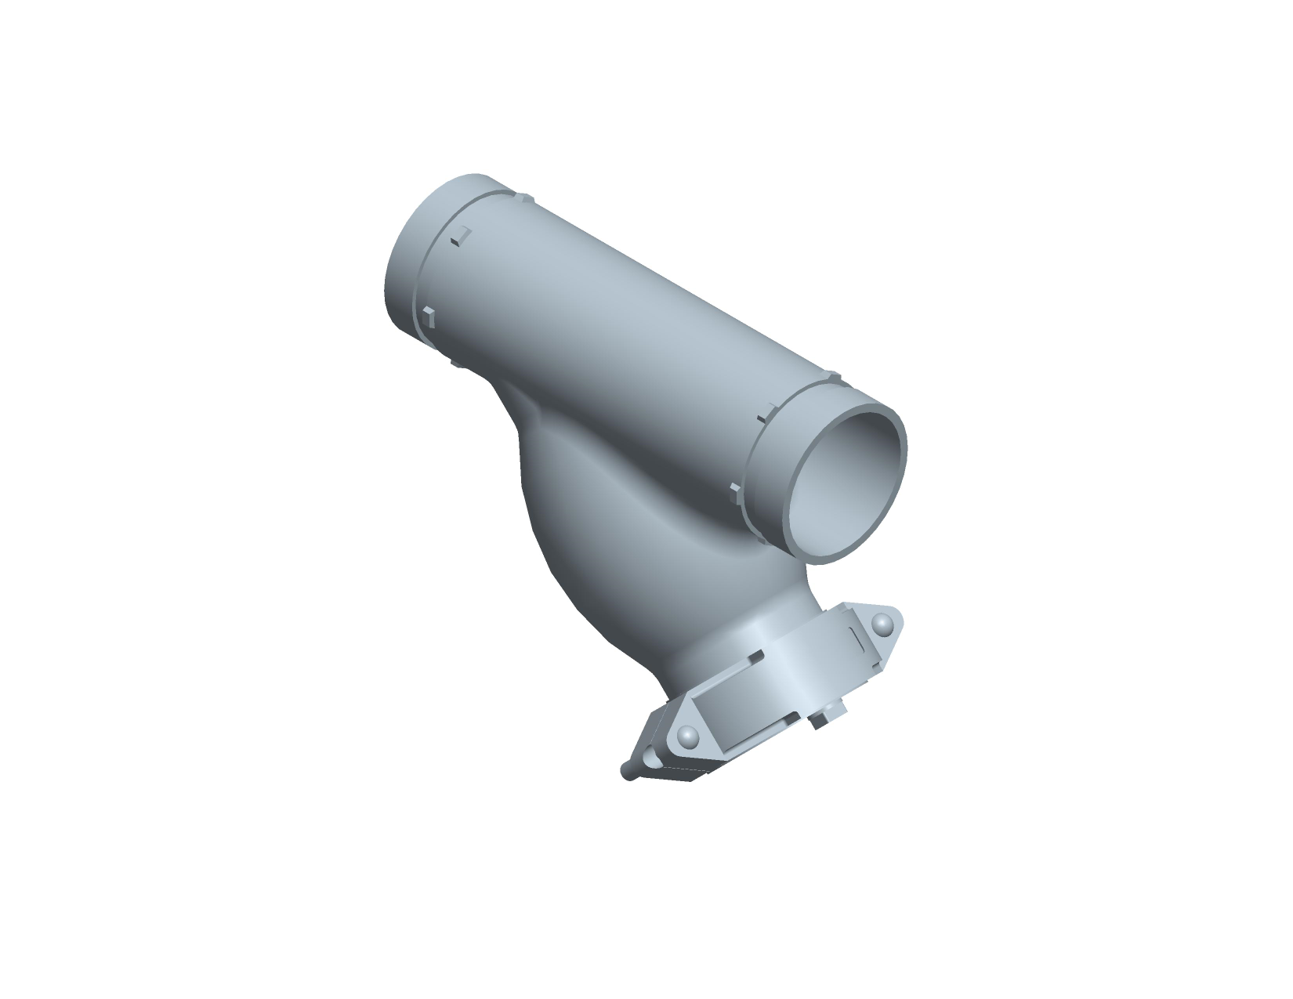
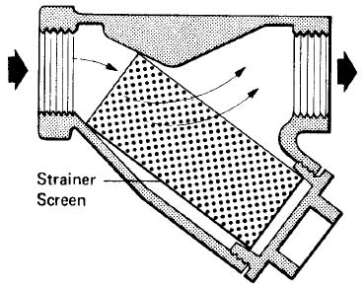
Technical Details 2. Brazed Plate Evaporator (4-6 fan available now, 8-10 fan 2013)
New evaporator:
316 stainless steel plates optimized for HFC-410A
20-mesh wye-strainer included standard
Risk of clogging primarily construction debris at startup (evap loop is closed)
Strainer can be serviced or mesh removed after startup
Pump kits have strainers already (and will continue)

Slide 27
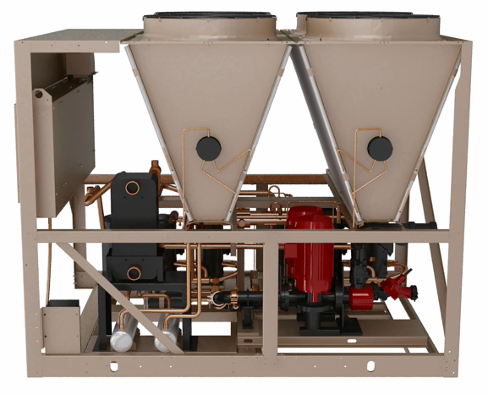
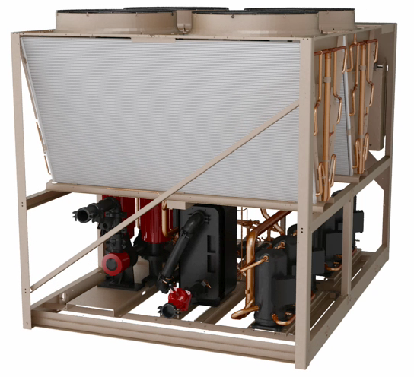
Technical Details 2. Brazed Plate Evaporator (4-6 fan available now, 8-10 fan 2013)
Customer connections to brazed plate evaporator:
4 - 6 fan: end connection (shown below); 8 - 10 fan: right side connection (not shown)
Evaporator back from edge to help Center of Gravity, minimize refrigerant piping
Standard “extension kit” – moves water connection to edge of unit, includes flow switch
Control Panel
Control Panel
Right Side View – Heat Recovery
End View – Evaporator & pump kit

Slide 28
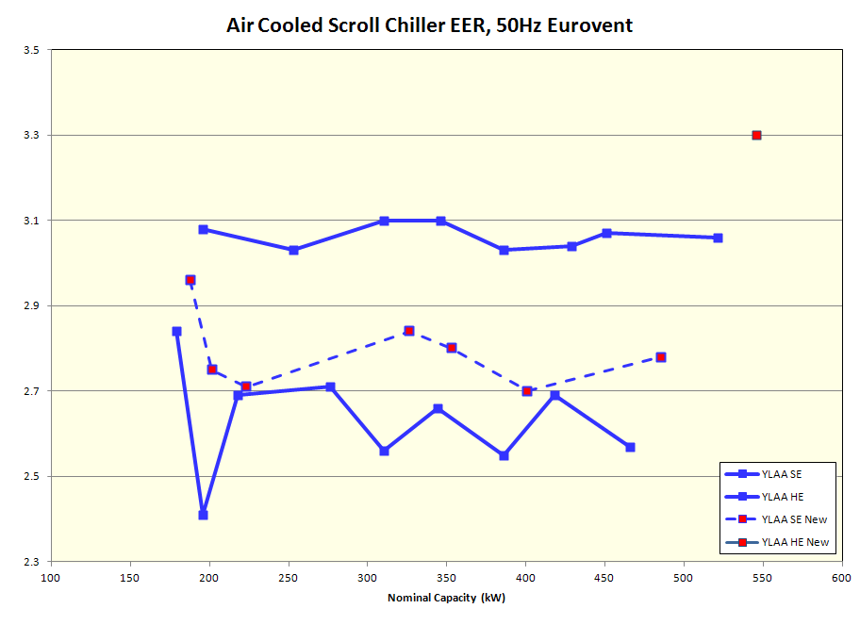
Refresh Overview 3. New 50Hz SE & HE models (2013 release)
50Hz SE goals:
Improve part load efficiency to 2.70 COP
Remain comparable to major competitors
Offer base efficiency at best footprint, value
Achieved with combination of evaporator and condenser changes
50Hz HE goals:
Overlap YVAA and have a tiered offering at this key design shift point
YVAA starts at 500 kW
Achieved by adding a new 10-fan model, capacity 550 kW
New models will be available with BPHX only

Slide 29
Technical Details 3. New 50Hz SE Models (2013 release)
Model (old/new) | Current Cap. (kW) | Curr.COP | New Cap. | New COP | Changes | Footprint Change?
180SE | 179 | 2.84 | 188 | 2.96 | Cooler Size | No
210SE 211SE | 196 | 2.41 | 202 | 2.75 | Compressors +1 Fan & Coil | Yes
240SE | 218 | 2.69 | 223 | 2.71 | Cooler Size | No
320SE 321SE | 310 | 2.56 | 326 | 2.84 | +2 Fans & Coils | Yes
360SE 361SE | 344 | 2.66 | 353 | 2.80 | +1 Fan & Coil | Yes
400SE 401SE | 386 | 2.55 | 401 | 2.70 | +1 Fan & Coil | Yes
485SE 486SE | 466 | 2.57 | 485 | 2.78 | +2 Fans & Coils | Yes
New HE model is a 10-fan unit, similar footprint to YVAA

Slide 30
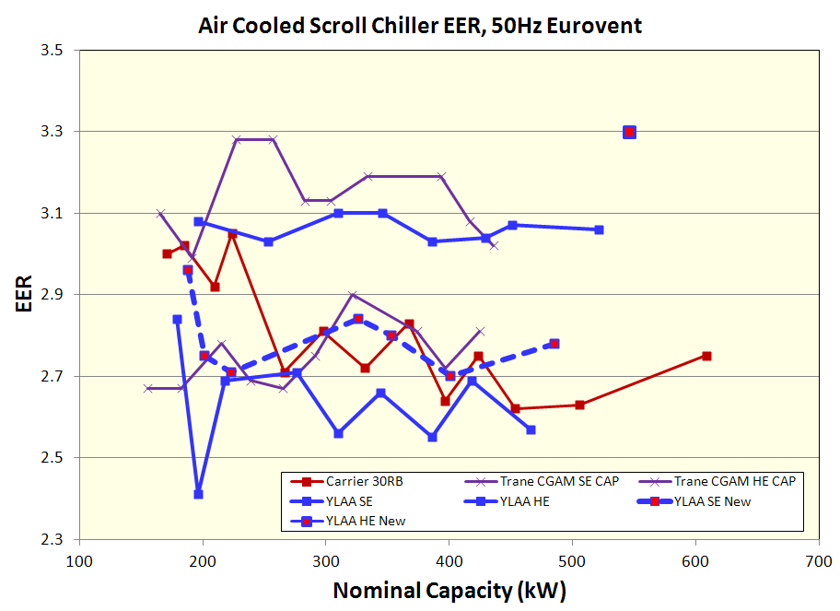
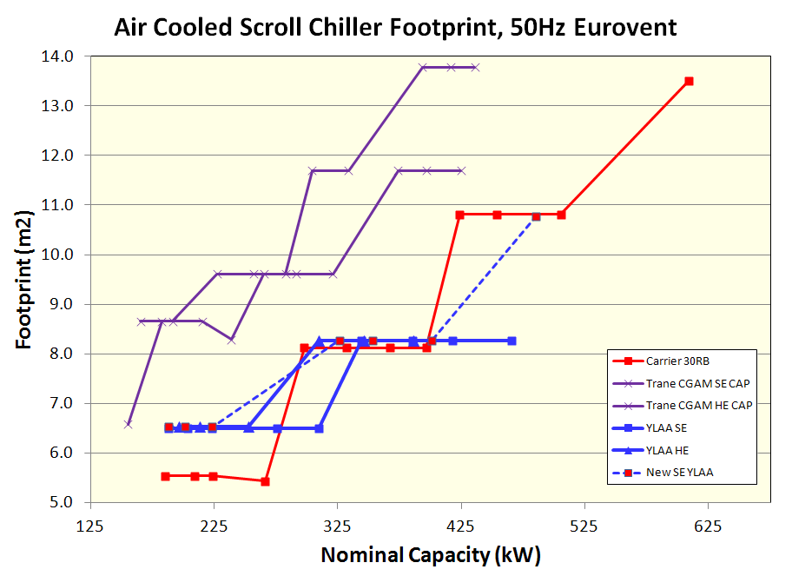
Competitive Comparison 3. New 50Hz Models – Full Load and Footprint (2013 release)
Competitive full load efficiency
Leading footprint in most sizes

Slide 31
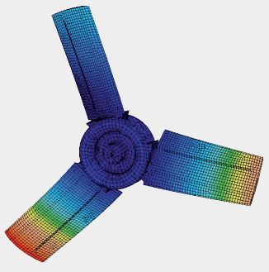
Refresh Overview 4. VSD Fans (New HE Option) (SQ now, 2013 option)
VSD Fans
New option on HE units
Improves sound, efficiency – entire coil active
Design similar to YVAA
Add-on inverter enclosure with fan terminals
Allows future retrofit kit for of installed units
Unit
Panel
Metal Wiring tray
VSD
One inverter per system

Slide 32
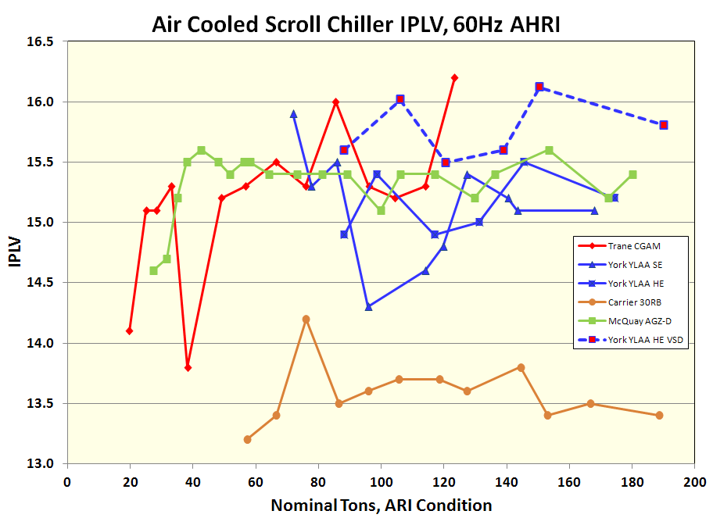
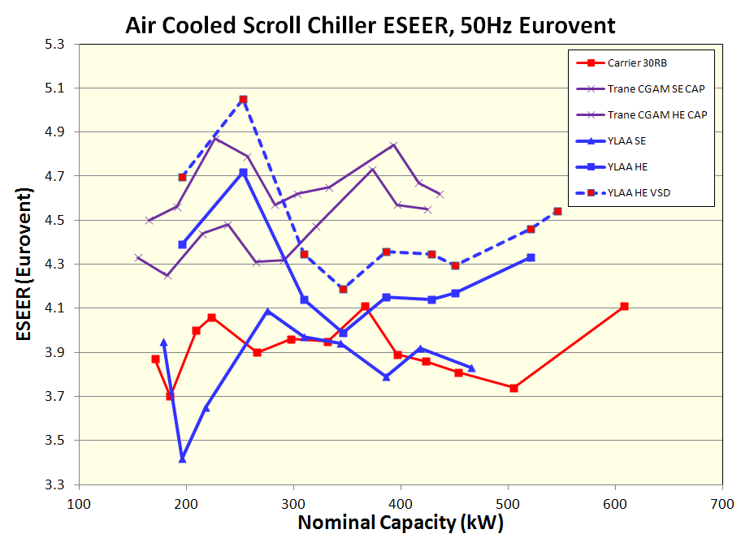
Performance Overview 4. VSD Fan Option – Part Load Efficiency (SQ now, 2013 option)
Gains 3-8% depending on unit size and configuration
Graphed with competition:
2014 “PE” project target
Conservative estimates…testing ongoing!

Slide 33
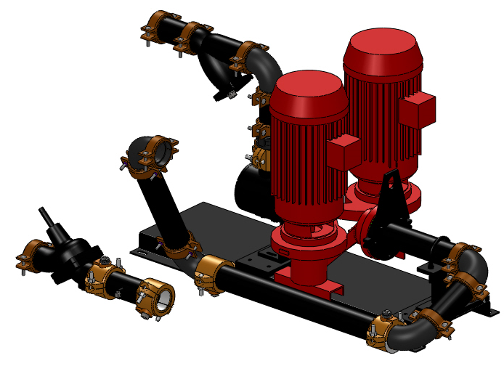
Refresh Overview 5. Pump Kit Improvements (available now, BPHX units)
Wider range of selections to include:
Primary-Secondary (down to 1.5 kW motors)
More impeller sizes – better match job
New Optional “Full Featured” Kit
Test ports, drain ports, expansion tank port
Base kit as today, plus drain/vent ports, flow switch
VSD Pumps by SQ
Future standard option

Slide 34
Technical Details 5. Pumps Kits – wider range, new options (available now, BPHX units)
YLAA was a leader in factory-installed pump kits
Our competitors have evolved and expanded
Trane standardized CGAM on VFDs for balancing & setup
Carrier offers tanks, optional VFDs
Both offer service valves
 | Dual Pump | VFD | IGV | Comb. Valve | PT Taps | Service Valves | Expansion Tank
Trane CGAM
Carrier 30RB
York YLAA
(SQ)
IGV = inlet guide vane / strainer
The new pump kits address all of these items

Slide 35
Technical Details 5. Pumps Kits – wider range, new options (available now, BPHX units)
Two levels of pump kits:
Base as today, plus shutoff valves (IGV, flow switch, balancing valve, pump, shutoff valves)
Full featured with above plus test ports, drains
VSDs and expansion tanks by SQ (future options)
Also offering a wider range of pumps
smaller motors suitable for primary-secondary;
more impeller sizes for better efficiency match to duty
New rating software into GCSS…flexibility, reports
Balancing valve a good idea…even with VFD!
recommended by pump manufacturers; allows fine tuning flow
Includes check valve function, shutoff valve and drain – fewer connections
a differentiator for YLAA
Increased flexibility, performance and easier to do SQ’s…

Slide 36
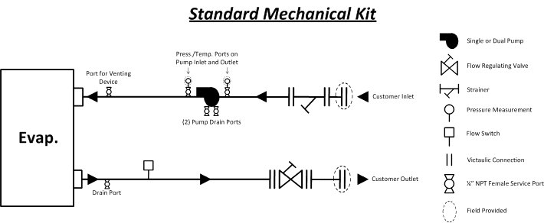
Technical Details 5. Pumps Kits – wider range, new options (available now, BPHX units)
Similar to current pump kit, with:
New vent & drain port in piping, flow switch

Slide 37
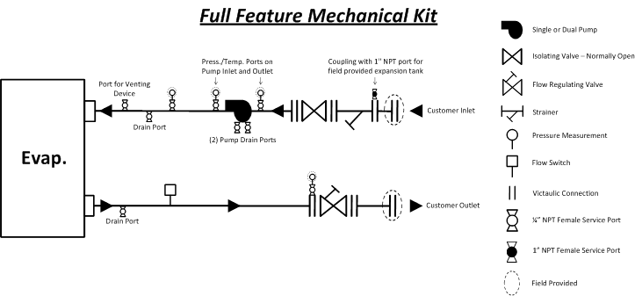
Technical Details 5. Pumps Kits – wider range, new options (available now, BPHX units)
Same as standard kit, plus inlet shutoff valve, additional ports for expansion tank and pressure/temperature measurement

Slide 38
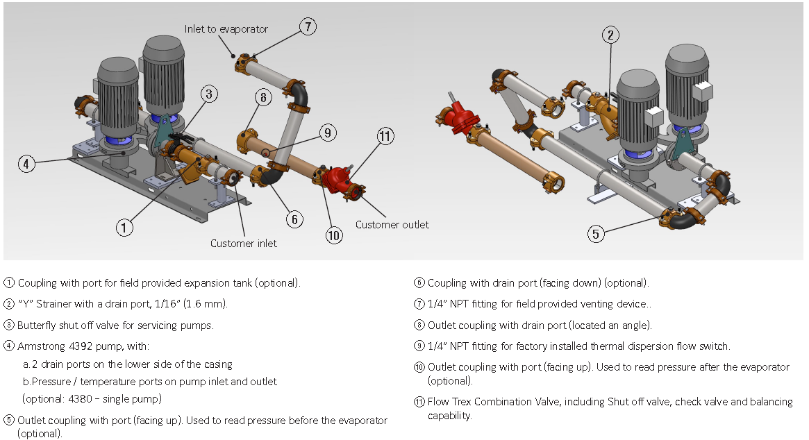
Technical Details 5. Pumps Kits – wider range, new options (available now, BPHX units)

Slide 39
Summary and Questions
Remember:
Our glycol chiller can stay loaded at higher ambient
Heat Recovery makes more usable heat, offers customizable performance
Brazed plate reduces weight, has price advantage
VSD fan an option on HE to improve part load, where chillers operate 97% of the time
Two levels of pump kits, match to customer needs
YLAA offers an excellent balance… Performance, flexibility, footprint, sound, and price
New features expand this position – sell the value
Bring us opportunities to help you win!

Slide 40
Appendix
Competitive Note
Heat Recovery Piping
GCSS Screenshots

Slide 41
Competitive Note Carrier Heat Recovery
Carrier Heat Recovery condenser is a Desuperheater type.
There are a few disadvantages to the design:
Low percentage of heat recovered (up to 10% THR)
A single brazed plate evaporator in each circuit. This makes field piping much more complex.
Condensers are not insulated for efficiency, or heat traced for winter storage. Adds field install labor and complexity.
YLAA uses a Partially Condensing heat recovery condenser. This design allows maximum flexibility to the user for heat and temperature balance, up to 85% THR and 60C (at lower %’s).
The YLAA also uses a single (dual circuit) condenser, for easier field piping install. And it is heat traced, with power from the unit panel. Insulation is standard.
Specify a single heat recovery condenser, heat trace and insulation.
Help design systems with high % heat recovery.
Explain the extra costs to contractors.

Slide 42
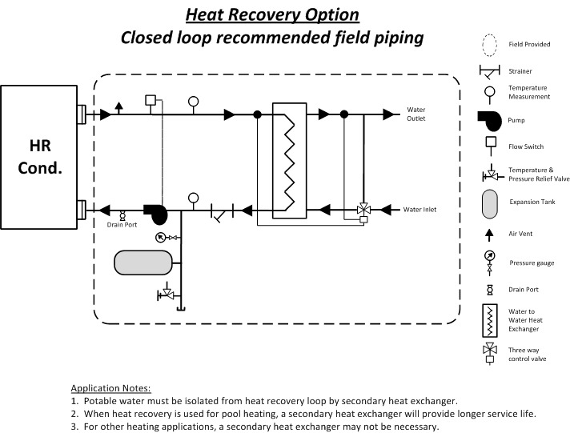
Heat Recovery Piping Recommendation
Closed loop should be used for heating potable water, pools

Slide 43
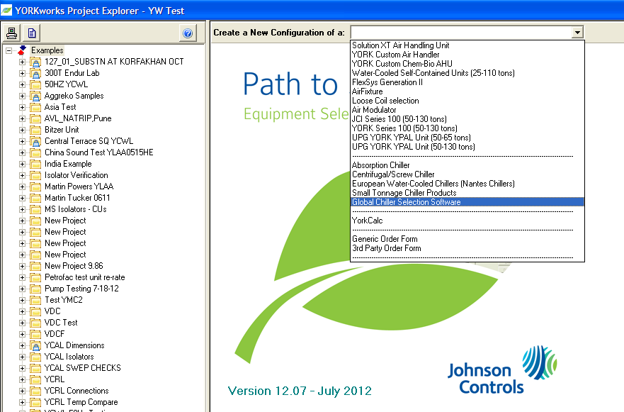
Global Chiller Selection Software Screenshot overview
New entry on drop-down menu
Old:
Small Tonnage Chiller Products
New:
Global Chiller Selection Software

Slide 44
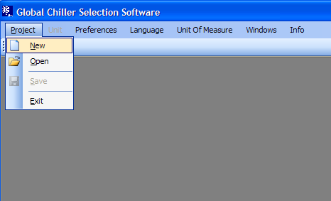
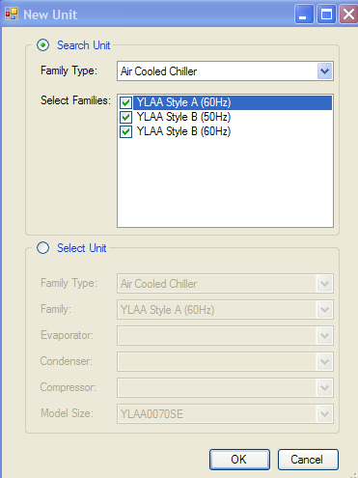
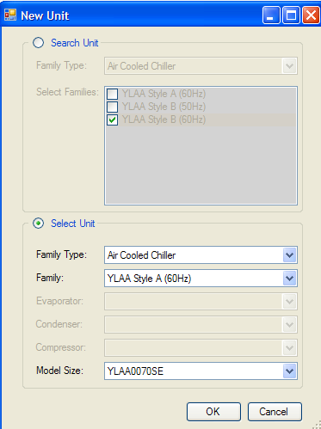
Global Chiller Selection Software Screenshot overview
Step 2:
Select unit types to rate
-or-
Select specific unit
Step 1:
Make new project
Note:
Style A = Shell & Tube
Style B = BPHX

Slide 45
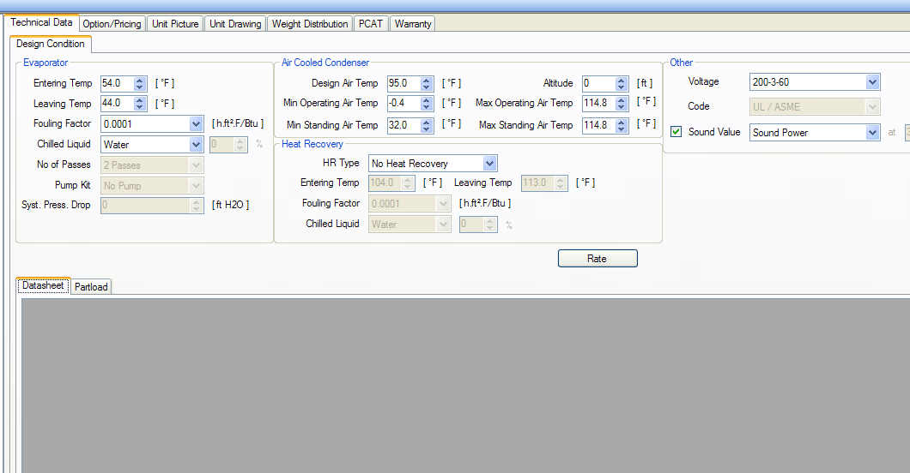
Global Chiller Selection Software Screenshot overview
Basic rating and selection screen
Step 3: Enter design conditions temperatures, voltage, liquid types
Step 4:
Click Rate

Slide 46

Global Chiller Selection Software Screenshot overview
Rating Results
Step 5:
Review performance data and re-rate or re-select if necessary

Slide 47

Global Chiller Selection Software Screenshot overview
Options and Reports
Step 6:
Select options, PCAT, access reports across top of screen

