Slide 1

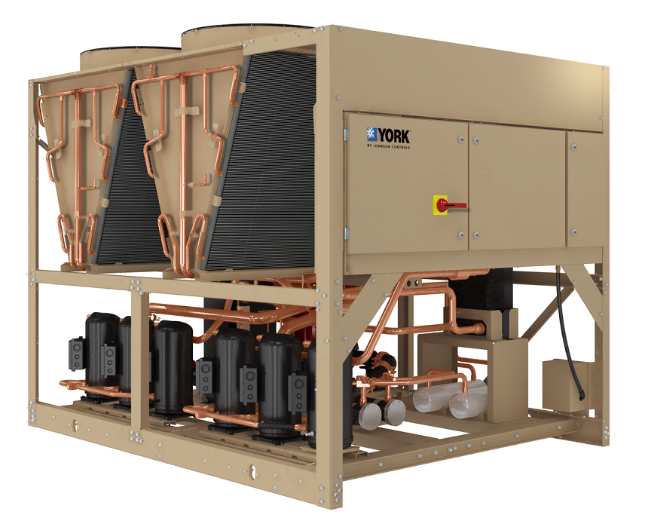

YLAA Air Cooled Scroll Chiller Refresh Overview 60 – 175 Tons
Finding the right balance for improved performance
North America Update
August 13, 2012

Slide 2

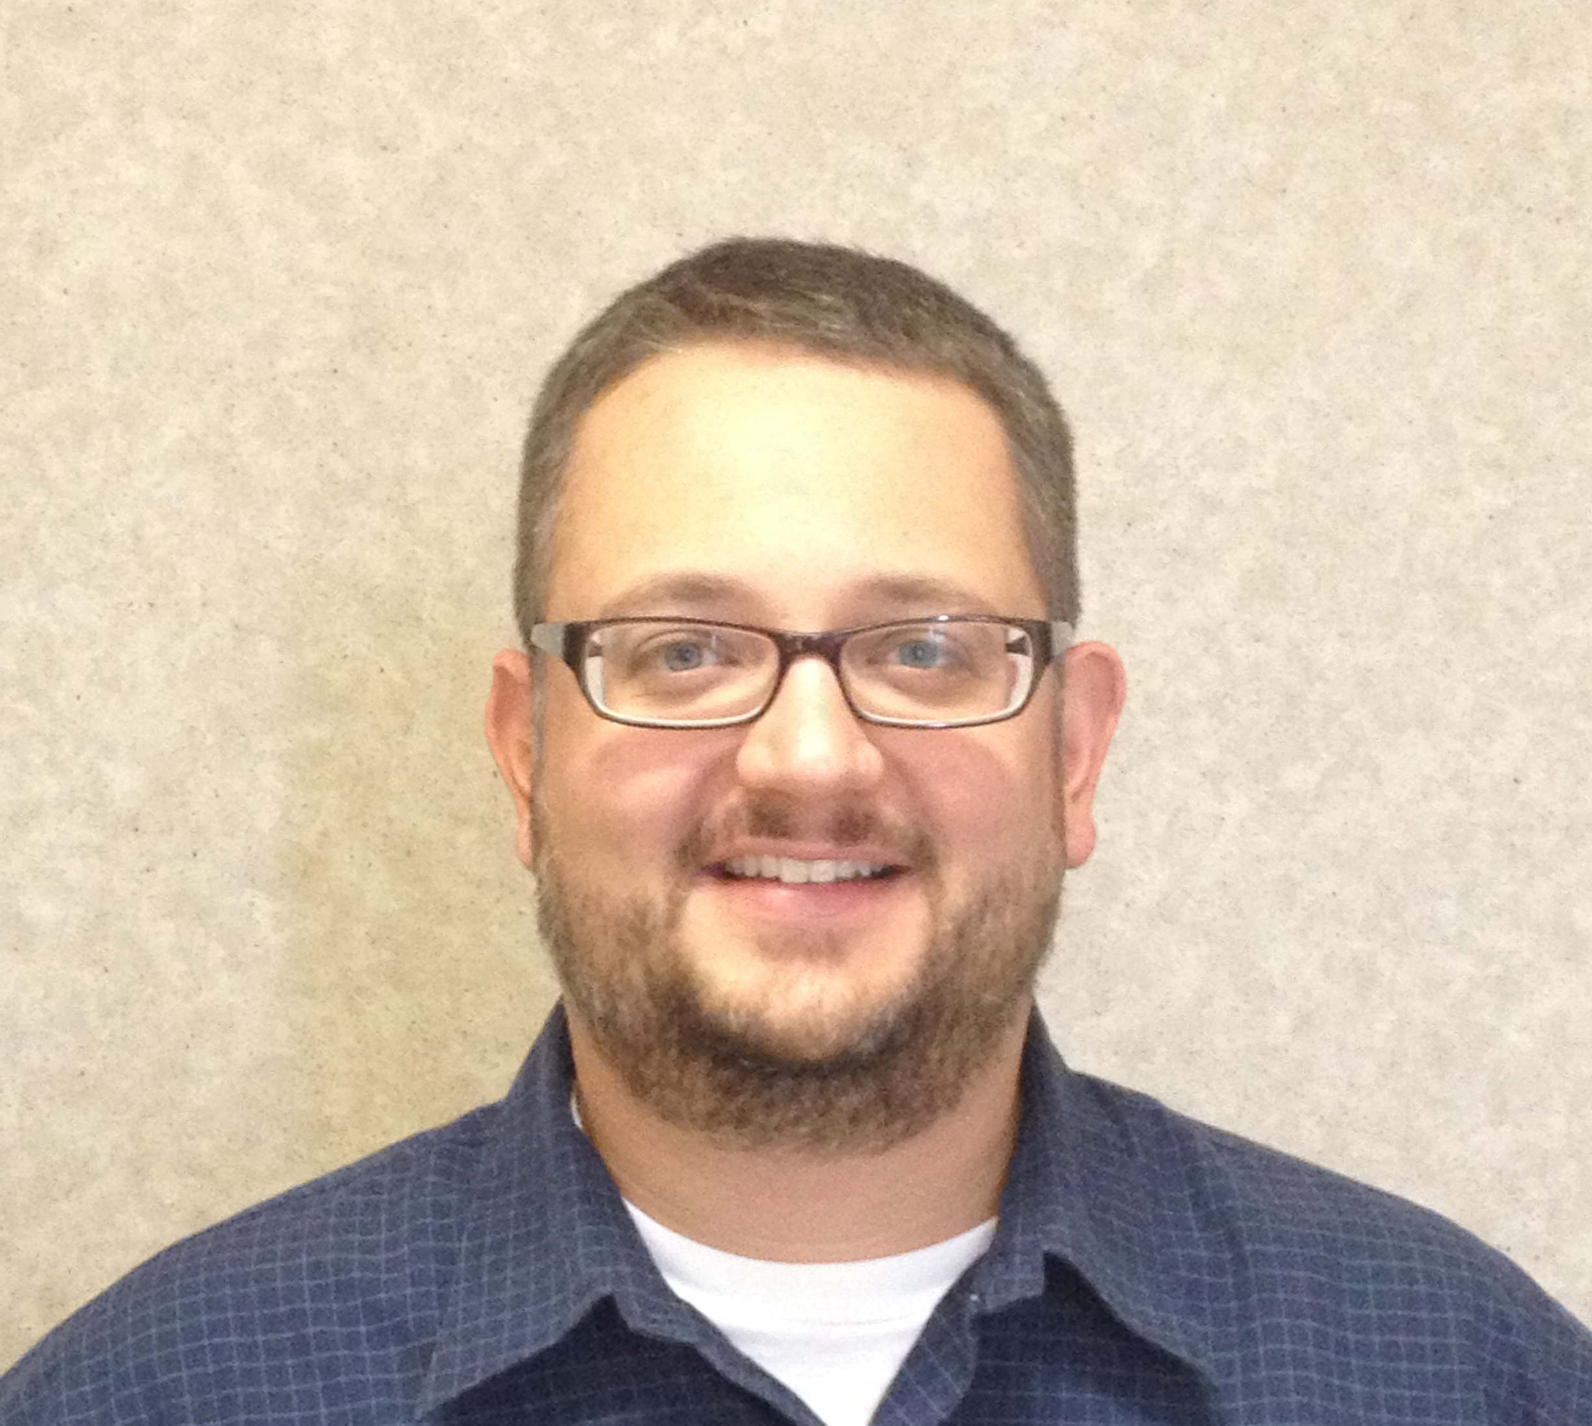

Presenter Introductions
Nicholas Staub, Product Portfolio Manager - North America
Christian Rudio, Global Product Line Manager - Scrolls
David Wolf, Application Engineer - Screw and Scroll Products

Slide 3
Today’s Expected Outcomes
Learn about our STC market potential, our share and ways to increase visibility
Learn about five new ways to promote and specify our YLAA offering with your consultants to:
Expand margin on every sale
Increase system performance and reliability
Outsmart your competition by driving up their costs
Learn more about our Global Chiller Selection software, our latest improvements and best practices around optimizing chiller selections
Need a Subject Matter Expert or sales materials to help you WIN more YLAA projects? You will meet the JCI STC Team today...they will help!

Slide 4
Agenda
YLAA product and market review
“Refresh project” overview & technical details
Glycol Applications
Heat Recovery
Brazed Plate Heat Exchanger
VSD Fan Option
Pump Kits – 2 different levels
YORKworks “Global Chiller Selection Software” demonstration
New Sales Tools:
Customer presentation, Sales Guide, Engineering guide
Questions

Slide 5
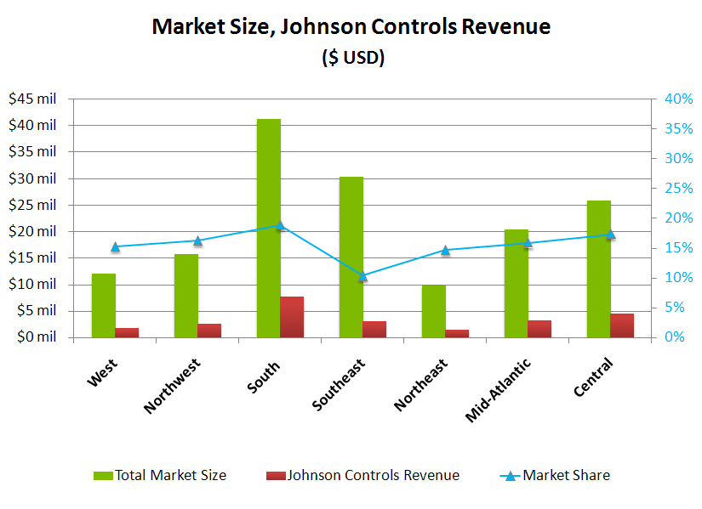
YLAA SHARE OF MARKET BY REGION
$2.4 Mil
$6.7 Mil
$2.0 Mil
$4.6 Mil
$2.9 Mil
$7.5 Mil
$3.9 Mil

Slide 6
YLAA SHARE OF MARKET BY REGION
$30 Million

Slide 7
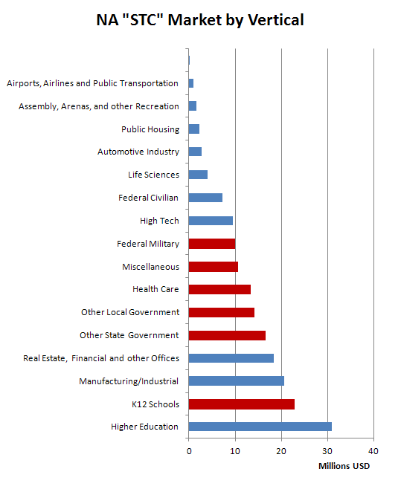
YLAA Vertical Market Applications
Top 5 (50% orders): K-12, Healthcare, Hotel, Federal Military, Local “other”
Opportunity on Manufacturing/Industrial, Real Estate/Financial Offices

Slide 8

What is the BEST Way to Penetrate this Hidden YLAA Market?
Review your Branch Market Plan with your BM/BAM
Review ARI performance, assigned accounts and account mgmt strategies
Seek opportunities through the following customers/ channels:
Customers you already call on
Design Build Contractors
Service Contractors
JCI Service team
UPG Distributors
Maintenance dept within K12, Higher Ed and CRE
Local Rigging Contractors

Slide 9
YLAA & Market Review

Slide 10

YLAA Overview A brief history…
2007…YLAA launched
Replaced R-22 chillers with R-410A, market leading performance
Led the market globally for 3 years – hospitals, education, light commercial top segments
Contributed to significant growth in North America
Multi-tier strategy proven successful
SE benefits footprint, low first cost, performance
HE offers a high efficiency value proposition
Sales Trends:
Globally: 60% SE, 40% HE
NA: 65% SE
LA: 75% SE in 2011
Europe: 75% HE
Asia: only offers HE
Successful Options:
Efficiency tiers
Multiple sound levels
Scalable option strategy
Integrated pump kits

Slide 11
YLAA Overview Industry Trends
Industry Trends, past and future:
Green buildings and energy costs… …raise efficiency, reduce sound & refrigerant charge quantity
Brazed Plate Evaporators, Microchannel… …technologies improve, reduce charge
Pump kits… …add application range, options
Fan sound levels… …improve industry-wide
VSD fans… …improve part load efficiency
Summary:
New technologies offer opportunity for improvement
No major competitive changes expected until next round of efficiency legislation (2015)

Slide 12
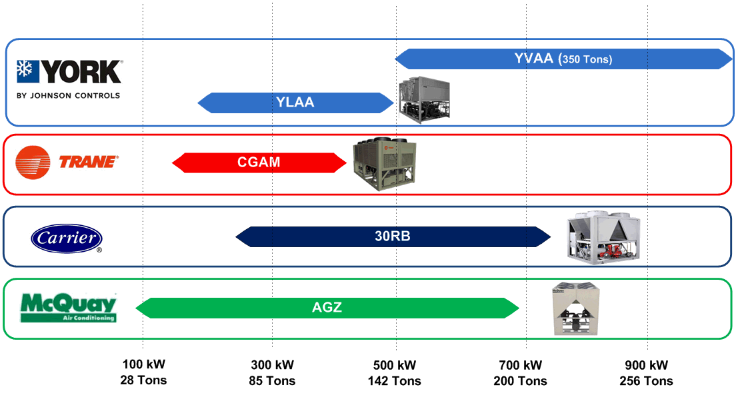
YLAA Overview Competitive Landscape (Current YLAA)

Slide 13
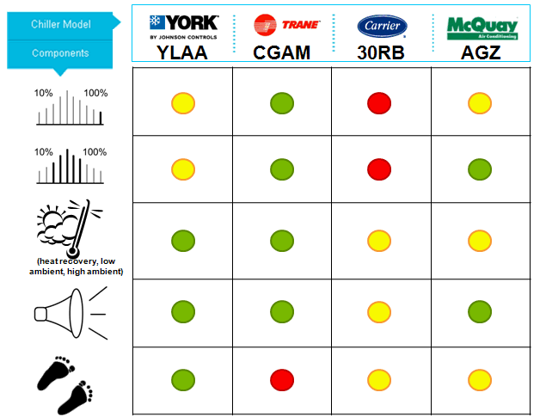
YLAA – YORK Air-Cooled Scroll Chiller Competitive benchmarking – Where we are today
Above Average
Average
Below Average
Trane CGAM good performance but large footprint & charge.
Carrier 30RB lags market and due for design refresh.

Slide 14
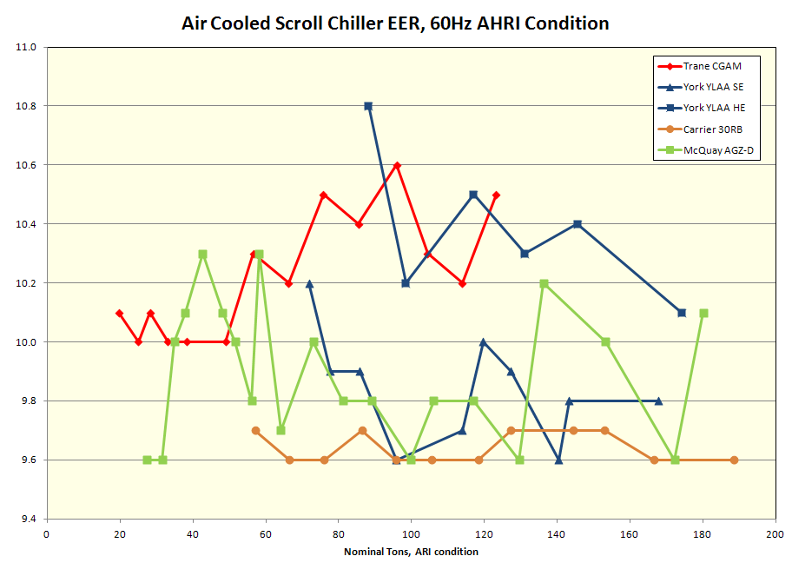
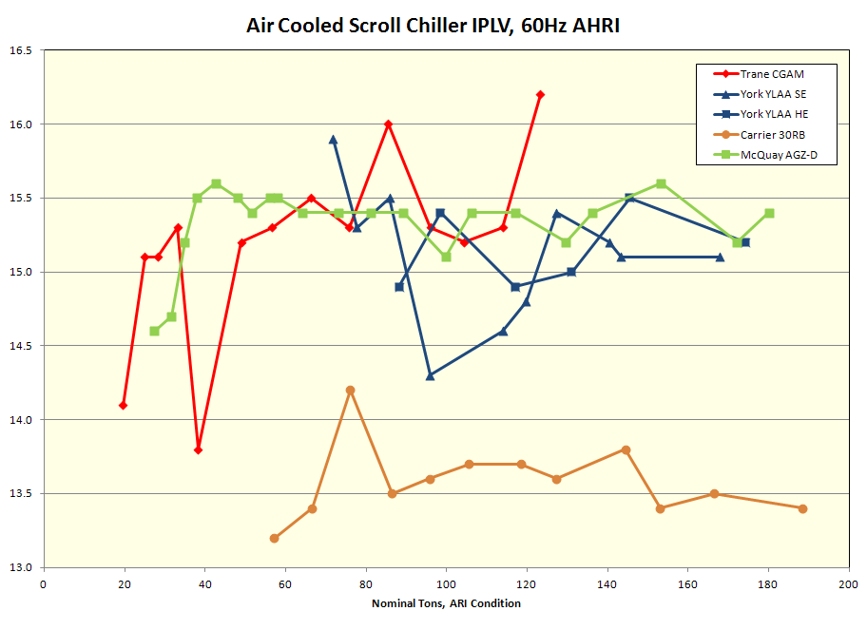
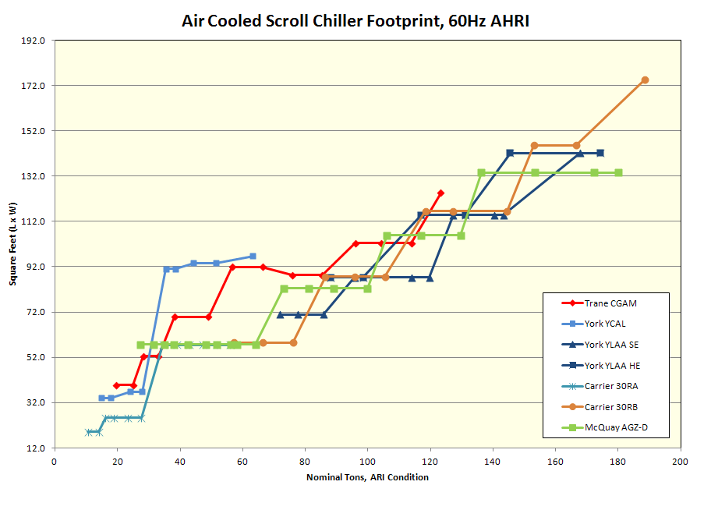
YLAA Overview Competitive Landscape…where we are today
Only manufacturer to offer two efficiency tiers, you can select your cost point
Very competitive part load performance, goal is to stay the market leader
YLAA still a good balance of efficiency, sound, charge and footprint, but competitors have closed the gap

Slide 15
YLAA Refresh Project

Slide 16
Refresh Project What, Why, How?
We talked about where we are today, the market, and the competition
We must continue to develop to remain competitive
A product line refresh was mapped out with several steps:
New Options – industry leading glycol and heat recovery options
Controls and technology to operate better
Structure as options – only pay for it when it’s needed
Brazed Plate Evaporators less weight, less volatility to copper
Combined with microchannel for a low refrigerant charge
New VSD fan option for HE part load improvement
New Pump options and range
New Premium Efficiency with low footprint
A large investment designed to maintain industry leadership.
Technical hurdles passed, drafting and implementation in progress.

Slide 17
YLAA Schedule

Slide 18

Refresh Project Schedule
New Options: Glycol & Heat Recovery
Launched August 2011
New Brazed Plate Models
First stage in YORKworks GCSS now (4, 5, 6 fan)
Remaining units available in October
VSD Fan Option
Early 2013 option
New Pump Kits
Available on new BPHX models
VSD pump design pending, can SQ today
Premium Efficiency
2013 development
2014 release
New Sales Tools!
New Sales Guide
New Customer Presentation
New Engineering Guides

Slide 19
YLAA Technical Details

Slide 20
Points to remember
Five important items to remember:
Lowest leaving glycol temperatures
Heat Recovery, gives more usable heat
Brazed plate reduces weight, integrates flow switch and strainer for reliability
VSD fan option on HE to improve part load
Two levels of pump kits, match to customer needs

Slide 21
Technical Details 1. Glycol – maximum capacity, colder glycol at higher ambient
Glycol Chilling Option: 10F leaving temperature
YLAA keeps making more capacity at higher ambients due to intelligent control
EEV also facilitates changeover duty with no derate at comfort cooling
Maximum capacity & colder glycol at higher ambient
No capacity penalty in changeover applications

Slide 22
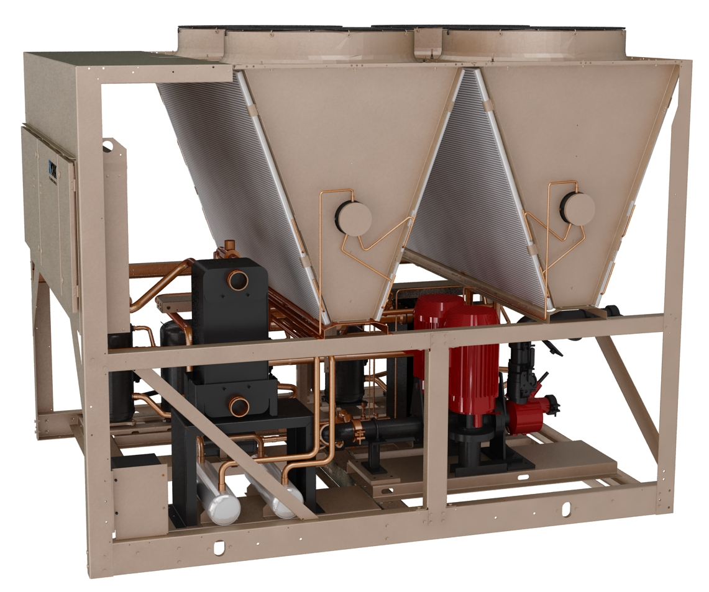
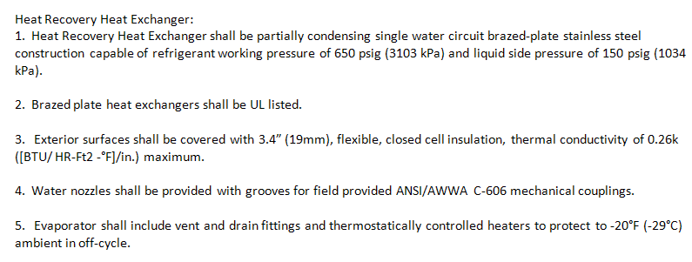
Technical Details 2. Heat Recovery – more heat, more flexibility
“Partially Condensing Heat Recovery”
Best balance of total heat recovered, temperature, and cost
Flexibility to dial performance to customer needs
YLAA design a global standard, shared components keeps cost competitive
Recovery Type | What is it? | HR Capacity | HR Temp. | Notes
Partially Condensing | Medium BPHX in discharge line | up to 85% | High (140F), Medium (100-125F) | YLAA design Excellent balance of performance, flexibility and price
Desuperheater | Small BPHX in discharge line | up to 10% | High (140F) | Used by Trane, Carrier and others
Secondary Condenser | Water-cooled condenser in parallel with air-cooled | 100% (no less) | Low (95-105F) | Unique to Carrier High price Refrigerant system complexities
Partially condensing heat recovery offers wide range of capacity and temperatures, at competitive cost

Slide 23
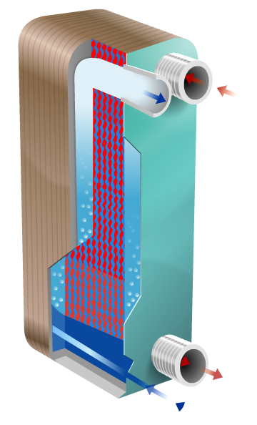
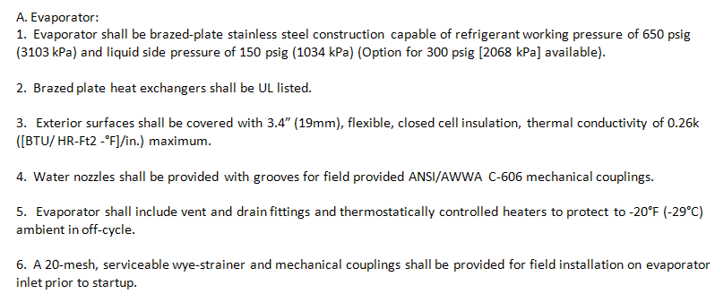
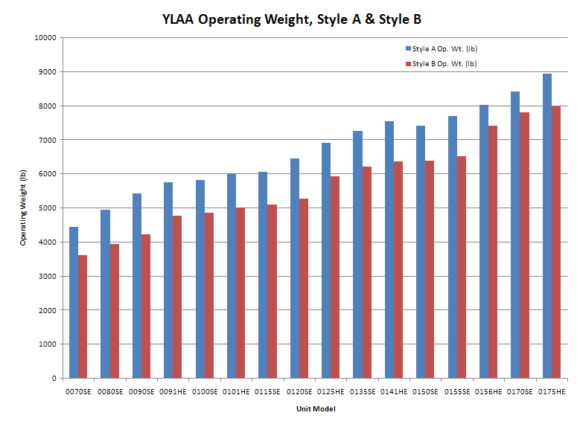
Refresh Project Overview 3. Brazed Plate Evaporators (4-6 fan available now, 8-10 fan 2013)
Average weight savings of 15%
Less structural steel, crane costs required on site
Reduced copper use – reduces price volatility
Shell & tube still available for existing jobs, new selections BPHX only

Slide 24
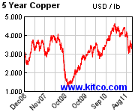
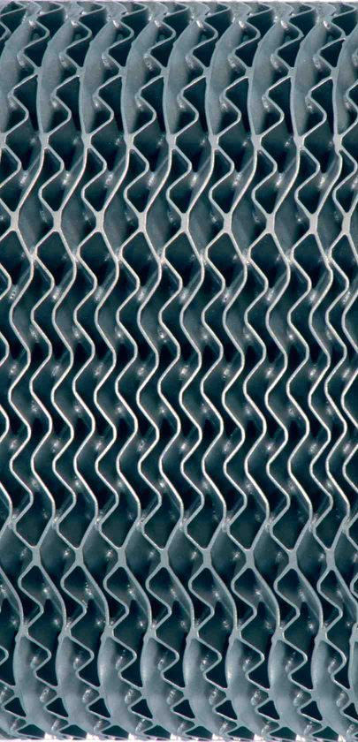
Technical Details 3. Brazed Plate Evaporator (4-6 fan available now, 8-10 fan 2013)
Why Now?
Performance lacking 5 years ago
copper costs driving development
technology now competitive to 200TR
No performance loss, lower water PD
Changes Required:
Testing, testing, testing….
Multiple sizes, full and part load, extreme conditions
Performance meets or exceeds shell & tube
Drafting
Unique opportunity to incorporate best practices
New pump kits, piping, sheet metal

Slide 25
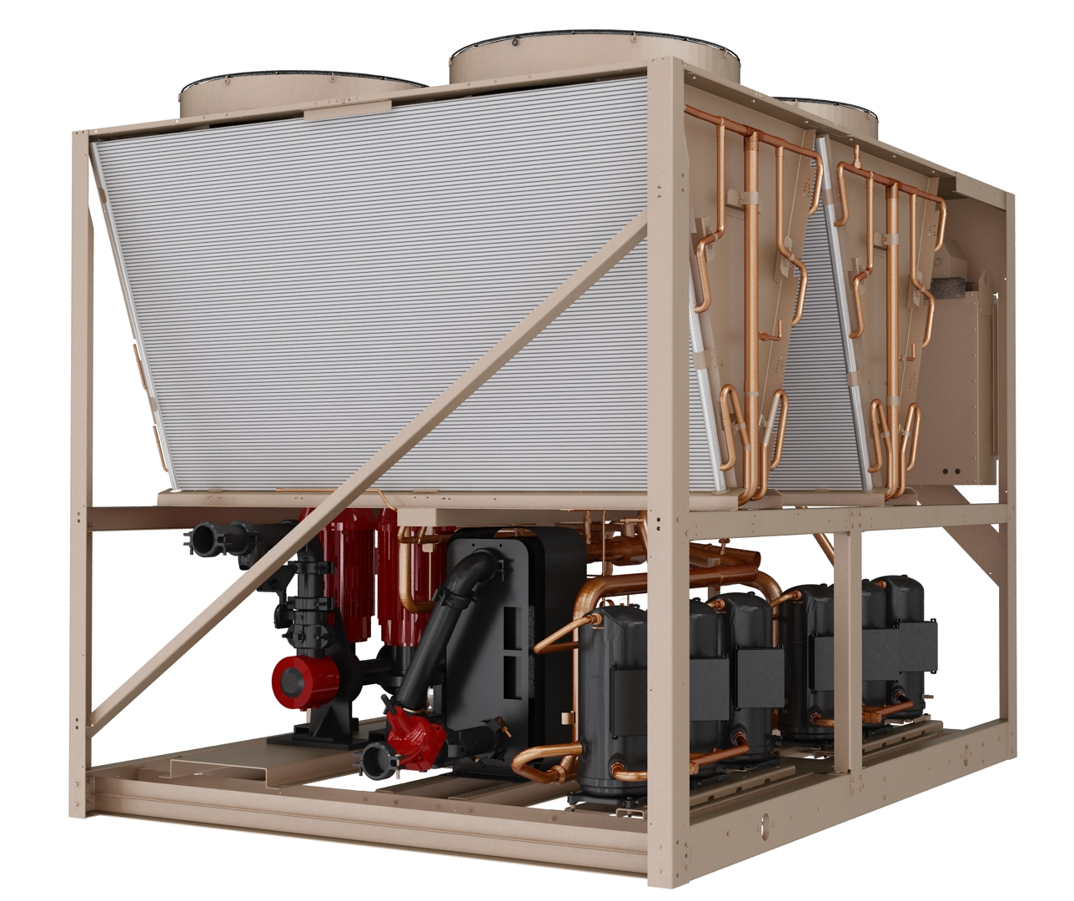
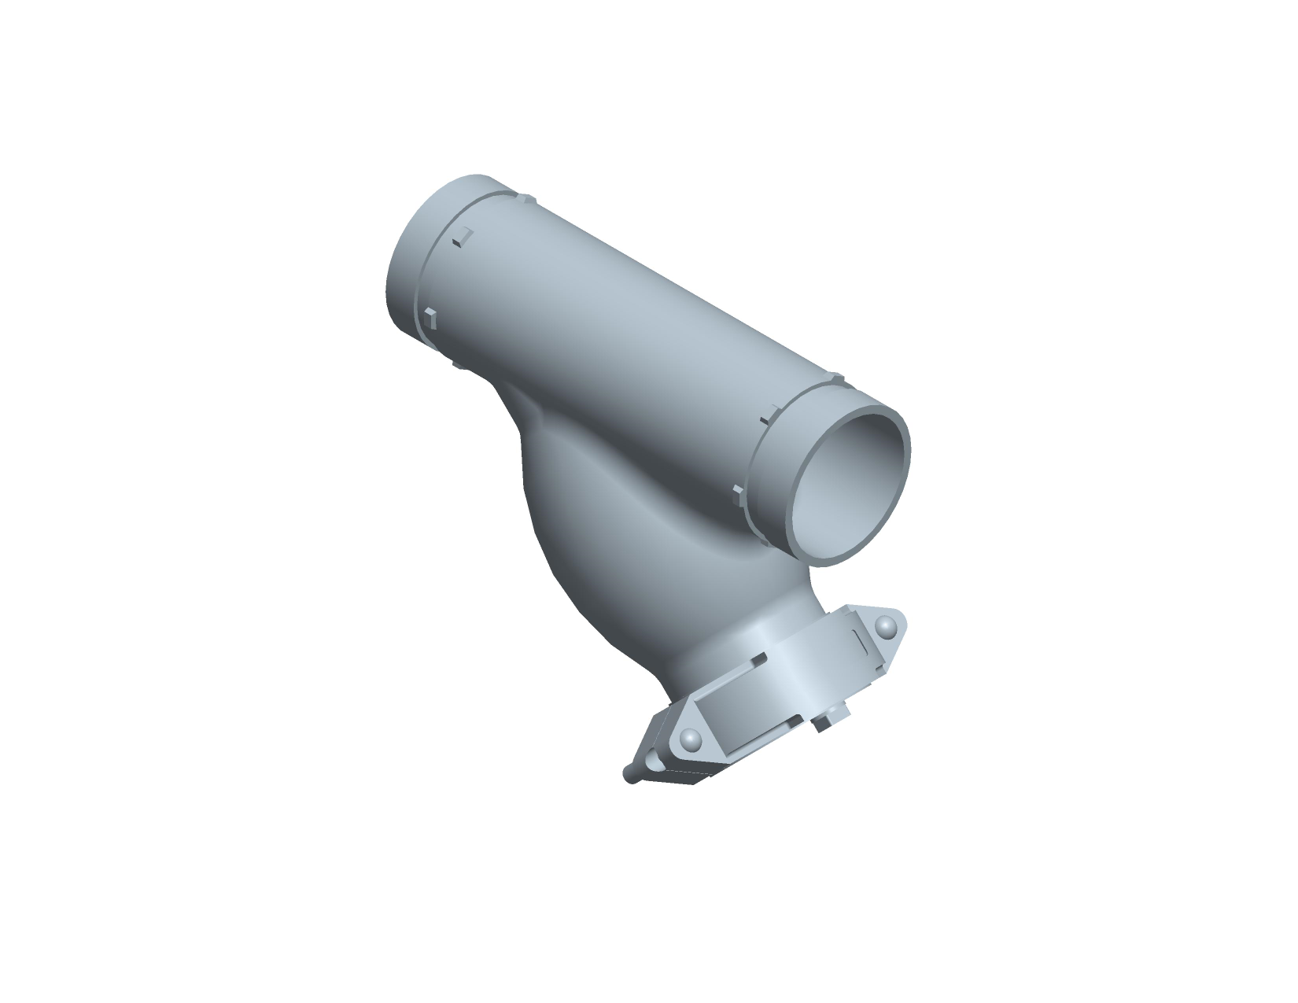
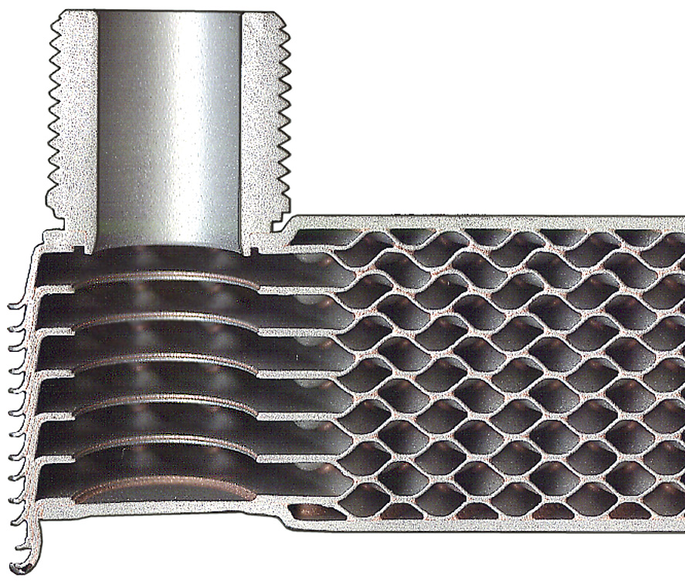
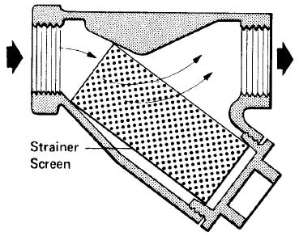
Technical Details 3. Brazed Plate Evaporator (4-6 fan available now, 8-10 fan 2013)
New evaporator:
316 stainless steel plates optimized for HFC-410A
Thermal dispersion flow switch standard
20-mesh wye-strainer included standard
Risk of clogging primarily construction debris at startup (evap loop is closed)
Strainer can be serviced or mesh removed after startup
Pump kits have strainers already (and will continue)

Slide 26
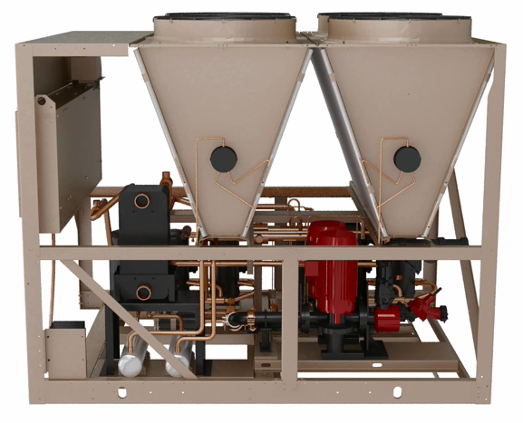
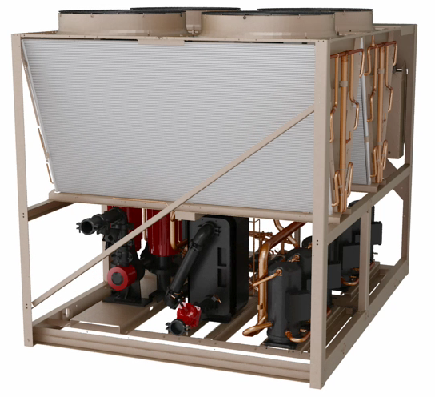
Technical Details 3. Brazed Plate Evaporator (4-6 fan available now, 8-10 fan 2013)
Customer connections to brazed plate evaporator:
4 - 6 fan: end connection (shown below); 8 - 10 fan: right side connection (not shown)
Evaporator back from edge to help Center of Gravity, minimize refrigerant piping
Standard “extension kit” – moves water connection to edge of unit, includes flow switch
Control Panel
Control Panel
Right Side View – Heat Recovery
End View – Evaporator & pump kit

Slide 27

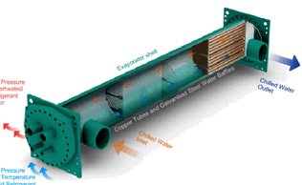
Technical Details 3. Brazed Plate Evaporator versus Shell and Tube
Clogging - The factory will include a 20 mesh strainer at no additional cost.
Smaller Evaporator - Enables new features and options
Water pipe extensions, water piping to edge of the unit (standard)
Thermal dispersion flow switch (standard)
Larger pump selections, with VSD
Lower unit weights
Competition - Trane and McQuay scroll chillers are designed with BPHX.

Slide 28
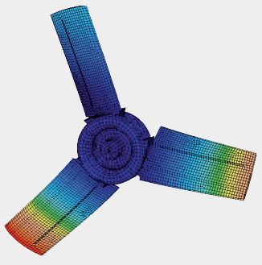
Refresh Overview 4. VSD Fans (New HE Option) (Available early 2013)
VSD Fans
New option on HE units
Improves sound, efficiency – entire coil active
Design similar to YVAA
Add-on inverter enclosure with fan terminals
Allows future retrofit kit for of installed units
Unit
Panel
Metal Wiring tray
VSD
One inverter per system

Slide 29
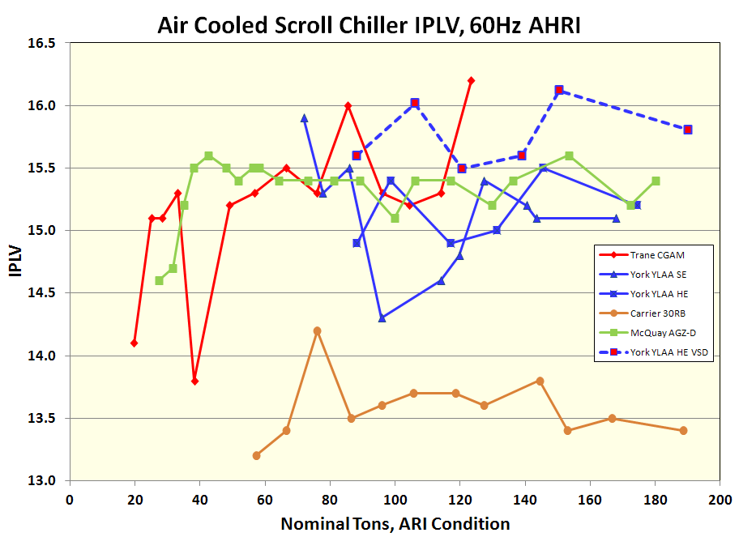
Performance Overview 4. VSD Fan Option – Part Load Efficiency (Available early 2013)
Gains 3-8% depending on unit size and configuration
Graphed with competition:
Conservative estimates…testing ongoing!

Slide 30
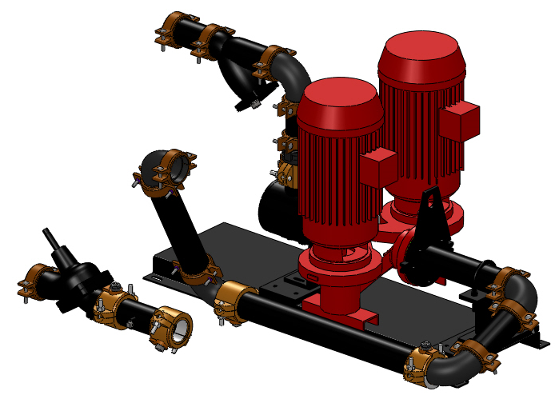
Refresh Overview 5. Pump Kit Improvements (available now, BPHX units)
Wider range of selections to include:
Primary-Secondary (down to 3hp motors)
More impeller sizes – better match jobs
New Optional “Full Featured” Kit
Inlet shutoff valve, Test ports, drain ports, expansion tank port
Base kit as today, plus drain/vent ports
VSD Pumps by SQ
Future standard option
Balancing valve a good idea…even with VFD!
recommended by pump manufacturers; allows fine tuning flow
Includes check valve function, shutoff valve and drain – fewer connections - Included as standard!
Increased flexibility, performance and easier to do SQ’s…

Slide 31
Technical Details 5. Pumps Kits – wider range, new options (available now, BPHX units)
YLAA was a leader in factory-installed pump kits
Our competitors have evolved and expanded
Trane standardized CGAM on VFDs for balancing & setup
Carrier offers tanks, optional VFDs
Both offer inlet service valves
 | Dual Pump | VFD | IGV | Comb. Valve | PT Taps | Service Valves | Expansion Tank
Trane CGAM
Carrier 30RB
York YLAA
(SQ)
IGV = inlet guide vane / strainer
The new pump kits address all of these items

Slide 32
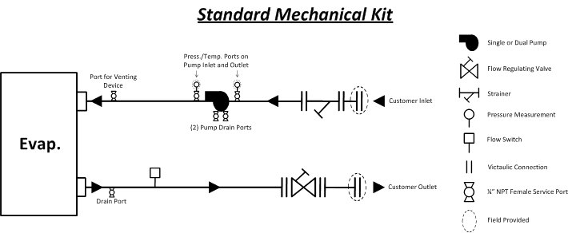
Technical Details 5. Pumps Kits – wider range, new options (available now, BPHX units)
Similar to current pump kit, with:
New vent & drain port in piping, flow switch

Slide 33
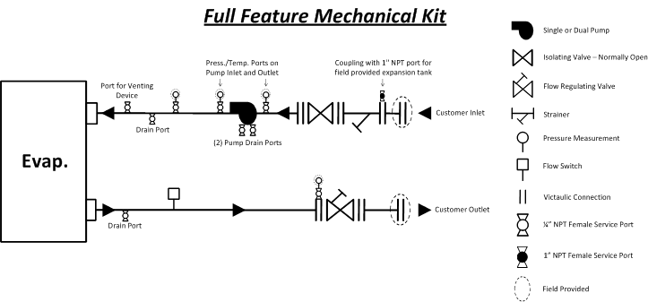
Technical Details 5. Pumps Kits – wider range, new options (available now, BPHX units)
Same as standard kit, plus inlet shutoff valve, additional ports for expansion tank and pressure/temperature measurement

Slide 34
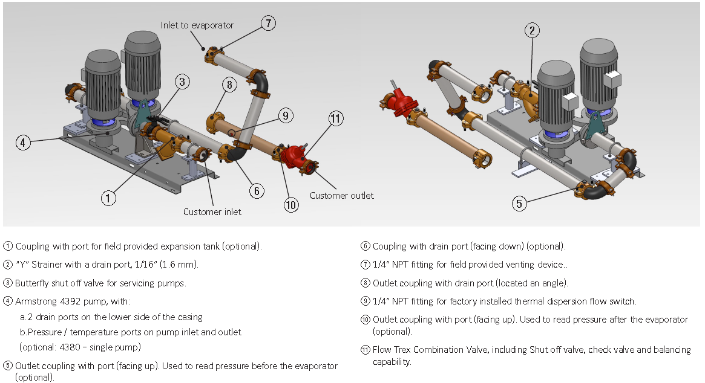
Technical Details 5. Pumps Kits – wider range, new options (available now, BPHX units)

Slide 35
YLAA GCSS Demonstration

Slide 36
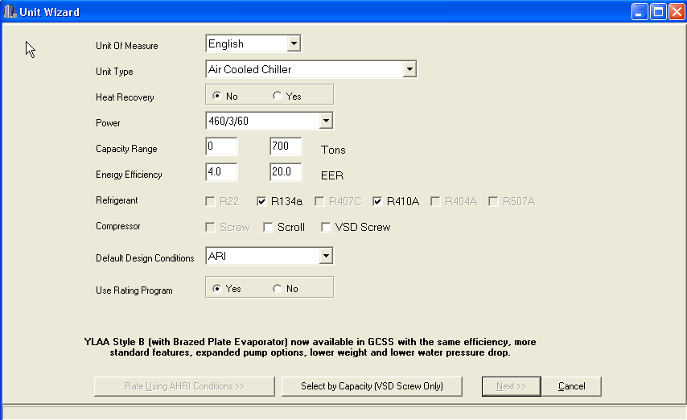
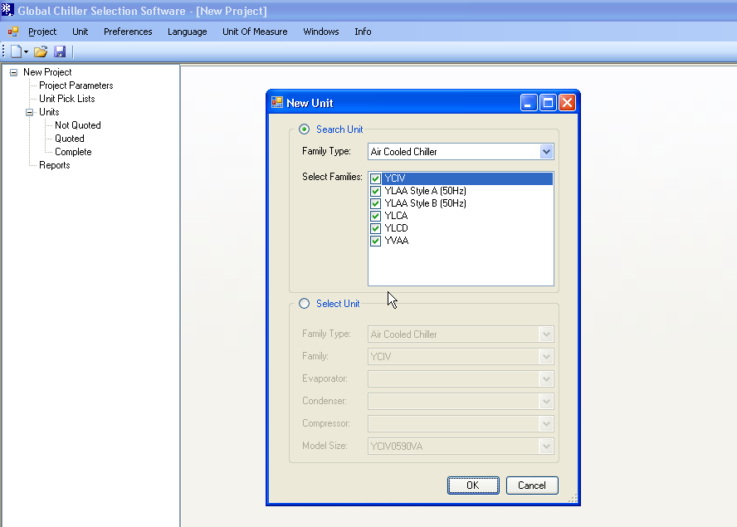
Global Chiller Selection Software Improvements / Concerns
Improvements over old STC software:
Access more information without having to save project
Ability to return to unit pick list without re-rating all models
Unit pick lists show BTP pricing
Can compare option and warranty pricing without saving
Ability to handle worldwide products and users with one software tool
Ability to update software without a patch
Major Issues Identified:
Efficiency, unit of measure (COP, EER, KW/ton)
Can’t rate by a temperature and flow
Can’t rate heat pumps easily (YVWA)
Option availability
Drawings in .dwg format
Need more descriptive error messages
Need option description / cutsheets added

Slide 37
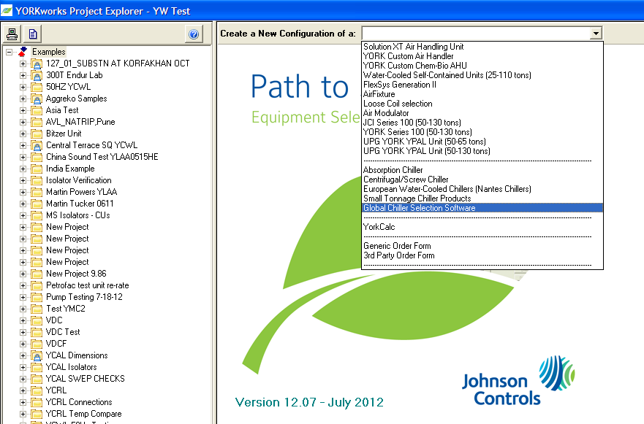
Global Chiller Selection Software Screenshot overview
New entry on drop-down menu
Old:
Small Tonnage Chiller Products
New:
Global Chiller Selection Software

Slide 38
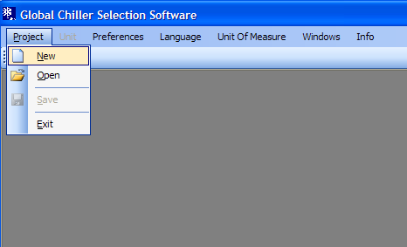
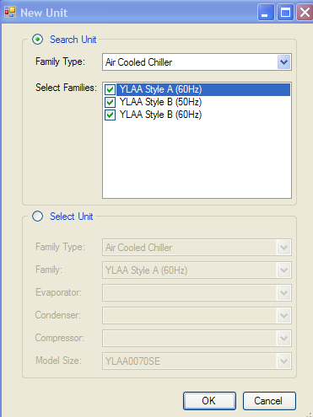
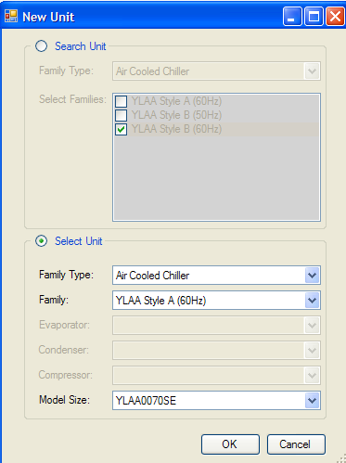
Global Chiller Selection Software Screenshot overview
Step 2:
Select unit types to rate
-or-
Select specific unit
Step 1:
Make new project
Note:
Style A = Shell & Tube
Style B = BPHX

Slide 39
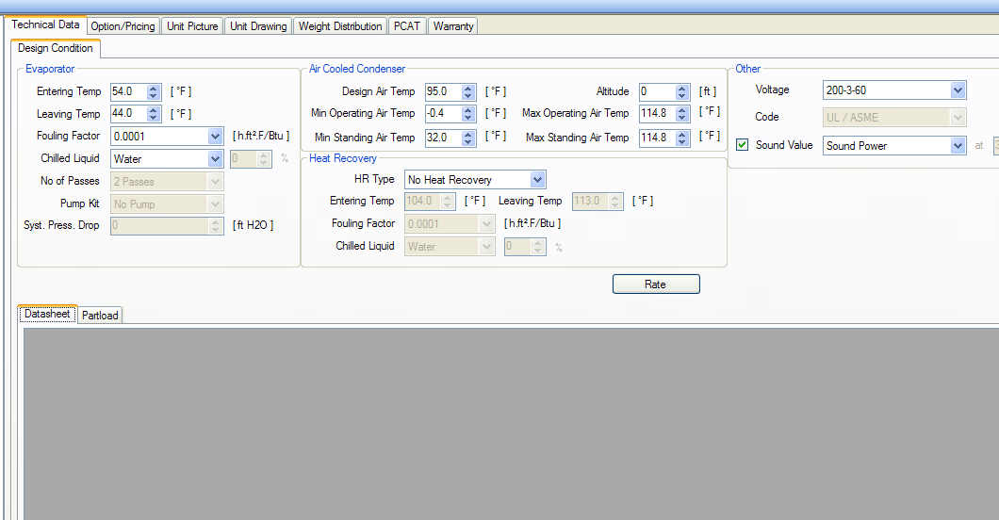
Global Chiller Selection Software Screenshot overview
Basic rating and selection screen
Step 3: Enter design conditions temperatures, voltage, liquid types
Step 4:
Click Rate

Slide 40
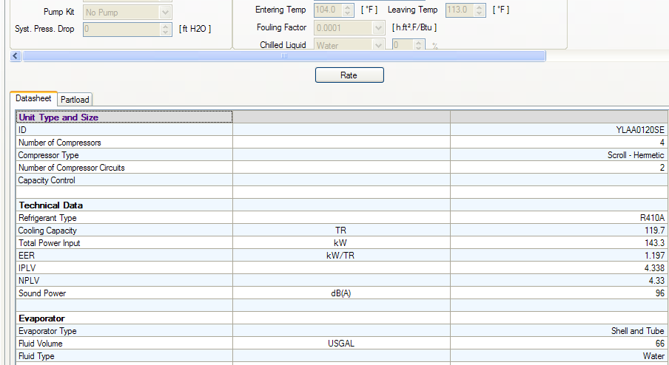
Global Chiller Selection Software Screenshot overview
Rating Results
Step 5:
Review performance data and re-rate or re-select if necessary

Slide 41
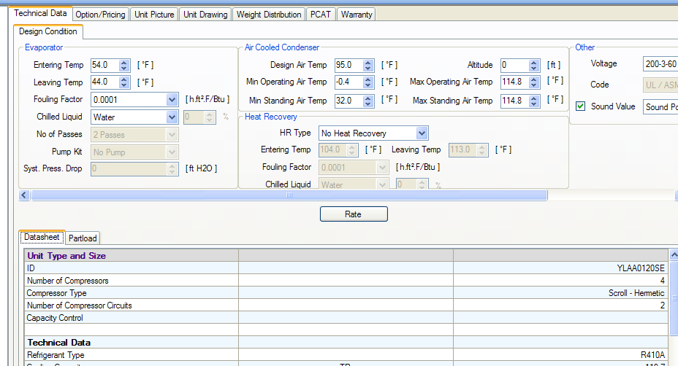
Global Chiller Selection Software Screenshot overview
Options and Reports
Step 6:
Select options, PCAT, and warranty across top of screen

Slide 42
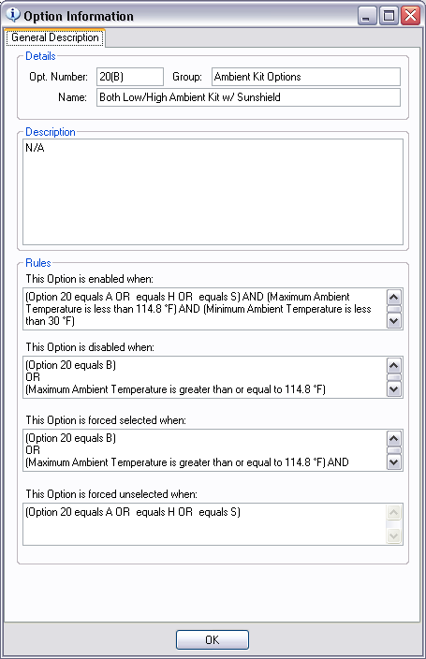
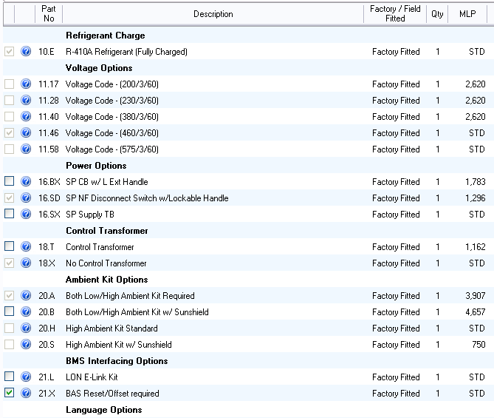
Global Chiller Selection Software Screenshot overview

Slide 43
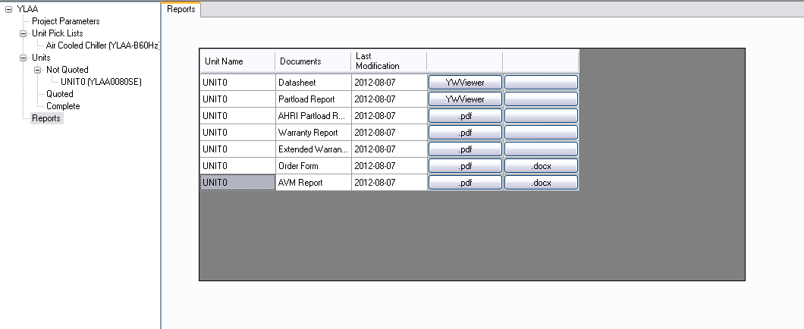
Global Chiller Selection Software Screenshot overview
Step 7:
Select the reports that you need including AHRI Part load

Slide 44
YLAA Sales Tools

Slide 45

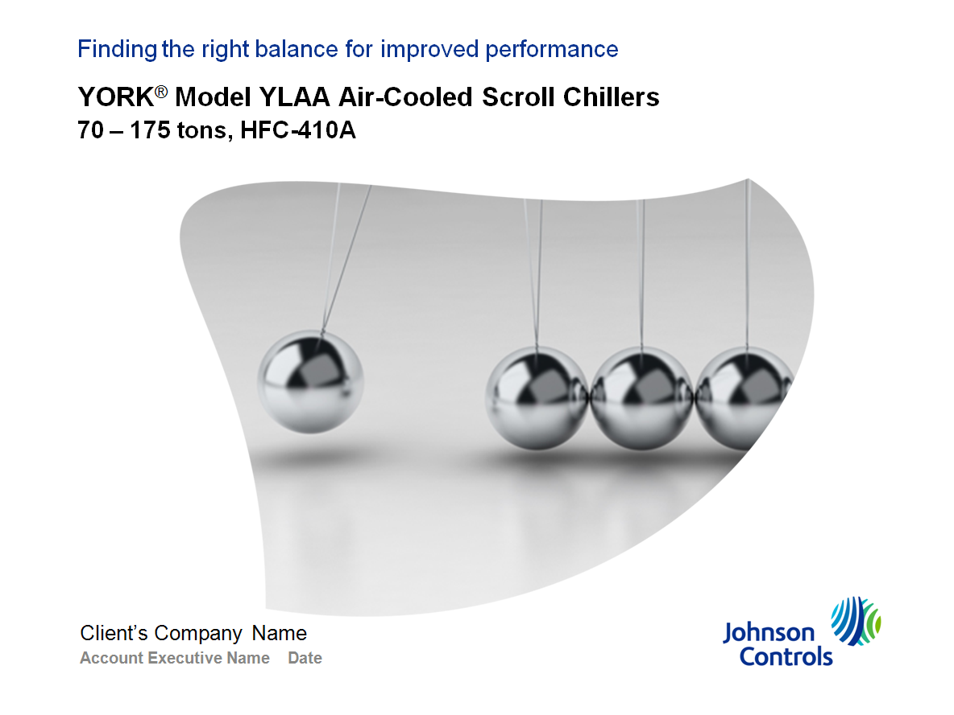

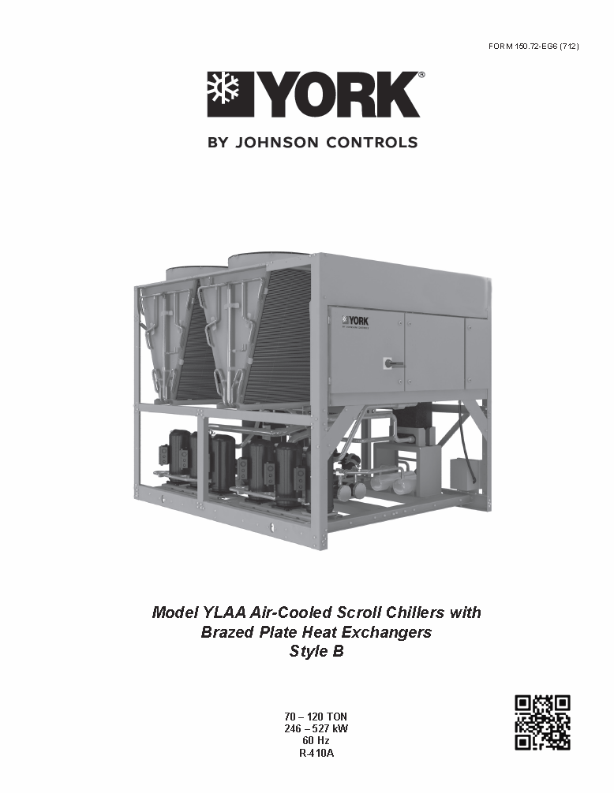
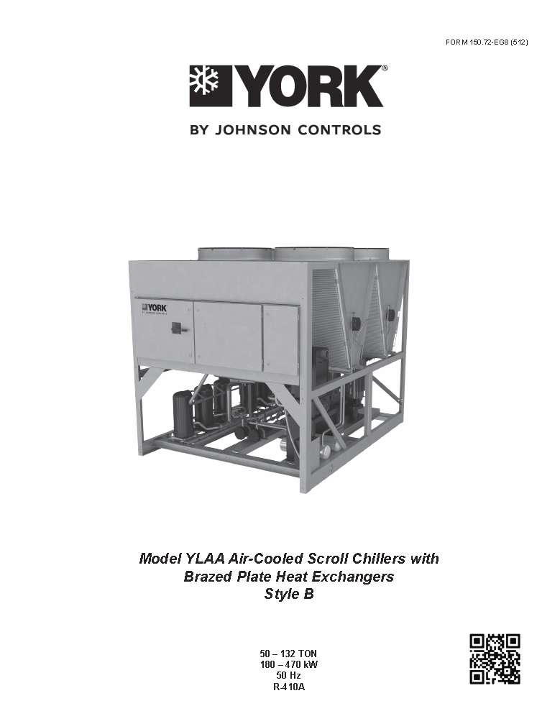
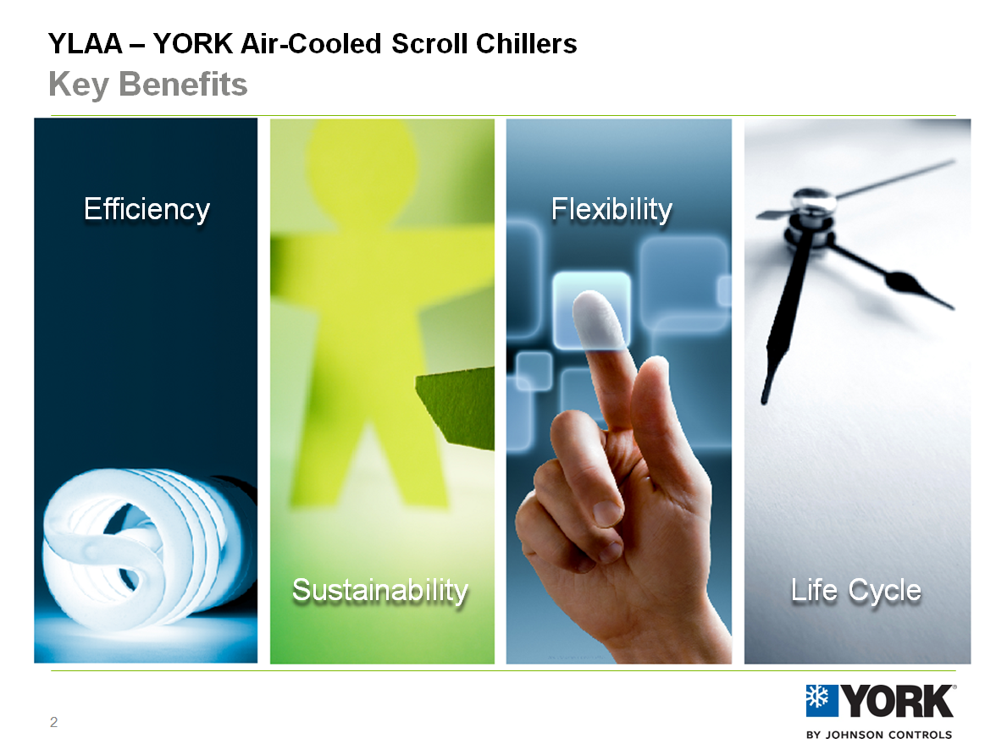
Sales Tools
60Hz Engineering Guide
Form: 150.72-EG6
Sales Guide
Form: PUBL-6886
Customer Presentation
Available on portal (review later)
50Hz Engineering Guide
Form: 150.72-EG8

Slide 46
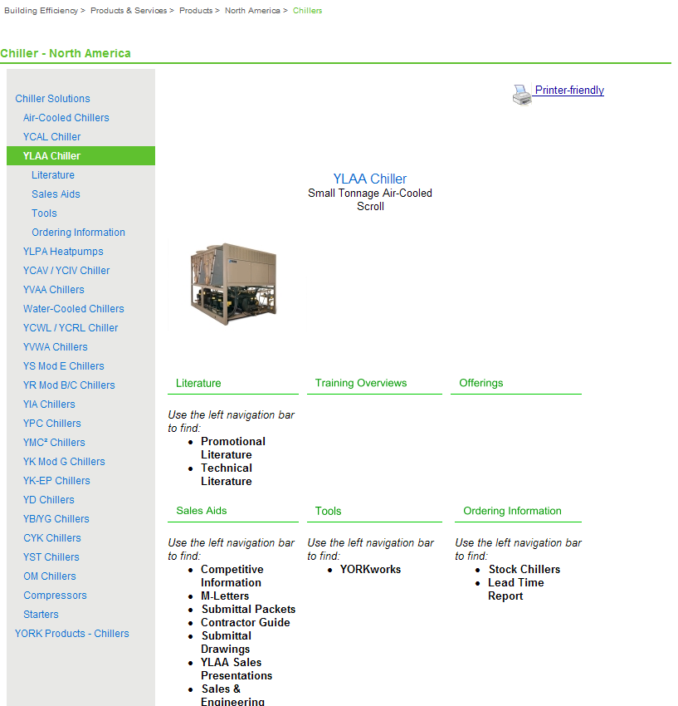
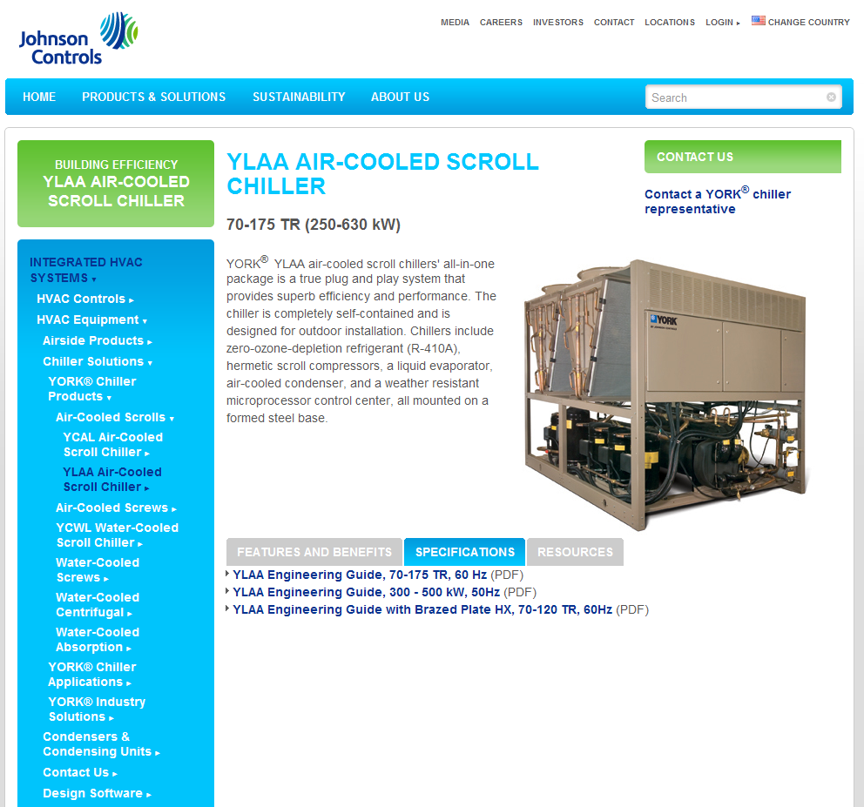
Information Access
Internal Portal
Products & Services >
Products > North America > Chillers
External Website
BPHX will be added in a few days

Slide 47
Summary and Questions
Remember:
Our glycol chiller can stay loaded at higher ambient
Heat Recovery makes more usable heat, offers customizable performance
Brazed plate reduces weight, integrates flow switch and strainer for reliability
VSD fan an option on HE to improve part load, where chillers operate 97% of the time
Two levels of pump kits, match to customer needs
YLAA offers an excellent balance… Performance, flexibility, footprint, sound, and price
New features expand this position – sell the value
Bring us opportunities to help you win!

Slide 48
Appendix
Competitive Note
Heat Recovery Piping
GCSS Screenshots

Slide 49
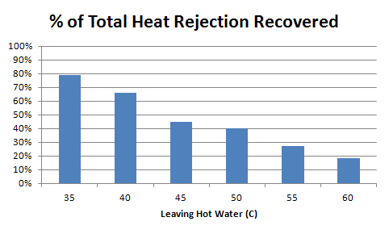
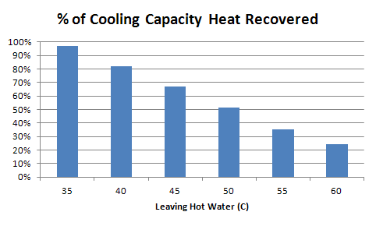
Technical Details 1. Heat Recovery – more heat, more flexibility
Amount of heat recovered depends on leaving hot water temperature
Recovery potential is cooling load plus work input
some competitors choose to ignore work input – to show higher heat recovery percentage
Heat recovery increases chiller efficiency slightly (depending on air temperature)
THR is what matters to our customers

Slide 50
Competitive Note Carrier Heat Recovery
Carrier Heat Recovery condenser is a Desuperheater type.
There are a few disadvantages to the design:
Low percentage of heat recovered (up to 10% THR)
A single brazed plate condenser in each circuit. This makes field piping much more complex.
Condensers are not insulated for efficiency, or heat traced for winter storage. Adds field install labor and complexity.
YLAA uses a Partially Condensing heat recovery condenser. This design allows maximum flexibility to the user for heat and temperature balance, up to 85% THR and 60C (at lower %’s).
The YLAA also uses a single (dual circuit) condenser, for easier field piping install. And it is heat traced, with power from the unit panel. Insulation is standard.
Specify a single heat recovery condenser, heat trace and insulation.
Help design systems with high % heat recovery.
Explain the extra costs to contractors.

Slide 51
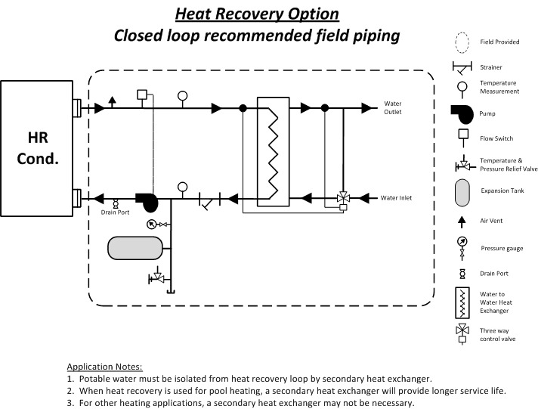
Heat Recovery Piping Recommendation
Closed loop should be used for heating potable water, pools

