Slide 1

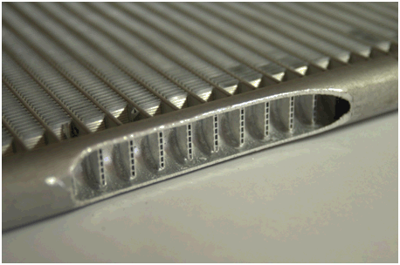
Microchannel Review
June 2013
Johnson Controls, Inc. – Proprietary and Confidential

Slide 2
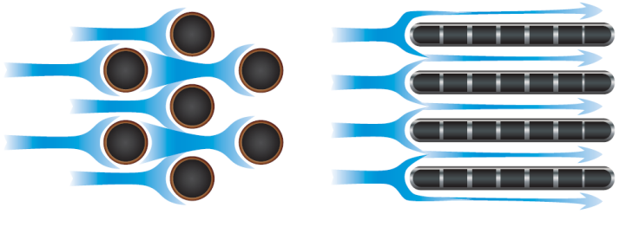
MCHX Benefits
  Why microchannel condenser?
  Fins secured and recessed between channels
  No galvanic corrosion – fins stay attached to the channels
  Lower airside pressure drop improves fan efficiency
  Reduced refrigerant charge (30-50%)
  Almost 50,000 in chiller application globally

Slide 3
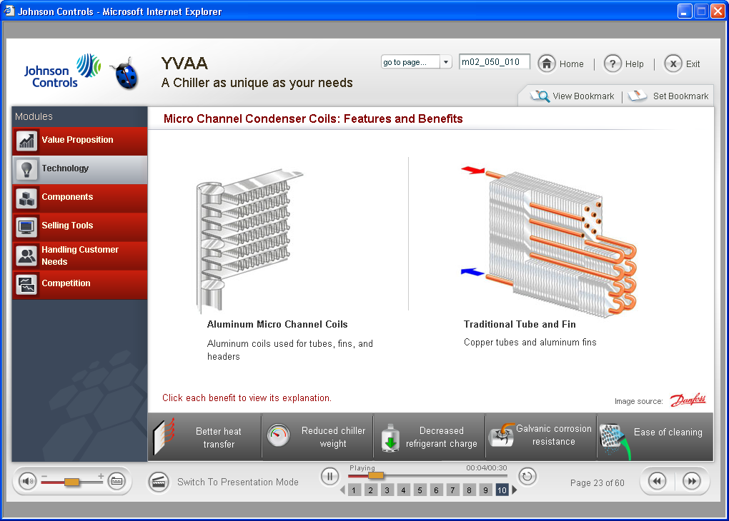
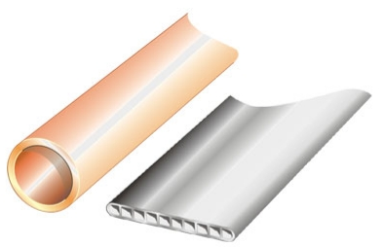

MCHX Benefits
  All Aluminum tubes, fins, and header
  Higher heat transfer per volume of coil – many small channels
  Increased heat transfer without adding chiller length or weight
Microchannel Coil
Round Tube Plate Fin Coil
Tube Cross Section
Round Tube
Microchannel
Images courtesy

Slide 4
MCHX Benefits
  Microchannel maintains the high efficiency over time
    All aluminum construction minimizes galvanic (dissimilar metal) corrosion
    Fins do not extend past the tubes making it easier to clean with water spray
    Microchannel coils are less deep, allowing more complete dirt removal when washing

Slide 5
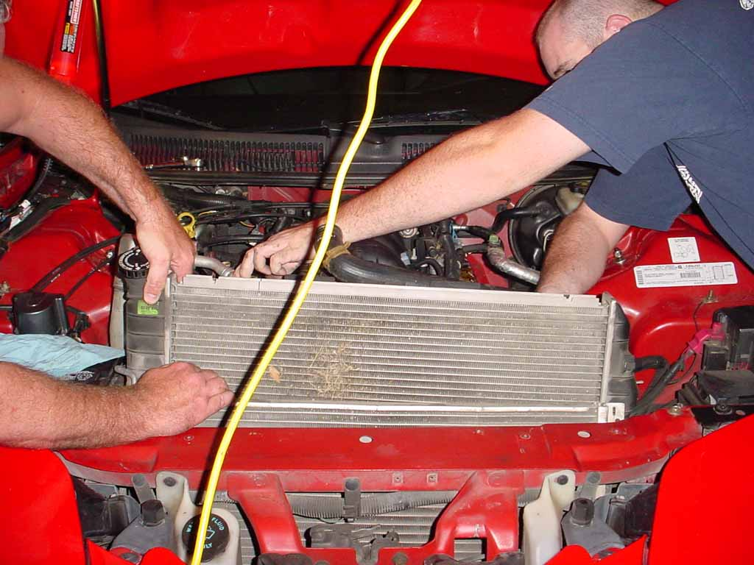
MCHX Early History
  MCHX entered mass production in automotive industry, 1980’s
    Due to switch from CFC-12 to HFC-134a
  Automotive application is severe
    Vibration from the engine and road
    Impact from debris
    Chemicals such as road salt, de-icers, oils,
    asphalt
    Air contaminant and pollution
    Temperature extremes

Slide 6
MCHX Early History
  MCHX is applied in 4 out 5 automobiles worldwide
    every country and every environment
  Extremely reliable in automotive applications
  Early HVAC applications assumed to be similar by some manufacturers
  Focus was put into mounting, bending, pressure testing for HFC-410A, etc ….
  Key application difference, with important implications, not discovered until after production in HVAC had started

Slide 7
MCHX Application on HVAC
  Key Application difference:
  HVAC coils are wet much longer than Automotive
    Automotive coils have high face velocity - helps remove moisture
      3,000 ft/min automotive v. 150-500 ft/min HVAC
    Automotive applications stay warm/hot under the hood
    Automotive coils stay shielded from precipitation
  HVAC applications are seasonal and remain exposed to outdoor conditions, but non-operational for several months per year
  Both applications get wet …but HVAC applications have a much higher possibility of retaining moisture for longer periods

Slide 8
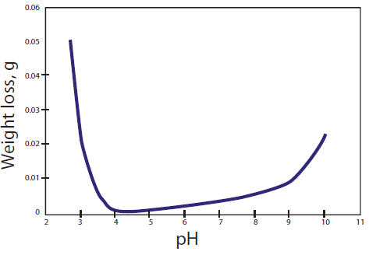
MCHX Application on HVAC
  Moisture… a key component required for corrosion
    Early generation MCHX from automotive MCHX suppliers used the braze flux from automotive applications
    This type braze flux created high pH conditions with extended exposure to moisture
  High pH creates an corrosive environment that directly attacks aluminum
Weight loss due to corrosion plotted by pH (over time)

Slide 9
MCHX Application on HVAC
  Production Challenges in early HVAC Experience:
    Zinc deposits in the tubes, created during tube fabrication, resulted in pockets where aluminum thickness was much lower than nominal wall thickness
    Early generation MCHX designs already had relatively thin tube wall thickness
      low weight for better auto fuel economy in automobile application
    Early generation MCHX tubes used a lower grade aluminum alloy
      cost control for auto industry
    Braze flux from automotive was not suited to high moisture environments
  Summary: Zinc deposits, less corrosion resistant alloy and flux, and thin wall tubes increased opportunity for tube failure (especially in coastal zones)

Slide 10
MCHX and YORK chillers
  Started with Industrial supplier
    Experience with stationary HVAC
    Production capacity to make larger coils
    Robust construction and thick wall tubes
  Co-development with JCI materials and heat transfer engineers
  Success with YORK model YLAA and YVAA air cooled chillers has been very good …
    More than 1,500 chillers per year with low coil failure rate (below RTPF)
    Shipped almost 50,000 MCHX coils since the production launch in 2007
    Includes many coastal installations…

Slide 11
Coastal Install Base & Chloride Concentrations
YLAA Installation site by locations in US.
Commercial markets often centered around coastal cities.
Larger dots indicate higher quantity of units in that location.

Slide 12
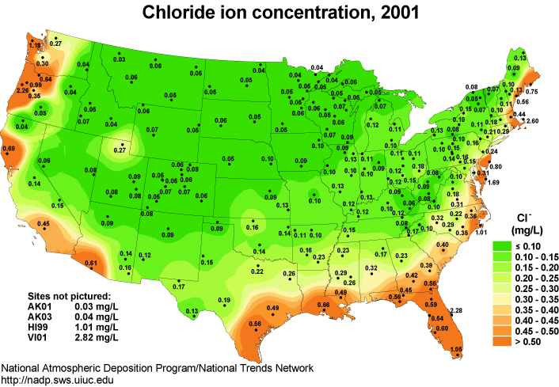
Coastal Install Base & Chloride Concentrations
High Salinity coastal locations are present in a large portion of the sites where YLAA are located.

Slide 13
JCI MCHX Development Process
  JCI “Heat Transfer Center of Excellence” (COE) set standards and performance requirements for MCHX
  Johnson Controls Materials Engineers specify:
    Tube alloy material
    Tube wall thickness
    Fin alloy material
    Braze flux material
  Johnson Controls Supplier Quality engineers:
    Inspect, approve and audit coil production facilities
    Developed inspection processes to ensure no zinc deposits from tube fabrication plant
    Inspect, approve and audit e-coating facilities
    Conduct extensive, ongoing testing of coil technologies and production samples

Slide 14
JCI MCHX Testing
  Four methods to evaluate accelerated corrosion:
    ASTM G85-A4 (Salt + SO2)
      Salt, sulfur dioxide gas, pH ~2.8-3.0 (Typical pollutant from coal / oil power plants)
    ASTM G85-A3 (SWAAT)
      Sea salt, acetic acid, pH ~2.5-3.0 (Common test for aluminum corrosion)
    Severe coastal, high chloride site testing
    Severe pollution and coastal site testing

Slide 15
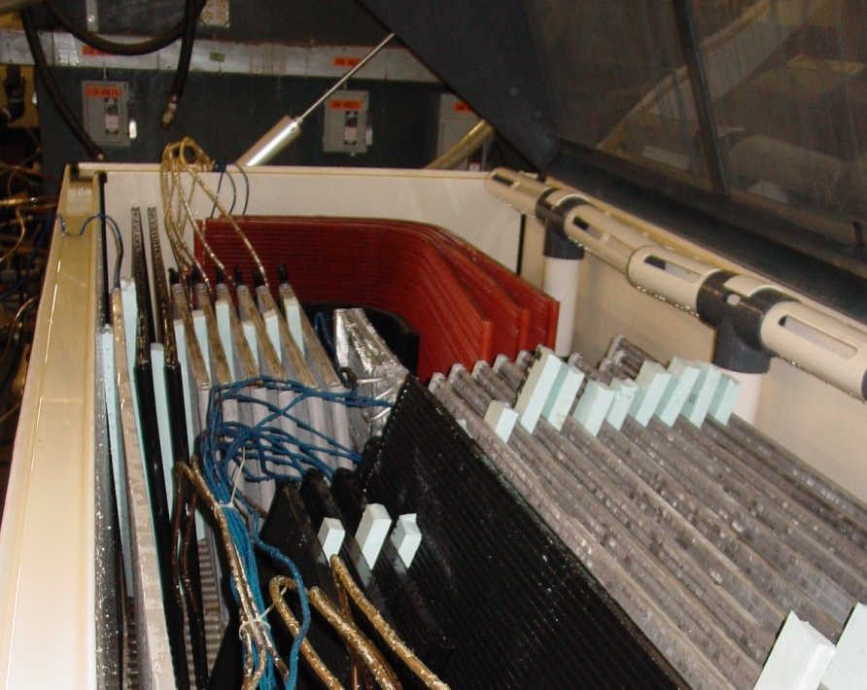
JCI MCHX Testing
  Sea Water Acetic Acid Test (SWAAT) - ASTM G85 A.3 (Modification of ASTM B117)
    Cyclic fogging test with pH of 3.
    An industry standard test used for validating aluminum heat exchangers
    Coils charged with nitrogen holding charge and gauge detects leak
    100 days in SWAAT approximates chiller design life
SWAAT chamber with coils prepared for test

Slide 16
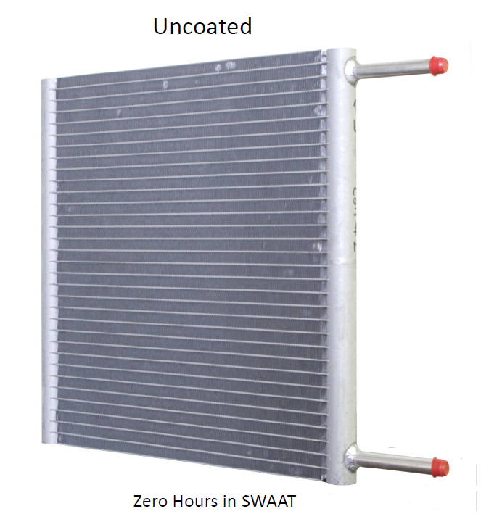
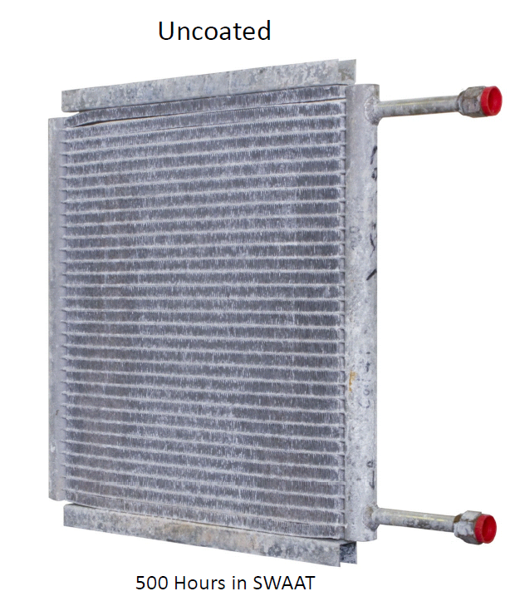
JCI MCHX Testing – Uncoated Coil SWAAT

Slide 17
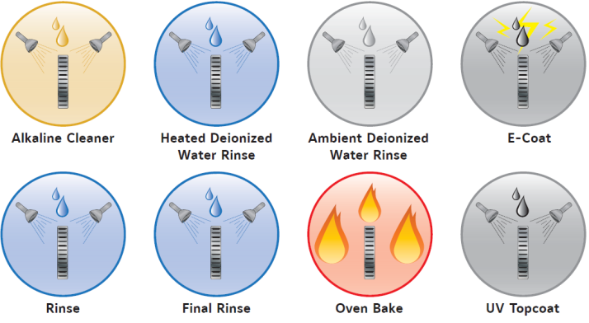
Additional Condenser Protection
  Electrostatic coating (e-coat) recommended for some applications
  Same coating as recommended for round tube plate fin (RTPF) coils
  Recommended applications:
    Industrial: Sulfur Dioxide (SO₂), Nitrogen Dioxide (NO₂) pollution; low pH acid rain (sulfuric or nitric acid); heavy dust (fossil fuel burn – iron & sulfur)
    Coastal: within 5 miles (8 km) of coast, or in prevailing wind (chloride)
    Other: High pH (pH>9) from cement dust, Agricultural operations
  E-coat option provides excellent protection against these elements

Slide 18
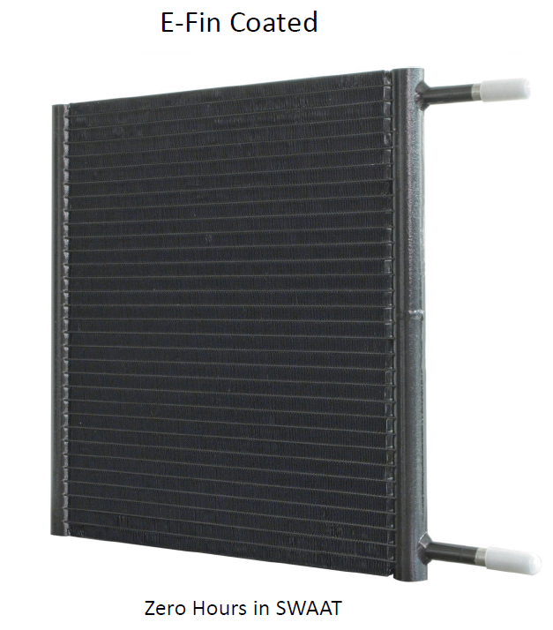
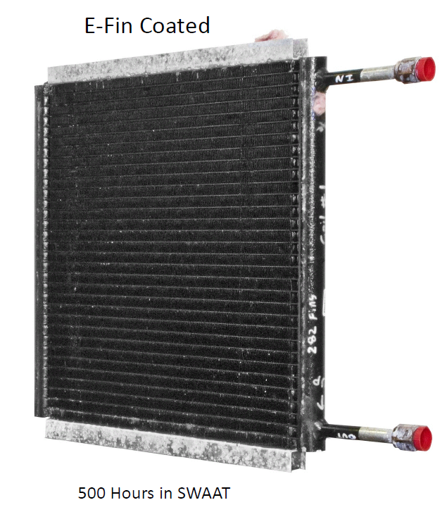
JCI MCHX Testing – E-Coated Coil SWAAT

Slide 19
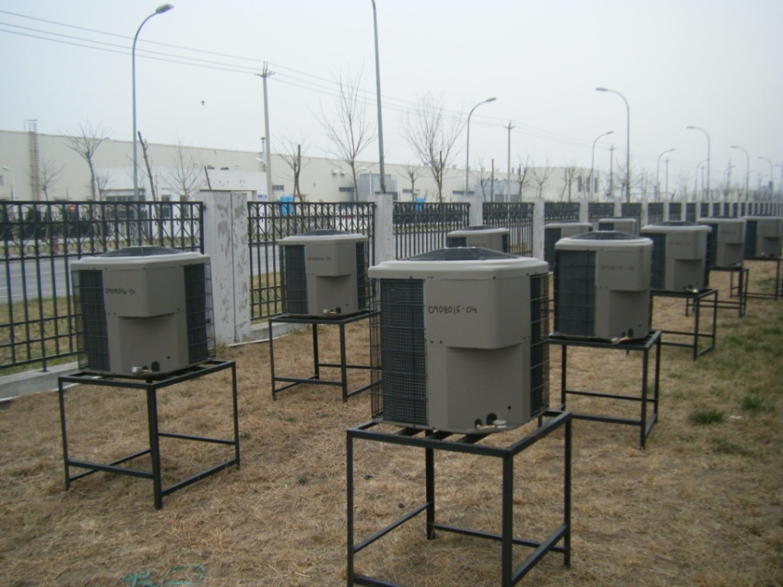
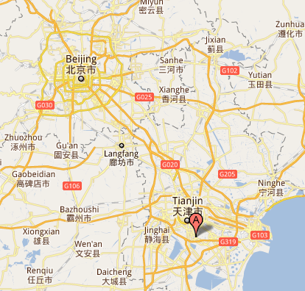
JCI MCHX Testing – Field Trial Site
  Tianjin, China
    Typical, urban, industrial city in China
  Recently identified as city with top 10 worst air pollution
  100 miles from Beijing, 37 miles from coast
100 Miles
37 Miles
Provides correlation between real world corrosion time and SWAAT chamber days, industrial environment

Slide 20
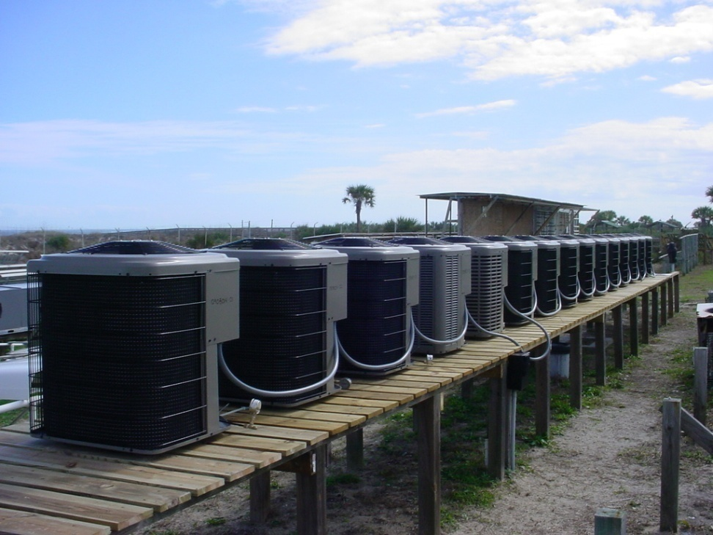
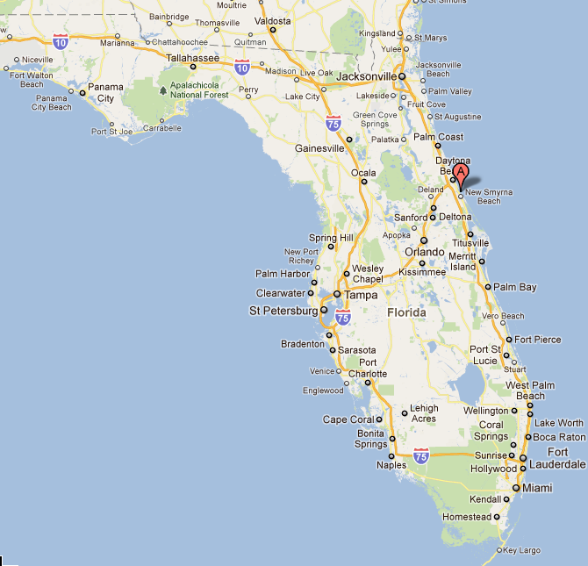
JCI MCHX Testing – Field Trial Site
  Battelle Memorial Institute, Florida
  Severe subtropical marine environment (Coastal Florida, USA)
  Category C4/C5 corrosive environment (ISO 9223)
Provides correlation between real world corrosion time and SWAAT chamber days, marine environment

Slide 21
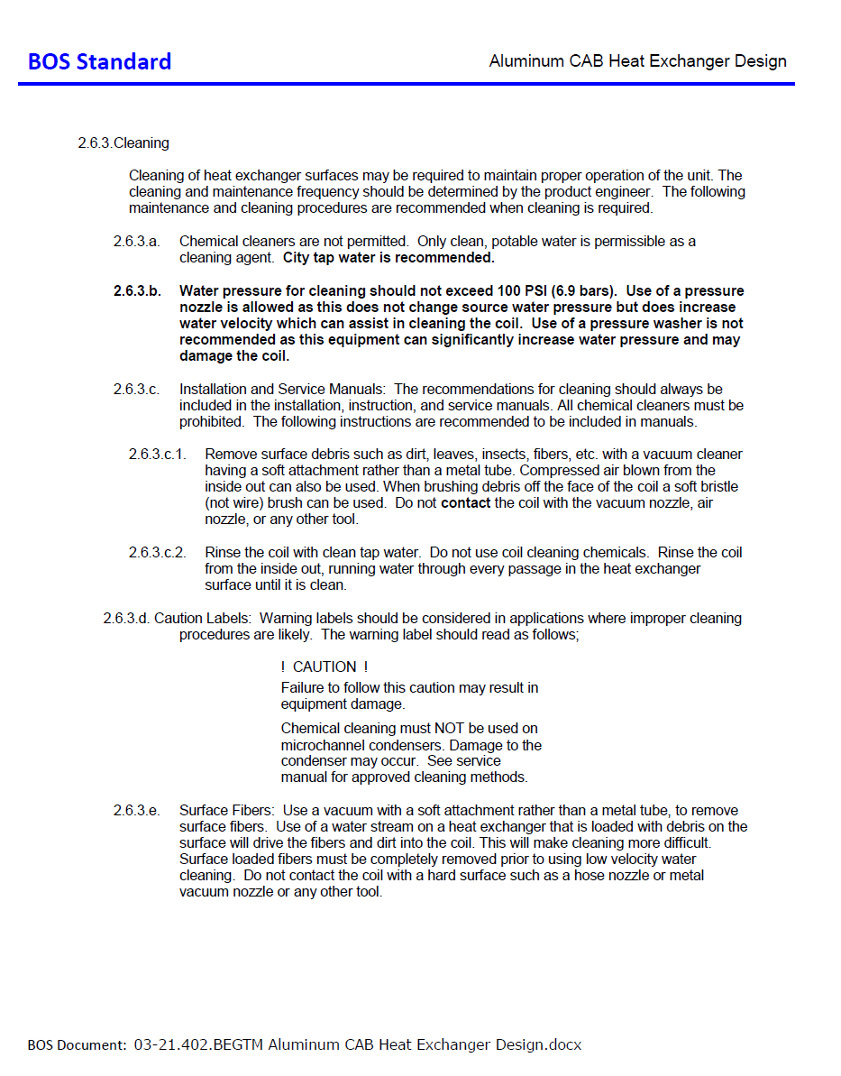
Coil Cleaning
  Cleaning Requirements are Documented … Key Points:
    Surface fibers, leaves, etc should be vacuumed with soft attachment (non-metallic) or blown out with compressed air
    Coils can be cleaned with potable water – cleaning agents are not allowed or required
    Maximum water pressure for cleaning is 100 psi
    If brushing coils, a soft bristle, non-metallic brush must be used

Slide 22
Conclusions
  JCI Application of MCHX on HVAC
    MCHX Technology is reliable for stationary HVAC applications in all global markets
    Coil e-coating is advised for more corrosive, especially coastal, locations
    Same coating recommended and offered for RTPF coils
    The research and development investment has been significant for more than 10 years in coils technology

