Slide 1


STC Air Cooled Chillers
YLAA – YCIV - YVAA
Nantes Sales Training November 2014 Roger Smeed

Slide 2
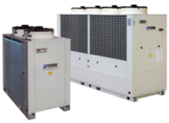
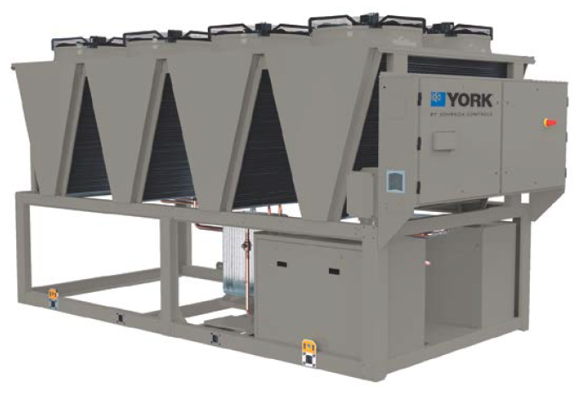
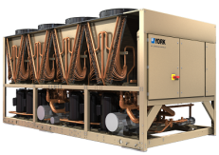
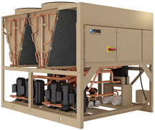
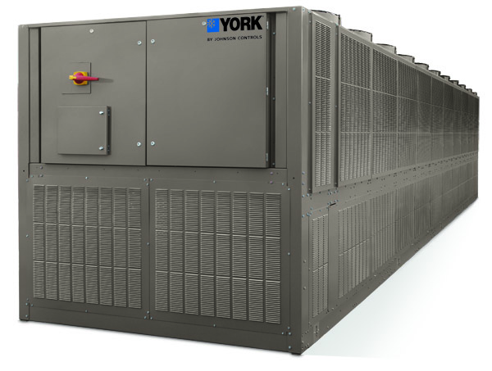
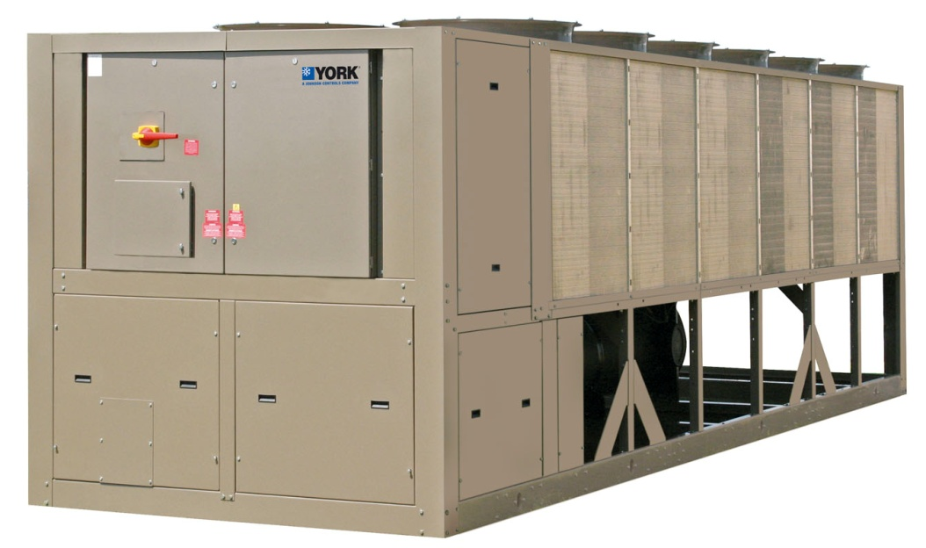
YVAA – YORK Variable Speed Air-Cooled Screw Chillers Introducing model range’s
kW
0 200 400 600 800 1000 1200 1400 1600 1800
YLxA
40-150
kW
YLRA/YLPA - Scroll HP
180-640 kW
YLAA - Scroll Comp
180-520 kW
YVAA- VSD Screw Comp (2nd Gen.) 525-1660 kW
YCIV- VSD Screw Comp (1st Gen.) 540-1450 kW (Special applications. Only)

Slide 3

YLAA Air-Cooled Scroll Chiller
Roger Smeed
3
Notes:
3

Slide 4
Air Cooled Chillers, Industry Factors Effecting YLAA
Green buildings and energy costs… …raise efficiency, reduce sound & refrigerant charge quantity
Brazed Plate Evaporators, Microchannel… …technologies improve, reduce charge reduced unit weight,
Pump kits for ease insulation… …add application range, options
Reduced sound levels… …improved fan options and compressor plus attenuation options.
Heating ability… …Heat Recovery option providing usable heat output
Summary:
New technologies… …offer opportunity for improvement
No major competitive changes expected… …until next round of efficiency …legislation (2015) EcoDesign.

Slide 5
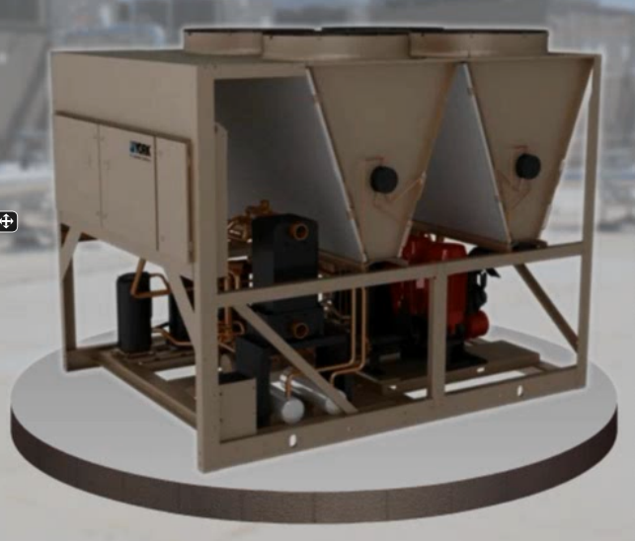
YLAA Air Cooled Chiller Product Overview
18 models in range.
Two tier strategy “SE” and “HE”. ….Balance of efficiency, sound and footprint.
All models have two refrigerant circuits. R410A refrigerant Zero ODP! Low GWP!
Multiple 4, 5 or 6 scroll compressors, …enabling a wide operating range around design ….conditions.
Zinc coated Aluminium Micro-channel …condenser ….High efficiency, low charge and pressure drop for ….air flow and sound optimisation.
Direct expansion. 316 Stainless steel. ….High efficiency, low water side pressure drop, brazed …...plate evaporators.
Heavy gauge galvanised steel, baked epoxy power coated, unit frame and control panel.
Unique system optimised JCI controls.
Flexible option packages to address wide range of applications and operational requirements.

Slide 6
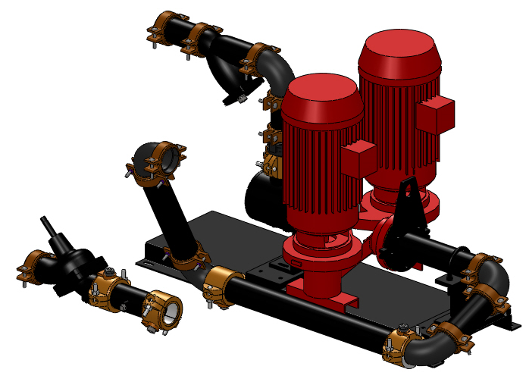
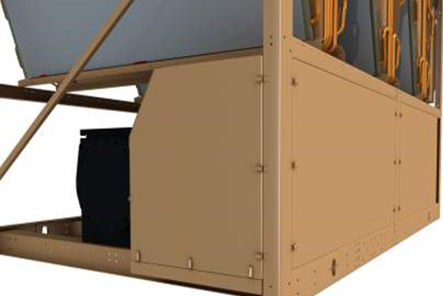
YLAA Air Cooled Chiller Major Product Options
Mechanical:
HYDROKIT Single Pump or Dual Pump
Large range also for choice of flow / head requirements. . . ….(no pump option below -7 glycol cooling). …...Standard feature (includes balancing valve, discharge check valve, discharge shutoff …...valve, thermal dispersion flow switch, pressure ports, Y-strainer, bleed and drain valves, and ……frost protection) .......Fully featured (+ service valves, expansion tank port‘s, additional pressor points).
Ultra quirt fans.
Compressor Acoustic Enclosure. (With ultra q fans reduce sound by 8dBA)
Dual Speed Fans (To balance off design sound and efficiency.)
EC fan for Low Ambient Operation (auto select below -1C ambient).
High Static Fans 75 Pa (Only above -1C ambient operation for internal application)
High Air flow fans (For increased cooling performance at high ambient +46C)

Slide 7
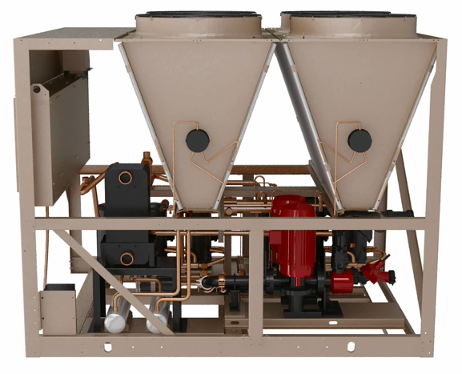
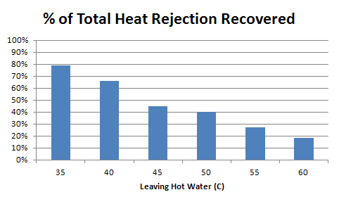
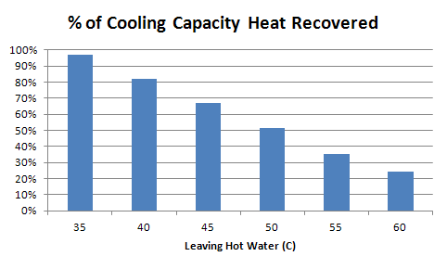
YLAA Air Cooled Chiller Major Product Options
Heat Recovery.
Design includes a partial condensing brazed plate heat exchanger.
Amount of heat recovered depends on leaving hot water temperature and operating ambient air temperature.
Recovery potential is cooling load plus work input
@ 35C ambient
@ 35C ambient

Slide 8
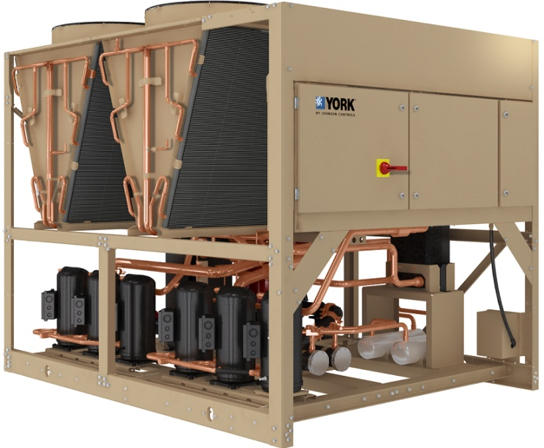
YLAA Air Cooled Chiller Major Product Options
E coat condenser coil epoxy coated corrosion protection
Unit / Condenser coil Wire Grill or Louvered Panels
Electrical:
Direct on line compressor starting
Optional Soft Start to reduce maximum inrush current
Additional Power Factor Correction to 0.9
Leaving water control temperature remote reset
Programed or Remote start stop and Common system fault monitoring.
Building Automation System (BAS) Interface
(BACnet and MODBUS protocols standard)
Keypad EPROM documentation available Languages
English, Spanish, French, German, Italian, Portuguese, Hungarian, Polish

Slide 9
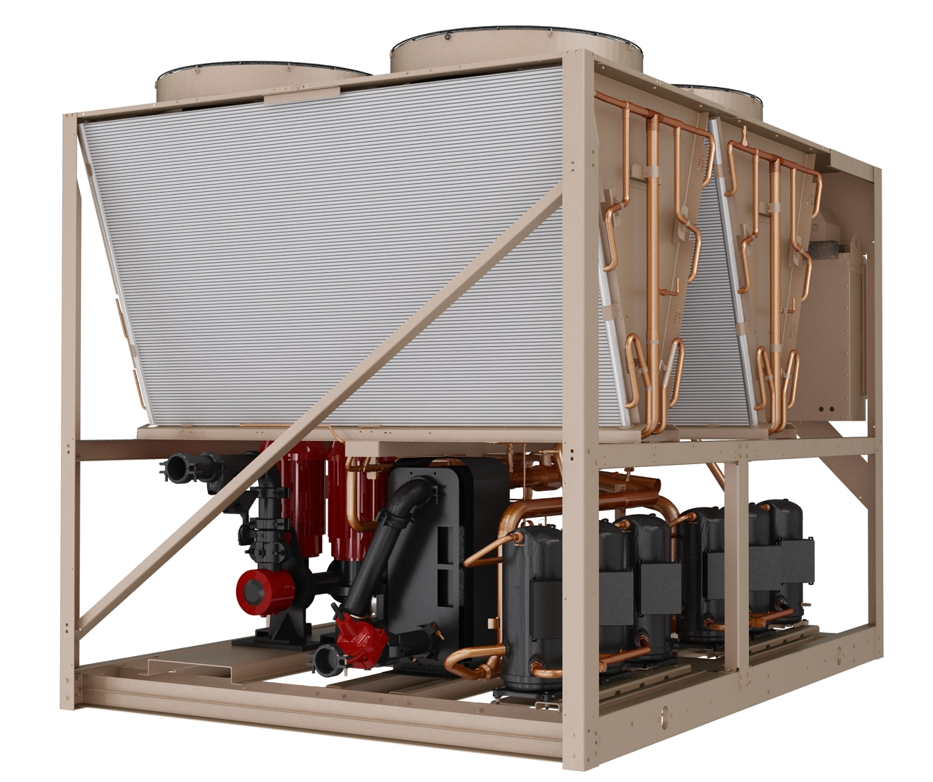
YLAA Air Cooled Chiller Key Operating Limitations
190 to 518 kW cooling capacity
-12 to 15C leaving evaporator liquid …. (-12C to 5C requires glycol)
-18 to 52C ambient …..(-1C / 46 C standard)
EER up to 3.2
ESEER up to 4.25
Sound Pressure as low as 50 dB(A) … @ 10m (parallel)
Optional Heat Recovery to 60C
Electrical power supply 400v 3ph 50 Hz

Slide 10
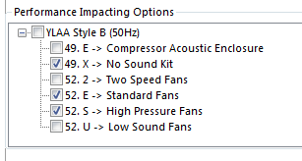
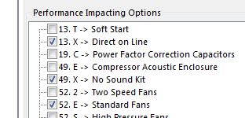
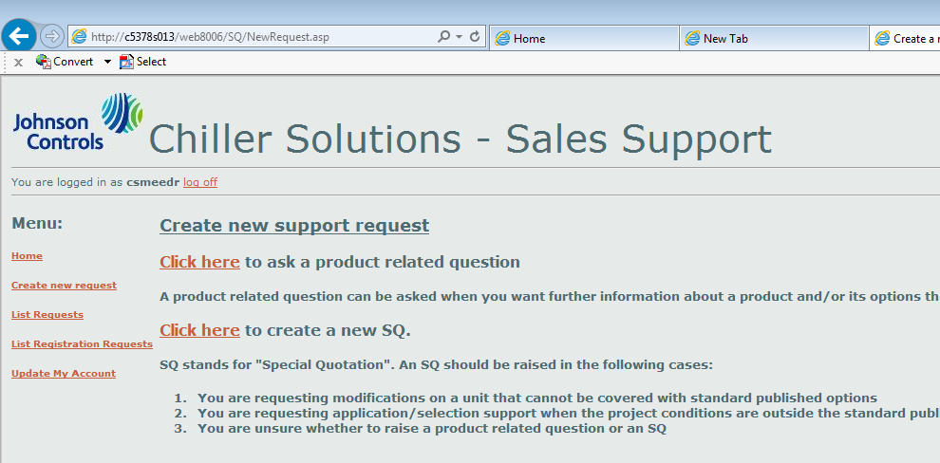
YLAA GCSS Selection / Pricing Program and Product Support
Selection performance effecting options Using selection pick list- Reduced list to speed up selection time
Selection performance effecting options Using specific unit selection- Note Increased list some options only available within operating limits (soft start, power factor correction below 35C ambient high pressure fans above -1C ambient, no pump selections below -7C leaving chilled liquid, EEV is automatically selected below 5C leaving liquid [SQ for other applications)
Special Quotation available for non-standard options (Flexibility is currently limited during the production transfer window from Sabadell to Manisa production Please however continue to submit your clients requests for Engineering / Production team review)
Application support continues through the SQ system

Slide 11
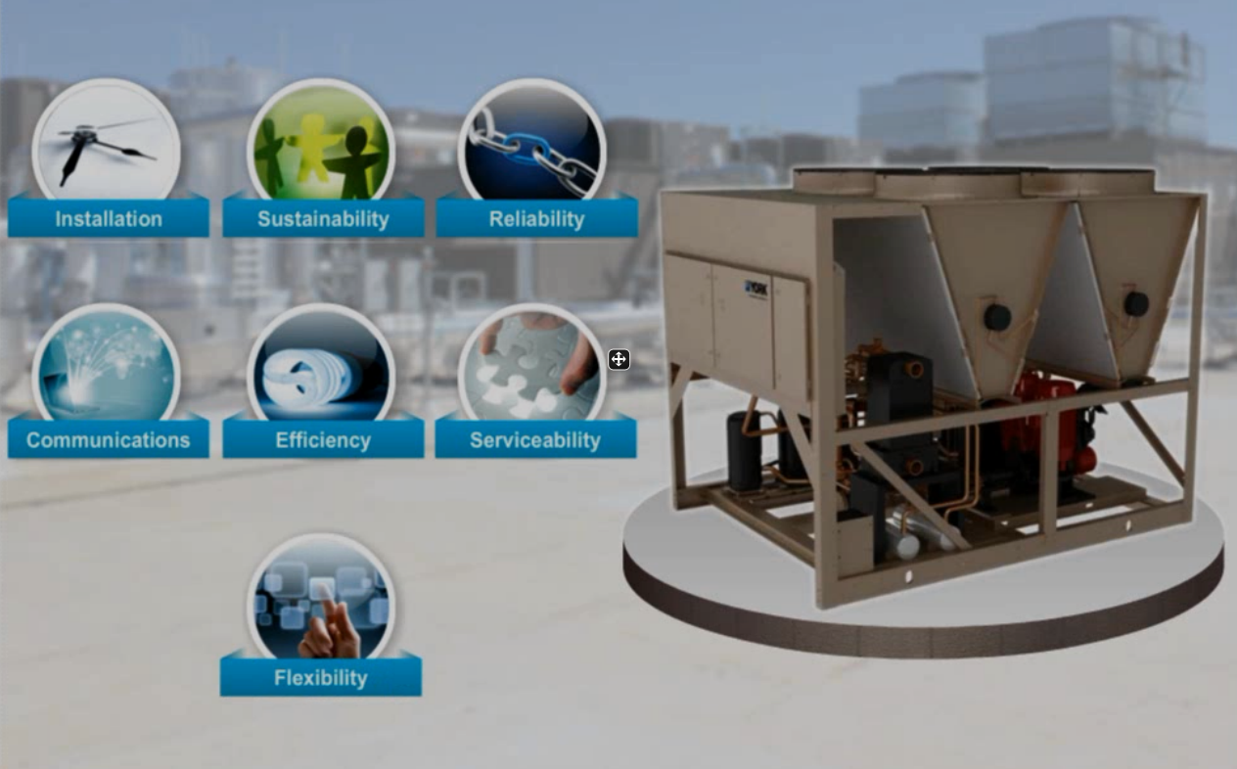
YLAA Conclusion

Slide 12
YVAA - YCIV Air-Cooled Screws
Roger Smeed
Notes:
12

Slide 13


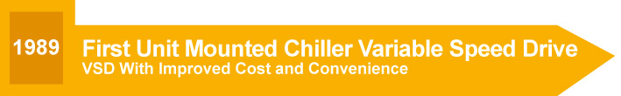


YORK Variable Speed Air-Cooled Screw Chillers A History of Leadership and Innovation
The global market leader in Variable Speed Drive chillers with 30 years of experience varying compressor motor speeds
Notes:
In 2004, we invented the first air-cooled VSD screw chiller. AND NOW, not only do we ship 100% of our air-cooled screw chillers with VSDs, the competition have started to copy us – this is high praise, for sure.
And now, in 2010, we are at it again. We are taking air-cooled screw chiller performance to a whole new level.
30 years experience with V-S-D chillers
2004 was the first V-S-D air cooled chiller and it was developed by York
Only focus on the third timeline piece…2004

Slide 14
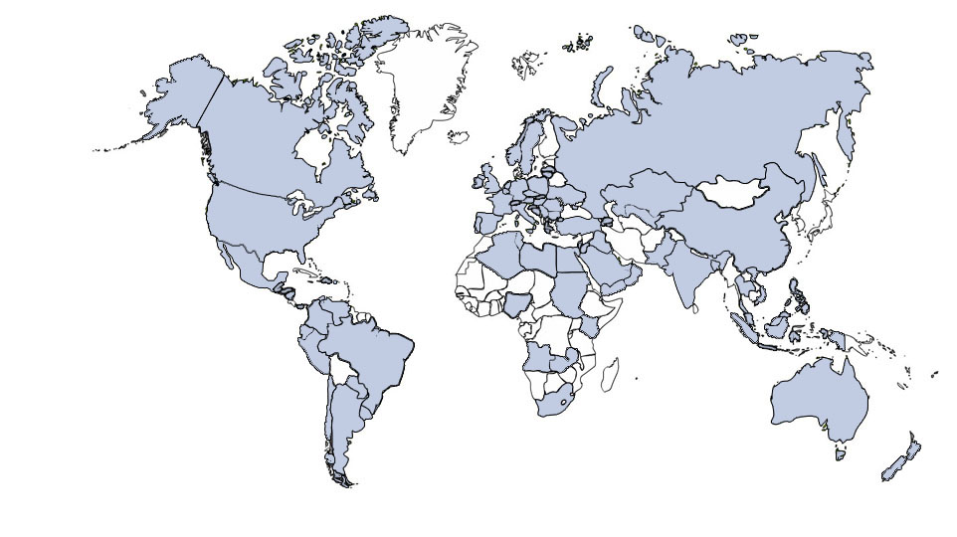
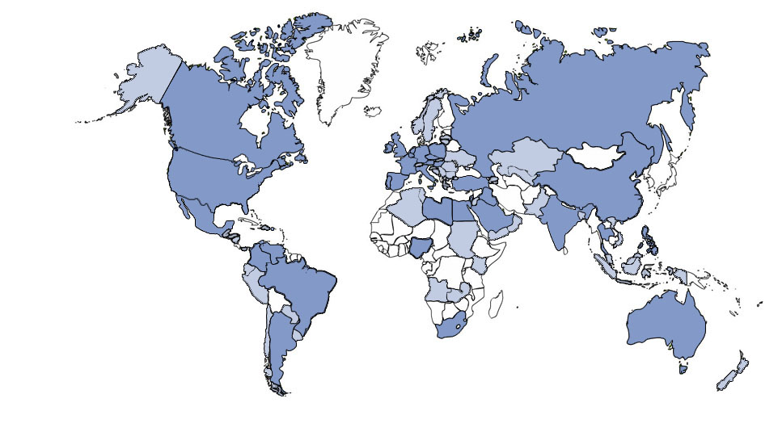
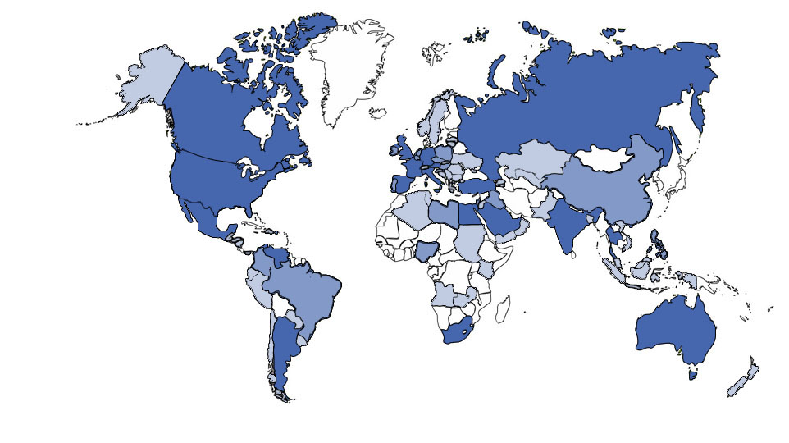
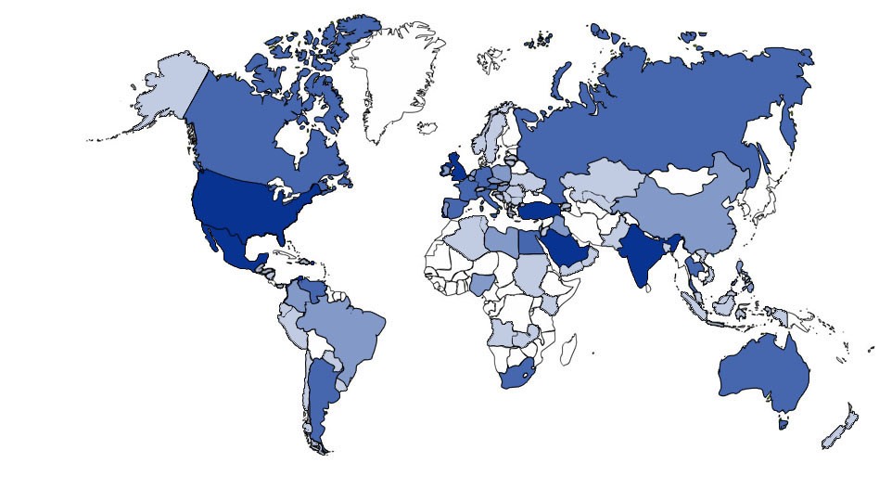
JCI Variable Speed Drive Chiller Experience
Proven by Experience
Over 10 Million kilowatts of VSD, YCAV/YCIV/YVAA/YVWA air-cooled screw chillers operating globally, in more than 100 countries since 2004
Add together with JCI Large tonnage water cooled centrifugal HT-OT, YT, YK, & YMC2
Strong installed base in Middle East where harshest outdoor requirements exist (McQuay current limits VSD option over 40ºC)
Large base in sound sensitive markets like Europe.
VSD is a standard feature on all YCAV/YCIV and YVAA/YVWA
All units combined, more than 30,000 years of cumulative field experience
Notes:
.
This image is copyrighted. JPL needs to build this from the data that Ian/Mike provided. Use the 2010 column as it is the cumulative number for experience for each region
Have 16,000 V-S-D air-cooled screw drive chiller units worldwide
Bottomline: Build great chillers, have the best specs, and the experience that goes along with that

Slide 15
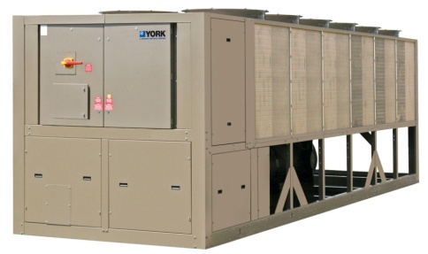
Product Overview YCIV
YCIV
JCI YORK Second generation Air cooled VSD chiller

Slide 16
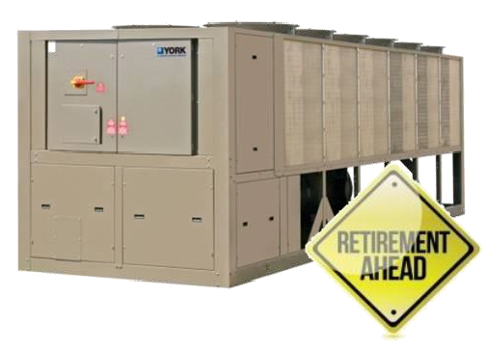
YVAA – YORK Variable Speed Air-Cooled Screw Chillers YCIV Phase Out
YCIV has been or is now being phased out:
North America: Phase out complete
Latin America: Phase out complete
Asia: Phase out complete
Europe Middle East and Africa Status:
YCIV phased out for standard application:
2-compressor YCIV: Phase out complete March 2012
3-compressor YCIV: Phase out complete March 2014
Remains available only for following applications
Low Temperature (especially Propylene Glycol)
Heat Recovery
Fin and Tube Condensers.
YCIV are on an extended lead time to YVAA

Slide 17
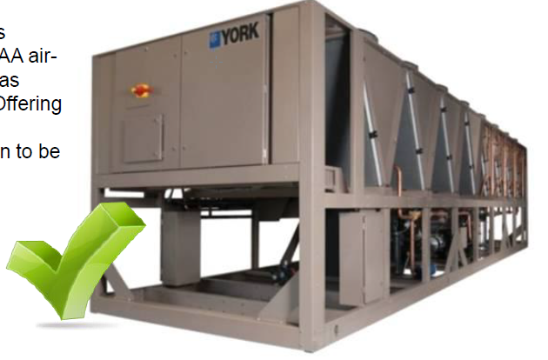
Product Overview YVAA / YCIV
YVAA
JCI YORK Third generation Air cooled VSD chiller

Slide 18
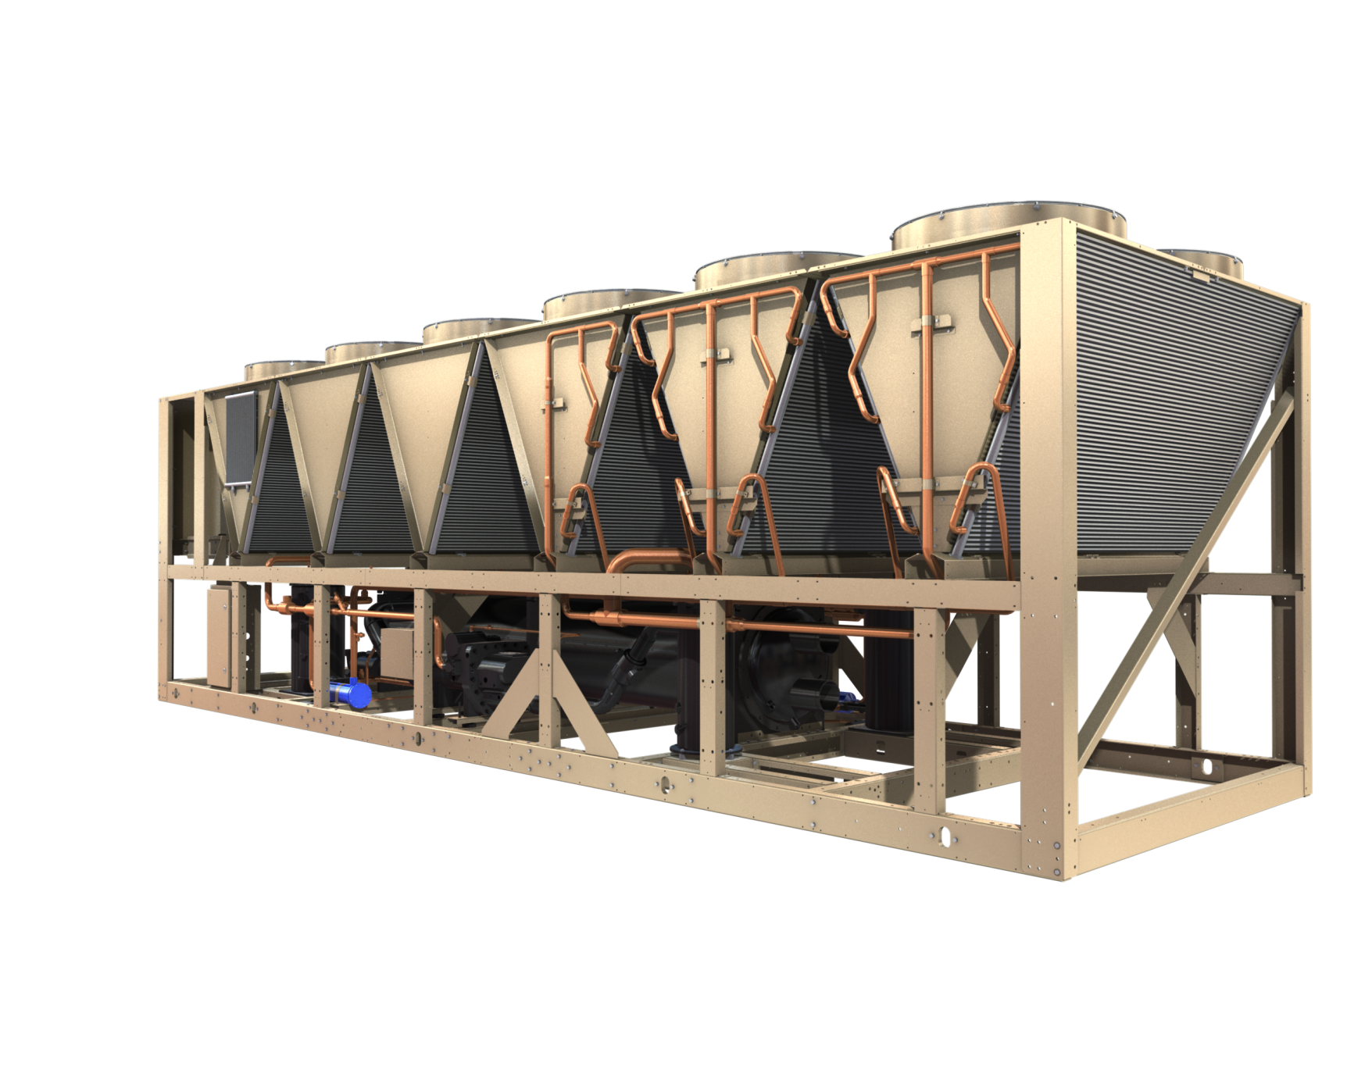
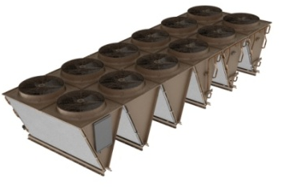
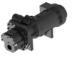
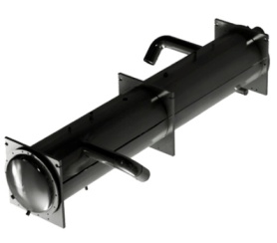
Product Overview YVAA Component Layout
Microchannel Condenser Coils
Microchannel Glycol Cooling Coil
Screw Compressor
High Efficiency Falling Film Evaporator

Slide 19
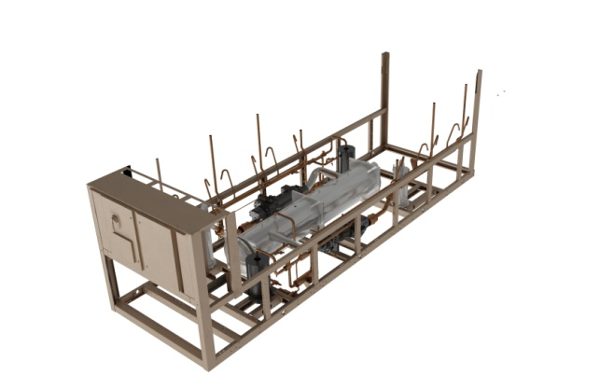
Product Overview YVAA Component Layout
High Efficiency Falling Film Evaporator
Compressor, Oil Separator, Filter Drier & Economizer Tank are Mirror Image on Both Sides of Evaporator
Oil Separator
Screw Compressor
Economizer Flash Tank

Slide 20
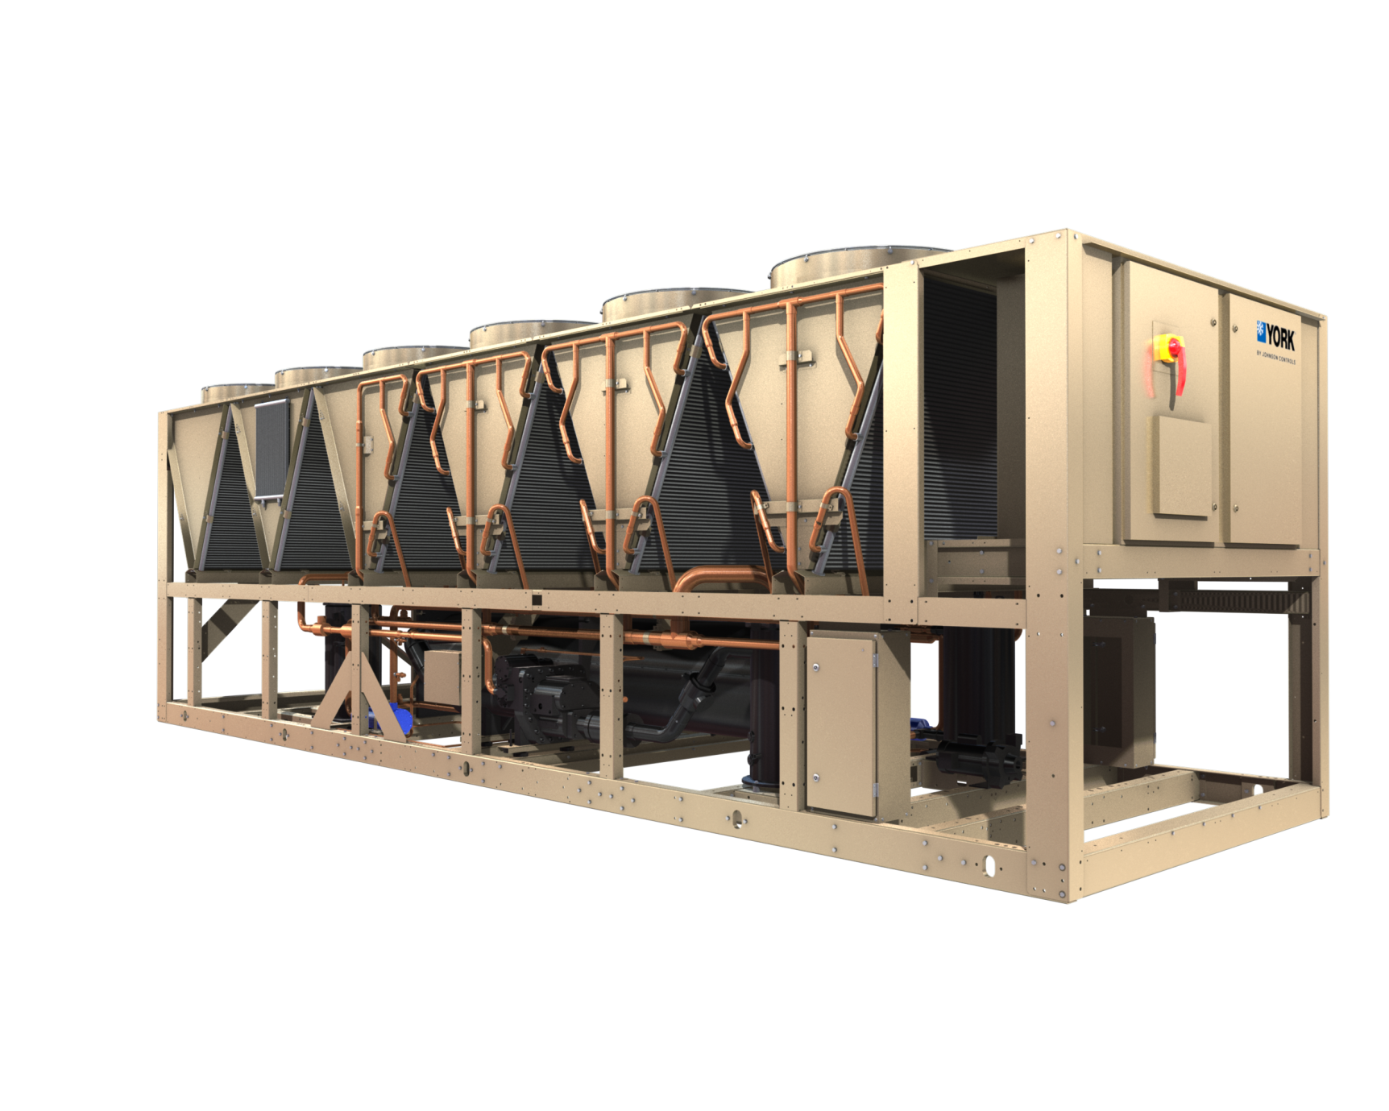
YVAA – YORK Variable Speed Air-Cooled Screw Chillers New Options
New condenser fans options:
High Air Flow
VSD High Air Flow
High Pressure
Sound Optimization
Single point power supply option on larger units only (standard on smaller models)
Additional box next to VSD Fans panel not shown on picture
Factory mounted, field configured E-Link option
Desuperheater
Available on SQ for condenser frame 3 not shown on picture
Condenser Fan VSD’s
Suction and filter drier service valve option
1-pass evaporator option
Glycol Pump

Slide 21
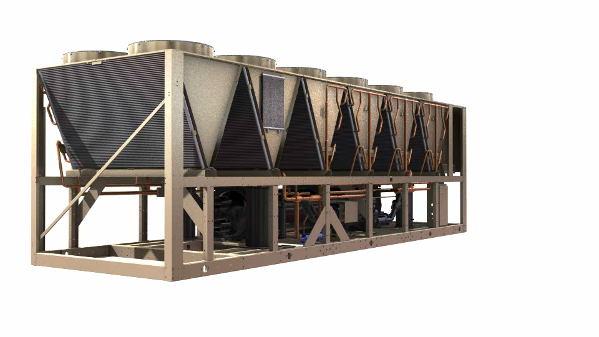
KEY BENEFITS
Tailor and Tune
Full load efficiency
Part load efficiency
Full load sound attenuation
Part load sound reduction
Notes:
As we mentioned at the start of this discussion, YORK invented the first VSD-driven, air-cooled screw chiller in 2004 after years of research and development. Although there are now some other manufacturers offering an option for VSD on air-cooled screw chillers, YORK is still the only manufacturer to make this a standard feature on all air-cooled screw chillers. AND no one else has the engineering and field experience we do in VSD air-cooled screw chillers.
Today, we have over 2 million refrigeration tons (5.2 million kW) of VSD-driven, air-cooled screw chillers operating globally. All units combined, we have more than 18,000 years of cumulative field experience in more than 100 countries.
This image is copyrighted. JPL needs to build this from the data that Ian/Mike provided. Use the 2010 column as it is the cumulative number for experience for each region
Have 16,000 V-S-D air-cooled screw drive chiller units worldwide
Bottomline: Build great chillers, have the best specs, and the experience that goes along with that

Slide 22
Full Load Efficiency
Behind the scenes …
Typical Chiller Today curve is based on a Class A unit with 3.1 COP
YVAA can be ‘Tailored & Tuned’ from 2.8 to 3.4 COP
YVAA Configurations
Various condenser and evaporator sizes can be selected in combination
Larger heat exchangers yield higher full load efficiency
Falling Film Evaporator and Microchannel Condenser Coils are key to Full Load Efficiency …
Notes:
The YVAA chiller allows you to exceed the ASHRAE 90.1 regulated minimum full load efficiency levels by more than 20%. AND exceed the ASHRAE 90.1 regulated minimum part load efficiencies by more than 50%.
Use the first two main points in content generation.
Not mentioned key: Tailor and Tune. Chiller can be built to spec for capacity and efficiency
Can use the above JCI paragraph to generate content
Design Conditions = Worst Case Scenario
Occuring 1% of the time of operation but the unit is built to ensure it can handle this
Off Design Conditions = Everyday Operating Scenario
Occuring 99% of the time of operation
The graph on this slide will need to be on of the images for the content page of brochure
JCI to provide data to JPL to improve design if needed
ASHRAE:
An industry engineering group that builds specification for the industry to abide by
SAE
AMA
LEED
Etc………

Slide 23
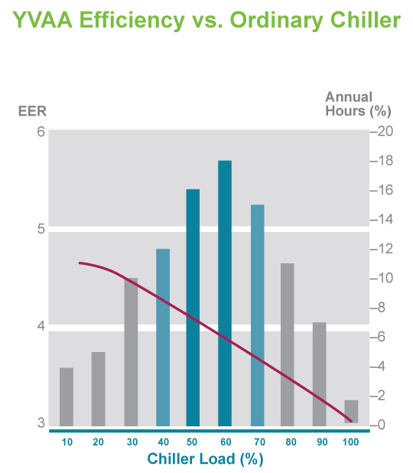
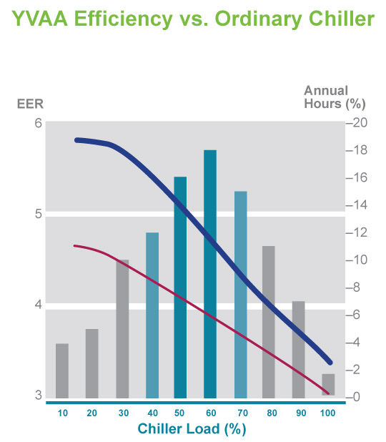
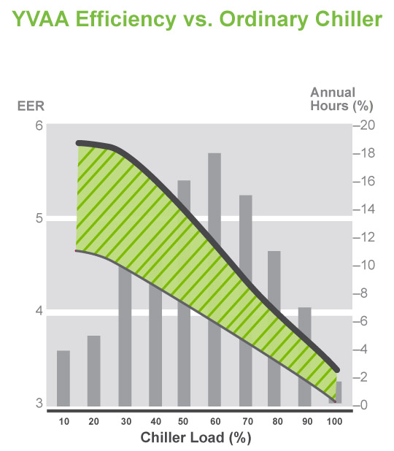
Part Load Efficiency
Behind the scenes …
Typical Chiller Today part load curve is based on a 4.0 ESEER
YVAA part load is based on an approximately 4.8 ESEER
YVAA Options
Standard YVAA typical selections have 4.0 – 4.2 ESEER
Combination of optimized compressor, VSD fans & increased unit frame size allow you to configure any point up to 4.8 ESEER
VSD’s are key to Part Load Efficiency …
Typical Chiller Today
YVAA
17%
Notes:
The YVAA chiller allows you to exceed the ASHRAE 90.1 regulated minimum full load efficiency levels by more than 20%. AND exceed the ASHRAE 90.1 regulated minimum part load efficiencies by more than 50%.
Use the first two main points in content generation.
Not mentioned key: Tailor and Tune. Chiller can be built to spec for capacity and efficiency
Can use the above JCI paragraph to generate content
Design Conditions = Worst Case Scenario
Occuring 1% of the time of operation but the unit is built to ensure it can handle this
Off Design Conditions = Everyday Operating Scenario
Occuring 99% of the time of operation
The graph on this slide will need to be on of the images for the content page of brochure
JCI to provide data to JPL to improve design if needed
ASHRAE:
An industry engineering group that builds specification for the industry to abide by
SAE
AMA
LEED
Etc………

Slide 24
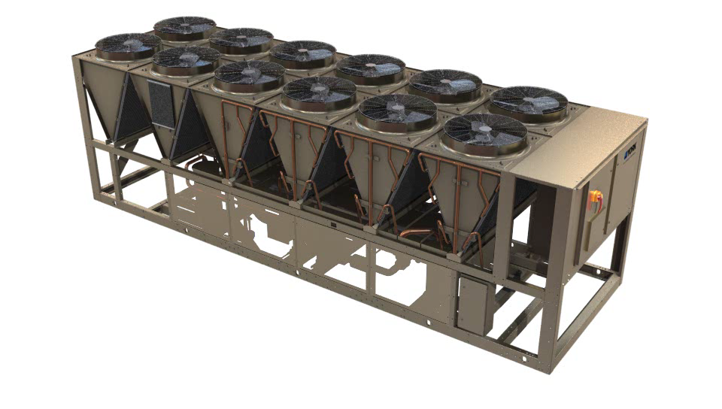
Full Load Sound Attenuation
Just like performance, the YVAA chiller allows you to tailor and tune sound reduction configurations to match your needs
Flexible selection system allows you to see sound benefit of reduced full load compressor speed (oversize the chiller and slow down the compressors)
Multiple selection configurations provide ways to offset performance impact of attenuation options
Notes:
Of course, there will always be design considerations that must consider the worst-case noise. Critical property-line sound values can be a controlling factor in placement of air-cooled chillers, or selection of sound attenuation options.
The YVAA chiller can use combinations of enclosures, insulation, and fans options to provide sound reduction to match your sound requirements at design conditions. The unique ability to tailor and tune your configuration provides unmatched flexibility, and applies to sound just as it does other design considerations.
The combination of state-of-the-art sound reduction at design conditions AND the inherent benefits of off-design sound reduction can deliver a perfect fit for almost any application.
This slide to be used for content/copy generation
Bottomline: Tailor and Tune as discussed previously

Slide 25
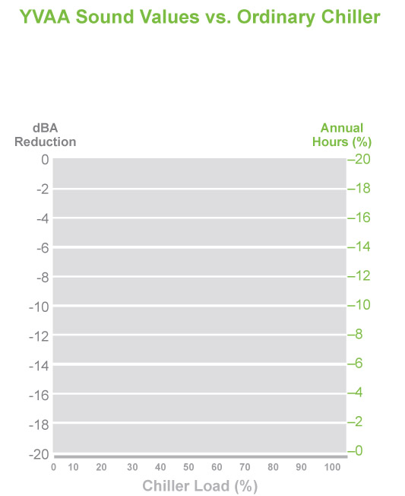
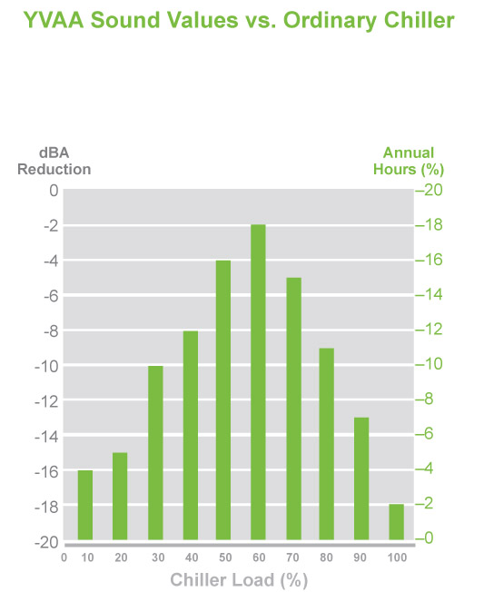
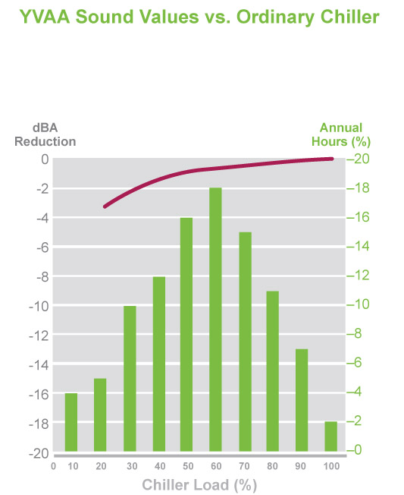
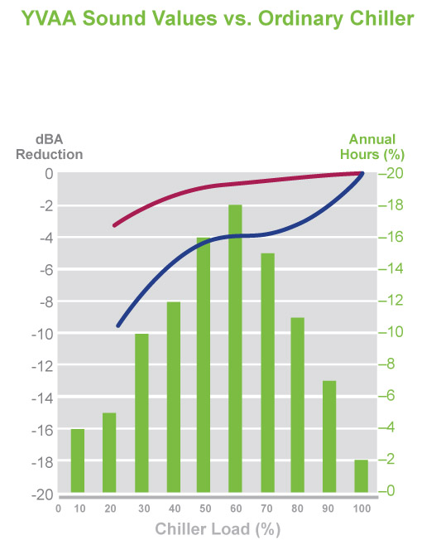
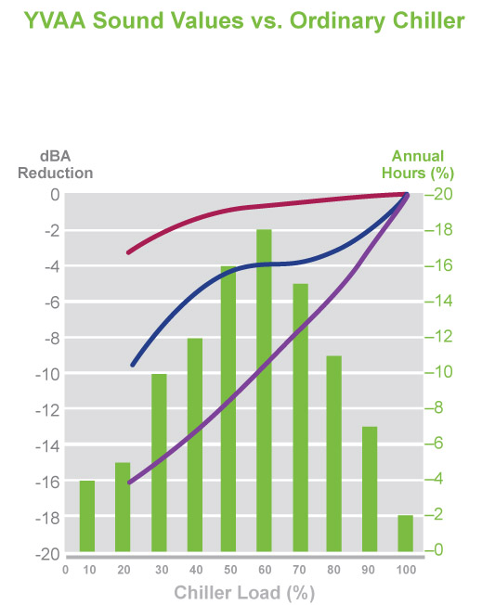
Part Load Sound Reduction
Behind the Scenes…
Typical chiller today is representative of the part load data we have found for chillers with fixed speed screw compressors (gas flow in unloading mechanism is noisy)
YVAA is a standard unit with staged fan control
YVAA Optimized adds the impact of VSD
As the YVAA unloads the compressor with VSD, the fans become the larger noise source unless VSD are also added to the fans
By combining the two technologies we are achieving performance that most competitor’s cannot offer
Typical Chiller Today
YVAA
YVAA Optimized
Notes:
Just as we discussed in regard to energy efficiency, design conditions of capacity and ambient temperature only occur a very small portion of the time a chiller operates. The YVAA chiller, with standard VSD-driven compressors, is unique among air-cooled screw chillers because it provides superior sound reduction as operating conditions become less stringent (lower capacity demand OR lower outdoor ambient temperature).
The hottest, stickiest days are when most neighbors are inside in the comfort of their own air-conditioning system. But on mild days when people are enjoying the outdoors, your chiller operating condition will yield lower sound. On evenings and weekends, when neighbors are more likely to be home and outside, is when sound regulations are the tightest – it is precisely these times when the benefit of lower cooling capacity demand and lower ambient temperatures are most likely to occur. And the addition of VSD drive to the condenser fans only multiplies the benefit you get in part load sound reduction.
The only thing better than having part load sound reduction, is the ability to put it in your control. The SilentNight feature provides ‘night setback’ for the neighborhood. SilentNight offers you BAS or programmable control to limit the chiller load and make sound your priority. This can be especially effective when changes in sound regulations are triggered by specific times of day.
All together, this makes the YVAA chiller a perfect fit for when quiet operation can make you a good neighbor.
SilentNight
This is a York/JCI term for load shedding or using the Building Automated System to artificially reduce the unit output to match sound specs for certain time mandated by government and surroundings
V-S-D will be extremely benifiical in controlling sound by allowing the compressor to run at reduced load during those off design conditions when sound regulations are tightest, evenings and weekends.
JCI will provide the graph data to JPL to enhance it visually

Slide 26
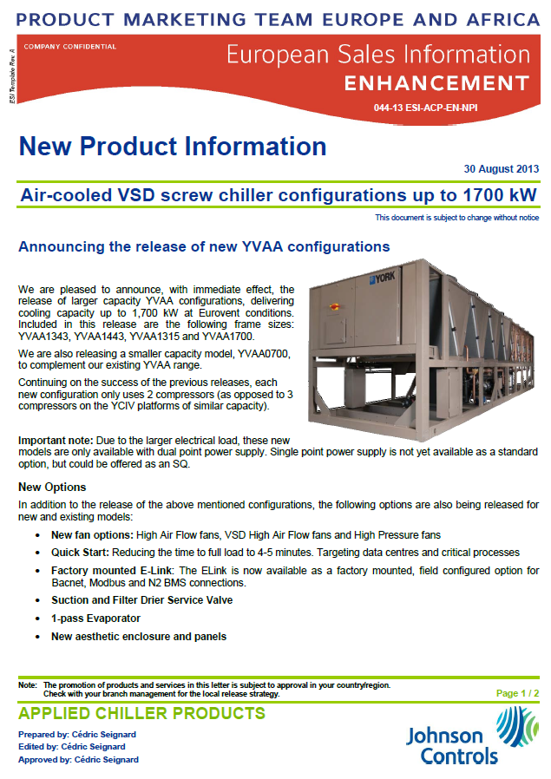
YVAA – YORK Variable Speed Air-Cooled Screw Chillers Configuration up to 1,660 kW released in August 2013
4 new configurations
YVAA 1343, YVAA1443, YVAA1315, YVAA1700
All using 2 compressors only
Fit for containerization (40ft) / road freight
Dual point power supply as standard (Single point available as an option)
New set of options

Slide 27
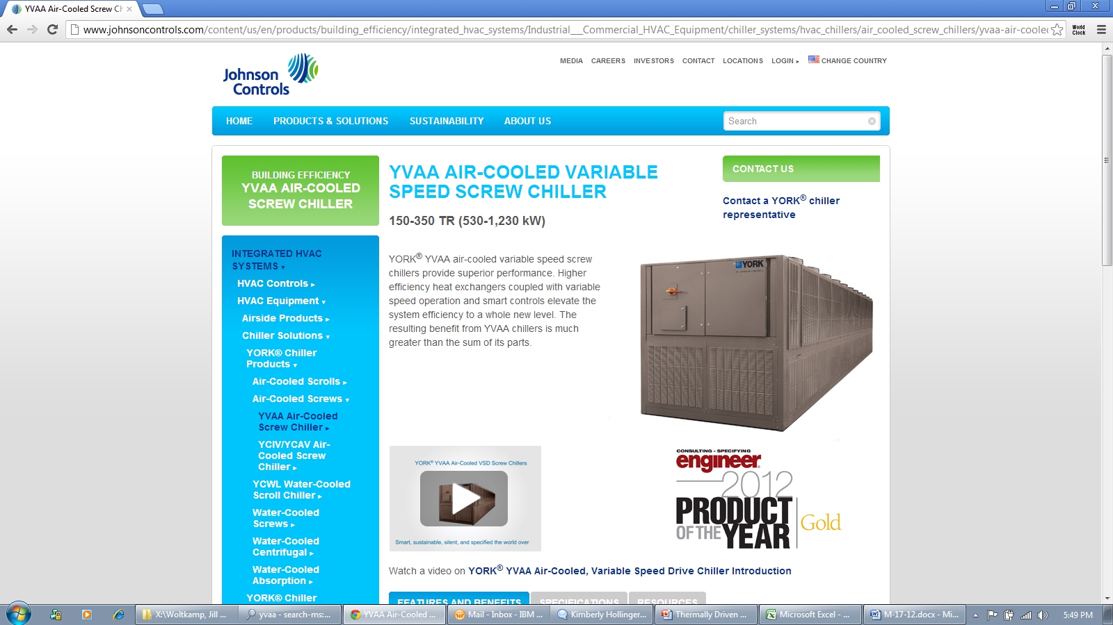
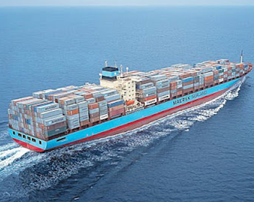
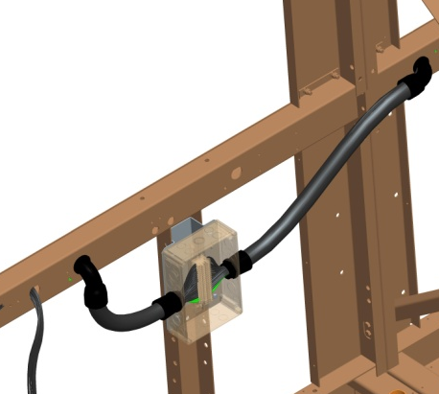
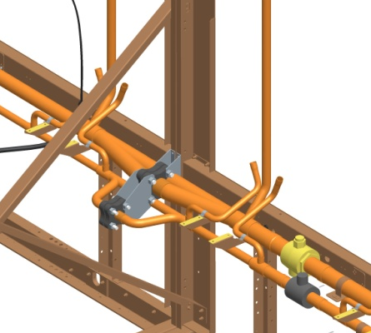
YVAA – YORK Variable Speed Air-Cooled Screw Chillers Larger configurations to 1,750kW planned for FY15 release
Capacity, efficiency increases – containers do not
YVAA provides maximum capacity in 20’ and 40’ container (frame size YVAA0700 and YVAA1700)
Large units designed to split
Units designed to fit in 40’ + 20’ container
Road transportation / Sea freight restrictions on larger units
Full refrigerant charge contained in primary section
Field connections via flange and plug – no wiring, no brazing
Design is complete, pending receipt of final PED/CE certificates to release

Slide 28
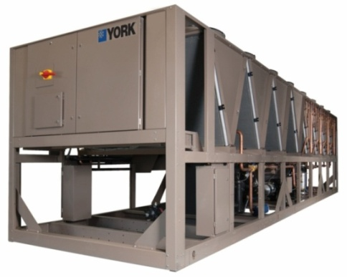
YVAA – YORK Variable Speed Air-Cooled Screw Chillers New Option – Quick Restart
Quick Restart option reduces the time to full load after a power failure
Quick Restart option to be offered to application meet the following criteria:
High cooling load year round
Value of “Time to full load” is high
Cooling serving business critical processes
Target Application: Data Centers, Industrial process cooling
Quick Restart customer benefits:
Rapidly re-establishes chilled water temperature
Keeps process equipment cooled / process on.
Reduces the chance of very expensive downtime
Reduces or eliminates buffer tanks or thermal storage systems

Slide 29
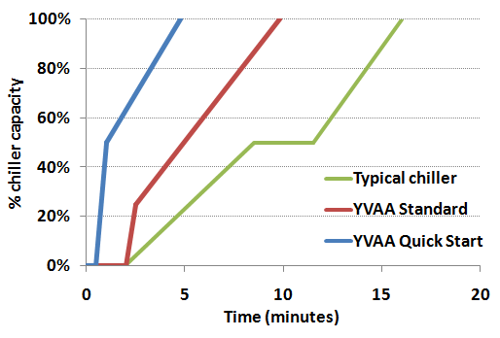
YVAA – YORK Variable Speed Air-Cooled Screw Chillers New Option – Quick Restart
Standard YVAA – Time to full load: 8-9 minutes – 50% better than average
Quick Start YVAA – Time to full load: 4-5 minutes – 4 times better than industry average
Compressors start in 30 seconds instead of normal 2 minutes
VSD technology enables both compressors to start simultaneously.
High cooling load enables us load the chiller faster than normal without risk of overshooting to shutdown conditions
Reducing the anti-recycle timer from 2 min to 30 sec

Slide 30
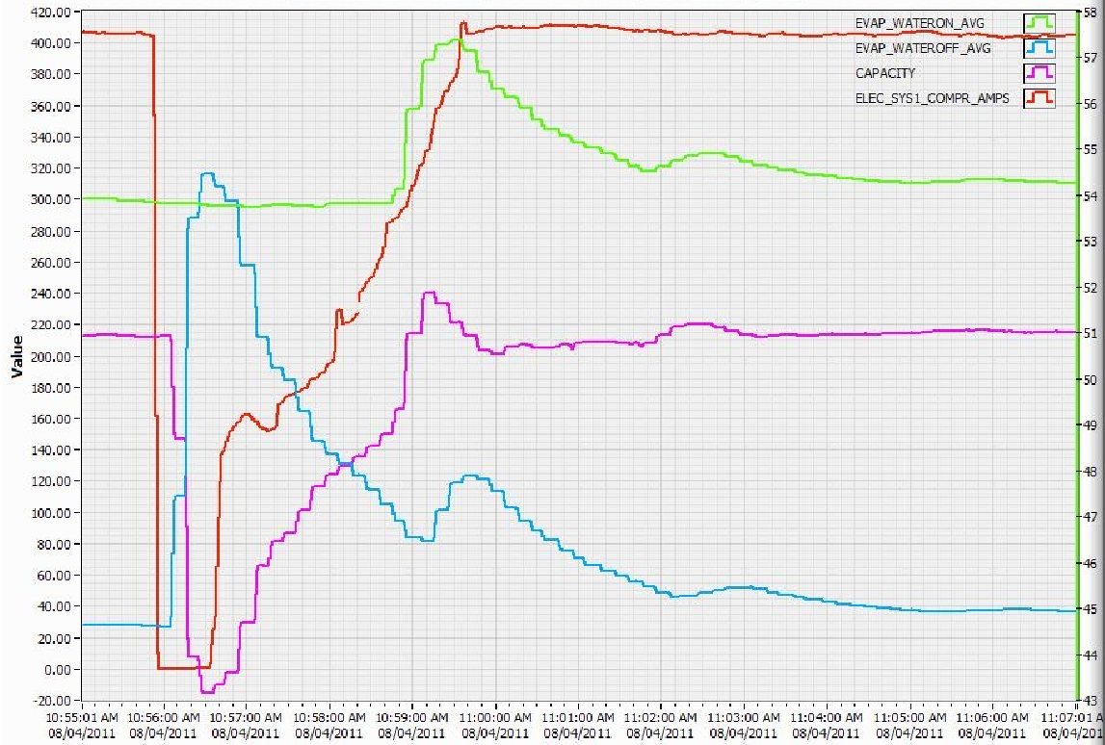
YVAA – YORK Variable Speed Air-Cooled Screw Chillers New Option – Quick Restart – Simulated Power Failure
Unit Current
Return Water Temp.
Cooling Capacity (TR)
Unit Current (Amps)
Cooling Capacity
Temperature (deg F)
Leaving Water Temp.
10:56:00
Power Failure
10:56:30
Unit restarts
10:59:00
Unit back to full load
Time to full load: 3 min

Slide 31
Monterrey Witness Test Facility Update

Slide 32



YVAA – YORK Variable Speed Air-Cooled Screw Chillers Monterrey Witness Test Laboratory
Test Lab. dedicated to customer witness tests
Opened Q3 2014 Demonstrated 4 Successful European tests
Designed for full load testing up to 1,750 kW; both 50 and 60 Hz
Full load, part load, sound testing
System safeties.
AHRI & Eurovent certified laboratory
Global test facility serving our customers across the Globe
There will be Video conferencing capabilities from key JCI offices
Brussels, YORK Pa, Milwaukee,…
Only Limited test slots allocated by region !!!
Highest risk: Overbooking the test lab
Key to success: balancing demand with lab. capacity
Process to quote is through the SQ data base need
Detail of all tests required, + Equipment data sheet, part load report

Slide 33



YVAA – YORK Variable Speed Air-Cooled Screw Chillers YVAA Eurovent and AHRI Certifications
Eurovent Certification:
This labority has allowed JCI to increase Eurovent certified models from our 2013 limit certify all models below 600 kW.
YVAA will participate into the voluntary certification program (600 kW – 1,500 kW)
YVAA up to 1,500 kW will be Eurovent certified
AHRI Certification:
Both 60 Hz and 50 Hz configurations are certified
YORKworks is AHRI certified
Eurovent and AHRI certification validates performance without need for customer testing. Specify performance certification first!

Slide 34
Competitive Landscape Update

Slide 35

YVAA – YORK Variable Speed Air-Cooled Screw Chillers Trane RTAE – Overview
Trane RTAE “Stealth” Chiller
Released to Europe in June 2014
Currently only available in 50Hz configurations
Capacity range: 500-1000 kW
8 fixed capacity models
Notable Features
Screw compressor technology “optimized for VSD operation”
“24-pulse” Adaptive Frequency Drive (AFD3)
“All Aluminum” condenser coils
“Permanent magnet” fan motors
“InviSound Superior” and “InviSound Ultimate” sound reduction package

Slide 36
YVAA – YORK Variable Speed Air-Cooled Screw Chillers Trane RTAE – What do we know so far?
Screw compressor technology “optimized for VSD operation”
Unlike other competitors, VSD is standard on RTAE (not an add-on option)
2 compressors operated at 4 different frequencies giving 8 models in total
Permanent magnet motors claimed to improve efficiency by 4%….more later
Same technology as ours…9 years later
“24-pulse” Adaptive Frequency Drive (AFD3)
Sales Brochure and Press Release are highlighting the use of a 24-pulse VFD.
RTAE based specification calling for 30% TDD and use of line reactor
Typical characteristics of a 6-pulse drive
YVAA complies
Strong indication that “24-pulse” drive is an option
24-pulse VFD typically costs around 3 to 4 times the cost of 6-pulse drive
Would represent around 50% add-on cost option

Slide 37
YVAA – YORK Variable Speed Air-Cooled Screw Chillers Trane RTAE – What do we know so far?
“All Aluminum” condenser coils
3-row coil with aluminum tubes and fins arrangement – NOT Microchannel
RTAE based specification calling for copper tubes and aluminum fins coils
“All Aluminum” condenser coils appears to be an option to bid on specification calling for MCHX
“The tubing is a long life alloy designed to deliver corrosion performance that meets or exceeds Microchannel coils.” (Extract from RTAE Engineering Guide)
“Permanent magnet” variable speed fan motors
Sales Brochure and Press Release are highlighting the use of permanent magnet, variable speed fan motors.
RTAE based specification calling for direct drive condenser fans
Permanent magnet motor claimed to increase efficiency at part load 5% or more….more later
Strong indication that fixed speed fans as standard and VSD fans as an option

Slide 38
YVAA – YORK Variable Speed Air-Cooled Screw Chillers Trane RTAE – What do we know so far?
“InviSound Superior” and “InviSound Ultimate” sound reduction packages
InviSound Superior: 99 dB(A) at 1000 kW. Easily matched with YVAA
InviSound Ultimate: 92 dB(A) at 1000 kW. YVAA can do 94 dB(A) at the same capacity
Includes fan rotation speed reduction to 60% of nominal value
Typically equates to 10-15% reduction in efficiency (dropping 2 Eurovent class)
Includes purpose built, pressed metal and acoustic lining compressor enclosure
Appears to be an expensive option
Limited Operating Range as standard
Standard Ambient Range: 0ºC to 40.6ºC
Low Ambient Range: -17.7ºC to 40.6ºC (additional control logic and sensors)
High Ambient Range: 0ºC to 52ºC (larger compressor motors and larger drive)
Force high cost on RTAE by specifying capability to operate in ambient conditions below 0ºC and above 40.6ºC

Slide 39
YVAA – YORK Variable Speed Air-Cooled Screw Chillers Trane RTAE Vs YORK YVAA – Head to Head Comparison
Trane Website:
“Trane® Stealth™ air-cooled chillers deliver the highest combination of part-load and full-load efficiencies and the lowest published sound levels. No other air-cooled chiller can match this kind of efficiency or sound performance.”
 | RTAE 165 | YVAA0665
Cooling Capacity | 570 kW | 570 kW | =
Input Power | 167 kW | 174.5 kW | û
Full Load Efficiency | 11.6 EER | 11.10 EER | û
NPLV | 18.7 | 19.1 | ü
Sound Pressure (at 30ft) | 70 dBA | 70 dBA | =
Water Pressure Drop | 36.4 ft H20 | 31.1 ft H20 | üü
Length | 283.7 in | 291.7 in | ü
Minimum Load | 19% | 10% | ü
Operating Conditions:
Chilled liquid: 13.8ºC/ 7.2ºC 35 % PG
Ambient temperature: 35ºC
Power Input: 400V / 3 ph. / 50 Hz

Slide 40
YVAA Competitive Landscape Update

Slide 41







YVAA – YORK Variable Speed Air-Cooled Screw Chillers
Competitive Landscape
YVAA
YCIV
30XA
RTAC
FOCS
AWS

Slide 42


Above Average
Average
Below Average
YVAA – YORK Variable Speed Air-Cooled Screw Chillers
Competitive benchmarking - Components
FOCS
Screw, variable speed standard | Screw, fixed speed | Screw, fixed speed | Screw, fixed speed | Screw, fixed speed
Micro channel, all aluminum | Traditional, copper tubes aluminum fins | Micro channel (optional copper tubes aluminum fins) | Traditional, copper tubes aluminum fins | Traditional, copper tubes aluminum fins
Totally Enclosed, Air Over (TEAO) | Standard: Open Drip Proof (ODP) Option: TEAO | Totally Enclosed, Air Over (TEAO) | Totally Enclosed, Air Over (TEAO) | Totally Enclosed, Air Over (TEAO)
Falling film | Falling film | Fully flooded | DX | DX

Slide 43

Above Average
Average
Below Average
YVAA – YORK Variable Speed Air-Cooled Screw Chillers
Competitive benchmarking - Components
FOCS
1 compressor per circuit | 2 compressors for 1 circuit for models with 3 and 4 compressors | 1 compressor per circuit | 1 compressor per circuit | 1 compressor per circuit
10% | 15% | 15% | 2 compressors: 15% without VSD 20% with VSD 3 compressors: 8% without VSD 13% with VSD | 2 Compressors stepped 25% 3 compressors stepped 17% 4 Compressors stepped 13%
R134a Low quantity | R134a High quantity | R134a Low quantity | R134a Medium quantity | R134a Medium quantity

Slide 44

Above Average
Average
Below Average
YVAA – YORK Variable Speed Air-Cooled Screw Chillers
Competitive benchmarking - Performance
FOCS
Tailor and tune | Standard and High | High | Standard, High, and Premium | Standard, High, and Premium
Tailor and tune | Standard | High | Standard, High, and Premium | Standard, High,
Low at full load Very low at part load | Medium | Low | Very low | Medium and Low

Slide 45

Above Average
Average
Below Average
YVAA – YORK Variable Speed Air-Cooled Screw Chillers
Competitive benchmarking – Physical Attributes
FOCS
Low | Very high | Low | Medium | Low
Small to medium | Very small | Medium | Medium to large | Medium
Standard: 0F to 125F (-18C to 52C) | Standard: 25F to 115F (-4C to 46C) | Standard: 0F to 115F (-18C to 46C) | Standard: 35F to 100F (2C to 38C) | Standard: 0F to 115F (-18C to 46C)
 | Options: Low ambient of to 25F (-18C to -4C) High ambient 115F to 125F (46C to 52C) | Options: High ambient 115F to 125F (46C to 52C) | Options: Low ambient 0F to 35F (-18C to 2C) High ambient 105F to 125F (40C to 52C) | Low Ambient -15C High ambient 46C

Slide 46

Above Average
Average
Below Average
YVAA – YORK Variable Speed Air-Cooled Screw Chillers
Competitive benchmarking - Electrical
FOCS
Standard: VSD with no inrush current | Standard: Across-the-line | Standard: Wye-delta | Standard: Solid state | Part Wind
 | Option: Wye-delta | Options: Across-the-line Non-fused disconnect | Options: Wye-delta VSD | Options: Wye-delta VSD
Standard: Single point power | 2 compressors: Standard: Single point power Option: Dual point power 3 or 4 compressors: Standard: Dual point power Option: Single point power | Up to 350 tons (1200 KW): Single point power Higher than 350 tons (1200 KW): Dual point power | Standard: Multi-point power with 1 disconnect switch per circuit (2 point for 2 compressors, 3 point for 3 compressors) No compressor breakers Option: Single point power | 2 compressor single point 3 & 4 Compressor dual point

Slide 47
YVAA GCSS Selection Program

Slide 48


YVWA and GCSS
YVAA is a Taylor and tune product family, providing many varied solutions to the specific conditions requested by your client.
There is a need for you to understand how our selection tool works so you can provide your client with the optimum selections(s)
As with the YLAA there are options that effect the unit performance and we recommend you review and deselect those which are not suitable for your project.
Compressor part load efficiency, Fan selection, Acoustic insulation.

Slide 49

YVWA and GCSS
For extreme low sound applications we also offer the
Optimised Sound optional program
For this selection please select the following performance effecting options
Both low and ultra low VSD fan options (only)
Both Standard and Optimised Compressors
Both sound kits 1 and 2.
Add the lowest acceptable EER

Slide 50
YVWA and GCSS
The Optimised Sound optional program
Looks to identify the balance point between the fan and compressor sound levels / speeds to meet the requested cooling capacity and minimum gross EER.
This is achieved by balancing the operating speeds of fan and compressor (+ acoustic insulation) so that neither element is dominant.
This option has reduced unit sound levels by up to 7dBA for a relative low price addition, compared to alternate acoustic solutions

Slide 51
New Collaterals

Slide 52



YVAA – YORK Variable Speed Air-Cooled Screw Chillers New Collaterals
“A chiller as unique as your data center”
Centered on data center applications
Walks through YVAA value proposition to data center customers
Energy efficiency, VSD technology, Quick Re-Start, Confidence
“Microchannel Review”
Review MCHX challenges specific to stationary HVAC applications
Explain JCI technology choices and qualification process
Good complement to the Microchannel technology white paper.
Chiller Solutions – Competitive Database Portal
New portal concentrating our Chiller competitive intelligence
First phase focused on YVAA
More details during tomorrow’s session

Slide 53

Questions?
Johnson Controls

