Slide 1
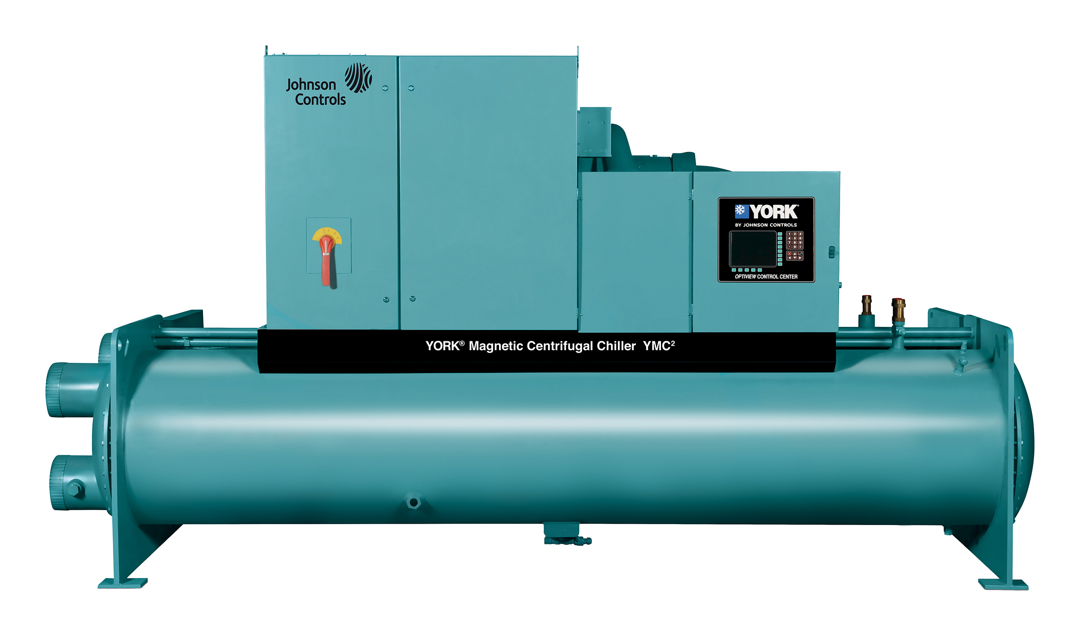
York ® YMC² Water-cooled magnetic Centrifugal chillers
165-1000 Tons (580-3500 kW)

Slide 2


Introducing the YORK YMC² Chiller
Let’s Explore More

Slide 3
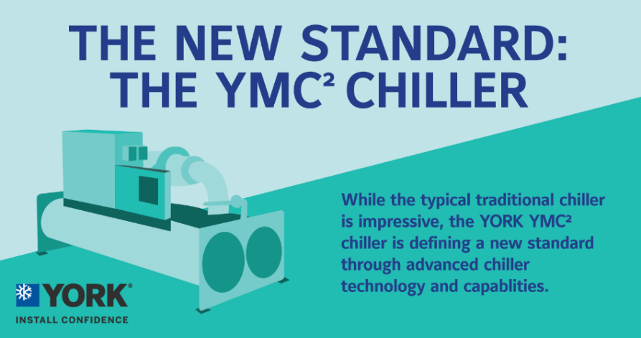

Slide 4

YMC² – YORK Magnetic Centrifugal Chillers YORK – A History of Leadership and Innovation
The global market leader in centrifugal chillers with a history of innovation:
OptiView™ Control Panel
Superior Chiller Control and Ease of Operation
OptiSound™ Variable Geometry Diffuser
Quiet Chiller Operation & Optimal Part Load Performance
Hybrid
Falling Film Evaporator
High efficiency evaporator that lowers the refrigerant charge within the unit
YMC² Extended Capacity & Optimized
kW/ton operation lower than 0.1
OptiSpeed™
Variable Speed Drive
Delivering Unsurpassed Real World Energy
Pioneered the Use of HFC 134a Refrigerant
1979
1989
1999
2004
2010
2015

Slide 5
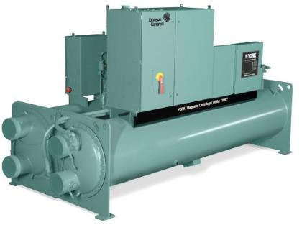
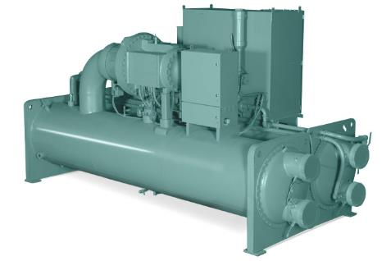
YMC² – YORK Magnetic Centrifugal Chillers Overview
Key Technology Elements of the Systems
Compressor Aerodynamics – proven YORK YK design
Heat Exchangers – high efficiency falling film evaporator
Controls – leveraging YORK and Johnson Controls technology (CPO 10 & 30)
Variable Speed Drive – from the pioneer in VSD centrifugal
Magnetic Bearings – industrial technology history, now for the mainstream

Slide 6
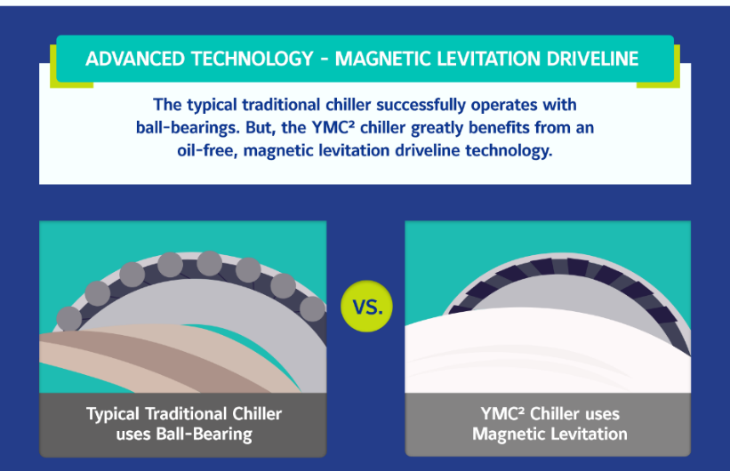

Slide 7
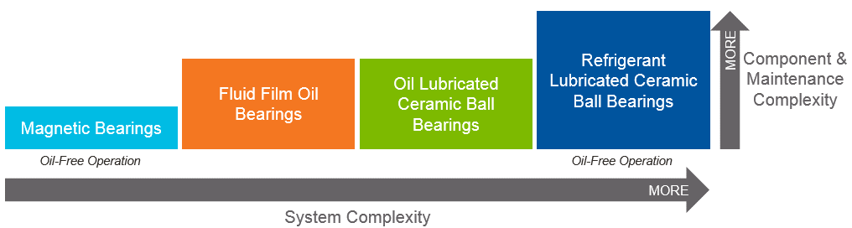
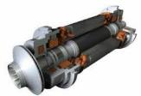
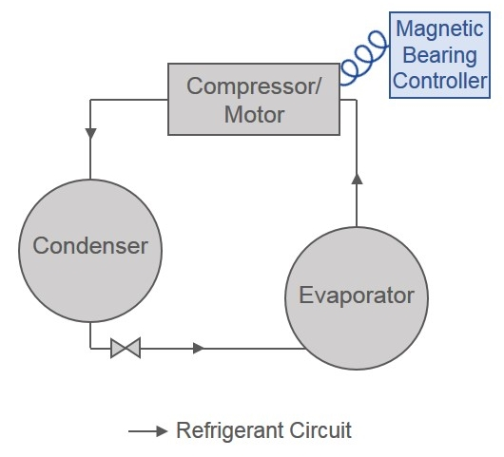
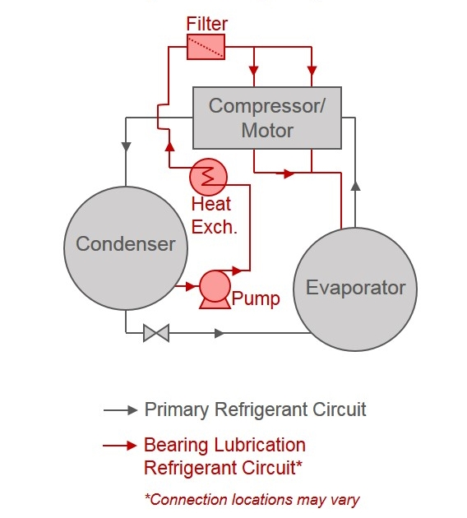
YMC² – YORK Magnetic Centrifugal Chillers Overview
Centrifugal Chiller Bearing Technology Comparison
Magnetic Bearings and Refrigerant Lubricated Ceramic Ball Bearings both offer oil-free operation, but Magnetic Bearings are the simplest design and have increased durability and reduced maintenance
Magnetic Bearings System Simplicity
Refrigerant Lubricated Ceramic Ball Bearings System Complexity

Slide 8
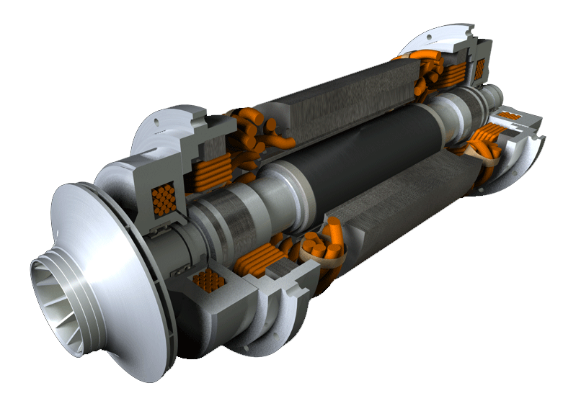
YMC² – YORK Magnetic Centrifugal Chillers Overview
Permanent magnet motor
Benefits of Permanent Magnet Motors?
Superior efficiency,
quiet operation,
excellent durability
by design
Active magnetic bearings (cartridges)
Proven aerodynamic designs from our flagship YK product line

Slide 9
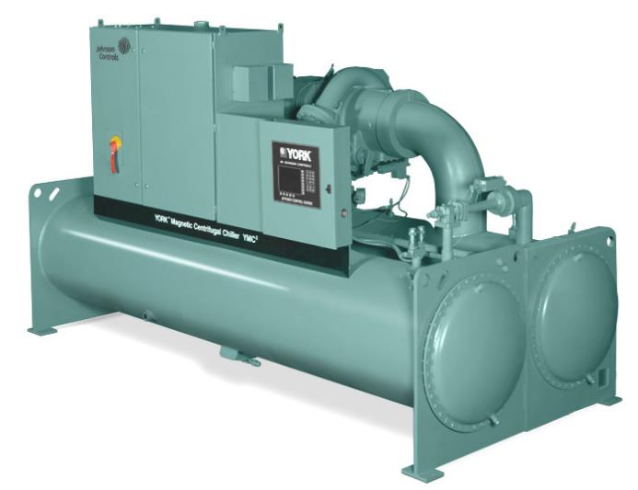
YMC² – YORK Magnetic Centrifugal Chillers Overview
OptiView Control Panel
OptiSpeed Variable Speed Drive - VSD
Condenser
(8, 10, 12, or 14 ft models)

Slide 10
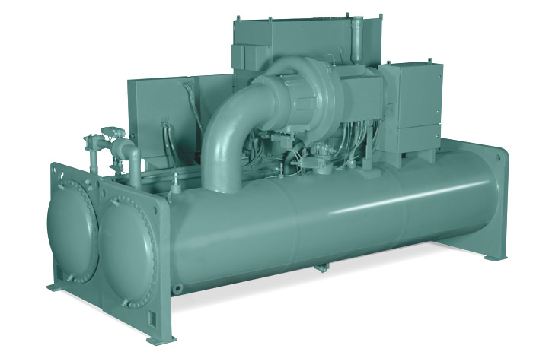
YMC² – YORK Magnetic Centrifugal Chillers Overview
Compressor with OptiSound Control
Power Panel with UPS
(Uninterrupted
Power Supply)
Evaporator
(8, 10, 12, or 14 ft models)
Permanent Magnet Motor and Magnetic Bearing Controller

Slide 11
YMC² – YORK Magnetic Centrifugal Chillers Five Key Benefits and a Bonus
Highly Efficient
Versatile
Strongly Dependable
Smart Investment
Sustainable
Lowest Sound Levels on the Market

Slide 12
YMC² – YORK Magnetic Centrifugal Chillers Five Key Benefits and a Bonus
Highly Efficient
Versatile
Strongly Dependable
Smart Investment
Sustainable
Lowest Sound Levels on the Market

Slide 13

The dawn of lower total cost of ownership
It’s a new day in the realm of chiller technology. The YMC² chiller’s revolutionary design reduces both initial and long-term operating and maintenance costs.

Slide 14

Smart Investment – Low Total Cost of Ownership
Competitive First Cost
Low Operation Costs
Low Maintenance Costs

Slide 15
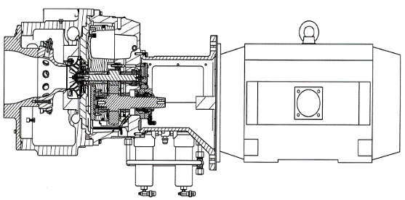
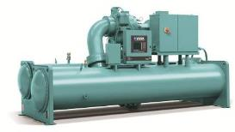
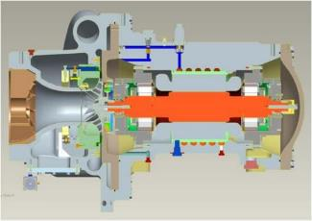
Smart Investment – Competitive First Costs
Uses Proven YORK Aerodynamics
YK
YMC²

Slide 16
Smart Investment – Low Operation Costs
Highly Efficient Chiller = Lower Energy Usage = Lower Energy Costs = Faster Payback and Return on Investment
13% Efficiency Gain
6% Efficiency Gain
2-3% Gain
Part Load Efficiency (kW/ton)
Traditional Centrifugal Chiller
YORK Magnetic Bearing Chiller
250 Tons 1000 Tons 1500 Tons
880 kW 3500 kW 5275 kW
Extremely Quick Payback
Moderate Payback
Longer Payback

Slide 17
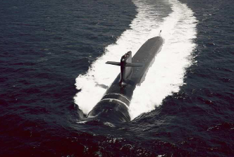

Smart Investment – Low Maintenance Costs
Durable YORK Design and Navy History
Over 125 magnetic projects undertaken since 1998 by Navy group
Mission critical application

Slide 18
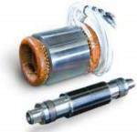

Smart Investment – Low Maintenance Costs
Oil-free Operation Reduces Scheduled Chiller Maintenance
No need for oil pumps, coolers, filters, reservoirs, etc.
If needed, field serviceable

Slide 19
YMC² – YORK Magnetic Centrifugal Chillers Five Key Benefits and a Bonus
Highly Efficient
Versatile
Strongly Dependable
Smart Investment
Sustainable
Lowest Sound Levels on the Market

Slide 20

Designed to make the most of energy
Like satellites that make optimum use of every bit of energy available, the YMC² chiller is designed for maximum energy efficiency.

Slide 21
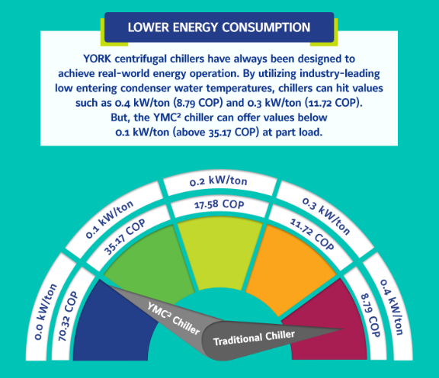
Highly Efficient – Real World Energy Operation

Slide 22
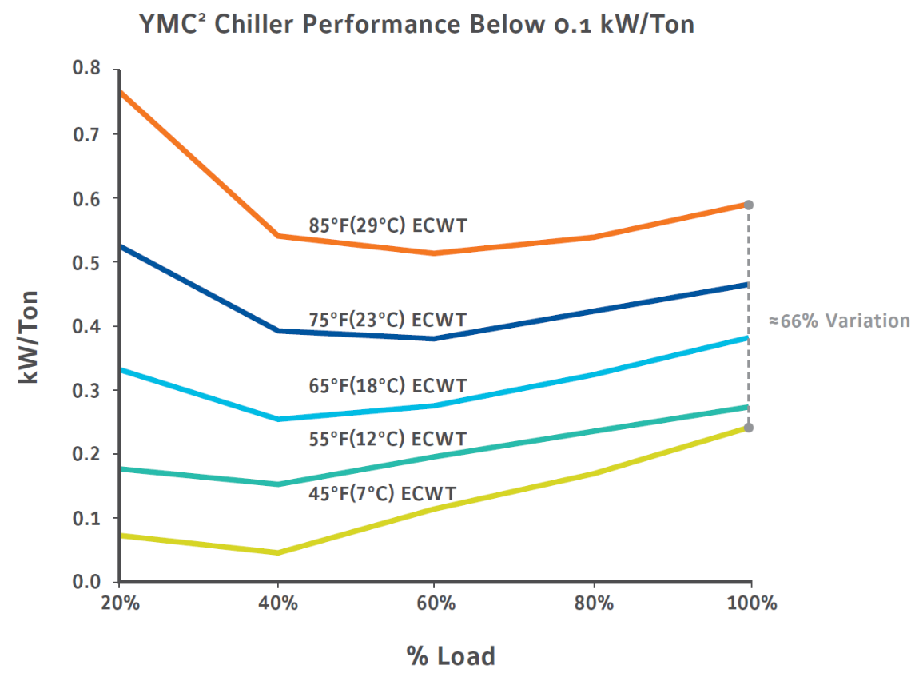
Highly Efficient – Real World Energy Operation
YMC² Chiller Performance Below 0.1 kW/Ton
85° F (29° C) ECWT
75° F (23° C) ECWT
66% Variation!!
kW/Ton
65° F (18° C) ECWT
55° F (12° C) ECWT
36° F (2.2° C) ECWT
IPLV Points
ECWT – Entering Condenser Water Temperature
% Load

Slide 23
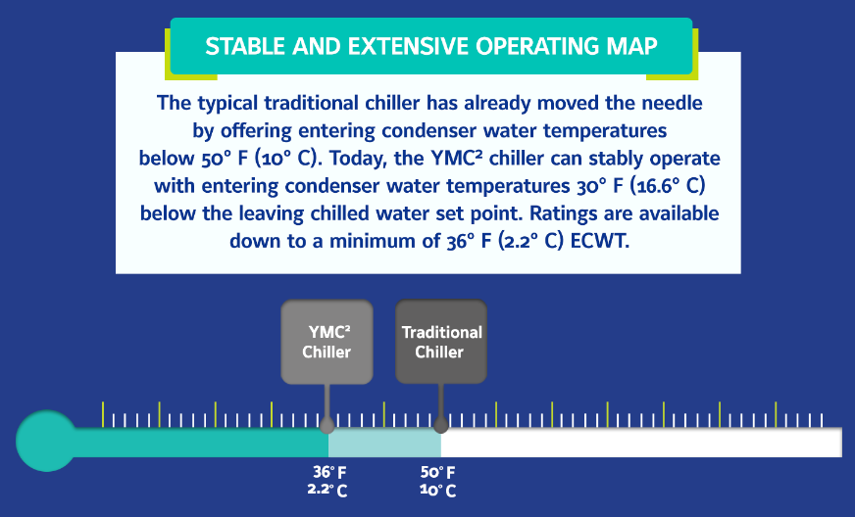
Highly Efficient – Real World Energy Operation

Slide 24
Highly Efficient – Real World Energy Operation
YMC² chiller can operate from 100% down to 10% load when ECWT drops below the leaving chilled water set point
Stable operation with ECWT 30°F (16.6°C) below the leaving chilled water set point
Ratings available down to a minimum of 36°F (2.2°C) entering condenser water
Minimum Entering Condenser Temperature =
Leaving Chilled Water Temperature –30°F (16.6°C)
EXAMPLE
450 Ton (1580 kW) YMC² Chiller – Standard AHRI Conditions
Load | 100% | 60-40%
Entering Condenser Water Temperature (ECWT) | 39° F (3.8° C) | 45° F (7.2° C) and lower
kW/Ton (COP) | 0.175 (20.1) | Below 0.1 (Above 35.17)
32% More Efficient than design point

Slide 25
Highly Efficient – Real World Energy Operation
Traditional Free Cooling
First Cost - $100,000+
Additional Costs
Additional pumping HP requirements
Installation of heat exchanger
Additional piping
Additional controls
Operation & Maintenance Costs
Higher condenser water pumping costs due to higher pressure drops
Yearly cleaning & maintenance ($3,500-5,000 annually)
YMC² Chiller
Eliminate water-to-water heat exchanger
Save on first cost, operating costs, and maintenance costs
Estimated cost to run YMC² chiller at 40% load with 38° F (3.3 ° C) ECWT is approximately $1.332 an hour ($0.10 kW/hr)
“Free Cooling” isn’t so free anymore.

Slide 26
YMC² – YORK Magnetic Centrifugal Chillers Five Key Benefits and a Bonus
Highly Efficient
Versatile
Strongly Dependable
Smart Investment
Sustainable
Lowest Sound Levels on the Market

Slide 27

Helping to keep the “Blue Planet” green
The YMC² chiller was created with sustainability in mind. It was carefully designed to minimize emissions that could negatively impact the environment.

Slide 28

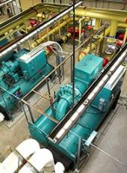
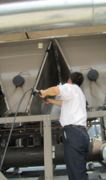
Sustainable – Low Impact on Environment
Indirect
Direct
Based on energy source mix of power generation (renewable vs. fossil fuels), the indirect environment impact can be very significant
With proper design, installation, operation, and maintenance – equipment leakage can be nearly zero

Slide 29
Sustainable – Low Impact on Environment
If you completely eliminate the refrigerant charge (which eliminates all of the direct global warming potential)
How much of the carbon footprint remains?

Slide 30
Sustainable – Low Impact on Environment
95% of the total global warming impact is indirect emissions of CO₂ due to
Electric energy usage
Production
Disposal of the equipment
95%

Slide 31
Sustainable – Low Impact on Environment
Comprehensive Approach to Minimize Emissions with the YMC²
Indirect
Direct
Ensure Equipment is:
Maintained
Controlled
Highly efficient
The YMC² has:
Low charge heat exchanger technology
Leak-free design
Improved refrigerant management practices
R-513A Low-GWP refrigerant future compatible

Slide 32
YMC² – YORK Magnetic Centrifugal Chillers Five Key Benefits and a Bonus
Highly Efficient
Versatile
Strongly Dependable
Smart Investment
Sustainable
Lowest Sound Levels on the Market

Slide 33


The versatility to perform under demanding conditions
Spacesuits are designed to function flawlessly no matter how severe the demands of the surrounding environment. The YMC² chiller is also designed to keep operating in conditions that would shut down other chillers.

Slide 34






Versatile
Ideal for Comfort and Process Cooling Installations
Manufacturing
Commercial Buildings
K-12 Schools
Pharmaceuticals
Medical Centers
Data Center

Slide 35
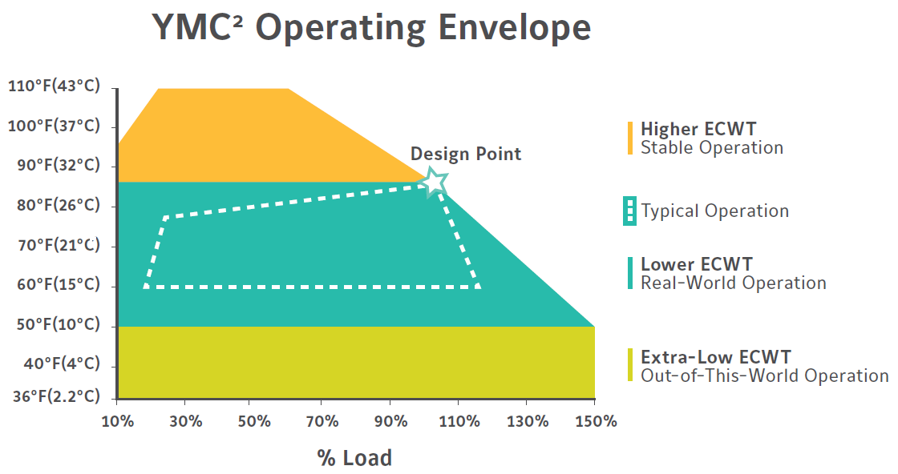
Versatile
Widest Operating Envelope
Higher ECWT
Stable Operation
Other Magnetic Bearing Chiller Operation Range
Lower ECWT
Real-World Operation
Extra-Low ECWT
Out-of-This-World Operation

Slide 36
Versatile
Higher ECWT – Stable Operation
If temperature rises from tower return, the chiller can adapt and continue to stay online without surging or shutting down
Dependable Operation
Lower ECWT – Real World Operation
Can accept lower entering condenser water temperature and product more tons of cooling
Operator can wait longer to turn on the less efficient / stable chiller
Extra Low ECWT – Out-of-This-World Operation
Can operate with minimum entering condenser water temperature below the leaving chilled water set point
Inverted or upside down operation
Able to eliminate water-side economizer system
“Free cooling isn’t so free anymore”

Slide 37
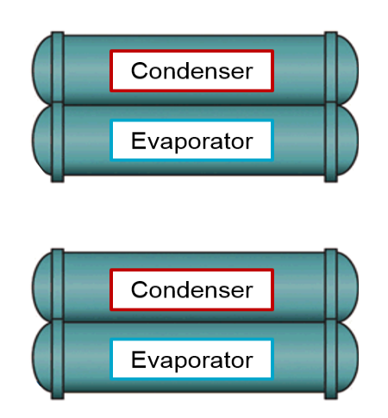
Versatile
1st Mag bearing chiller to provide Heat Pump capability
Ideal for Hospitals, Process, and High Rises
Simultaneous heating and cooling available with 2 YMC² chiller in cascade arrangement
Maximum Leaving Condenser Water of 150⁰F
Currently Heating Offering of about 8500 MBH
100⁰F
Heating Load
130⁰F
90⁰F
80⁰F
40⁰F
Cooling Load
50⁰F

Slide 38
YMC² – YORK Magnetic Centrifugal Chillers Five Key Benefits and a Bonus
Highly Efficient
Versatile
Strongly Dependable
Smart Investment
Sustainable
Lowest Sound Levels on the Market

Slide 39

Few things are as dependable as the YMC² chiller
Just as you can count on the North Star to invariably take its appointed place in the sky, you can count on the YMC² chiller to stay online in situations that would shut down less resilient chillers.

Slide 40



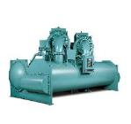


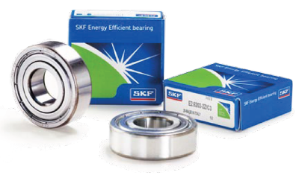
Strongly Dependable
Reliable Time-tested Components
Fully integrated chiller design using proven and optimized chiller aerodynamics
Magnetic technology utilized on Navy ships and submarines
120,000+ rotating machines equipped with magnetic bearings and PM motors

Slide 41
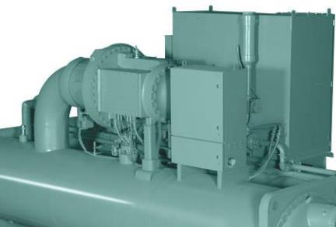
Strongly Dependable
Reduced Down-time
Oil Free Design – cutting down on required chiller maintenance.
Fast starts, fast restarts
OptiSound™ Control – ensures safe operation over a wide range of load and lift conditions
OptiSpeed™ VSD – for improved motor life
OptiView™ Control – with trending capabilities
Field Serviceability – by highly trained YORK service team

Slide 42
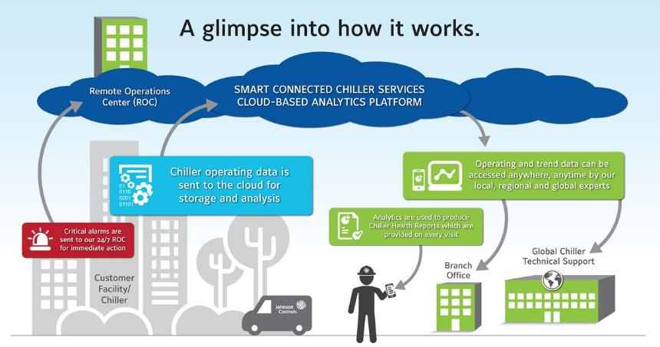
Strongly Dependable
Smart Connected Chiller Services

Slide 43
Strongly Dependable
Power Failure
Office Building
Data Center
Server Downtime
Process Cooling
Lower Employee Productivity
Manufacturing Downtime
$$$$$

Slide 44
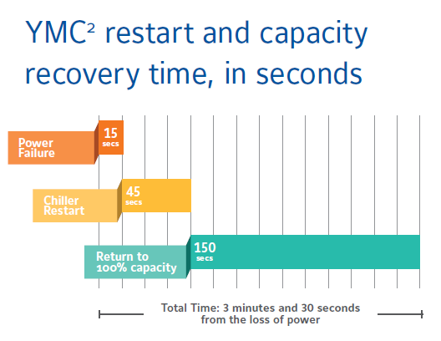
Strongly Dependable
Restart and capacity times for a typical YMC² chiller after a 15 second power failure

Slide 45
Strongly Dependable
Quick Start Feature is standard and will not cost additional $$
Factors that may affect restart times:
Chiller configuration
% load at power failure
Length of power failure

Slide 46
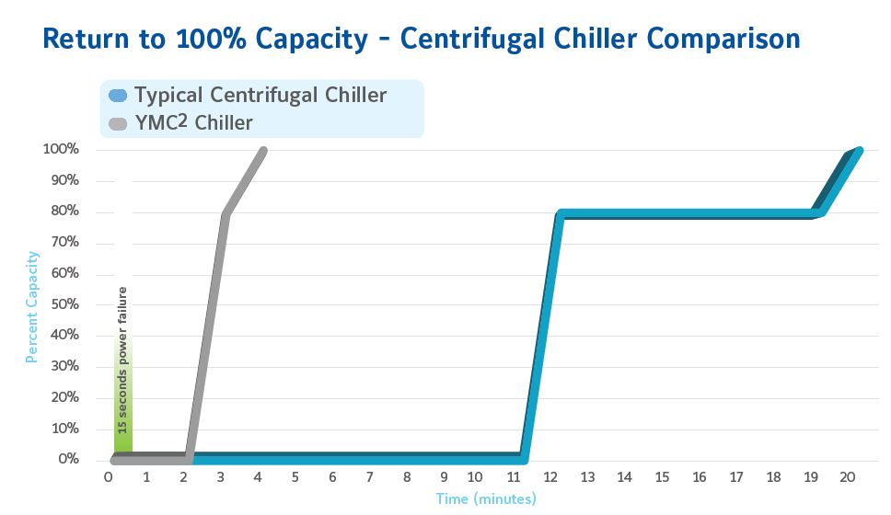
Strongly Dependable

Slide 47
YMC² – YORK Magnetic Centrifugal Chillers Five Key Benefits and a Bonus
Highly Efficient
Versatile
Strongly Dependable
Smart Investment
Sustainable
Lowest Sound Levels on the Market

Slide 48

Extraordinarily Quiet
Space is known for the absence of sound and, thanks to a design that features fewer moving parts, so is the YMC² chiller.

Slide 49
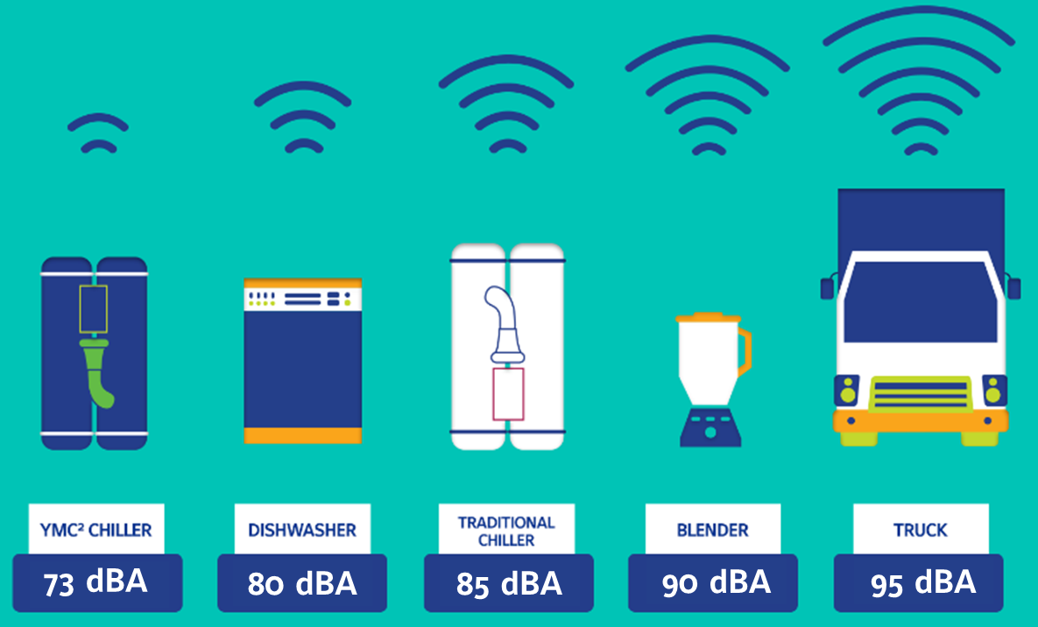
Impressive Sound Levels
Sound Levels Achieved through the use of:
Permanent magnet motor with active magnetic bearings
OptiSoundTM Control
Sound Levels as Low as 73 dBA (AHRI 575 Rating)

Slide 50
Summary
Highly Efficient
Versatile
Strongly Dependable
Smart Investment
Sustainable
Lowest Sound Levels on the Market

Slide 51

YMC² – YORK Magnetic Centrifugal Chillers Q&A

Slide 52







YMC² – YORK Magnetic Centrifugal Chillers Q&A
QUESTIONS?
THE NEW STANDARD:
THE YMC² CHILLER

